Slide 1
System-friendly competitive RE procurement in India
Fabian Wigand
PACE-D 2.0 RE Team

Slide 2
Aim of this presentation
From demand analysis to procurement
The previous presentation focused on resources to meet demand, this presentation will focus on the procurement side - how to procure the identified resources.
A broader look at procurement
System-friendly competitive procurement considers system costs and benefits of RE in the award decision by minimizing both generation and system integration costs.
Increasing importance
This becomes more relevant with higher shares of RE and is particularly relevant in India with low RE costs but significant system costs
Best practices
India has already taken important steps towards system-friendly competitive procurement – this presentation will present them and introduce further global best practices

Slide 3
Agenda
The opportunity for system-friendly RE procurement
Key issues shaping RE system integration in India
Status of system-friendly RE procurement in India
3.1 Examples from India
3.2 Experience with RE hybrid procurement in India
Global trends in system-friendly RE procurement
Recommendations

Slide 4
System-friendly procurement: Why is it relevant for India?
1. The opportunity for system-friendly RE procurement
RE projects contracted at very competitive prices* (generation costs)
Solar | Wind | Solar-wind hybrid | NTPC average cost of thermal generation
2019: 2.50 INR/kWh (3.60 cents**/kWh) | 2018: 2.51 INR/kWh (3.61 cents/kWh) | 2019: 2.69 INR/kWh (3.87 cents/kWh) | 2018: 3.42 INR/kWh (4.93 cents/kWh)
India needs to auction 40 GW of solar & wind capacity every year until 2028 to meet its RE target of 40% of total installed capacity by 2030.
System costs become more important with more RE generation added to the grid. However,
they are currently not reflected in power tariffs, but
Can represent up to 50% of recent RE bid prices (e.g. 1.5 INR/kWh or 2.16 cents/kWh in 2017 in Tamil Nadu and Gujarat)
Competitive procurement is an opportunity to purchase a power mix with system-friendly attributes, i.e. allowing easier system integration of RE.
* BNEF Tool 2019
**1 USD = 69.3510 INR as of June 2019. Source: Reuters India, 2019

Slide 5
System-friendly RE procurement minimizes both generation and system integration costs
1. The opportunity for system-friendly RE procurement
+ | Generation costs ≠ system integration costs Investment and operational costs
+ | Cost of capital (debt, equity)
= | Electricity generation costs
+ | Grid expansion and upgrade costs
+ | Balancing costs (including redispatch costs)
+ | Provision of reserves
= | System integration costs of RE generation
Example: RE integration costs in Tamil Nadu/Gujarat (2017)
1.5 INR/kWh*** (2.16 cents/kWh)
*** CEA 2017 USD = 69.3510 INR as of June 2019
System-friendly RE procurement considers both cost types in award decision, i.e.
falling generation costs of RE, and
the system costs and benefits of RE
Result: DISCOMs are able to increase the uptake of RE generation and reduce their power purchase cost by taking advantage of falling RE prices.

Slide 6
System-friendly RE procurement is an opportunity to increase the uptake of RE in India
1. The opportunity for system-friendly RE procurement
Matching demand curve
Challenge: Changing demand patterns and trend toward higher evening peaks.
Opportunity: Dispatchable RE (hybrids, storage) during peak time through higher tariffs/supply blocks following load patterns.
Mitigating grid integration/transmission costs
Challenge: Grid constraints at the transmission level leading to congestion and curtailment or higher grid connection costs.
Opportunity: Requirement for minimum capacity utilization factors (CUF), consideration of grid connection costs in bids
Reducing intermittency
Challenge: Balancing of real-time generation shortages and surpluses.
Opportunity: Procurement of more firm RE power, e.g. virtual or physical hybrids with higher CUFs (solar-wind + storage).

Slide 7
4 key issues shaping RE system generation in India (1/2)
2. Key issues shaping RE system integration in India
1. Introduction of grid connection charges for RE projects
Expiration of waiver for grid connection charges for RE in 2019
Expiration of the waiver for transmission charges for the use of the inter-state transmission system (ISTS) in 2022
Result: if implemented → RE producers internalize grid connection and use costs, which will incentivize less RE deployment in areas with grid congestion.
2. Potential phase-out of RE “must-run” status in the merit order dispatch
“Must-run” status: high revenue certainty for RE developers but also few incentives to optimize generation to more closely follow demand and grid constraints.
Result: if implemented → RE producers have incentive to invest in accurate forecasting.

Slide 8
4 key issues shaping RE system generation in India (2/2)
2. Key issues shaping RE system integration in India
3. Introduction of responsibility for forecast deviations for RE generation
For inter-state solar and wind projects, penalties for forecast errors that exceed 15% of available capacity apply.
In most states, there are no penalty charges for forecast deviations above or below 15% (in 4 states the range is less than 10%). 5 states impose penalties.
Result: Increased contribution of RE to grid stability.
But: Increased costs of compliance (IT systems, quality forecasts, penalties), unfair competition with thermal generation concerns RE producers → Lowering the risk of curtailment could support compliance.
4. Wholesale electricity market reforms proposed by CERC
Most DISCOMs self‑schedule generators with which they have bilateral contracts. This can lead to curtailment of RE and higher marginal power costs.
Result: Centralized day-ahead scheduling and real-time dispatch to create a liquid power market that could generate time and locational price signals.

Slide 9
India has experience with innovative procurement approaches for RE system integration
3. Status of system-friendly RE procurement in India
Examples | Global Trend
SECI competitive procurement for hybrids | Physical hybrids (Global Trend 1)
SECI competitive procurement for hybrids with assured peak supply | Time-based incentives & physical hybrids (Global Trends 1 & 3)
SECI as demand aggregator | Virtual hybrid/aggregator (Global Trend 2)
Bundling solar PV with thermal power | Virtual hybrid/aggregator (Global Trend 2)
Banking power arrangements between DISCOMs | Virtual hybrid/aggregator (Global Trend 2)
State-level & substation-specific competitive procurement | Locational signals (Global Trend 4)
SECI site-specific competitive procurement | Locational signals (Global Trend 4)

Slide 10
Status of hybrid RE procurement in India
3. Status of system-friendly RE procurement in India
Aim of physical RE hybrids in India:
Efficient utilization of land (i.e. kWh/m²) and transmission capacity (i.e. MWh/MW)
Reduction in the intermittency of RE generation to increase grid stability.
Physical hybrid capacities tendered (2018-19): Roughly 6 GW
Wind-PV (2.59 GW); floating solar (1.72 GW); PV-storage (1.46 GW/3.96 GWh)
Two central-level tenders for large-scale hybrid installations held by SECI:
1st round (2018): 840 MW awarded (2 projects at 2.69 INR/kWh or 3.87 cents/kWh
2nd round (2019): 720 MW awarded (2 projects at 2.69 INR/kWh or 3.87 cents/kWh & 2.70 INR/kWh or 3.89 cents/kWh)
Design element to incentivize system-friendliness in SECI hybrid tenders
Guaranteed generation requirement (CUF of min. 30-40%)
In case generation below 90% of the declared CUF penalties apply
Excess generation beyond 120% of CUF can be sold at full PPA tariff

Slide 11
RE hybrid procurement can support system integration in India
3. Status of system-friendly RE procurement in India
Lower grid connection costs
RE projects with a high Capacity Utilization Factor (CUF) such as hybrids have lower grid connection costs than other RE projects.
From 2022 RE producers will pay for grid connection costs, hence system advantage of hybrids will be priced in and compensated.
Generation that better matches the demand curve
Time-based tariffs or supply blocks can provide a better demand-generation match.
Hybrid plants w/ storage closely aligns generation w/ peak demand via “peak tariff”.
Balancing out intermittency
Co-location of different technologies (e.g. wind and solar) in one installation can result in more balanced generation curves throughout the day and year.
Hybrid plants incorporating storage (e.g., pumped hydro or batteries) can provide balancing energy to the grid (however, few incentives so far).

Slide 12
RE hybrid procurement also faces challenges in India
3. Status of system-friendly RE procurement in India
Uniform and ambitious CUF and ceiling prices across states
Only achievable in regions with higher RE resource potential which can restrict number of participating bidders or risk the non-completion of awarded projects.
Developers: Ceiling price for hybrids of 2.70 INR/kWh (3.89 cents/kWh) too low for many regions → concentration of RE projects.
Can bidders offering a high CUF meet the requirement with seasonal variations?
Fixed costs of long-term contracts with thermal plants in some states
Several DISCOMs have long-term take-or-pay PPAs with thermal power plants. Fixed costs in the form of capacity charges also accrue even if no power is being taken by DISCOMs, and amount to roughly 1.39-1.66 INR/kWh (2.00-2.39 cents/kWh)
DISCOMs may be inclined to procure least-cost RE rather than hybrid installations, despite their potential savings in grid connection.
End of life for thermal power plants: Fixed costs become increasingly less important.

Slide 13
Draft Guidelines on wind-solar hybrid competitive procurement (MNRE) address some challenges
CUF
Option to revise declared CUF during first 3 years of operation gives bidders flexibility to consider plant performance and gather site measurements
Min. 30%: how are different regional resource potential and seasonal variability considered?
Ceiling price
Procuring entities can specify own ceiling prices, which
provides flexibility to account for regional resource potential, and
lowers risk for undersubscription compared to uniform ceiling price that is too ambitious for most bidders
Bidding parameters
Procuring entities can define parameters to procure RE with
reduced intermittency, or
guaranteed supply for defined hours during the day
Additional guideline for states on how to define these parameters would further support the use of this option

Slide 14
4 global trends in RE system-friendly procurement
4. Global trends in system-friendly procurement
1. Time-based incentives and penalties
Design options that incentivize RE generation to more closely match the DISCOM demand curve (e.g. price adjustment factors, supply blocks).
2. Aggregators (virtual hybrids)
Several RE installations at different grid connection points are bundled and dispatched via virtual control systems. Virtual hybrids can thus feed in exactly as much electricity as has been purchased.
3. Procurement of (physical) hybrid solutions
Competitive procurement of RE electricity from installations combining technologies such as wind, solar, storage or dispatchable technologies with the aim of combining complementary generation profiles to offset technology-specific intermittencies and to reduce grid connection costs.
4. Locational signals
Locational signals aim to steer the location of projects to specific areas/grid connection points to avoid the concentration of projects in resource-rich but costly-to-connect areas.

Slide 15
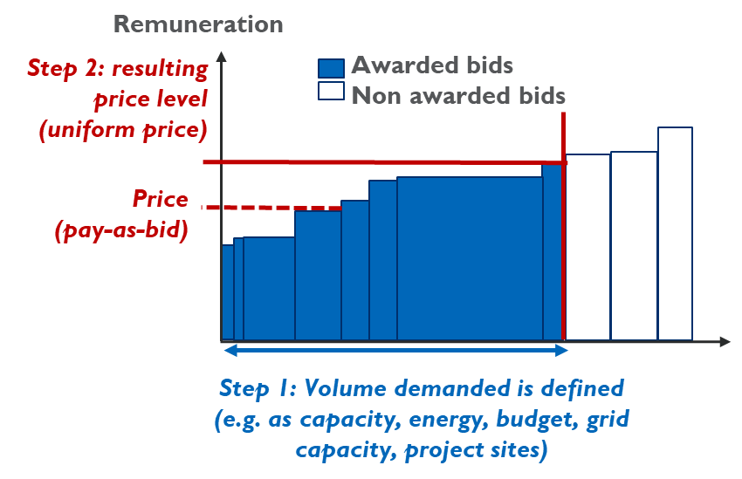
Global trend 1: Time-based incentives & penalties
4. Global trends in system-friendly procurement
Time-based incentives and penalties
Design options that incentivize RE generation to more closely match the DISCOM demand curve (e.g. price adjustment factors, supply blocks).
GW
00:00 – 07:59
08:00 – 17:59
18:00 – 22:59
23:00 – 23:59
Stylized demand curve
8:00
18:00
23:00
Time in hours

Slide 16
Global trend 1: Time-based incentives & penalties (pt. 2)
4. Global trends in system-friendly procurement
Country experience: Intraday and seasonal supply blocks in Chile
This policy with time blocks enabled Chile to save on both its daytime and nighttime supply – and both times RE & storage were cheaper than thermal power.
Challenge | Allowing intermittent technologies to optimize their feed-in potential and guarantee supply to distribution companies.
Design Solution | Supply blocks: Intra-day hourly (12am-8am + 11pm-12am; 8am-6pm; 6pm-11pm) + four 3-month blocks . Supply block translates generation risk to RE producer → Production deviation are settled at spot-market prices.
Results | In the technology-neutral auctions 2017, only RE projects won (2,200 GWh of electricity awarded). Auction average price was 3.25 cents/kWh (2.24 INR/kWh) - lowest ever recorded in country. Lowest bids: 3.29 cents/kWh (2.28 INR/kWh), for wind and 2.15 cents/kWh (1.49 INR/kWh) for solar Non-RE alternatives more expensive: Thermal price 7.54 cents/kWh (5.22 INR/kWh)

Slide 17
Global trend 1: Time-based incentives & penalties (pt. 3)
4. Global trends in system-friendly procurement
Considerations for application in India
Advantages | Disadvantages
Time-based incentives help matching RE generation with the demand curve, thus avoiding an inefficient & costly capacity addition pathway for utilities. Price adjustment factors offer financial compensation to RE producers for optimizing a supply that meets the demand profile. Supply blocks limit supply timeframe to time/season-specific demand, increasing producer long-term revenue certainty and encouraging intermittent RE generation to provide reliable electricity. | Compared to the wholesale market, (fixed) time-based incentives increase the risk of overcompensating RE electricity that will be less valuable in a few years. Adapting supply blocks and volume regularly could mitigate the risk of future mismatch between generation and demand profiles.

Slide 18
Global trend 2: Aggregators (virtual hybrids)
4. Global trends in system-friendly procurement
Aggregators (virtual hybrids)
Several RE installations at different grid connection points are bundled and dispatched via virtual control systems. Virtual hybrids can thus feed in exactly as much electricity as has been purchased.
GW
GW
Time
Control center
Time
GW
Time
GW
Stylized Demand curve (power purchased)
Stylized Feed-in profile
Time

Slide 19
Global trend 2: Aggregators (virtual hybrids pt. 2)
4. Global trends in system-friendly procurement
Country experience: Virtual power plant (VPP) “NextKraftwerke” in Germany
This policy enables the German virtual power plant to provide reliable, dispatchable power for balancing just with RE.
Challenge | Integrating smaller intermittent RE to provide balancing energy products to the balancing market.
Design Solution | Digitally aggregating multiple decentralized RE of different producers into a single centralized control system Different generation technologies (PV, wind, hydro, biogas etc.) are bundled to offset intermittency risks. This allows them to be forecasted, optimized and traded as one single power plant.
Results | 2016: Provision of 67 MW as primary reserve, 67 MW as secondary reserve, and 1160 MW as tertiary reserve This reduces provision of these products by thermal generation

Slide 20
Global trend 2: Aggregators (virtual hybrids pt. 3)
4. Global trends in system-friendly procurement
Considerations for application in India
Advantages | Disadvantages
Possibility to sign shorter contracts with DISCOMs/institutional buyers, resulting in prices better adapting to changing demand needs and RE market prices. Enabling compliance with time-specific generation requirements or balancing. | Business case (e.g. to provide balancing services) is weak: So far, no dedicated ancillary market for private players in India. If virtual hybrids portfolio is composed of mainly shorter contracts, cost-covering bids from virtual hybrids will likely not be successful. Compared to physical hybrids, virtual hybrids do not lead to lower grid connection costs per each RE asset.

Slide 21
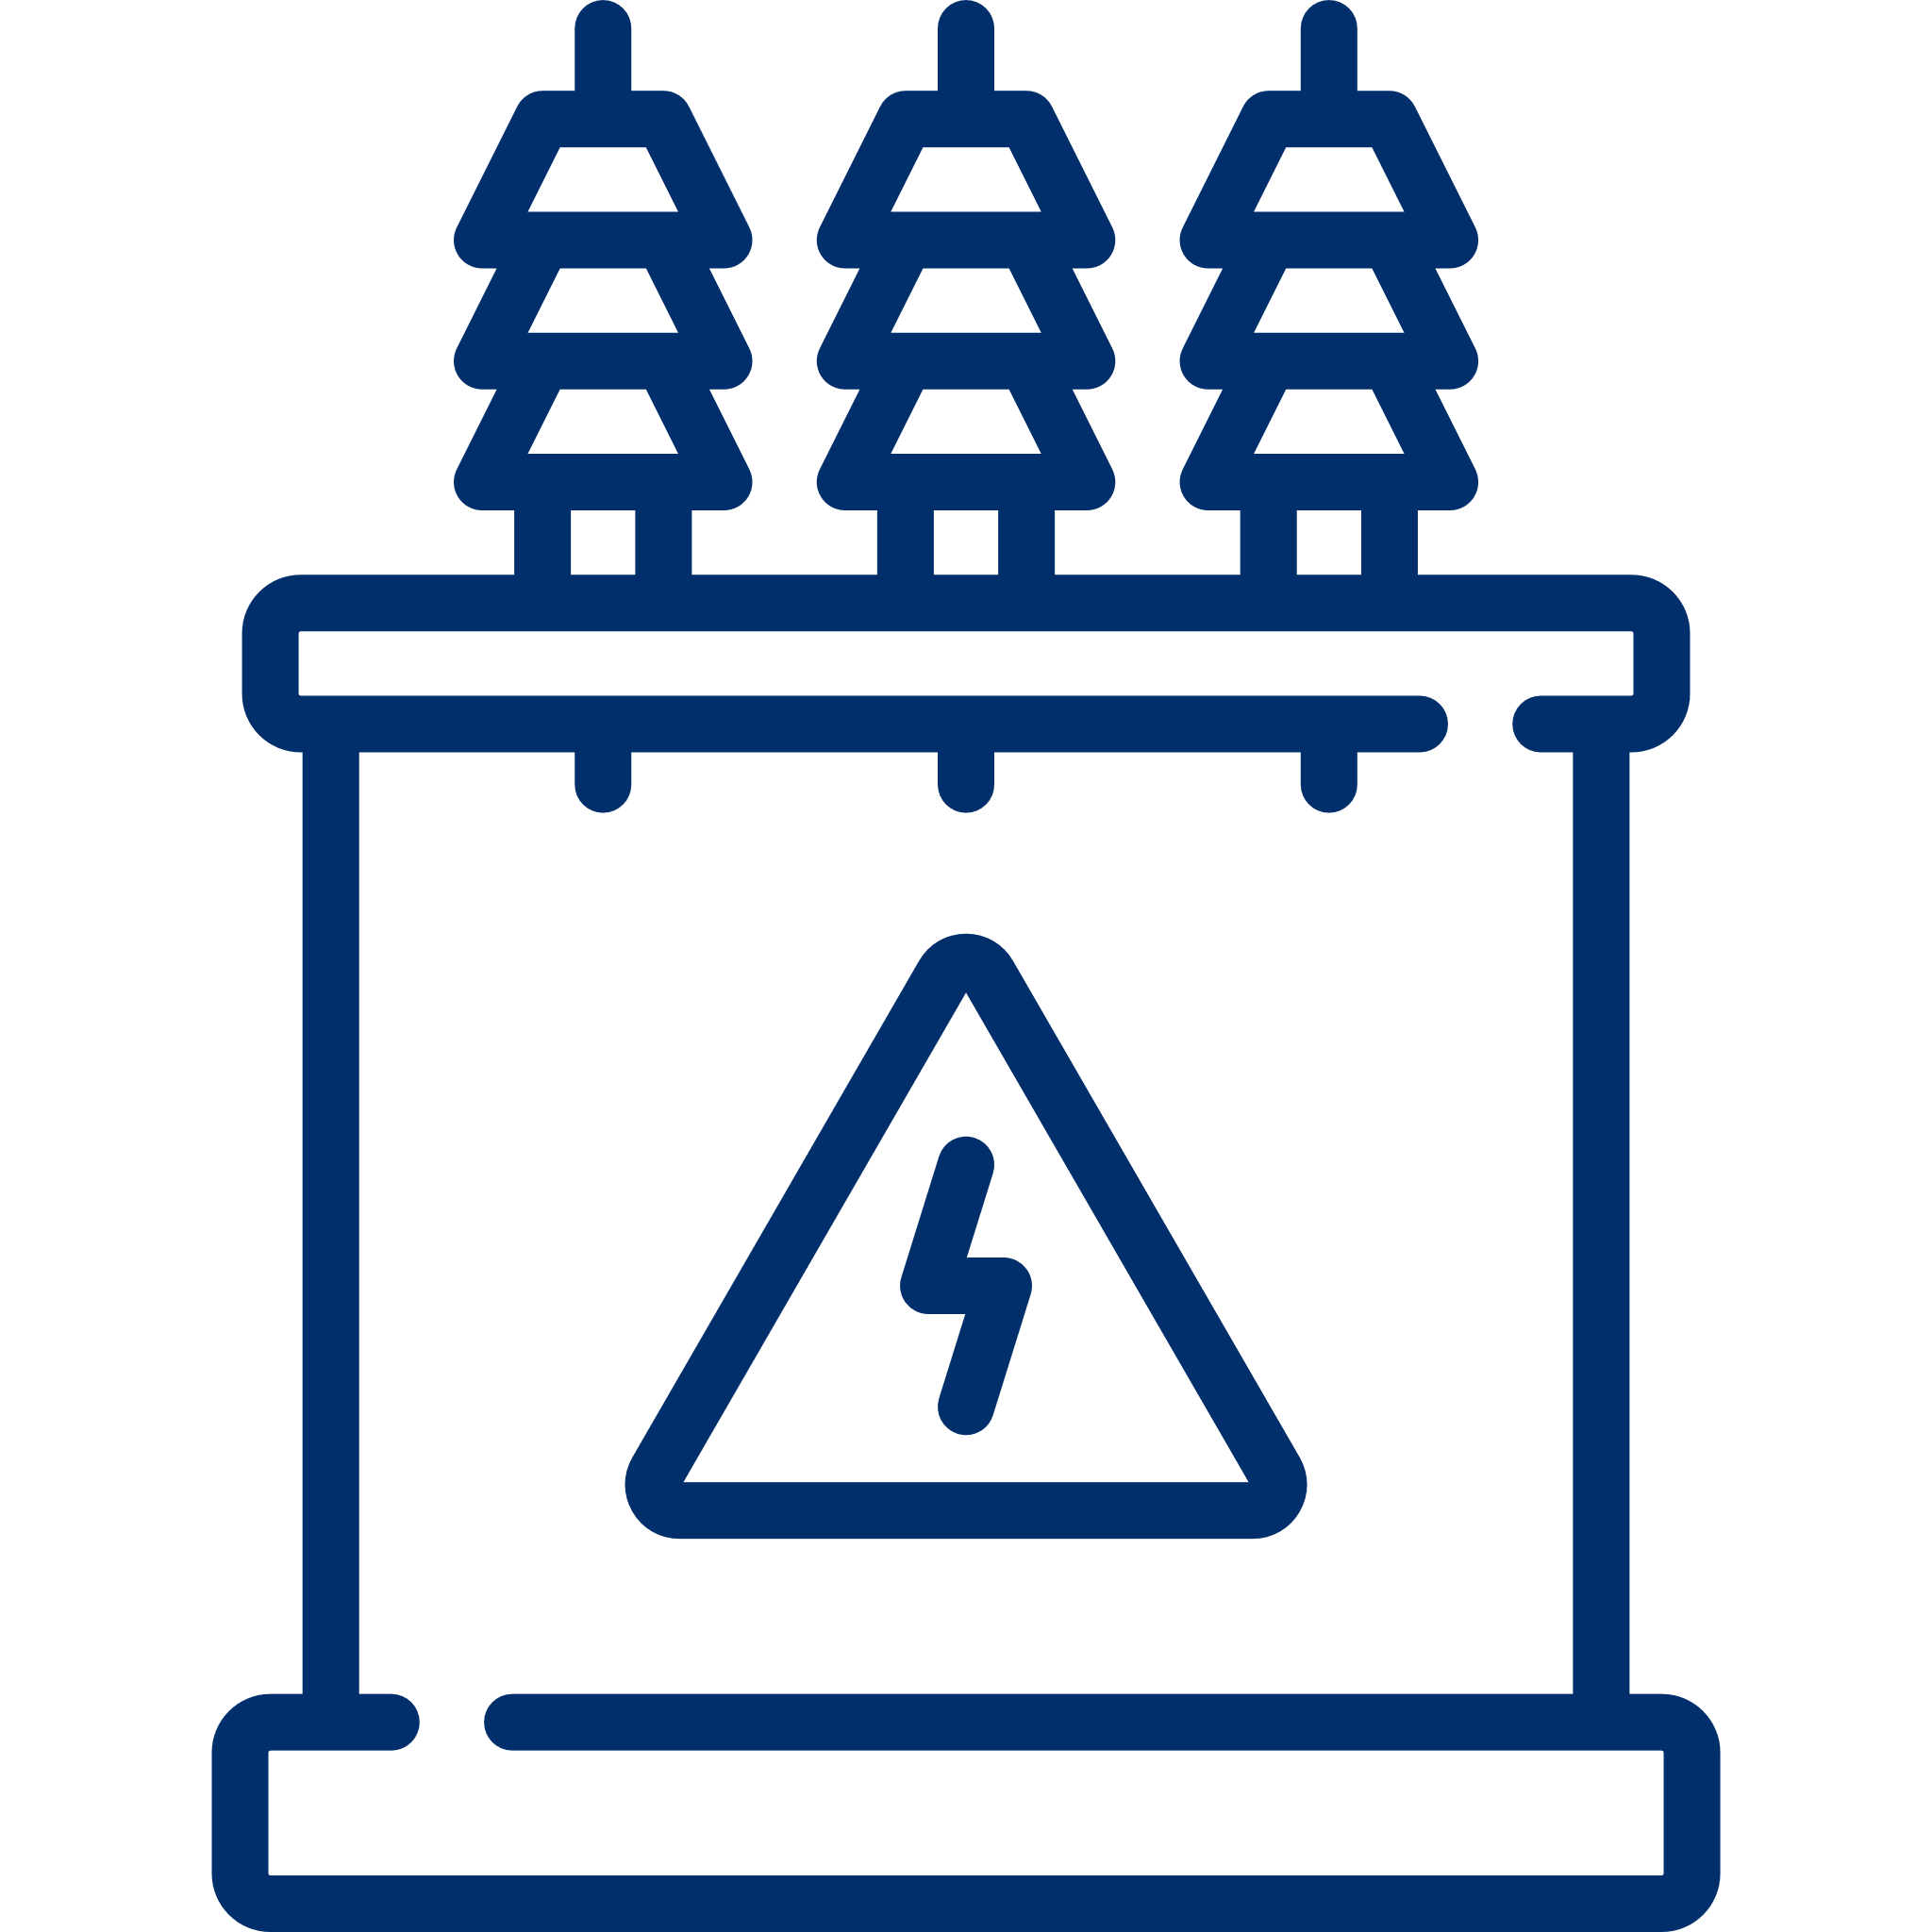
Global trend 3: Procurement of (physical) hybrids
4. Global trends in system-friendly procurement
Procurement of (physical) hybrid solutions
Competitive procurement of RE electricity from installations combining technologies such as wind, solar, storage or dispatchable technologies with the aim of combining complementary generation profiles to offset technology-specific intermittencies and to reduce interconnection costs.
GW
Time
GW
Time
Substation
Transmission
GW
Time
Stylized generation profile

Slide 22
Global trend 3: Procurement of (physical) hybrids (pt. 2)
4. Global trends in system-friendly procurement
Country experience: Hybrid procurement for firm energy in Thailand
This policy enabled Thailand to purchase dispatchable RE with guaranteed evening generation.
Challenge | Ensure a continuous supply of electricity even during peak hours, reduce intermittency of RE generation
Design Solution | Peak: 100% contracted capacity, ± 2% tolerance range (Mon.-Fri., 9:00am-11pm) Off-peak: 65% of contracted capacity, ± 2% tolerance range (at all other times) Penalty: 20% of fixed tariff (FIT_{f}) component (FIT = FIT_{f} + FIT_{v})
Results | Volume offered: 755 MW (of technically qualified bids), against 300 MW demanded Average bid price: 7.39 cents/kWh (5.13 INR/kWh) represented against a ceiling price of 11.09 cents/kWh (7.69 INR/kWh) Technology: predominantly biomass with 258.7 MW, biomass-solar with 29.31 MW, solar + storage with 12 MW

Slide 23
Global trend 3: Procurement of (physical) hybrids (pt. 3)
4. Global trends in system-friendly procurement
Considerations for application in India
Advantages | Disadvantages
More efficient use of land and grid infrastructure and higher CUF compared to single-technology plant. Savings on grid connection and transmission cost, since time-of-day generation patterns of wind and solar can be complimentary (Note: connection charges to Indian ISTS are high and waivers for RE expire in 2019). More balanced power mix for sale, given the lower peak-to-average power for the same hour throughout the year than for single-technology wind- or solar plants. | Correct parametrization of design elements for competitive procurement is more complex than in single-technology procurement (e.g. due to varying project development durations for solar & wind). Higher prices for hybrid procurement compared to single-technologies as grid cost savings in hybrids are not yet reflected in bids submitted by bidders.

Slide 24
Global trend 4: Locational signals
4.. Global trends in system-friendly procurement
4. Locational signals
Locational signals aim to steer the location of projects to specific areas/grid connection points to avoid the concentration of projects in resource-rich but costly-to-connect areas.
Awarded projects
2 cents /kWh
3 cents /kWh
With capacity quotas
Ø auction price: 3.33 cents/kWh
Substation I (20 MW)
4 cents /kWh
5 cents /kWh
Substation 2 (40 MW)
Projects
20 MW
20 MW
20 MW
20 MW
Bid prices
2 cents /kWh
3 cents /kWh
4 cents /kWh
5 cents /kWh

Slide 25
Global trend 4: Locational signals (pt. 2)
4.. Global trends in system-friendly procurement
4. Locational signals
Locational signals aim to steer the location of projects to specific areas/grid connection points to avoid the concentration of projects in resource-rich but costly-to-connect areas.
Awarded projects
2 cents /kWh
3 cents /kWh
W/o capacity quotas
Ø auction price: 3 cents/kWh
Substation I
4 cents /kWh
5 cents /kWh
Substation 2
Projects
20 MW
20 MW
20 MW
20 MW
Bid prices
2 cents /kWh
3 cents /kWh
4 cents /kWh
5 cents /kWh

Slide 26
Global trend 4: Locational signals (pt. 3)
4. Global trends in system-friendly procurement
Incorporating locational steering in procurement design:
Site-agnostic auction
RE projects are built everywhere (i.e. best resources sites)
Bid bonus/
penalty
Bonus applied to bids in places with available grid capacity or power capacity needs
RE Zones
Zones with simpler environmental/grid connection approval process
Maximum capacity quota
Capacity limits (quotas) are defined in certain areas
Site-specific auction
Authorities select a site according to grid and land availability
Hard locational signals
No locational signals
Most RE auctions
Germany, Mexico
South Africa
Kasachstan, Germany
Zambia, Germany

Slide 27
Global trend 4: Locational signals (pt. 4)
4. Global trends in system-friendly procurement
Country experience: Capacity Quotas in Kazakhstan
This policy enables Kazakhstan to limit grid expansion needs to the minimum by using only already existing substations for its RE.
Challenge | Limiting new transmission costs from auctioned installations and ensure that the system can absorb additional generation capacity.
Design Solution | Set capacity limits at mutiple nodes in the grid. Maximum capacity and number of possible grid connection points are communicated to bidders before the auction. If bids for a node exceed the capacity limit, bids will be excluded in descending order of bid price until capacity limit is reached.
Results | 857.9 MW of RE projects at nodes with sufficient grid capacities contracted. But: 7 rounds cancelled due to undersubscription. Awarded technologies: wind (500.9 MW), solar (270 MW), hydro (82.1 MW), biogas (5 MW). Lowest awarded bids: hydro (3.5 cents or 2.43 INR/kWh), wind (4.7 cents or 3.26 INR/kWh), and solar (4.9 cents or 3.40 INR/kWh).

Slide 28
Global trend 4: Locational signals (pt. 5)
4. Global trends in system-friendly procurement
Considerations for application in India
Advantages. | Disadvantages
Reduce total system costs by identifying an optimal trade-off between required grid extensions/ reinforcements and RE generation costs. Potential in allowing a faster deployment. Reduce the need for short-term grid extensions. | Procured prices might be higher when locational signals are applied. Effectiveness of location-specific and capacity quotas strongly depends on the capacity of state planning.

Slide 29
Recommendations (1/6)
5. Recommendations
Recommendation 1: Develop guidelines to support “RE delivered at least cost” instead of “RE generated at least cost”
Aim: Achieve overall system cost savings and promote system-friendly RE projects by:
revising the regulatory provisions associated with the exemption of RE grid integration and transmission costs
further developing of model procurement documents that enable the implementation of system friendly RE projects.
Agencies to undertake regulatory revisions can include CERC, SERCs and FoR. A model procurement document can be developed by SECI, MNRE and FoR.
The draft guidelines on wind-solar hybrid competitive procurement (MNRE) issued in October 2019 represent an important step (e.g. flexibility to adjust the CUF during the first 3 years of operation, definition of state-specific ceiling prices)
Guide documents on how to define specific design elements to procure RE that is less intermittent or guaranteed during certain hours of the day

Slide 30
Recommendations (2/6)
5. Recommendations
Recommendation 2: Design tender documents to allow for RE procurement with time-based incentives and supply blocks to promote dispatchable RE
Aim: Allow for time responsive and dispatchable RE to align to a liquid wholesale market generating time-specific price incentives.
The tender documents can be developed by RE procuring agencies such as SECI, DISCOMs and state procurement agencies (including bulk consumers of power such as Indian Railways and DMRC).

Slide 31
Recommendations (3/6)
5. Recommendations
Recommendation 3: Design procurement guidelines to promote strong locational signals for RE
Aim:
Optimize RE project location and development and
reflect an optimal trade-off between system benefits, such as reduced grid extensions/reinforcements and RE generation costs.
Locational signals can be included by RE procuring agencies such as SECI, DISCOMs and state procurement agencies and informed by transmission assessments by POSOCO and state transmission system operators.

Slide 32
Recommendations (4/6)
5. Recommendations
Recommendation 4: Recognize the value of firm RE power supply
Aim: System-friendly RE procurement designs (e.g. for physical or virtual hybrids) can address the intermittency of RE power and consequent need for balancing.
Value of balancing RE in India is not sufficiently compensated currently. Therefore:
the procuring entity should assess the need for lower power intermittency from RE plants, e.g. through higher associated balancing costs, and
assess if complementary use of wind, PV and storage can reduce intermittency
To incentivize the use of virtual, dispatchable hybrids, MNRE could introduce
stricter forecasting deviation responsibilities for RE plants or
a balancing market for additional revenue streams for balancing RE plants.
SECI, DISCOMs & state procurement agencies can facilitate less intermittent RE generation by compensating storage & procurements for physical hybrids.

Slide 33
Recommendations (5/6)
5. Recommendations
Recommendation 5: Tailor RE procurement design to regional conditions
Aim: Reduce the risk of geographical concentration at project sites and states with the best resources.
Physical RE procurement: SECI, DISCOMs and state procurement agencies should
consider different ceiling prices across states or regions with different RE resources, and
take seasonal RE generation patterns into account when setting the capacity utilization factor.

Slide 34
Recommendations (6/6)
5. Recommendations
Recommendation 6: Engage bidders early to minimize RE procurement undersubscription
Aim: Avoid undersubscription and gather input from stakeholders
Prior consultation with bidders, lenders and industry experts can help
to alert procuring institutions on potential pitfalls and
to create a bankable process.
Publishing the draft and final versions of tender documentation increases transparency in the process.
All procuring agencies (SECI, DISCOMs and state procurement) should facilitate the engagement process. Bidders, investors and industry associations should actively and vocally participate.

