Slide 1
Developing a Procurement Package
November 19, 2019

Slide 2
Agenda
Procurement design
Project agreements
  PPA
  Implementation agreement
Guarantees
Facilitated financing: example staple financing
Key take-aways

Slide 3
Requirements stemming from procurement design can be similar to some requirements of banks for project bankability
Procurement design
Certified resource measurement (e.g. probability of exceedance values such as P90 or P75) give signal of likely revenue and inform acceptable equity/debt ratio and interest rate by lender.
Required permits such as land lease, grid connection reduce risk of project delay/failure.
Supply commitments that accommodate the seasonality and daily feed-in profile of RE (e.g. intra-day supply blocks) lower merchant (price) risk.

Slide 4

PPA and Implementation Agreement (IA) are essential project agreements between producer and off-taker/government
Project agreements
Host country
Private Sector
Host Government
Lenders
Implement-ation
Agreement
Contractor/
Construction
Loan Agreement
EPC
Agreement
Off-taker/utility
PPA
Long Term Service
Agreement
Equipment supplier
Transmission
Distribution
Intercon-nection
Agreement
Project Company
Q&M
Agreement
Operator
Equity Contribution
Agreement
Source: Based on Power Africa, Understanding Power Purchase Agreements
Sponsors

Slide 5
Clear risk allocation in PPA gives more certainty about the amount and price of generation (I/IV)
Project agreements
The PPA is crucial to bankability → it is the source of revenue for RE producer → if no revenues flow under PPA, there are no funds to repay lenders and to pay operating expenses.
PPA elements
PPA term should be long enough to allow debt to be repaid or refinancing of the remaining debt.
  For solar and onshore wind projects often 15-20 years, exact duration depends on the market.
  In general, lenders aim to reduce merchant risk exposure → shorter terms can acceptable if alternative source of revenue exist (off-take by a large company)

Slide 6
“How can I be certain I will be connected on time?
“What happens if I’m not?”

Slide 7
Clear risk allocation in PPA gives more certainty about the amount and price of generation (II/IV)
Project agreements
Commercial operations date (COD) should be compatible with project development cycle since delays trigger:
  Penalties such as liquidated damages for each day of delay from required COD
  Default event from RE producer (seller) and PPA termination
Interconnection:
  Responsibilities between the off-taker and the RE producer need to be spelled out
  Timeline of construction and COD should be compatible
  Failure of off-taker to connect triggers „deemed completion“

Slide 8
“How can I be sure that I will get paid for the delivery of energy?”

Slide 9
Clear risk allocation in PPA gives more certainty about the amount and price of generation (II/IV) (cont’d)
Project agreements
PPA elements (cont’d)
Deemed energy: energy RE producer is deemed to have generated during a curtailment event.
  Take-or-pay clause: off-taker takes & pays a fixed tariff for energy delivered. If output is “curtailed,” energy will be calculated and paid for on a “deemed” delivered basis.
Liquidity support: A limited amount of cash which is ‘on demand’ to RE producer (letter of credit, bank guarantee or escrow), generally equivalent to 3-12 months of PPA revenues (but depending on jurisdiction and lender requirements).
Examples of deemed energy
Annual threshold of hours of allowed grid outage
(e.g. 100 hours).
Annual cap on deemed energy aggregated with actual production to ensure that the developer is not over-compensated during a contract year of good generation followed by a curtailment.

Slide 10
“What happens if the law changes against my contracts?”

Slide 11
Clear risk allocation in PPA gives more certainty about the amount and price of generation (III/IV)
Project agreements
Changes in Law and Tax:
PPA should explicitly state which party takes the risk of the law or tax regime changing after the date of the agreement.
Governing law and dispute resolution:
  Local governing law of the PPA and IA is generally acceptable.
  International arbitration (ICC, LCIA , UNCITRAL ) with a foreign seat is important to developers; arbitration may be located in close physical proximity (e.g. Singapore).
  A waiver of sovereign immunity by the off-taker is essential.

Slide 12
“How is the tariff paid?”

Slide 13
Clear risk allocation in PPA gives more certainty about the amount and price of generation (IV/IV)
Project agreements
Billing and Payment: The billing period from the off-taker to the producer should be frequent enough (monthly) to ensure schedule of debt service payments is adhered to.
Currency indexation: In less developed lending market there can be a mismatch between the off-taker’s revenues (in local currency) and the debt of RE producers (in hard currency).
  Key questions: Convertibility & repatriation of revenues

Slide 14
PPA design considerations
Project agreements
Key considerations before should be taken as guidance.
The importance of legal counsel: The off-taker should seek the advice of qualified legal counsel when preparing the PPA.
The PPA should also be satisfactory to the lender
If PPA has been signed, amendment could be contained in an addendum to the PPA, or in the “direct agreement“.
Direct agreement: entered into by the off-taker, the producer, and the lenders.

Slide 15
Implementation Agreement indicates responsibilities for the buyer and the producer during project implementation
Project agreements
Implementation Agreements = concession agreement: granting the right to RE producer to develop the project is the core of this agreement.
Primary support obligations from Government on issues such as land, access, permitting, relief from import restrictions
RE producer will also have reciprocal obligations to the Government, such as limitations on change of control, decommissioning of the project and compliance with law.
IA covers risks not fully covered in the PPA, such as
  political events,
  force majeure,
  change in law and change in tax,
  convertibility and repatriation and expropriation.

Slide 16
“What if the credit strength of the buyer is an issue?”

Slide 17
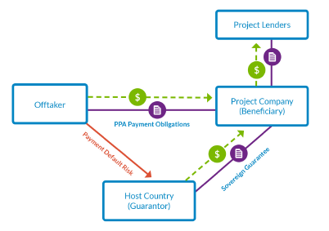
A sovereign guarantee backs payment obligations under the PPA
Guarantees
Sovereign Guarantee Structure
A sovereign guarantee is a contingent liability on the government’s balance sheet.
  Government should weigh up the cost of providing the guarantee (contingent liability) against the economic stimulus benefits of the project.
Lenders consider strength of government guarantee (credit quality of the host government), i.e. can the guarantee be enforced?
Source: Power Africa, Understanding Project Finance

Slide 18
“What if the credit strength of the government is an issue?”

Slide 19
Partial risk guarantees (PRGs) can alleviate concerns about government’s ability to meet contractual obligations
Guarantees
PRG Structure
A payment guarantee may cover a number of different payment obligations:
  Recurring payments by the off-taker to the RE producer under a PPA
  Early termination payments by the government to RE producer
Country example: AfDB Partial Risk Guarantee: Kenya, Lake Turkana wind project, 310 MW
Risks: delays in transmission line interconnection & payment default.
AfDB PRG €20 million + €70 million from the government = €90 million in escrow account.
Ensured first 6 months of payment obligations.
Source: Power Africa, Understanding Project Finance

Slide 20
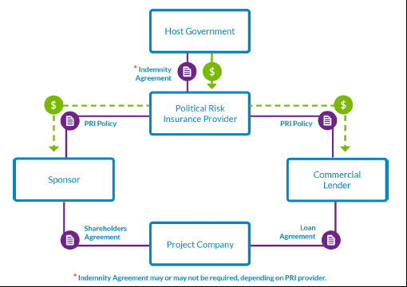
Political risk insurance (PRI) covers risks outside the PPA or to back stop those risks
Guarantees
PRI Structure
Risks covered:
  war/terrorism/civil disturbance
  currency inconvertibility and inability to transfer fund abroad
  breach/repudiation of contract by the utility
  expropriation
Example: PRI policy could cover currency inconvertibility for the portion of the currency that was not provided by the government.
Source: Power Africa, Understanding Project Finance

Slide 21
“What are acceptable financing terms for the market?”

Slide 22
Staple financing is a pre-arranged financing package offered to bidders
Facilitated financing: example staple financing
Zambia Scaling Solar, 2016
Concessional element | Estimated tariff reduction
Staple financing: 33% concessional loan tranche (LIBOR flat) | $0.5 cents/kWh
Staple financing: 33% OPIC (US Government) financing (longer tenor) | $0.3 cents/kWh
Site selection and pre-development: development costs funded (US Government) ($2m) | $0.2 cents/kWh
Total | $1.0 cents/kWh
For RE producer: speeds financial closure, especially for new market entrants
For banks: another lender has determined that the structure is bankable (and thus is comfortable with the risk)

Slide 23
Consult widely with the market before launch of the procurement package
Key take-aways
Conflicting expectations between off-taker and buyer:
  Buyer expects prices from other markets w/o corresponding design & risk allocation.
  Producer cherry picks risk allocation but expects high returns.
Feedback from the market occurs before or after the auction
  If after the auction: risks of implementation delay or undersubscription
Consider road testing a hypothetical project structure (RfP with procurement design,
PPA, Implementation Agreement), but also:
  regulatory, agency roadblocks in procuring generation licenses, connection permits etc.
  possible due diligence, legal road blocks, land, permitting, security structures
Source: based on Fieldstone, USAID workshop July 2019

Slide 24
Key messages
Key take-aways
Clear risk allocation in PPA gives more certainty about the amount and price of generation. The off-taker should seek the advice of qualified legal counsel when preparing the PPA
Implementation Agreements indicate responsibilities for the buyer and the producer during project implementation.
A sovereign guarantee backs payment obligations under the PPA. Depending on the strength of the guarantee, lenders might require additional instruments such as guarantees backed by development finance institutions (DFIs)
Consult widely with the market before launch of the procurement package.

Slide 25
Thank you!

