Slide 1
Definition and advantages of RE competitive procurement
July 16, 2019

Slide 2
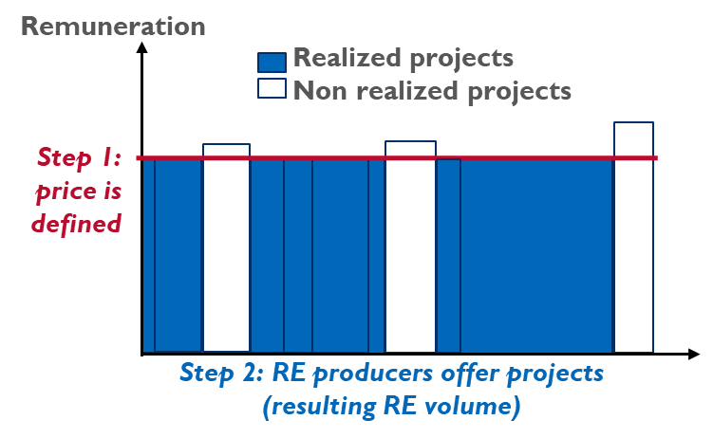
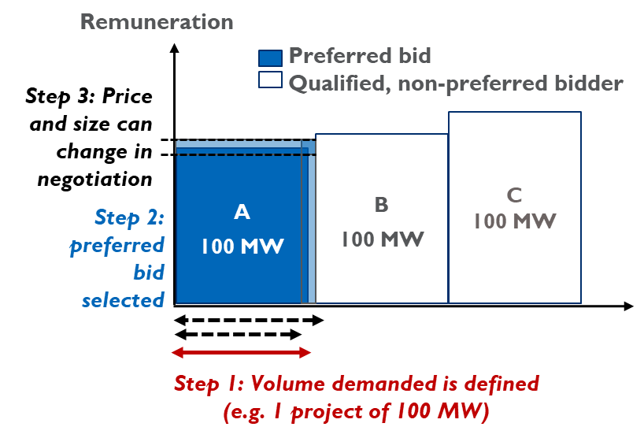
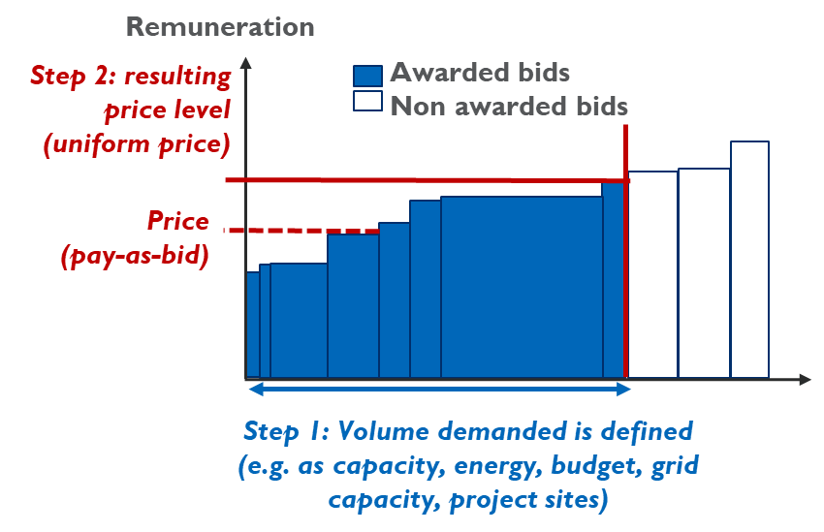
3 ways to determine RE tariffs: competitive procurement, negotiated procurement, admin. FITs
All serve and require different levels of renewable energy market maturity
All result in different reflection of market knowledge
Market-based tariff setting
Admin. Feed-in tariff
Negotiated procurement
Competitive procurement

Slide 3
Admin. feed-in tariffs provide high certainty for producers, but little volume control and price competition
Advantages
Does not require intense competition for the mechanism to function properly.
Low risk for RE producers: access to the tariff is not restricted to the group of successful bidders.
Disadvantages
Low volume control unless FIT has budget/capacity cap.
Slow in reacting to market price changes.

Slide 4
Negotiated procurement provides greater flexibility, but are less scalable and transparent
Advantages
Volume control and greater flexibility to tailor projects to need than auction.
Some competition in pricing but lower than in auction.
Disadvantages
Difficult to scale if many bidders are present.
Risk of delayed project execution due to negotiation stage → prices no longer reflective of current market conditions.
Limited transparency in selection process

Slide 5
Competitive procurement provides strong volume control, price pressure and scalability, but needs competition
Definition | Process for procuring RE electricity designed to allocate a supply contract or incentive based solely on the bids submitted by the participating bidders according to transparent awarding rules.
Advantages
Volume control.
Competitive pricing.
Faster project execution after award than in negotiated procurement.
Easier to scale up for multiple projects and rounds.
Disadvantages
Requires competition.
Bidders face risk of not being awarded and sunk cost of project predevelopment.
Risk of underbidding and project non-completion.

Slide 6
… is competitive procurement always the best fit?
No.
Less mature technologies or small-scale generators with difficulties managing risk/transaction costs from participating in an auction.
Admin. feed-in tariff

Slide 7
… can competitive procurement be implemented in small RE markets?
Competitive procurement
Yes.
Formal participation and award criteria reduces the room for discretionary judgment calls in the process.
Challenges in and to the process of negotiated procurement are not uncommon → causes delays in the process

Slide 8
Country examples show negotiated procurement can pose problems
Limited pressure for developers to offer the lowest acceptable price for power
Opportunities for corruption.
Inclusion of negotiated project terms adverse to the offtaker’s interest.
Nigeria | Price negotiations for more than 5 years with 8 solar IPPs. No defined timeline for commissioning.
Pakistan | Termination of 11 out of 19 contracts (3,400 MW) on alleged corruption/technical grounds. After 3-year period of negotiations, and facing mounting arrears owed to the IPPs, government defaulted on its obligations.
India | Enron’s $2.9 billion 2,184 MW Dhabol IPP in Maharashtra. The project was renegotiated while in operation, mothballed for several years during arbitration, and eventually sold to new investors. Allegations made about corruption and excessive costs
Indonesia | PT Paiton’s $2.7 billion 1,230 MW IPP in Java Law suits and renegotiations in 1991-2001 after plant was commissioned. Allegations: overpriced electricity + free project equity to members of the President Suharto’s family.

Slide 9
Why competitive procurement?
Contract the least-cost renewable energy projects possible
Allocate available funding efficiently
Create attractive investment conditions
Reliably achieve renewable energy target
Optional: achieve other policy goals such as
System integration: e.g. reduce RE intermittency
Contract projects with a positive (local) socio-economic impact
Ensure a certain regional distribution of generation facilities (e.g. for grid concerns)
Maintain or achieve a certain mix of market players

