Slide 1
Auction Design – Part 2
November 18, 2019

Slide 2
Agenda
Auction Design Elements – Part 2
  Ceiling prices
  Financial guarantees
  Penalties

Slide 3
Overview of different design elements and functions
Auction design elements – Part 2
General design
Technology type, auctioned item (kWh, KW, budget), site selection approach
Competitive procurement
procedure
Static vs. dynamic auctions, selection criteria, pricing rule
Conditions for participation
Timing of the auction, ceiling price, pre-qualification requirements, financial guarantees
Enforcement of obligations
Deadlines and penalties
Institutions
Auction regulation, design, implementation, contract off-taker

Slide 4
Ceiling prices control costs and generate market signals, but setting is a challenge
Ceiling prices
No ceiling price vs. with ceiling price
Ceiling prices: relevance and calculation
Successful bids
Unsuccessful bids
Relevance:
Control over maximum costs
Create price signal for market
Disadvantage:
Too high could signal lack of competition.
Too low could crowd-out competition.
Ceiling difficult to set if little information
Calculation:
LCOE + producer rent
If applicable: previous feed-in tariff
Cash-flow model analysis
Adapt based on experience
Price
in Cent/kWh
Volume
in MW
Defined volume

Slide 5
How to calculate the levelized cost of electricity (LCOE)?
Ceiling prices
What does the LCOE tell us?
Revenue needed to cover total costs of building and operating a power plant over its life.
Calculated over 20 years
Expressed in units of currency per kWh
Net present value → time value of money through discount rate.
Discount rate → weighted average cost of capital (WACC)

Slide 6
Levelized cost of energy (LCOE)
Ceiling prices
Net present value of project lifetime costs
Upfront investment cost (e.g. $1,446.34/kW wind in Brazil 2015)
O&M: O&M contract, land leases, insurance (e.g. $39.87/kW wind in Brazil 2015)
Net present value of project lifetime generation
Plant capacity * full-load hours (8760 * capacity factor, e.g. 47.5% wind in Brazil 2015)
– loss in quality/line losses
Ceiling price: LCOE + margin

Slide 7
Most countries disclose ceiling prices
Ceiling prices
Disclosing ceiling price
Price
in Cent/kWh
Benefits:
Helps prevent projects from being rejected in the auction.
Gives bidders more planning security (sunk costs).
Disadvantages:
Bids close to ceiling price if low competition
Ceiling price
(e.g. LCOE-based)
Volume
in MW
Country examples
Defined volume
Undisclosed ceiling price
South Africa, Peru (rounds 1-3)
Disclosed ceiling price
Brazil (combined with undisclosed auction volume), Mexico, India, Peru (round 4)
Successful bids
Unsuccessful bids

Slide 8
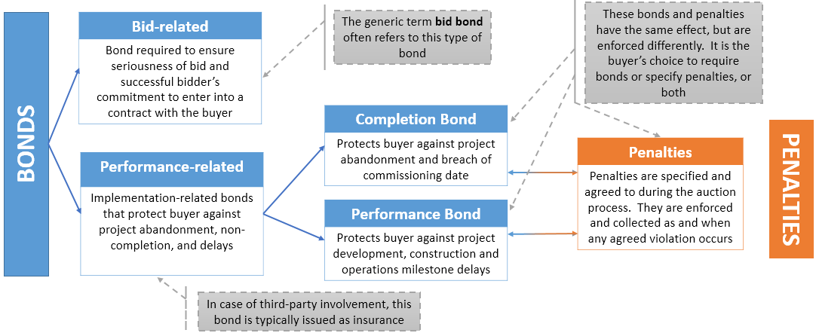
Financial guarantees can be bid- or performance-related
Financial guarantees

Slide 9
Financial guarantees help ensure seriousness of bid and project completion
Financial guarantees
Considerations
Country examples
Sufficiently high financial guarantees help ensure seriousness of bid and project completion
  Balance with technical requirements and consider and risks.
Splitting financial guarantees between commitment (bid bond) and completion (performance/completion bond) helps:
  Seriousness of bid according to milestones
  Balancing burden on bidders.
Ethiopia (government-sited, 100MW)
  Bid bond: $3/kW
  Completion bond: $15/kW
Zambia (government-sited, 2x50 MW)
  Bid bond: $26/kW
  Completion bond: $300/kW ($15M/project)
South Africa (bidder-sited)
  Bid bond: $8/kW
  Completion bond: $16/kW
Brazil (bidder-sited)
  Bid bond: 1% of investment cost
  Completion bond: 5% of investment cost

Slide 10
Penalties enforce project realization (1/II)
Penalties
Planning
Approval process
Construction
Operation
No/delayed realization
Considerations
Penalties imposed in case project is delayed or fails to comply with the requirements stated in the PPA contract.
Examples of penalties:
Execution of financial guarantees if:
Signing of PPA is delayed
Project delays or cancellation
Cancellation of the PPA
Exclusion of bidder and/or project from future rounds.
Deadlines and penalties
  Incentive to realize due to penalties
  Risk for bidders increases
  Prohibitive barrier for (some) bidders

Slide 11
Penalties enforce project realization (1I/II)
Penalties
Calibrate your penalty
  Assume installation costs of $1671/kW for utility scale solar PV, and completion bond of 5-7%
  Assume penalty is applied during year 1 after realization deadline
    Penalty at 5%? → $83.55/kW / Penalty at 7%? → $116.97/kW
Consider incentive to pay the penalty given yearly module price reduction
  If savings > penalty → in theory, incentive to delay by 1 year
Penalties can also be calculated based on the cost for the off-taker of procuring the power elsewhere (wholesale market) or with a different source, i.e. the “liquidated damages” approach.

Slide 12
Penalties: country examples
Penalties
India | For delays of up to 3 months in plant commissioning → performance bank guarantee on a prorated daily basis and capacity not commissioned. For delays in commissioning of more than 3 months, a reduction in tariff begins to apply as well.
France | No penalties were levied in the EOLE 2005 auction program. Five years after the auction, only 10% of the generation contracted was actually produced. For subsequent auctions, penalties were included for delays in plant construction.
UK | No non-performance penalties were included in the NFFO auctions (1990s), resulting in a fairly low share of the contracted capacity (36%) being built.
Brazil | If electricity production falls below 90%: penalty of 115% of the feed-in-tariff is to be paid for the electricity shortage below 90%. After four years, producers are required to clear their balance and to compensate for deficient or over-production by buying or selling electricity from other producers.

Slide 13
Thank you!

