Slide 1
Design elements and country experiences II: ceiling prices, financial guarantees, and penalties
July 17, 2019

Slide 2
Ceiling prices control costs and generate market signals, but setting is a challenge
Ceiling prices: relevance and calculation
No ceiling price vs. with ceiling price
Relevance:
Control over maximum costs
Create price signal for market
Disadvantage:
Too high could signal lack of competition.
Too low could crowd-out competition.
→ India: Developers deemed $3.89* ct/kWh unrealistic in hybrid procurement.
Ceiling difficult to set if little information
Calculation:
LCOE + producer rent
If applicable: previous feed-in tariff
Cash-flow model analysis
Adapt based on experience
Successful bids
Unsuccessful bids
Price
in Cent/kWh
Ceiling price
(e.g. LCOE-based)
Volume
in MW
Defined volume
(*1 USD = 69.3510 Indian Rupees)

Slide 3
How to calculate the levelized cost of electricity (LCOE)?
What does the LCOE tell us? | Revenue needed to cover total costs of building and operating a power plant over its life. Calculated over 20 years Expressed in units of currency per kWh
Net present value → time value of money through discount rate.
Discount rate → weighted average cost of capital (WACC)

Slide 4
Levelized cost of energy (LCOE)
Net present value of project lifetime costs Upfront investment cost (e.g. $1,446.34/kW wind in Brazil 2015) O&M: O&M contract, land leases, insurance (e.g. $39.87/kW wind in Brazil 2015)
Net present value of project lifetime generation Plant capacity * full-load hours (8760 * capacity factor, e.g. 47.5% wind in Brazil 2015) – loss in quality/line losses
Ceiling price: LCOE + margin
©Abt Associates

Slide 5
Most countries disclose ceiling prices
Disclosing ceiling price
Benefits:
Helps prevent projects from being rejected in the auction.
Gives bidders more planning security (sunk costs).
Disadvantages:
Bids close to ceiling price if low competition
Price
in Cent/kWh
Ceiling price
(e.g. LCOE-based)
Country examples
Undisclosed ceiling price
South Africa, Peru (rounds 1-3)
Disclosed ceiling price
Brazil (combined with undisclosed auction volume), Mexico, India, Peru (round 4)
Volume
in MW
Defined volume
Successful bids
Unsuccessful bids

Slide 6
Auction procedure: ceiling prices
Interactive Session
Assume a ceiling price of USD 7 cent/kWh (ceiling price chosen arbitrarily)
Have a look at the assignment sheet – you will find project costs assigned to you.
Given this information, note down the bid you are willing to make
Static sealed bid auction – all bidders hand in their bids at the same time
Announcement and quick evaluation of the results.

Slide 7
Financial guarantees: considerations and country examples
Considerations
Country examples
Sufficiently high financial guarantees help ensure seriousness of bid and project completion
  Balance with technical requirements and consider and risks.
Splitting financial guarantees between commitment (bid bond) and completion (project completion) helps:
  Seriousness of bid according to milestones
  Balancing burden on bidders.
Ethiopia (government-sited, 100MW)
Bid bond: $3/kW
Completion bond: $15/kW
Zambia (government-sited, 2x50 MW)
Bid bond: $26/kW
Completion bond: $300/kW ($15M per project)
South Africa (bidder-sited)
Bid bond: $8/kW
Completion bond: $16/kW
Brazil (bidder-sited)
Bid bond: 1% of investment cost
Completion bond: 5% of investment cost

Slide 8
Penalties enforce project realization
Planning
Approval process
Construction
Operation
No/delayed realization
Considerations
Penalties imposed in case project is delayed or fails to comply with the requirements stated in the PPA contract.
Examples of penalties:
Execution of financial guarantees if:
Signing of PPA is delayed
Project delays or cancellation
Cancellation of the PPA
Exclusion of bidder and/or project from future rounds.
Deadlines and penalties
  Incentive to realize due to penalties
  Risk for bidders increases
  Prohibitive barrier for (some) bidders
Country examples
Zambia: termination of PPA if longstop deadline missed.
South Africa: Reduction of PPA duration by 2 days/1 day of delay. Termination of PPA if deadline missed > 180 days.

Slide 9
Example: setting financial guarantees (1/II)
How to calculate them? | Define level as a percentage of total investment costs International examples show: 1-2% for the bid bond, 5-7% for the completion bond Assume installation costs of $1671/kW for utility scale solar PV What is the value range for the bid bond? $16.71 - $33.42/kW What is the value range for the completion bond? $83.55 - $116.97/kW 4. Calibrate your ranges: Bid bond: consider the permits and approvals to balance burden on bidders (remember: avoid too high sunk cost!) Completion bond: consider the savings potential in e.g. module price reductions delaying project construction enables

Slide 10
Example: setting financial guarantees (1I/II)
When to apply them? | Bid bond Submitted with the bid, returned after the Power-Purchase-Agreement (PPA) is signed For non-awarded projects the bid bond should be returned directly after the auction Completion guarantee: Submitted with the signature of the PPA Returned once the project is commissioned

Slide 11
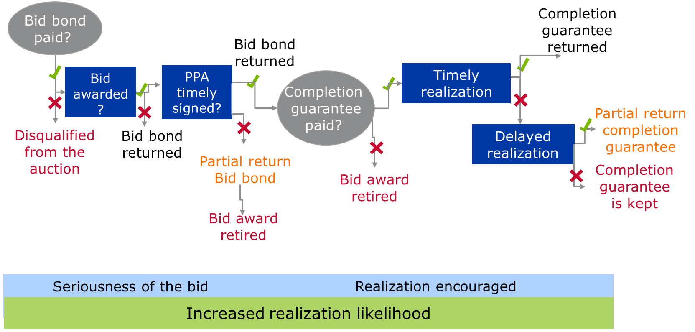
Conditions for participation: financial guarantees

Slide 12
Example: setting penalties (1/III)
How to calculate them? | 1. Calibrate your penalty Assume installation costs of $1671/kW for utility scale solar PV, and completion bond of 5-7% Assume penalty is applied during year 1 after realization deadline What is the penalty at 5%? → $83.55/kW What is the penalty at 7%? → $116.97/kW 2. Consider: Incentive to pay the penalty given yearly module price reduction Savings = $1671/kW x % share module costs on total project costs x (1 – % module price reduction after 1 year) Careful: Calculation is a simplification! Savings = $1671/kW x 0.385 ($644.5/$1671) x 0.74 (1- 0.26) Savings = $476.1 = higher than penalty → In theory, incentive to delay by 1 year

Slide 13
Example: setting penalties (1I/III)
Caveats | → Savings assume that past module decrease will continue over a year: e.g. between Dec. 2016 and Dec. 2017, crystalline silicon module price decline of 1% - 7% → In practice, bidders might avoid delay: the prospect of saving in project costs vs. risk of losing the PPA.

Slide 14



Example: setting penalties (1II/III)
When to apply them? | Penalties are to be executed in case of delays in the commissioning of the project. The penalty should execute the completion bond, e.g. $83.55/kW - $116.97/kW Consider escalation of the penalty over time, e.g. over a 12-month delay period. Ex.: 1/12 of the penalty per month of delay. PPA cancellation in case of severe delays (e.g. of more than a year)
Realization deadline
2 years
No delays
Construction
Operation
Delay up to 1 year
Construction
Operation
Delay > 1 year
Construction

