Slide 1
RE Procurements in a High Penetration Grid Hawaii Case Study
Grid System Technologies Advanced Research Team
Leon R. Roose, Esq.
Principal & Chief Technologist, GridSTART
Marc M. Matsuura, PE
Sr. Smart Grid Program Manager, GridSTART
Hawaii Natural Energy Institute
School of Ocean & Earth Science & Technology
University of Hawaii at Manoa
1680 East-West Road, POST 109
Honolulu, Hawaii 96822
International Workshop sponsored by the U.S. Agency for International Development (USAID)
Asia EDGE Competitive Procurement Dialogue
November 18-20, 2019
Conrad Bangkok
Bangkok, Thailand

Slide 2
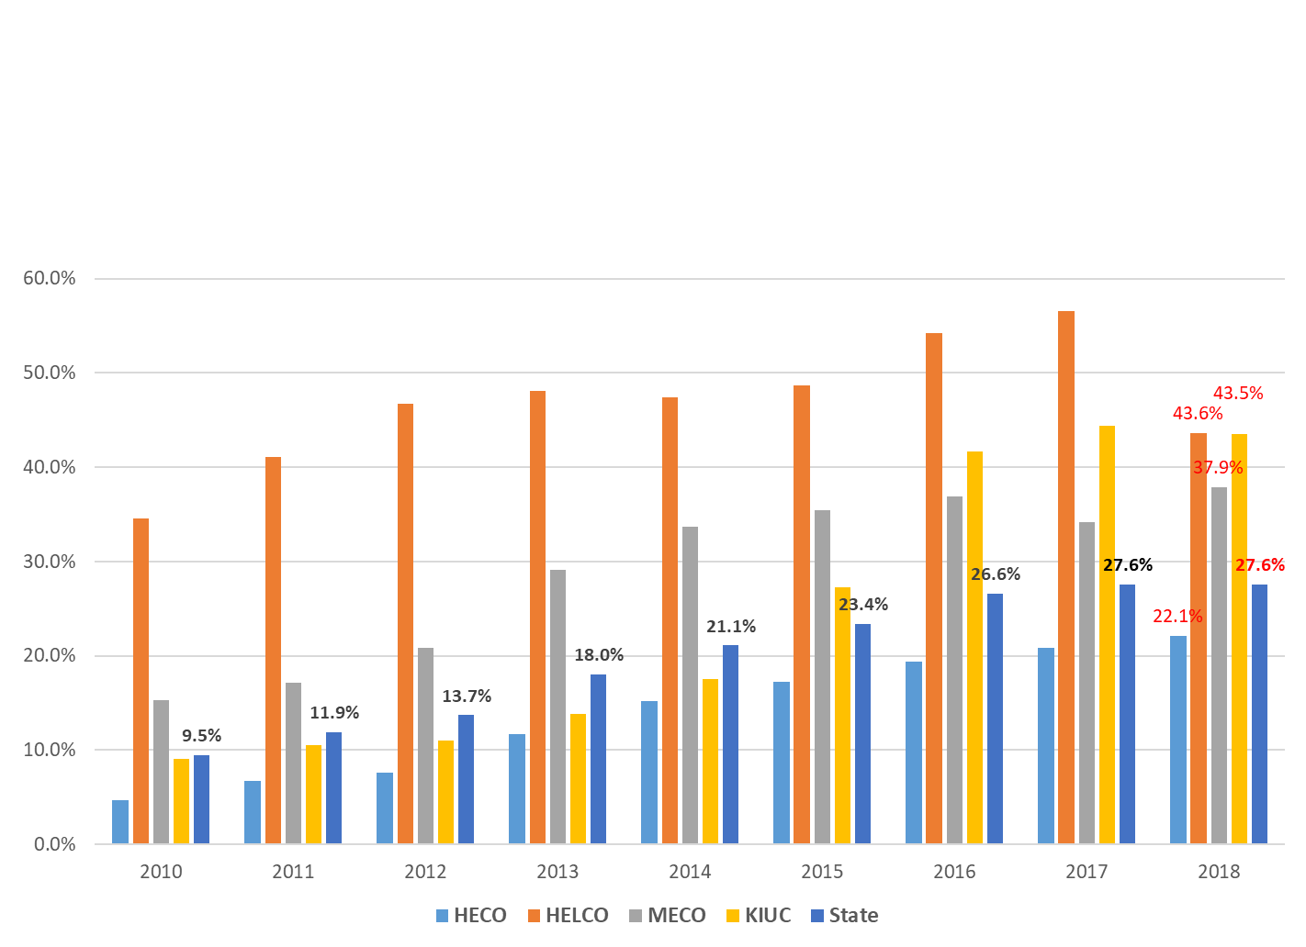
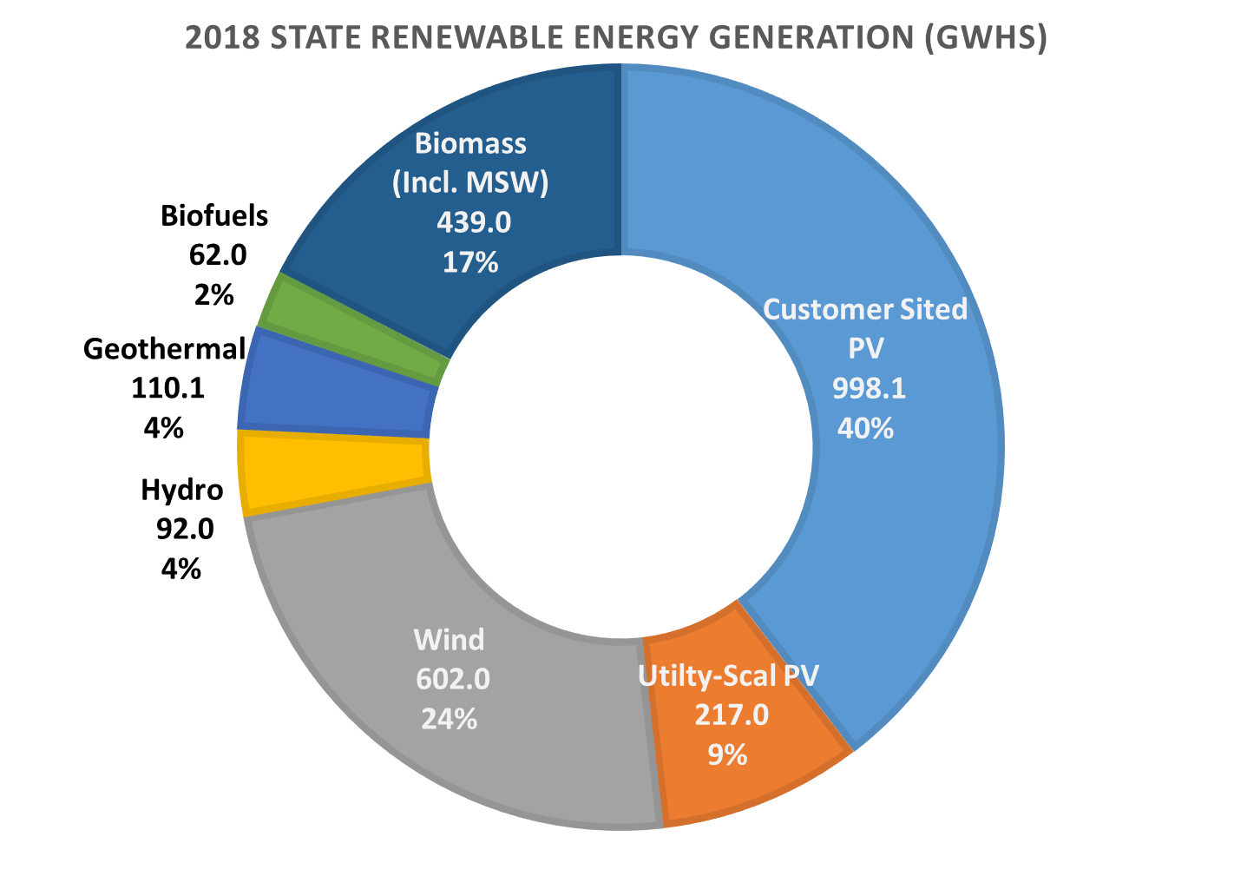
How we got here and procurement path ahead
Hawaii RPS Goals
2015 - 15%
2020 - 30%
2030 - 40%
2040 - 70%
2045 - 100%
Loss of
Geothermal May 2018
Production
Source: Hawaiian Electric and Kaua’i Island Utiltiy Cooperative 2018 RPS Reports

Slide 3
Procurement Methods have Evolved
PURPA
Unsolicited proposals & Bilateral negotiations
for
As-Available RE Energy
Competitive Bidding
for
As-Available
RE Energy
Competitive Bidding
Take or Pay for Energy
Lump Sum Payments
Dispatchable
Competitive Bidding Framework

Slide 4
Competative Bidding Framework
Required method of generation resource procurement in Hawaii
Consistent with Integrated Resource Plan (Power Development Plan)
Waivers may be allowed under certain circumstances if approved by the regulator (Hawaii Public Utilities Commission)
Separate bid evaluation and self-build teams
A Code of Conduct shall be signed by each utility employee involved in advancing a self-bid project or implementing the competitive bidding process
No unauthorized oral or written contacts between employees on separate teams
All bidders, including the self-bid team, to be treated the same in terms of access to information, time of receipt of information, and response to questions
A Commission approved Independent Observer is required when the utility intends to submit a self-bid project

Slide 5
As-Available vs. Take or Pay vs. Lump sum
As-Available
Take or Pay
Lump Sum
Utility only pays for energy export
Accounting is simple.
RE project bears the risk of curtailment and risk is priced into their energy price.
PPA curtailment order is reverse-chronological seniority.
Curtailment risk estimated with grid modeling and projection of utility operating practices and system changes over PPA term.
Utility bears a significant and increasing risk of litigation over curtailment events and practices.
Utility pays for available energy.
Available energy must be calculated during curtailment events or an average energy amount can be agreed to up front.
Risk is better placed; utility in best position to make grid and operational changes to reduce curtailment risk.
Utility bears the risk of curtailment which reduces the energy price; more bankable.
Litigation risk greatly reduced.
Most recent structure used to procure “dispatchable” RE.
Unlocks more flexibility and grid benefits from resources.
Decouples payments from the energy production.
Sets target for project operational “availability” & MWh “performance”.
Further reduces developer risk / price.

Slide 6
As-Available Curtailment Provisions
Curtailment is only allowed:
to accommodate construction or maintenance of the grid
when safety or reliability are in jeopardy
to avoid excess energy events during light load conditions
if the project fails to meet it performance requirements or does not operate in accordance with good engineering and operating practices
Curtailment is implemented in reverse chronological order according to each project’s non-appealable PUC approval order date; difficult to administer
Capacity of the project’s curtailment priority is adjusted downward if its Annual Contract Energy over four consecutive years is less than 60% of its initial Annual Contract Energy.

Slide 7
Dispatchable RE Provisions
Grid Operator (utility) has full dispatch control of the facility’s output
Lump sum monthly payment ($/month) for fixed costs (capital)
Net energy payment ($/MWh) for variable costs, if any
Interconnection Cost Savings Rate ($/100,000 cost savings) for shared interconnection facilities
Liquidated damages assessed for not meeting availability requirements
Project defaults if availability factor is below 84% for more than 3 consecutive years
Liquidated damages assessed for not meeting a measured performance ratio of 95% (adjusted for degradation)
Project defaults if performance ratio is below “Tier 2” performance for more than 3 consecutive years

Slide 8
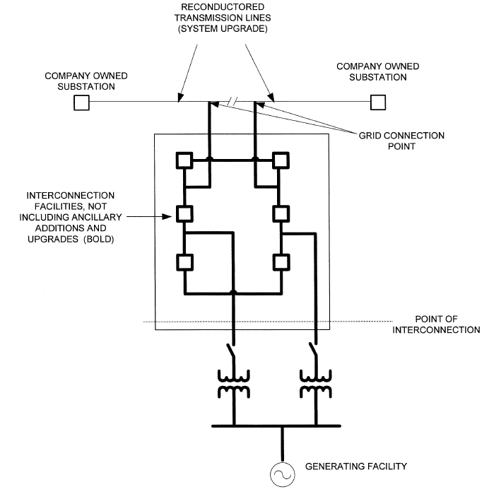
Interconnection and Transmission Upgrades
Interconnection Requirements Study (IRS) Process
System, planning and design information is provided in the RFP to enable bidders to effectively estimate cost for interconnection facilities.
Cost of interconnection facilities and upgrades are also determined by utility for each bid and factored into its evaluation and development of a short list.
Full IRS conducted for short list bids and provided to each bidder at the bidders expense.
Bidders incorporate the IRS results into their bids and may be able to adjust their price. However, an increase in price triggers a re-evaluation of the short list.

Slide 9
Interconnection and Transmission Upgrades (cont.)
Interconnection and system upgrade costs
Bidder is responsible for the cost of interconnection facilities.
Cost of “interconnection facilities” and “system upgrades” are determined for each bid and factored into the evaluation and development of a short list.
Facilities from the Point of Interconnection to the Grid Connection Point will be owned by the Utility.
Utility installs and maintains the system upgrades at its cost (this cost is considered in the bid evaluations).
System Benefits and/or Betterments are also considered in the bid evaluations.

Slide 10
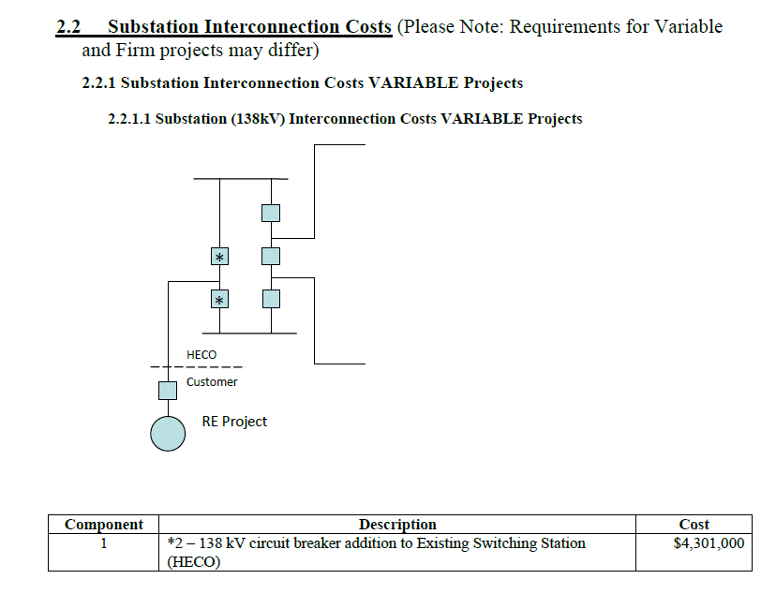
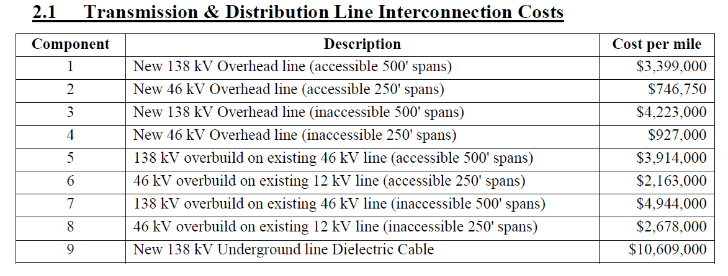
Unit Cost Estimates

Slide 11
Evolution of Performance Requirements
Fault ride-through
Frequency regulation
Fast frequency response
Voltage regulation
Ramp rate limits
Transient OV mitigation
Frequency and voltage ride-through
Fully Dispatchable

Slide 12
Other Technical Provisions
Day ahead production forecast
Project and meteorological data to support utility forecasting
Detailed equipment specific models
Model escrow process

Slide 13
Takeaways
Risk allocation and pricing mechanisms have evolved as lessons were learned, experience/confidence gained and system needs changed
Continuous improvement; what works today may not be best for tomorrow
Characteristics of a successful competitive procurement:
Requirements based on planning studies – understand needs & minimize surprises
Provide as much information as possible - minimize unknowns
Effective risk allocation and mitigation
Clear requirements, process and schedule
There is no “free lunch.” Added Risks = Added cost
Risk placed on the entity in best positioned and enabled to manage that risk
Utility and RE projects require cost recovery for interconnection facilities and upgrades
Who pays for infrastructure improvements depends on who can best manage cost and who benefits from the upgrades

Slide 14
Mahalo! (Thank you)
For more information, contact:
Marc M. Matsuura
Sr. Smart Grid Program Manager
GridSTART
Hawaii Natural Energy Institute
School of Ocean & Earth Science & Technology
University of Hawaii at Manoa
1680 East-West Road, POST 109
Honolulu, Hawaii 96822
Office: (808) 956-5070
Mobile: (808) 321-8928
E-mail: marc.matsuura@hawaii.edu
Website: www.hnei.hawaii.edu
Grid System Technologies Advanced Research Team

Slide 15
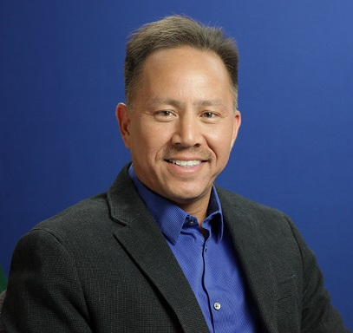
Grid System Technologies Advanced Research Team
Mr. Roose is a tenured faculty member of the Hawaii Natural Energy Institute (HNEI), University of Hawaii, where he formed and leads GridSTART, (Grid System Technologies Advanced Research Team), a research team focused on the integration and analysis of energy technologies and power systems, including smart grid and micro grid applications.
He served in numerous leadership roles at the Hawaiian Electric Company for 19 years prior including management of renewable energy planning and integration, generation resource planning and competitive procurement, negotiation of all power purchase agreements for the utility, transmission and distribution system planning, smart grid planning and projects, system relaying and protection, and fuel purchase and supply to utility generating plants. He is a licensed attorney, worked in private law practice in Hawaii and was formerly Associate General Counsel at Hawaiian Electric. He holds a B.S. in Electrical Engineering and a J.D. from the University of Hawaii.
Leon R. Roose
Chief Technologist

Slide 16
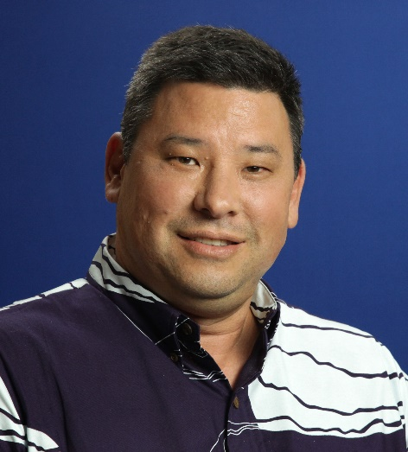
Grid System Technologies Advanced Research Team
Marc M. Matsuura
Sr. Smart Grid Program Manager
Marc joined the Hawaii Natural Energy Institute (HNEI), School of Ocean & Earth Science & Technology, University of Hawaii at Manoa, in 2013 as the Senior Smart Grid Program Manager and is a founding member of GridSTART (Grid System Technologies Advanced Research Team).
Prior to joining HNEI, he was with the Hawaiian Electric Company for 21 years. His career at Hawaiian Electric included positions in the areas of Transmission & Distribution (T&D) Engineering, T&D Standards and Technical Services, System Operations, Transmission Planning, Smart Grid Planning, and System Integration. Marc is a licensed professional electrical engineer in Hawaii. He holds a B.S. in Electrical Engineering and an M.B.A. from the University of Hawaii.

Slide 17
Hawaii Natural Energy Institute (HNEI) University of Hawai‘i at Mānoa
Organized Research Unit in School of Ocean and Earth Science and Technology (SOEST) Founded in 1974, established in Hawai‘i statute in 2007 (HRS 304A-1891)
Conduct RDT&E to accelerate and facilitate the use of resilient alternative energy technologies and reduce Hawaii’s dependence on fossil fuels.
Diverse staff includes engineers, scientists, lawyers; students and postdoctoral fellows; visiting scholars
Areas of Interest
Policy and Innovation
Grid Integration (GridSTART)
Alternative Fuels
Electrochemical Power Systems
Renewable Power Generation
Building Efficiency
Transportation
Core Functions
State Energy Policy Support
Research & Development
Testing and Evaluation
Analysis
Workforce Development

Slide 18
Established to develop and test advanced grid architectures, new technologies and methods for effective integration of renewable energy resources, power system optimization and resilience, and enabling policies
Serves to integrate into the operating power grid other HNEI technology areas: energy efficiency, renewable power generation, biomass and biofuels, fuel cells and hydrogen
Strong and growing partnerships with Hawaii, national and international organizations including Asia-Pacific nations
Expertise & Focus:
Energy Policy
Renewable Energy Grid Integration
Smart Grid Planning & Technologies
Power Systems Planning
Power Systems Operation
Power Systems Engineering and Standards
Communications Design and Testing
Project Management and Execution
Lead for many public-private demonstration projects

Slide 19
Core Team Members:
Richard Rocheleau Director, HNEI
Leon Roose * Specialist & Chief Technologist
Mark Glick * Specialist, Energy Policy
John Cole * Senior Policy Strategist
James Maskrey * Energy Efficiency Program Manager
Marc Matsuura * Senior Smart Grid Program Manager
Kanoa Jou * Power Systems Engineer
Staci Sadoyama * Power Systems Engineer
Thai Tran Junior Power System Engineer
Silas Oliviera de Toledo Junior Power System Engineer
Brian Chee Communications & IT System Analyst
Dax Mathews Renewable Energy Resources Forecasting
Kevin Davies Assistant Researcher
Saeed Sepasi Assistant Researcher
Jonathan Kobayashi Research Associate
Sharon Chan GIS Specialist
Yan Chen Post-Doctoral Fellow
Quynh Tran Post-Doctoral Fellow
Arif Rahman Post-Doctoral Fellow
Sampling of Sponsors & Partners:
Team members combine for 75+ years of utility and regulatory experience
* Prior electric utility company senior management and staff
* Prior Commissioner of the Hawaii State Public Utilities Commission
* Prior Administrator of the Hawaii State Energy Office

