Slide 1
Bangladesh Climate-Resilient Ecosystem Curriculum (BACUM)
Module 2: REDD+ in Climate Change Context

Slide 2
Module 2: REDD+ in Climate Change Context
SECTION III: ANALYZING FUTURE OPTIONS FOR REDD+
3.3. The Costs and Benefits of REDD+

Slide 3
REDD+ in Climate Change Context (REDD+)
ENABLING ENVIRONMENT OF REDD+
1.1. Forests, Forest Carbon and Climate Change
1.2. Fundamentals of REDD+ and the UNFCCC
1.3. Stakeholder Engagement
ASSESSING CURRENT CONDITIONS OF REDD+
2.1. Drivers of Deforestation and Forest Degradation
2.2. Fundamentals of Forest (Emission) Reference Levels
2.3. National Forest Monitoring Systems (NFMS) for REDD+
ANALYZING FUTURE OPTIONS FOR REDD+
3.1. Policies and Measures for REDD+ Implementation
3.2. REDD+ Safeguards under the UNFCCC
3.3. The Costs and Benefits of REDD+
DEVELOPING REDD+ STRATEGIES AND ACTION PLANS
4.1. Negotiation in REDD+
4.2. National Strategies and Action Plans
4.3. Approaches for Incentive Allocation System
MONITORING, EVALUATION AND ADAPTATION
5.1. Establish M&E Framework for REDD+ Action Plan
5.2. Monitor and Measure Implementation Progress
5.3. Evaluate, Report and Adapt

Slide 4
Acknowledgements
EXPERT CONTRIBUTORS | SPECIFIC INPUTS
Prof. (Dr.) Manzoor Rashid | Curriculum Development for all topics
Prof. (Dr.) Md. Danesh Miah | REDD+, Forest Carbon
Prof. (Dr.) Md. Jakariya | Community NR Management, Climate Change, Natural Resources Management
UNIVERSITIES
Bangladesh Agricultural University
University of Chittagong
Dhaka University
Independent University, Bangladesh
Khulna University
Noakhali University of Science and Technology
Shahjalal University of Science and Technology
Sher-e-Bangla Agriculture University
North South University
CREL STAFF | CREL STAFF
John A Dorr | Utpal Dutta
Abu Mostafa Kamal Uddin | Ruhul Mohaiman Chowdhury
Kevin T. Kamp | Rahima Khatun
Paul Thompson | Sultana Razia Zummi
Abdul Wahab | Shams Uddin
Shahzia Mohsin Khan
DESIGN, LAYOUT AND CONTENT DEVELOPMENT: Ms. Chi Pham, Curriculum Development Expert, Bangkok, Thailand

Slide 5
Learning Objectives
At the end of this section, students will be able to:
Differentiate between opportunity costs, implementation costs and transaction costs
Recognize the scale of funding, effort and time needed for different phases of REDD+
Apply the methods to estimate the costs of REDD+ to inform strategic decisions

Slide 6
Pre-Class Preparation
Students should read:
IUCN. 2009. REDD-plus and benefit sharing: Experiences in forest conservation and other resource management sectors. International Union for Conservation of Nature. (8 pages)

Slide 7
REDD+ Benefits and Costs
REDD+ aims both to lower emissions and to generate co-benefits. How will those benefits be distributed or shared?
Lowering emissions also means there will be costs (opportunity costs and implementation costs). How will the costs be distributed or shared? How will those costs be compensated?
We might also consider risks (a cost with an associated probability) and opportunities (a benefit with an associated probability?)
General Principle: Two reasons to think about how the costs and benefits are distributed are:
Effectiveness
Equity
Notes:
KEY MESSAGE:
This slide iterates two key principles for us to consider in the distribution of different benefits and costs from PEDD+ activities: effectiveness (of the project or the program, tied to achieving project goals or outcomes) and equity (can also be tied to outcomes, or can also be tied to process, e.g. planning and implementation).
Students should be asked to think and talk about:
how the distribution or sharing of costs and benefits might impact project/program effectiveness
how the distribution might impact social equity
References:
USAID. 2015. USAID LEAF‘s Climate Change Curriculum. USAID Lowering Emissions in Asia Forests Program (USAID LEAF). Winrock International and US Forest Service. Bangkok, Thailand.

Slide 8
Elite Capture of Benefits
Many people worry that there will be elite capture of benefits:
What does this mean?
Why do they worry about this?
For effectiveness?
For equity?
Revisit REDD+ Benefits:
Various potential types of benefits
Can be monetary and non-monetary
Can be tangible and intangible
Notes:
KEY MESSAGE:
The instructor should remind the students about the potential types of benefits. If the earlier course material on benefits has not been covered, here the instructor would need to introduce some of this material.
References:
USAID. 2015. USAID LEAF‘s Climate Change Curriculum. USAID Lowering Emissions in Asia Forests Program (USAID LEAF). Winrock International and US Forest Service. Bangkok, Thailand.

Slide 9
Exclusions: 2 kinds
Many people worry there will be exclusions:
Exclusions from resources or processes (leading to costs)
From land or territory access
Curtailed access to forest products (timber, NTFPs)
Exclusion from forest management or other resource decision-making regimes
Exclusion from subsequent project benefits
Revenues
Other benefits: employment, training opportunities, goods and services
Our focus here
Notes:
KEY MESSAGE:
There can be different kinds of exclusions that can result from projects like REDD+ projects. Some of these exclusions are exclusions of people from resources that they previously had access to (but now don’t because of the new project). These types of exclusions lead to people experiencing new costs. Exclusions that lead to costs could signal a need for compensation mechanisms.
The other type of exclusions are exclusions of people from sharing in or receiving some of the benefits that the new project might generate—especially financial benefits (but also other in-kind benefits as well). This module section on REDD+ benefits sharing focusses on the exclusion from benefits.
NTFP=non-timber forest products
References:
USAID. 2015. USAID LEAF‘s Climate Change Curriculum. USAID Lowering Emissions in Asia Forests Program (USAID LEAF). Winrock International and US Forest Service. Bangkok, Thailand.

Slide 10
Benefit Distribution Systems
Benefit Distribution Systems are designed to address these concerns:
What are benefits?
Who gets benefits?
How is this managed?
How are concerns over the distribution of costs addressed?
Notes:
Key Message: To some degree, concerns over the distribution of costs can be addressed through benefit distribution systems. Systems can be designed so the benefits go to the people who bear the costs, but this is not necessarily the case. An example: Benefits might go to people in a community based on the holding of land rights. Men are often more likely to hold land rights. But women may actually experience the costs of curtailed resource access, by having to collect NTFPs from a further distance with an associated time cost. So men may get the project benefit, while women may bear the opportunity cost. And we cannot assume that project benefits are shared equitably within households.
References:
USAID. 2015. USAID LEAF‘s Climate Change Curriculum. USAID Lowering Emissions in Asia Forests Program (USAID LEAF). Winrock International and US Forest Service. Bangkok, Thailand.

Slide 11
Scales of Distribution Systems
Financial flows are likely to occur at a number of different scales:
From international to national levels (e.g. between national governments)
From national governments to local communities
Within communities
$
Country A
Country B
$
$
Community B
Community A
$
$
Household A
Household B
Notes:
Key Message: Benefit distribution systems can be designed and organized at different scales, because the financial flows associated with REDD+ can occur at different scales. This slide makes the simple point that the flows can occur at different scales.
References:
USAID. 2015. USAID LEAF‘s Climate Change Curriculum. USAID Lowering Emissions in Asia Forests Program (USAID LEAF). Winrock International and US Forest Service. Bangkok, Thailand.

Slide 12
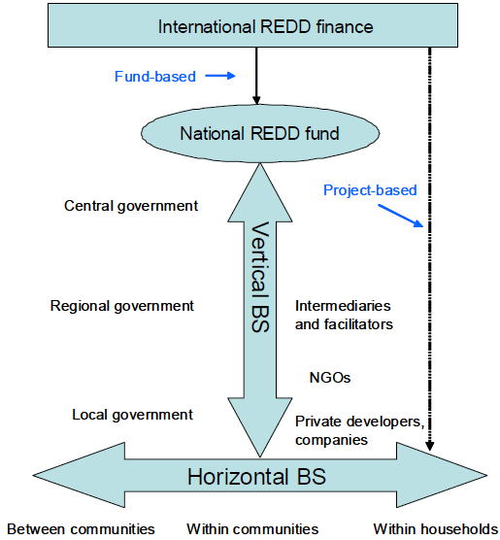
Horizontal vs. Vertical Benefit Sharing
Notes:
KEY MESSAGE:
This graphic now moves from the very abstract and simplified diagram on the previous slide to a more realistic depiction of various horizontal and vertical flows of benefits within a REDD+ context. Note that this graphic also demonstrates the “within-household” scale to raise the issue of the sharing of benefits among the individuals within the same households (e.g. among men and women in the same household).
This graphic is replicated here from the suggested pre-class reading to be assigned to students.
BS=Benefit Sharing
Graphic source:
IUCN. 2009. REDD-plus and benefit sharing: Experiences in forest conservation and other resource management sectors. International Union for Conservation of Nature.
References:
USAID. 2015. USAID LEAF‘s Climate Change Curriculum. USAID Lowering Emissions in Asia Forests Program (USAID LEAF). Winrock International and US Forest Service. Bangkok, Thailand.

Slide 13
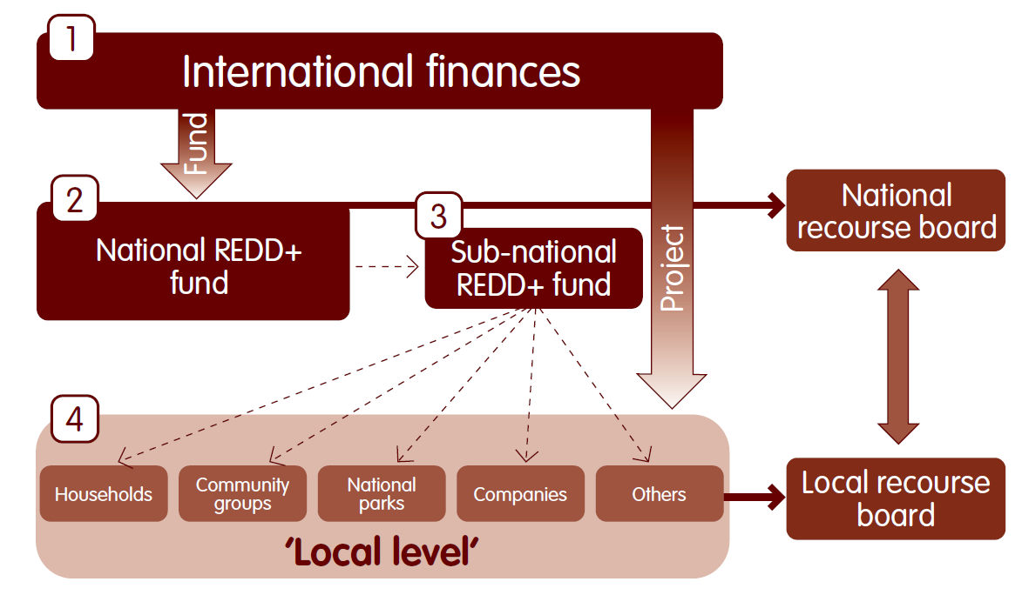
Flow of Benefits: Vietnam Example
Notes:
KEY MESSAGE:
This diagram illustrates yet another way to visualize the potential flows of benefits. This diagram is specific to the Vietnam case, and in other cases distribution systems can have different flows. Here we see the flows of benefits via projects or funds at four different tiers: (1) the international tier, (2) the national tier (as a national REDD+ fund), (3) the sub-national tier (as a sub-national REDD+ fund), and the local tier. We can think of these as the four potential tiers of benefit distribution systems, all of which we might see in the case of some countries (while in other countries we might see only a subset of the four tiers). This diagram also includes the concept of including recourse mechanisms (here depicted as a local recourse board and national recourse board) as a part of distribution systems, in order to address grievances that arise.
Graphic source:
SNV, 2012. Benefit Distribution Systems. SNV Pro Poor REDD+ Briefing Paper.
References:
USAID. 2015. USAID LEAF‘s Climate Change Curriculum. USAID Lowering Emissions in Asia Forests Program (USAID LEAF). Winrock International and US Forest Service. Bangkok, Thailand.

Slide 14
Elements of a Benefits Distribution System
Three main elements of a REDD+ benefit distribution system:
The types of benefits that arise through REDD+;
The actors (including the beneficiaries) between whom benefits are shared; and
The cross-cutting formal and informal rules that govern how benefits are shared.
Notes:
KEY MESSAGE:
Now that we have discussed some of the scalar mechanics of benefit distribution systems, by thinking about the flows of benefits, we can turn to thinking a bit more conceptually about the elements of any distribution system (whether it be an international system, a national system, or a local project-based system). This slide presents these three main elements (types of benefits, actors, and rules).
Reference:
Peskett, L. 2011. Benefit Sharing in REDD+: Exploring the Implications for Poor and Vulnerable People. World Bank and REDD-net. http://siteresources.worldbank.org/EXTSOCIALDEVELOPMENT/Resources/244362-1232059926563/5747581-1239131985528/5999762-1318623469948/BenefitSharingReport.pdf
USAID. 2015. USAID LEAF‘s Climate Change Curriculum. USAID Lowering Emissions in Asia Forests Program (USAID LEAF). Winrock International and US Forest Service. Bangkok, Thailand.

Slide 15
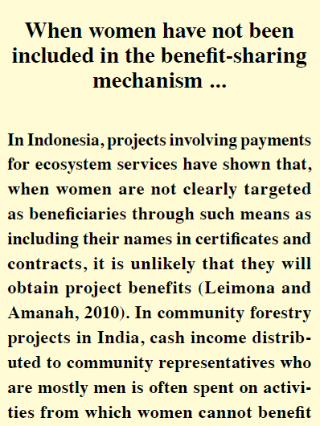
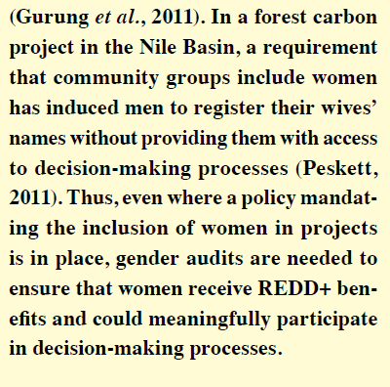
Activity: Women’s Access to PES/REDD+ Benefits
For Discussion in Small Groups:
Applying the 3 case examples in the passage here, what are the impacts of women’s lack of participation in benefits for effectiveness and for equity? Think of additional examples.
Notes:
Divide the class into small groups. Ask each group to silently read the passage, or ask one member to read it aloud to the others. Then ask each group to restate briefly the details of the three case examples found within the passage. Finally, ask the group to discuss the given discussion question. If time allows, small groups can report back to the full class in plenary-style to share across groups.
PES=Payment for Ecosystem Services
Source of Textbox:
Setyowati, A. 2012. Ensuring that women benefit from REDD+. Unasylva 239, Vol. 63, 2012/1.

Slide 16
Let’s focus now on one particular benefit: Revenue
Notes:
KEY MESSAGE:
Revenues are one type of benefit. There are other types of potential benefits, but here we will focus on revenue, as it is arguably the critical one. The revenue may be converted into other types of benefits at lower scales. For example, a community might decide to spend part of the revenues on community projects and distribute part as payments to households.
Graphic source:
http://www.clipartpanda.com/categories/money-tree-images

Slide 17
Categories of Revenues
Revenue is a key type of benefit. There are different categories of revenues:
Compensation of opportunity costs: Opportunity costs are equal to the value of the next most profitable land or resource use.
Funding for productive activities (reimbursement of implementation costs): These are the funds used to support the implementation of productive activities that store carbon.
REDD+ ‘rent’: This represents the difference between the cost actually experienced (opportunity cost plus the funding needed to implement) and the average global carbon price at which emissions reductions credits from REDD+ could be sold; i.e., the rent is the profit that could be made from REDD+.
Notes:
KEY MESSAGE:
There are three categories of revenue or money that a project might generate:
1. Revenue to compensate for opportunity costs. Here is an example for opportunity costs from Peskett: “For example, in cases where forests are protected from conversion to growing oil palm, the opportunity cost per hectare is equal to the value of the palm oil per hectare.”
Opportunity costs are equal to the value of the next most profitable land or resource use.
2. Revenue to pay for the expenses of implementing the project. On this slide we refer to “funding for productive activities.” This is the same as reimbursement for “implementation costs”). Here is an example for implementation costs from Peskett: “For example, they may include tree planting activities that aim to relieve pressure on natural forests.”
3. Additional revenue or “rent” due to a carbon price that is higher than that price that would be needed to cover the opportunity and implementation costs.
References:
Peskett, L. 2011. Benefit Sharing in REDD+: Exploring the Implications for Poor and Vulnerable People. World Bank and REDD-net.
USAID. 2015. USAID LEAF‘s Climate Change Curriculum. USAID Lowering Emissions in Asia Forests Program (USAID LEAF). Winrock International and US Forest Service. Bangkok, Thailand.

Slide 18
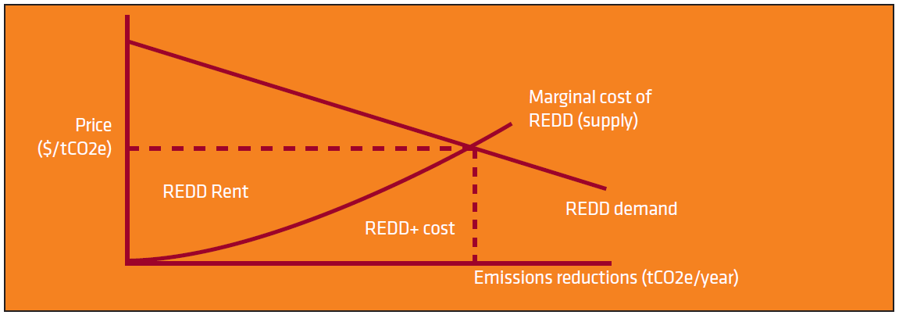
REDD Supply & Demand
Notes:
KEY MESSAGE:
Let’s look at those revenue categories visually in the context of a supply curve and a demand curve. Both the opportunity and implementation costs are captured by the “REDD+ cost.” Here is an excerpt from the figure caption in the original source (Peskett, 2011):
“REDD supply and demand illustrating the differences between opportunity costs and the REDD ‘rent’. Theoretically developed countries could at a minimum pay the opportunity cost associated with reaching a certain level of emissions reductions or they could pay the same price for all reductions (i.e., paying ‘rent’). In addition to the opportunity costs, transaction and administrative costs also need to be considered in terms of determining the overall scale of financial benefits from REDD+.”
An instructor could use this graphic to discuss how some REDD+ projects might occur with costs that fall somewhere along the left side of the supply curve (with costs less than the price that is set at the intersection of the supply curve and the demand curve). These projects would cover costs and also generate additional “rent” revenue.
References:
Peskett, L. 2011. Benefit Sharing in REDD+: Exploring the Implications for Poor and Vulnerable People. World Bank and REDD-net.
USAID. 2015. USAID LEAF‘s Climate Change Curriculum. USAID Lowering Emissions in Asia Forests Program (USAID LEAF). Winrock International and US Forest Service. Bangkok, Thailand.

Slide 19
Performance-Based Payments
REDD+ is performance based. Revenue flows will be linked to emissions reductions.
But at “lower” scales of distribution, payments and other benefits may or may not be linked to performance:
“…benefit sharing systems could be based purely on emissions metrics, with those actors who have demonstrated reductions/removals being provided a level of benefits linked to the volume of reduced emissions/enhanced removals.” (Peskett, 2011)
For Discussion:
Will performance-based payments at all scales lead to an equitable distribution of benefits? Why or why not? Under what conditions would it or wouldn’t it? At which scales should distribution be performance-based?
Notes:
Key Message:
Now that we have talked about the types of revenue, let’s talk about how monetary payments generated out of those revenues might be allocated (within a community’s project, for example). In theory perhaps, size of payments and their allocation should reflect “performance”—the amount of carbon sequestered or the amount of greenhouse gas emissions avoided. But this approach may not work well for an equitable outcome.
From Peskett (2011): “This [benefit sharing based on emissions reduction performance] will not necessarily result in an equitable distribution of benefits, if it is difficult to identify which actors have been involved.” This is a key point that could arise in the discussion and these are the conditions referenced in the discussion question. Another key point that could arise is that benefit distribution systems may have other social and environmental goals in addition to the project effectiveness goals (tied to proper incentives) and the project equity goals (tied to the fairness of benefits sharing).
References:
Peskett, L. 2011. Benefit Sharing in REDD+: Exploring the Implications for Poor and Vulnerable People. World Bank and REDD-net.
USAID. 2015. USAID LEAF‘s Climate Change Curriculum. USAID Lowering Emissions in Asia Forests Program (USAID LEAF). Winrock International and US Forest Service. Bangkok, Thailand.

Slide 20
Proxy Measures for Performance
Measures something we think should be correlated with carbon reductions/removals
Could measure a different output, e.g. forest area
Could measure an input instead of output, e.g. project labor
“In the case of Vietnam, for example, local consultations have suggested that the number of hours spent patrolling forested areas to protect against illegal deforestation may be an appropriate proxy measure for avoided deforestation and the resulting emissions reductions.” (Enright et al, 2012)
For Discussion:
What are the advantages and disadvantages of proxy measures?
What impact could use of a proxy measure have on revenues and other benefits?
Notes:
KEY MESSAGE:
Because it may be difficult to measure emissions performance (for example, how much carbon has a given household sequestered?), we might instead consider using a proxy measure. This slide details what proxy measures are, gives examples, and engages students to think about the pluses and minuses of proxy measures.
References:
Peskett, L. 2011. Benefit Sharing in REDD+: Exploring the Implications for Poor and Vulnerable People. World Bank and REDD-net.
Enright, A., McNally, R., and T. Sikor. 2012. An Approach to Designing Pro-Poor Local REDD+ Benefit Distribution Systems: Lessons from Vietnam. SNV - Netherlands Development Organisation, REDD+ Programme.
USAID. 2015. USAID LEAF‘s Climate Change Curriculum. USAID Lowering Emissions in Asia Forests Program (USAID LEAF). Winrock International and US Forest Service. Bangkok, Thailand.

Slide 21
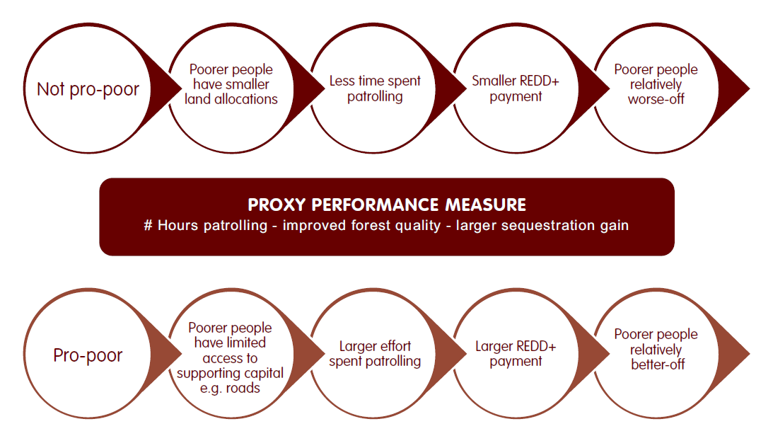
The proxy performance measure selected and the specific local context both matter for distribution impacts…
Source: Enright et al, 2012
Notes:
Key Message:
The proxy performance measure selected and the specific local context both matter for distribution impacts. This scenario example comes out of the Vietnam experience (SNV, 2012). It builds on the example presented from Vietnam on the previous slide—the use of number of hours patrolled as a proxy measure.
Use of this particular proxy measure could turn out to be pro-poor or not pro-poor, depending on the local context of poverty (e.g. are poorer households poor due to smaller land allocations or are they poor due to lack of access to other capital necessary for the productive use of their land?)
Reference:
Enright, A., McNally, R., and T. Sikor. 2012. An Approach to Designing Pro-Poor Local REDD+ Benefit Distribution Systems: Lessons from Vietnam. SNV - Netherlands Development Organisation, REDD+ Programme.
SNV, 2012. Benefit Distribution Systems. SNV Pro Poor REDD+ Briefing Paper.
Graphic source:
Enright, A., McNally, R., and T. Sikor. 2012. An Approach to Designing Pro-Poor Local REDD+ Benefit Distribution Systems: Lessons from Vietnam. SNV - Netherlands Development Organisation, REDD+ Programme.

Slide 22
Small Group Activity
Task: Design a Benefit Distribution System for a REDD+ Project
Steps:
Divide into groups of 3-4 students.
Each group should design a simple benefits distribution system for a local REDD+ project. First, determine the nature of the project and identify the potential benefits (types). Second, identify the actors. Third, specify a set of rules for who receives what benefit.
Share among the groups, asking each group to briefly describe their system.
Discuss or debate which group’s system will be:
more effective in providing incentives
more equitable
Notes:
This activity is likely to take at least 30 minutes total. It would constitute the start of a second class session on this topic. Note that the assignment is to create a benefit distribution system at the scale of a REDD+ project. This approach to the activity simplifies it and makes it more accessible to most students. After students complete this activity, the student products should be re-visited in light of the content on the following two slides.

Slide 23
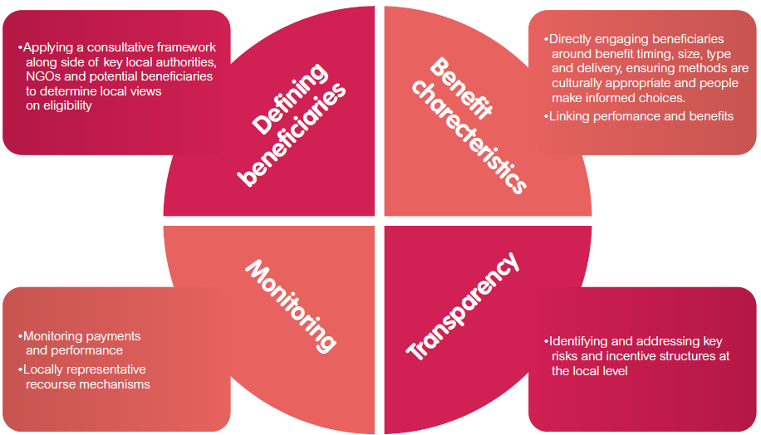
Local Benefit Distribution System Design: The SNV Approach
Notes:
KEY MESSAGE:
The following is an excerpt from the SNV (Eright, 2012) document (see topic references):
“1. Defining beneficiaries: correctly defining the beneficiaries will help determine where responsibilities lie for carrying out REDD+ activities. It will also help identify those stakeholders who may be directly or indirectly affected by these activities. This process will need to begin with an assessment of existing land tenure arrangements and identify how customary rights and overlapping land claims could influence whether people have legitimate claims to REDD+ benefits…
2. Benefit characteristics: Directly engaging the identified beneficiaries in decisions around the types, timing and size of benefits will help to tailor the BDS [benefit distribution system] to local needs. This builds on the above process by acknowledging that different beneficiaries, particularly those with different tenure and land entitlements, will have different benefit preferences. For example, those beneficiaries without formal recognition of land title may see this as an important potential benefit from REDD+. The participation of local stakeholders in arrangements to oversee the delivery of benefits will also facilitate smooth and transparent benefit sharing. Support to local groups must be linked to performance in order to change behaviur. Payments may be linked directly to the reduction in carbon emissions or may use agreed proxy measures for performance.
3. Monitoring performance: The BDS design will need to consider how REDD+ activities are monitored. At the local level, this process could be facilitated through local engagement in monitoring activities. This could allow local actors to self-check the benefits they receive against their performance in any REDD+ mechanism. Monitoring efforts and benefit delivery should always be supported by robust recourse mechanisms. These will ensure complaints or disputes around the BDS are acted upon. Local representation on recourse mechanism bodies will be vital in terms of being seen by beneficiaries as a group of non-biased and independent individuals that can be openly approached.
4. Transparency: The design of local level benefit sharing systems must involve steps to mitigate the risks of corruption at the local level. Corruption risks should be identified early across all processes in the BDS design and operation. Opportunities to mitigate these risks should first consider the integration into existing local processes to ensure the cost effectiveness of risk mitigation measures.”
If the instructor has used the activity on the preceding slide, students should be asked here to comment on whether or not their benefit distribution system included all four of the aspects outlined here. It is likely that they defined beneficiaries, as part of identifying actors. They also probably discussed benefits characteristics, as part of discussing types of benefits and rules for their allocation/distribution. But did they think about monitoring and transparency? Probably not, since it was not explicitly part of the assignment (although rules can be part of monitoring and transparency).
Reference and graphic source:
SNV, 2012. Benefit Distribution Systems. SNV Pro Poor REDD+ Briefing Paper.

Slide 24
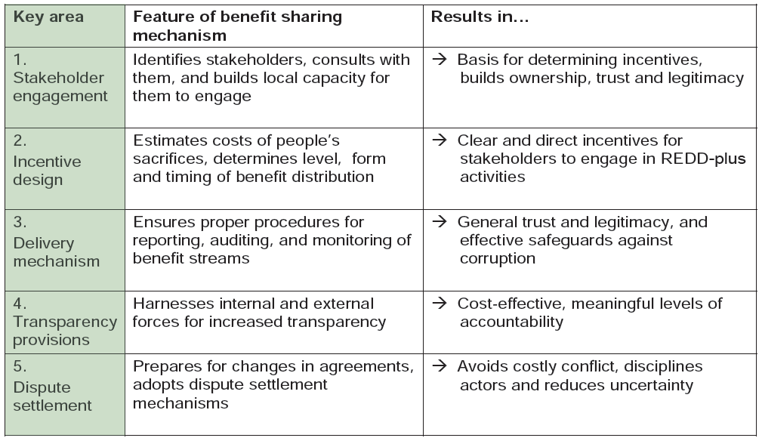
Key Aspects of Well-Functioning Benefit Sharing Mechanisms
Notes:
KEY MESSAGE:
If the instructor has used the activity on the preceding slide, students should be asked here to comment on whether or not the benefit distribution system they designed meets the key aspects of a well-functioning system, as outlined here.
Reference:
IUCN. 2009. REDD-plus and benefit sharing: Experiences in forest conservation and other resource management sectors. International Union for Conservation of Nature.

Slide 25
TAKE HOME MESSAGE
REDD+ and other PES programs and projects results in both costs and benefits.
Costs and benefits are distributed and shared across society through benefit distribution systems.
Benefit distribution systems consist of benefits, actors, and rules.
Revenue is a key benefit
REDD+ payments are inherently performance-based, but they may rely on proxy measures of performance.
The choice of proxy measure matters for the impact on different actors.
There may be a variety of approaches to incorporating social and environmental goals into payment systems and weighting payments by a index coefficient is one example.

Slide 26
References
Peskett, L. 2011. Benefit Sharing in REDD+: Exploring the Implications for Poor and Vulnerable People. World Bank and REDD-net.
Costenbader, J. 2011. REDD+ Benefit Sharing: A Comparative Assessment of Three National Policy Approaches. The Forest Carbon Partnership Facility and The UN-REDD Programme.
Enright, A., McNally, R., and T. Sikor. 2012. An Approach to Designing Pro-Poor Local REDD+ Benefit Distribution Systems: Lessons from Vietnam. SNV - Netherlands Development Organisation, REDD+ Programme.
IUCN. 2009. REDD-plus and benefit sharing: Experiences in forest conservation and other resource management sectors. International Union for Conservation of Nature.
Mohammed, E. Y. 2011. Pro-poor benefit distribution in REDD+: Who gets what and why does it matter? REDD Working Paper. IIED, London. (includes Vietnam case study)
Peskett, L. 2011. Benefit Sharing in REDD+: Exploring the Implications for Poor and Vulnerable People. World Bank and REDD-net.
Setyowati, A. 2012. Ensuring that women benefit from REDD+. Unasylva 239, Vol. 63, 2012/1.
SNV, 2012. Benefit Distribution Systems. SNV Pro Poor REDD+ Briefing Paper.
USAID. 2015. USAID LEAF‘s Climate Change Curriculum. USAID Lowering Emissions in Asia Forests Program (USAID LEAF). Winrock International and US Forest Service. Bangkok, Thailand.

Slide 27
References and Resources
The curriculum of USAID’s Climate-Resilient Ecosystems and Livelihoods (CREL) in Bangladesh is a free resource of teaching materials for university professors, teachers and climate change training experts.
Reproduction of CREL’s curriculum materials for educational or other non-commercial purposes is authorized without prior written permission from the copyright holder, provided the source is fully acknowledged.
Suggested citation: Winrock International. 2016. USAID‘s Climate-Resilient Ecosystems and Livelihoods (CREL). Winrock International. Dhaka, Bangladesh.
Disclaimer: The CREL’s curriculum is made possible by the support of the American People through the United States Agency for International Development (USAID). The contents of the curriculum do not necessarily reflect the views of USAID or the US Government.

Slide 28
USAID's Climate-Resilient Ecosystems and Livelihoods (CREL) Project Winrock International Headquarters 2101 Riverfront Drive, Little Rock Arkansas 72202-1748 USA Tel: 1-501-280-3000 Web: www.winrock.org

