Slide 1
Bangladesh Climate-Resilient Ecosystem Curriculum (BACUM)
Module 1: Introduction to Climate Change

Slide 2
Module 1: Introduction to Climate Change
SECTION III: REPONSES TO CLIMATE CHANGE - MITIGATION AND ADAPTATION
3.6. Effective Communications in Climate Change

Slide 3
Introduction to Climate Change (ICC)
HOW AND WHY THE CLIMATE IS CHANGING
  1.1. Introduction to Climate Science and Climate Change
  1.2. Causes of Climate Change
  1.3. Climate Intensification: Floods, Droughts and Cyclones
IMPACTS OF CLIMATE CHANGE ON PEOPLE AND THE ENVIRONMENT
  2.1. Introduction to Climate Change Impacts
  2.2. Sea Level Rise
  2.3. Climate Change and Water Resources
  2.4. Climate Change and Food Security
  2.5. Climate Change and Human Health
  2.6. Climate Change and Terrestrial Ecosystems
REPONSES TO CLIMATE CHANGE – MITITAGATION AND ADAPTATION
  3.1. Climate Change and Forest Management
  3.2. Climate Change and Water Resources: Responses and Adaptation
  3.3. Principles and Practice of Climate Vulnerability Assessment
  3.4. Uncertainties in Climate Change
  3.5. Climate Change and Ecosystem Services
  3.6. Effective Communications in Climate Change

Slide 4
Acknowledgements
EXPERT CONTRIBUTORS | SPECIFIC INPUTS
Prof. (Dr.) Manzoor Rashid | Curriculum Development for all topics
Prof. (Dr.) Md. Danesh Miah | REDD+, Forest Carbon
Prof. (Dr.) Md. Jakariya | Community NR Management, Climate Change, Natural Resources Management
UNIVERSITIES
Bangladesh Agricultural University
University of Chittagong
Dhaka University
Independent University, Bangladesh
Khulna University
Noakhali University of Science and Technology
Shahjalal University of Science and Technology
Sher-e-Bangla Agriculture University
North South University
CREL STAFF | CREL STAFF
John A Dorr | Utpal Dutta
Abu Mostafa Kamal Uddin | Ruhul Mohaiman Chowdhury
Kevin T. Kamp | Rahima Khatun
Paul Thompson | Sultana Razia Zummi
Abdul Wahab | Shams Uddin
Shahzia Mohsin Khan
DESIGN, LAYOUT AND CONTENT DEVELOPMENT: Ms. Chi Pham, Curriculum Development Expert, Bangkok, Thailand

Slide 5
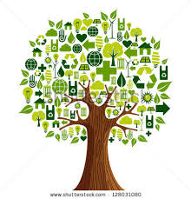
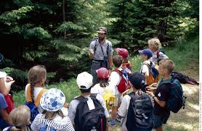
Environmental Communication
The importance and sense of urgency about many environmental problems has also invited interest in the field of environmental communication.
Our understanding of the environment, our efforts to inform, educate or persuade people can’t be separated from the need to communicate with others
Notes:
Key Message: These are the two points presented on the slide itself.
Photo credit: Nature Deficit Disorder at http://naturedeficitdisorder202.blogspot.com/

Slide 6
Content
Communication
Climate change communication
Challenges and opportunities of climate change communication
Communication principles in climate change

Slide 7
Learning Objectives
At the end of this session, students will be able to:
Explain communication process and components
Analyze the challenges and opportunities in communicating climate change
Describe six communication principles in climate change
Apply effective communication when discussing climate change to different types of audience with special attention to the disadvantaged (women, disable, old etc.)

Slide 8
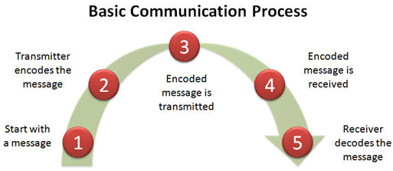
Communication
Communication is the process of exchanging ideas and conveying information
Language is the tool
Listening is ½ of communication
Notes:
Key message: The basic communication process:
1. It all starts with a message. The message has to go from one person to the next.
2. The first person (transmitter) encodes the message into a signal that can be transmitted and received by the second person (receiver).
3. The message is transmitted.
4. Once the message is received, it is decoded.
5. Then the receiver responds to the message. This process repeats itself, back and forth.
To make it less technical, think of how we communicate in various languages. Suppose you have two people. One speaks German, the other Spanish. In order for them to communicate, they need to find a common language. A common language allows them to use words that they can communicate and understand (encoding and decoding).
Reference: http://www.articulate.com/rapid-elearning/how-do-you-communicate-with-your-e-learners/

Slide 9
Communication components
Barrier
Encode
Message
Decode
Sender
Receiver
Channels
Feedback
Notes:
Key message: The graphic shows key components of two-way communication in a basic communication model.
The graphic is adapted by the communication model by Belch and Belch (2004).
Reference:
http://padmanegara.com/2008/12/23/word-of-mouth-communication-womc-as-a-potential-promotional-tool/

Slide 10
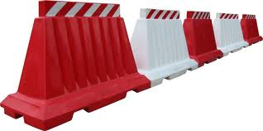
Can you guess what this means?
Notes:
Key message: Language is the one of the BIGGEST barrier!

Slide 11
Exercise
What is the biggest barrier in communication?
Notes:
Key message: Language is the one of the BIGGEST barrier!

Slide 12
What are the barriers in communication?
Language is the one of the BIGGEST barriers!
But, others are:
  Cultural differences: Value, believes, motivation…
  Education differences: knowledge, skill, attitude…
  Not suitable messages or channels for communication
  OTHER BARRIERS?
Notes:
Key message:
Language is one of the biggest language barriers in communication.
the right message in climate change communication remains problematic.
The following slides provide some communication models and main principles to overcome these barriers, especially in communicating the right message of climate change to the world.
Apart from language as one of the biggest barrier as language, cultural and education differences can also contribute to widening the gap in communication.

Slide 13
A clear message?
“I know that you believe you understand what you think I said, but I am not sure you realize that what you heard is not what I meant!”
  (Quote from a U.S. government official)
Unclear communication can lead to confusing interpretations and to emphasize the need for clarity when communicating

Slide 14
Barriers to communication
Physical
Environment
Barriers
Semantic
Barriers
Cultural
Barriers
Psychological
Attitudinal
Barriers
Educational/
Perceptional
Barriers
(Caused by)
(Caused by)
(Caused by)
(Caused by)
(Caused by)
Different
Meanings of
Same Words
Diversity of
cultures
Moods,
Attitudes,
Relations
Time, place, space, climate, noise,
choice of medium
Level of understanding/ comprehension

Slide 15
Effective level model
 |  | Level 3 Changing behavior
 | Level 2 Affecting attitude
Level 1 Increasing awareness
Notes:
There are three distinct levels the affective communication supports. The final level, LEVEL 3, is the important on as this is when the receiver of information actually makes a change in their behavior as a result of the information.

Slide 16
Adoption/Rejection Sequence
Awareness
Interest
Evaluation
Trial
Adoption
Notes:
Key Message: There is a five step path that each individual appears to go through, although some people are slower to transition between steps.
Awareness. The individual is simply aware the innovation exists.
Interest. The individual wants more information. They begin to wonder if the innovation can help them.
Evaluation. The individual mentally examines the innovation using the information gathered, trying to determine whether it will really impact their work.
Trial. The individual actually tests the innovation to see if reality matches expectations.
Adoption. The individual likes the innovation and adopts it wholeheartedly.
Internet source:
http://www.spreadingscience.com/2008/09/17/a-five-step-process/
http://en.wikipedia.org/wiki/Technology_adoption_lifecycle

Slide 17
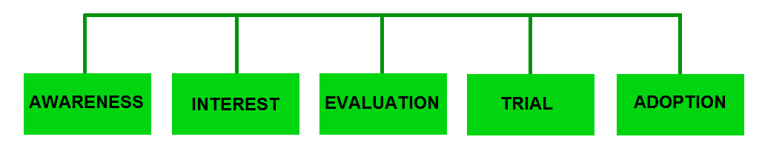
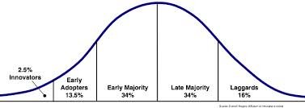
Adoption Curve by E. Roger
Notes:
Key message: The slide visualizes the Adoption Curve by Everett Rogers, a professor of communication studies in his book Diffusion of Innovations (1962).
Diffusion of innovations is a theory that seeks to explain how, why, and at what rate new ideas and technology spread through cultures. Everett Rogers, a professor of communication studies, popularized the theory in his book Diffusion of Innovations; the book was first published in 1962, and is now in its fifth edition (2003).[1] Rogers argues that diffusion is the process by which an innovation is communicated through certain channels over time among the participants in a social system. The origins of the diffusion of innovations theory are varied and span multiple disciplines. Rogers proposes that four main elements influence the spread of a new idea: the innovation itself, communication channels, time, and a social system. This process relies heavily on human capital. The innovation must be widely adopted in order to self-sustain. Within the rate of adoption, there is a point at which an innovation reaches critical mass. The categories of adopters are: innovators, early adopters, early majority, late majority, and laggards.[2] Diffusion manifests itself in different ways in various cultures and fields and is highly subject to the type of adopters and innovation-decision process.
Graphic: Roger’s Adoption Curve, retrieved from http://www.spreadingscience.com/2008/09/17/a-five-step-process/
Internet source: Technology adoption lifecycle at http://en.wikipedia.org/wiki/Technology_adoption_lifecycle

Slide 18
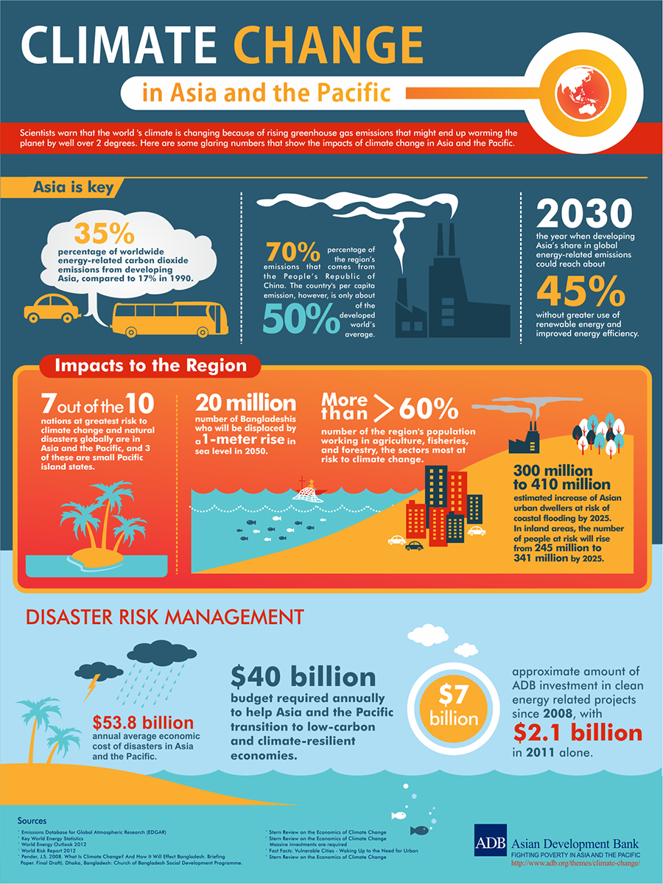
Climate Change Communication
KEY MESSAGES AND INFORMATION STAND OUT
7 out of 10
nations at greatest risk to climate change and natural disasters are in Asia.
An urgent need to build awareness of the devastating impact of climate change and mobilize a critical mass of people to support mitigation and adaptation efforts.
Notes:
As economies grow, the region is fast becoming a major source of greenhouse gas emissions. There is an urgent need to build awareness of the devastating impact of climate change and mobilize a critical mass of people to support mitigation and adaptation efforts.
Questions for students discussion:
Why do you care about climate change?
How has climate change impacted you, your family/friends, hometown, country?
Why should other people care about climate change? Why aren’t people more active?
Why is it important to communicate effectively about climate change?
Raise awareness → influence attitudes → change behaviors → build core people to implement mitigation/adaptation and disaster risk reduction strategies/influence national policies/integrate traditional knowledge into scientific research and engage other sectors
More background (ADB): With more than half the world’s population and two-thirds of its poor, the Asia-Pacific region has seen remarkable economic expansion over the past decades. But progress has come at a high cost to the environment and, as a consequence, to human development.
Having become a main driver of the climate change crisis, the region jeopardizes its own development. If future production and consumption patterns remain carbon intensive, Asia’s developing countries will account for more than 40 percent of global greenhouse gas emissions in the next decade.
Climate change consequences in the region:
Decreasing freshwater availability, particularly in large river basins, threatening water, energy, and food security.
Declining crop yields in Central, West and South Asia, falling by up to 30%.
Rising sea levels, threatening low-lying coastal areas and island nations.
Increasing risk of flooding in coastal areas, especially in the densely populated coastlines of South, East, and Southeast Asia.
Melting glaciers, leading to increased flooding, decreased summer river flows, landslides and erosion.
Growing pressures for large-scale migration.
Jeopardizing sources of livelihoods, particularly for the poor in highly vulnerable areas.
Increasing health risks from heat waves, vector-borne diseases, and water shortages and contamination.
Deepening economic damage from the combined and cumulative effects of these impacts.

Slide 19
Climate Change Communication
…is the process of transmission and sharing information on the causes and impacts of climate change; and response measures (both mitigation and adaptation) to climate change in order to ….
raise awareness
influence attitude
change behavior

Slide 20
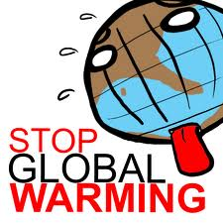
Effective communication in CC
  Why is it important to communicate effectively about climate change?
  build core people to implement mitigation, adaptation & disaster risk reduction strategies
  influence national policies
  integrate traditional knowledge into scientific research
  engage other sectors
Notes:
Key message:

Slide 21

Challenges of Climate Change Communication
Confusion: Climate vs weather
Overwhelming: too much & probabilistic information
Risk: Decision makers can be risk-averse
Denial/doubt/disbelief: “climate change is not occurring”
Vested interests: Who benefits from doubt in climate change?
Notes:
Want to learn more? Check out this video: The Challenges of Climate Change Communication, by 30onClimate: http://www.youtube.com/watch?v=l44s0jWHBdU
Challenges: A topics that is complex, confusing, uncertain, sometimes overwhelming, and often emotionally and politically loaded.
Confusion: Climate vs weather
Overwhelming: Too much/probabilistic information.
Risk: Decision-makers can be risk-averse.
Denial/doubt/disbelief: “Climate change is not occurring”
Vested Interests: Who benefits from doubt in climate change?
Opportunities
Impacts everyone
Empowerment
Past successes
Future change

Slide 22
Doubt about biodiversity loss
Number of species in nature are estimated fluctuate from 3,635,000 to 111,655,000 …. but only 1,750,000 species are identified! WHAT DOES THAT MEAN???
Biodiversity conservation is a luxury product of developed countries that developing countries should not be concerned
Notes:
Key message: This is an example of the challenge of environmental communication in general.

Slide 23
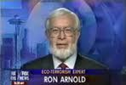
The groups against environmental protection
Our goal is to destroy environmentalism
once and for all!
Environmental protection and compliance with environmental protection regulations will reduce economic growth and increase unemployment.
They do not believe in human induced Climate Change
For example: Ron Arnold's Center for the Defense of Free Enterprise
Notes:
Key message: This is an example of the group against environmental protection in general and specifically do not believe in climate change.
Source: Communication Skills for Conservation Professionals. 2009. Susan Jacobson. Island Press, Washington DC 2009 461pp.

Slide 24

Opportunities of Climate change Communication
Climate Change impacts everyone
Knowledge can empowerment
New more effective types of communication and media available
More people are concerned about climate change
Past successes to learn from
Future change is more certain
Environmental
Communication
Notes:
Want to learn more? Check out this video: The Challenges of Climate Change Communication, by 30onClimate: http://www.youtube.com/watch?v=l44s0jWHBdU
Challenges: A topics that is complex, confusing, uncertain, sometimes overwhelming, and often emotionally and politically loaded.
Confusion: Climate vs weather
Overwhelming: Too much/probabilistic information.
Risk: Decision-makers can be risk-averse.
Denial/doubt/disbelief: “Climate change is not occurring”
Vested Interests: Who benefits from doubt in climate change?
Opportunities
Impacts everyone
Empowerment
Past successes
Future change

Slide 25
Communication Principles

Slide 26

P 1. Know Your Audience
Knowledge, Skills & Attitudes with Changes
Values & Norms
Motivation
Satisfaction
Behavior
What do they think?
How will they behave?
What drives them?
Notes:
What are the values of the people you’re trying to talk to? (water, food, security)
Select message goals that will resonate with audience, set goals
Confirmation bias, promotion/prevention focus, framing an issue, future thinking
Come across as friendly communicator: validate the audience, affirm their sense of self, appreciate past accomplishments, speak to what they care about/treasure/value/aspire to, sympathize with their struggles and concerns; connect climate action to something they already do.
Learn more about your audience using online tools like BBC’s ClimateAsia Data Portal – What are people’s biggest concerns? What are people already doing? What actions are people willing to take? What will motivate them to act? What is the best communication channel?

Slide 27
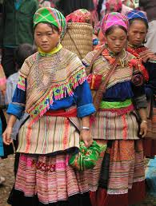
P1. Know Your Audience: Why?
Knowing your audience is important in designing messages and selecting modes/means of communication for an effective communication program
→ It helps to reduce barriers and promote behavior change

Slide 28
P1. Communication Modes
Time
same
different
Same Time
Different Place
Different Time Different Place
Instant messaging
Conference Calls
Webinars / Video Meetings
Literature, Email/Voice Mail, Web Apps, Web Courseware
different
Use them all
Place
Same Time
Same Place
Different Time Same Place
same
Classes, Meetings, Workshops, Flip charts, Projected notes,
White boards…
Bulletin Boards, WIKIS
Shared Servers, ‘O’ Drive
Local mailing lists

Slide 29
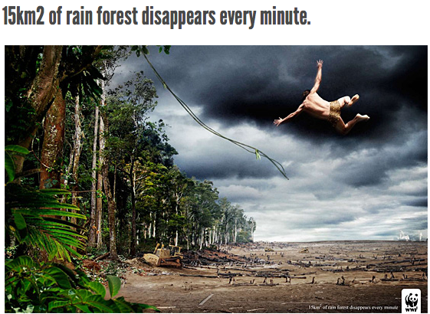
P2. Translate Scientific Data into Concrete Experience
Experiential vs. analytical: experimental processing is a stronger motivation for action
Use vivid imagery: video, metaphors, stories…both emotional and analytical appeals
Avoid jargon, especially scientific terms and acronyms because people are confused by them
Notes:
Ongoing challenge is to use data to show a sense of urgency in many audiences. Psychologically, distant risks don’t bring about as much concern as immediate risks.
Tips:
Experiential vs analytical processing: Social science evidence shows that experiential processing is a stronger motivator for action, but most climate change communication remains geared toward the analytical processing system. Personal or anecdotal accounts of climate change experiences, which could easily outweigh statistical evidence, are rarely used – use them wisely and make it memorable.
Use vivid imagery – video, metaphors, personal stories, real-world examples, concrete comparisons, using both emotional and analytical appeals
Avoid jargon, scientific terms, acronyms – if you must use a complex term, thoroughly explain it to the audience

Slide 30
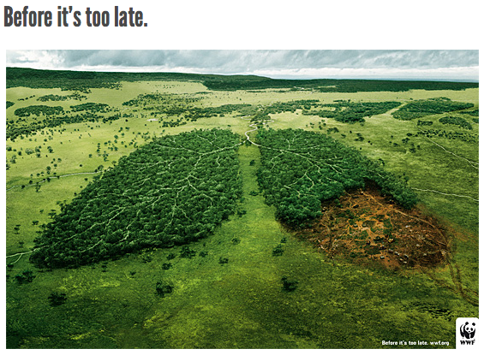
P3. Beware of Overuse of Emotional Appeals
Finite pool of worry: People have limited capacity to worry
Emotional numbing: Repeated exposure to emotionally draining situation
Single action bias: Tendency of taking one action even if it is not the most effective
Notes:
Yet not all communicate about climate change should be emotional. The most effective communication targets both emotional and analytical.
Emotional appeals can get attention early on but can be challenging later on with results difficult to reverse
Finite pool of worry: People have limited capacity to worry – we can only care about so many issues at once
Emotional numbing: Repeated exposure to emotionally draining situation
People have short attention spans
Single action bias: We have a tendency to focus and simplify our decision making – when responding to a threat we may take one action even if its not the most effective. We often take no further action because we presume the first one worked (at least in reducing our worry!)
Analytic products like trend analyses, forecast probabilities, range of uncertainty help people absorb facts and can be valuable tools, but they alone won’t compel people to take effective steps.

Slide 31
P4. Acknowledge Scientific and Climate Uncertainties
Be strategic about word use:
Words with Different Meanings to Scientists and the General Public
Scientific Words | Non-Scientific Meaning | Better Words
Enhance | Improve | Intensify, Increase
Uncertainty | Not Knowing | Range
Risk | Low-probability event | Probability
Error | Wrong, incorrect | Uncertainty associated with measuring device or model
Bias | Unfair and deliberate distortion | Offset from the observed value
Notes:
Precautionary Principle: We will never have 100% certainty/confidence – but we can make predictions based on the best available data, quantifying uncertainties associated with those predictions.
Because as humans we have a need for predictability, uncertainty can be uncomfortable.
Climate science often conveys the mistaken impression that as scientists we may be confused, when in reality scientific uncertainties about how much warmer the planet will be in 100 years doesn’t change the very high confidence scientists have that human-made GHGs are warming the planet and will continue to do so.
Open Dialogue: People may understand probabilistic information better when presented to a group, where there is the opportunity to discuss with a range of knowledge, skills and personal experience to share diverse perspectives and work together to problem solve.
Group discussions allow for a greater chance that multiple sources of information – both experiential and analytic – will be considered in climate change decision-making processes. People devote more energy to implementing solutions after participating in group discussion.
Whenever possible, present climate change information to informal groups where people are free to ask questions and discuss with the speaker and each other.

Slide 32
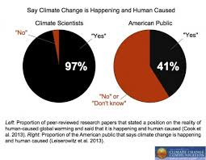
P4. Acknowledge Scientific and Climate Uncertainties
Precautionary principle: We will never have 100% certainty/confidence
But we can make predictions based on the best available data, quantifying uncertainties associated with those predictions.
Notes:
Precautionary Principle: We will never have 100% certainty/confidence – but we can make predictions based on the best available data, quantifying uncertainties associated with those predictions.
Because as humans we have a need for predictability, uncertainty can be uncomfortable.
Climate science often conveys the mistaken impression that as scientists we may be confused, when in reality scientific uncertainties about how much warmer the planet will be in 100 years doesn’t change the very high confidence scientists have that human-made GHGs are warming the planet and will continue to do so.
Open Dialogue: People may understand probabilistic information better when presented to a group, where there is the opportunity to discuss with a range of knowledge, skills and personal experience to share diverse perspectives and work together to problem solve.
Group discussions allow for a greater chance that multiple sources of information – both experiential and analytic – will be considered in climate change decision-making processes. People devote more energy to implementing solutions after participating in group discussion.
Whenever possible, present climate change information to informal groups where people are free to ask questions and discuss with the speaker and each other.

Slide 33
P4. Acknowledge Scientific and Climate Uncertainties
Open dialogue: People may understand probabilistic information better when presented to a group
Provide opportunity to discuss with a range of knowledge, skills and personal experience to share diverse perspectives and work together to problem solve.
Notes:
Precautionary Principle: We will never have 100% certainty/confidence – but we can make predictions based on the best available data, quantifying uncertainties associated with those predictions.
Because as humans we have a need for predictability, uncertainty can be uncomfortable.
Climate science often conveys the mistaken impression that as scientists we may be confused, when in reality scientific uncertainties about how much warmer the planet will be in 100 years doesn’t change the very high confidence scientists have that human-made GHGs are warming the planet and will continue to do so.
Open Dialogue: People may understand probabilistic information better when presented to a group, where there is the opportunity to discuss with a range of knowledge, skills and personal experience to share diverse perspectives and work together to problem solve.
Group discussions allow for a greater chance that multiple sources of information – both experiential and analytic – will be considered in climate change decision-making processes. People devote more energy to implementing solutions after participating in group discussion.
Whenever possible, present climate change information to informal groups where people are free to ask questions and discuss with the speaker and each other.
Photo: LEAF Program

Slide 34
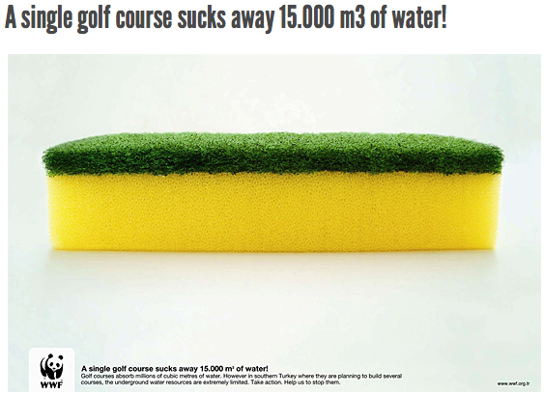
P5. Connect to social identities and affiliations
Promote participatory decision making process
Allow ample time for discussion
Discussions in small group
Notes:
Made to stick: Simple, unecpected, concrete, credible, emotional, stories
Participatory decision making
Stakeholders who feel like they are a part of the decision-making process are more likely to support the outcome.
Encourage early participation in the decision-making process to ensure that the group identifies key problems that require solutions
Ample time for discussion
Lots of dense information – leave ample time for discussion
Small group discussions
Breaking large groups into smaller groups can help initiate discussion

Slide 35

P6. Make Behavior Change Easier
Default effects:
  Human tendency to stick with the option that is selected automatically instead of choosing an alternate option
  Take advantage of this to encourage people to change their behavior that will help mitigate effects of climate change
Notes:
Default effects
Human tendency to stick with the option that is selected automatically instead of choosing an alternate option
Take advantage of this to encourage audiences to make changes in their behavior that will help mitigate effects of climate change
Immediate incentive
When making decisions about consumption, people tend to be more patient when the default option is to receive something now.
Because the default option requires no action, it is always easier, and so people tend to accept it whether or not they would have chosen it if it were not the default option
Giving people an immediate incentive, if possible, makes behavior change easier
Monitor/evaluate

Slide 36

P6. Make Behavior Change Easier
Immediate incentive:
  People choose default option to receive something immediately…Because it requires no action, it is always easier.
  Giving people an immediate incentive, if possible, makes behavior change easier
Notes:
Default effects
Human tendency to stick with the option that is selected automatically instead of choosing an alternate option
Take advantage of this to encourage audiences to make changes in their behavior that will help mitigate effects of climate change
Immediate incentive
When making decisions about consumption, people tend to be more patient when the default option is to receive something now.
Because the default option requires no action, it is always easier, and so people tend to accept it whether or not they would have chosen it if it were not the default option
Giving people an immediate incentive, if possible, makes behavior change easier
Monitor/evaluate

Slide 37
TAKE HOME MESSAGES
Climate change information must be actively communicated with appropriate language, made vivid through visual imagery and experiential scenarios, balanced with scientific information.
Gaining public support for climate change policies and encouraging environmentally responsible behavior depends on a clear understanding of how people process information and make decisions. There is no “one size fits all” approach.
Ensuring that people feel both a personal connection with climate change and a desire to take action to mitigate its impact is key. People need to know that there are solutions that they can be a part of.
Notes:
“The ultimate solutions to climate change are workable, cost effective technologies which permit society to improve living standards while limiting and adapting to changes in climate. Yet scientific solutions are not enough. Societies must be motivated and empowered to adopt the needed changes.” –Jeffrey Sachs
In order for climate science information to be fully absorbed by audiences, it must be actively communicated with appropriate language, combined with narrative storytelling, made vivid through visual imagery and experiential scenarios, balanced with scientific information, and delivered by trusted messengers in group settings.
The task is a mammoth one and the road long, but mobilizing a critical mass of people in support of mitigation and adaptation efforts using effective communications and engagement strategies, remains crucial to our success in the fight against climate change.
Gaining public support for climate change policies and encouraging environmentally responsible behavior depends on a clear understanding of how people process information and make decisions. There is no “one size fits all” approach.
Each of the barriers/challenges presents a new opportunity to improve the way we present information about climate change and the behaviors required to mitigate it.
Ensuring that people feel both a personal connection with climate change and a desire to take action to mitigate its impact, without becoming overwhelmed by the scale of the problem, is key. People need to know that there are solutions that they can be a part of.

Slide 38
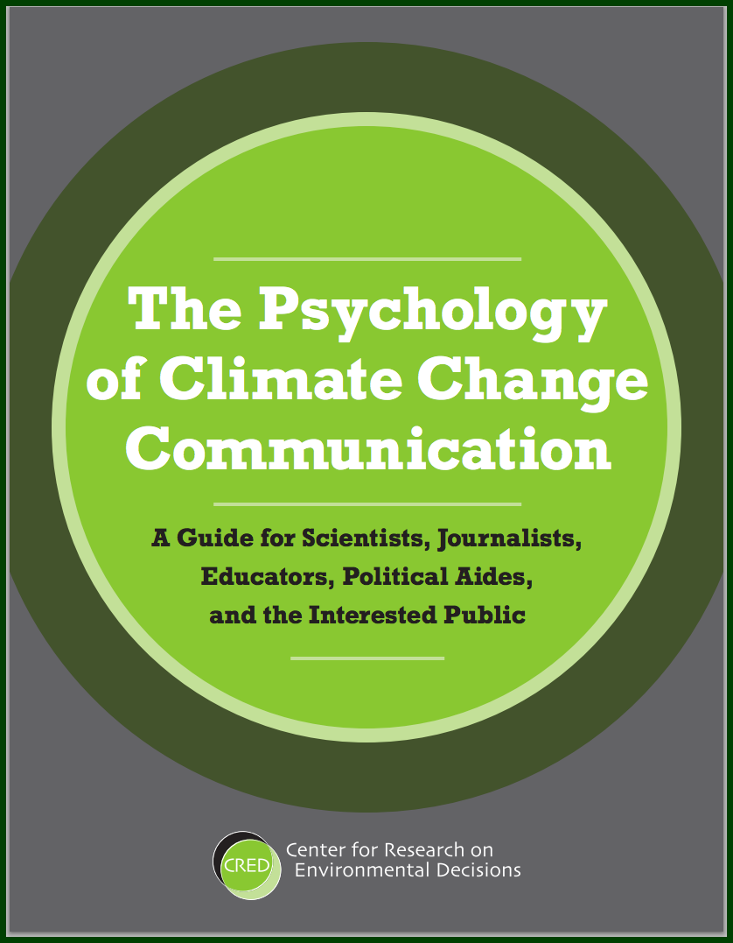
Key Reference
http://guide.cred.columbia.edu/downloads.html

Slide 39
Resources
USAID LEAF’s Climate Change Curriculum. Module 1: Basic Climate Change. 2015. Winrock International.
Columbia University Center for Research on Environmental Decisions: http://www.csc.noaa.gov/digitalcoast/_/pdf/CRED_Psychology_Climate_Change_Communication.pdf
BBC Climate Asia Data Portal: http://www.bbc.co.uk/mediaaction/climateasiadataportal/dataportal
Twitter: Yale Forum on Climate Change and Media: @Yalemediaforum
Facebook: #AsianClimateChange via ADB
Video: The Challenges of Climate Change Communication, by 30onClimate: http://www.youtube.com/watch?v=l44s0jWHBdU
IIED Policy Brief: Why Media Matters in a Warming World - Guide for Policy Makers in the Global South: http://pubs.iied.org/pdfs/G03119.pdf
Notes:
CRED: Actually 8 principles in their Psychology of Climate Change Communication Guide for scientists, journalists, educators, policy aides and the interested public.
BBC: Climate Asia is the largest ever study of people’s experience of climate change in seven countries – Bangladesh, China, India, Indonesia, Nepal, Pakistan and Vietnam.

Slide 40
References and Resources
The curriculum of USAID’s Climate-Resilient Ecosystems and Livelihoods (CREL) in Bangladesh is a free resource of teaching materials for university professors, teachers and climate change training experts.
Reproduction of CREL’s curriculum materials for educational or other non-commercial purposes is authorized without prior written permission from the copyright holder, provided the source is fully acknowledged.
Suggested citation: USAID. 2016. Bangladesh Climate-Resilient Ecosystem Curriculum (BACUM). USAID‘s Climate-Resilient Ecosystems and Livelihoods (CREL) Project. Winrock International. Dhaka, Bangladesh.
Disclaimer: The CREL’s curriculum is made possible by the support of the American People through the United States Agency for International Development (USAID). The contents of the curriculum do not necessarily reflect the views of USAID or the US Government.

Slide 41
USAID's Climate-Resilient Ecosystems and Livelihoods (CREL) Project
Winrock International
House 13/B, Road 54, Gulshan 2, Dhaka 1212
Bangladesh
Tel: +880-2-9848401 www.winrock.org

