Slide 1
Bangladesh Climate-Resilient Ecosystem Curriculum (BACUM)
Module 1: Introduction to Climate Change

Slide 2
Module 1: Introduction to Climate Change
SECTION III: REPONSES TO CLIMATE CHANGE - MITIGATION AND ADAPTATION
3.5. Climate Change and Ecosystem Services

Slide 3
Introduction to Climate Change (ICC)
HOW AND WHY THE CLIMATE IS CHANGING
  1.1. Introduction to Climate Science and Climate Change
  1.2. Causes of Climate Change
  1.3. Climate Intensification: Floods, Droughts and Cyclones
IMPACTS OF CLIMATE CHANGE ON PEOPLE AND THE ENVIRONMENT
  2.1. Introduction to Climate Change Impacts
  2.2. Sea Level Rise
  2.3. Climate Change and Water Resources
  2.4. Climate Change and Food Security
  2.5. Climate Change and Human Health
  2.6. Climate Change and Terrestrial Ecosystems
RESPONSES TO CLIMATE CHANGE – MITIGATION AND ADAPTATION
  3.1. Climate Change and Forest Management
  3.2. Climate Change and Water Resources: Responses and Adaptation
  3.3. Principles and Practices of Climate Vulnerability Assessment
  3.4. Uncertainties in Climate Change
  3.5. Climate Change and Ecosystem Services
  3.6. Effective Communications in Climate Change

Slide 4
Acknowledgements
EXPERT CONTRIBUTORS | SPECIFIC INPUTS
Prof. (Dr.) Manzoor Rashid | Curriculum Development for all topics
Prof. (Dr.) Md. Danesh Miah | REDD+, Forest Carbon
Prof. (Dr.) Md. Jakariya | Community NR Management, Climate Change, Natural Resources Management
UNIVERSITIES
Bangladesh Agricultural University
University of Chittagong
Dhaka University
Independent University, Bangladesh
Khulna University
Noakhali University of Science and Technology
Shahjalal University of Science and Technology
Sher-e-Bangla Agriculture University
North South University
CREL STAFF | CREL STAFF
John A Dorr | Utpal Dutta
Abu Mostafa Kamal Uddin | Ruhul Mohaiman Chowdhury
Kevin T. Kamp | Rahima Khatun
Paul Thompson | Sultana Razia Zummi
Abdul Wahab | Shams Uddin
Shahzia Mohsin Khan
DESIGN, LAYOUT AND CONTENT DEVELOPMENT: Ms. Chi Pham, Curriculum Development Expert, Bangkok, Thailand

Slide 5
Learning objectives
At the end of this unit, students will be able to:
Explain and apply the framework of ecosystem services in climate change assessment and response
Describe the basic concepts of the emerging ecosystem markets for carbon and watershed services
Analyze the role of ecosystem-based adaptation and mitigation solutions

Slide 6
Outline
Definitions
Categories of ecosystem services
Current condition and trend of ecosystem
Payments for ecosystem services
Markets of ES

Slide 7
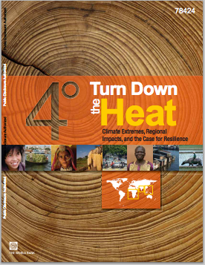
Assigned Reading
2013. Turn down the heat : climate extremes, regional impacts, and the case for resilience
Chapter 5 – South Asia
pages 105-138
Introduction to Ecosystem Services
Washington DC ; World Bank. http://documents.worldbank.org/curated/en/2013/06/17862361/turn-down-heat-climate-extremes-regional-impacts-case-resilience-full-report
Notes:
“World Bank. 2012. Turn Down the Heat: Why a 4°C Warmer World Must Be Avoided. Washington, DC. © World Bank. https://openknowledge.worldbank.org/handle/10986/11860 ”
What are ecosystem services? What are some of the ecosystem services provided by ocean and coastal environments in South Asia?
Why are mangrove forests so important to human wellbeing in South Asia? How are they being threatened by climate change and other human activities?
What are the threats to coral reef ecosystems from both climate change and human activities? How would the loss of coral reef communities affect local coastal livelihoods?
Explain how increasing CO2 levels lead to ocean acidification and some ways in which this affects marine life.
What level of atmospheric CO2 concentration has been suggested as the long-term viability limit for coral reefs?
What causes coral bleaching events? What might cause the likelihood of coral bleaching to vary by location?
What level of warming is projected to cause severe bleaching events for coral reefs?
How does increasing ocean temperature affect the tolerance of marine species to ocean acidification?
What are some of the ecosystem services provided by coral reefs that will be lost as these ecosystems are degraded?
How are changes in ocean chemistry and water temperature expected to affect marine life and consequently fisheries in South East Asia?
How does ocean stratification change with increasing sea surface temperatures? How does this affect ocean productivity?
What is ocean hypoxia? What contributes to this phenomenon? How does it affect marine organisms?

Slide 8
Definitions: What are ecosystems?
An ecosystem is a dynamic complex of plant, animal and microorganism communities and the non-living environment, interaction as a functional unit.
Focus shifts from resources to process and function
Notes:
Reference: Millennium Ecosystem Assessment, 2005. Ecosystems and Human Well-being: Synthesis. Island Press, Washington, DC. http://www.millenniumassessment.org/documents/document.356.aspx.pdf
Message: Ecosysem services are a way of accounting for and communicating about the things we get from natural systems; the things that we value from nature, from forests and rivers, air, soil, water, wildlife, solitude, and so on.
From: Elioth
Describing and accounting services in this way makes them more tangible to people, and leads them to understand "what is in it for me?" and therefore a greater appreciation.
*

Slide 9

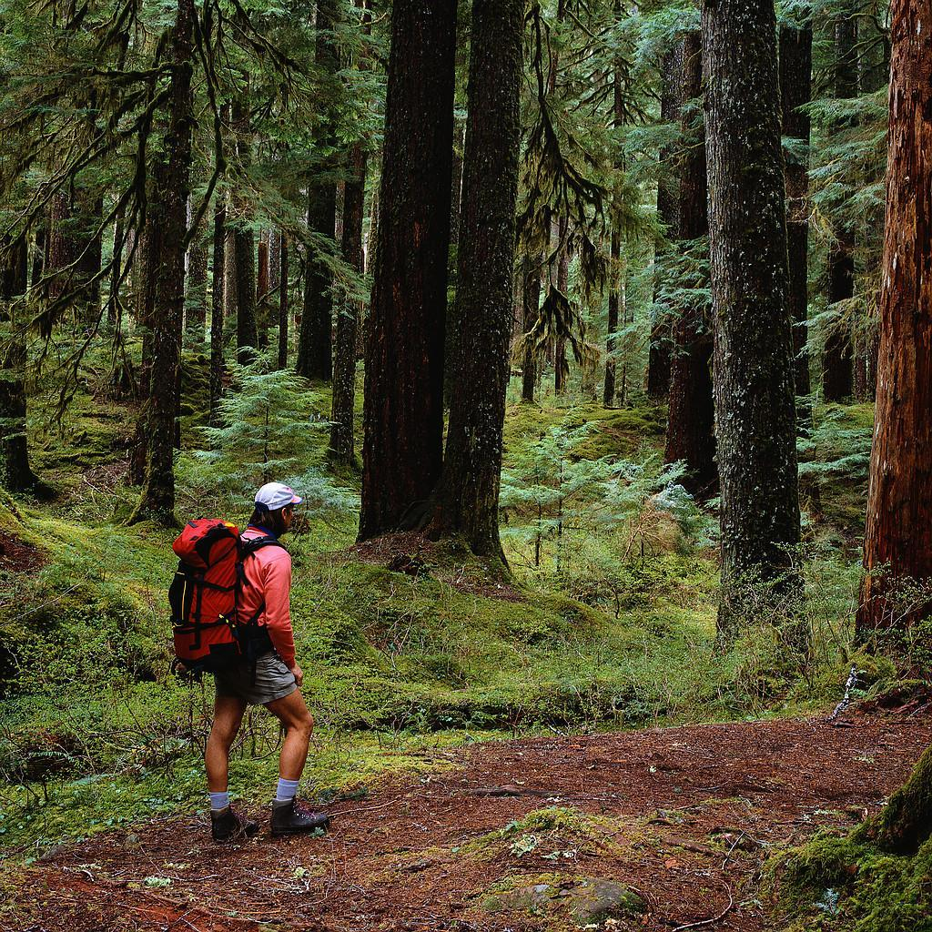
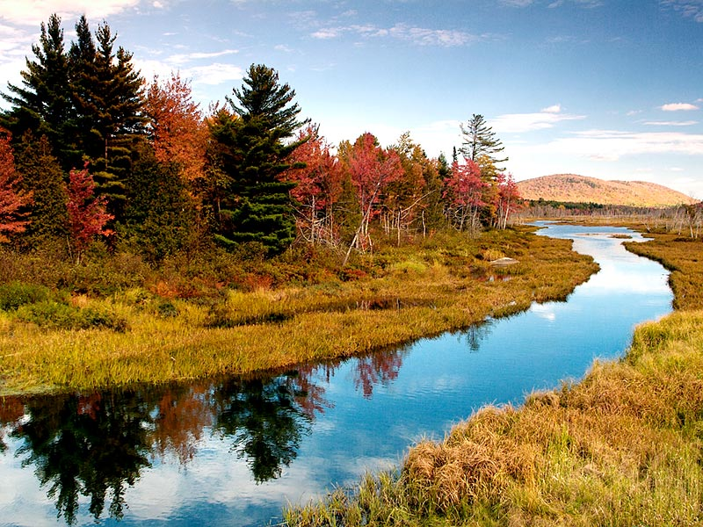
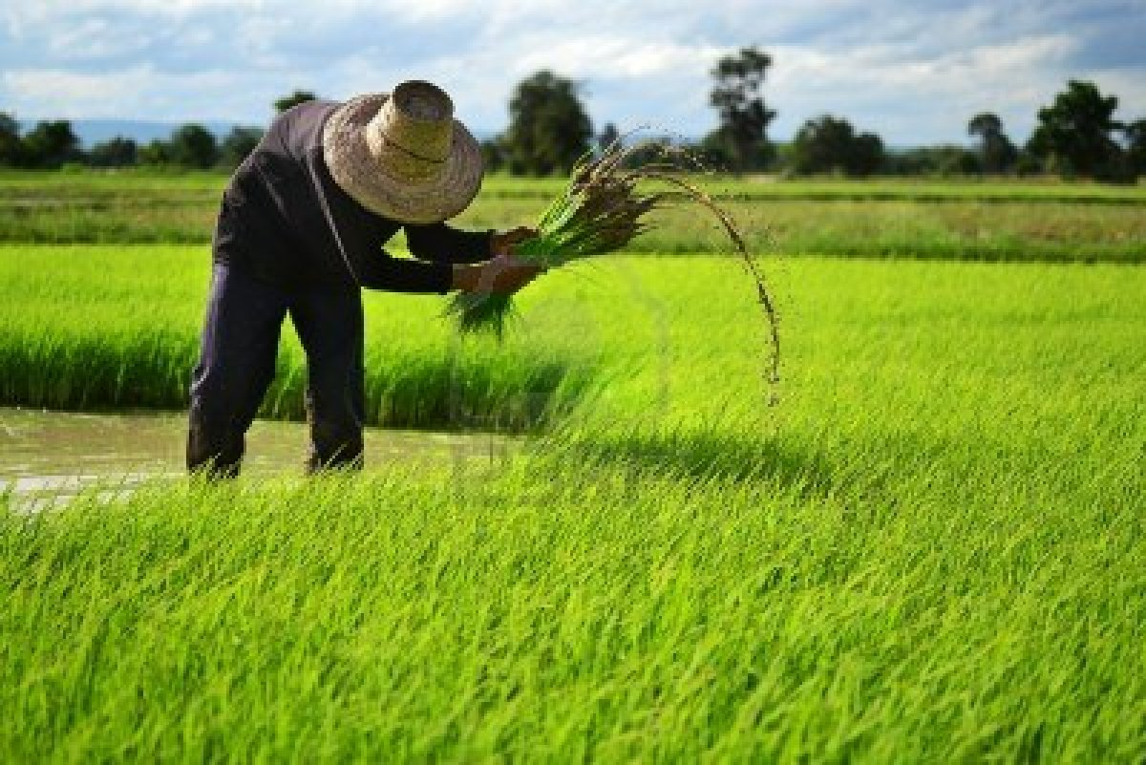
Definitions
  What are ecosystem services?
  The multiple benefits provided to human society by the ecosystems
Focus shifts from resources to process and function
Notes:
Ecosysem services are a way of accounting for and communicating about the things we get from natural systems; the things that we value from nature, from forests and rivers, air, soil, water, wildlife, solitude, and so on.
From: Elioth
*

Slide 10
Definitions
What are ecosystem services?
Ecosystems provide essential services on which humans depend
  Provisioning services
  Regulating services
  Supporting services
  Cultural services
Disturbance of ecosystems can lead to loss or degradation of ecosystem services
Notes:
Ecosystem services are divided into four different types of services.
It is appropriate for students to understand these categories

Slide 11
What does that include?
Millennium Ecosystem Assessment classifies four categories:
  Provisioning (food, fresh water,timber, wood and fiber, genetic resources, medicines and, etc.)
  Cultural (educational, aesthetic beauty, cultural heritage, recreation, spirtual and religious values and tourism)
  Regulating (climate, air quality, water, disease regulation, pest control and pollination)
  Supporting (processes necessary for proper functioning of other services, such as provision of habitat, primary production, soil formation and nutrient cycling)
Notes:
The categories were first promulgated in the millennium ecosystem assessment Here are the categories and some examples

Slide 12
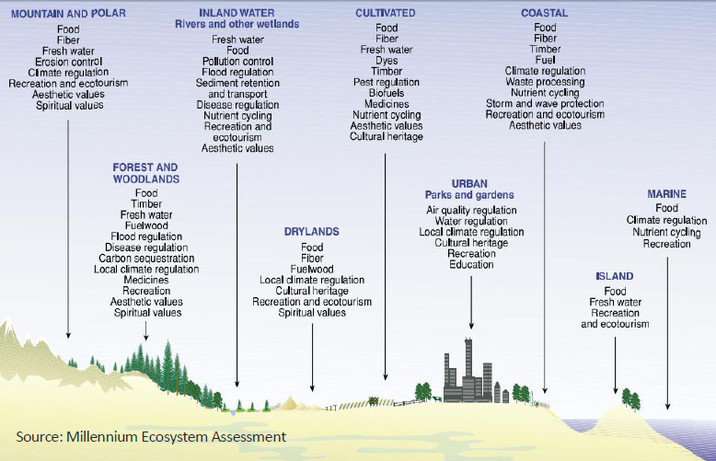
Different ecosystems & the services they provide
Notes:
Reference: Millennium Ecosystem Assessment, 2005. Ecosystems and Human Well-being: Synthesis. Island Press, Washington, DC.
The Millenium Ecosystem Assessment classifies ES into four broad categories, represented here: Supporting, Provisioning, Regulating, and Cultural. These are worth memorizing.
*

Slide 13
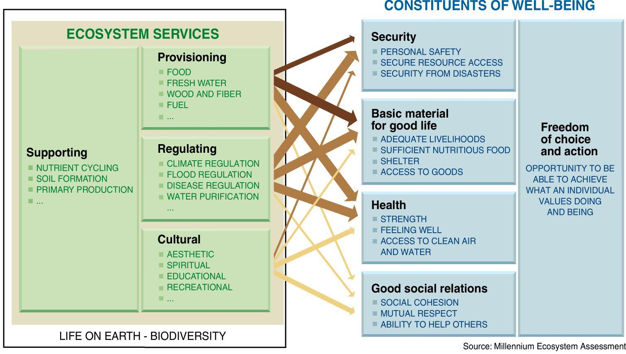
Ecosystem services explicitly connect human well being with ecosystem health
Notes:
Reference: Millennium Ecosystem Assessment, 2005. Ecosystems and Human Well-being: Synthesis. Island Press, Washington, DC.
This chart connects ecosystem services to well-being. It looks more complex than it is.

Slide 14
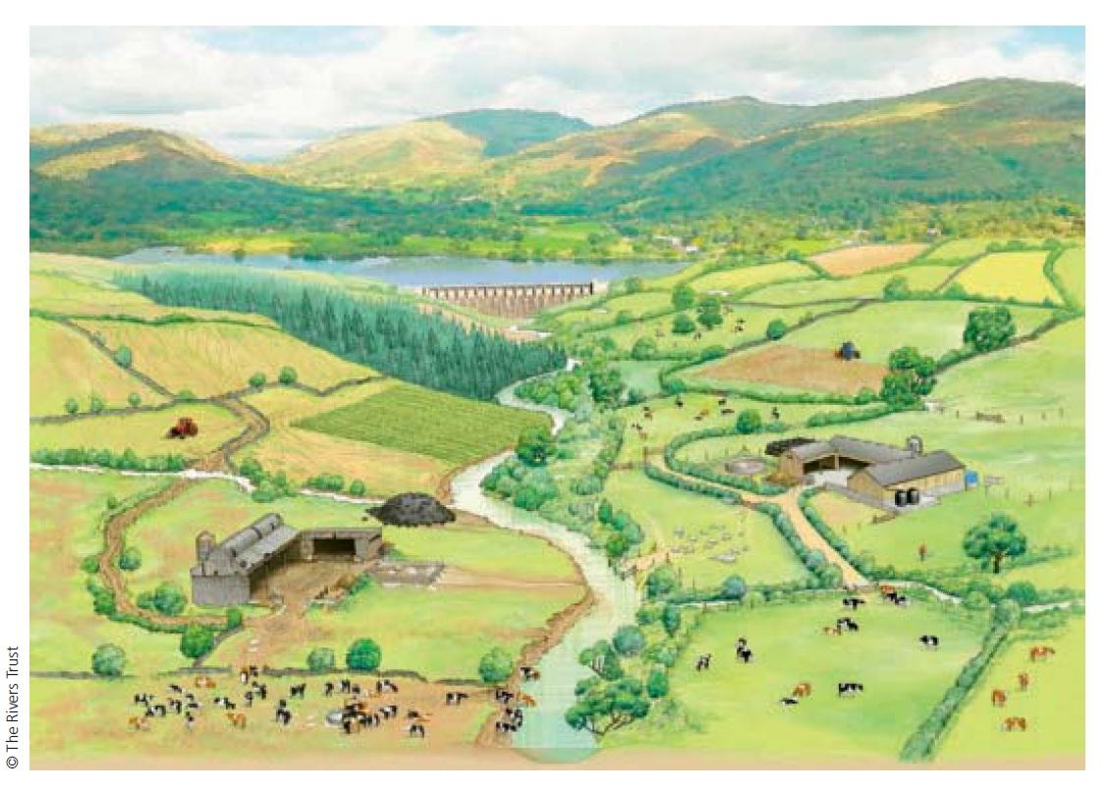
Examine this image
What ecosystem services are depicted here?
How are they related?
Are any of these in conflict?
What impacts might diminish these services?
How might climate change affect the services?
Notes:
Reference: The Rivers Trust
Examine this image: What ecosystem services are depicted here? How are they related? Are any of these in conflict? What impacts might diminish these services? How might climate change affect the services?

Slide 15
How are these ecosystem services valued?
Undervalued
Have no financial value
Unsustained
Overexploited (i.e. fish stock)
Degraded faster than recovered (i.e. soil nutrient)
Destroyed…
Notes:
At present, however, many of these ecosystem services are either undervalued or have no financial value at all. As day-to-day decisions often focus on immediate financial returns, many ecosystem structures and functions are being fundamentally undercut. The most comprehensive assessment of ecosystem services to date — the Millennium Ecosystem Assessment, which included over 1,300 scientists from 95 countries — found that over 60% of the environmental services studied are being degraded faster than they can recover.

Slide 16
Condition and trends of ecosystem services
Provisioning services:
  Water resource scarcity;
  Water overuse;
  High level of arsenic;
  High concentration of pollutants and microorganism;
  Declining water availability…
Notes:
At present, however, many of these ecosystem services are either undervalued or have no financial value at all. As day-to-day decisions often focus on immediate financial returns, many ecosystem structures and functions are being fundamentally undercut. The most comprehensive assessment of ecosystem services to date — the Millennium Ecosystem Assessment, which included over 1,300 scientists from 95 countries — found that over 60% of the environmental services studied are being degraded faster than they can recover.

Slide 17
Condition and trends of ecosystem services
Regulating services:
  Declining farmland productivity;
  Soil erosion;
  High salt accumulation in soil;
  Declining water quality…
Notes:
At present, however, many of these ecosystem services are either undervalued or have no financial value at all. As day-to-day decisions often focus on immediate financial returns, many ecosystem structures and functions are being fundamentally undercut. The most comprehensive assessment of ecosystem services to date — the Millennium Ecosystem Assessment, which included over 1,300 scientists from 95 countries — found that over 60% of the environmental services studied are being degraded faster than they can recover.

Slide 18
Condition and trends of ecosystem services
Cultural services:
  Disturbing landscapes;
  Declining non-recreational cultural services …
  Increasing tourism and recreation condition
Notes:
At present, however, many of these ecosystem services are either undervalued or have no financial value at all. As day-to-day decisions often focus on immediate financial returns, many ecosystem structures and functions are being fundamentally undercut. The most comprehensive assessment of ecosystem services to date — the Millennium Ecosystem Assessment, which included over 1,300 scientists from 95 countries — found that over 60% of the environmental services studied are being degraded faster than they can recover.

Slide 19
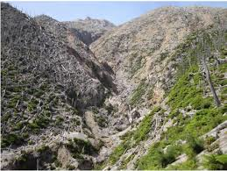
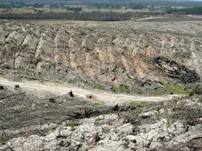
Condition and trends of ecosystem services
Supporting services:
  Destroying biogeochemical cycles;
  Losing wildlife habitats;
  Declining biological productivity…
Notes:
References: USFS photo. F Swanson and http://hancockwatch.nfshost.com/docs/carbon.htm
At present, however, many of these ecosystem services are either undervalued or have no financial value at all. As day-to-day decisions often focus on immediate financial returns, many ecosystem structures and functions are being fundamentally undercut. The most comprehensive assessment of ecosystem services to date — the Millennium Ecosystem Assessment, which included over 1,300 scientists from 95 countries — found that over 60% of the environmental services studied are being degraded faster than they can recover.

Slide 20
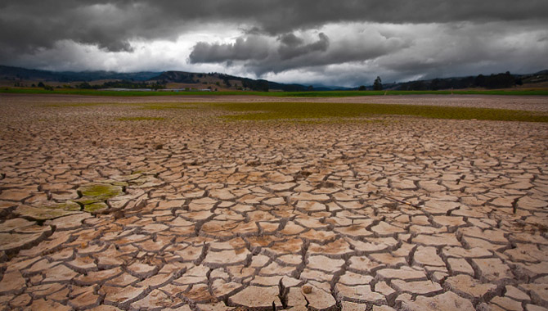
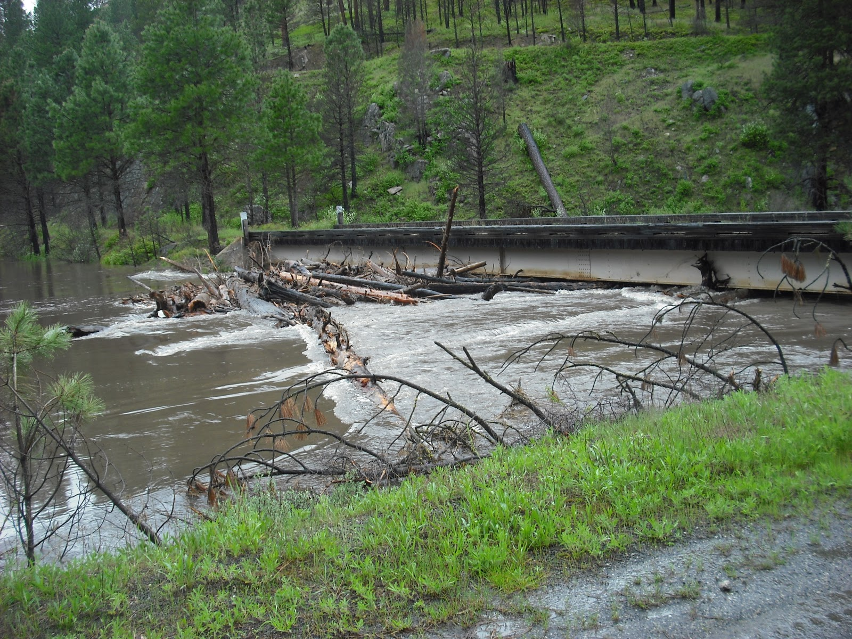
Identifying drivers of climate change influencing ecosystem services and indicators
Notes:
References:
http://climatedesk.org/tag/agriculture/
USFS http://1.bp.blogspot.com/_UVYYmFqSy-8/TLfhEG2IoII/AAAAAAAAABI/eh_WKAlg0kI/s1600/DSCF0069.JPG
Key answers: Drivers:
If greenhouse gas emissions and other stresses continue at or above current rates, the resilience of many ecosystem of many ecosystems is likely to be exceed by an unprecended combination of change in climate, associated disturbances (droughts, floods) and other stressors (global change drivers), including land use change, pollution and resource over exploitation
The Increasing temperature leads to an increasing risk of extinction
Indicators:
Unprecedented changes in climate such as floods, droughts,
Increasing percentage of threatened species
Unprecedented changes in ecosystem structure and function
The increasing temperature also leads to changes in ecosystem structure and function;

Slide 21
Optional Topic
Payments for ecosystem services

Slide 22
Optional Topic: Payments for ecosystem services
What are payments for ecosystem services?
Incentives offered to farmers or landowners in exchange for managing their land to provide some sort of ecological service.
They have been defined as "a transparent system for the additional provision of environmental services through conditional payments to voluntary providers.”
(Tacconi, L. (2012))
Notes:
Note to Instructor: This is a more advanced topic and one with many complex economic concepts and nuances. However, it is a popular approach, and one that advanced students in environmental science should have at least a basic understanding of. Students of business, economics, or with a particular interest, and advanced students of forestry and environmental science are appropriate for this topic.
Reference: Tacconi, L., 2012. Redefining payments for environmental services. Ecological Economics, 73(1): 29-36

Slide 23
Payments for Ecosystem Services
Four key ingredients:
Defined Ecosystem Service or Bundle of Services (“product”)
Buyer (one or more people) – willing to pay
Seller (one or more people) – willing to provide
Voluntary
3 different recipes:
Private Transactions
Mixed Schemes
Public Schemes (Gov’t as buyer or intermediary)
Notes:
Reference: USFS
PES schemes generally have 4 key ingredients that can be combined into 3 different “recipes”
These ingredients are:
Defined ecosystem service or bundle of services (the “product”, which is typically an ecosystem function or process) – the maintenance or supply of the product must be of importance to someone. Water is a very good example.
Buyer (one or more people, communities, governments, companies) – willing to pay for the product (to ensure a continued supply – may be both in terms of quality and quantity)
Seller (one or more people, communities, governments, companies) – willing to preserve the product in exchange for $
(usually) Voluntary transaction – there may or may not be regulation as an underlying factor, but parties are not required to enter into THIS particular contract for THIS particular reason. Rather, they realize the value that each has to gain – just like any other market transaction where goods and services are exchanged, they do so voluntarily.
Can be formal or informal. Involves the exchange of $$$.
Three different recipes: ex. Preserve water quality in mountains/headwaters upstream
Private transactions – individual/company pay individuals/community upstream – ex. Manufacturing that requires very pure water
Public Schemes (Are most common) – government acts as a buyer or intermediary (could be local gov). - ex. Many of the programs administered by USDA (Conservation Reserve Program, Environmental Quality Incentives Program, Forest Legacy Program, etc). Another example (on a local level) is when city water utility pays farmers/forest owners upstream to preserve, because it will reduce their costs of filtration
Mixed – both public and private sectors recognize value of upstream preservation, and both contribute to payments

Slide 24
Markets for Ecosystem Services
Ingredients are the same, but quantity is various. Also, markets can be voluntary or regulatory.
Defined Ecosystem Service
Carbon Market
Buyer
Seller
Voluntary
Buyer
Regulatory
Seller
Buyer
Defined Ecosystem Service
Biodiversity Mkt
Seller
Seller
Defined Ecosystem Service
Watershed Mkt
Seller
Notes:
Reference: USFS
Payments and Markets for Ecosystem Services can be thought of as 2 sides of the same coin. Payments generally involve fewer buyers and sellers whereas markets have more buyers, sellers, and transactions.
Markets – Several categories of markets, defined by the type of ecosystem service being offered.
Typically more buyers, definitely more sellers – just like a typical farmers market, for example. Consumers have more choice.
Whereas PES are typically voluntary, markets can be voluntary or regulatory

Slide 25
Markets for Ecosystem Services
Different ecosystem services have value at different scales. Scale is not the same for all markets:
Global
(carbon sequestration)
Local
(water quantity & quality)
Defined Ecosystem Service
Carbon Market
Defined Ecosystem Service
Biodiversity Mkt
Defined Ecosystem Service
Watershed Mkt
Notes:
Markets – Several categories of markets, defined by the type of ecosystem service being offered. Carbon is global, it doesn’t matter exactly where a ton is produced or sequestered if we are primarily concerned about the overall atmospheric concentration. Water is particular to a watershed, and has importance on a local scale, so the spatial scale of the market will be limited.
Typically more buyers, definitely more sellers – just like a typical farmers market, for example. Consumers have more choice.

Slide 26
What’s the story with markets?
The ecosystem services concept is an interdisciplinary concept with an emphasis on economics
Valuing ecosystem services prevents internalizing benefits without payment
Notes:
Source: Elioth
*

Slide 27
Payments & markets for carbon
How to avoid emissions and enhance sequestration?
What are PES/market opportunities?
Notes:
Avoid emissions/enhance sequestration through:
Afforestation/Reforestation
Improved Forest Management
Avoided Conversion (international: REDD, REDD+)
→ Quality methodologies are available
Why?
Regulatory Mkts: buyers purchase offsets to meet mandated emissions reduction targets
Voluntary Mkts: pre-compliance, good corporate citizenship, personal interest, etc.
Payments: cost-share and tax-incentive programs for private forest landowners (carbon is not the only objective)

Slide 28
Payments & markets for biodiversity
How to maintain/enhance biodiversity?
What are PES/market opportunities?
Notes:
How to maintain/enhance biodiversity?
Payments for biodiversity management activities
Payments for private access to farms/forests/ranches (ecotourism and/or hunting leases) that maintain/enhance complimentary biodiversity
Tradable credits or offsets
Eco-certification or labeling for products
→ Quality methodologies are available
Why?
Regulatory or Voluntary Markets: Maintain biodiversity at a landscape-scale for its inherent values, economic and medicinal benefits to humans, and cultural, spiritual, and aesthetic values.
Payments: ecotourism access; hunting leases/access

Slide 29
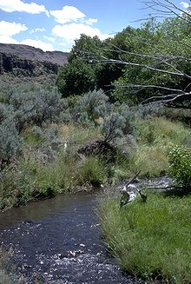
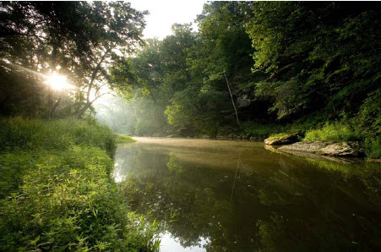
Payments & markets for water
How to maintain/enhance water quantity/quality?
What are PES/market opportunities?
Notes:
Reference: http://mochf.org/contact-us/ and http://biomesworld.com/Riparian
How to maintain/enhance water quantity/quality?
Maintain forest cover
Reforestation (focus on native species)
Wetland restoration
Sustainable/Best Management Practices (BMPs)
Some good methodologies available.
Why?
Voluntary or Regulatory water quality trading/credits, especially in areas impaired by farming or urban runoff.
Payments by governments or corporations to minimize soil loss and sedimentation; maintain vegetation to better regulate water flows throughout the year; control for flooding; or enhance water quality

Slide 30


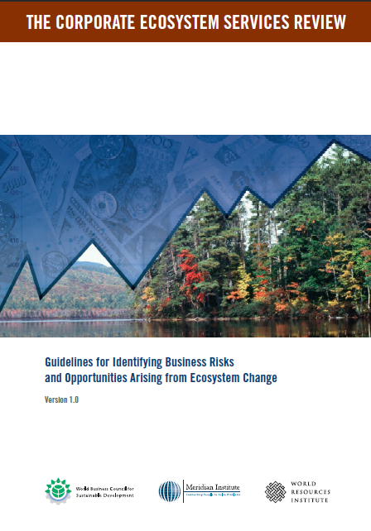


Engaging buyers
Notes:
Why would businesses consider investing in ecosystem services by either buying ES credits on a market, or engaging/starting a PES project?
Strengthen corporate strategy. Certain ES can be very important to certain businesses. For many businesses, water is critical. Understanding and assessing the vulnerability of key resources can help to inform proactive solutions, that may include reducing demand while engaging in PES to help sustain an adequate supply of quality water.
Lower regulatory compliance costs. Many early actors in the voluntary carbon market were motivated by wanting to “get some practice” before potential regulation took effect, and by the prospect of receiving credit for their early actions. City water planners understand that investing in green infrastructure upstream can lower water treatment costs – both in terms of facilities required and ongoing operation & maintenance.
Reduced costs for capital acquisition. We don’t have a whole lot of data here yet, but a (slightly outdated) report by Government Metrics Institute found that companies with excellent governance, labor, and environmental practices significantly outperformed those with decidedly lax practices. It remains whether high social and environmental standards may lead to better performance (which, in turn, makes it easier and cheaper for a company to attract investors, i.e. raise capital).
Identify New Products and Services. Businesses that undergo an ecosystem services review can become more aware of future ecosystem-related challenges. For example, understanding the drivers and likelihood of water scarcity in a region can prompt an agricultural company to begin developing more drought-resistant crops.
Improve corporate performance. An ecosystem services review can help managers uncover new risks and opportunities that improve business decisions and strategy, avoid reputational risk, avert supply chain disruption, and decrease uncertainty.
The WBCSD (World Business Council for Sustainable Development) has a tool that helps corporations think about the ES they depend on and understand risks.

Slide 31
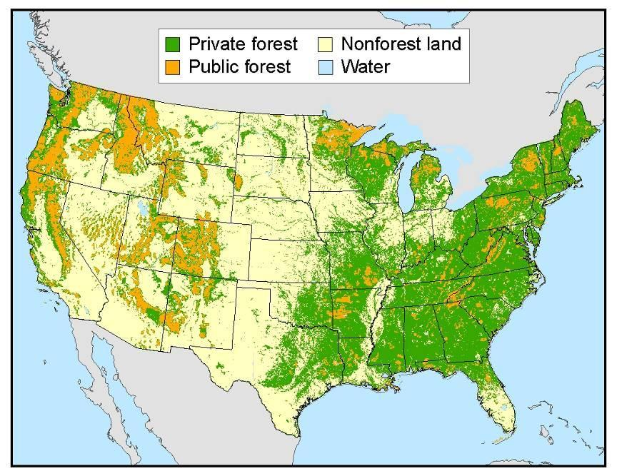




Engaging sellers
Butler, 2008. National Woodland Owner Survey. US Forest Service Gen Tech Report NRS-27
Notes:
Reference: Butler, 2008. National Woodland Owner Survey. US Forest Service Gen Tech Report NRS-27
Here in the US, we obviously know quite a bit about our forest land base and we know much about our private forest land owners, thanks to researchers here at the US Forest Service. Our federal public lands do not engage in selling ES, but private forest landowners may choose to. We have learned some key lessons about these potential sellers:
People own forest land for lots of different reasons and if we’re going to engage them, we need to understand their perspective. Most of the time, these people aren’t familiar with or compelled by “Ecosystem Service Markets”. This language and these ideas aren’t attractive. Instead, we must know their interests and start there. If they appreciate wildlife and biodiversity, that the way to approach talking about a wetland restoration project for water quality.
Size of landholding influences options available, from an economic perspective. Carbon markets can involve lots of start-up and transaction costs, so a landowner may need hundreds or thousands (not dozens) of acres to have an economically viable project. But, a much smaller landowner may be eligible to participate in a payments for watershed services project, for example, that involves maintaining or restoring forest, or using particular best management practices.
Policies around markets/payments have a big influence. In general, landowners are very reluctant to sign long-term agreements (like is required in most carbon markets). Landowners do not like limiting their long-term options (or those of their heirs). So, short-term contracts – more likely in PES - can be far more attractive to landowners, or “sellers”.
Community is often very important. Community participation in the design and implementation of PES schemes can contribute to their success. Markets tend to be large-scale and complicated, so design, implementation, and policies tend to be pre-established. Nonetheless, individuals and communities are more likely to engage if they can learn from or through a trusted source or network.

Slide 32
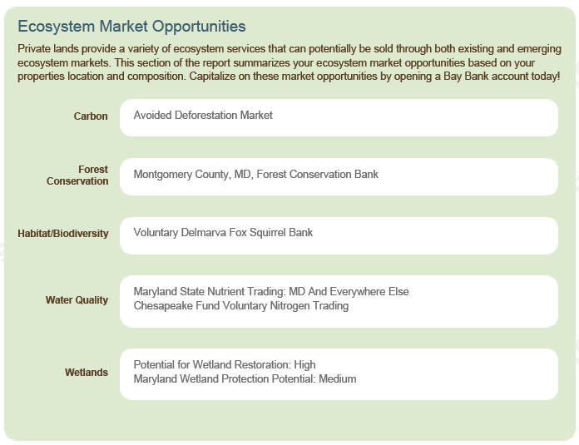

Ensuring PES or market success
$
Notes:
Reference: Butler, 2008. National Woodland Owner Survey. US Forest Service Gen Tech Report NRS-27
There are certain market conditions to ensuring success of any PES or market scheme
Demand and a willingness to pay for a well-defined ecosystem service exists
Supply is constrained/limited
Specific actions or practices can address supply constraints
Brokers and intermediaries exist (to carry out monitoring, certification, and verification)
Resource tenure is clear and laws are enforceable
In addition, there is always a social and cultural component to market success. Oftentimes, developing trust and relationships is critical to setting up any kind of PES system, or engaging people in a market. (Perhaps this will change over time, as these become more common and accepted)

Slide 33
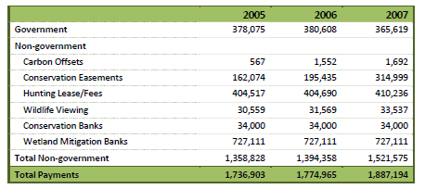
But success is not guaranteed…
Total Payments for Forest-Based Ecosystem Services from Gov’t and Non-Gov’t Organizations and Individuals (in 1000s of constant 2005 $). Taking Stock: Payments for Forest Ecosystem Services in the United States. Forest Trends. 2011.
Notes:
Reference: Butler, 2008. National Woodland Owner Survey. US Forest Service Gen Tech Report NRS-27
In the US in 2007:
Total revenues related to ecosystem service markets & payments was $1.9 billion.
Wetland mitigation accounted for 38% of this total, but payments were made to only 173 mitigation banks.
Voluntary forest carbon offset revenue totaled $1.7 million
As a point of reference, Americans spend $8 billion annually on cosmetics.
“.. The economic and social forces that have led to forest fragmentation and loss in the US are so strong that Payments for Ecosystem Services have had a minimal impact on forest land use at the regional or national level.”

Slide 34
Markets: Stacking vs. Bundling
A single project provides multiple benefits. These benefits may sold separately (stacked) or be packaged together (bundled):
$$$
Integrated Credit
Multiple buyers
$Carbon Credit
$ Water Credit
$Biodiversity Credit
Plot of land with an Ecosystem Services Project
Single buyer
Multiple markets
Integrated Market
STACKING
BUNDLING
Notes:
Reference: USFS
A single project can provide multiple benefits. Sometimes just one benefit is sold. Sometimes several benefits are sold seperately. Or, sometimes all benefits can be bundled and sold as a package. Much depends on the project and circumstances. Credits that are stacked and sold seperately cannot sell the same benefit twice. This can be a challenge, as benefits are sometimes distinct yet all closely related.

Slide 35
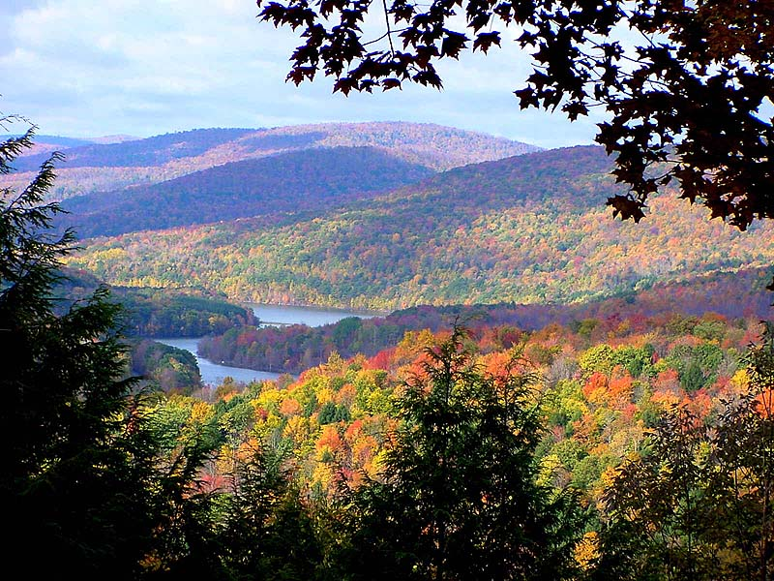
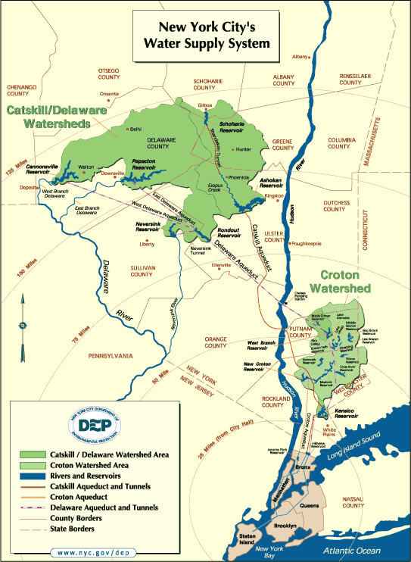
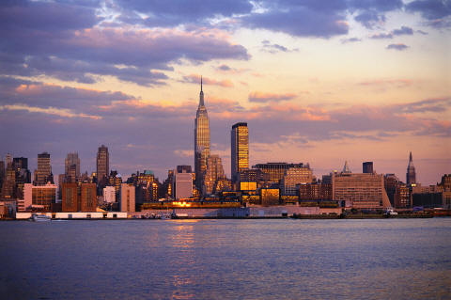
Examples of PES
NYC Watershed Program
Notes:
Reference: NYC DEP, http://www.pwconserve.org/issues/watersheds/newyorkcity/
Images: http://wnyt.com/wnytimages/repository/cs/CATSKILLS.jpg, http://www.f1online.pro/en/image-details/360928.html
Government Funded PES
90% of NYC’s drinking water comes from the Catskills Mountains & surrounding Watershed
Declines in water quality in the 1990s prompted the EPA to require the city to make improvements.
Rather than spending $6 to 8 billion on a new filtration plant (plus $300 million in annual operating expenses),
New York City chose instead to invest in protecting and conserving lands in the watershed.
NYC spent about $1-2b in acquiring lands and paying farmers and forest landowners for protection and better land-use and management. In 2008, the City invested nearly $209 million dollars in watershed management activities to maintain its high level of water quality.
Boston, San Francisco, and Seattle have made similar (but smaller-scale) investments that include land acquisition, road decommissioning, habitat restoration, and public education for their watersheds.

Slide 36
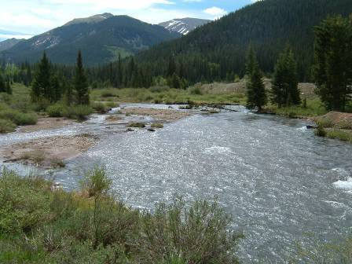


Examples of PES
Denver, CO
Notes:
Reference: USFS and Denver Water
In Denver, CO, Denver water has a responsibility to deliver water to 1.3 million people. Denver Water has entered into a 5-year, $33m partnership with the US Forest Service to implement projects to reduce the risk of wildfire, reforest areas damaged by wildfire, and minimize erosion and sedimentation on 38,000 acres of National Forest Land. The $33m investment represents a 50/50 match between the FS & Denver.

Slide 37
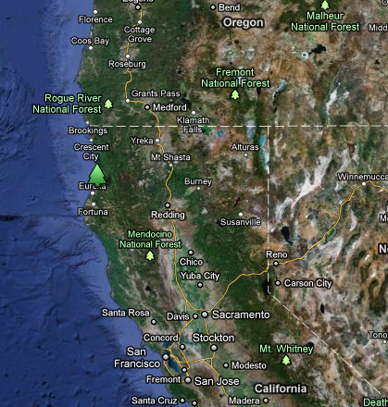
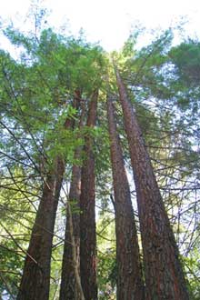
Examples of markets
Van Eck Working Forest in Arcata, CA
Notes:
Reference: USFS
A 2,200 acre improved forest management (IFM) project in Northern California that was spearheaded by Pacific Forest Trust
First project registered on CA’s voluntary forestry protocol registry
Expected to reduce 500,000 tons CO2 over 100 year lifespan through less intensive harvesting practices
Voluntary credits have been sold on the Climate Action Reserve (CAR) and will convert to Compliance credits through the “Early Action” program of the California Air Resources Board.

Slide 38
EXAMPLES OF MARKETS
The California Cap-and-Trade program puts a price on forest carbon (1)
CURRENT EMISSIONS
REGULATORY CAP
The California Cap-and-Trade system sets a cap on GHG emissions from regulated entities
The Cap declines over time
Allowances (permits to pollute) must be surrendered every 3 years to show compliance with the cap
Entities can achieve their required GHG reductions through:
    Increased efficiency, technology change, different fuels etc.
    Purchasing Allowances from other covered entities or brokers
    Purchasing Offsets from project developers or brokers
PES ➔
Notes:
Reference: http://www.arb.ca.gov/cc/capandtrade/capandtrade.htm
A Cap-and-Trade market system was launched in California in January, 2012. It establishes a program for setting GHG emission caps on regulated entities and issuing Allowances (permits to pollute) that can be auctioned and traded. It also establishes the rules (“Protocols”) for generating carbon offsets in non-capped sectors (e.g. forests and agriculture).
The cap sets a definite level on the amount of GHGs that can be emitted by a regulated entity. Entities demonstrate that have met their cap by reporting every year, and submitting Allowances and Offsets equal to their cap every 3 years. Entities can meet their cap by reducing their own emissions, submitting allowances they have purchased from elsewhere, and submitting up to 8% offset credits (ARBOCs).
Market forces of supply and demand a set a price on carbon through the auction and trade of Allowances, and a trading market for Offsets.
A market price on carbon allows entities to make the most cost-efficient decisions on how to achieve their emission reductions
.

Slide 39
EXAMPLES OF MARKETS
The California Cap-and-Trade program puts a price on forest carbon (2)
WHAT IS AN OFFSET?
An offset is a reduction in GHG emissions made in one place in order to compensate for emissions made elsewhere.
Offsets standards must be stringent: “A Ton is a Ton”
Offsets must meet the tests of: real, permanent, quantifiable, verifiable, enforceable, and additional.
Offsets are used to provide flexibility in GHG reduction programs because they are usually less expensive than allowances or technology change, but still provide equal carbon reductions.
Trading markets for Allowances and Offsets allow the market to set a price on carbon based on supply and demand.

Slide 40
EXAMPLES OF MARKETS
The California Cap-and-Trade program puts a price on forest carbon (3)
USE OF OFFSETS
Offsets can be used for 8% of the compliance obligation of an entity to reduce its GHGs
Offsets can be generated from 4 protocols
Ozone depleting substances
Livestock methane
Forest projects
Urban forest projects
CURRENT EMISSIONS
REGULATORY CAP
OFFSETS are an example of a PAYMENT FOR ENVIRONMENTAL SERVICE
= A payment to a landowner for providing a benefit to the environment.
For example: For storing more carbon in a forest than would otherwise occur, according to the rules of the Forest Project Protocol
Notes:
See: http://www.arb.ca.gov/cc/capandtrade/capandtrade.htm

Slide 41
EXAMPLES OF MARKETS
The California Cap-and-Trade program puts a price on forest carbon
WHAT IS A FOREST CARBON OFFSET?
The “U.S. Forest Project Protocols” set the rules for forest landowners to create a new type of forest product, called a “Forest Carbon Offset” www.arb.ca.gov/cc/capandtrade/protocols/usforestprojects.htm
  Each offset equals 1 metric ton of CO₂.
  Each offset represents an additional ton of carbon that is stored in the forest above what would otherwise occur under “business as usual” forest management. This can be achieved by:
    Reforestation of sites that have been out of production at least 10 years
    Improved Forest Management (IFM) that increases the carbon storage of stands through longer rotations and harvesting less than growth.
    Avoided Conversion: Avoiding land conversion and loss of forests that would have otherwise occurred.
Notes:
Reference: http://www.arb.ca.gov/cc/capandtrade/protocols/usforestprojects.htm
In other words, offsets are actions taken to reduce GHG emissions additional to what would otherwise occur, in order to compensate for emissions elsewhere.

Slide 42
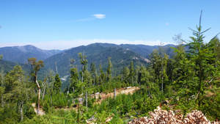
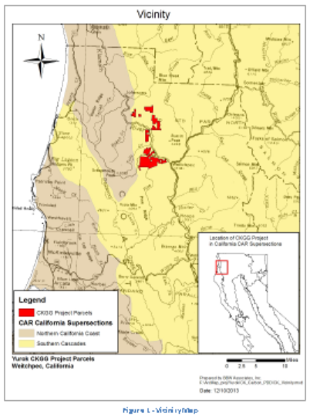
EXAMPLES OF MARKETS
The California Cap-and-Trade program puts a price on forest carbon (5)
EXAMPLES OF PROJECTS SELLING
COMPLIANCE-QUALITY FOREST OFFSETS
1. Yurok Tribe CKGG Forest Carbon Project, Northern California.
7,660 acres of Douglas-fir and hardwoods along the Klamath River
Projected offset issuance of 815,000 offset credits through 2018.
Management designed to improve cultural and ecological values while generating income from carbon offset sales and logging, with the aim of developing higher value and larger trees.
Notes:
Reference: Yurok project:
https://thereserve2.apx.com/mymodule/reg/prjView.asp?id1=993http://www.arb.ca.gov/cc/capandtrade/protocols/usforestprojects.htm
http://www.arb.ca.gov/newsrel/newsrelease.php?id=597

Slide 43

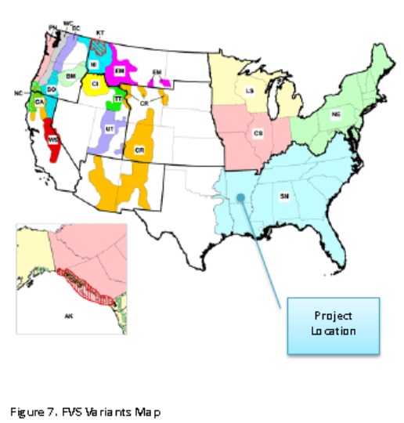
EXAMPLES OF MARKETS
The California Cap-and-Trade program puts a price on forest carbon (6)
EXAMPLES OF PROJECTS SELLING
COMPLIANCE-QUALITY FOREST OFFSETS
2. Moro Big Pine project, Arkansas
      IFM Project on approximately 16,000 acre tract of land in Calhoun county, Arkansas.
    The project merges habitat conservation for the endangered red-cockaded woodpecker, industrial timber management, and carbon yields.
    Received an initial issuance of 220,208 ARB compliance carbon offsets.
Notes:
See:
Moro Big Pine project, Arkansas:
http://www.finitecarbon.com/2014/01/07/potlatch-ca-arb-compliance-offsets-issued/
https://thereserve2.apx.com/mymodule/reg/prjView.asp?id1=648

Slide 44
EXAMPLES OF MARKETS
The California Cap-and-Trade program puts a price on forest carbon (7)
PRICE OF OFFSETS
Market prices for Allowances and Offsets continue to change as the market matures, players learn how the system works, and covered entities calculate their best options for meeting their GHG reduction obligations.
The sales of offsets are private transactions between sellers and buyers and prices are not publically posted. Offsets will always be priced somewhat below Allowance price.
The price for Allowances in the first 2 years of the program has remained near the effective price floor set by the ARB
    Allowance Price = around $10-$11 per ton of CO₂ emissions (2014)
    Approx. 5.6 million forest offset credits (ARBOCs) have been issued by the California Air Resources Board as of June, 2014.
Notes:
See: CaliforniaCarbon.info:
http://us7.campaign-archive2.com/?u=1bca4a471e2ba68b03c5ccdcd&id=eba79e4aa2&e=0804bbe142

Slide 45
Economic opportunities (markets)
Potential markets: carbon, watershed services
Carbon emission reduction markets
Heavy press but science and numbers still developing
A climate change mitigation activity– high priority!
Watershed services
Locally-based; many opportunities here
PES in Lam Dong province and beyond in Việt Nam and PES in Costa-Rica

Slide 46
Review
What is an ecosystem service?
List at least 10 ecosystem services for a forested area you are aware of.
How are ecosystem services important to humans?
How do payments for ecosystem services and market approaches contribute to mitigate and adapt to climate change?

Slide 47
Instructor Review of Materials
What was useful?
What is missing?
How did you, or would you, modify the materials to make them better fit your instructional context?
Please share your experience and modifications here: climatecurriculum@googlegroups.com

Slide 48
Readings
Tacconi, L., 2012. Redefining payments for environmental services. Ecological Economics, 73(1): 29-36
UP, 2010, Millennium Ecosystem Assessment,
UNEP, 2008, Payments for Ecosystem Services: Getting Started
WB, 2013, Turndown the heat

Slide 49
References
An excellent collection of online references on ecosystem services compiled at Duke University can be found here:
http://nicholasinstitute.duke.edu/initiatives/national-ecosystem-services-partnership/selected-references-ecosystem-services
Butler, 2008. National Woodland Owner Survey. US Forest Service Gen Tech Report NRS-27 http://www.treesearch.fs.fed.us/pubs/15758
Millennium Ecosystem Assessment, 2005. Ecosystems and Human Well-being: Synthesis. Island Press, Washington, DC. http://www.millenniumassessment.org/documents/document.356.aspx.pdf

Slide 50
References and Resources
The curriculum of USAID’s Climate-Resilient Ecosystems and Livelihoods (CREL) in Bangladesh is a free resource of teaching materials for university professors, teachers and climate change training experts.
Reproduction of CREL’s curriculum materials for educational or other non-commercial purposes is authorized without prior written permission from the copyright holder, provided the source is fully acknowledged.
Suggested citation: USAID. 2016. Bangladesh Climate-Resilient Ecosystem Curriculum (BACUM). USAID‘s Climate-Resilient Ecosystems and Livelihoods (CREL) Project. Winrock International. Dhaka, Bangladesh.
Disclaimer: The CREL’s curriculum is made possible by the support of the American People through the United States Agency for International Development (USAID). The contents of the curriculum do not necessarily reflect the views of USAID or the US Government.

Slide 51
USAID's Climate-Resilient Ecosystems and Livelihoods (CREL) Project
Winrock International
House 13/B, Road 54, Gulshan 2, Dhaka 1212
Bangladesh
Tel: +880-2-9848401 www.winrock.org

