Slide 1
Bangladesh Climate-Resilient Ecosystem Curriculum (BACUM)
Module 1: Introduction to Climate Change

Slide 2
Module 1: Introduction to Climate Change
SECTION III: REPONSES TO CLIMATE CHANGE - MITIGATION AND ADAPTATION
3.4. Uncertainties in Climate Change

Slide 3
Introduction to Climate Change (ICC)
HOW AND WHY THE CLIMATE IS CHANGING
1.1. Introduction to Climate Science and Climate Change
1.2. Causes of Climate Change
1.3. Climate Intensification: Floods, Droughts and Cyclones
IMPACTS OF CLIMATE CHANGE ON PEOPLE AND THE ENVIRONMENT
2.1. Introduction to Climate Change Impacts
2.2. Sea Level Rise
2.3. Climate Change and Water Resources
2.4. Climate Change and Food Security
2.5. Climate Change and Human Health
2.6. Climate Change and Terrestrial Ecosystems
RESPONSES TO CLIMATE CHANGE – MITIGATION AND ADAPTATION
3.1. Climate Change and Forest Management
3.2. Climate Change and Water Resources: Responses and Adaptation
3.3. Principles and Practices of Climate Vulnerability Assessment
3.4. Uncertainties in Climate Change
3.5. Climate Change and Ecosystem Services
3.6. Effective Communications in Climate Change

Slide 4
Acknowledgements
EXPERT CONTRIBUTORS | SPECIFIC INPUTS
Prof. (Dr.) Manzoor Rashid | Curriculum Development for all topics
Prof. (Dr.) Md. Danesh Miah | REDD+, Forest Carbon
Prof. (Dr.) Md. Jakariya | Community NR Management, Climate Change, Natural Resources Management
UNIVERSITIES
Bangladesh Agricultural University
University of Chittagong
Dhaka University
Independent University, Bangladesh
Khulna University
Noakhali University of Science and Technology
Shahjalal University of Science and Technology
Sher-e-Bangla Agriculture University
North South University
CREL STAFF | CREL STAFF
John A Dorr | Utpal Dutta
Abu Mostafa Kamal Uddin | Ruhul Mohaiman Chowdhury
Kevin T. Kamp | Rahima Khatun
Paul Thompson | Sultana Razia Zummi
Abdul Wahab | Shams Uddin
Shahzia Mohsin Khan
DESIGN, LAYOUT AND CONTENT DEVELOPMENT: Ms. Chi Pham, Curriculum Development Expert, Bangkok, Thailand

Slide 5
Learning Objectives
At the end of this session, learners will be able to:
Evaluate the sources of uncertainties associated with projected climate change impacts
Analyze uncertainties during decision making processes
Use scenarios, smart adaptive thinking and measures to deal with uncertainties appropriately

Slide 6
Outline
Introduction
Sources of Uncertainty when applied to climate impacts
Modeling climate variability – the Surprise Scenarios and Adaptation
Social uncertainty
Scientific uncertainty
Approaches to Management Given Uncertainty
Forest management planning strategies
Uncertainty in Modeling
Reflections

Slide 7
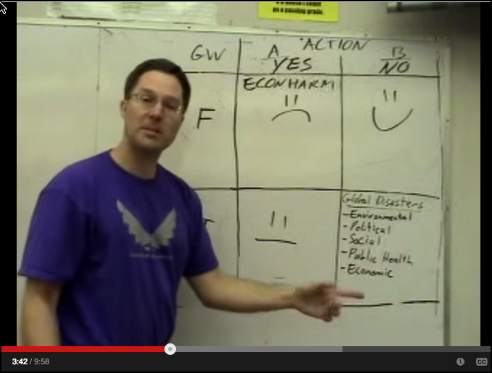
Video for in-class viewing
https://www.youtube.com/watch?v=mF_anaVcCXg
A good treatment risk assessment with uncertainty. Demonstrates how the benefits of taking action against climate change outweigh the costs and risks of being wrong.

Slide 8
Discussion questions about video on previous slide
What are the four possible conditions of certainty and action?
Are these common to many decision situations where uncertainty exists?
Can you apply this same logic to floods and droughts?
Do you see any flaws in the arguments presented?
Can you see how this same logic would work even if no “belief” were involved, but rather unknown probabilities?
Extra: Review the other videos by this same author on YouTube: wonderingmind42

Slide 9
Sources of Uncertainty when applied to climate impacts
Emissions scenarios
Global Climate Models (GCMs)
Downscaling methods
Impact models
Interactions among multiple stressors
Scale of impact assessment vs. management actions
Notes:
Reference: MJFurniss
The first step in managing natural resources in the face of uncertainty is to try and understanding the main sources and extent of the uncertainties. Each of these components have some uncertainty.
There are several main sources of uncertainty.
How will societies and economies evolve in coming decades?
Different GCMs produce different results. How sensitive is the climate to changes in GHG concentrations?
Different downscaling methods and impact models produce slightly different results.
The uncertainties cascade or accumulate through this analysis chain.

Slide 10
Uncertainty does not mean complete ignorance
Usually greater confidence in broader scale projections
Greater confidence in mid-century projections than late-century
Greater confidence in projections of some climate variables than others (i.e., temperature vs. precipitation)
Evaluate the evidence and judge the confidence in specific projected impacts for specific areas – look for convergence among impact models

Slide 11
Confidence in projections
Climate Variables:
Atmospheric CO₂ concentration
Global-mean sea-level
Global-mean temperature
Regional seasonal temperature
Regional temperature extremes
Regional seasonal precipitation/cloud cover
Changes in climatic variability (e.g. El Niño, daily precipitation regimes)
Rapid or non-linear change (for example, disintegration of the West Antarctic Ice Sheet)
High confidence
Low confidence
Very low or unknown
Notes:
Reference: MJFurniss
Key message:
Confidence in projects is highly variable. Temperature is relatively simple to model and the models are skillful. Precipitation, climate variability, and non-linear change are much less certain.

Slide 12
Modelling climate variability – the surprise scenarios
Most impacts to ecosystem and humans are sensitive to climate variability rather than the mean
But climate models represent climate variability relatively poorly
Extremes of precipitation and “storminess” don’t come out of the models
We will need to build and maintain resilience without knowing the odds of exposure and risk.
Notes:
Key message:
It is important to understand that climate model projections do not give us useful projections of climate variaiblity. Most climatologists believe that variability will increase for most parameters, even though it cannot be quantified at this time.

Slide 13
Philosophy for adaptation:
The onset and continuance of climate change over the next century requires policy makers to think differently about appropriate management than they have in the past.
Preparing for and adapting to climate change is as much a cultural and intellectual challenge as it is a scientific one.
Jill Baron
Notes:
Reference: Photos from US Park Service; Text: Baron JS, Gunderson L, Allen CD, et al. Options for National Parks and Reserves for Adapting to Climate Change. Environmental Management. 2009;44(6):1033-1042. doi:10.1007/s00267-009-9296-6. http://www.ncbi.nlm.nih.gov/pmc/articles/PMC2791479/

Slide 14
Climate change effects occur in addition to contemporary resource problems
Complexity:
Interactions already occur among stressors
Altered Disturbance Regimes
Habitat Fragmentation/Loss
Invasive Species
Pollution
Climate change will alter our ability to manage all of the above
Notes:
Reference: Photos from C. Millar USFS
Very important: climate change is not the only problem we have. In fact, climate change amplifies mosyt existing and ongoing problems and stressors. This add complexity. We should not assess climate change in isolation or independently of other problems.

Slide 15
Adaptation: Thinking Differently
Develop and implement management strategies for adaptation
Nurture and cultivate human capital
Diversify portfolio of management approaches
Accelerate capacity for learning
Assess, plan, and manage at multiple scales
Let the issues define appropriate scales of time and space
Form partnerships with other resource management organizations
Reduce other human-caused stress to ecosystems
Notes:
The issue of climate change gives us the opportunity and need to re-think our management, human and ecosystem needs, and perhaps to think differently.

Slide 16
Social uncertainty: value social capital
Resource management advances by incremental learning and gradual achievement of goals.
There are gradients between success and failure, with learning along the way.
As climate changes, some failure must be tolerated and even expected.
Protect and reward the wisdom and experience of front line managers.
Notes:
*
Value Social Capital

Slide 17
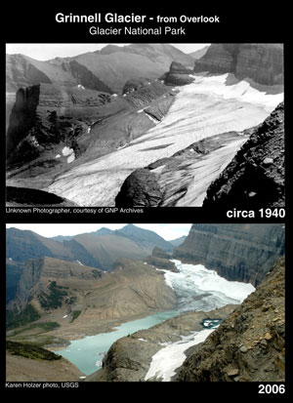
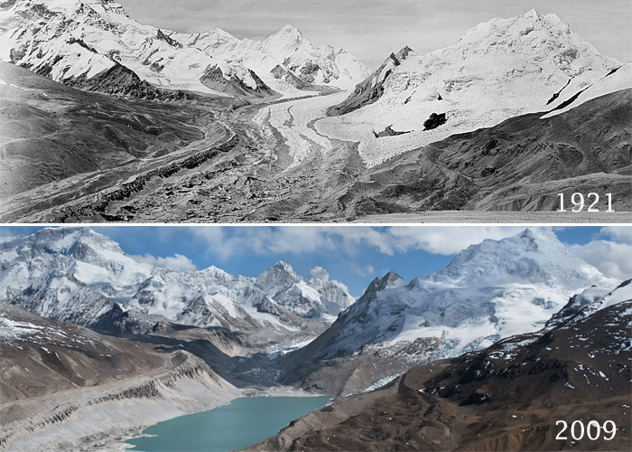
Scientific Uncertainty
Foreseeable and tractable changes
Imagined or surprising changes
Unknown changes
Notes:
Reference: USGS http://nrmsc.usgs.gov/repeatphoto
We can forsee some changes and understand them well.

Slide 18
Climate feedbacks
Ocean – Carbon Dioxide Feedback
Water Feedback
Ice-Albedo Feedback
Methane Feedback
Cloud Feedback
Biological Feedback
Ocean Circulation Feedback
See the climate basics and climate modeling topics for more on climate feedback mechanisms.
Notes:
But the climate system is extremely complex and feedbacks are not well-understood or modeled, so surprises will happen.

Slide 19
Scientific uncertainty
Foreseeable and tractable changes
Imagined or surprising changes
Unknown changes
November 2006 Flood
Mount Rainier N.P.
Notes:
Reference: USFS photos
Some changes will be surprises, and many changes can be imagined but not well anticipated.

Slide 20
Scientific uncertainty
Foreseeable and tractable changes
Imagined or surprising changes
Unknown changes
Notes:
Reference: USFS
Many coming changes are simply unknown. Changes have also happened in the past….often which might not have been foreseeable.

Slide 21
Approaches to management given uncertainty
HIGH
Adaptive
Management
Scenario
Planning
Uncertainty
Optimal
Control
Hedging
LOW
CONTROLLABLE
UNCONTROLLABLE
Controllability
Peterson et al. 2003
Notes:
*
Reference: Peterson, G. D., Cumming, G. S. and Carpenter, S. R. (2003), Scenario Planning: a Tool for Conservation in an Uncertain World. Conservation Biology, 17: 358–366. doi: 10.1046/j.1523-1739.2003.01491.x
Approaches to Management Given Uncertainty

Slide 22
Optimal control and hedging
Optimal Control examples: wildlife management, exotic species removal
Hedging Examples: restoring fish habitat for anadromous fishes (Hilsha??)
Elk management in National Parks may involve culling
Large woody debris replacement
To improve fish habitat
Notes:
Reference: Jill Baron; US National Park Service

Slide 23
Adaptive management
Treats management activities as hypotheses
Accepts there is uncertainty
Emphasizes learning through experiments and management
Setting baseline standards for the quality of adaptive management and tailor assurances for the quality and certainty of data
Most successful when there is sufficient ecological resilience to accommodate mistakes
AND where there is institutional willingness to experiment for the purpose of learning
Requires trust, cooperation, other forms of social capital, involving public and multiple agencies
Notes:
*
Adaptive Management

Slide 24
Scenario-based planning
Expert judgment with stakeholders: Brainstorming alternative, but plausible, futures
Incorporates ideas of complexity
Assigns probabilities of occurrence
Forces consideration of low probability but high risk scenarios
Stories informed by data and experts
Can be quantitative or qualitative
Benefits from outside views and perceptions
Notes:
The lack of certainty can often be effectively dealt with by building "scenarios" (stories) of credible change, and then planning based on a range of scenarios that planning teams have agreed to.

Slide 25
Group Discussion
List at least 5 types of uncertainties in each category
Social
Scientific

Slide 26
Forest management planning strategies
Setting harvest priorities
Assessing risk and locating that risk spatially
Developing strategies to deal with risks
Setting a harvest schedule that responds to those priorities and risks
Recognizing and detecting disturbance
Implementing strategies
Periodically revising the plan
COULD THIS ALSO BE
THE FRAMEWORK FOR
A FISHERIES PLANNING
STRAGEGY??
Notes:
Please see the LE-LUP Module for more on forest management planning.
J. Kenneth Day, David Manuel Pérez. 2013. Reducing uncertainty and risk through forest management planning in British Columbia. Forest Ecology and Management, Vol. 300, 117-124
http://www.sciencedirect.com/science/article/pii/S0378112712007116

Slide 27
Modeling
To project future distributions of ecosystems or species climate niches
To assess the potential impacts of climate change
To adapt forest management to present or expected disturbances
Notes:
Please see the "Modeling" topic in this module for much more on modeling.
Students must understand what models are and how they are used to be "climate literate".

Slide 28
Important sources of uncertainty in model predictions
Input data
Model parameter values
Model structure/ conceptual model/ environmental model – main source of uncertainty

Slide 29
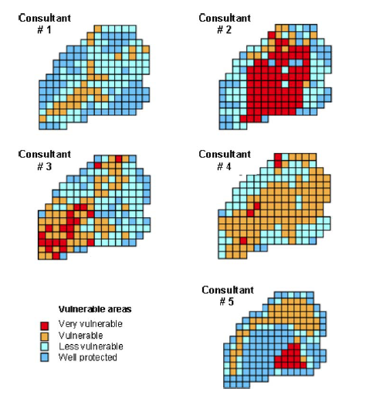
Example (conceptual uncertainty)
Given the same site and common field data
5 consultants were asked:
Which parts of this area are most vulnerable to nitrate groundwater pollution and need to be protected?
J.C. Refsgaard et al. (2006)
Notes:
Reference: Jens Christian Refsgaard, Jeroen P. van der Sluijs, James Brown, Peter van der Keur. 2006. A framework for dealing with uncertainty due to model structure error. Advances in Water Resources, Vol. 29(11), 1586-1597
http://www.sciencedirect.com.www.ezplib.ukm.my/science/article/pii/S0309170805002903

Slide 30
Instructor Review of Materials
What was useful?
What is missing?
How did you, or would you, modify the materials to make them better fit your instructional context?
Please share your experience and modifications here: climatecurriculum@googlegroups.com

Slide 31
Different conclusions
Different perceptions of what causes the pollution
Used models with different processes
Different interpretations and interpolations, e.g. areal means of precipitation and evapotranspiration and thickness of various geological layers
From existing field data, it is impossible to tell which is the most reliable

Slide 32
No “silver bullet” for model prediction
Relying on only one climate change scenario or model
Increase the likelihood of producing biased projection
Misleading conclusions
Where non-linear rates of change are ignored, decisions are exposed to more extreme outcomes
Different set of options
More robust across several scenarios and their evolution over time
Important during decision making process
The inability of local government to absolutely protect communities becomes clearer
Triggering consideration of more flexible and adaptive responses
Notes:
NO single answer. Use scenarios and smart adaptive thinking and measures to deal with uncertainties.

Slide 33
Reference
Peterson, David L.; Millar, Connie I.; Joyce, Linda A.; Furniss, Michael J.; Halofsky, Jessica E.; Neilson, Ronald P.; Morelli, Toni Lyn. 2011. Responding to climate change in national forests: a guidebook for developing adaptation options. Gen. Tech. Rep. PNW-GTR-855. Portland, OR: U.S. Department of Agriculture, Forest Service, Pacific Northwest Research Station. 109 p.
Solomon, S. (Ed.). (2007). Climate change 2007-the physical science basis: Working group I contribution to the fourth assessment report of the IPCC (Vol. 4). Cambridge University Press

Slide 34
References and Resources
The curriculum of USAID’s Climate-Resilient Ecosystems and Livelihoods (CREL) in Bangladesh is a free resource of teaching materials for university professors, teachers and climate change training experts.
Reproduction of CREL’s curriculum materials for educational or other non-commercial purposes is authorized without prior written permission from the copyright holder, provided the source is fully acknowledged.
Suggested citation: USAID. 2016. Bangladesh Climate-Resilient Ecosystem Curriculum (BACUM). USAID‘s Climate-Resilient Ecosystems and Livelihoods (CREL) Project. Winrock International. Dhaka, Bangladesh.
Disclaimer: The CREL’s curriculum is made possible by the support of the American People through the United States Agency for International Development (USAID). The contents of the curriculum do not necessarily reflect the views of USAID or the US Government.

Slide 35
USAID's Climate-Resilient Ecosystems and Livelihoods (CREL) Project Winrock International House 13/B, Road 54, Gulshan 2, Dhaka 1212 Bangladesh Tel: +880-2-9848401 www.winrock.org

