Slide 1
Bangladesh Climate-Resilient Ecosystem Curriculum (BACUM)
Module 1: Introduction to Climate Change

Slide 2
Module 1: Introduction to Climate Change
SECTION III: REPONSES TO CLIMATE CHANGE -
MITIGATION AND ADAPTATION
3.2. Climate Change and Water Resources: Responses and Adaptation

Slide 3
Introduction to Climate Change (ICC)
HOW AND WHY THE CLIMATE IS CHANGING
  1.1. Introduction to Climate Science and Climate Change
  1.2. Causes of Climate Change
  1.3. Climate Intensification: Floods, Droughts and Cyclone
IMPACTS OF CLIMATE CHANGE ON PEOPLE AND THE ENVIRONMENT
  2.1. Introduction to Climate Change Impacts
  2.2. Sea Level Rise
  2.3. Climate Change and Water Resources
  2.4. Climate Change and Food Security
  2.5. Climate Change and Human Health
  2.6. Climate Change and Terrestrial Ecosystems
RESPONSES TO CLIMATE CHANGE – MITIGATION AND ADAPTATION
  3.1. Climate Change and Forest Management
  3.2. Climate Change and Water Resources: Responses and Adaptation
  3.3. Principles and Practices of Climate Vulnerability Assessment
  3.4. Uncertainties in Climate Change
  3.5. Climate Change and Ecosystem Services
  3.6. Effective Communications in Climate Change

Slide 4
Acknowledgements
EXPERT CONTRIBUTORS | SPECIFIC INPUTS
Prof. (Dr.) Manzoor Rashid | Curriculum Development for all topics
Prof. (Dr.) Md. Danesh Miah | REDD+, Forest Carbon
Prof. (Dr.) Md. Jakariya | Community NR Management, Climate Change, Natural Resources Management
UNIVERSITIES
Bangladesh Agricultural University
University of Chittagong
Dhaka University
Independent University, Bangladesh
Khulna University
Noakhali University of Science and Technology
Shahjalal University of Science and Technology
Sher-e-Bangla Agriculture University
North South University
CREL STAFF | CREL STAFF
John A Dorr | Utpal Dutta
Abu Mostafa Kamal Uddin | Ruhul Mohaiman Chowdhury
Kevin T. Kamp | Rahima Khatun
Paul Thompson | Sultana Razia Zummi
Abdul Wahab | Shams Uddin
Shahzia Mohsin Khan
DESIGN, LAYOUT AND CONTENT DEVELOPMENT: Ms. Chi Pham, Curriculum Development Expert, Bangkok, Thailand

Slide 5
Learning Objectives
At the end of this session, students will be able to:
Explain and evaluate how people (men and women differently) and ecosystems can adapt to climate change impacts on water resources
Apply best practices considering gender needs for water resource and watershed protection to effectively adapt to climate change
Notes:
Learning objectives

Slide 6
Outline
Intensification of the hydrologic cycle: Climate change is hydrologic change
Brief review of effects of CC on water
Best Management Practices
Adaptation (some examples)
Case studies in local watersheds
Notes:
Overview

Slide 7
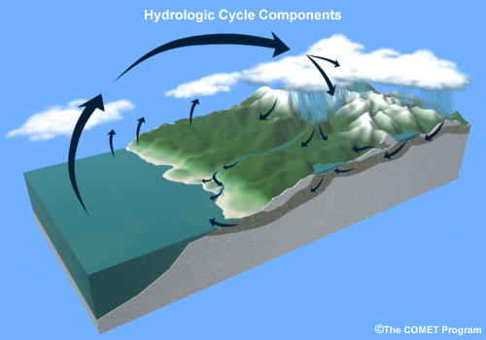
Review Water Resources Schema:
Climate change is hydrologic change
Less precipitation in some areas, more in other areas. Greater interannual variability
More rain and less snow. Snow melts sooner in Spring
More intense storms with more flooding and extreme winds
More evapotranspiration. Drier vegetation and soils. More frequent and severe droughts. Increased wildfires and area burned. Reduced stream flows.
Glaciers are reduced or eliminated. Increased high elevation erosion.
Increased reliance on groundwater for basic supply.
Sea level rises. More coastal erosion. Saltwater intrusion into coastal freshwater aquifers. Sea water acidification.
Earlier spring runoff. Larger flood peaks. Less summer stream flow. Smaller headwater stream networks
Water in streams and lakes becomes warmer.
Notes:
Reference: Base image from COMET, University Corporation for Atmospheric Research (UCAR). Annotations by MJ Furniss
Key message:
“According to model predictions, the most significant manifestation of climate change would be an acceleration of the global water cycle, leading to … a general exacerbation of extreme hydrologic regimes, floods and droughts” (NASA Global Water and Energy Cycle, 2000).
“There is evidence that suggests that the global hydrologic cycle may be intensifying, leading to an increase in the frequency of extremes” (Hornberger et al, USGCRP water cycle science plan)
The hydrological cycle is intimately linked with changes in atmospheric temperature and radiation balance.
Climate warming observed over the past several decades is consistently associated with changes in a number of components
of the hydrological cycle and hydrological systems such as: changing precipitation patterns, intensity and extremes;
widespread melting of snow and ice; increasing atmospheric water vapour; increasing evaporation; and changes in soil
moisture and runoff. There is significant natural variability – on interannual to decadal time-scales – in all components of the
hydrological cycle, often masking long-term trends. There is still substantial uncertainty in trends of hydrological variables
because of large regional differences, and because of limitations in the spatial and temporal coverage of monitoring networks
(Huntington, 2006). At present, documenting interannual variations and trends in precipitation over the oceans remains
a challenge. [WGI 3.3, IPCC technical report on Climate Change and Water]

Slide 8
Climate change impacts on water resources
Climate change amplifies risks we already face,
and have faced for many years:
  Drought
  Flood
  Water supply shortages and distribution
  Poor water quality
  Disrupted watershed processes
  And so on
Climate Change increases the risks, problems and stakes.
Notes:
Mention CC has many impacts on water resource. Such as flood, drought, water shortage, water quality and so on.

Slide 9
Potential climate change impacts to water
Less snow, more rain
Increased winter flooding
Less snowpack
Earlier snowmelt
Lower summer streamflows
Increased stream and lake temperature
Increased risk to aquatic ecosystems and fish species
Notes:
You’ve all seen or heard about the potential impacts of climate change on ecosystems and natural resources.

Slide 10
Potential climate change impacts
Longer, warmer growing seasons
Increased and decreased forest growth and ecosystem productivity
Warming surface waters
Intense droughts
Longer and more severe fire seasons
Increased insect and disease
Notes:
The potential impacts are so diverse, significant, and unprecedented.

Slide 11
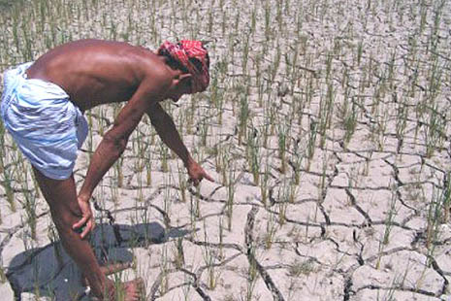
For Example: Drought intensity and severity is expected to increase
Drought in Bangladessh rice fields
Notes:
Reference: Caritas. ttps ://www.google.com.bd/search?q=drought+in+Bangladesh&espv=2&biw=1093&bih=530&source=lnms&tbm=isch&sa=X&ved=0ahUKEwj98MrDoc3QAhXBpI8KHdxBA7oQ_AUIBigB#imgrc=T6zJp7lIx-T5pM%3A

Slide 12
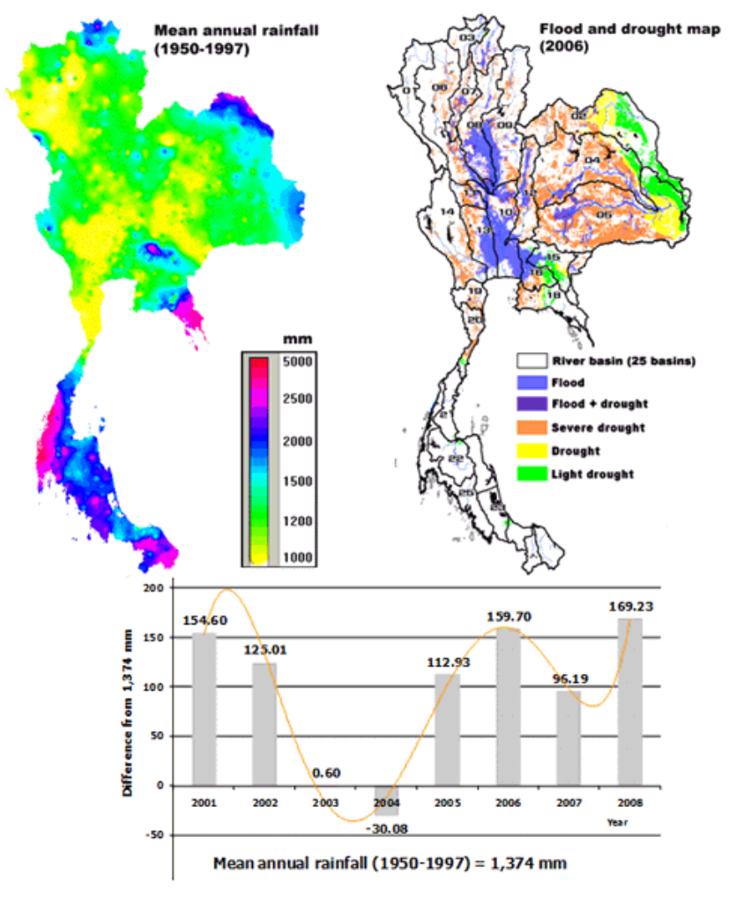
Drought in Thailand
Notes:
Reference: Royol Chitradon, Surajate Boonya-aroonnet and Porranee Thanapakpawin: "Risk Management of Water Resources in Thailand in the Face of Climate Change”, Sasin Journal of Management, Special Edition on Global Imbalance Stream of Crises, pp 64-73, June 2009. Retrieved from: http://www.haii.or.th/haiiweb/index.php?option=com_remository&Itemid=85&func=startdown&id=55&lang=en

Slide 13
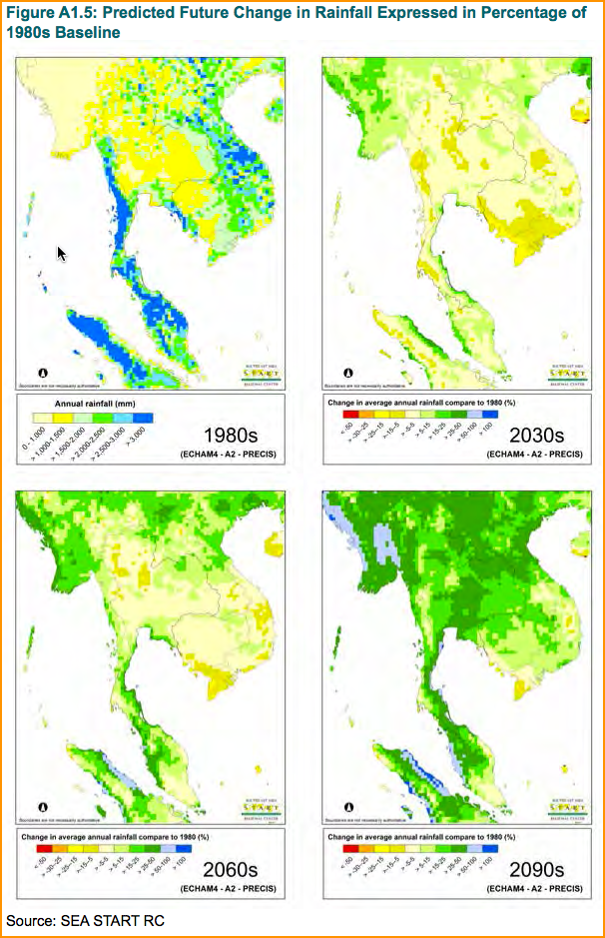

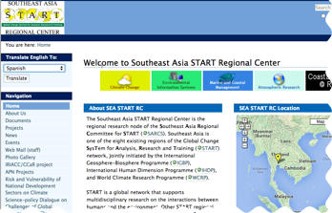
Predicted Future Change in Rainfall Expressed in Percentage of 1980s baseline
Notes:
Reference: SEA Start RC, as referenced in http://www.gms-eoc.org/uploads/resources/446/attachment/Climate%20Change%20%26%20Rural%20Communities%20in%20the%20GMS%20-%20A%20Framework%20for%20Assessing%20Vulnerability%20%26%20Adaptation%20Options.pdf
From: World Bank. 2014.
http://www.gms-eoc.org/uploads/resources/446/attachment/Climate%20Change%20%26%20Rural%20Communities%20in%20the%20GMS%20-%20A%20Framework%20for%20Assessing%20Vulnerability%20%26%20Adaptation%20Options.pdf
& Southeast Asia START Regional Center
www.start.or.th/

Slide 14
Codify best practices to protect water and soils
The US Forest Service has completed this at the national level. Called Best Management Practices.
Also includes an efficient and comprehensive system for monitoring the implementation and effectiveness of each practice.
Notes:
Key message:
Give an idea about BMP, an approach to practice to protect water and soil systematically.
Reference:
USDA, US Forest Service. 2012. National Best Management Practices for Water Quality Management on National Forest System Lands. Volume 1: National Core BMP Technical Guide. FS-990a. http://www.fs.fed.us/biology/watershed/BMP.html

Slide 15
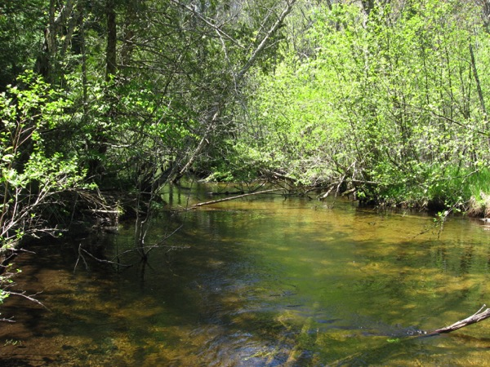
BMP Monitoring Protocols
Standardized procedures
Focused on BMP objectives
Emphasize objective observations and techniques
Interdisciplinary
Typical riparian buffer (AMZ) along the 2nd South Branch of the Oconto River
Chequamegon-Nicolet NFs, Wisconsin
Notes:
Reference. USFS photo
There are 42 monitoring protocols. Each protocol evaluates one or more of the national core BMPs. There are monitoring protocols for all resource activities.
As with the core BMPs, teams of resource professionals developed the monitoring protocols – range folks were involved in the range BMP monitoring protocols, recreation specialists helped with the rec protocols, etc. The monitoring protocols are a series of questions that focus on the objective or outcome of the BMP, not the specific practice. For example, the monitoring protocols evaluate whether or not sediment was delivered to a waterbody regardless of the specific method or site-specific practice that was used.
Each protocol provides instructions on where to look at the selected sample sites and what to look for. The protocols use objective observations and techniques in a systematic manner to reduce subjectivity in the evaluation. All observations are made on land, outside of the water – there is no requirement for water samples or laboratory analyses, and no need to get wet.
The protocols also recommend who should complete the evaluation – it is best to use an IDT. The adaptive management process is much more effective if those people who are involved in developing and implementing the site-specific BMP prescriptions are also involved in the monitoring. So timber sale administrators should be involved in monitoring mechanical vegetation BMPs, and engineers involved in evaluations of road BMPs. The program does not just belong to the hydrologists and soil scientists – participation by everyone is necessary for a successful program.

Slide 16
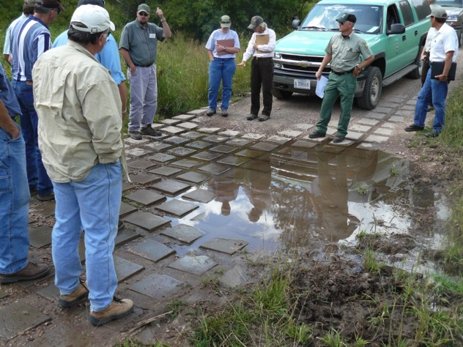
National BMP Monitoring in USA
This has just been completed.
Codified best practices for protecting water quality, soils, and watershed health.
Provides data to demonstrate protection of water quality values
Identifies practices and procedures that need improvement
2009 South Dakota BMP Audit – IDT review of concrete mat armor in a low water crossing
Black Hills NF, South Dakota
Notes:
Reference. USFS photo
Key message:
The monitoring component of the national BMP program provides the foundation for adaptive management to protect water quality. Without monitoring, we won’t have the information we need to correct deficiencies or improve our practices.

Slide 17
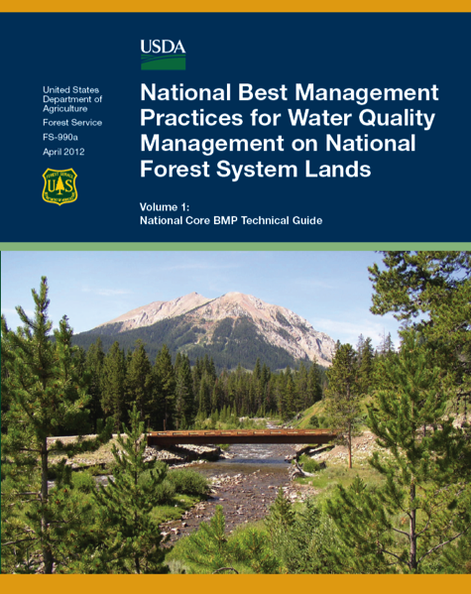
National Core BMPs in the USA
BMPs for all resource activities
75 practices in 11 resource areas:
General Planning
Aquatic Ecosystem Management
Chemical Use
Facilities & Non-recreation Special Uses
Wildland Fire Management
Minerals
Range Management
Recreation
Roads
Mechanical Vegetation Management
Water Uses
FS-990a Technical Guide Volume 1 The National Core BMPs
US Forest Service
Notes:
Key message:
The national core BMPs were recently published in a technical guide, publication FS-990a. This document is available on the WO internet page and we are in the process of distributing hard copies to all administrative units.
As I mentioned before, this program is not just about timber and roads – we have 75 core BMPs in 11 resource areas. It pretty much encompasses all of our on-the-ground activities and land uses.
Reference:
USDA, US Forest Service. 2012. National Best Management Practices for Water Quality Management on National Forest System Lands. Volume 1: National Core BMP Technical Guide. FS-990a. http://www.fs.fed.us/biology/watershed/BMP.html

Slide 18
Climate adaptive
All actions that protect and restore water and watersheds are climate adaptive
Climate change amplifies risks we already face, and have faced for many years:
We have the knowledge now to understand and adapt. Good news!
For example, we understand flooding, coastal erosion, how to identify vulnerable land and people.
Notes:
Key message:
All management practices that protect and restore watersheds and water serve to adapt to climate change. Best Management Practices are more important than ever.
GOOD NEWS! WE ALREADY KNOW HOW TO DO IT! (Mostly)

Slide 19
Wildlands adaptation
Codify Best Management Practices (BMPs) to describe how water quality will be protected.
Monitor BMPs to determine if they are implemented and if they work.
Roads are often the greatest impact in wildland watersheds. Locate, design, construct, monitor, and restore roads with up-to-date science and technology that minimizes impacts.
  See Water-Roads Ideals in BCC References

Slide 20
Wildlands adaptation
Manage forests to reduce impacts to water and watershed function (use BMPs)
Use controlled fire where possible to reduce fuel buildup and the potential for large catastrophic fires.
Subject all land-use to Low-Impact Land Use Planning (See RECCCD Module)

Slide 21
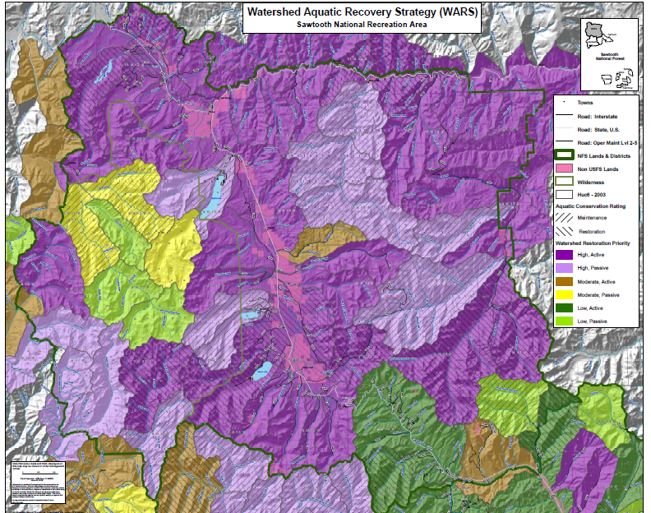
Wildlands adaptation
Conduct vulnerability assessment to set priorities and inform decisions
Overlay results with existing strategies, constraints and opportunities to set priorities
Notes:
Reference: US Forest Service
Further see BCC_3.3_Climate Change Vulnerability Assessment - Principles and Practice

Slide 22
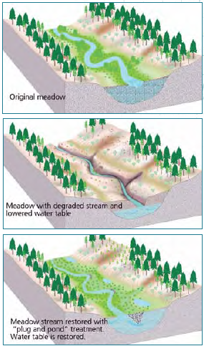
Adapt by restoring degraded landscapes, such as gullied meadows, valley bottoms, riparian areas
For Example: Restoring groundwater levels in eroded meadows and valley bottoms can increase watershed resilience in many forested watersheds.
Warming and late-season drying trends greatly increase the ecological importance of wet mountain meadows and valley bottoms, which provide myriad ecological services.
Restoring groundwater levels in these places adds resistance and resilience to watersheds, reducing the vulnerability of ecosystem services to climate change.
Bangladesh Example: Mangrove tree replanting on embankments in shrimp gher areas.
Notes:
Reference: Image by MJ Furniss and K Ronnenberg, USFS
Some example for response to climate change impacted on water resource in case of protect and restore watershed processes.

Slide 23
Agriculture adaptation (1)
Raise Irrigation efficiency
Expand drip irrigation
Improve rain-fed farming
Shift cropping patterns and crops
Lift nutritional value
Expand urban farming
Promote sorjan systems
Postel
Notes:
Give some examples for adaptation in agriculture

Slide 24
Agriculture adaptation (2)
Improve crops for drought resistance
Study land suitability for crop choices
Select the best crop for suitable land
Promote crop rotation and mixed crops
Support soil and water conservation
Raise ground in low areas
Plant shorter rotation crops
Postel
Notes:
Give some examples for adaptation in agriculture

Slide 25
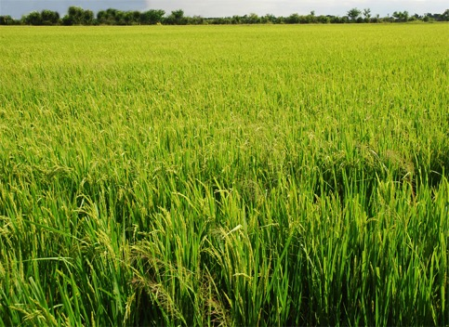
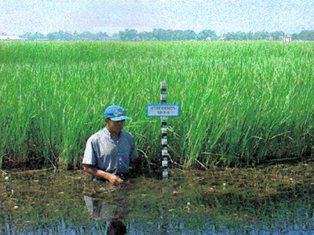
Agriculture adaptation (3)
Adaptation by Changing
Changing suitable varieties
Flooding
Previous varieties
Adaptable varieties in water
(more resistance in water)
Postel
Notes:
References: https://www.youtube.com/watch?v=ktP1RGFM3a0 http://www.rakbankerd.com/2014/agriculture/page.php?id=5032&s=tblrice
Some ideas about adaptation by changing;

Slide 26
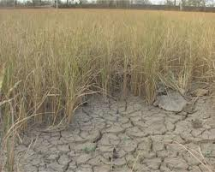
Agriculture adaptation (4)
Adaptation by Changing
Changing suitable varieties
Drought
Previous varieties
Adaptable varieties in dry condition (more resistance in drought)
Postel
Notes:
References: https://www.youtube.com/watch?v=ktP1RGFM3a0 http://www.thaigreenagro.com/Aticle.aspx?id=14852&Param2=14
Also adaptation by changing suitable crop varieties in the drought situation. !!! Climate information is very important, particularly forecasting

Slide 27
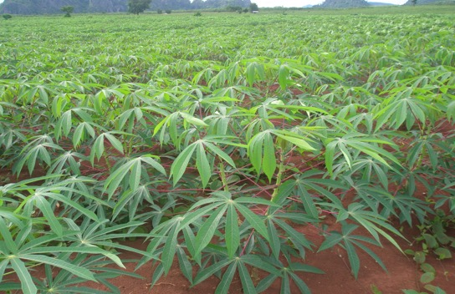
Agriculture adaptation (5)
Adaptation by Changing
Changing crop types
Drought
Previous crop
Suitable new crop
Postel
Notes:
References: https://www.youtube.com/watch?v=ktP1RGFM3a0 http://www.tapiocathai.org/English/NewsPDF_e.html
Sometimes can change by totally crop types. In case of the situation is very bad from water resource and finally to the soil conditions. (This case might be hard for farmers)

Slide 28
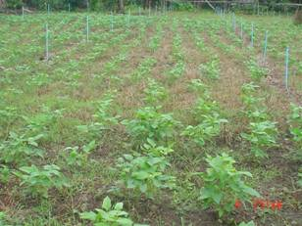
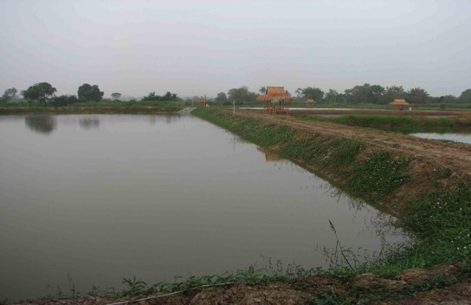
Agriculture adaptation (6)
Adaptation by Changing
Changing to alternative profession
Flooding
Cropping
Fish ponds
Postel
Notes:
Reference: http://www.taiyai.org/index.php?name=plants&file=readplants&id=1 http://www.siamfishing.com/board/view.php?tid=38708
Changing to new alternative career, such as from cropping to fish ponds, in case of more flooding every year.

Slide 29
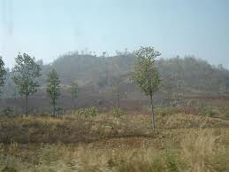
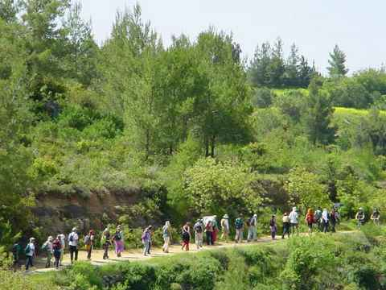
Agriculture adaptation (7)
Adaptation by Changing
Changing to alternative profession
Drought
Cropping
Eco-tourism business
Postel
Notes:
References: http://www.bloggang.com/m/viewdiary.php?id=moonfleet&month=03-2010&date=12&group=104&gblog=152 http://www.infoplease.com/encyclopedia/science/conservation-natural-resources.html
Changing from cropping to do eco-tourism business, in case of severe drought and the area has some local attractive location or historical sites.

Slide 30
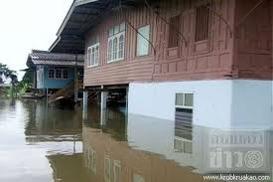
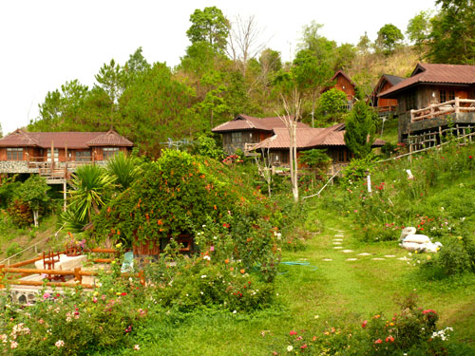
Residential adaptation
Adaptation by moving (relocate)
Moving from flooding area to upper area
Drought
Flooding zone
Mountainous zone
Postel
Notes:
References: http://www.thaiflood.com/ http://www.lycheetravel.com/guilin/pingan-zhuang-village.html
Adaptation by moving or relocate such as move permanently or sometimes from flooding area to higher zone.

Slide 31
Create Mechanisms to Invest in Healthy Watersheds
Place | Mechanism
Lâm Đồng Province, Vietnam: | Pays rural residents to prevent forest conversion
Quito, Ecuador: | Watershed trust fund
New York City; Portland, Oregon, USA | Pays land-owners for purification services
Costa Rica: | Payments for forested watershed services
Bangladesh | Establishment of aquatic sanctuaries for fish
Notes:
Message: Bangladesh watersheds, for most of the country, are flat. World by WorldFish and others to make rice fields more friendly for fish populations during the rainy season to ensure higher levels of reproductive success is one example of rice field watersheds.

Slide 32
Case Study: Water-related land-use planning in Northern Thailand: Mai Tha Catchment

Slide 33
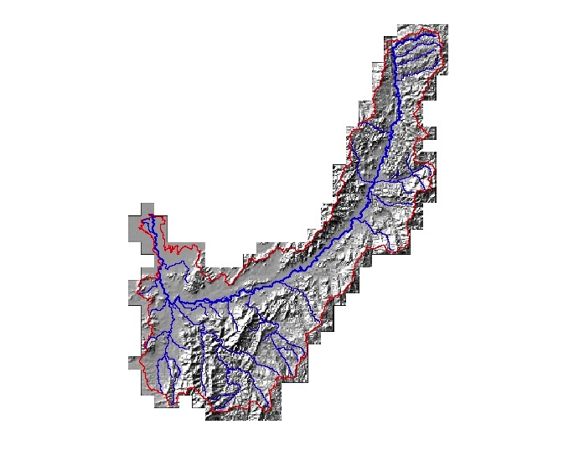
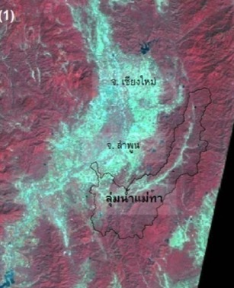

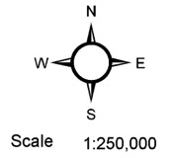

An example in Mae Tha Watershed
Lumphun, Northern Thailand
Elevation (msl.)
High: 1362.20 meters
Low: 284.52 meters
Stream lines
  Watershed Assessment
  Using Spatial Scenario
Notes:
Key Message: The next 30 slides are from Thailand. These are a series of research data and analysis that cover a wide range of elements related to water resources and climate change. These represented a very detailed analysis for which some of it might or might not be valuable for all students or professors in their discussions. It is valuable to look at many of the GIS-generated maps that provide individual and overlapping data sets which are important to adapt to or mitigate against the impacts of climate change. This includes looking at water resources, soil types, land use, forest zoning, etc. These are then articulated in flood and drought risk zones. Additional social information maps are then introduced, including poverty mapping, income, urbanization and a development index. A number of photos of “processes” are then presented.
Reference: Thaworn Onpraphai, CMU

Slide 34
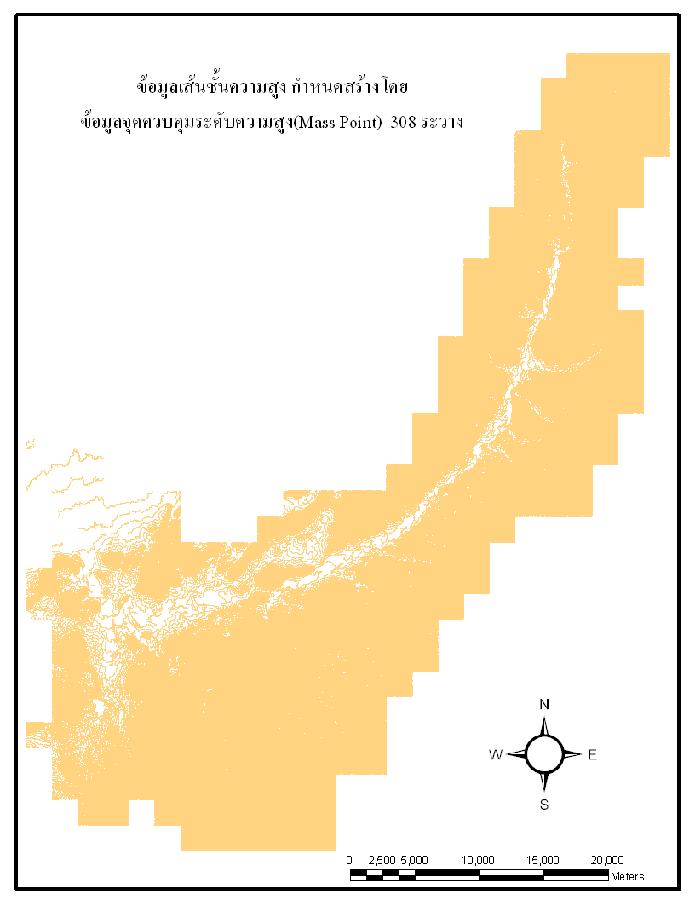
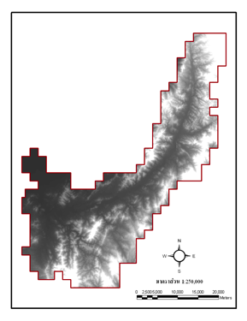
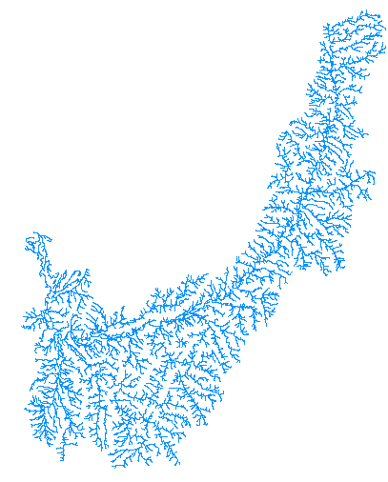
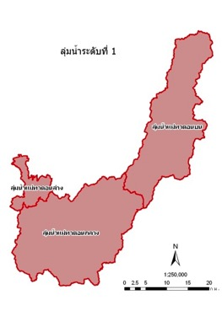
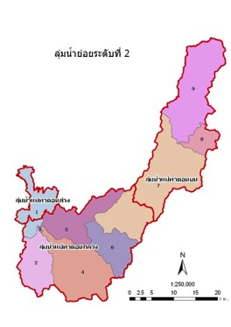
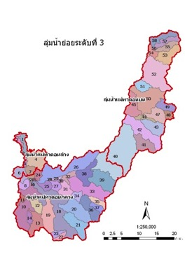
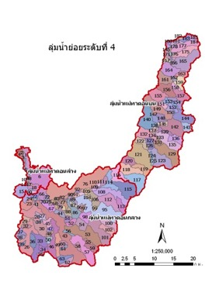
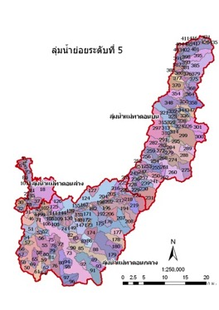
Sub-watershed Prioritization
Pfefstetter
(Verdin, 1997; Pinpetch, 2005)
Reference streamlines
Contour lines
DEM
1st Order
2nd Order
3rd Order
4th Order
5th Order
Notes:
Reference: Thaworn Onpraphai, CMU

Slide 35
Criteria to assess a watershed status (MCDA-GIS)
1) Ecological Criteria
1.1) Vegetation Biomass (Agri.+Forest)
1.2) Vegetation Biodiversity (Agri.+Forest)
1.3) Soil Erosion
1.4) Use of Conservative lands
1.5) Available Water in Watershed
2) Productivity Criteria
2.1) Ratio of Agri. Land Use
2.2) Ratio of Irrigation Zones to Agri. areas
2.3) Drought Risk in Agri. Areas
2.4) Flooding Risk in Agri. Areas
3) Socio-economic Criteria
3.1) Household Income
3.2) Population Density
3.3) Development Level of Community

Slide 36
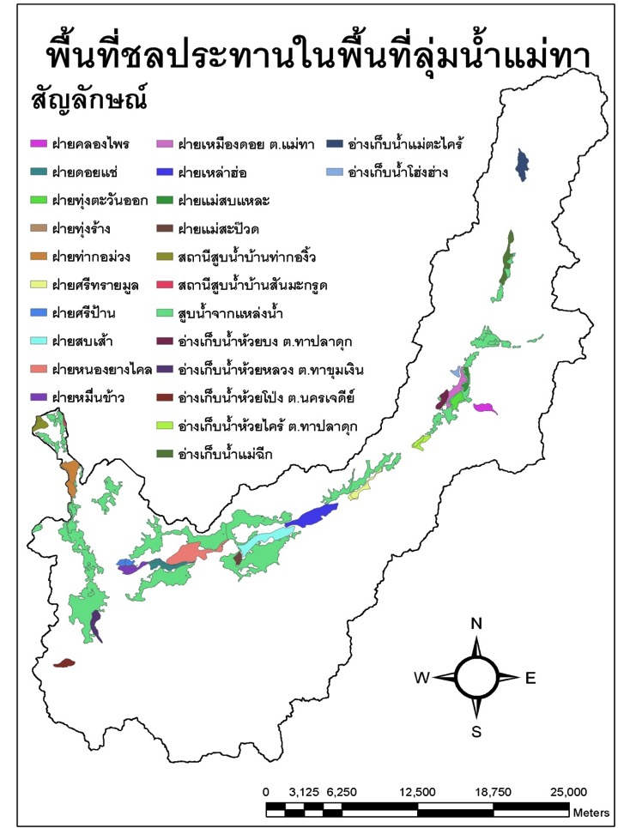
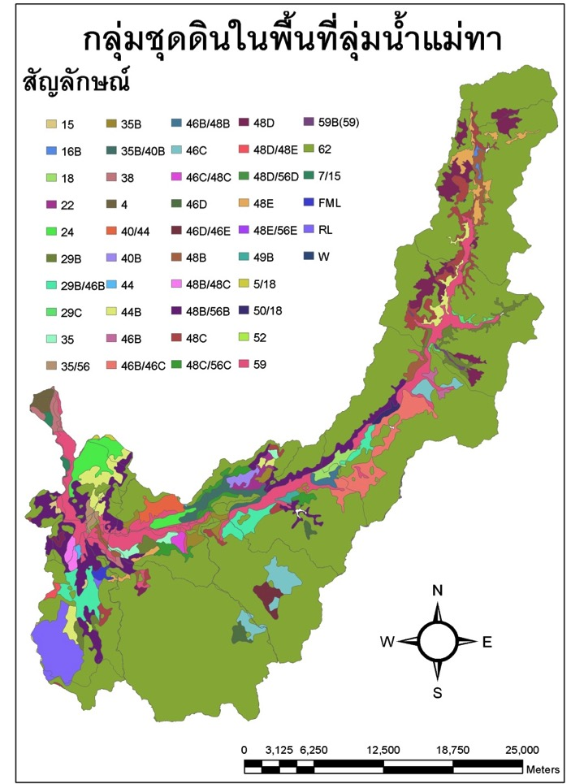
Irrigation zone
Soil series
Notes:
Key Message: The next 30 slides are from Thailand. These are a series of research data and analysis that cover a wide range of elements related to water resources and climate change. These represented a very detailed analysis for which some of it might or might not be valuable for all students or professors in their discussions. It is valuable to look at many of the GIS-generated maps that provide individual and overlapping data sets which are important to adapt to or mitigate against the impacts of climate change. This includes looking at water resources, soil types, land use, forest zoning, etc. These are then articulated in flood and drought risk zones. Additional social information maps are then introduced, including poverty mapping, income, urbanization and a development index. A number of photos of “processes” are then presented.
Reference: Thaworn Onpraphai, CMU

Slide 37
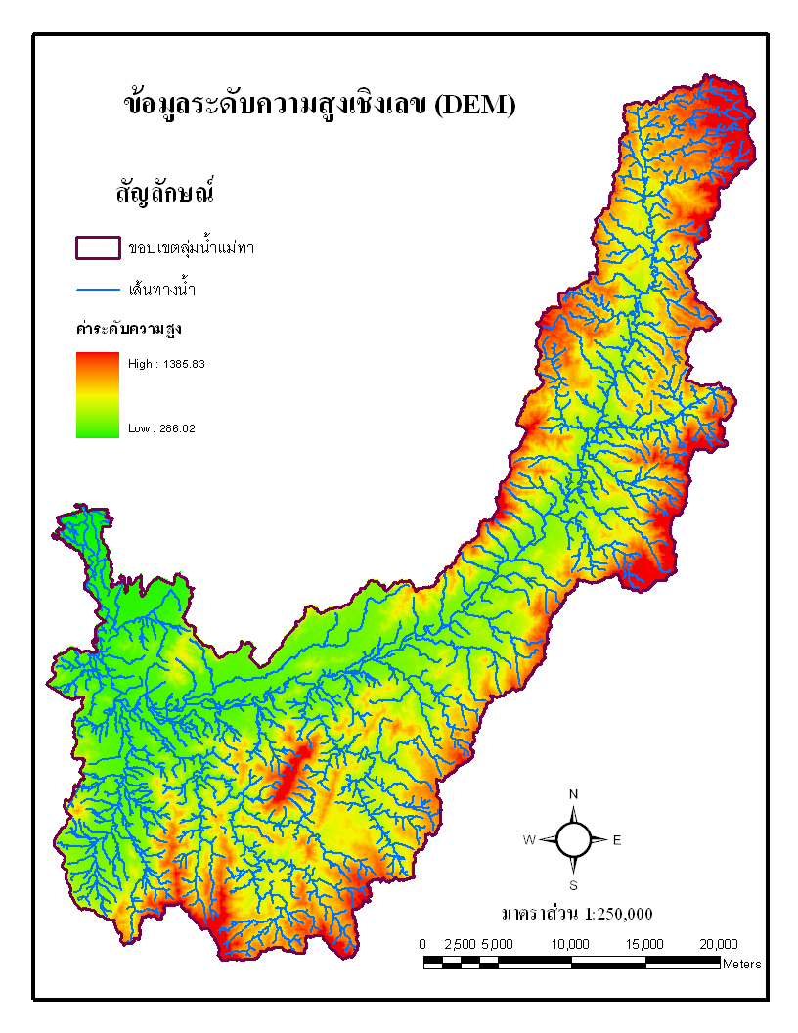
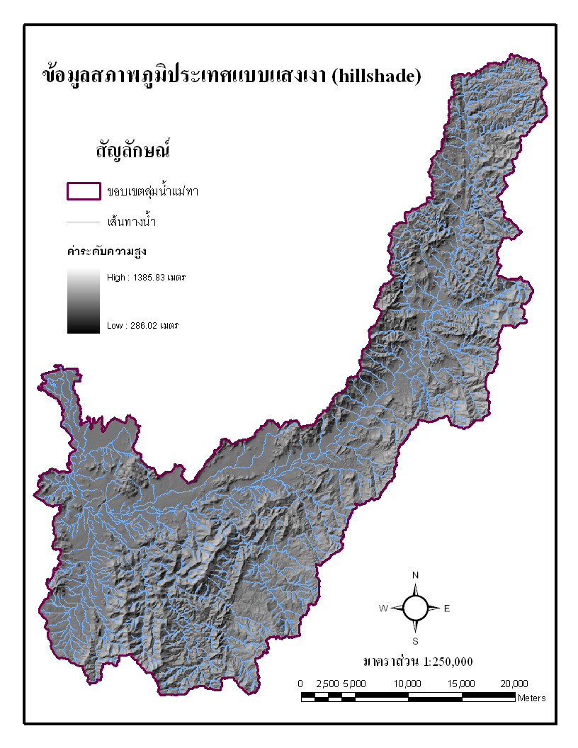
Digital Elevation Model
Topography
Notes:
Reference: Thaworn Onpraphai, CMU

Slide 38
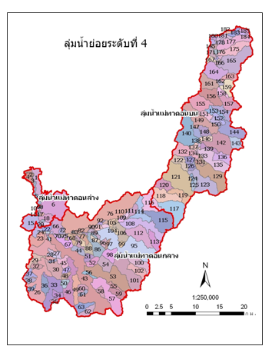
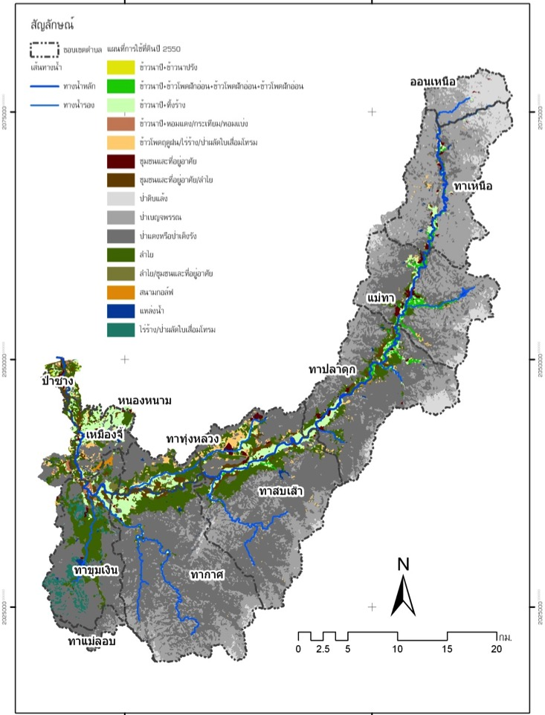
การใช้ประโยชน์ที่ดิน ปี 2550
Reference: Thaworn Onpraphai, CMU
Sub-watershed area
Land Use
Notes:
Reference: Thaworn Onpraphai, CMU

Slide 39
Forest Zoning
Notes:
Reference: Thaworn Onpraphai, CMU

Slide 40
Drought Risk Zone
Notes:
Reference: Thaworn Onpraphai, CMU

Slide 41
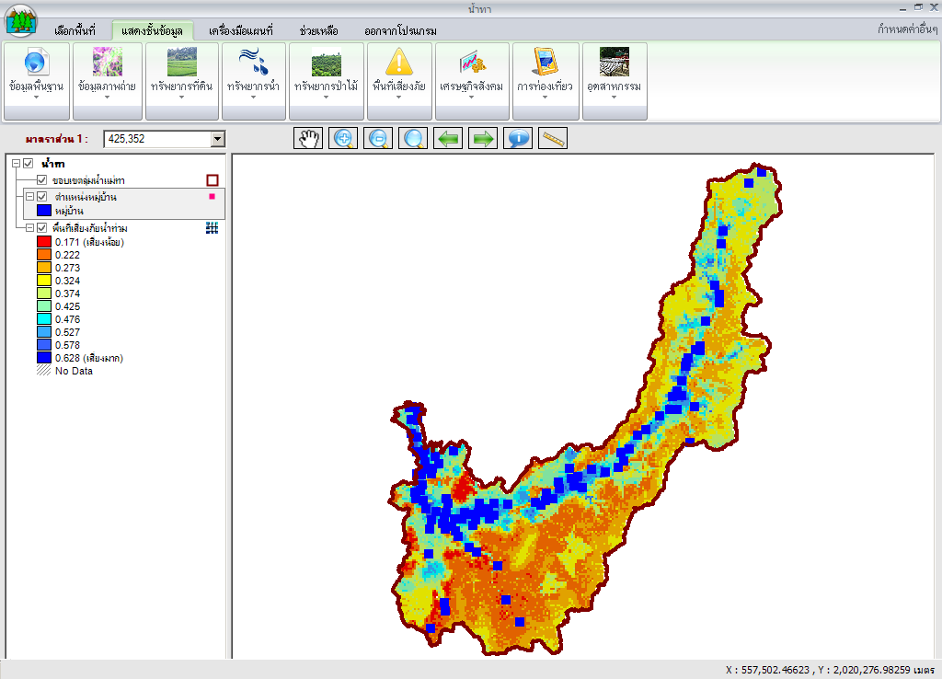
Flooding Risk Zone
Notes:
Reference: Thaworn Onpraphai, CMU

Slide 42
Population Density
ความหนาแน่นของประชากร
Notes:
Reference: Thaworn Onpraphai, CMU

Slide 43
รายได้เฉลี่ยต่อคน
Annual Income
Notes:
Reference: Thaworn Onpraphai, CMU

Slide 44
Development Index
Notes:
Reference: Thaworn Onpraphai, CMU

Slide 45
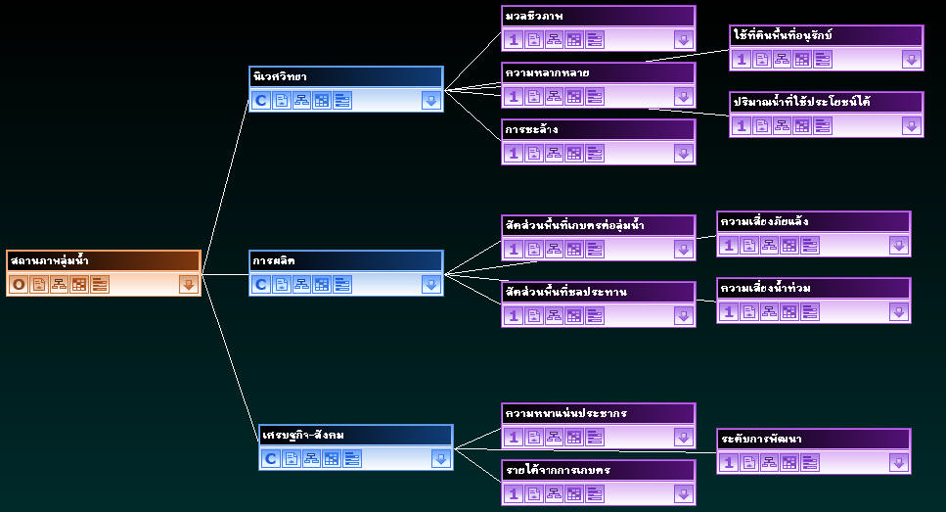
Weighting Criteria
Biomass
Use of conservative lands
Ecology
Biodiversity
Available water
Soil erosion
Farming ratio
Drought risk
Watershed Status
Agri. productivity
Irrigation ratio
Flooding risk
Socio-economic
Population density
Development level
Farming income
Notes:
Reference: Thaworn Onpraphai, CMU
Key message:
Initially we thought we would be able to combine all values together, all sensitivities, all stressors and come our with one ranking by watershed. Then we would be able to look at the predicted climate changes and identify potential effects, which would then lead us to A vulnerability ranking for each watershed.
We quickly discovered our process concept was oversimplified.

Slide 46
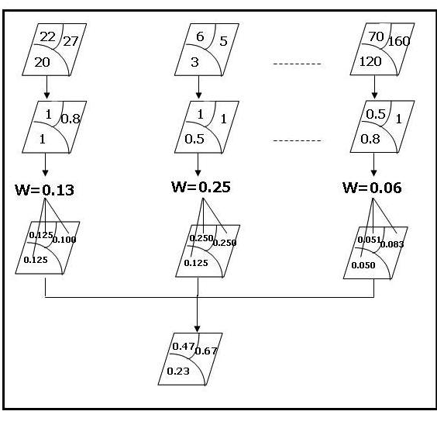
Steps of Assessing Watershed Status
Biomass
Biodiversity
Amount of Water)
Criteria (ex.)
Actual Values
Standardization
Weighting Values
Adaptive Values
Map of Assessing
Watershed Status
Notes:
Reference: Thaworn Onpraphai, CMU
Initially we thought we would be able to combine all values together, all sensitivities, all stressors and come our with one ranking by watershed. Then we would be able to look at the predicted climate changes and identify potential effects, which would then lead us to A vulnerability ranking for each watershed.
We quickly discovered our process concept was oversimplified.

Slide 47
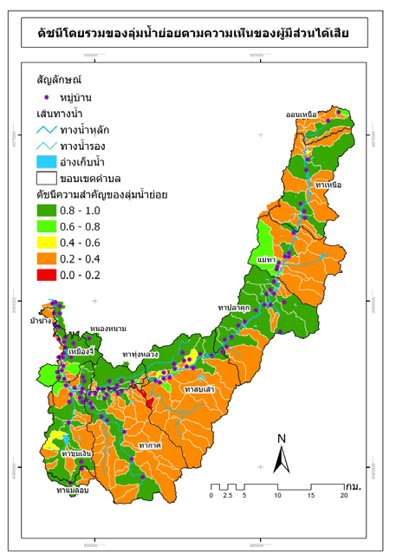
Priority watershed for protection
Notes:
Reference: Thaworn Onpraphai, CMU
Initially we thought we would be able to combine all values together, all sensitivities, all stressors and come our with one ranking by watershed. Then we would be able to look at the predicted climate changes and identify potential effects, which would then lead us to A vulnerability ranking for each watershed.
We quickly discovered our process concept was oversimplified.

Slide 48
Example analysis for Drought
Criteria | Rainfall | Distance from Irrigation Zone & Water Sources | Ground Water | Density of Streams & Rivers | Soil Drainage | Land Use
Actual Values | mm. | m. | m³ | km./km² | Bad-Good | Water – Construction
Standardization | 1-4 | 1-4 | 1-4 | 1-4 | 1-4 | 1-4
Weighting Values | 6 | 5 | 4 | 3 | 2 | 1
Adaptive Values | 6-24 | 5-20 | 4-16 | 3-12 | 2-8 | 1-4
Map of Risk of Drought | ----------------------------No risk – High risk ----------------------------------
Notes:
Reference: Thaworn Onpraphai, CMU
Start VA- after you done these...

Slide 49
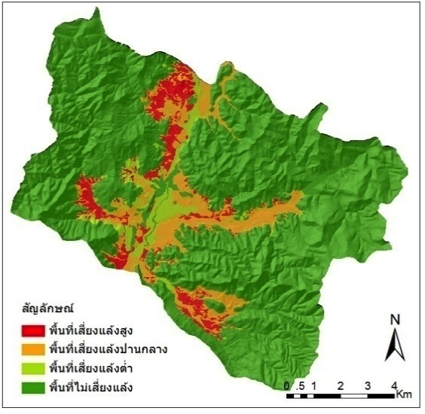
Risk of Drought in Mae Tha
Symbol
Highly Risk
Moderately Risk
Low Risk
No Risk
Notes:
Reference: Thaworn Onpraphai, CMU

Slide 50
Example analysis for Flooding
Criteria | Rainfall | Slope | Density of Streams & Rivers | Water Way Blocked | Size of Sub-watershed | Soil Drainage | Land Use
Actual Values | mm. | % | km./km² | No./km² | km² | Clayey-Sandy | Trees – Construction
Standardization | 1-4 | 1-4 | 1-4 | 1-4 | 1-4 | 1-4 | 1-4
Weighting Values | 7 | 6 | 5 | 4 | 3 | 2 | 1
Adaptive Values | 7-28 | 6-24 | 5-20 | 4-16 | 3-12 | 2-8 | 1-4
Map of Risk of Flooding | ----------------------------No risk – High risk ----------------------------------
Notes:
Reference: Thaworn Onpraphai, CMU

Slide 51
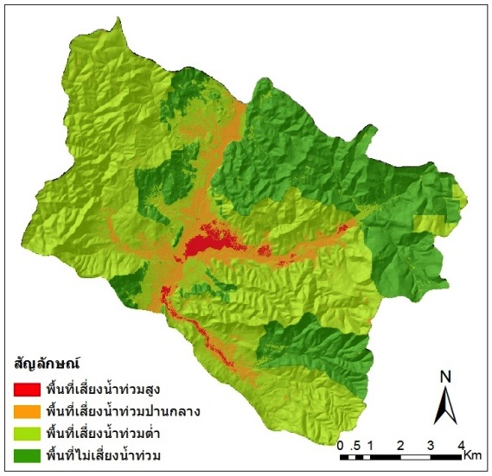
Risk of Flooding in Mae Tha
Symbol
Highly Risk
Moderately Risk
Low Risk
No Risk
Notes:
Reference: Thaworn Onpraphai, CMU
Start VA- after you done these...

Slide 52
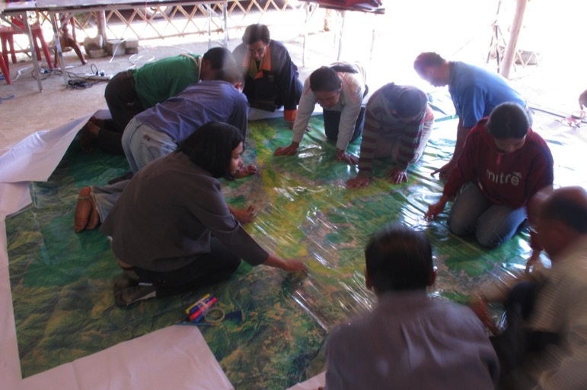
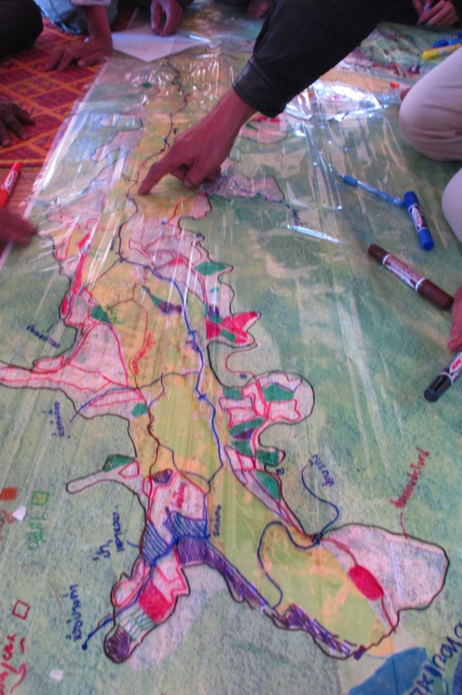
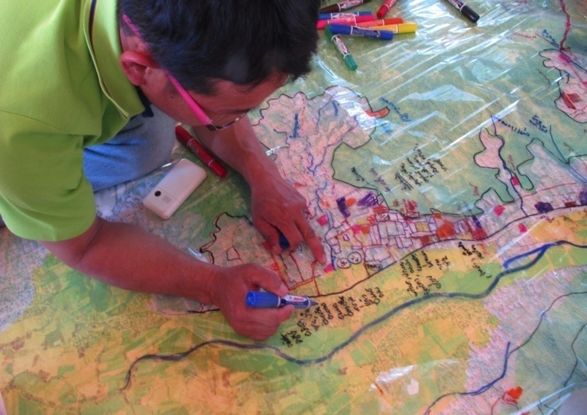
Notes:
Reference: Thaworn Onpraphai, CMU

Slide 53
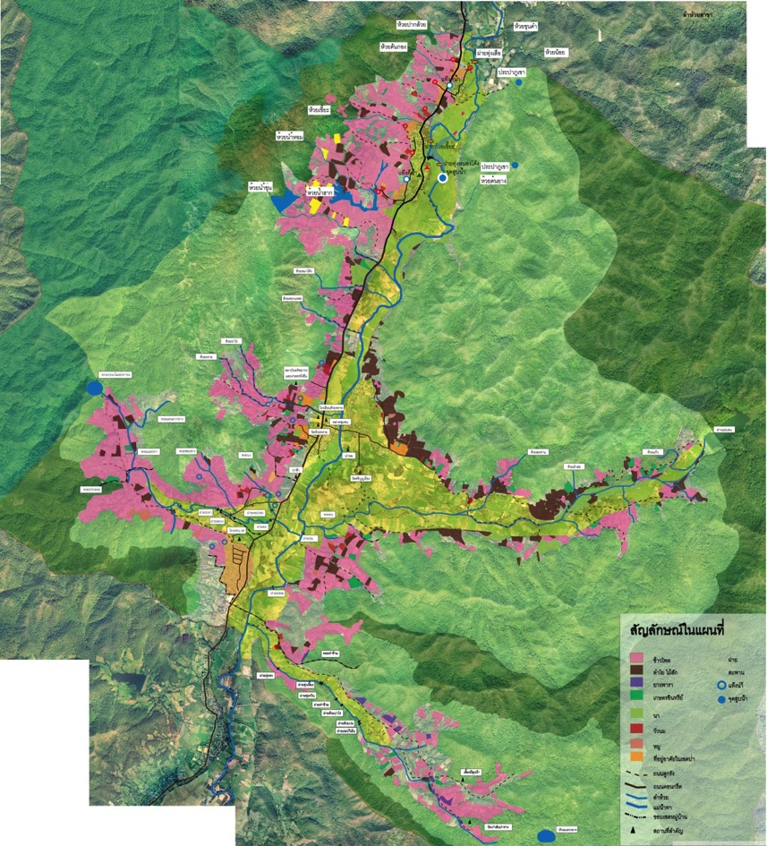
Land Use Planning for Water Management
Notes:
Reference: Thaworn Onpraphai, CMU

Slide 54
Land Use | Area (m²) | Area (rai)
Organic farming areas | 8,508,365.35 | 5,317.73
Suitable lands for maize | 4,614,229.50 | 2,883.89
Residential areas | 1,837,615.05 | 1,148.51
Projected residential areas | 9,232,202.58 | 5,770.13
Agricultural learning area | 502,324.16 | 313.95
Suitable lands for live stock | 5,271,745.76 | 3,294.84
Community center area | 2,520,762.98 | 1,575.48
Water resource development areas | 2,061,000.00 | 1,288.13
Ecological recovery areas | 708,960.02 | 443.10
Notes:
Reference: Thaworn Onpraphai, CMU
Land Use Planning for Water Management

Slide 55
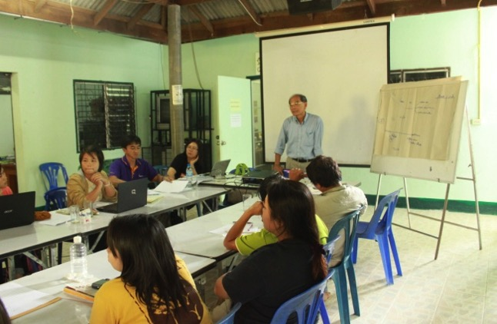
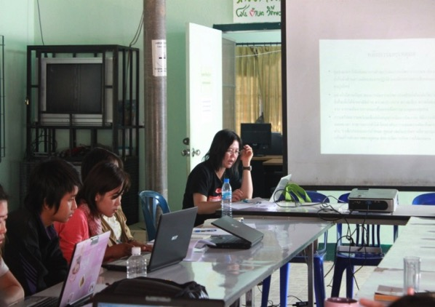
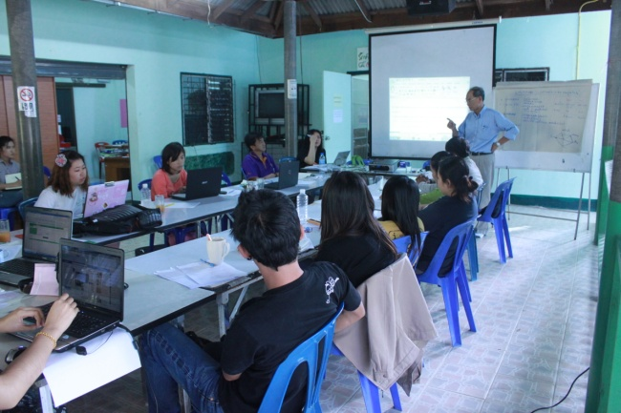

Community Participation (Participatory Action Research: PAR)
Notes:
Reference: Thaworn Onpraphai, CMU

Slide 56



Exploring and evaluating reservoir sites
Notes:
Reference: Thaworn Onpraphai, CMU

Slide 57

Planning for Water Supply
Topographical Elevation
Cross-section of
Reservoir
Water way
Water level
Reservoir
Area
Dam Line
Water level
Topographical Elevation
Assessment of Water Reserved Areas in Mae Tha: Reservoir Area
Notes:
Reference: Thaworn Onpraphai, CMU

Slide 58

Assessment of Water Reserved Areas in Mae Tha: Watershed
Watershed
Notes:
Reference: Thaworn Onpraphai, CMU

Slide 59

Assessment of Water Reserved Areas in Mae Tha: Dam Structure
[cross-section]
Dam Top
Top level
Back
Front
Highest water level
Dam Height
Bottom (stream base)
Base Core
Notes:
Reference: Thaworn Onpraphai, CMU

Slide 60
Assessment of Water Reserved Areas in Mae Tha: Site Description
1. | Name of Reservoir
2. | Location of Dam | Ban............. (X = 529131 Y = 2060898)
3. | Water Reserved Leveling (by topography) | +546.000 m. (msl)
4. | Reservoir Area (by topography) | 580,902.37 m²
5. | Watershed Area | 7.74 rai
6. | Dam Length | 129 m.
7. | Dam Height | 13 m.
8. | Average Annual Rainfall | 1,100 mm./year
9. | Maximum Reserved Water | 53,585.06 m.³
10. | Annual Runoff | 3,485.41 m.³
11. | Water Capacity | 0.192 million m.³
12. | Leveling of Dam Top | 18 m.
13. | Width of Dam Top | 4 m.
14. | Flooding Land Use (-)
 | - Crop Areas | 2.47 rai
 | - Forest Areas | 5.27 rai
15. | Benefit Land Use (+)
 | - Paddy Rice | 53.59 rai
 | - Crops | 32.15 rai
16. | Minimum Budget | 1,607,550 Baht
Notes:
Reference: Thaworn Onpraphai, CMU

Slide 61

Assessment of Water Reserved Areas in Mae Tha: Dam Sites
ลำดับ | ชื่ออ่างเก็บน้ำ
1 | ห้วยเหี้ยะ
2 | แม่ทา 1
3 | แม่ทา 2
4 | ห้วยปงกา 1
5 | ห้วยปงกา 2
6 | แม่บอน 1
7 | แม่บอน 2
8 | แม่บอน 3
9 | แม่บอน 4
10 | แม่บอน 5
11 | ห้วยต้นเดื่อ 1
12 | ห้วยต้นเดื่อ 2
13 | ห้วยแม่เลาะ 1
14 | ห้วยแม่เลาะ 2
Mae Tha
Notes:
Reference: Thaworn Onpraphai, CMU

Slide 62




Planning for Water Supply
Meeting with Mae Tha Community
Notes:
Reference: Thaworn Onpraphai, CMU

Slide 63
Discussion
What are the predicted changes to water resources in your region?
How do these changes add to or mitigate existing risks, stresses, and problems with water supplies and aquatic ecosystems?
What options does your region have in terms of adaptation for water supplies? Is it too late?
What options does your region have in terms of adaptation to protect aquatic ecosystems?

Slide 64
Discussion
How can land managers adapt to changes in climate with current infrastructure?
How much is known about the vulnerability of the infrastructure in your home watershed? In the University watershed.
Discuss natural adaptation vs. technical or engineering solution to sea level rise to deltas, estuaries, and freshwater wetlands.

Slide 65
Discussion
In regions where water supply comes from mountain glaciers, discuss what steps should be taken to adapt and secure supply in the future?
What are the issues now and how do they differ from issues in the future for this area.

Slide 66
Instructor Review of Materials
What was useful?
What is missing?
How did you, or would you, modify the materials to make them better fit your instructional context?
Please share your experience and modifications here: climatecurriculum@googlegroups.com

Slide 67
Assigned Reading
Read pages 50-60 in:
  “Water, Climate Change, and Forests: Watershed Stewardship for a Changing Climate” 2010
What can you say in general about what we can do about the impacts of climate change on water resources?
How important is collaboration in watershed management? Why?
Give at least 5 examples of best practices for watershed management that might need improvement in your home watershed; and in the watershed where your University is located.
How does science contribute to adapting to climate change?
What are Best Management Practices?
What is the connection between energy generation and water?
How is watershed management different in SE Asia than in the USA?

Slide 68
Reference
Furniss, Michael J.; Staab, Brian P.; Hazelhurst, Sherry; Clifton, Cathrine F.; Roby, Kenneth B.; Ilhadrt, Bonnie L.; Larry, Elizabeth B.; Todd, Albert H.; Reid, Leslie M.; Hines, Sarah J.; Bennett, Karen A.; Luce, Charles H.; Edwards, Pamela J. 2010. Water, climate change, and forests: watershed stewardship for a changing climate. Gen. Tech. Rep. PNW-GTR-812. Portland, OR: U.S. Department of Agriculture, Forest Service, Pacific Northwest Research Station. 75 p. http://www.fs.fed.us/pnw/pubs/pnw_gtr812.pdf
Peterson, David L.; Millar, Connie I.; Joyce, Linda A.; Furniss, Michael J.; Halofsky, Jessica E.; Neilson, Ronald P.; Morelli, Toni Lyn. 2011. Responding to climate change in national forests: a guidebook for developing adaptation options. Gen. Tech. Rep. PNW-GTR-855. Portland, OR: U.S. Department of Agriculture, Forest Service, Pacific Northwest Research Station. 109 p http://www.fs.fed.us/pnw/pubs/pnw_gtr855.pdf
Eastham, J., F. Mpelasoka, M. Mainuddin, C.Ticehurst, P. Dyce, G. Hodgson, R. Ali and M. Kirby, 2008. Mekong River Basin Water Resources Assessment: Impacts of Climate Change. CSIRO: Water for a Healthy Country National Research Flagship
http://wacc.edu.vn/vi/wp-content/uploads/2013/06/wfhcMekongWaterResourcesAssessment.pdf
USDA, US Forest Service. 2012. National Best Management Practices for Water Quality Management on National Forest System Lands. Volume 1: National Core BMP Technical Guide. FS-990a.
http://www.fs.fed.us/biology/watershed/BMP.html

Slide 69
References and Resources
The curriculum of USAID’s Climate-Resilient Ecosystems and Livelihoods (CREL) in Bangladesh is a free resource of teaching materials for university professors, teachers and climate change training experts.
Reproduction of CREL’s curriculum materials for educational or other non-commercial purposes is authorized without prior written permission from the copyright holder, provided the source is fully acknowledged.
Suggested citation: USAID. 2016. Bangladesh Climate-Resilient Ecosystem Curriculum (BACUM). USAID‘s Climate-Resilient Ecosystems and Livelihoods (CREL) Project. Winrock International. Dhaka, Bangladesh.
Disclaimer: The CREL’s curriculum is made possible by the support of the American People through the United States Agency for International Development (USAID). The contents of the curriculum do not necessarily reflect the views of USAID or the US Government.

Slide 70
USAID's Climate-Resilient Ecosystems and Livelihoods (CREL) Project
Winrock International
House 13/B, Road 54, Gulshan 2, Dhaka 1212
Bangladesh
Tel: +880-2-9848401 www.winrock.org

