Slide 1
Bangladesh Climate-Resilient Ecosystem Curriculum (BACUM)
Module 1: Introduction to Climate Change

Slide 2
Module 1: Introduction to Climate Change
SECTION II: IMPACTS OF CLIMATE CHANGE ON PEOPLE AND THE ENVIRONMENT
2.2. Sea Level Rise

Slide 3
Introduction to Climate Change (ICC)
HOW AND WHY THE CLIMATE IS CHANGING
  1.1. Introduction to Climate Science and Climate Change
  1.2. Causes of Climate Change
  1.3. Climate Intensification: Floods, Droughts and Cyclones
IMPACTS OF CLIMATE CHANGE ON PEOPLE AND THE ENVIRONMENT
  2.1. Introduction to Climate Change Impacts
  2.2. Sea Level Rise
  2.3. Climate Change and Water Resources
  2.4. Climate Change and Food Security
  2.5. Climate Change and Human Health
  2.6. Climate Change and Terrestrial Ecosystems
RESPONSES TO CLIMATE CHANGE – MITIGATION AND ADAPTATION
  3.1. Climate Change and Forest Management
  3.2. Climate Change and Water Resources: Responses and Adaptation
  3.3. Principles and Practices of Climate Vulnerability Assessment
  3.4. Uncertainties in Climate Change
  3.5. Climate Change and Ecosystem Services
  3.6. Effective Communications in Climate Change

Slide 4
Acknowledgements
EXPERT CONTRIBUTORS | SPECIFIC INPUTS
Prof. (Dr.) Manzoor Rashid | Curriculum Development for all topics
Prof. (Dr.) Md. Danesh Miah | REDD+, Forest Carbon
Prof. (Dr.) Md. Jakariya | Community NR Management, Climate Change, Natural Resources Management
UNIVERSITIES
Bangladesh Agricultural University
University of Chittagong
Dhaka University
Independent University, Bangladesh
Khulna University
Noakhali University of Science and Technology
Shahjalal University of Science and Technology
Sher-e-Bangla Agriculture University
North South University
CREL STAFF | CREL STAFF
John A Dorr | Utpal Dutta
Abu Mostafa Kamal Uddin | Ruhul Mohaiman Chowdhury
Kevin T. Kamp | Rahima Khatun
Paul Thompson | Sultana Razia Zummi
Abdul Wahab | Shams Uddin
Shahzia Mohsin Khan
DESIGN, LAYOUT AND CONTENT DEVELOPMENT: Ms. Chi Pham, Curriculum Development Expert, Bangkok, Thailand

Slide 5
Learning Objectives
At the end of this session, students will be able to:
Explain global and local sea level rise and factors contributing to both
Explain the causes of sea level change
Explain current observations, projections of future sea levels, and their respective uncertainties
Explain the mechanisms underlying potential risks and vulnerabilities and their geographic distribution
Explain how see level rising increase women vulnerabilities and what are the potential adaptive and mitigating measure to reduce vulnerabilities
Describe and evaluate potential adaptations to reduce or avoid the impacts to people (men and women) and ecosystems

Slide 6
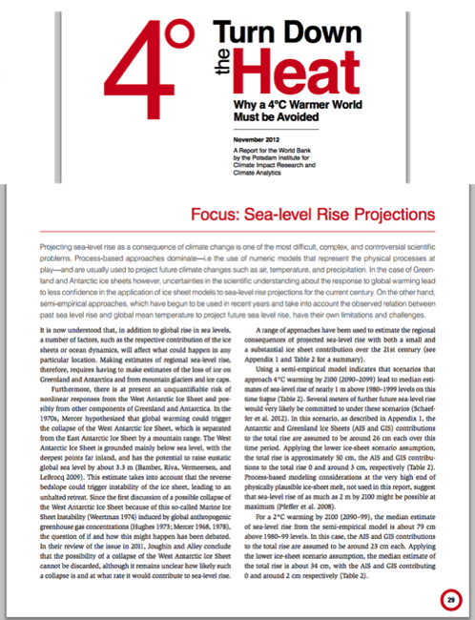
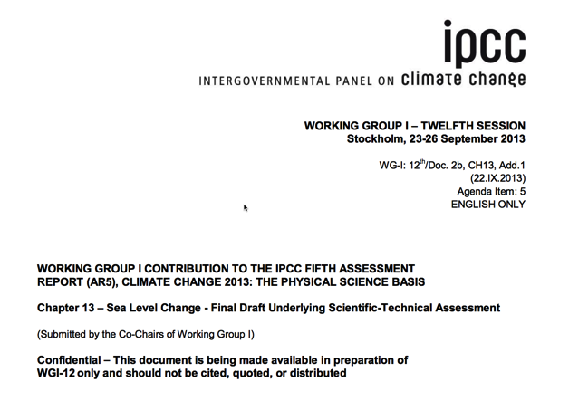
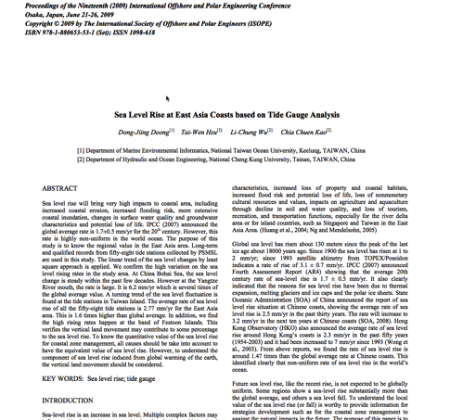
Key Literature/Assigned Reading
Three important sources:
Dong-Jiing et al. Sea Level Rise at East Asia Coasts based on Tide Gauge Analysis
IPCC AR5 Chapter 13
Turn Down the Heat. World Bank. Pages 29-34
Notes:
References:
IPCC AR5. Chapter 13
http://www.ipcc.ch/report/ar5/wg1/
Dong-Jiing et al. Sea Level Rise at East Asia Coasts based on Tide Gauge Analysis
http://www.comc.ncku.edu.tw/chinese/h_paper/%E6%9C%9F%E5%88%8A%E8%AB%96%E6%96%87%E6%AA%94%E6%A1%882012/98%E5%B9%B4%E5%BA%A6%20Sea%20Level%20Rise%20at%20East%20Asia%20Coasts%20based%20on%20Tide%20Gauge%20Analysis.pdf
World Bank. Turn Down the Heat 2012
http://documents.worldbank.org/curated/en/865571468149107611/pdf/NonAsciiFileName0.pdf

Slide 7
Turn Down the Heat 2013: Questions
By the end of the 21st century, how does projected sea level rise along the South Asian coastline compare to the global mean sea level rise?
What are the projections for sea level rise in a 2°C world versus a 4°C world?
What is land subsidence? What are some of its causes? Why is it particularly important at river deltas?
Both agriculture and aquaculture in South Asia are concentrated along river deltas. This makes them particularly vulnerable to sea level rise and land subsidence. Can you think of an example of how coastal agriculture in your region has already been impacted by climate change and what steps are being taken to mitigate this risk?
What risks does salt water intrusion pose? What are some of the drivers that cause salt water intrusion to extend further inland in addition to sea level rise?
What are some of the health risks of consumption of salt contaminated water?
What are some of the impacts of coastal erosion? What is one way to mitigate coastal erosion?
Agricultural productivity in South Asia is projected to decline with climate change. Even rice production, which is largely grown in deltaic regions and is relatively tolerant of unstable water levels, is at risk. What are the major threats to rice cultivation? Can you think of any ways in which rice cultivation could be adapted to be more resilient to climate change?
Aquaculture plays an important role in Bangladesh’s economic development. What aspects of climate change threaten aquaculture? Name at least 3.
What are some ways to adapt aquaculture so that it is less vulnerable to climate change? What are some of the barriers to such adaptation?

Slide 8
Exercise: Classroom or Homework
What areas near you are vulnerable to sea level rise? Define these places at distance intervals given by the instructor.
Are there assessments that have been done of coastal vulnerability to sea level rise for any of these areas?
Can you obtain these assessments?
What do they show?
Notes:
Do this in small groups.

Slide 9
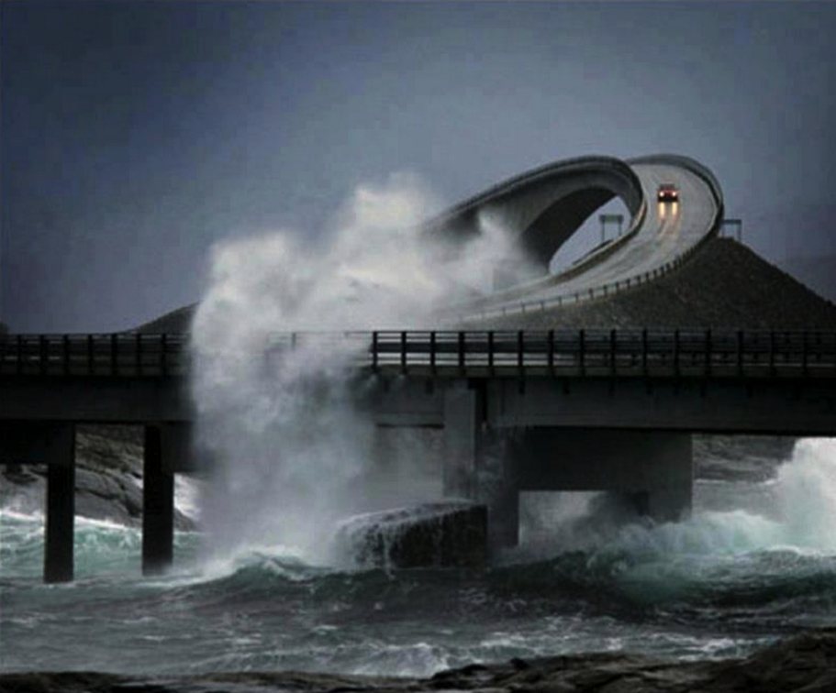
VIDEO: Dangerous ocean in Norway
https://www.youtube.com/watch?feature=player_embedded&v=__AhijdLmaE#!
Notes:
KEY MESSAGE:
Roads are one of the most common forms of infrastructure near the coast.
The ocean is a very high energy environment, even without rising sea levels.
Much engineering technology has been developed to deal with the energetic threats of the ocean and dynamic coastal lands to infrastructure like roads.
Video Source:
https://www.youtube.com/watch?feature=player_embedded&v=__AhijdLmaE#!

Slide 10
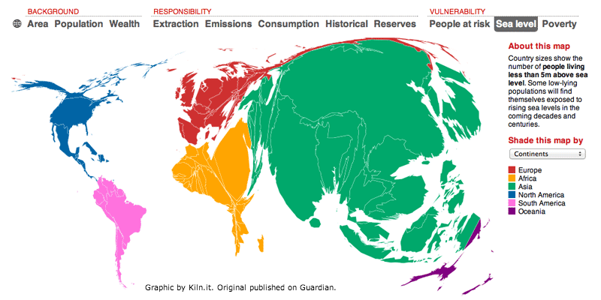
Population within 5m of sea level
Notes:
KEY MESSAGE:
Asian countries and populations are the most vulnerable of all.
This map shows how populations that are near sea level are concentrated in Asia, and this is because of South East Asia and the Asian Pacific.
Sea level rise is slow but very serious (sometimes called “A slow-motion flood”)
Sea level has been rising since the early 1900s
After ~6,000 years of stability
Will continue for centuries and perhaps millennia regardless of what humanity does about GHG.
A lot of SLR is already “cooked in” to the climate system by past human emissions. It is happening and cannot be stopped.
Easy to ignore because flooding does not become obvious until there are rare peak episodic sea-level events (large storms, flood, storm-surge).
Salinization of waters, soils, and groundwater happen first and before inundations and are highly disruptive.
There will not be better answers anytime soon, so this is the best time to act.
Reference:
Graphic by Kiln.it
http://www.carbonmap.org/#SeaLevel

Slide 11
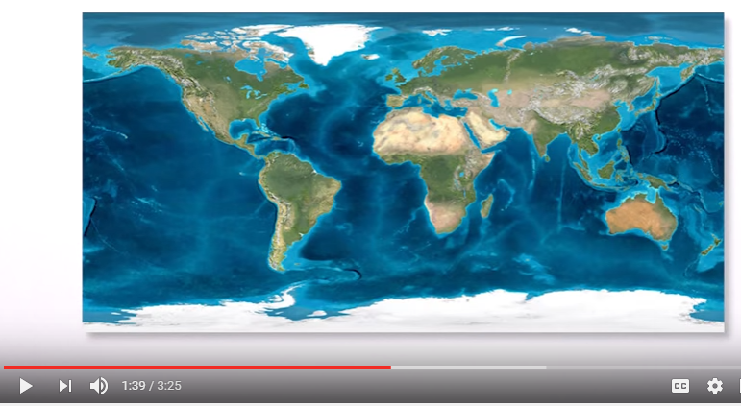
Video: What is sea level?
Notes:
Video Source:
What is Sea Level?
https://www.youtube.com/watch?v=q65O3qA0-n4

Slide 12
How SLR Matters in South Asia and South East Asia
Population and agriculture is concentrated in low-elevation coastal areas that are vulnerable to sea level rise.
Sea level rise appears to be a serious problem, but the uncertainties are large
Impacts are strongly influenced by human choice
Reducing GHG emissions reduces but does not avoid sea level rise impacts.
Preparing to adapt is prudent, particularly given the need to address multiple stresses and managing existing problems
Notes:
KEY MESSAGE:
South East Asia and South Asia are especially vulnerable to sea level change.
References:
IPCC AR5. Chapter 13
http://www.ipcc.ch/report/ar5/wg1/
Dong-Jiing et al. Sea Level Rise at East Asia Coasts based on Tide Gauge Analysis
http://www.comc.ncku.edu.tw/chinese/h_paper/%E6%9C%9F%E5%88%8A%E8%AB%96%E6%96%87%E6%AA%94%E6%A1%882012/98%E5%B9%B4%E5%BA%A6%20Sea%20Level%20Rise%20at%20East%20Asia%20Coasts%20based%20on%20Tide%20Gauge%20Analysis.pdf
World Bank. Turn Down the Heat 2012
http://documents.worldbank.org/curated/en/865571468149107611/pdf/NonAsciiFileName0.pdf

Slide 13
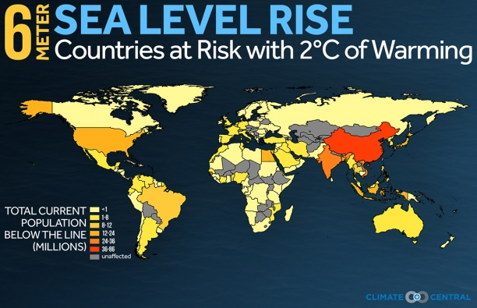
Countries at Risk of Sea Level Rise
Notes:
KEY MESSAGE:
If, as suggested by a comprehensive new review in the journal Science, 2°C of global warming will lock in at least 6 meters (20 feet) of eventual sea level rise, what would 2°C of warming (3.6°F) mean for the future and heritage of global nations and cities?
It would mean a world we don’t recognize, one losing more than 444,000 square miles of land, where more than 375 million people live today.
China, the world’s largest emitter of greenhouse gases, is home to by far the largest share of those people, nearly a quarter.
The U.S., second biggest emitter, ranks seventh on the exposure list — but is the most affected nation, by total population, outside of heavily threatened Asia.
Many large and small nations face much more daunting challenges from the perspective of the percentage of their populations on land at risk.
It should be considered that sea level rise is only one consequence of a changing climate. More frequent extreme weather events such as storms, droughts, heat waves and landslides will likely provoke further fatalities and economic damage.
Image & Reference:
Climate Central
http://www.climatecentral.org/news/nations-megacities-face-20-feet-of-sea-level-rise-19217

Slide 14
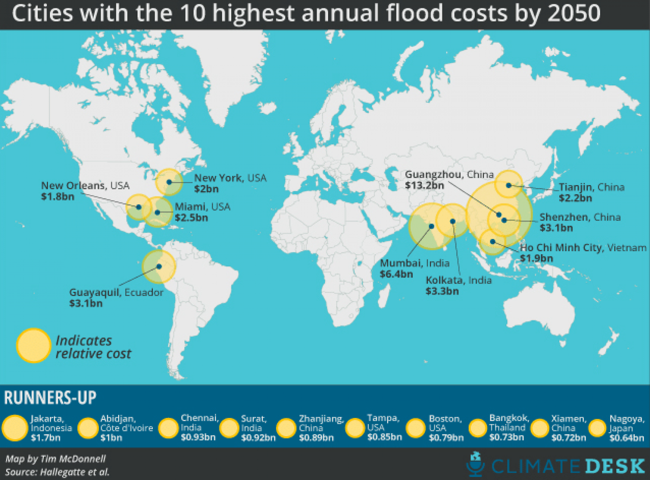
Notes:
KEY MESSAGE:
Tim McDonnell of Climate Desk has put together a helpful map from the data in the study showing the 20 cities facing the highest annual average flooding costs by mid-century
It's worth noting, however, that climate change is only part of the reason for the increase in flooding risks. The authors estimate that average flood damage would increase to about $52 billion annually even if climate change wasn't a factor at all — just based on population and economic growth. (As more and more Americans move to the coast, the cost of flooding goes up.) Rising sea levels then add another $11 billion per year on top of that.
Another option is to look at which cities are expected to face the most damage as a percentage of their overall GDP. In that case, the top-ten list looks a bit different, composed more heavily of cities in poorer countries:
1) Guangzhou, China
2) New Orleans, United States
3) Guayaquil, Ecuador
4) Ho Chi Minh City, Vietnam
5) Abidjan, Cote d'Ivoire
6) Zhanjing, China
7) Mumbai, India
8) Khulna, Bangladesh
9) Palembang, Indonesia
10) Shenzen, China.
Reference & Image:
Washington Post
https://www.washingtonpost.com/news/wonk/wp/2013/08/20/these-20-cities-have-the-most-to-lose-from-rising-sea-levels/

Slide 15
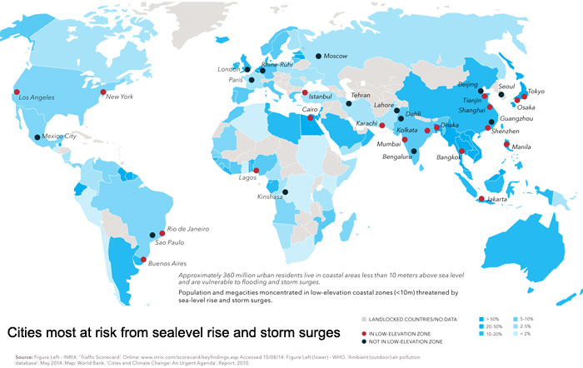
Cities at Risk of Sea Level Rise
Notes:
KEY MESSAGE:
The researchers asked over 6,000 business leaders in over 21 countries what they thought were the growing opportunities around the risks facing the world. Overwhelmingly, the top response was innovation in supplying and using water.
Three out of the five top-ranking sustainable business opportunities are water-related. They point at water-efficient agriculture and innovation to address the lack of fresh water around the world as key examples. This, they say, will be the new "Gold Rush".
Reference & Image:
http://www.sustainablecitiescollective.com/david-thorpe/1038231/revealed-greatest-global-business-and-societal-opportunities-sustainability

Slide 16
Discussion Questions
Does melting sea ice contribute to sea level rise?
Do you think sea ice is important to global climate? Why?
The sea surface is not flat, and so the sea level is not uniform over the globe. However, do you think sea level rises in a uniform manner over the globe?
Notes:
Hint: Archimedes principle.

Slide 17
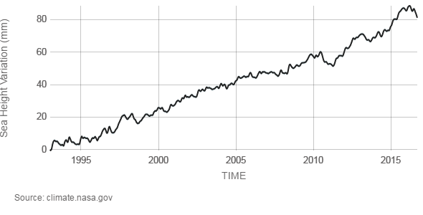
Causes of Sea Level Rise
Sea level rise is caused primarily by two factors related to global warming:
the added water from melting land ice
the expansion of sea water as it warms.
Notes:
KEY MESSAGE:
This chart tracks the change in sea level since 1993 as observed by satellites by NASA (National Aeronautics and Space Administration).
The seas of the Earth are rising, a direct result of a changing climate. Ocean temperatures are increasing, leading to ocean expansion. And as ice sheets and glaciers melt, they add more water. An armada of increasingly sophisticated instruments, deployed across the oceans, on polar ice and in orbit, reveals significant changes among globally interlocking factors that are driving sea levels higher.
Yet the globally averaged trend toward rising sea levels masks deeper complexities. Regional effects cause sea levels to increase on some parts of the planet, decrease on others, and even to remain relatively flat in a few places, including, in recent decades, on the California coast. Thermal expansion of seawater can be the product of regional phenomena, such as El Niño, the periodic warming of the eastern tropical Pacific. But some of these regional cycles so far show no direct link to long-term global climate change—despite, at times, independently exerting a powerful short-term influence on global climate.
And while Greenland, Antarctica and most of the world’s glaciers are melting, a distinction must be made between glacial discharge into the oceans, a more permanent type of ice loss, and changes in the precipitation and evaporation that is feeding those glaciers and ice sheets, which fluctuate on the scale of decades.
Reference:
NASA Sea Level Change Portal
https://sealevel.nasa.gov/understanding-sea-level/causes/overview
Graphic:
NASA.
http://climate.nasa.gov/vital-signs/sea-level/

Slide 18
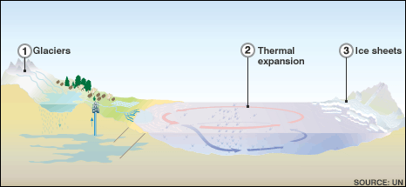
Global Sea Level
Notes:
KEY MESSAGE:
Glaciers: If the reserves contain billions of tonnes of frozen water - if the largest of them (the East Antarctic ice sheet) melts, the global sea level will rise by an estimated 64mworld's mountain glaciers and icecaps melt, sea levels will rise by an estimated 0.5m
Thermal expansion: The expansion of warming oceans was the main factor contributing to sea level rise, in the 20th Century, and currently accounts for more than half of the observed rise in sea levels
Ice sheets: These vast reserves contain billions of tonnes of frozen water - if the largest of them (the East Antarctic ice sheet) melts, the global sea level will rise by an estimated 64m
Image Source :
http://news.bbc.co.uk/2/hi/science/nature/8387137.stm

Slide 19
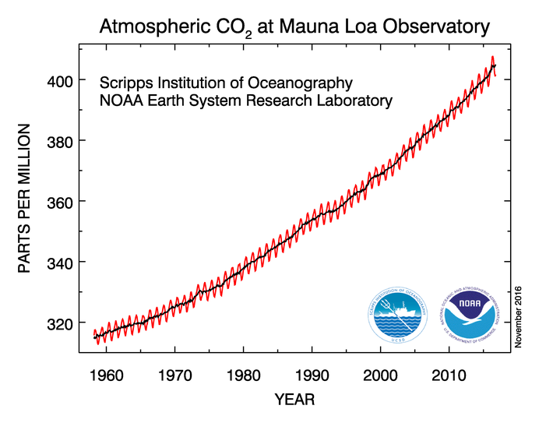
Atmospheric CO2
There has been a steady rise in carbon dioxide since the measurements began
You can see the rise and fall on a yearly basis due to plants growing and absorbing CO2 every spring and summer.
In 2015 the annual growth rate jumped by 3.05 parts per million, the largest year-to-year increase in their 56 years of measurements.
Notes:
KEY MESSAGE:
The carbon dioxide data (red curve), measured as the mole fraction in dry air, on Mauna Loa constitute the longest record of direct measurements of CO₂ in the atmosphere.
The black curve represents the seasonally corrected data.
Data are reported as a dry mole fraction defined as the number of molecules of carbon dioxide divided by the number of molecules of dry air multiplied by one million (ppm).
Image
NOAA - National Oceanic and Atmospheric Administration
http://www.esrl.noaa.gov/gmd/ccgg/trends/full.html
Reference:
http://ocean.si.edu/sea-level-rise

Slide 20
Why Sea Level on the Rise: Thermal Expansion
One property of water is that warm water takes up more space than cold water.
So as the ocean warms from climate change, seawater expands to fill a greater volume and takes up more space.
This is called thermal expansion, and it is responsible for the remaining one-third of sea level rise to date.
Thermal expansion is an ongoing contributor to sea level rise as long as ocean water continues to increase in temperature.
Notes:
KEY MESSAGE:
The idea that water expands when heated seems strange, but it is a property of most objects that occurs at the molecular level. When water molecules are heated, they absorb energy. That energy causes the molecules and atoms to move around more and, in the process, take up more space.
If you heat up a cup of water, the small molecular expansions don't add up to a difference we can detect by eye. But when you have vast numbers of water molecules, like in the ocean, the tiny expansions add up to something we can see.
Reference:
http://ocean.si.edu/sea-level-rise

Slide 21
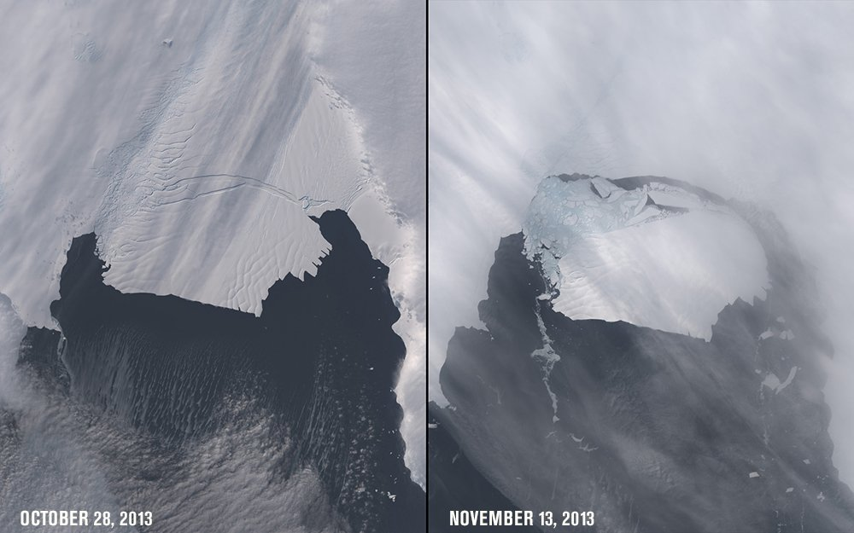
Why Sea Level on the Rise: Melting Ice
Glaciers and ice sheets, large land-based formations of ice, are melting as global temperatures rise.
That meltwater drains into the sea, increasing the ocean's water volume and global sea level.
Melting ice has caused about two-thirds of the rise in sea level to date, one-third from land ice in Greenland and Antarctica and one third from melting ice on mountains.
Notes:
KEY MESSAGE:
Ice sheets and glaciers in Greenland and Antarctica melt three ways:
from above due to warming air
from the sides as they break off into the sea
from below due to warming ocean water where the ice extends over the sea.
Because of this, the rate of ice melt varies from place to place as conditions change.
The Artic is warming more quickly than the Antarctic, which explains why the ice there is thinning more quickly. However, recent research suggests that the melting of Antarctica's ice shelves may be unstoppable -- although the process may take centuries.
Reference and Image:
Ocean Portal. Smithsonian National Museum of Natural History
http://ocean.si.edu/sea-level-rise

Slide 22
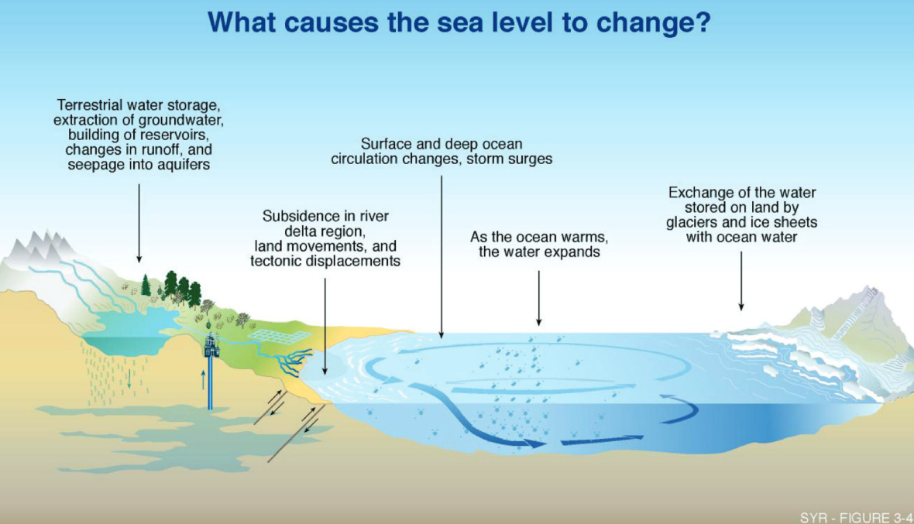
Why Sea Level on the Rise:
Other Contribution
Notes:
KEY MESSAGE:
The Earth cycles water annually between land and ocean, in regional patterns of precipitation and evaporation, and this cycle also may be accelerating in response to climate change—with more variability, more flooding and more frequent drought.
There are other small contributions to sea level rise. As ice caps melt, the gravitation pull on Earth will change, affecting local sea level in complicated ways. Sea levels may rise in some places, and drop in others.
When people use wells to pump water from underground reservoirs, that water eventually reaches the ocean. Other human impacts can decrease sea level rise, such as building dams and artificial reservoirs to store water.
Human manipulation of this water cycle, including increasingly high levels of groundwater withdrawal, contributes to sea level rise; the water withdrawn is ultimately reclaimed by the sea. And while the contribution is smaller than that of thermal expansion and melting ice, it is not insignificant. None of these are capable of influencing sea level to the same extent as thermal expansion and the melting of large glaciers and ice sheets.
Image Source:
University of Connecticut. http://circa.uconn.edu/sea-level-rise/
Reference
NASA Sea Level Change Portal.
https://sealevel.nasa.gov/understanding-sea-level/causes/drivers-of-change
Ocean Portal. Smithsonian National Museum of Natural History
http://ocean.si.edu/sea-level-rise

Slide 23
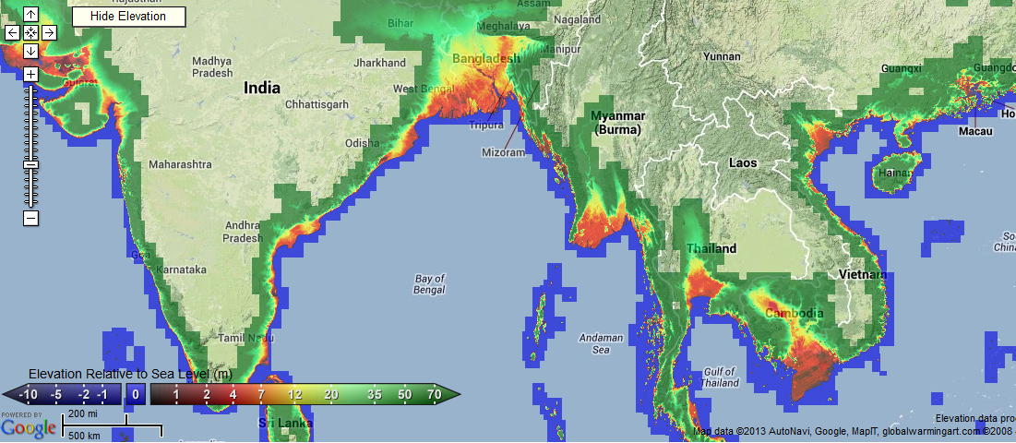
Sea Level Change in Bangladesh & Vietnam
Notes:
KEY MESSAGE:
Many people live on low-lying coastlines. The effect of this has been in the news recently after the tsunami in Asia (26 December 2005), which chiefly affected populations on the low-lying coasts of Asia (although not the area shown in the maps above). Although the occurrence of tsunamis is not related to climate change, the effects may be exacerbated by an increase in sea level rise.
Vietnam would face similar problems with 7 millions of people having to be displaced and the country losing vast areas of the Mekong Delta, home to more than 60% of the country’s seafood and 50% of its rice production. It is self-explaining that this would have not only dramatic social consequences but also immense financial impacts for already economic disadvantaged countries.
Major Issues:
Abundant low-elevation lands, deltas and coastal plains
Very high populations in deltas and low coastal lands
Has especially high regional sea levels in equatorial regions
Low financial resources for adaptation
Image Source:
https://globalvisionremixed.wordpress.com/2013/09/19/throwing-the-first-punch-why-people-like-tony-abbott-should-be-taken-to-an-international-court-and-not-become-prime-minister/

Slide 24
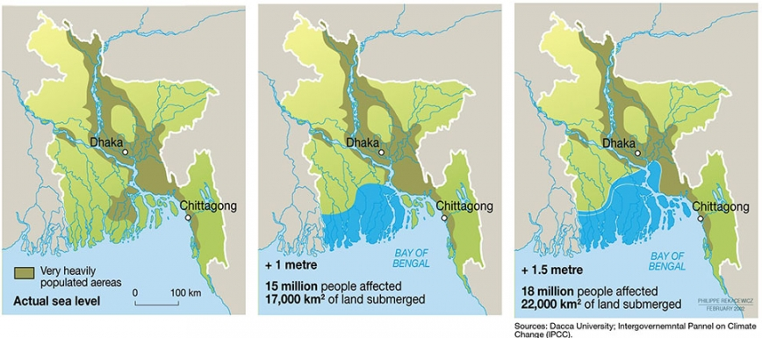
Sea Level Rise in Bangladesh
Notes:
KEY MESSAGE:
A predicted sea level rise of 1m within this century will see millions of people either abandon their homes and being displaced or stay and drown.
In Bangladesh alone, 20% of the country’s surface will likely disappear, forcing a displacement of 15 million people.
Much of coastal Bangladesh is very close to sea level. Thus, sea level rise is expected to cause widespread flooding as climate continues to change. This low-lying area, vulnerable to flooding.
Reference:
Center for Science Education.
http://scied.ucar.edu/sea-level-change-bangladesh

Slide 25
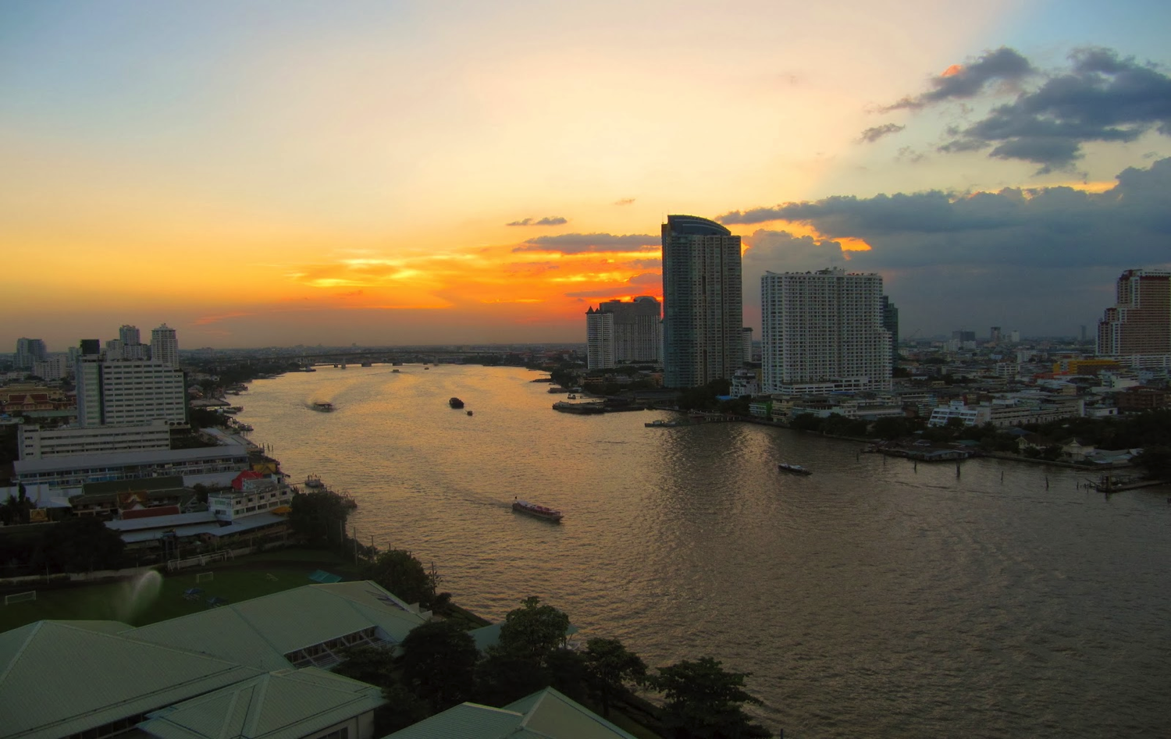
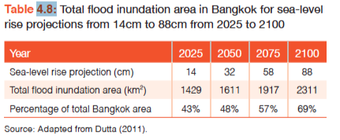
Example of Bangkok, Thailand
Notes:
KEY MESSAGE:
Bangkok is built on the delta of the Chao Praya River and is largely very close to sea level, and therefore highly vulnerable to sea level rise. In addition, much of Bangkok is subsiding, due to groundwater extraction and the weight of built infrastructure, exacerbating sea level elevations.
Flooding of the Chao Praya River, high tides, storm surges, and further land subsidence increases the vulnerable area substantially from the table. The analysis of the area affected by combined and additive events is more difficult to model than simple inundation, but inundation only does not give a sufficient picture…
We must know land movement and the historic frequency of floods, storm surge, and tides to understand what is vulnerable. What will be the flooding reality in Dhaka, and Bangladesh?
Reference:
World Bank: Turn Down the Heat.
http://documents.worldbank.org/curated/en/2013/06/17862361/turn-down-heat-climate-extremes-regional-impacts-case-resilience-full-report
Photo Source:
Courtesy of Dr. Thaworn Onpraphai, University of Chiang Mai, Thailand

Slide 26
Exercise
Discussion or Small Group Questions:
Who is affected by sea level rise?
List the countries and major cities that will be most vulnerable.
Are we prepared for sea level change?
What can we do to better prepare and adapt?

Slide 27
Discussion Questions
What are the major contributors to sea level rise?
Is sea level rising in your local area? What is the rate of change?
Is sea level rise consistent around the globe?
What factors help determine sea level in a local area, on any particular coastline?
How much has sea level risen since you were born? Since your parents were born? Their parents? (hint, the change is significant and tells us something about what SLR can do in a short time. )

Slide 28
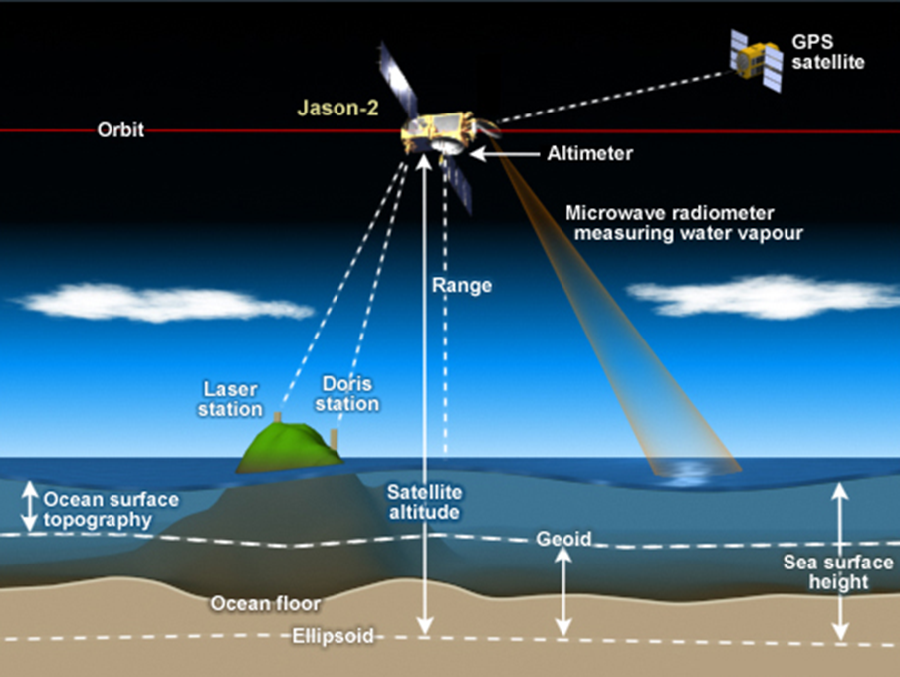
Measuring Global Sea Level
Notes:
KEY MESSAGE:
To understand sea level change, researchers compare multiple global datasets taken over several decades. They use various tools, including satellites that measure the topography of the ocean, Earth's gravity field, sea surface temperature, ice sheets, ocean salinity, and more
Global sea level is the height of the ocean's surface averaged throughout the world, and is what is often discussed in the news.
Historically, it has been challenging to measure because the ocean's surface isn't flat; it changes daily or hourly based on winds, tides, and currents. Up until 1993, tide gauges measured global sea level. Tide gauges are usually placed on piers, and they continuously record the height of the water level compared to a stable reference point on land. There are around 2,000 tide gauges around the world run by around 200 countries. Some have been recording sea level data since the 1800s—and a few for even longer.
But thanks to satellites, scientists have gotten a better handle on global sea level and how it has changed over time. Satellites take much more comprehensive measurements.
Image:
Ocean Portal. Smithsonian National Museum of Natural History
http://ocean.si.edu/sea-level-rise
References:
NASA Sea Level Change Portal
https://sealevel.nasa.gov/understanding-sea-level/causes/drivers-of-change
Ocean Portal. Smithsonian National Museum of Natural History
http://ocean.si.edu/sea-level-rise

Slide 29
Major Local Impacts of Sea Level Rise
Storms and Flooding
Changing Coastlines
Saltwater Intrusion
Subsidence
Tides
Notes:
KEY MESSAGE:
As sea level rises, ocean waves won’t roll onshore and submerge houses and communities all at once like in a summer blockbuster. The first signs of sea level rise will be increased damage from hurricanes and other storms and even high tides. Minor and major flooding will become more frequent. Coastlines will erode and creep backward almost imperceptibly. In fact, all of these impacts are already happening.
Storms and Flooding:
As the waterline creeps up along coasts, storms and flooding will happen more frequently and dramatically. As the waterline creeps up along coasts, storms and flooding will happen more frequently and dramatically.
Think of the ocean as the launching pad for storms and floods: the closer the sea is to human communities, the easier it is for floods to reach homes, roads and towns. Flooding over roads, which is already becoming more common in some places during high tides, can cause traffic jams and block emergency vehicles from reaching flooded areas.
Tides:
Sea level changes near coastlines include tides, a kind of wave caused by the gravitational effects of the sun and moon, along with the Earth’s rotation.
Tidal changes across various time scales, though cyclic, can be superimposed upon the background rise in global sea level; add regional rise driven by ocean circulation, and the highest tides can begin to cause flooding in coastal zones that were previously unaffected, or that experienced such flooding at lower frequencies.
Changing Coastlines:
Sea level rise will reshape coastlines as incoming water floods dry areas and erodes coastal features like beaches, cliffs and dunes. This already occurs during big storms like Hurricanes Katrina and Isaac, and encroaching sea level will cause more drastic changes. As waves reach further inland, they can inundate wetlands and kill the marsh grass that holds the sediment in place. Without grass as an anchor, sediment and mud can be pulled to sea or pushed further inland.
Saltwater marshes are actually quite resilient and capable of moving up and inland when threatened by sea level rise if they are given the space. But many coasts have physical barriers that would impede this adaptation.
Saltwater Intrusion:
Sea level rise is not just a problem of water, it is also a problem of salt. Imagine if salt water flooded a farmer's field, or a coastal forest. Not only does the area have to survive flooding, but also a drenching in salt water that can kill plants and irreversibly alter soil chemistry. Saltwater flooding can mean death for these ecosystems. Already scientists have seen stands of "ghost forests" where once-healthy trees were killed by saltwater flooding, and farmers' fields are being converted to tidal marsh and salt flats.
This isn't just an effect of flooding. Salty ocean water can also flow underground into groundwater reservoirs, which are used for drinking water. It can also flow into the water table below the surface of the land, making the soil too salty for trees and plants to grow. This is called saltwater intrusion. Saltwater intrusion can also affect estuaries and freshwater areas that fisheries and coastal communities rely upon.
Subsidence:
Relative sea level also can rise because the land itself is sinking—visible in extreme form in the California Bay Delta. Some of the islands amid this 2,900-square-kilometer network of water channels and farmland have dropped to eight meters or more below sea level, due mainly to microbial oxidation and soil compaction—the legacy of more than a century of farming. One low-resolution modeling study suggested the additional strain placed on levees as the land surface subsides, coupled with rising sea levels, are sharply increasing the risk of floods resulting from levee failure. These factors contributed to the study’s estimate of a two in three chance of catastrophic flooding in the Delta by 2050, triggered by a 100-year flood or earthquake event.
While subsidence occurs naturally, it can be greatly accelerated by human activity. Groundwater and hydrocarbon extraction, for example, can cause compaction of sediments.
Subsidence related to groundwater withdrawal can be especially pronounced in river deltas with large populations and extensive agriculture, among them
the Bengal Delta of India and Bangladesh
Thailand’s Chao Phraya
China’s Yangtze
the Egyptian Nile.
References:
NASA Sea Level Change Portal
https://sealevel.nasa.gov/understanding-sea-level/causes/drivers-of-change
Ocean Portal. Smithsonian National Museum of Natural History
http://ocean.si.edu/sea-level-rise

Slide 30
Socioeconomic Impacts of Local Sea Level Rise
Loss of property and land
Loss of property value due to increased risk
Loss of agricultural capacities
Impacts on agriculture and aquaculture through decline in soil and water quality
Increased flood risk/loss of life
Damage or loss of coastal protection works and other infrastructure
Loss of renewable and subsistence resources
Loss of tourism, recreation, and coastal habitats
Notes:
KEY MESSAGE:
Increased loss of property and coastal habitats: Relocation of affected populations locally and globally, associated political, economical, institutional, and cultural stress of both the displaced population and the host countries.
Increased flood risk and potential loss of life: Direct threats to human life, inundation, storm surges
Damage to coastal protection works and other infrastructure: Decline in land and housing property values. Threats to major infrastructure (including strategic harbors, coastal roads, railways). Threats to major coastal industry and services (including oil/petrochemical plants, pipelines).
Loss of renewable and subsistence resources, including timber, livestock forage, recreation, water, and wildlife and fisheries
Loss of tourism, recreation, and transportation functions (ports, roads, railways).
Impacts on agriculture and aquaculture through decline in soil and water quality: Threats to food production capacity, including decline in irrigation water quality, decline in coastal crop yields, and degradation/disappearance of crucial ecosystems such as mangroves, coral reefs, and coastal lagoons which act worldwide as fish and shellfish nurseries.
Secondary impacts of accelerated sea level rise:
Impacts on livelihoods and human health.
Decline in health/living standards as a result of decline in drinking water quality, threat to housing quality, associated increasing health hazards linked to relocation, and spreading of disease vectors.
Impacts on infrastructure and economic activity:
Diversion of resources to adaptation responses to sea level rise impacts.
Increasing protection costs, which may not be affordable to certain developing countries unless substantial aid is obtained.
Increasing insurance premiums.
Political and institutional instability, and social unrest.
Threats to particular cultures and ways of life (e.g., in specific environments such as atolls where retreat to higher inland areas is not feasible).
Reference:
UNFCCC
https://unfccc.int/files/national_reports/non-annex_i_natcom/cge/application/vnd.ms-powerpoint/coastal_zones.pps

Slide 31
Ecosystem Loss
Inundation and displacement of wetlands
  e.g., mangroves, saltmarsh, intertidal areas
Areas provide
  Flood protection
  Nursery areas for fisheries
  Important for nature conservation
Loss of valuable resources, tourism
Notes:
KEY MESSAGE:
The third of the vulnerability assessment areas, ecosystem loss, involves an analysis of the inundation and displacement of wetlands such as mangroves and saltmarshes. It does not consider coral reefs.
Wetland areas are important because they provide flood protection; they also are important nursery areas for juvenile fish and often fish species that are important for fisheries and therefore for the local economy. Wetlands are important for nature conservation because of the diversity of species present. The loss of wetland area can result in a loss of valuable resources, including the possible use of the area for tourism.
Reference:
UNFCCC
https://unfccc.int/files/national_reports/non-annex_i_natcom/cge/application/vnd.ms-powerpoint/coastal_zones.pps

Slide 32

Coastal Squeeze
Sea Level Rise
(a) no hard defenses
(b) hard defenses
Notes:
KEY MESSAGE:
The presence of hard coastal defences causes coastal squeeze of wetlands such as mangroves and saltmarsh.
As sea level rises, the habitat should accrete vertically and migrate landward
(a); if hard defences are present
(b) this is not possible and the habitat will become smaller over time and eventually not viable.
Reference:
UNFCCC
https://unfccc.int/files/national_reports/non-annex_i_natcom/cge/application/vnd.ms-powerpoint/coastal_zones.pps
NOAA - National Oceanic and Atmospheric Administration
http://oceanservice.noaa.gov/hazards/natural-hazards/

Slide 33
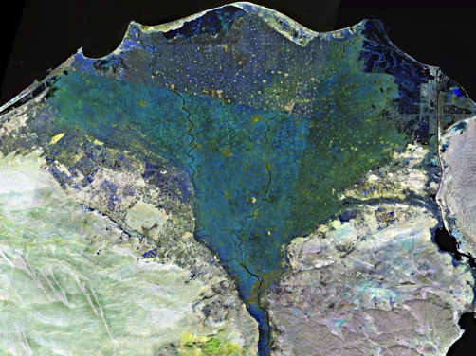
Vulnerable Coastal Physical System Types
Deltas/estuaries (especially populated mega-deltas)
Coral reefs (especially atolls)
Ice-dominated coasts
Low-lying coastal wetlands
Small islands
Sand and gravel beaches
Soft rock cliffs
NASA satellite photograph of the Nile River Delta
Notes:
Reference:
UNFCCC
https://unfccc.int/files/national_reports/non-annex_i_natcom/cge/application/vnd.ms-powerpoint/coastal_zones.pps
NOAA - National Oceanic and Atmospheric Administration
http://oceanservice.noaa.gov/hazards/natural-hazards/
Image Souce:
http://en.wikipedia.org/wiki/Nile_Delta

Slide 34
Methods to Assess Impacts of Sea Level Rise
Sea level rise and climate change scenarios
Levels of assessment
  Screening assessment
  Vulnerability assessment
  Erosion
  Flooding
  Coastal wetland loss
  Planning assessment
Notes:
KEY MESSAGE:
The first stage is to develop sea level scenarios, which could involve downscaling of global scenarios to the regional or local level.
This is just an overview of the methods applied but not explicitly discussed here.
It is often best, however, to use a range of sea level rise scenarios.
Reference:
UNFCCC
https://unfccc.int/files/national_reports/non-annex_i_natcom/cge/application/vnd.ms-powerpoint/coastal_zones.pps
NOAA - National Oceanic and Atmospheric Administration
https://coast.noaa.gov/digitalcoast/tools/slr.html

Slide 35
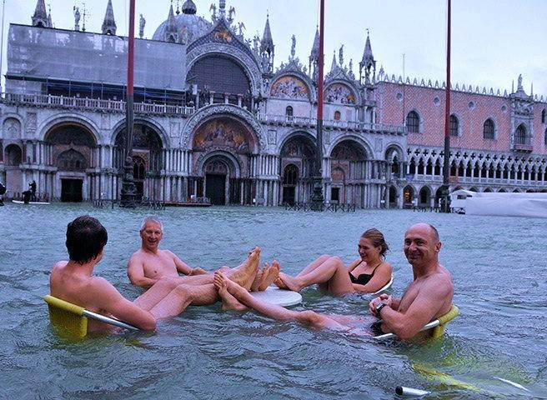
Adaptation and Solutions to Sea Level Rise
What can we do about sea level rise?
Notes:
KEY MESSAGE:
So, what can be done, now, to adapt?
Besides mitigation efforts to reduce greenhouse gas emissions, which is crucial, we have a lot of options.
Image Source:
http://news.nationalgeographic.com/news/2012/11/pictures/121113-venice-floods-italy-world-science-swimming-flooding/

Slide 36
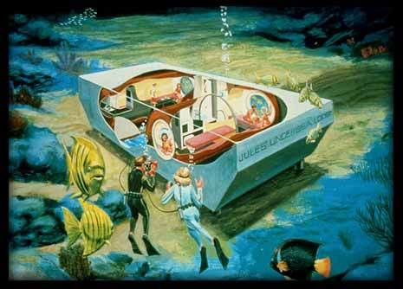
Can we live like this?
Notes:
Image Source:
Jakes Undersea Lodge
http://www.jul.com/

Slide 37
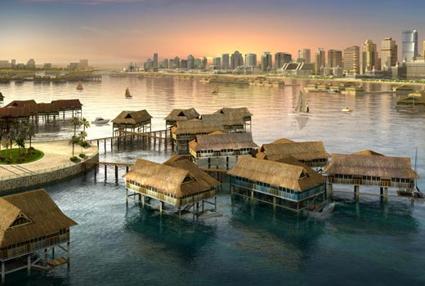
Is This Practical for Many People?
Notes:
Image Source:
http://www.eikongraphia.com/?p=1882

Slide 38
Discussion
What short term measures can be taken to adapt to sea level rise?
- Local, Provincial, National, Regional
What long-term measures can be taken to adapt to sea level rise?
- Local, Provincial, National, Regional

Slide 39
Adaptation: Responding to Coastal Change
Retreat
Accommodation
Protect
  Soft
  Hard
Notes:
KEY MESSAGE:
Each of these strategies are designed to protect human use of the coastal zone and, if applied appropriately, they each have different consequences for coastal ecosystems. Retreat and accommodation avoid coastal squeeze because onshore migration of coastal ecosystems is not hindered.
In contrast, protection will lead to a coastal squeeze, although this can be minimized using soft approaches to defense, such as beach nourishment.
Accommodate and retreat are best implemented proactively, whereas protect can be either reactive or proactive.
There are a variety of methods of adaptation within the three IPCC categories of retreat, accommodation, and protect.
Reference:
UNFCCC
https://unfccc.int/files/national_reports/non-annex_i_natcom/cge/application/vnd.ms-powerpoint/coastal_zones.pps
Nicholls and Klein, 2005. Klein, Richard JT, and Robert J. Nicholls. "Assessment of coastal vulnerability to climate change." Ambio (1999): 182-187.

Slide 40
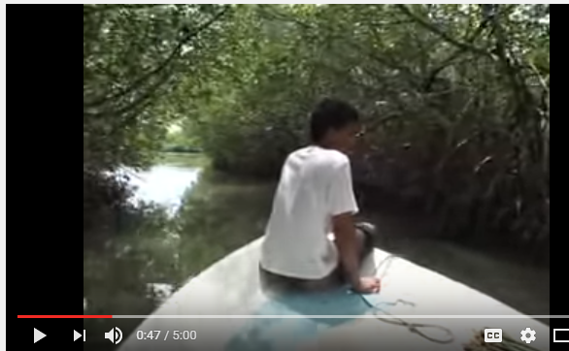
Video for Discussion
Watch the video
Question for Discussion:
How are mangrove forests helpful in reducing the impacts of climate change/ sea level rise?
http://www.youtube.com/watch?v=G3KCThs4XQU
Notes:
Video:
http://www.youtube.com/watch?v=G3KCThs4XQU

Slide 41
Exercise
For your interest area:
How much land would be needed to substitute for land that becomes unsuitable for residential, industrial, and agricultural uses?
Where might this land be found? Estimate the costs of relocating land uses.

Slide 42
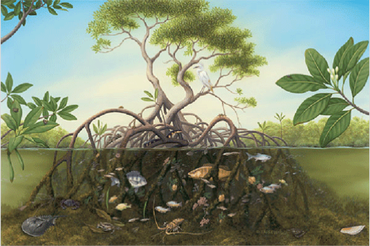
Mangroves and Wetlands: Impacts and Solutions
Notes:
KEY MESSAGE:
Mangroves are crucial and important components of many coastal ecosystems.
They provide some protection against sea level rise, and their habitats will be strongly influences by sea level rise.
Mangrove forest structure is highly variable. Frequency and duration of tidal inundation, wave action, and freshwater inputs can influence environmental factors that determine which species will dominate.
Image:
http://www.naturefoundationsxm.org/education/mangroves/red_mangrove.htm

Slide 43
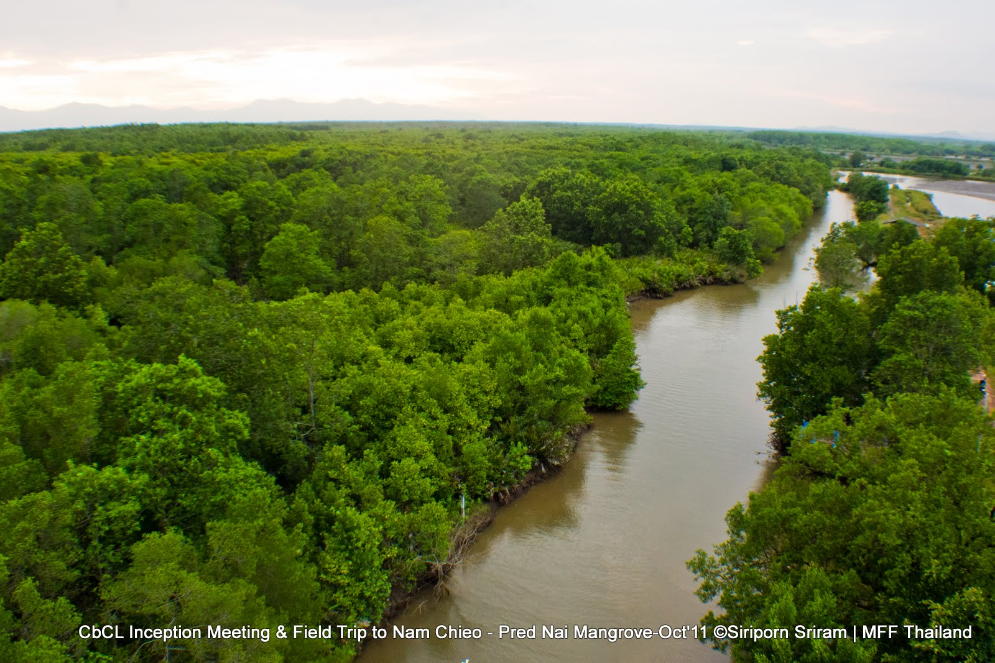
Mangrove Swamp
Notes:
KEY MESSAGE:
In tropical and subtropical regions the major wetland at risk from coastal flooding is the mangrove. It is an easily recognized habitat found on coastlines and in brackish estuaries and deltas, and is made up of evergreen shrubs and trees growing on tidal mud and sand flats. The plant community is known as a mangal or mangrove and is typically a forest with a dense canopy. Although they occur along approximately 2/3 of all saline tropical coastlines, mangroves are a very linear feature and as such as are fairly vulnerable.
These areas are highly productive and should be valued as very important as nursery grounds for fish and molluscs. They also serve as excellent sediment sinks and protect the coastline from waves.
The ability of mangroves to adapt to rising sea level will depend on their ability to move inland or to accrete vertically. Like other coastal wetlands, mangroves can move inland only if there is land available, but the land area behind mangroves is commonly the most developed area in the tropics.
Photo Source:
Mangrove for the Future (MFF) Thailand
http://www.mangrovesforthefuture.org/
Reference:
The Nature Conservancy
http://www.nature.org/media/oceansandcoasts/mangroves-for-coastal-defence.pdf

Slide 44
Coastal Habitats: Roles
Mangroves
Seagrasses
Notes:
KEY MESSAGE:
Mangroves and sea grasses such as eelgrass have a variety of roles on coastal environments. Each type of habitat has very specific conditions. If those conditions change, they the habitat will change or disappear.
Mangroves, seagrasses and intertidal flats provide nursery and feeding areas for coastal fish and shellfish.
Vegetation near the shore protects land features from erosion.
Targeted invertebrates reside permanently in seagrasses (e.g. sea cucumbers and molluscs)
Maintaining these habitats is critical for coastal fisheries
Image Source:
http://www.spc.int/climate-change/fisheries/assessment/e-book/files/assets/seo/page319.html
Reference and Image:
Bell JD, Johnson JE and Hobday AJ (eds) (2011) Vulnerability of Tropical Pacific Fisheries and Aquaculture to Climate Change. Secretariat of the Pacific Community, Noumea, New Caledonia.
http://www.spc.int/climate-change/fisheries/assessment/e-book/index.html#/3/zoomed

Slide 45
Exercise
Get a map of the sundarban mangrove forest.
How might the sundarban mangrove forests be affected by 0.5m of SLR? By 1-2m of SLR
Can the sundarban forests mitigate SLR and reduce the adverse impacts to humans (men and women)and ecosystems?

Slide 46
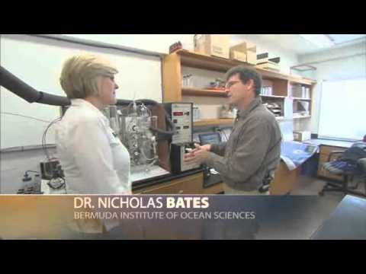
Video: Ocean Temperatures -- Changing Planet NSF
Observations document that the Earth's ocean is warming.
As the ocean warms, it will also expand in volume, causing sea level to rise. This rise is in addition to the sea level rise that results from water added from melting ice and snow on the land.
Today, there are large human populations living in coastal areas worldwide that will be affected by rising sea level.
~ 6 minutes
Notes:
Video link:
Ocean Temperatures -- Changing Planet. National Science Foundation.
http://www.youtube.com/watch?v=0WyD2aiqP_s

Slide 47
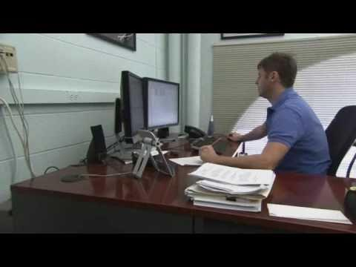
Video: Rising Sea Levels -- Changing Planet NSF
In the past century, as the climate has warmed, sea level rise has accelerated.
Scientists predict it will only increase, and they're studying changes in the ocean and land to better understand how and why the water is rising.
~ 5 minutes
~ 6 minutes
Notes:
Video link:
Rising Sea Levels -- Changing Planet. National Science Foundation.
https://www.youtube.com/watch?v=GHbkmGljo_M

Slide 48
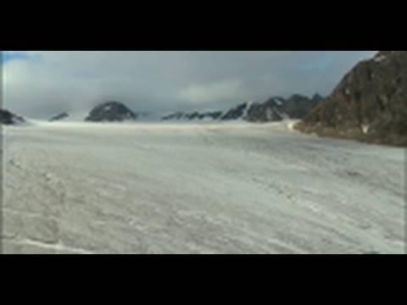
Video: Melting Ice, Rising Seas (NASA Earth Science Week)
One of the bellwether species on the impact of climate change to our environment is the butterfly.
Scientists say that warmer temperatures are affecting where butterflies live and breed, causing some species to migrate toward cooler climates near the earth's poles.
~ 6 minutes
Notes:
Video Link:
NASA Earth Science Week: Melting Ice, Rising Seas. NASA Goddard.
https://www.youtube.com/watch?v=VEuEqgdJXHg

Slide 49
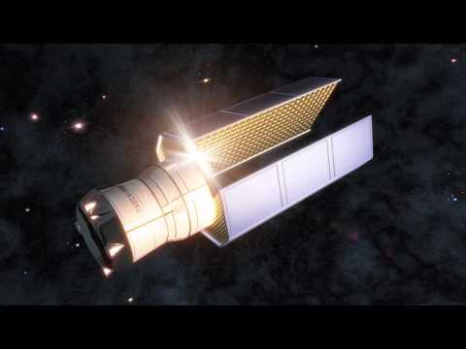
Video: How Do We Know: Greenland's Melting Ice Sheet
Greenland is covered in so much ice that if it all melted, it would raise sea level around the world by 23 feet.
While it's not all melting, scientists say that climate change is turning a lot of that ice to water.
But, how do we know?
~ 1 minute
Notes:
Video link:
How Do We Know: Greenland's Melting Ice Sheet. National Science Foundation.
https://www.youtube.com/watch?v=XNjIjnFaqgQ

Slide 50

Video: Arctic Glacier Collapses
Steve Leonard and Arctic expert Jason Roberts looking for Polar bears.
Glacier calving too close for comfort.
From the program Incredible Journeys BBC.
~ 3 minutes
Notes:
Video Link:
Arctic Glacier Collapses
http://www.youtube.com/watch?NR=1&v=zt8qoggxWVg&feature=endscreen

Slide 51
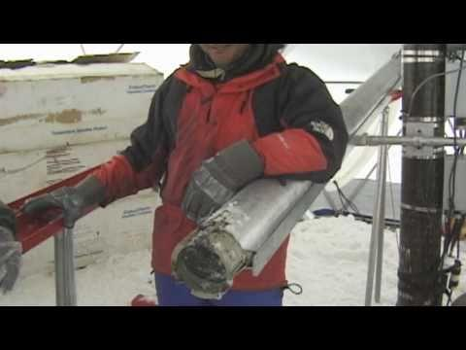
Video: Melting Mountain Glaciers -- Changing Planet
The world's glaciers are shrinking at alarming rates, and many scientists believe it is due to changes in climate.
Dr. Lonnie Thompson of Ohio State University and Dr. Douglas Hardy of UMass-Amherst discuss glaciers and how they melt, and pay special attention to Africa's tallest mountain, Mt. Kilimanjaro.
~ 7 minutes
Notes:
Video Link:
Melting Mountain Glaciers -- Changing Planet. National Science Foundation.
https://www.youtube.com/watch?v=XNjIjnFaqgQ

Slide 52
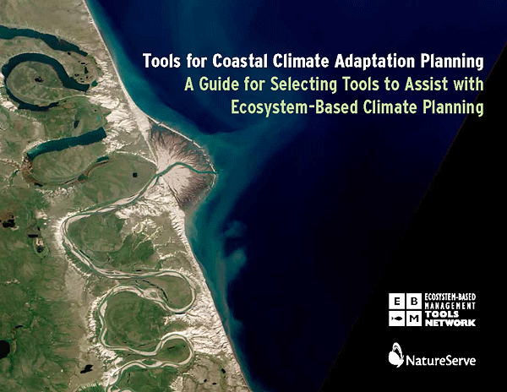
Tools: Coastal Climate Adaptation Planning
Tools for Coastal Climate Adaptation Planning: A guide for selecting tools to assist with ecosystem-based climate planning:
The purpose of this guide is to provide the information necessary for coastal natural resource managers and community planners to select appropriate tools for their projects.
The guide focuses on spatially explicit solutions for climate-related planning.
Notes:
Reference:
Rozum JS and Carr SD. 2013. Tools for Coastal Climate Adaptation Planning: A guide for selecting tools to assist with ecosystem-based climate planning. Arlington, Va.: NatureServe. 48pp.
www.natureserve.org/climatetoolsguide

Slide 53
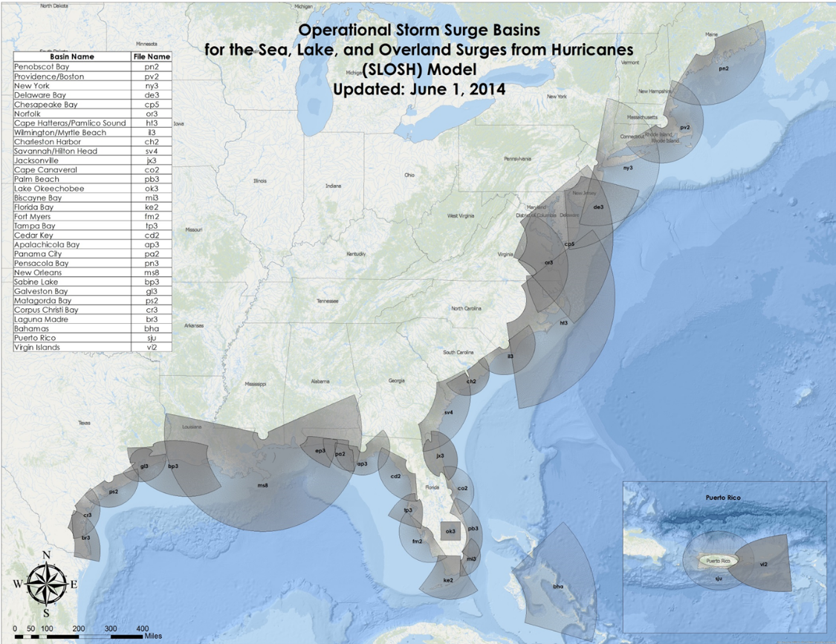
Tools: SLOSH
Sea, Lake, and Overland Surges from Hurricanes (SLOSH) Model
The Sea, Lake and Overland Surges from Hurricanes (SLOSH) model is a computerized numerical model developed by the National Weather Service (NWS) to estimate storm surge heights resulting from historical, hypothetical, or predicted hurricanes by taking into account the atmospheric pressure, size, forward speed, and track data. These parameters are used to create a model of the wind field which drives the storm surge.
The SLOSH model consists of a set of physics equations which are applied to a specific locale's shoreline, incorporating the unique bay and river configurations, water depths, bridges, roads, levees and other physical features.
Notes:
Reference:
NOAA. Sea, Lake, and Overland Surges from Hurricanes (SLOSH)
http://www.nhc.noaa.gov/surge/slosh.php

Slide 54
Sample Test Questions
1. Climate scientists and oceanographers expect that in the next 100 years rapid global warming is likely to cause global sea levels to:
Decrease at least 100 cm
Stay the same
Increase by between ~25 and 200 cm
2. Global sea level since the last ice age ended 20,000 years ago:
Has risen rapidly in the last 10,000 years
Has been mostly stable, with small increases only
Rose rapidly, but leveled off about 7,000 years ago
Is too difficult to discern beyond about 500 years ago
3. What are the two main factors that influence the global sea level rise?
4. What kinds of landscapes are the most vulnerable to sea level rise
Coastal mountains
Deltas, estuaries, and other low-lying coastal depositional features
Coastal sandy beaches and barrier islands
Inland seas
5. What are the biggest sources of uncertainty about how much SLR will occur in the next 100 years?
Difficulty in modeling climate
Unknown emissions totals
Changes in ocean salinity are imprecise
Response of continental ice sheets to climate warming
6. Describe 3 adaptation measures of sea level rise in populated areas

Slide 55
TAKE HOME MASSAGE
Sea level rise could be a serious problem, but the uncertainties are large
Impacts are strongly influenced by human choice. Rising sea level is a threat to people who live near the ocean
Reducing GHG emissions reduces but does not avoid sea level rise impacts
Some low-lying areas will have more frequent flooding, and very low-lying land could be submerged completely
Rising sea level can also harm important coastal ecosystems like mangrove forests and coral reefs
Preparing to adapt would seem prudent, in the context of multiple stresses and managing existing problems

Slide 56
References and Resources
IPCC AR5. Chapter 13
http://www.ipcc.ch/report/ar5/wg1/
Dong-Jiing et al. Sea Level Rise at East Asia Coasts based on Tide Gauge Analysis
http://www.comc.ncku.edu.tw/chinese/h_paper/%E6%9C%9F%E5%88%8A%E8%AB%96%E6%96%87%E6%AA%94%E6%A1%882012/98%E5%B9%B4%E5%BA%A6%20Sea%20Level%20Rise%20at%20East%20Asia%20Coasts%20based%20on%20Tide%20Gauge%20Analysis.pdf
World Bank. Turn Down the Heat 2012
http://documents.worldbank.org/curated/en/865571468149107611/pdf/NonAsciiFileName0.pdf
Climate Central
http://www.climatecentral.org/news/nations-megacities-face-20-feet-of-sea-level-rise-19217
Washington Post
https://www.washingtonpost.com/news/wonk/wp/2013/08/20/these-20-cities-have-the-most-to-lose-from-rising-sea-levels/
Sustainable Collective
http://www.sustainablecitiescollective.com/david-thorpe/1038231/revealed-greatest-global-business-and-societal-opportunities-sustainability
NASA Sea Level Change Portal
https://sealevel.nasa.gov/understanding-sea-level/causes/overview
NOAA - National Oceanic and Atmospheric Administration
http://www.esrl.noaa.gov/gmd/ccgg/trends/full.html

Slide 57
References and Resources
Ocean Portal. Smithsonian National Museum of Natural History
http://ocean.si.edu/sea-level-rise
Center for Science Education
http://scied.ucar.edu/sea-level-change-bangladesh
UNFCCC
https://unfccc.int/files/national_reports/non-annex_i_natcom/cge/application/vnd.ms-powerpoint/coastal_zones.pps
Bell JD, Johnson JE and Hobday AJ (eds) (2011) Vulnerability of Tropical Pacific Fisheries and Aquaculture to Climate Change. Secretariat of the Pacific Community, Noumea, New Caledonia.
http://www.spc.int/climate-change/fisheries/assessment/e-book/index.html#/3/zoomed

Slide 58
References and Resources
The curriculum of USAID’s Climate-Resilient Ecosystems and Livelihoods (CREL) in Bangladesh is a free resource of teaching materials for university professors, teachers and climate change training experts.
Reproduction of CREL’s curriculum materials for educational or other non-commercial purposes is authorized without prior written permission from the copyright holder, provided the source is fully acknowledged.
Suggested citation: USAID. 2016. Bangladesh Climate-Resilient Ecosystem Curriculum (BACUM). USAID‘s Climate-Resilient Ecosystems and Livelihoods (CREL) Project. Winrock International. Dhaka, Bangladesh.
Disclaimer: The CREL’s curriculum is made possible by the support of the American People through the United States Agency for International Development (USAID). The contents of the curriculum do not necessarily reflect the views of USAID or the US Government.

Slide 59
USAID's Climate-Resilient Ecosystems and Livelihoods (CREL) Project
Winrock International
House 13/B, Road 54, Gulshan 2, Dhaka 1212
Bangladesh
Tel: +880-2-9848401 www.winrock.org

