Slide 1
Bangladesh Climate-Resilient Ecosystems Curriculum (BACUM)
Module 1: Introduction to Climate Change

Slide 2
Module 1: Introduction to Climate Change
SECTION I: HOW AND WHY THE CLIMATE IS CHANNGING
1.1. Introduction to Climate Science and Climate Change

Slide 3
Introduction to Climate Change (ICC)
HOW AND WHY THE CLIMATE IS CHANGING
1.1. Introduction to Climate Science and Climate Change
1.2. Causes of Climate Change
1.3. Climate Intensification: Floods, Droughts and Cyclones
IMPACTS OF CLIMATE CHANGE ON PEOPLE AND THE ENVIRONMENT
2.1. Introduction to Climate Change Impacts
2.2. Sea Level Rise
2.3. Climate Change and Water Resources
2.4. Climate Change and Food Security
2.5. Climate Change and Human Health
2.6. Climate Change and Terrestrial Ecosystems
REPONSES AND ADAPTATION TO CLIMATE CHANGE
3.1. Climate Change and Forest Management
3.2. Climate Change and Water Resources: Responses and Adaptation
3.3. Principles and Practice of Climate Vulnerability Assessment
3.4. Uncertainties in Climate Change
3.5. Climate Change and Ecosystem Services
3.6. Effective Communications in Climate Change

Slide 4
Acknowledgements
EXPERT CONTRIBUTORS | SPECIFIC INPUTS
Prof. (Dr.) Manzoor Rashid | Curriculum Development for all topics
Prof. (Dr.) Md. Danesh Miah | REDD+, Forest Carbon
Prof. (Dr.) Md. Jakariya | Community NR Management, Climate Change, Natural Resources Management
UNIVERSITIES
Bangladesh Agricultural University
University of Chittagong
Dhaka University
Independent University, Bangladesh
Khulna University
Noakhali University of Science and Technology
Shahjalal University of Science and Technology
Sher-e-Bangla Agriculture University
North South University
CREL STAFF | CREL STAFF
John A Dorr | Utpal Dutta
Abu Mostafa Kamal Uddin | Ruhul Mohaiman Chowdhury
Kevin T. Kamp | Rahima Khatun
Paul Thompson | Sultana Razia Zummi
Abdul Wahab | Shams Uddin
Shahzia Mohsin Khan
DESIGN, LAYOUT AND CONTENT DEVELOPMENT: Ms. Chi Pham, Curriculum Development Expert, Bangkok, Thailand

Slide 5
Learning Objectives
At the end of this session, students will be able to:
Distinguish climate from weather
Describe the components of the climate system
Explain how the components have changed
Explain the difference between climate variability and climate change

Slide 6
Exercise: What Do You Know?
List the following things about climate science and climate change:
3 Things you know about the topic
2 things you want to learn
1 question you want to ask
Pair yourself to the one sitting on your right hand side and discuss your answers.
Notes:
Warming Up of the session
Ask student to work individually on the given questions.
Give student 3-5 minutes to think of these questions.

Slide 7
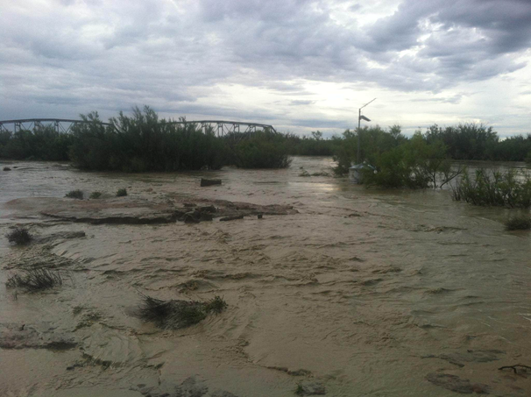
Why Study Climate?
Determines the type and location of human-managed ecosystems, such as agricultural farmlands.
Affects the weathering of rock, the type of soil that forms,
and the rate of soil formation.
Affects people and society
Helps to determine the quantity and quality of water available for
human use.
Determines the severity of droughts, storms, and floods.
Largely determines the nature and locations of biomes -major terrestrial ecosystems, defined based on their plant communities.
How does climate affect Bangladesh?
Notes:
KEY MESSAGES:
Nearly everything is affected by weather and climate and many of our activities themselves affect the climate, through the release of greenhouse gasses (GHG).

Slide 8
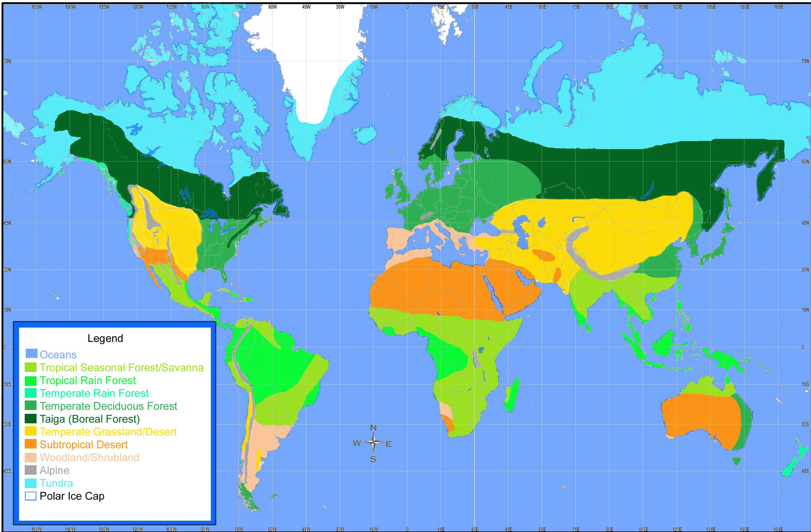
Biomes of the World Depend on Climate
Notes:
KEY MESSAGES:
Biomes are major types of ecological communities. These communities are recognizable on a regional scale, although many other communities may exist there as well. For instance, here in eastern North America where Marietta College is located, our biome is the temperate deciduous forest. At La Selva, in Costa Rica, the biome is the tropical rain forest.
Biomes are formed as a result of the climate present at a site (more on this in a minute). Perhaps you are familiar with the concept of succession, whereby a series of biological communities replace each other over time in a predictable fashion. For instance, in southern Ohio, an abandoned farm field will first be covered with a community of weeds and grasses; organisms whose seeds are small and which can colonize the disturbed habitat quickly. Plants like milkweed, goldenrod, smartweed and joe-pye weed also come early to an abandoned field. Over time, certain shrubs and small tree species (sassafras, hawthorn, aspen, locust, etc.) will begin to take over from the grasses. Following these small trees are the larger ones such as oaks, hickories (and, some time ago, chestnuts). If the site is undisturbed for a very long time - hundreds of years - it may be completely taken over by beech trees. This sequence will occur over and over again in southern Ohio as long as the climate does not change. The end result of succession in southern Ohio is always a temperate deciduous forest, where trees lose their leaves in the cold winters. Down in Costa Rica at La Selva, succession is different, with different plant species making up the communities, and there the end result is a tropical rain forest. In western Costa Rica, the final result of succession is a tropical seasonal forest. In terms of succession, these final communities that develop at a site are called climax communities, and these climax communities form the basis for the biome classification.
Reference: http://www.marietta.edu/~biol/biomes/biomes.htm

Slide 9
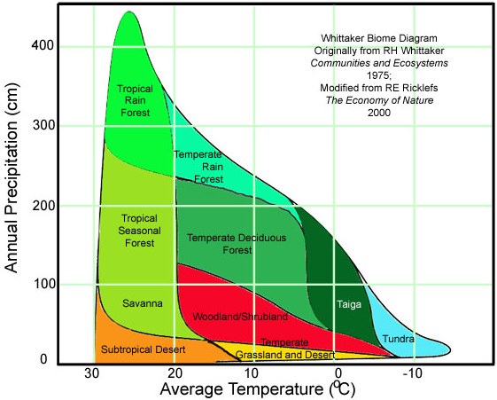
Biomes of the World: A Function of Climate
WHERE IS
BANGLADESH?
Notes:
KEY MESSAGES:
The graph here is just an example to indicate climate determines the distribution of forests in the world.
Taiga (known as boreal forest) is a biome characterised by coniferous forests consisting of mostly of pines, spruces, and larches.
Robert Whittaker, an American ecologist, plotted rainfall vs. temperature for points all over the globe on a single graph (see below). He then looked at what biomes had developed at those sites, and was able to group the different biomes according to mean annual temperature and precipitation, as the shaded areas in the graph below indicate.
Reference:
http://www.marietta.edu/~biol/biomes/biomes.htm
9

Slide 10
Weather vs. Climate
What is Weather?
What is Climate?
Are they the same? How are they related? How can they be confused?
Notes:
KEY MESSAGES:
Prior knowledge inquiry:
Instructor asks students to think what climate and weather are defined and differentiate them
Ask at least 2 students to speak out
Do discussion on Climate vs. Weather

Slide 11
Climate vs. Weather
Weather
The actual state of the atmosphere in a period of several hours up to a few days (in a given place) (Gramelsberger & Feichter, 2011).
Climate
A statistical description in terms of the mean and variability of relevant quantities over a period ranging from months to thousands or millions of years (IPCC).
The classical period is 30 years, which are most often surface variables such as temperature, precipitation, and wind. Climate in a wider sense is the state, including a statistical description, of the climate system (World Meteorological Organization (WMO)).
Notes:
KEY MESSAGES:
Climate is what you expect. Weather is what you get.

Slide 12
Characteristics of Weather and Climate
Temperature
Wind
Clouds
Precipitation
Humidity
Storms (cyclones!)
Notes:
KEY MESSAGES:
Weather can be defined as: “State of the atmosphere with respect to heat or cold, wetness or dryness, calm or storm, clearness or cloudiness. Also, weather is the meteorological day-to-day variations of the atmosphere and their effects on life and human activity. It includes temperature, pressure, humidity, clouds, wind, precipitation and fog.” From: Weather Glossary and Terminology
Enquiry students about characteristic on weather and discuss it thoroughly
Characteristic of weather takes around 5 mins
Reference:
http://www.timeanddate.com/weather/glossary.html

Slide 13
Meteorology – the Study of Weather
The field of atmospheric science which is most well-known and of practical importance to the general public is meteorology, the study of weather.
Meteorology is usually concerned only with the lowest region of the atmosphere, the troposphere.
Weather is influenced not only by vertical, diurnal, and seasonal variations of atmospheric density and temperature, and of solar heating, but also by horizontal variations over Earth’s surface.
Atmospheric winds and circulation are influenced by Earth’s rotation, and by surface conditions (i.e. whether land or sea, topography, and surface temperature).
The advent of weather-monitoring satellites, and of supercomputers, have greatly facilitated the science and application of meteorology in recent years.
Notes:
Notes:
Meteorology is the study of weather. Climatology is the study of climate.
Reference:
https://en.wikipedia.org/wiki/Meteorology

Slide 14
Climatology – The Study of Weather Statistics, Patterns, and Trends
Climatology, the study of climate, differs from meteorology in that climate is the long-term pattern of temperature, precipitation, wind patterns, etc. at a particular location, over periods of a year or more, whereas weather is the current (or very near-term) state of affairs at the location or region of interest.
For example, the climate in Antarctica is quite different from that in the Sahara Desert, or the Amazon river basin.
The latter two are also quite different from each other, despite being at nearly the same latitudes on Earth.
Climate can, however, change over long periods of time, and the topic of climate change is currently of practical importance, because of the known or potential effects of human activity on local, regional, or even world-wide climates.
Notes:
Reference:
https://en.wikipedia.org/wiki/Meteorology

Slide 15
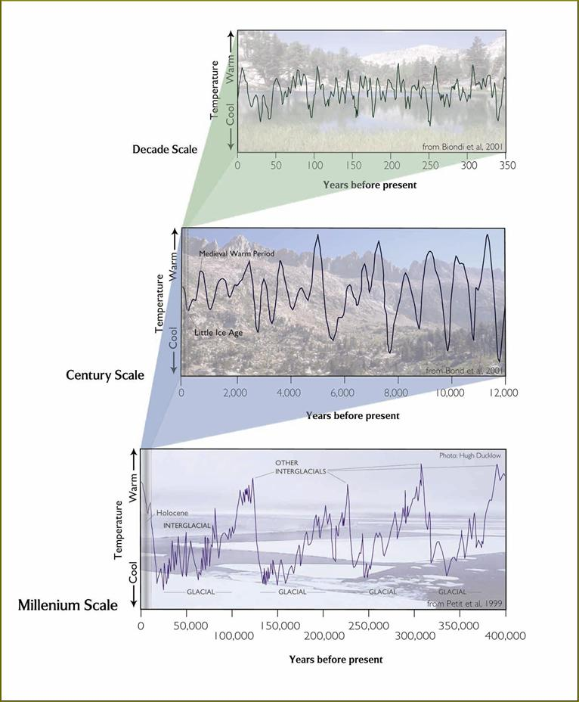
The climate is Always Changing, Always has Changed
1,000,000 year time scales
Plate tectonics
100,000 year time scales
Orbital variations and glacial periods
100-10 year time scales
Events like the Little Ice Age and Medieval Warm Period
10-5 year time scales
El Niño – La Niña cycles
Other short-term cycles due to ocean circulation
Notes:
KEY MESSAGES:
The climate has always been changing and is complex and highly dynamic
Flash animation available for this figure in the References Section of the Gdrive “symphony.swf”
Reference:
C. Millar and MJ Furniss

Slide 16
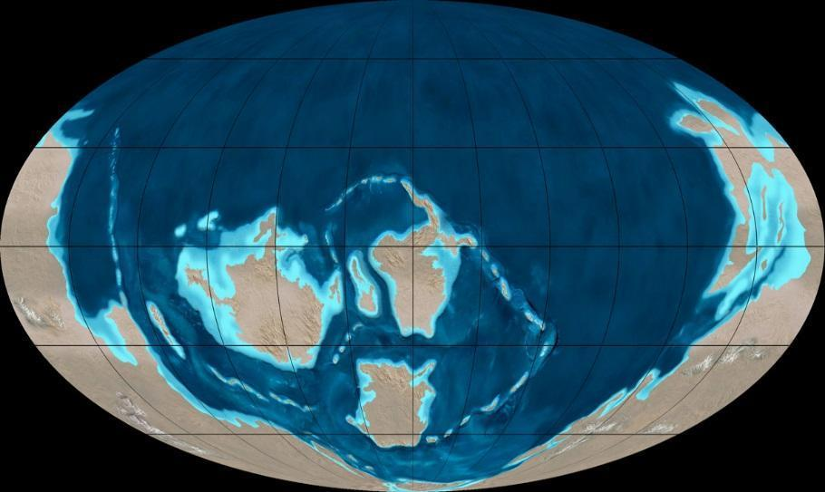
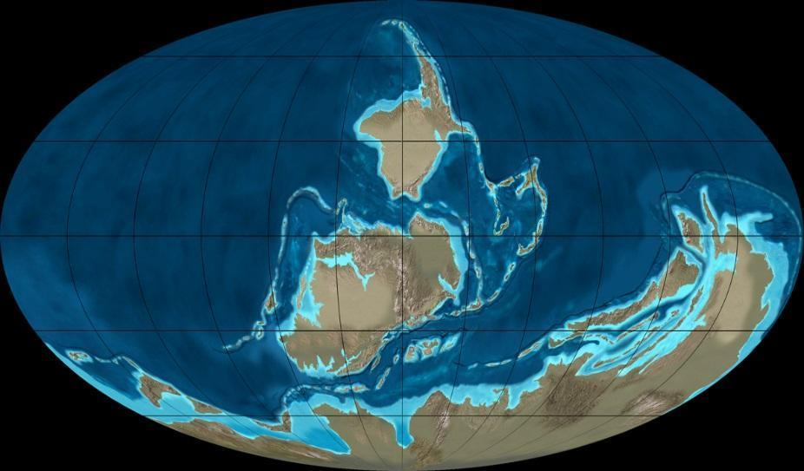
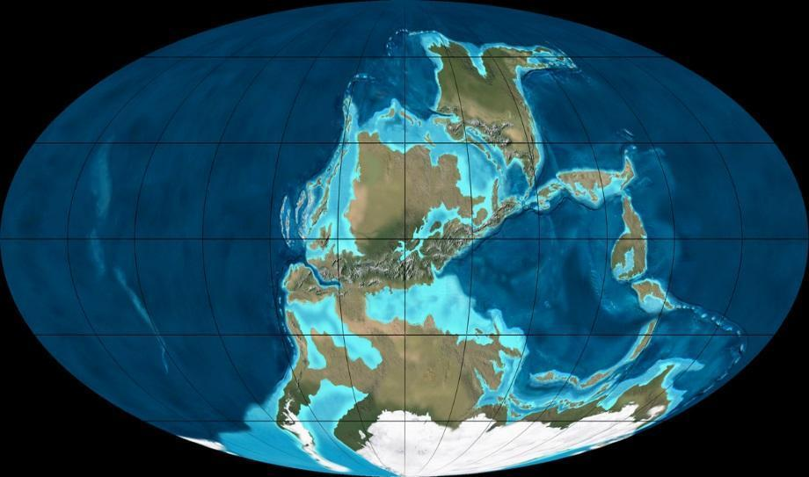
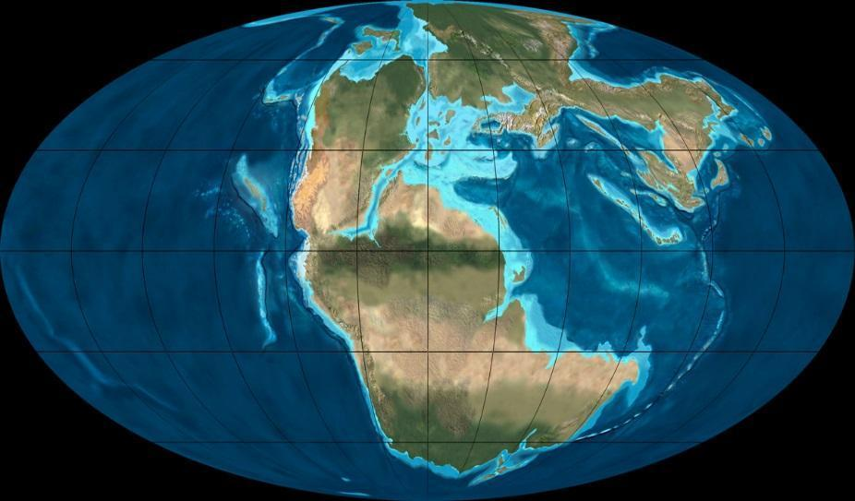
1,000,000 year Time Scales
500 mya
400 mya
300 mya
200 mya
Ice sheets can only grow when continents are at the poles.
Notes:
KEY MESSAGES:
Plate tectonics
Earth's surface is broken up into "lithospheric" plates that slowly move over the top of the mantle.
Movement determines placement on the earth relative to the poles and equator
The shape and size of the continents and ocean basins also affects climate.
When plate tectonic processes lower sea level, exposed limestone or carbonate rocks undergo a weathering process releasing CO₂ into the atmosphere.
Most volcanic eruptions are caused by plate tectonic movement, leading to release aerosols into atmosphere which reduce global insolation and decrease global average temperature.
e.g., Aerosols Mt. Pinatubo eruption in 1991 in the Philippines reduced global insolation by 5% and decreased average global temperature by about 0.5% the following year
Flood basalt eruptions are extremely rare, but strongly potential to climate effects. These propel ash, dust, and aerosols into the atmosphere, block sunlight and cause global cooling. Together, the eruptions release CO₂ leading to global warming.
Reference:
http://commons.wikimedia.org/wiki/File:Blakey_500moll.jpg

Slide 17
Which Diagram is Closest to The Shape of Earth’s Orbit?
A
B
C
Notes:
KEY MESSAGES:
Answer is B. It is not round, only slightly elliptical

Slide 18
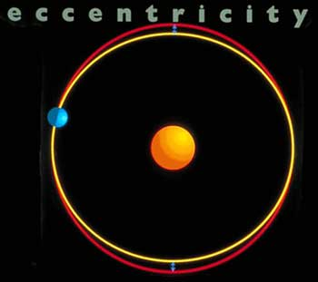
Earth’s Orbit
EARTH
The Earth’s orbit is almost a perfect circle with slight variations every 100,000 and 400,000 years.
Notes:
KEY MESSAGES:
Like all planets in our solar system, the Earth is in an elliptical orbit around our Sun. In Earth's case, its orbit is nearly circular, so that the difference between Earth's farthest point from the Sun and its closest point is very small. Earth's orbit defines a two-dimensional plane which we call the ecliptic. Since the Earth travels around the Sun in an almost perfect circle (the most accurate way to draw the earth's path around the Sun is as a circle), it really doesn't change by much how far away we are from the Sun. (Variations in orbital eccentricity have a small impact on the total amount of radiation received at the top of earth's atmosphere (on the order of 0.1%) Besides, we have summer in North America when it is winter in South America, so something else must cause the seasons.
Reference:
http://www.morehead.unc.edu/Shows/EMS/seasons.htm

Slide 19
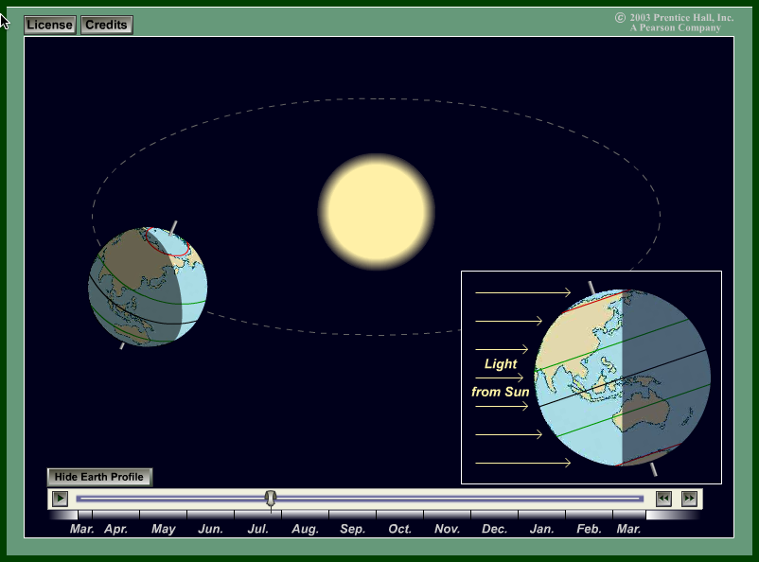
Animation of Earth Orbit
Notes:
KEY MESSAGES:
Explain what the purpose of this video and ask students to note down for discussion after watching
5 mins recap.
Reference:
http://esminfo.prenhall.com/science/geoanimations/animations/01_EarthSun_E2.html

Slide 20
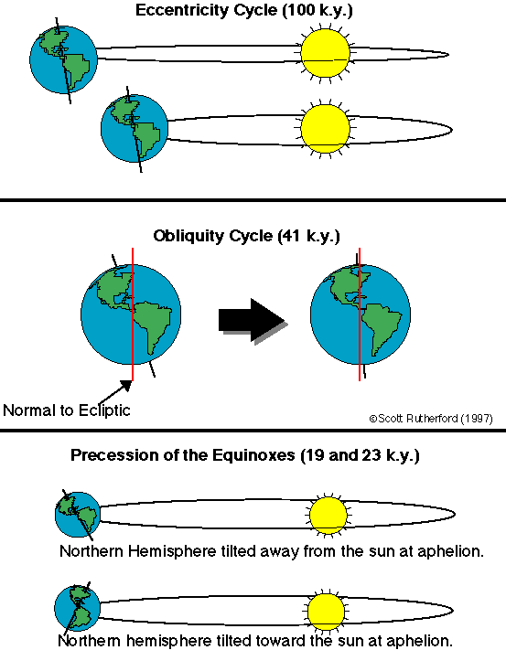
100,000 year Time Scales
Notes:
KEY MESSAGES:
Variations in the Earth’s Position relative to the Sun
Eccentricity - Earth’s orbit around the Sun changing from a more circular route to more elliptical one in a cycle from 90,000 to 100,000 years.
Obliquity is the axial tilt of the Earth rotating around the Sun. This tilt changes the Earth’s seasons throughout the year. It varies between 21.5 and 23.5 degree over a period of about 41,000 years.
Precession – Like a rotating toy top, the direction of the rotation axis executes a slow precession with a period of 26,000 years.
Earth’s axis of rotation now points toward Polaris (the North Star).
Eccentricity : When the orbit is more circular, as it is now, the amount of solar radiation the Earth receives during a year differs by only 6%. When the orbit is at its most elliptical, solar radiation varies by between 20% and 30%. Such a large variation in solar radiation profoundly affects global climate.
Obliquity: The Northern Hemisphere is tilted the most toward the Sun on summer solstice (June 21 or 22), when the Sun’s rays reach the farthest north. The Northern Hemisphere is tilted farthest away from the Sun on winter solstice (December 21 or 22). The smaller the planet’s tilt, the less variation there is between summer and winter in the middle and high latitudes. When winters are milder and summers are cooler in the high latitudes, glaciers are more likely to form.
The Northern Hemisphere’s summer will take place when Earth is closest to the Sun (unlike now) and Northern Hemisphere winter will be when Earth is farthest from the Sun (also unlike now). As a result, winters will be much colder and summers will be much warmer than they are today.
Reference:
http://en.wikipedia.org/wiki/Precession (more information about precession) and
http://deschutes.gso.uri.edu/~rutherfo/milankovitch.html

Slide 21
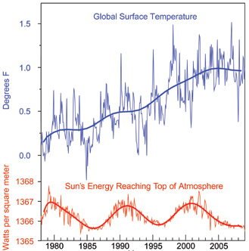
Global Surface Temperature
Notes:
KEY MESSAGES:
Since 1978, a series of satellite instruments have measured the energy output of the sun directly. The satellite data show a very slight drop in solar irradiance (which is a measure of the amount of energy the sun gives off) over this time period. So the sun doesn't appear to be responsible for the warming trend observed over the past 30 years.
Longer-term estimates of solar irradiance have been made using sunspot records and other so-called “proxy indicators,” such as the amount of carbon in tree rings. The most recent analyses of these proxies indicate that solar irradiance changes cannot plausibly account for more than 10 percent of the 20th century’s warming.
Reference:
http://climate.nasa.gov/causes/

Slide 22
Which Graph Best Shows the Overall Change in Output of the Sun’s Energy in the Last 30 Years?
A
B
C
Notes:
KEY MESSAGES:
See next slide for the answer, however, while it does fluctuate there have been no long term observable changes. So “A” is the correct answer.
Indeed, the output of energy from the sun has been monitored by satellites for thirty years and has not increased during this period of rapid global warming.

Slide 23
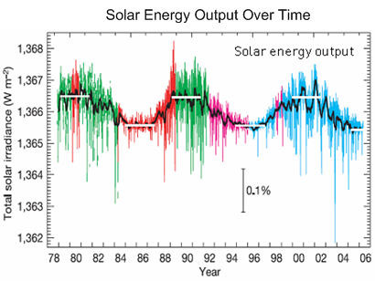
Solar Energy Output Over Time
Notes:
Reference:
Foukal et al. 2006. Variations in solar luminosity and their effect on the Earth's climate. Nature 443: 161-166.

Slide 24
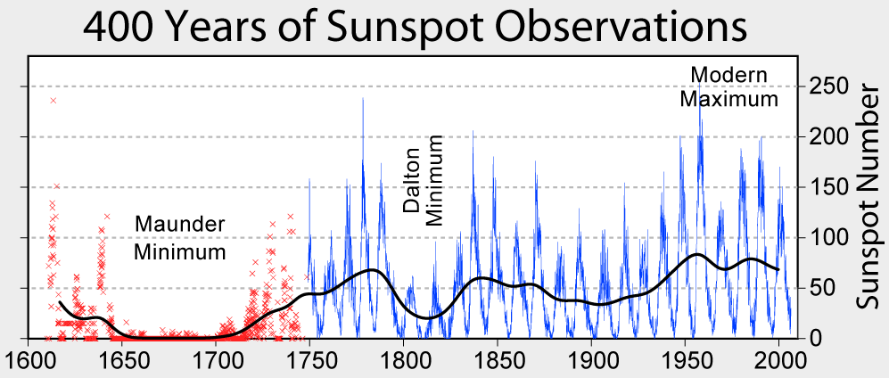
100-10 year Time Scales
Notes:
KEY MESSAGES:
Solar cycles (sunspot cycles) explain a significant amount of the climate change we see on shorter timescales.
Variations in solar radiation is in small number but it also influences the climate. Solar cycles (sunspot cycles) explain a significant amount of the climate change we see on shorter timescales.
Sunspot is caused by magnetic storm that appear as dark, relatively cool regions on the Sun’s surface.
Sunspots are temporary phenomena on the photosphere of the Sun that appear visibly as dark spots compared to surrounding regions. They are caused by intense magnetic activity, which inhibits convection by an effect comparable to the eddy current brake, forming areas of reduced surface temperature. They usually appear as pairs, with each sunspot having the opposite magnetic pole to the other.
Although they are at temperatures of roughly 2700–4200 °C, the contrast with the surrounding material at about 5,500 °C leaves them clearly visible as dark spots, as the luminous intensity of a heated black body (closely approximated by the photosphere) is a function of temperature to the fourth power. If the sunspot were isolated from the surrounding photosphere it would be brighter than the Moon. Sunspots expand and contract as they move across the surface of the Sun and can be as small as 16 kilometers and as large as 160,000 kilometers in diameter, making the larger ones visible from Earth without the aid of a telescope. They may also travel at relative speeds ("proper motions") of a few hundred meters per second when they first emerge onto the solar photosphere.
Reference:
Sunspot information: http://solarscience.msfc.nasa.gov/SunspotCycle.shtml
http://en.wikipedia.org/wiki/Solar_variation
http://en.wikipedia.org/wiki/Sunspot

Slide 25
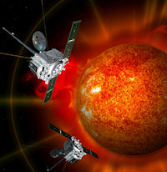
Energy from the sun
The output of energy from the sun has been monitored by satellites for thirty years and has not increased during this period of rapid global warming.
Notes:
KEY MESSAGES:
While natural variability does play an important role in climate change, the data does not support the sun’s output being the major contributor to the present warming scenario.
The 2009 NOAA State of the Climate report draws on data for 10 key climate indicators that all point to the same finding: the scientific evidence that our world is warming is unmistakable. More than 300 scientists from 160 research groups in 48 countries contributed to the report, which confirms that the past decade was the warmest on record and that the Earth has been growing warmer over the last 50 years human activity is the primary driver of the current warming.
Reference:
http://science.nasa.gov/science-news/science-at-nasa/2011/06feb_fullsun/

Slide 26
Characteristics of Climate
Climate is affected by a combination of factors from three different systems:
Solar System
Earth System
Earth’s Dynamics (how planet earth is changing at a macro scale)
Notes:
KEY MESSAGES:
- Ask students about their thoughts on this topics

Slide 27
Solar System
The earth’s solar system (our sun and the associated planets, etc.) have an impact on the Earth’s System composed of five components:
Atmosphere (all air)
Hydrosphere (all water)
Biosphere (all living things)
Geosphere (solid portion of the earth)
Cryosphere (frozen water part of the earth)
Notes:
KEY MESSAGES:
Introduce the radiative forcing on earth, with 5-component interaction (1. Atmosphere, 2. Hydrosphere, 3. Biosphere, 4. Geosphere, 5. Cryosphere) of the Earth system.

Slide 28
Earth System (Interaction)
Atmosphere (all air)
Hydrosphere (all water)
Biosphere (all living things)
Geosphere (solid portion of the earth)
Cryosphere (frozen water part of the earth)
Air
Ice
Water
Land
Life
Notes:
KEY MESSAGES:
Ask students to interpret this picture, specifically how all systems are connected and ask students to give examples how they are connected.
Reference: http://www.oercommons.org/courses/earth-system-science-lab-5-it-s-all-connected-global-circulation

Slide 29
Climate System
Notes:
KEY MESSAGES:
Give more detailed description of this picture or ask students to discuss what is happening.
Changes in Sun’s strength or UV strength: a) Latitude; b) Time of day; c) Ozone levels; d) Reflection (water and snow); e) Altitude; and f) clear skies and clouds
Changes in Earth’s orbit: changing the incoming solar radiation;
Changes in a plate tectonics: changing greenhouse gas concentrations
The Earth's climate system is a compilation of the following components and their interactions-
1. The atmosphere
2. The hydrosphere, including the oceans and all other reservoirs of water in liquid form, which are the main source of moisture for precipitation and which exchange gases, such as CO2, and particles, such as salt, with the atmosphere. 3. The geosphere, which affect the flow of atmosphere and oceans through their morphology (i.e. topography, vegetation cover and roughness), the hydrological cycle (i.e. their ability to store water) and their radiative properties as matter (solids, liquids, and gases) blown by the winds or ejected from earth's interior in volcanic eruptions. 4. The cryosphere, or the ice component of the climate system, whether on land or at the ocean's surface, that plays a special role in the Earth radiation balance and in determining the properties of the deep ocean. 5. The biosphere - all forms of life - that through respiration and other chemical interactions affects the composition and physical properties air and water. The biosphere is that part of Earth's atmosphere, land, oceans that supports any living plant, animal, or organism. It is the place where plants and animals, including humans, live. Large quantities of carbon dioxide are exchanged between the land-based biosphere and the atmosphere as plants take in carbon dioxide and give off oxygen, and animals inhale oxygen and exhale carbon dioxide.
Describe the slide carefully and discuss the cause, climate system and climate variations based on the note above.
This takes around 5-10 mins
Reference:
http://www.earthlyissues.com/climatesystem.htm
Image Source:
http://www.ncdc.noaa.gov/paleo/ctl/images/figure01_05.gif

Slide 30
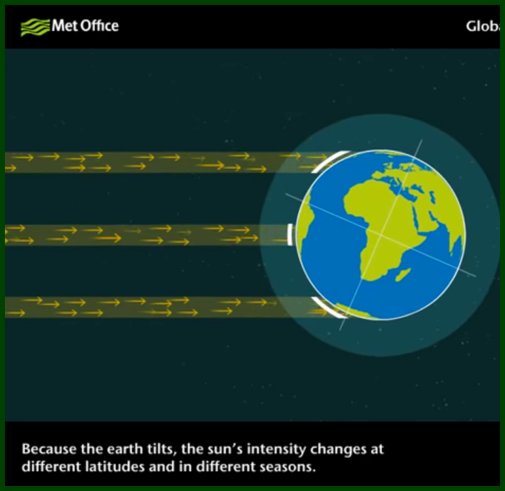
Video: How Does the Climate System Work?
Global Climate System Video
www.youtube.com/watch?v=lrPS2HiYVp8
Notes:
KEY MESSAGES:
Recap the what the video is about!
Discuss for 10-15 minutes
Reference:
https://www.youtube.com/watch?v=lrPS2HiYVp8

Slide 31
Class Exercise
List two important things you have learned from this Video:
1
2

Slide 32
Assignment
Individual Work:
Think of 3 - 5 situations where weather has influenced your life, your plans. Write these down and describe its influences to your daily life.
Discuss with other students and the full class.

Slide 33
Global Energy Flows (W/m²)
Notes:
KEY MESSAGES:
Estimate of the Earth’s annual and global average energy balance - all units are W/m⁻² (watts per square metre). About half the incoming solar radiation is absorbed by the Earth’s surface. This energy is transferred to the atmosphere by warming the air in contact with the surface (thermals), by evaporation from the Earth’s surface and plant transpiration, and by long-wave radiation that is partially absorbed by clouds and greenhouse gases. The atmosphere in turn re-radiates long-wave energy back to Earth (the ‘greenhouse effect’) as well as out to space.
Reference:
http://climateknowledge.org/figures/WuGblog_figures/RBRWuG0086_Trenberth_Radiative_Balance_BAMS_2008.GIF

Slide 34
Dynamics of the Earth
Atmospheric Circulation
Ocean Circulation
Land Surface Processes
Vegetation
Carbon Cycle
Snow and Ice

Slide 35
Atmospheric Circulation
What is atmospheric circulation?
What is Coriolis effect?
1 2 3
1 2 3
Notes:
KEY MESSAGES:
Review all of this concepts to students

Slide 36
Atmospheric Circulation
The atmospheric convection cells play to convey heat from the warm equatorial region to the cold polar regions.
Warm air rises near the equatorial latitudes.
When the rising warm air reaches the peak of the troposphere, it moves toward the poles, and when the air cools, it flows and becomes dense enough to sink at latitudes of about 30ºN or 30ºS.
When this cold air reaches the Earth's surface, it is moved toward the equator, and it then warms and rises.
Where the air is rising or sinking at the equator, 30º, 50º, 60º, and at the poles.
Notes:
Reference:
USAID’s Climate Resilient Ecosystems and Livelihoods (CREL) Project’s. CREL internal group discussions. Dhaka, Bangladesh. (2016).

Slide 37
General Atmospheric Circulation
Jet Stream occurs here
Jet Stream occurs here
Notes:
KEY MESSAGES:
The amount of heat in the atmosphere varies from place to place. This keeps it moving constantly (circulating).
Most atmospheric circulation takes place in the troposphere, the layer of the atmosphere closest to the Earth. The troposphere extends to an altitude of 10-15 km and contains about 90% of the mass of the atmosphere.
Circulation happens because of convection, a form of heat transfer in which a gas or fluid expands and rises as it gets warmer.
The Earth gets more of the Sun's heat at the Equator than it does at the poles. So as the air at the Equator gets warmer, it expands and rises. It continues to rise until it gets to the top of the troposphere, where it spreads out toward the poles and then comes back down to Earth again.
The Simple Model of Global Circulation
To understand this model, we need to make three assumptions. For the sake of argument, let's assume that:
The Earth is not rotating in space
The entire surface of the Earth is covered by the same material, and
The air is hotter at the Equator and colder at the poles (this is the only one of the assumptions that's true)
Reference:
E Teaching Assistance Program (ETAP). Earth Science Lesson 5: Heat Driven Convections on Earth. Check it out at https://legacy.etap.org/demo/Earth_Science/es5/instruction1tutor.html
Hurricanes: Science and Society. Check it out at http://www.hurricanescience.org/science/basic/atmcirculation/
Image Source:
http://www.hurricanescience.org/science/basic/atmcirculation/

Slide 38
Coriolis Effect
Coriolis Effect comes from the Earth’s rotation influencing the direction of the air movement.
The Coriolis Effect causes moving objects or currents on the surface of a rotating planet to veer to the right (clockwise) in the Northern Hemisphere and to the left (counterclockwise) in the Southern Hemisphere.
Air moves horizontally from high to low pressure zones, forming the major wind belts, including the trade winds, between the equator and 30ºN and 30ºS; between 30ºN and 30ºN and 50º to 60ºN and 50º to 60ºS; and the polar winds.
Notes:
KEY MESSAGES:
Self-explanatory message from the slide.
Further explanation:
The Coriolis Effect is named after (Gaspard) Gustave de Coriolis, the 19th-century French mathematician who first explained it.
Home exercise:
You could observe the Coriolis Effect if you and a friend stood on a rotating merry-go-round and threw a ball back and forth. To you and your friend, the ball’s path would appear to curve. Actually, the ball would be traveling in a straight line. You and your friend would be moving out of its path while it is in the air. A third person, standing on the ground near the merry-go-round, would be able to confirm that the ball travels in a straight line.
Reference:
E Teaching Assistance Program (ETAP). Earth Science Lesson 5: Heat Driven Convections on Earth. Check it out at https://legacy.etap.org/demo/Earth_Science/es5/instruction1tutor.html
National Geographic Education. Check it out at http://education.nationalgeographic.com/education/encyclopedia/coriolis-effect/?ar_a=1

Slide 39
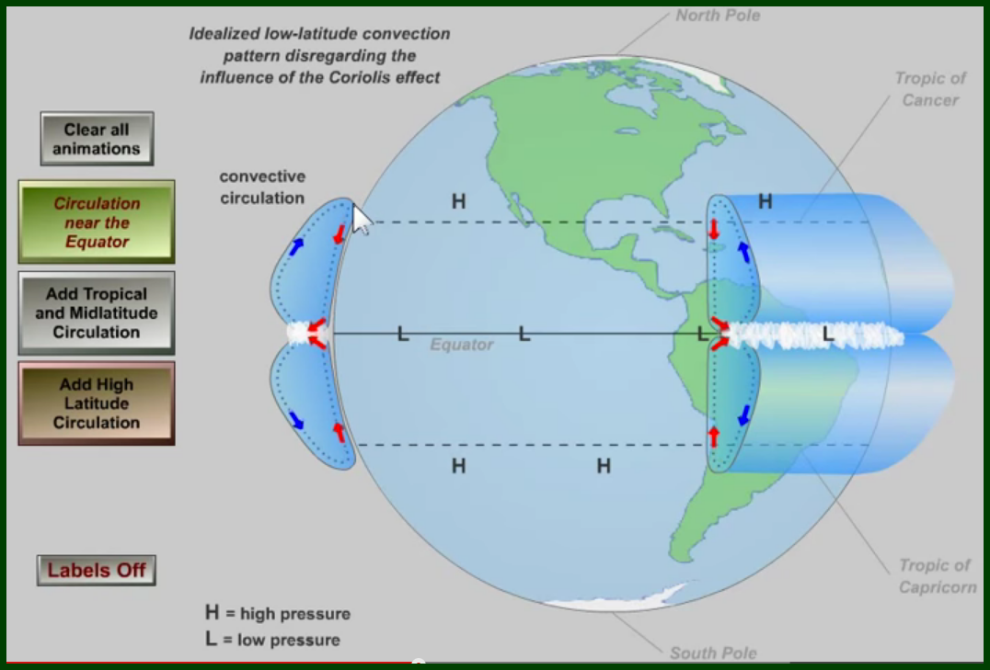
Video: Atmospheric Circulation
https://www.youtube.com/watch?v=Ye45DGkqUkE
Atmospheric Circulation
Notes:
KEY MESSAGES:
Spend 5 mins to wrap up the the video and questions.
Reference:
https://www.youtube.com/watch?v=Ye45DGkqUkE

Slide 40
Ocean Circulation
The oceans play a large part of in determining the existing climate of the Earth.
It seems to have a crucial influence on climate change due to human activities.
Ocean and atmosphere are close interactions and have a strong system.
Oceans have high capacity to contain heat compared with the atmosphere driving to gradually raise temperature in the oceans.
Oceans redistribute heat throughout the climate system through their internal circulation.
Notes:
Reference:
http://education.nationalgeographic.com/education/encyclopedia/coriolis-effect/?ar_a=1

Slide 41
Ocean Circulation has A Large Effect on Weather and Climate
Notes:
KEY MESSAGES:
When this deep current is flowing, it acts as a “heat conveyor belt”, bringing warm surface water to the North Atlantic, and keeping the whole Northern Hemisphere warmer. But, this current could stop forming if the water in the North Atlantic did not get dense enough to sink. This could happen if a lot of less dense fresh water flowed into the North Atlantic. This would stop the consistent flow of warm water into the North Atlantic, possibly leading to an ice age!
Reference:
http://www.srh.noaa.gov/jetstream/ocean/circulation.htm

Slide 42
Vegetation - Carbon
Carbon only affects climate when it is in the atmosphere
Gases move through the Earth reservoirs:
Atmosphere
Biosphere (living things)
Lithosphere (solid earth)
Hydrosphere (freshwater and oceans)
Notes:
Reference:
USAID’s Climate Resilient Ecosystems and Livelihoods (CREL) Project’s. CREL internal group discussions. Dhaka, Bangladesh. (2016).

Slide 43
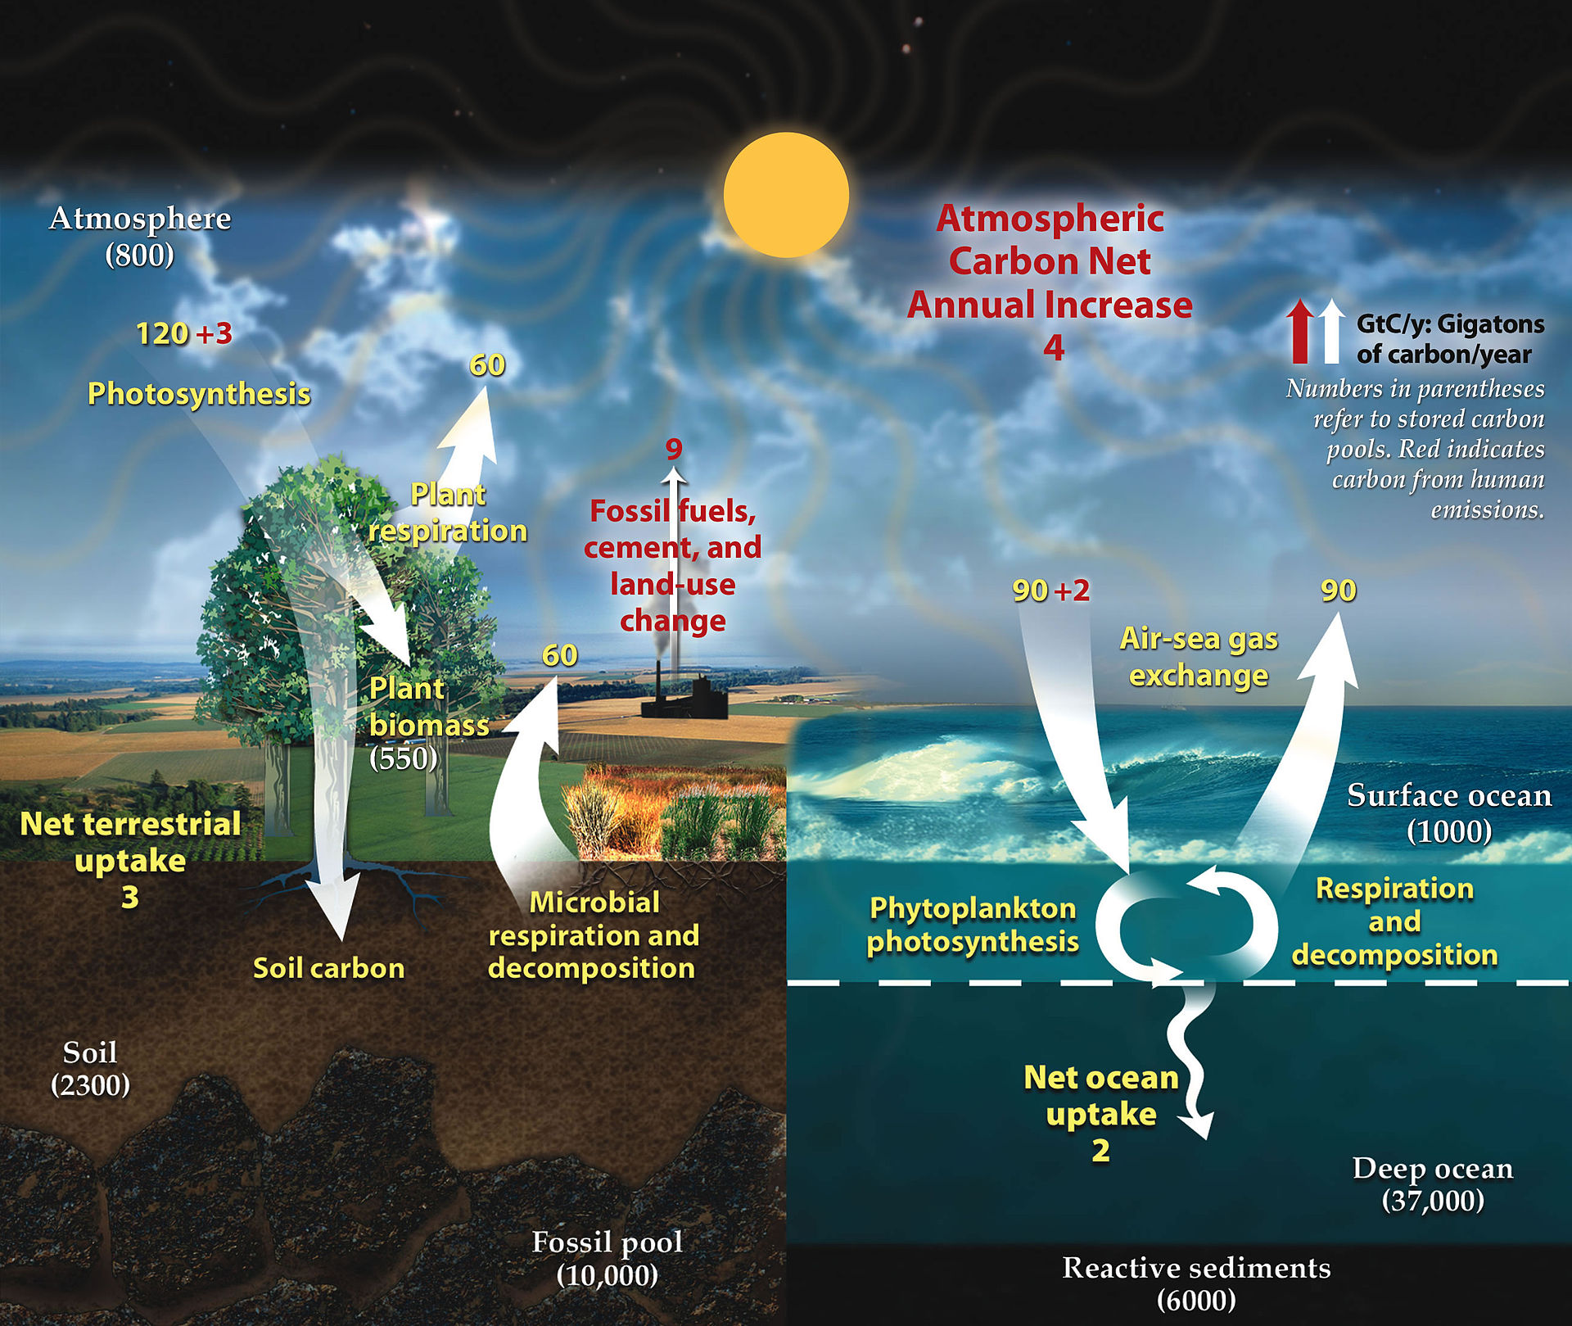
Carbon Cycle
Notes:
KEY MESSAGES:
An artist's rendering of the carbon cycle. In any given year, tens of billions of tons of carbon move between the atmosphere, hydrosphere, and geosphere. Human activities add about 5.5 billion tons per year of carbon dioxide to the atmosphere. The illustration above shows total amounts of stored carbon in black text (in giga-tons of carbon), and annual carbon fluxes in purple text (Giga-tons Carbon per year). Credit: NASA Earth Observatory
Carbon is the fourth most abundant element in the universe and a naturally occurring element on our planet. It is a critical building block of life and there is a fixed amount of it which cycles between living (biotic) and the nonliving (abiotic) environment. As it cycles, it changes states moving between the biosphere, geosphere, ocean and atmosphere. This biogeochemical movement is called the Carbon Cycle. Click on each graphic below to go the respective animation that demonstrates the carbon cycle.
Reference:
http://earthobservatory.nasa.gov/Features/CarbonCycle/

Slide 44
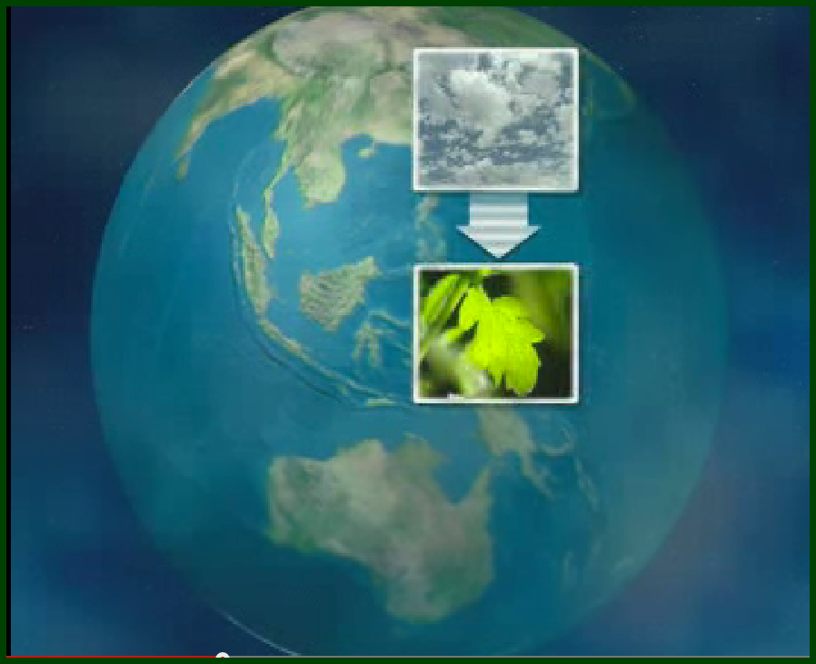
Video: The Carbon Cycle
https://www.youtube.com/watch?v=mldBE9Ee3zY
Notes:
KEY MESSAGES:
Wrap up with for about 3-5 minutes and explain how it’s related to climate change
Reference:
https://www.youtube.com/watch?v=mldBE9Ee3zY

Slide 45
Snow and Ice
The presence or absence of snow and ice affects warming and cooling over the Earth’s surface, influencing the Earth’s energy balance.
Changes in snow and ice cover affect freshwater availability, air temperatures, sea levels, ocean currents, and storm patterns.
Notes:
Reference:
USAID’s Climate Resilient Ecosystems and Livelihoods (CREL) Project’s. CREL internal group discussions. Dhaka, Bangladesh. (2016).

Slide 46
Reductions of Snow and Ice
A reduction in snow cover and ice causes the Earth’s surface to absorb more energy from the sun (decreased albedo), which is a positive feedback, causing stronger warming
Albedo is the "whiteness" of a surface
Notes:
Notes: The amount of energy that is reflected by a surface is determined by the reflectivity of that surface, called the albedo. A high albedo means the surface reflects the majority of the radiation that hits it and absorbs the rest. White colors reflects more than dark colors. So as the white area of ice caps shrink and less snow in winter in northern climates allow more dark colors to appear more soon in the spring season, the assumption is that the earth will warm more…creating a cycle of increased warming and reductions in snow cover.
Reference:
USAID’s Climate Resilient Ecosystems and Livelihoods (CREL) Project’s. CREL internal group discussions. Dhaka, Bangladesh. (2016).

Slide 47
El Niño and Global Warming
El Niño in general occurs in every 3 to 7 years and appears around Christmas period.
Droughts and floods occurring almost all continents are associated with El Niño.
ENSO (El Niño Southern Oscillation) is caused by the shift of the atmospheric-oceanic conditions, due to the way the oceans store and transport heat.
Notes:
Reference:
USAID’s Climate Resilient Ecosystems and Livelihoods (CREL) Project’s. CREL internal group discussions. Dhaka, Bangladesh. (2016).

Slide 48
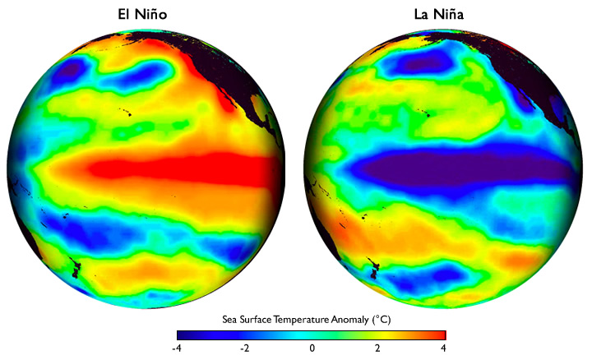
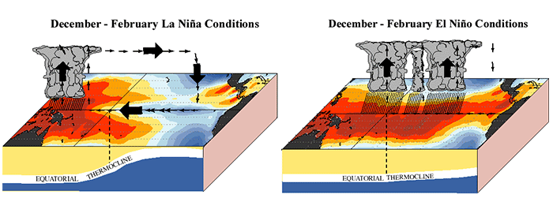
At Decadal and Annual Time Scales
Decadal & Annual-Scale Cycles (2 to 45 yr periods)
Pacific Decadal Oscillation 25 - 45 yr cycle
El Niño/La Niña (ENSO) 2 - 8 yr cycle
Driven by changes in ocean circulation
Notes:
KEY MESSAGES:
El Niño/La Niña cycles (ENSO) - a disruption of the ocean-atmosphere system in the Tropical Pacific having important consequences for weather and climate around the globe.
Reference:
Mantua, N.J., S.R. Hare, Y. Zhang, J.M. Wallace, and R.C. Francis, 1997: A Pacific decadal climate oscillation with impacts on salmon. Bulletin of the American Meteorological Society, Vol. 78, pp 1069-1079.
Image Source:
https://www.climate.gov/news-features/understanding-climate/can-we-blame-el-ni%C3%B1o and
http://www.srh.noaa.gov/ssd/html/elnino.htm

Slide 49
El Niño
What is El Niño?
El Niño is the prolonged warming in the Pacific Ocean sea surface temperature compared with the average value. It is a warming of at least 0.5°C (0.9°F) averaged over the east-central tropical Pacific Ocean.
A pattern of ocean surface temperature in the Pacific off the coast of South America, which has a large influence on world climate (Houghton, 2009).

Slide 50
El Niño
The first signs of an El Niño are:
Rise in surface pressure over the Indian Ocean, Indonesia and Australia
Fall in air pressure over Tahiti and the rest of the central and eastern Pacific Ocean
Trade winds in the south Pacific weaken or head east
Warm air rises near Peru, causing rain in the northern Peruvian deserts
Warm water spreads from the west Pacific and the Indian Ocean to the east Pacific. It takes the rain with it, causing extensive drought in the western Pacific and rainfall in the normally dry eastern Pacific.
Notes:
Reference:
http://en.wikipedia.org/wiki/El_Ni%C3%B1o

Slide 51
El Niño
El Niño: Warm water pool approaches South American coast. Absence of cold upwelling increases warming
Notes:
KEY MESSAGES:
El Niño is a band of anomalously warm ocean water temperatures that periodically develops off the western coast of South America and can cause climatic changes across the Pacific Ocean. There is a phase of 'El Niño–Southern Oscillation' (ENSO), which refers to variations in the temperature of the surface of the tropical eastern Pacific Ocean (El Niño and La Niña) and in air surface pressure in the tropical western Pacific. The two variations are coupled: the warm oceanic phase, El Niño, accompanies high air surface pressure in the western Pacific, while the cold phase, La Niña, accompanies low air surface pressure in the western Pacific.
The extremes of this climate pattern's oscillations cause extreme weather (such as floods and droughts) in many regions of the world. Developing countries dependent upon agriculture and fishing, particularly those bordering the Pacific Ocean, are the most affected.
Reference:
http://en.wikipedia.org/wiki/El_Ni%C3%B1o

Slide 52
La Niña
La Niña: Equatorial winds gather warm water pool toward the west. Cold water upwells along South American coast
Notes:
KEY MESSAGES:
La Niña is the name for the cold phase of ENSO, during which the cold pool in the eastern Pacific intensifies and the trade winds strengthen. The name La Niña originates from Spanish, meaning "the girl", analogous to El Niño meaning "the boy". It has also in the past been called anti-El Niño, and El Viejo (meaning "the old man").
Reference:
http://en.wikipedia.org/wiki/File:Enso_lanina.png

Slide 53
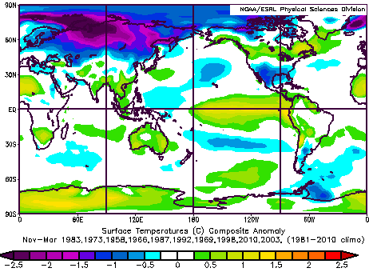
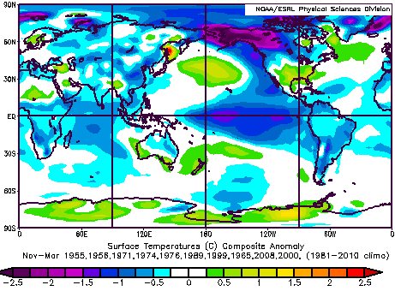
Sea Surface Temperature Anomalies for El Niño (Dry) and La Niña (Wet) Conditions
SST °C
SST °C
El Niño
La Niña
Droughts in SE Asia
Flooding in SE Asia
Notes:
KEY MESSAGES:
In SE Asia, El Niño brings drought, while La Niña brings flooding.
It is just the opposite in the Eastern Pacific, for north and south America.
Reference:
http://www.esrl.noaa.gov/psd/enso/compare/images/tsurf.e.all.a.w.gif

Slide 54
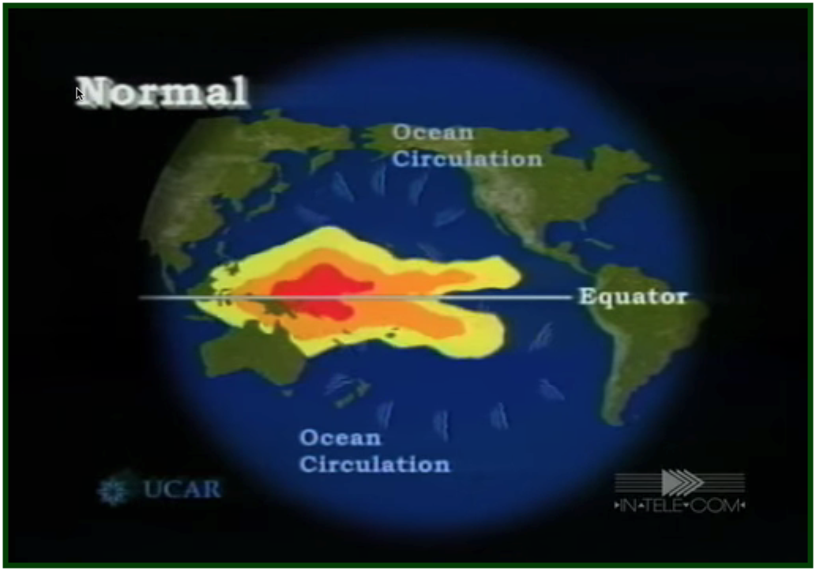
Video: El Niño y La Niña
El Niño and La Niña
https://www.youtube.com/watch?v=7FVZrw7bk1w
Notes:
Reference:
https://www.youtube.com/watch?v=7FVZrw7bk1w

Slide 55
What is Climate Change?
IPCC, 3rd Assessment Report:
Climate change: a statistically significant variation in either the mean state of the climate or in its variability, persisting for an extended period (typically decades or longer).
Climate change may be due to natural internal processes or external forcings, or to persistent anthropogenic changes in the composition of the atmosphere or in land use .
UNFCCC, Article 1:
“climate change”: “a change of climate which is attributed directly or indirectly to human activity that alters the composition of the global atmosphere and which is in addition to natural climate variability observed over comparable time periods.”
Notes:
Reference:
IPCC

Slide 56
What is Climate Variability?
IPCC, 3rd AR:
Climate variability refers to variations in the mean state and other statistics (such as the occurrence of extremes, etc.) of the climate on all temporal and spatial scales beyond that of individual weather events. Variability may be due to natural internal processes within the climate system (internal variability), or to variations in natural or anthropogenic external forcing (external variability)
Notes:
KEY MESSAGES:
Common drivers of climate variability include El Niño and La Niña events, which are shifts of warm, tropical Pacific Ocean currents that can dramatically affect Michigan’s winters. El Niños give us milder, less snowy winters (such as the winter of 2009-2010), while La Niña give us colder, snowier winters (such as the winter of 2007-2008). Other drivers of climate variability include volcanic eruptions and sunspots. Sometimes climate varies in ways that are random or not fully explainable.
Reference:
IPCC

Slide 57
What are the Primary Indicators of Climate Change?
Let the students work in group
They can draw the indicators
They can list the indicator
Let them present the results and discuss amongst themselves
Notes:
KEY MESSAGES:
Seven of these indicators would be expected to increase in a warming world and observation show that they are, in fact, increasing. Three would be expected to decrease and they are, in fact, decreasing.
As explained by the US agency, the National Oceanic and Atmospheric Administration (NOAA), there are 7 indicators that would be expected to increase in a warming world (and they are), and 3 indicators would be expected to decrease (and they are):
Reference:
http://skepticalscience.com/global-cooling.htm

Slide 58
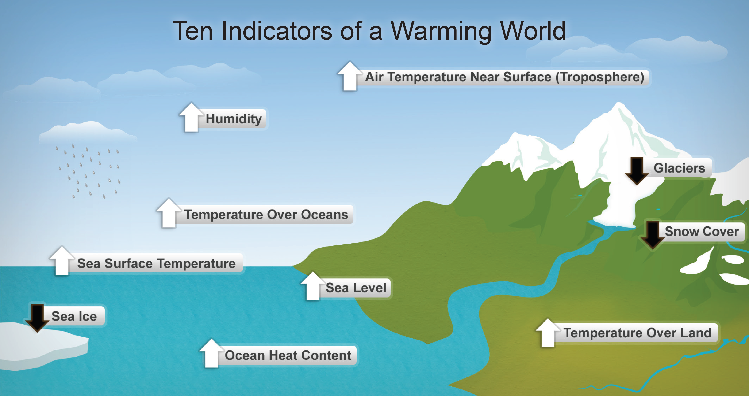
What are the Primary Indicators of Climate Change?
Notes:
KEY MESSAGES:
Seven of these indicators would be expected to increase in a warming world and observation show that they are, in fact, increasing. Three would be expected to decrease and they are, in fact, decreasing.
As explained by the US agency, the National Oceanic and Atmospheric Administration (NOAA), there are 7 indicators that would be expected to increase in a warming world (and they are), and 3 indicators would be expected to decrease (and they are):
Reference:
http://skepticalscience.com/global-cooling.htm

Slide 59
Warming of Climate
Increases in global sea and air temperatures
Widespread melting of snow and ice
Rising global sea level
What other effects?
Notes:
Reference:
USAID’s Climate Resilient Ecosystems and Livelihoods (CREL) Project’s. CREL internal group discussions. Dhaka, Bangladesh. (2016).

Slide 60
Widespread Melting Snow and Ice
Most mountain glaciers are getting smaller.
Snow cover is retreating earlier in the spring.
Sea ice in the Arctic is shrinking in all seasons, most dramatically in summer.
Reductions are in the permafrost, seasonally frozen ground and river and lake ice.
Important coastal regions of ice sheets on Greenland and West Antartica, and the glaciers of the Antartic Peninsular, are thinning and contributing to sea level rise.
Notes:
Reference:
USAID’s Climate Resilient Ecosystems and Livelihoods (CREL) Project’s. CREL internal group discussions. Dhaka, Bangladesh. (2016).

Slide 61
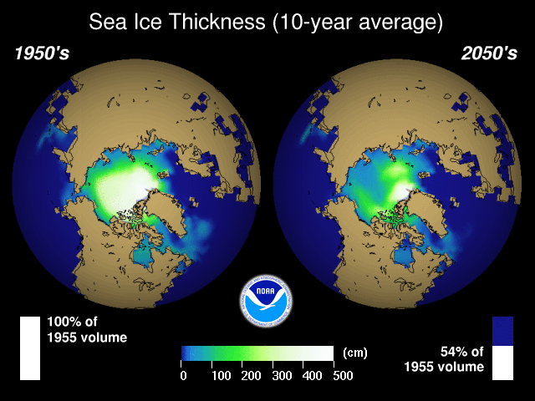
Sea Ice Thickness (10-year average)
Notes:
KEY MESSAGES:
Shows about the prediction of sea ice thickness from 1950s to 2050s! Notice the dramatic reduction.
Reference:
NOAA: http://celebrating200years.noaa.gov/breakthroughs/climate_model/modeling_seaice.html

Slide 62
How Does this Affect Temperature?
The change in sea ice in the previous slide:
Discuss:
How does this change affect the heating of the Earth’s atmosphere?
Notes:
KEY MESSAGES:
The melting of the ice increases albedo, as while and reflective ice is converted to dark, absorptive ocean water surface, greatly increasing the absorption of heat.

Slide 63
Rising Global Sea Level
Two major causes of global sea level rise:
Thermal expansion of the oceans (water expands as it warms)
Loss of land-based ice due to increased melting and movement from land to sea (glaciers and continental ice caps)
Notes:
KEY MESSAGES:
See Sea Level Rise topical unit for much more.
Reference: See Sea Level Rise topic in this module 2.2.

Slide 64
Historic Record of Global Climate Change
Warming of the climate system evidence:
Increases in global average air and ocean temperature
Widespread melting of snow and ice
Rising global mean sea level
Notes:
KEY MESSAGES:
Observed changes in:
global average surface temperature,
global average sea level from tide gauge (blue) and satellite (red) data and
(c) Northern Hemisphere snow cover for March-April. All changes are relative to corresponding averages for the period 1961–1990.
Smoothed curves represent decadal average values while circles show yearly values. The shaded areas are the uncertainty intervals estimated from a comprehensive analysis of known uncertainties (a and b) and from the time series (c).
Reference:
IPCC, 2007: Climate Change 2007: The Physical Science Basis. Contribution of Working Group I to the Fourth Assessment Report of the Intergovernmental Panel on Climate Change [Solomon, S., D. Qin, M. Manning, Z. Chen, M. Marquis, K.B. Averyt, M.Tignor and H.L. Miller (eds.)]. Cambridge University Press, Cambridge, United Kingdom and New York, NY, USA.

Slide 65
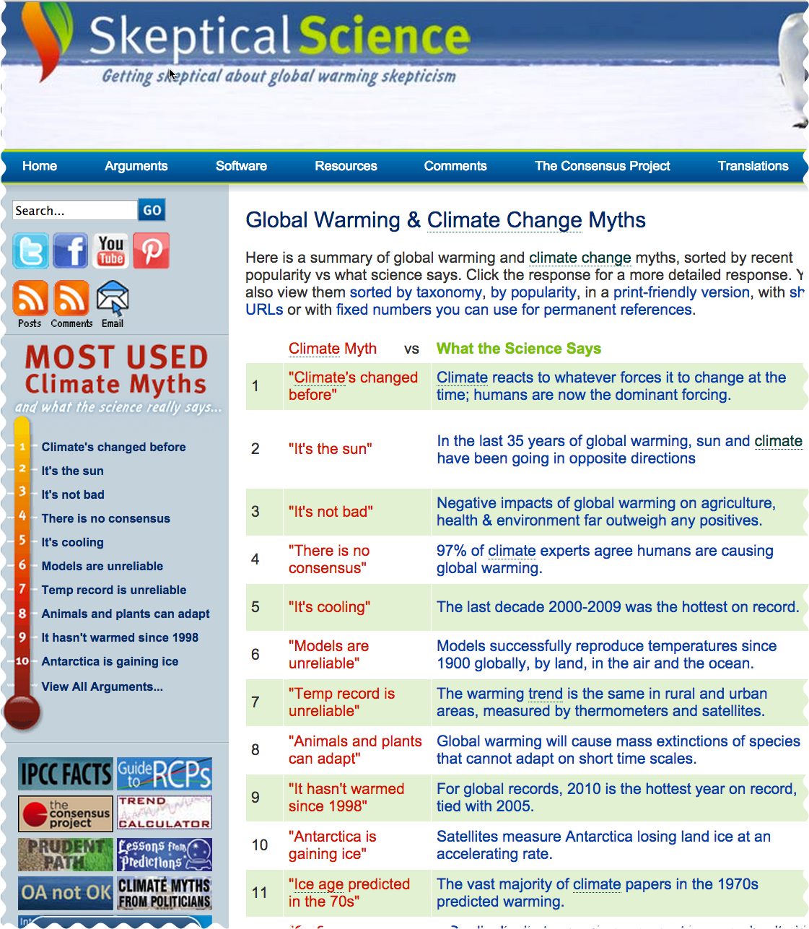
Arguments that Global Warming is Real? Look Here:
https://www.skepticalscience.com/argument.php
Notes:
Image Source:
https://www.skepticalscience.com/argument.php

Slide 66
References and Further Reading
USAID. 2015. USAID LEAF‘s Climate Change Curriculum. USAID Lowering Emissions in Asia Forests Program (USAID LEAF). Winrock International and US Forest Service. Bangkok, Thailand.
Climate Science Primer: http://www.fs.usda.gov/ccrc/climate-basics/climate-primer
Climate Basics - Frequently Asked Questions http://www.fs.usda.gov/ccrc/climate-basics/climate-faq
Foukal, P., C. Frohlich, H. Spruit, and T. M. L. Wigley. 2006. Variations in solar luminosity and their effect on the Earth's climate. Nature 443: 161-166.
Global Warming & Climate Change Myths https://www.skepticalscience.com/argument.php

Slide 67
References and Further Reading
International Panel on Climate Change (IPCC) Assessment Reports: http://www.ipcc.ch/publications_and_data/publications_and_data_reports.shtml
Mantua, N.J., S.R. Hare, Y. Zhang, J.M. Wallace, and R.C. Francis, 1997: A Pacific decadal climate oscillation with impacts on salmon. Bulletin of the American Meteorological Society, Vol. 78, pp 1069-1079.
World Bank. 2012. Turn Down the Heat: Why a 4°C Warmer World Must Be Avoided. Washington, DC. © World Bank. https://openknowledge.worldbank.org/handle/10986/11860

Slide 68
References and Resources
The curriculum of USAID’s Climate-Resilient Ecosystems and Livelihoods (CREL) in Bangladesh is a free resource of teaching materials for university professors, teachers and climate change training experts.
Reproduction of CREL’s curriculum materials for educational or other non-commercial purposes is authorized without prior written permission from the copyright holder, provided the source is fully acknowledged.
Suggested citation: USAID. 2016. Bangladesh Climate-Resilient Ecosystem Curriculum (BACUM). USAID‘s Climate-Resilient Ecosystems and Livelihoods (CREL) Project. Winrock International. Dhaka, Bangladesh.
Disclaimer: The CREL’s curriculum is made possible by the support of the American People through the United States Agency for International Development (USAID). The contents of the curriculum do not necessarily reflect the views of USAID or the US Government.

Slide 69
USAID's Climate-Resilient Ecosystems and Livelihoods (CREL) Project Winrock International House 13/B, Road 54, Gulshan 2, Dhaka 1212 Bangladesh Tel: +880-2-9848401 www.winrock.org

