Slide 1
Bangladesh Climate-Resilient Ecosystem Curriculum (BACUM)
Module 3: Forest Carbon Measurement and Monitoring

Slide 2
Module 3: Forest Carbon Measurement and Monitoring
SECTION III: FOREST CARBON MEASUREMENT AND MONITORING METHODS
3.6. Creating Activity Data and Emissions Factors

Slide 3
Forest Carbon Measurement and Monitoring (FCMM)
FUNDAMENTALS OF FOREST CARBON IN REDD+ CONTEXT
  1.1. Forests, the Global Carbon Cycle and Climate Change
  1.2. The Roles of Forests and Forest Carbon in Global Climate Negotiations
  1.3. Challenges for Forest-based Climate Change Mitigation
FOREST CARBON STOCKS AND IPCC GUIDELINES
  2.1. Overview of Forest Carbon Pools (Stocks)
  2.2. Land Use, Land Use Change, and Forestry (LULUCF)
  2.3. IPCC Guidelines for Forest Carbon Measurement and Monitoring
  2.4. Reference Levels – Monitoring against a Baseline
FOREST CARBON MEASUREMENT AND MONITORING METHODS
  3.1. Overview of Forest Carbon Measurement and Monitoring
  3.2. Quality Assurance and Quality Control (QA/QC)
  3.3. Field Sampling Design Methods
  3.4. Forest Carbon Field Measurement Methods
  3.5. Carbon Stock Calculation and Available Tools
  3.6. Creating Activity Data and Emissions Factors
  3.7. Considerations in Developing a Monitoring System

Slide 4
Acknowledgements
EXPERT CONTRIBUTORS | SPECIFIC INPUTS
Prof. (Dr.) Manzoor Rashid | Curriculum Development for all topics
Prof. (Dr.) Md. Danesh Miah | REDD+, Forest Carbon
Prof. (Dr.) Md. Jakariya | Community NR Management, Climate Change, Natural Resources Management
UNIVERSITIES
Bangladesh Agricultural University
University of Chittagong
Dhaka University
Independent University, Bangladesh
Khulna University
Noakhali University of Science and Technology
Shahjalal University of Science and Technology
Sher-e-Bangla Agriculture University
North South University
CREL STAFF | CREL STAFF
John A Dorr | Utpal Dutta
Abu Mostafa Kamal Uddin | Ruhul Mohaiman Chowdhury
Kevin T. Kamp | Rahima Khatun
Paul Thompson | Sultana Razia Zummi
Abdul Wahab | Shams Uddin
Shahzia Mohsin Khan
DESIGN, LAYOUT AND CONTENT DEVELOPMENT: Ms. Chi Pham, Curriculum Development Expert, Bangkok, Thailand

Slide 5
Learning Objectives
At the end of this session, students will be able to:
Explain how local land cover classification helps in the calculation of emission factors
Calculate emissions factors for land cover transitions
Calculate carbon emissions for land cover transitions using emissions factors and activity data
Notes:
KEY MESSAGES:
The goal is to have the students leave the class understanding how EFs and ADs are calculated and how they are used and given appropriate data be able to calculate both and carbon emissions.

Slide 6
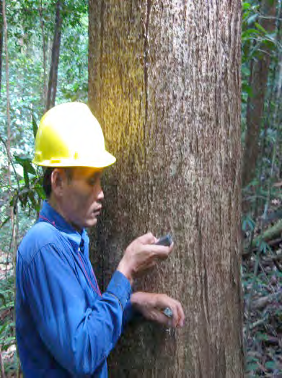
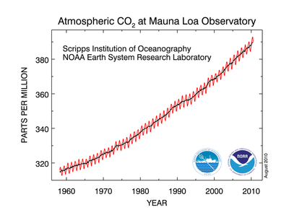
Introduction
How do we get from biomass and carbon pools to calculating CO₂ emissions
Notes:
KEY MESSAGES:
With respect to climate change and climate change mitigation we are concerned with the emission of carbon (or removal in some cases) from the atmosphere
In the previous lectures you have learned how to sample forest biomass and how to convert those biomass values into carbon stocks. Today we are going to learn how to use carbon stocks and estimates of land area undergoing land use transitions to convert carbon stock assessments into estimates of carbon emissions. We discussed some of these ideas briefly in the overview on carbon measurements
Image sources:
Walker et al. 2012. Standard Operating Procedures for Terrestrial Carbon Measurement: Version 2012. Winrock International
http://oceanacidification.msi.ucsb.edu/resources/image-gallery/data/co2_data_mlo.png/image

Slide 7
Carbon Emissions Calculations
The amount of carbon released when an area is converted from one land use to another
The area of land undergoing the transition in question
X
=
Emissions
Emissions Factor
Activity Data
Notes:
KEY MESSAGES:
This is the basic formula for calculating emissions. We are going to examine how biomass measurements and carbon calculations are used to build emissions factors for different land use transitions and also how to determine activity data

Slide 8
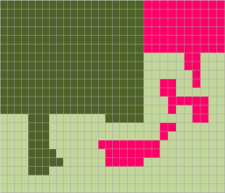

Emissions from Deforestation
Activity data | * | Emission factor | = | Emissions from Deforestation
1000 ha | * | 495 t CO₂/ha | = | 495,000 t CO₂e
Notes:
KEY MESSAGES:
This slide illustrate the example of emissions; activity data and emission factor. Important to again highlight that the units are tons of CO2 equivalent.

Slide 9
Land-use Land-cover Transitions
Notes:
KEY MESSAGES:
In REDD the land-use/ land-cover transitions of interest include conversion of forest to agriculture often though burning or after logging, degradation of mature forest to degraded forest often through logging. Additional forests can be converted to bare land for urban development or mining. Of course transitions can also move the other way as well ie reforestation or afforestation of abandoned agricultural lands. From the carbon perspective this means replacing an original land use with one level of carbon stocks with a new land use which has different amounts of carbon stored

Slide 10
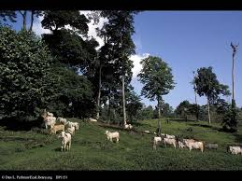
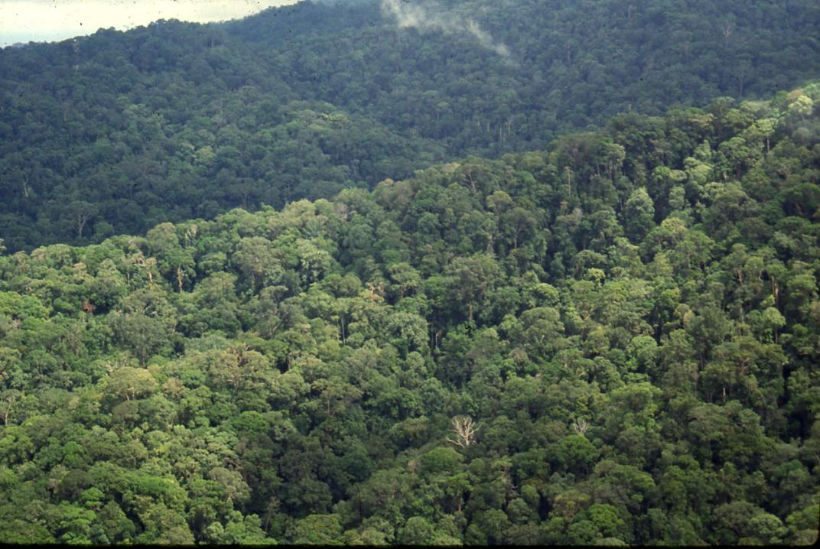
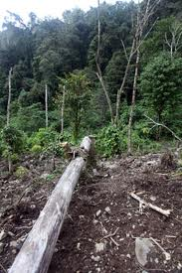
Developing Emissions Factors
CARBON STOCK
CARBON STOCK
CARBON STOCK
Notes:
KEY MESSAGES:
To calculate emissions factors we need information on the carbon stocks in the original land cover and the carbon stocks in the final land cover.
Images sources:
Forest photo courtesy of Dr Deborah Lawrence,
Pasture: http://www.ecolibrary.org/images/full_image/Pasture_and_Cattle_Formerly_Rainforest_DP1151.jpg
Degraded forest: http://photos.mongabay.com/10/0805papua_9760_1.jpg

Slide 11
IPCC Tier 1 Forest Classes and C stocks
Forest | Region | AGB (Mg/ha) | C stocks (Mg/ha)
Rain forest | Continental Asia | 280 | 180
 | Insular Asia | 350 | 225
Moist deciduous forest | Continental Asia | 180 | 105
 | Insular Asia | 290 | 169
Montane Forest | Continental Asia | 135 | 81
 | Insular Asia | 205 | 122
Dry Forest | Continental Asia | 130 | 78
 | Insular Asia | 160 | 96
Notes:
KEY MESSAGES:
The IPCC has been collecting data on biomass and carbon stocks in various biomes and regions and the Tier 1 approach would be to use these data to estimate the original carbon stocks when calculating emissions factors.
Notes: The data in the table is taken from a US Government web site (see link below). Units are not given in the web site. They are presumed to be tons / ha = Mg / ha. It might be a useful homework assignment to have students verify that these units are correct.
Reference:
Data for the table from: http://cdiac.ornl.gov/epubs/ndp/global_carbon/tables.html#tables.

Slide 12
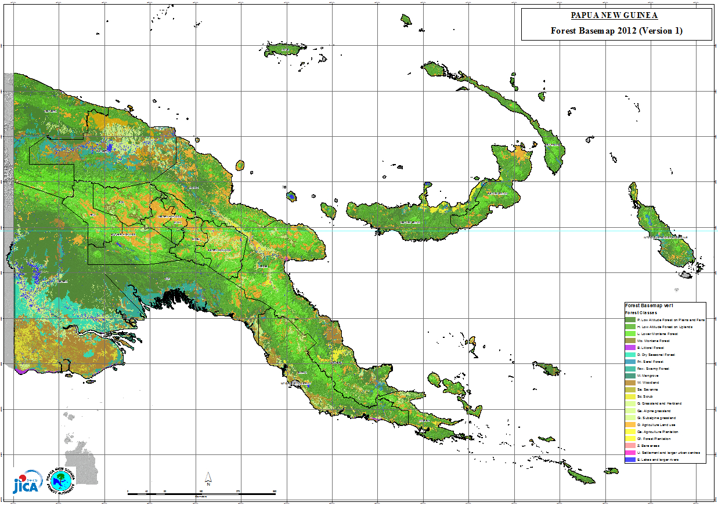
Tier 2: National Level Forest Definitions
Notes:
KEY MESSAGES:
To reach Tier 2 levels of accuracy and precision many countries have their own system of forest classification which correspond to local conditions. Using national categories rather than the very general categories of the IPCC database national increases the precision of the carbon stock estimation. The definition of a forest as well as forest types are decided independently by each country. This map is an example from Papua New Guinea and includes 9 forest types and one woodland classification.
Image source:
http://www.jica.go.jp/png/english/office/topics/c8h0vm00008ps13t-att/140306.jpg

Slide 13
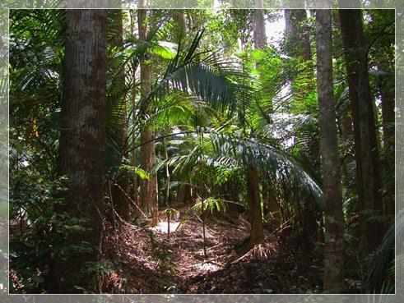
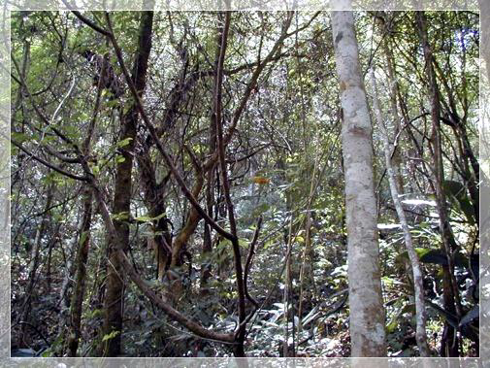
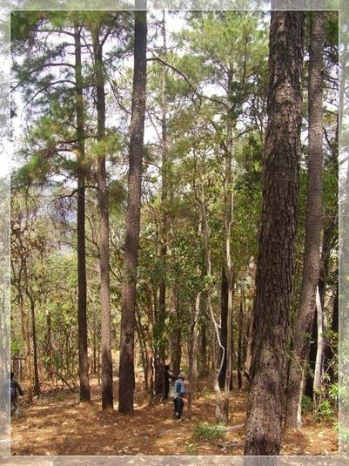
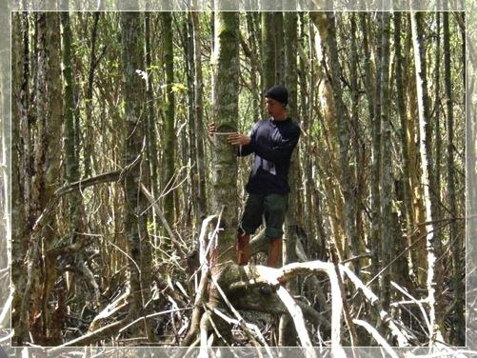
Tier 2: National Level Forest Definitions
Tropical Evergreen Forest
Dry Evergreen Forest
Hill Evergreen Forest
Pine Forest
Freshwater Swamp Forest
Mangrove Forest
Swamp Forest
Beach Forest
Mixed Deciduous Forest
Dry Dipterocarp Forest
Forest Plantation
Disturbed Forest
Notes:
KEY MESSAGES:
Similarly Thailand has 9 natural forest types defined plus 2 plantation types and disturbed forest in their system, Stratifying the forests and other land covers into similar classes means the average values determined for biomass and carbon will be more representative of the class and thus improve the confidence in carbon emission calculations. Note the disturbed forest category will be very useful in determining emissions factors for forest degradation
Reference for forest types:
R-PP for Thailand. 2013. Forest Carbon Partnership Facility. http://forestcarbonpartnership.org/sites/fcp/files/2014/MArch/March/Thailand%20R-PP%20Nov2013.pdf
Images source:
Forest Inventory in Thailand. A presentation prepared by National Parks Wildlife and Plant Conservation

Slide 14
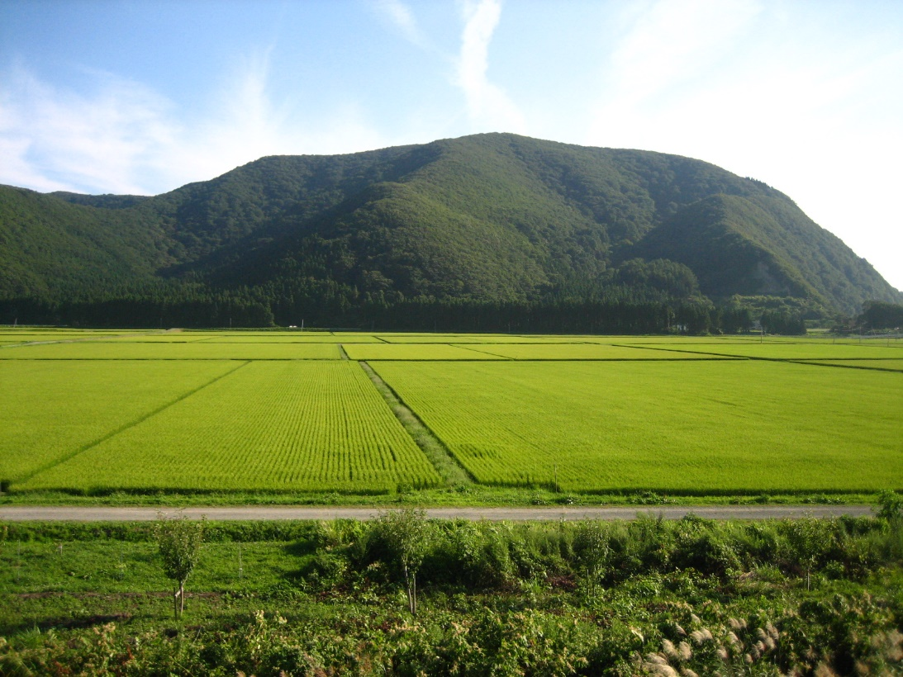
Other Land Covers
Calculate carbon stocks in the other land cover classes just as was done for forests
The IPCC has global default values for Tier 1 calculations but where possible using local values is preferred
Notes:
KEY MESSAGES:
Just as for forest we need carbon stocks for the other land cover types. This includes degraded forest as a land cover type as emissions from degradation are important. If there are multiple drivers of degradation then getting a good estimate of each type of degraded forest will improve your ability to estimate emissions. This goes back to the discussion of stratification and sampling in an earlier lecture.
Images source:
http://upload.wikimedia.org/wikipedia/commons/e/e9/Rice_Paddies_In_Aizu,_Japan.JPG
http://www.ecolibrary.org/images/full_image/Pasture_and_Cattle_Formerly_Rainforest_DP1151.jpg

Slide 15
Class Exercise
Rank the following land cover types highest carbon stocks to lowest and justify your rankings
Tropical rain forest
Dry forest
Flooded rice paddy
Mangrove forest
Natural savanna
Corn field
Orchard
10 minutes
Notes:
KEY MESSAGES:
Have the students arrange the list from the land cover they think has the highest carbon stocks to the one with the lowest and then compare lists. You can go a little deeper and ask the students to describe the major carbon stocks (aboveground biomass, soils etc. for each land cover)

Slide 16
Methods to Estimate Emission Factors
There are two different but equally valid methods to estimate emission factors
  Stock Change method: Estimate difference in carbon stocks before and after land use/land cover change
  Gain-Loss method: Estimate net balance of additions to and removals from all carbon pools
Notes:
KEY MESSAGES:
So to calculate emissions factors there are a variety of methods: The two most common are presented here and these and other methods will be discussed in more detail in a following lecture.

Slide 17
Methods to Estimate Emission Factors
 | Stock Change | Gain-Loss
Definition | Difference in C stocks in a particular pool in pre- and post-forest cover change | Net balance of additions to and removals from a carbon pool
Data requirements | Data needed on forest carbon stocks in key pools before and after conversion | Annual data needed on C losses and gains. For example, annual tree harvest volume and annual rates of forest growth post-harvest
Applications | Avoided deforestation and afforestation/reforestation | Forest degradation caused by tree harvest and the enhancement of carbon stocks in existing forests
Notes:
KEY MESSAGES:
The stock change method is straightforward EF= (original C stock- final C stocks) or simply how much C is lost during the transition and assumed emitted to the atmosphere.
Notes:
The Gain-Loss method is appropriate where you have good measures of the rates of carbon input (growth) and loss (harvest, damage or other losses) and you can calculate the emission factor as the amount of loss minus the amount of carbon gain,
Emission factors are reported in tons of Carbon per hectare.

Slide 18

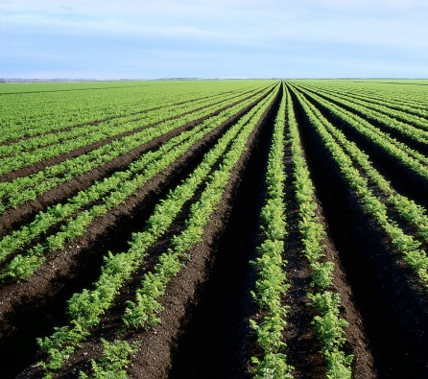

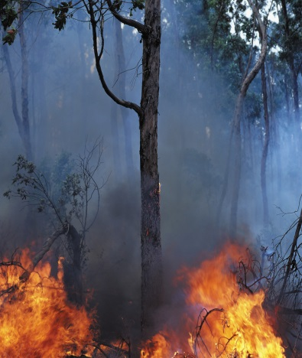
Emissions
Emissions factors for transitions that include long-term storage of carbon in wood products and non CO₂ GHG emissions those components need to be included in a complete assessment.
Pre-deforestation carbon stocks
C storage in wood products
Non-CO₂ emissions
C stocks on future land use
120 t C/ha
5 t C/ha
Notes:
KEY MESSAGES:
Calculation of non CO2 GHG emissions and the impact of carbon storage in long lived products are discussed in upcoming lectures. They are mentioned briefly here to make sure students are aware of the issues to be considered.
Photo sources:
[these are generic and probably should be replaced by locally relevant photos based on instructor’s experience]
Forest: http://4.bp.blogspot.com/-WRGmnbepFTY/TzlYGx3R1II/AAAAAAAASFo/u7kQXgILBwc/s320/2-771329.jpg
House construction: http://www.tradersmessageboards.com/wp-content/uploads/2013/10/building-material-choice.jpg
Forest fire: http://www.visitcookcounty.com/wp-content/plugins/dksupload/file.php?name=http://www.visitcookcounty.com/wp-content/uploads/2013/06/FlamesForest.jpg&width=898&height=359
Row crops: https://pbs.twimg.com/profile_images/82900038/RowCrops_big_400x400.jpg

Slide 19
Developing Emissions Factors
Assess existing data as well as data gaps
  Compile and examine spatial data and stratify land cover classes
  Assess suitability of existing data for activity specific emission factors
  Develop sampling design and collect field measurements
Notes:
KEY MESSAGES:
In the next three slides we outline the emissions factor calculation process that we have just described in as a step by step process. Note that the process is the same for deforestation, forest degradation and afforestation activities. In all cases you need the original and final carbon stocks or the carbon in and output fluxes. In the case of afforestation or reforestation the emission factor will be a negative value indicating that carbon is sequestered rather than emitted.

Slide 20
Developing Emission Factors
Estimate pre-transition carbon stocks
Estimate carbon stocks in post-transition land cover
Estimate carbon stocks stored as wood products if relevant
Determine soil carbon emitted as a result of transition
Determine which method is most appropriate for determining the emissions factor given the data collected and the type of project.
Notes:
KEY MESSAGES:
Go through the steps- this is a summary of the process just described so it should go fairly quickly

Slide 21
Class Activity
Have the students divide into small groups and research emissions factors in the IPCC Emissions Factors Database. (http://www.ipcc-nggip.iges.or.jp/EFDB/main.php)
Students can choose which transitions and which location to research
15 minutes
Notes:
KEY MESSAGES:
Help students understand and gain experience calculating emission factors for different contexts.

Slide 22
Activity Data
The amount of carbon released when an area is converted from one land use to another
The area of land undergoing the transition in question
X
=
Emissions
Emissions Factor
Activity Data
Notes:
KEY MESSAGES:
Now that you are familiar with Emissions factors and how they are calculated we are going to talk about the second component of the equation Activity Data. Brainstorm with the students before going forward to hear about how they think activity data is collected/ measured.

Slide 23
Steps to Develop Activity Data for Deforestation:
Initial Considerations
Establish definition of ‘forest’
Define deforestation activity types
Assess existing land cover data
Mining extraction
Agricultural expansion
Select method for identifying activity data
Link land cover classes to deforestation activity types
Infrastructure development
Notes:
KEY MESSAGES:
We are going to start by describing the process of collecting activity data for deforestation activity. The process is much the same for forest degradation but only recently have methods been developed to detect degradation within a forest reliably.

Slide 24
Developing Activity Data
Post classification comparison change detection
  Create a forest map for Y1 and again for Y2
  Estimate area deforested (deforestation AD) for the first time period Y1-Y2
  Estimate deforestation AD for the second time period Y2-Y3
Notes:
KEY MESSAGES:
Activity data is reported on a hectares per unit time- so how many hectares were deforested, degraded or afforested over a given period of time. To calculate activity data you need good information about the spatial extent of each land cover at each time point. Remote sensing is an important tool in developing accurate maps of land cover and accurate activity data estimates.

Slide 25
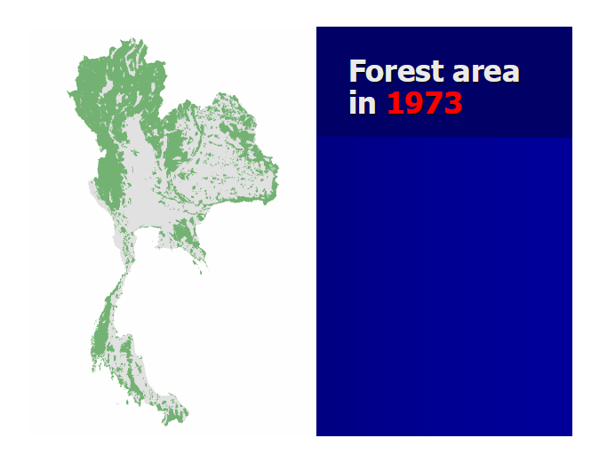
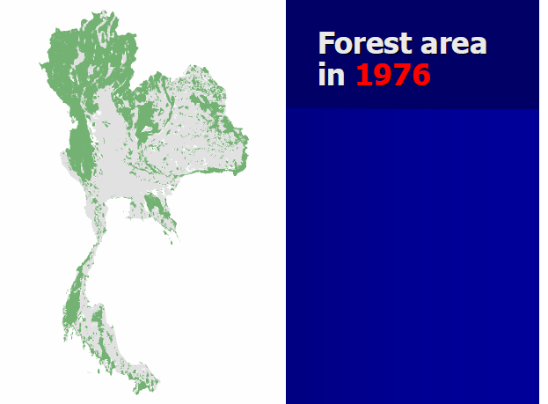
Forest Cover Mapping Example from Thailand
Notes:
KEY MESSAGES:
Here we have forest maps for Thailand created in 1973 and 1976
Image Source:
This example from Thailand is from the Forest Cover Assessment by Omsomwang and Rattanasuwan presented at the 2nd GEO Forest Monitoring Symposium, Chiang Mai Thailand 2009.
Accessible at https://www.earthobservations.org/documents/cop/ag_forest/20090701_thailand/15%20Forest%20Cover%20Assessment%20in%20Thailand.pdf

Slide 26
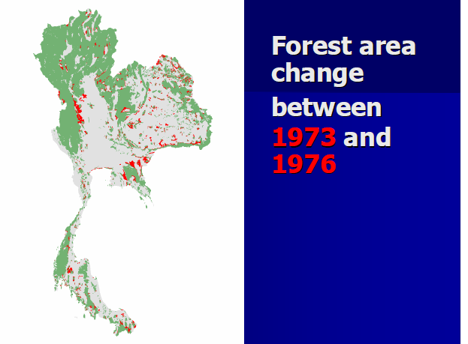
Forest Cover Mapping Example from Thailand
Notes:
KEY MESSAGES:
Here in red are the areas where forest cover was converted to non-forest in that time period. The activity data for this time period would be the sum of that area
Image Source:
Omsomwang and Rattanasuwan presented at the 2nd GEO Forest Monitoring Symposium, Chiang Mai Thailand 2009.
Accessible at https://www.earthobservations.org/documents/cop/ag_forest/20090701_thailand/15%20Forest%20Cover%20Assessment%20in%20Thailand.pdf

Slide 27
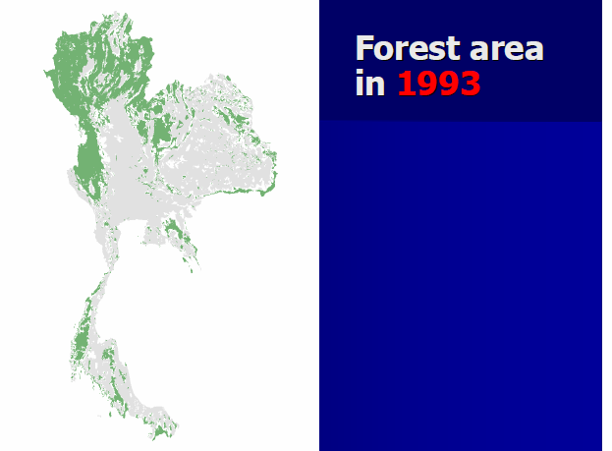
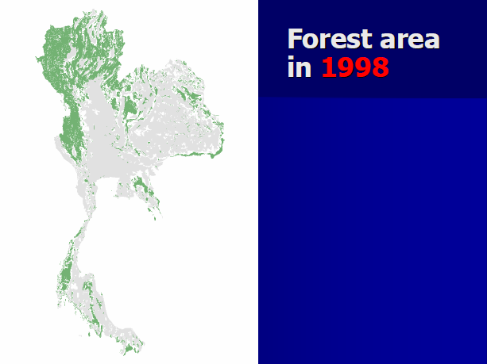
Forest Cover Mapping Example from Thailand
Notes:
KEY MESSAGES:
The mapping was repeated in 1993 and 1998
Image Source:
Omsomwang and Rattanasuwan presented at the 2nd GEO Forest Monitoring Symposium, Chiang Mai Thailand 2009.
Accessible at https://www.earthobservations.org/documents/cop/ag_forest/20090701_thailand/15%20Forest%20Cover%20Assessment%20in%20Thailand.pdf

Slide 28
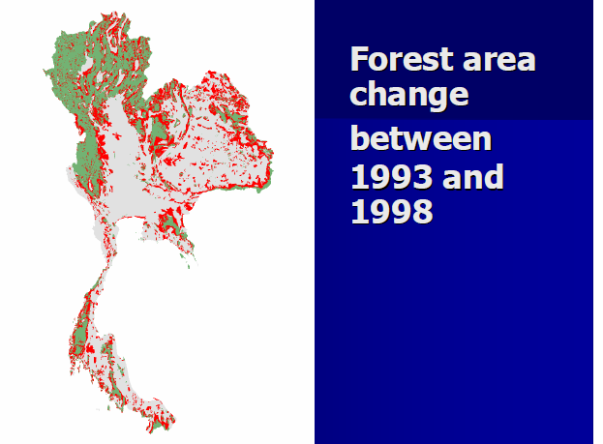
Forest Cover Mapping Example from Thailand
Notes:
KEY MESSAGES:
Again activity data for the time period is the sum of the area marked in red. With activity data one must specify the time period and spatial area covered (national, regional etc.) How does the deforestation activity data from 1993- 1998 compare to that for the period 1990-1993? Note this was a simple case of forest/non-forest activity to be more accurate you would have to classify forest- pasture, forest- urban etc. as separate activities each with its own activity data.
Image Source:
Omsomwang and Rattanasuwan presented at the 2nd GEO Forest Monitoring Symposium, Chiang Mai Thailand 2009.
Accessible at https://www.earthobservations.org/documents/cop/ag_forest/20090701_thailand/15%20Forest%20Cover%20Assessment%20in%20Thailand.pdf

Slide 29
Take Home Message
Carbon emissions are calculated as Emissions Factor times Activity Data.
There is a database of global emissions factors available
To increase the accuracy of the calculation national to local scale information on land cover classifications, carbon stocks and activity data are necessary

Slide 30
Homework
Have students calculate emissions factors based on real world estimates of land cover transition area. The students should look up emissions factors in the IPCC database and calculate emissions factors based on national scale data provided. Have the students compare the effect of Tier 1 vs Tier 2 data in their report
Notes:
KEY MESSAGES:
Provide students with an assessment of area in each of two or three land cover transitions in your country or in one with good national data available.

Slide 31
References
USAID. 2015. USAID LEAF‘s Climate Change Curriculum. USAID Lowering Emissions in Asia Forests Program (USAID LEAF). Winrock International and US Forest Service. Bangkok, Thailand.
Ashton, M.S., Tyrrell, M.L., Spalding, D., and Gentry, B. (Eds.). 2012. Managing Forest Carbon in a Changing Climate. Springer. ISBN 978-94-007-2232-3
Chave et al. 2005. Tree allometry and improved estimation of carbon stocks and balance in tropical forests. Oecologia, 145: 87–99
Pearson, Timothy R H, Sandra Brown and Felipe M Casarim, 2014. Carbon emissions from tropical forest degradation caused by logging. Winrock International
Walker, SM et al., 2012. Standard Operating Procedures for terrestrial carbon measurement. Winrock International
IPCC (1996a). Revised 1996 IPCC Guidelines for National Greenhouse Gas Inventories, Greenhouse Gas Inventory Reporting Instructions. http://www.ipcc-nggip.iges.or.jp/public/gl/invs1.html
IPCC (1996b). Revised 1996 IPCC Guidelines for National Greenhouse Gas Inventories, Greenhouse Gas Inventory Workbook. http://www.ipcc-nggip.iges.or.jp/public/gl/invs1.html
IPCC (1996c). Revised 1996 IPCC Guidelines for National Greenhouse Gas Inventories, Greenhouse Gas Inventory Reference Manual. http://www.ipcc-nggip.iges.or.jp/public/gl/invs1.html

Slide 32
References and Resources
The curriculum of USAID’s Climate-Resilient Ecosystems and Livelihoods (CREL) in Bangladesh is a free resource of teaching materials for university professors, teachers and climate change training experts.
Reproduction of CREL’s curriculum materials for educational or other non-commercial purposes is authorized without prior written permission from the copyright holder, provided the source is fully acknowledged.
Suggested citation: Winrock International. 2016. USAID‘s Climate-Resilient Ecosystems and Livelihoods (CREL). Winrock International. Dhaka, Bangladesh.
Disclaimer: The CREL’s curriculum is made possible by the support of the American People through the United States Agency for International Development (USAID). The contents of the curriculum do not necessarily reflect the views of USAID or the US Government.

Slide 33
USAID's Climate-Resilient Ecosystems and Livelihoods (CREL) Project
Winrock International Headquarters
2101 Riverfront Drive, Little Rock
Arkansas 72202-1748 USA
Tel: 1-501-280-3000
Web: www.winrock.org

