Slide 1
Bangladesh Climate-Resilient Ecosystem Curriculum (BACUM)
Module 3: Forest Carbon Measurement and Monitoring

Slide 2
Module 3: Forest Carbon Measurement and Monitoring
SECTION III: FOREST CARBON MEASUREMENT AND MONITORING METHODS
3.4. Forest Carbon Field Measurement Methods

Slide 3
Forest Carbon Measurement and Monitoring (FCMM)
FUNDAMENTALS OF FOREST CARBON IN REDD+ CONTEXT
  1.1. Forests, the Global Carbon Cycle and Climate Change
  1.2. The Roles of Forests and Forest Carbon in Global Climate Negotiations
  1.3. Challenges for Forest-based Climate Change Mitigation
FOREST CARBON STOCKS AND IPCC GUIDELINES
  2.1. Overview of Forest Carbon Pools (Stocks)
  2.2. Land Use, Land Use Change, and Forestry (LULUCF)
  2.3. IPCC Guidelines for Forest Carbon Measurement and Monitoring
  2.4. Reference Levels – Monitoring against a Baseline
FOREST CARBON MEASUREMENT AND MONITORING METHODS
  3.1. Overview of Forest Carbon Measurement and Monitoring
  3.2. Quality Assurance and Quality Control (QA/QC)
  3.3. Field Sampling Design Methods
  3.4. Forest Carbon Field Measurement Methods
  3.5. Carbon Stock Calculation and Available Tools
  3.6. Creating Activity Data and Emissions Factors
  3.7. Considerations in Developing a Monitoring System

Slide 4
Acknowledgements
EXPERT CONTRIBUTORS | SPECIFIC INPUTS
Prof. (Dr.) Manzoor Rashid | Curriculum Development for all topics
Prof. (Dr.) Md. Danesh Miah | REDD+, Forest Carbon
Prof. (Dr.) Md. Jakariya | Community NR Management, Climate Change, Natural Resources Management
UNIVERSITIES
Bangladesh Agricultural University
University of Chittagong
Dhaka University
Independent University, Bangladesh
Khulna University
Noakhali University of Science and Technology
Shahjalal University of Science and Technology
Sher-e-Bangla Agriculture University
North South University
CREL STAFF | CREL STAFF
John A Dorr | Utpal Dutta
Abu Mostafa Kamal Uddin | Ruhul Mohaiman Chowdhury
Kevin T. Kamp | Rahima Khatun
Paul Thompson | Sultana Razia Zummi
Abdul Wahab | Shams Uddin
Shahzia Mohsin Khan
DESIGN, LAYOUT AND CONTENT DEVELOPMENT: Ms. Chi Pham, Curriculum Development Expert, Bangkok, Thailand

Slide 5
Session Outline
In class
  Lectures ( 2 lectures: first 50 min, second 25 min)
    Refresh on concepts
    Locating plots
    SOP for Forest Carbon Measurements
    Field work group assignments
    Data Management and Reporting
    Field report presentations ( second half of second lecture period)
  Video
  Activities
    Student discussions on a given topic
Field work
  Safety briefing
  Carbon pool measurement using the SOP’s
Homework
  Data quality assessment and report writing
Notes:
Explain to the students the methodology in achieving the learning outcomes. Lectures are presented in the early part of this course before the field work.

Slide 6
Learning Objectives
At the end of this session, students will be able to:
Apply carbon measurement methods by Standard Operating Procedure (SOP) in field work
Determine minimum plots to be established for different types of forests and pool
Design plot shape and size for each forest type and pool
Identify appropriate methods to locate sample plots
Present a report on terrestrial field carbon measurement
Notes:
Explain to the students the outcomes of this course. 2 learning outcomes

Slide 7
Lecture Outline
Review of Carbon cycle and major forest carbon pools
Guidelines for plot establishment
SOP’s for the measurement of forest carbon pools
Plot slope corrections
Field data management
Notes:
Go through the list of topics and explain the importance of each topic

Slide 8
Concept - Terrestrial Carbon
Terrestrial carbon is stored in vegetation and soil through photosynthesis
R
P
P
Live biomass
Photosynthesis (P)
fixes CO₂
R
Respiration (R)
releases CO₂
Dead wood
Litter
Soil and roots
Photosynthesis exceeds respiration, resulting in storage of carbon
Notes:
KEY MESSAGES:
Storage of carbon in biomass is due to photosynthesis and the balance between photosynthesis and respiration. Review the role of plants in carbon cycling, through photosynthesis, respiration and organic matter decomposition and how this is linked to sequestration projects
Notes: This slide should be review as the key concepts discussed here should have been covered in earlier lectures including 1.2 and 2.1. Involve students to discuss the concepts presented here- the processes that link vegetation and the carbon cycle

Slide 9
Review: Fundamental Concepts for Carbon Measurement
In living and dead organisms, carbon is always found combined with other elements in molecules
If a tree or other vegetation is dried and weighed carbon atoms constitute about 47 % of its dry mass
Litter is approximately 37 % carbon
Soil carbon concentration must be measured in a laboratory
Notes:
KEY MESSAGES:
Different parts of biomass have different carbon content. Carbon content in dry mass is different from litter. For default value, IPCC has recommend default values for each different carbon pool.

Slide 10
Review: Major Carbon Pools to Consider
Forest carbon is stored in five pools within and around vegetation
  Above-ground biomass:
  stems, bark, leaves, etc.
  Below-ground biomass:
  roots of all sizes
  Dead wood or dead
  organic matter in dead wood
  Litter or dead organic matter in
  litter
  Soil organic carbon (SOC)
Notes:
KEY MESSAGES:
Major carbon pools in forest ecosystem
Review with the students the major forest carbon pools. Discuss the Completeness component of TACCC principles- and prioritizing pools to measure for an inventory

Slide 11
Class Exercise: Carbon Measurement
Video on Measuring Biomass in Mangrove Forest
Objectives:
Activity: Students watch the video and comment on the measuring biomass in mangrove forest.
Time: 10 minutes
Notes:
KEY MESSAGES:
Carbon measurement in mangrove forest- gives students a view of the process in a forest environment that is often overlooked- this is a fun video and does set up the lecture well but if you are concerned about time it could be skipped or assigned as homework
Link to USAID LEAD Program: https://www.youtube.com/watch?v=AsP1ljKFxQ4
Notes:
Video showing participants a training program measuring carbon in a mangrove forest.
Discussion with students on forest carbon measurement in mangrove forest

Slide 12
Standard Operating Procedures
What are Standard Operating Procedures for field measurements?
  Methods for conducting field measurements are developed and documented prior to inventory
  Those implementing inventory are trained in methods
  Ensures that measurements implemented consistently between field crews and between inventories
Can be used to measure carbon stocks of forests as well as other land cover types
Notes:
KEY MESSAGES:
SOPs ensure that measurements are done in a consistent manner over time and across teams. Note this fits with the Consistency component of TACCC
Standard operating procedure is important to ensure work is being done in the same manner by different personnel. It also serves as a reference for future work. The techniques described in this presentation are based on Winrock SOPs for Terrestrial Carbon Measurement. There are multiple SOPs all of which are equally valid. The important thing is that once a SOP is decided upon for a project it is used consistently for the whole project.

Slide 13
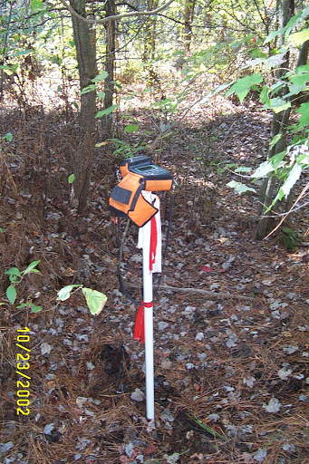
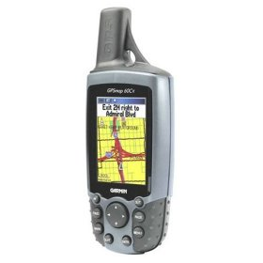
Plot Establishment
Locating plots in the field with GPS
Notes:
KEY MESSAGES:
In plot establishment plots are located using existing maps and GPS. The locations are transferred into GIS database and can be used for future reference and monitoring activities.
Navigate to predetermined latitude and longitude using a GPS
At the plot center/corner, mark a “waypoint’ on GPS and record GPS coordinates, accuracy, elevation, and waypoint number. Allow GPS to record for >5 minutes prior to marking ‘waypoint’
Image source:
http://lh3.ggpht.com/-zjogw5WVOik/TMh9hG6SnzI/AAAAAAAACQA/mnsdnjQSu8k/DCP_0539.JPG

Slide 14
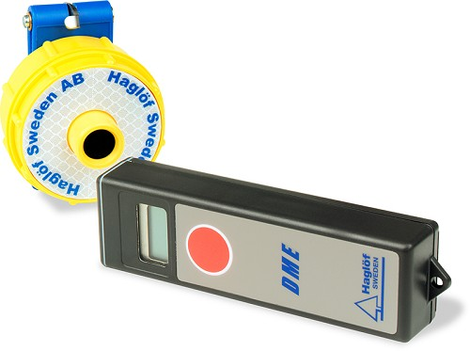
Plot Establishment
Boundaries of temporary rectangular plots established using stakes and rope or flagging tape
Boundaries of temporary circular plots may be established using Haglöf Distance Measuring Equipment (DME) 201 Cruiser or measuring tape
Transponder
Distance measuring instrument
Notes:
KEY MESSAGES:
Boundaries can be established using a number of different ways – it is very important that the plot area be clearly marked and accurately measured. Details on how to set up the plot were discussed in the last lecture and students can review on their own if they feel the need.
Image source:
Walker et al. 20124. Standard Operating Procedures for Terrestrial Carbon Measurement: Version 2014. Winrock International

Slide 15
SOP Measurement of Trees
Allometric equations, built on destructive sampling, allow measurements of diameter (DBH) to substitute for measuring the actual biomass
Example:
AG biomass = 0.0288*DBH^{2.6948}
BG biomass = 0.23*AG biomass
Notes:
KEY MESSAGES:
Allometric equations have historically been developed by destructively sampling a large number of trees and measuring the above and in some cases belowground dry biomass of the entire tree and building a relationship between measured biomass and tree diameter (dbh) and some cases diameter and height. Allometric relationships built for a specific species at a specific location are extremely accurate but we also have some that are more general and they are still quite accurate allowing us to measure biomass without cutting the tree down. There have been fewer equations developed for belowground biomass.
Notes: Below-ground biomass accounts for an appreciable portion of total biomass. In many forests, below-ground biomass accounts for 20-26% of total biomass according to the reference below. The equation given in this slide is just an example. Where possible, ecosystem / forest-type specific equations should be used.
Reference:
For BG biomass equation: Advances in Global Change Research Volume 29, 2008, pp 149-156 in Carbon Inventory Methods Handbook for Greenhouse Gas Inventory, Carbon Mitigation and Roundwood Production Projects. See http://link.springer.com/chapter/10.1007/978-1-4020-6547-7_11#page-1
Graphic:
Alex Grais and Felipe Casarim, Estimation of Carbon Stocks, USAID LEAF’s Technical Training on Carbon Assessment.
See http://www.leafasia.org/sites/default/files/public/resources/4-LEAF_Estimation-of-Carbon-Stocks_Post_field.pdf

Slide 16
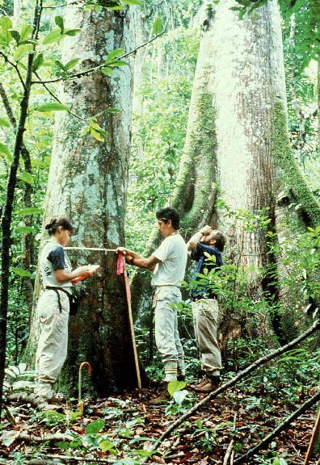
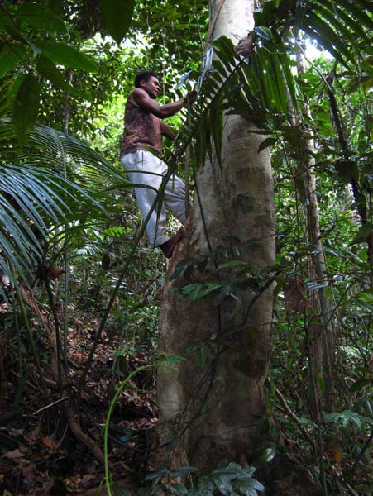
SOP Measurement of Trees
Measure DBH at 1.3 m using DBH tape
Sometimes you have to go higher due to buttresses or aerial roots
Notes:
KEY MESSAGES:
Diameter of trees is generally measured at what is referred to as breast height which has been standardized to 1.3 m above the ground.
Might have 1.3 meters marked on a wall or post in the classroom and have each student find dbh on their own body- it helps in the field to know where 1.3 meters is rather than measuring up at each tree. There are some exceptions- if a tree has significant butresses or aerial roots diameter is measured above the butress or roots and the diameter and height are both recorded
Image sources:
http://daac.ornl.gov/NPP/guides/brr_2.jpg
http://apscience.org.au/projects/APSF_07_5/APSF_07_5_image_01_full.jpg

Slide 17
SOP Measurement of Trees
Proper use of DBH tape:
  Push hook of DBH tape into bark and pull tape to RIGHT
  Pull tape around tree and ABOVE hook; numbers on tape should be right side up
  If the tree is leaning, wrap DBH along tree angle, NOT parallel to ground
  Boundary trees: If >50% of tree inside plot, then measure tree
  Forked tree: measure both boles, record as two trees
  Always measure 1.3 m from up slope side of tree
Notes:
KEY MESSAGES:
Diameter tape is often used in measuring tree diameter. This tape is specially calibrated to give diameter value of the tree measured. Some diameter tapes have standard measuring tapes on one side and diameter conversions on the other and it is important to check and ensure you are using the diameter scale.

Slide 18
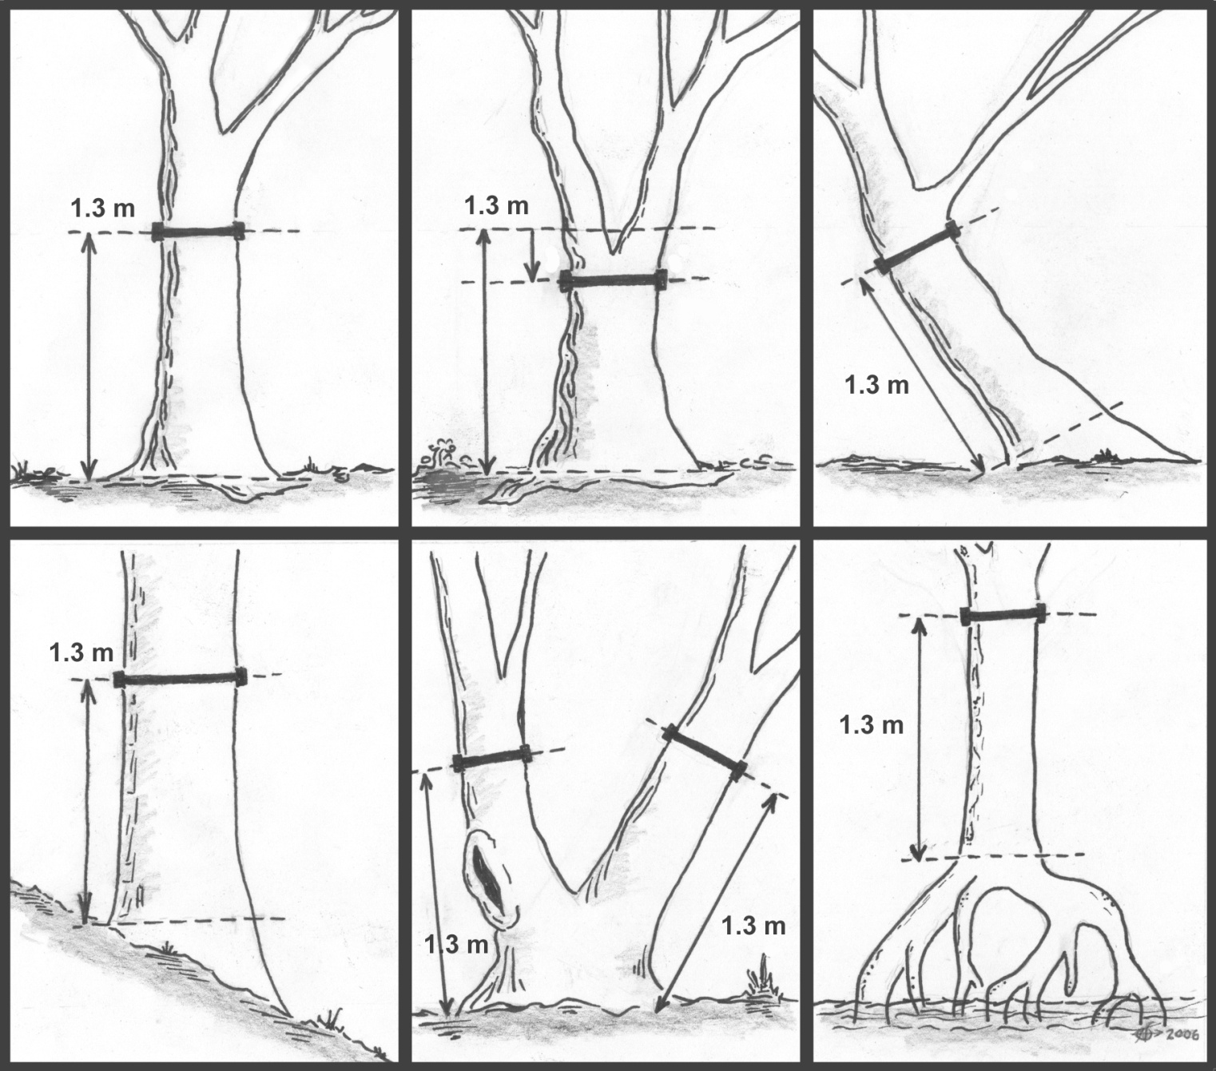
Dbh Measurements
Notes:
KEY MESSAGES:
Here are more examples of measuring dbh under tricky situations. If you have to measure dbh at a height greater than 1.3 m above the ground due to aerial roots (as in the last picture) or due to buttresses it is important to note the actual height at which is was measured in the field notes so if measurements are redone they can be made at the same height. One possible exercise is to have students practice measuring dbh on either columns in the class room if available or if possible to bring in a log or something similar and set it up at the correct height
Notes: As noted early in the lecture, various SOPs exist. The pictures here show Winrock’s SOP for measuring DBH under tricky situations. It’s worth noting that SWAMP’s SOP for DBH in mangroves with prop roots differs from the rule suggested in the bottom right picture. The SWAMP protocol suggests measuring DBH @ 30 cm above the highest prop root which can be accessed safely. An annotated version of SWAMP’s protocol can be accessed at http://www.lowemissionsasia.org/news/mangrove-annotated-protocol. The full reference can be accessed at: http://www.cifor.org/library/3749/protocols-for-the-measurement-monitoring-and-reporting-of-structure-biomass-and-carbon-stocks-in-mangrove-forests/. This protocol for mangroves is the same as the method indicated by the figure on p. 28 of Winrock’s SOP (version July 2014).
Image source:
Walker et al. 2014. Standard Operating Procedures for Terrestrial Carbon Measurement: Version 2014. Winrock International

Slide 19
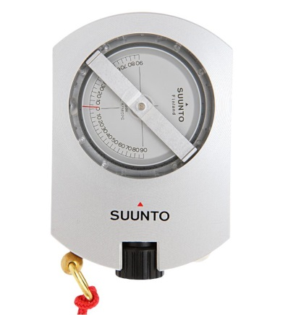
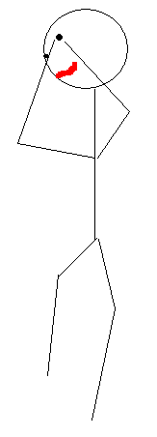
Measurement of Tree Height
Measurement of tree height
  A clinometer may be used to measure tree height
  For each tree, two separate measurements of height should be taken
a %
a %
dist_{tree}
- b %
dist_{tree}
H_{eye}
Notes:
KEY MESSAGES:
There are many methods of measuring tree height. One of the instruments used is a clinometer and is one of the popular instruments in measuring tree height. To calculate tree height you need to record angle from the observer’s eye to the top of the tree and distance from the tree and the height of the clinometer above the ground during the measurement. If the observer is on a slope s/he can record angle to the top of the tree and the bottom of the stem as well as the distance. There are other instruments available to measure tree height.
Image source:
Walker et al. 2014. Standard Operating Procedures for Terrestrial Carbon Measurement: Version 2014. Winrock International

Slide 20
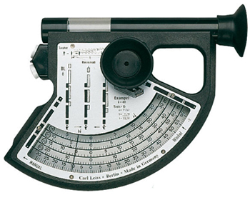
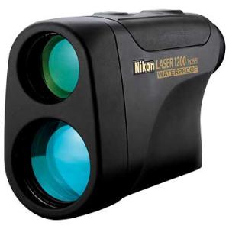
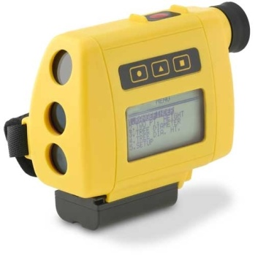
Instruments for Tree Heights
Blume-leiss hypsometer
Laser range finder
Digital hypsometer
Notes:
KEY MESSAGES:
These are instruments that can be used to measure tree heights. More laser-based instruments have been developed for tree measurements. However, the high price of some of these instruments may hinder the usage of these instruments.

Slide 21
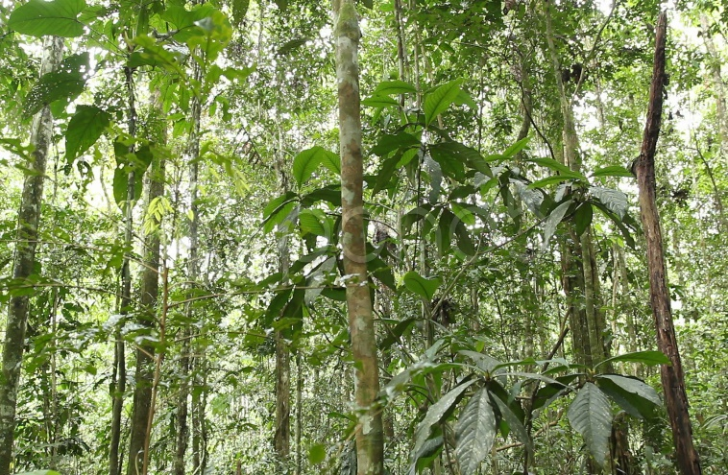
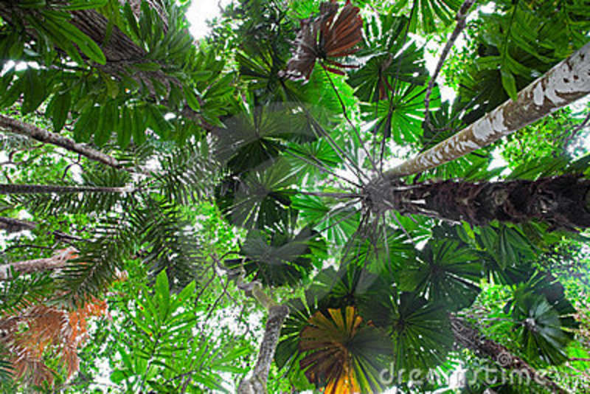
SOP Measurement of Trees: Special Cases
Saplings
  Count number of saplings (trees less than 10 cm DBH and greater than 1.3 m height) in smallest nested tree plot
Palms
  Measure height
Notes:
KEY MESSAGES:
Height is a better predictor of biomass than DBH for palms. This is because as palms grow, their height increases but DBH remains fairly constant.
Image sources:
http://d3thflcq1yqzn0.cloudfront.net/008778168_prevstill.jpeg
http://static7.depositphotos.com/1008768/732/i/950/depositphotos_7325744-palm-tree-forest-canopy.jpg

Slide 22
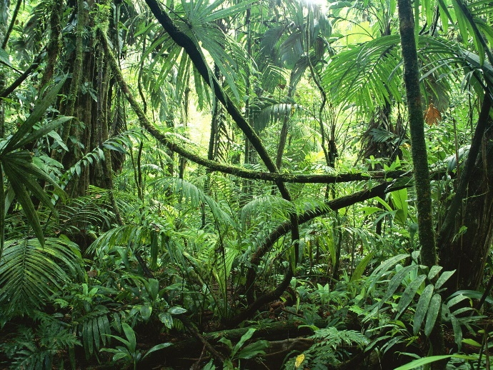
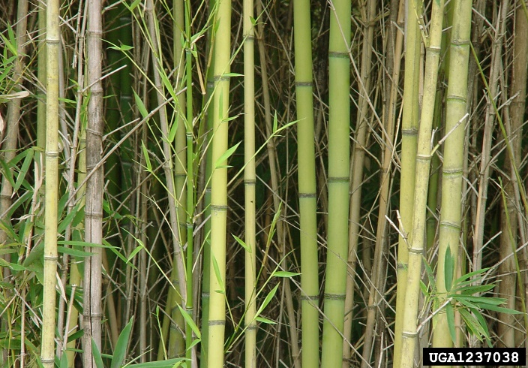
SOP Measurement of Trees: Special Cases
Lianas
  Only measure if significant portion of biomass
  Measure DBH
Bamboo
  Measure height
  Diameter N-S and E-W
  Number of culms in patch
Notes:
KEY MESSAGES:
Lianas are not usually included in biomass measurements but in some forests they do make up a significant portion of the biomass
Notes:
Culm (bamboo) = (as in other grasses), a culm is an aerial stem bearing the inflorescence; strictly, from the base of the plant to the lowest involucral bract (or base of the inflorescence).
This link has a good diagram of bamboo anatomy showing the culm: http://www.bamboobotanicals.ca/img/about-bamboo/bamboo-culm-anatomy.gif
Image Sources:
https://www.cwi.nl/system/files/rainforest1.jpg
https://encrypted-tbn1.gstatic.com/images?q=tbn:ANd9GcQbpj9IZrkIr5kzC1aDqaz_yud5OuEtNB1ujs5unzYZkdbRqu1Luw

Slide 23
SOP Measurement of Herbaceous and
Non-tree Woody Vegetation
Includes all above-ground vegetation not measured in tree plots or as saplings
  Trees < 1.3 m in height
  Shrubs (if shrubs are large, may be measured separately)
  Grasses
  Herbaceous plants
Measured by cutting and weighing vegetation within a “clip plot”
Notes:
KEY MESSAGES:
Herbaceous plants and non-tree woody vegetation are an important source of carbon and should be included in the carbon inventory. Composition of the herbaceous plants and non-tree woody vegetation vary and will depend on the phase of the forest. Disturbed forest will have higher herbaceous plants and non-tree woody vegetation compared to undisturbed forest.

Slide 24
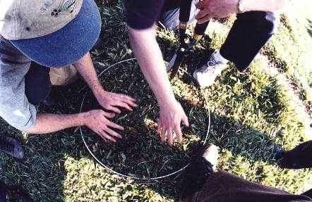
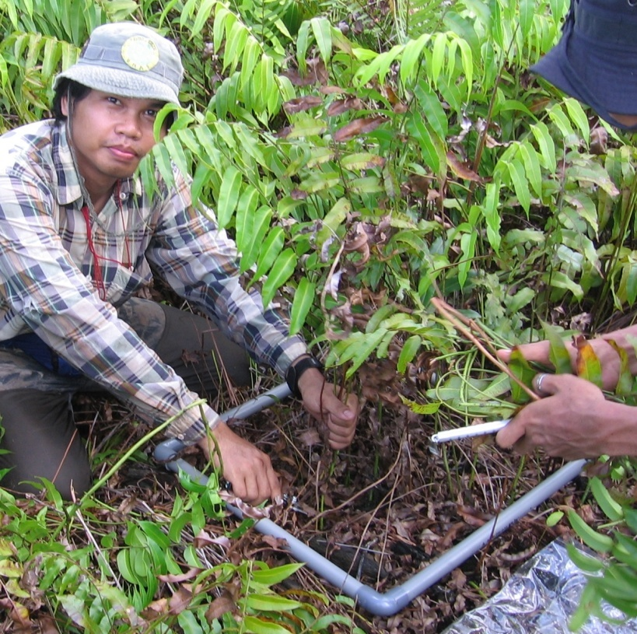
Measurement of Non-tree Pools
Create sampling frame using stiff, long lasting material (e.g. PVC pipe)
Frame needs to be able to open up to place around vegetation – DO NOT GLUE TOGETHER
Clip plot can be square or circular
Notes:
KEY MESSAGES:
Sampling frames are usually made of PVC and not glued to make transportation to the field easier. Clip all the vegetation within the frame at ground level with clippers
Images source:
Walker et al. 2014. Standard Operating Procedures for Terrestrial Carbon Measurement: Version 2014. Winrock International

Slide 25
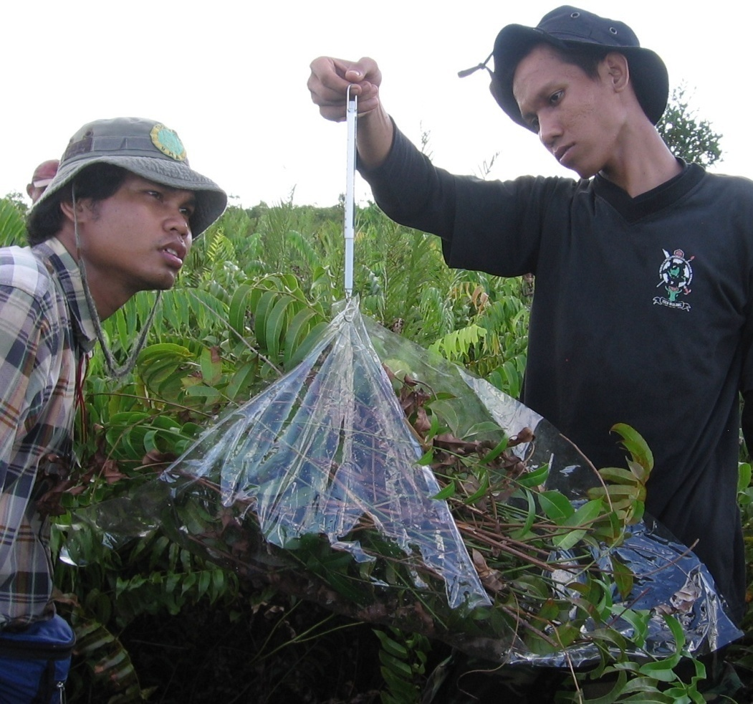
Measurement of Non-tree Pools
Clip all live vegetation originating in the plot at ground level
Place vegetation on plastic sheet
Weigh clipped vegetation
At next sampling period, measure in different location
Notes:
KEY MESSAGES:
You need to have a scale with you in the field to weigh the clipped vegetation fresh. It is important to change sampling locations at each time so that the vegetation has a chance to grow back – resampling in the same location would result in much lower values at the second timepoint unless the inventories are so far apart in time the vegetation has had enough time to recover
Image Source:
Photo taken in Central Kalimantan, Indonesia, by Dr. Sarah Walker, Winrock International.

Slide 26
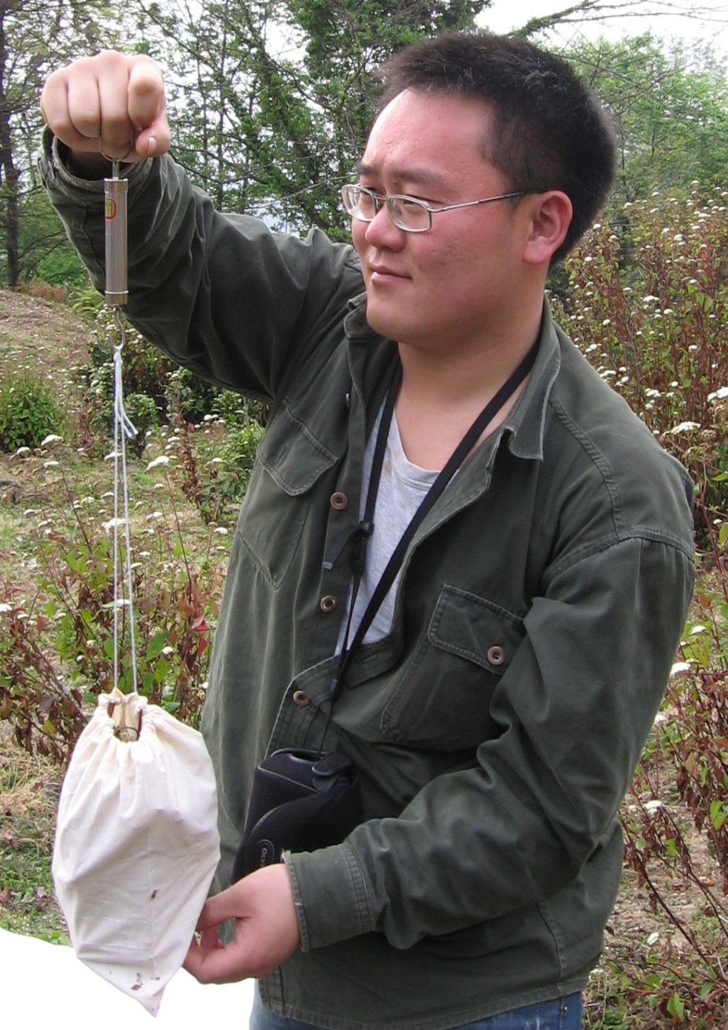
Measurement of Non-tree Pools
Collect subsample and place in paper/cloth bag
Repeat for remaining sampling frames in plot
Combine all the subsamples in ONE bag
Dry subsample to constant mass in laboratory
Use constant mass to estimate dry weight of all non-tree vegetation in sampling frame
Notes:
KEY MESSAGES:
Vegetation mass is always reported on a dry mass (constant dry weight) basis to avoid the effect of moisture. This way whether or not it has rained recently has no effect on the mass values and allows you to compare collections made at different times.
Image source:
Walker et al. 2014. Standard Operating Procedures for Terrestrial Carbon Measurement: Version 2014. Winrock International

Slide 27
SOP Measurement of Non-tree Pools
Shrubs
  Where shrubs are small and not a dominant component of biomass, shrub vegetation can be included in non-tree vegetation plots
  Where shrubs are larger or make up a dominant component of biomass
    Allometric equations can be used to estimate biomass of individual shrubs in plot
    Shrub parameters measured (e.g. diameter, height) depend on required inputs to allometric equation selected
Notes:
KEY MESSAGES:
In forests shrubs are often a minor component and can be included in non-tree vegetation plots. However in some forests shrubs are a significant pool and should be measured separately.

Slide 28
Measurement of Litter
Litter is all the dead organic material on top of the mineral soil
  Some of this material will still be recognizable (dead leaves, twigs, dead grasses, and small branches) and some will be unidentifiable decomposed fragments of organic material
  Note that dead wood with a diameter < 10 cm is included in the litter layer (not fallen dead wood pool)
Notes:
KEY MESSAGES:
Litter is defined as all dead leaves, twigs, small branches, fruits and flower parts as well as dead wood less than 10 cm in diameter

Slide 29
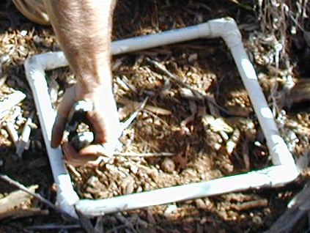
Measurement of Litter
Location of plots can be same location as non-tree biomass
Number of plots can be same as non-tree biomass or in proportion to number of tree plots
Use non-tree biomass sampling frame to delineate area
At next sampling period, measure in different location
Notes:
KEY MESSAGES:
Location and number of plots- collection of litter from the soil surface is done with the same methods as were used for the non-tree vegetation including collection of a sub-sample in a cloth or paper bag to be dried in the laboratory to determine a conversion factor to convert field fresh weights into dry weights.
Image source:
Walker et al. 2014. Standard Operating Procedures for Terrestrial Carbon Measurement: Version 2014. Winrock International

Slide 30
Measurement of Litter
After cutting away the non-tree vegetation, collect all litter inside the frame
Weigh litter in the field (fresh weight)
Collect a subsample and place in paper/cloth bag
Repeat for all the remaining sampling frames in plot
Put all subsamples in ONE bag
Dry subsample to constant mass and use dry weight to fresh weight ratio to estimate dry weight of all litter in sampling frame
Notes:
KEY MESSAGES:
Litter like the herbaceous samples requires a total fresh weight and both a fresh and dry weight for a subsample. Having fresh and dry weight for a subsample allows the calculation of a dry weight for the entire original sample.

Slide 31
Measurement of Dead Wood
Two measurement approaches for two types of dead wood:
  Standing dead trees
  Fallen dead wood
Estimation of dead wood density is needed for both methods
Use dead wood density to calculate biomass
Notes:
KEY MESSAGES:
Dead wood includes all wood with a diameter equal to or greater than 10 cm on the soil surface as well as all standing dead trees. Because decomposition may have significantly change wood density, inventory requires both measurements of diameter to calculate volume or biomass as well as of wood density.

Slide 32
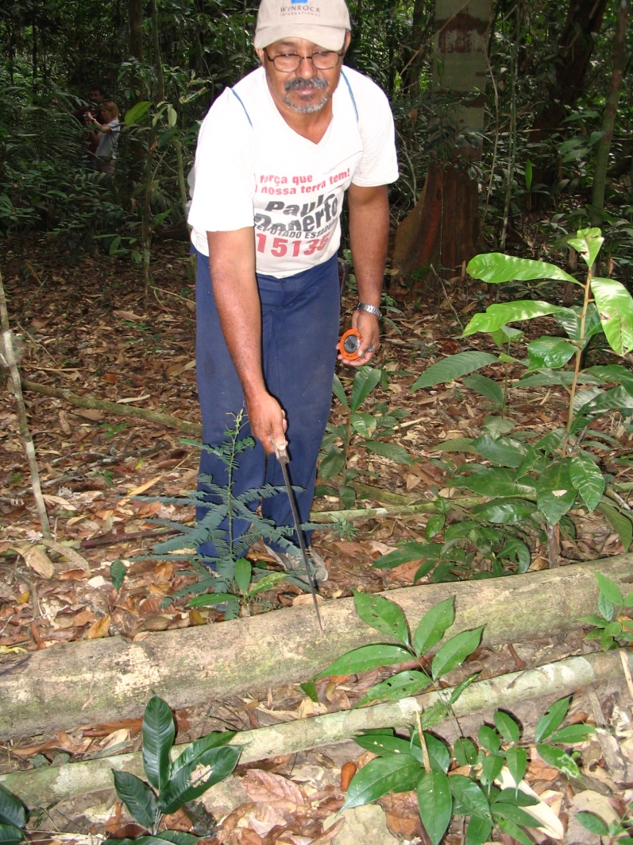
Estimation of Dead Wood Density
All dead wood is classified into one of three density classes
  Rotten – Disintegrates when struck with machete
  Intermediate – Machete sinks into wood
  Sound – Machete bounces off wood
Notes:
KEY MESSAGES:
Wood density is estimated with a very simple test. Dead wood is classified into one of three groups: sound- similar to live trees, intermediate- some effects of decomposition and finally rotten- disintegrates when struck with a machete- in the final stages of decomposition.
Image Source:
Winrock International. Slide 19 in 2012 presentation: http://www.ffpri.affrc.go.jp/redd-rdc/ja/seminars/reports/2012/02/07/01/feb_8_wed/16_Sarah_Walker_session2_0208.pdf

Slide 33
Estimation of Dead Wood Density
Collect samples of each density class
  Remove a “slice” from dead log
  Determine volume of slice – may need to measure space where slice was taken from in rotten logs
  Place sample in paper/cloth bag and remove to laboratory
In laboratory
  Dry sample to constant mass
  Use constant mass to estimate dry weight in volume of dead wood
Notes:
KEY MESSAGES:
Collect samples of known volume (or samples where volume can be determined) and bring them to the lab to be oven-dried so that dry mass can be determined. Once you have volume and dry mass you can calculate wood density. With multiple samples for each class you can calculate a mean density for each of the three classes.

Slide 34
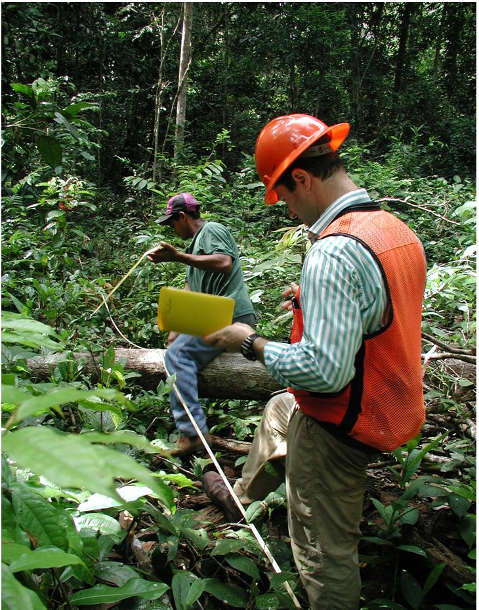
Measurement of Fallen Dead Wood
Fallen dead wood is measured using line-intersect method (Harmon and Sexton 1996)
50 m
50 m
Notes:
KEY MESSAGES:
As mentioned before fallen dead wood is usually measured on transects. Each fallen log that intersects the transect line is counted
Image source: http://www.intechopen.com/source/html/31970/media/image2.jpeg

Slide 35
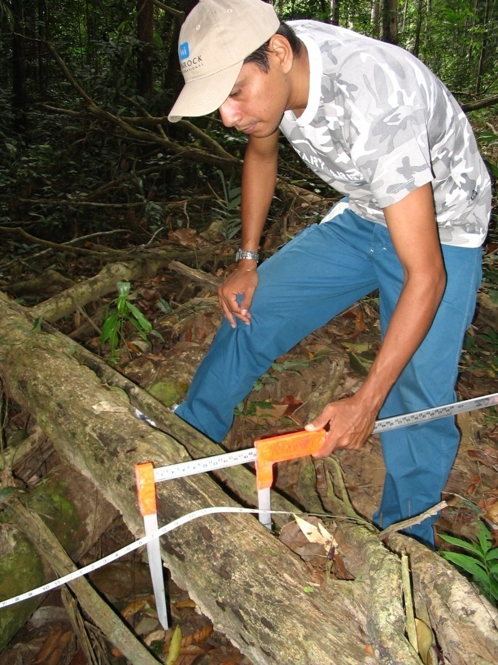
Measurement of Fallen Dead Wood
For each piece of wood measure:
  Diameter
    Use calipers (or DBH tape)
  Wood density class: sound, intermediate, rotten
At next sampling period, use a new transect
Notes:
KEY MESSAGES:
For each fallen log that intersects the transect measure the diameter at the point where the log meets the transect and record the wood density class.
Image Source:
Photo taken in northern Brazil by Dr. Sarah Walker, Winrock International.

Slide 36
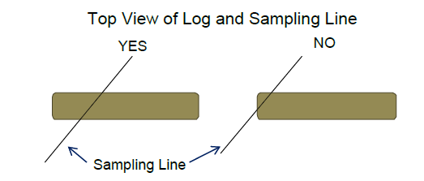
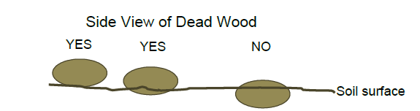
SOP Measurement of Fallen Dead Wood
Fallen dead wood = all woody material on the ground with a minimum diameter ≥ 10 cm
  Smaller diameter pieces sampled with litter pool
Fallen dead wood intersecting transect is measured if:
  ≥ 50% of the log is aboveground
  Line crosses ≥ 50% of diameter
Notes:
KEY MESSAGES:
Logs that are buried or only touch the transect are not included in the survey.
Image source:
Walker et al. 2014. Standard Operating Procedures for Terrestrial Carbon Measurement: Version 2014. Winrock International

Slide 37
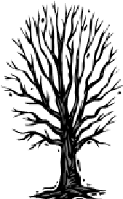
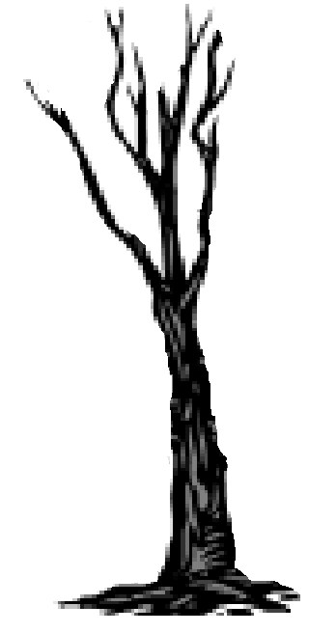
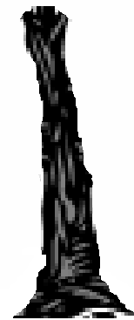
Measurement of Standing Dead Wood
Within live tree plots, standing dead trees should also be measured and classified into two classes
    Class 1: Tree with branches and twigs and resembles a live tree (except for leaves)
    Class 2: Trees ranging from those containing small and large branches to those with bole only
Class 1
Class 2
Class 2
Notes:
KEY MESSAGES:
Standing dead wood is divided into two classes that are measured differently.
Image Source:
Walker et al. 2014. Standard Operating Procedures for Terrestrial Carbon Measurement: Version 2014. Winrock International

Slide 38
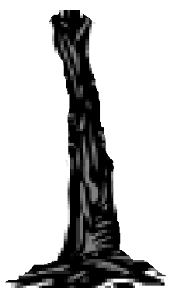
Measurement of Standing Dead Wood
Class 1 trees:
  Measured DBH using methods for live trees
  Note tree as DEAD on datasheet
Class 2 trees:
  Measure DBH using methods for live trees
  Measure diameter at base of tree
  Measure height of bole using a clinometer
  Measure diameter at top directly if possible
DBH (cm)
D_{top} (cm)
H (m)
DBH (cm)
D_{base} (cm)
Notes:
KEY MESSAGES:
Class 1 trees are treated the same as live trees in the field but it is important to make sure they are marked as DEAD on the field data sheet
Class 2 trees require more data- diameter at the trunk and top (if possible) as well as height.
Image source:
Walker et al. 2014. Standard Operating Procedures for Terrestrial Carbon Measurement: Version 2014. Winrock International

Slide 39
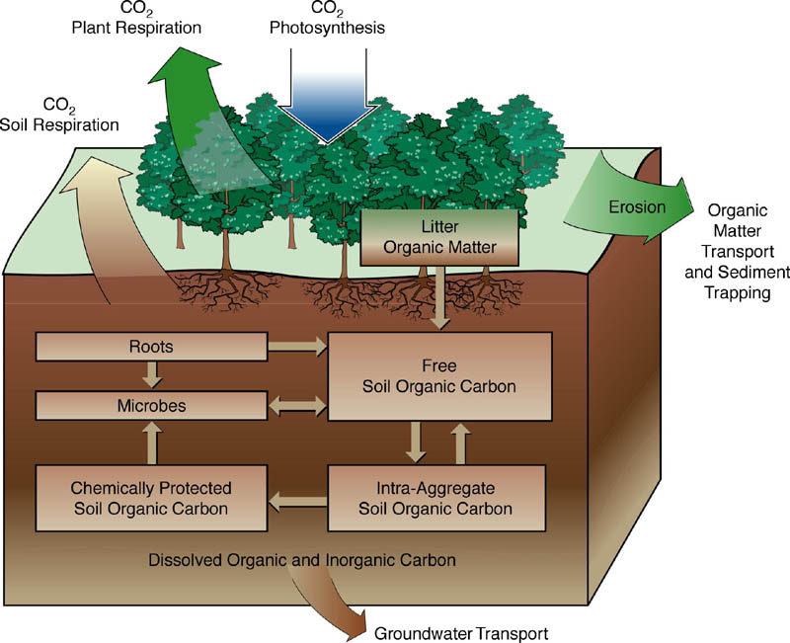
Soil Carbon
Notes:
KEY MESSAGES:
Soil carbon can be found as organic as well as inorganic carbon. Inorganic carbon in soils is usually bicarbonates and only found in soils with relatively high pH, organic carbon is decaying organic matter as well as material transformed by microbial processing.
Soil carbon is often divided into 3 or more pools: fast, intermediate, and slow cycling pools. Fast cycling carbon is usually oxidized to CO2 in a year or less while slow cycling pools can remain in the soil for centuries.
Image Source:
http://www.gaiaengineering.com/sustainability.role_soil_sequestration.php

Slide 40
Measurement of Soil Carbon
Sampling will take place outside of tree plots
Can use same locations as non-tree vegetation and litter sampling
At next sampling period, measure in different location
To calculate need two measurements:
  Concentration of carbon in soil
  Bulk density
Notes:
KEY MESSAGES:
Soil carbon pools require a measurement of soil bulk density (grams of soil per cm3) as well as soil carbon concentration. Bulk density requires a fresh weight of a sample of known volume (can be done in the field) as well as a fresh and dry weight of a subsample so that density can be reported on a dry weight basis. Carbon concentration is commonly measured using combustion of the sample and measurement of the CO2 produced though there are also wet chemisty methods.

Slide 41
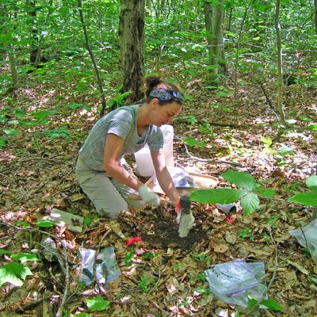
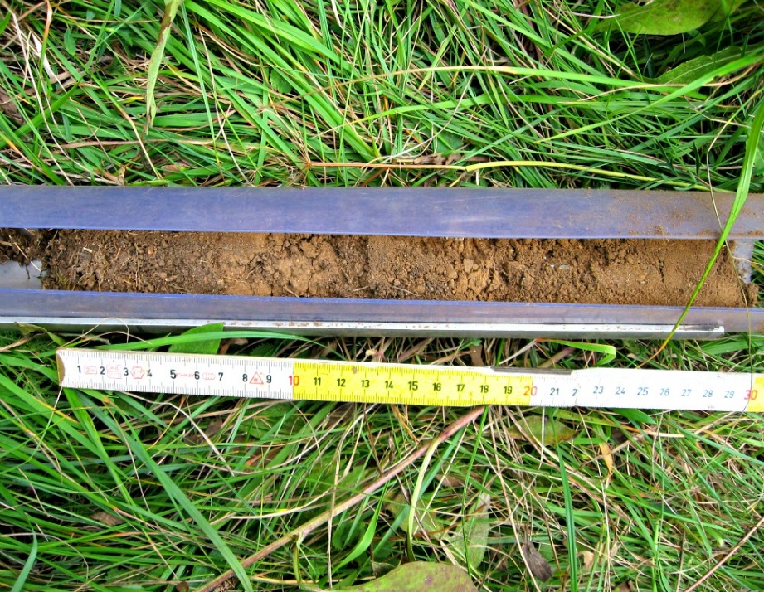
Measurement of Soil Carbon
Remove all vegetation and litter from the soil surface
Insert soil probe to standard depth (30 cm)
If depth of soil < standard depth, record depth of soil
Notes:
KEY MESSAGES:
Soil samples are taken in the field using a probe or auger. The depth to be collected should be determined before going into the field. Sub-samples for dry weight analysis and for carbon analysis can be collected from the bulk density core after it has been weighed or the carbon sample could be collected separately. To better represent the sample plot you can pool or aggregate the soil carbon samples into one larger sample in the field
Image sources
https://encrypted-tbn1.gstatic.com/images?q=tbn:ANd9GcQotmFB4Dj8iaJZQuNqvXYE6O7Vx2SIl5jAk2_eDVVfxIt-doUm
http://gsoil.files.wordpress.com/2013/05/img_4051.jpg

Slide 42
SOP Measurement of Soil Bulk Density
For bulk density analysis:
Insert soil probe to 30 cm depth as for the carbon sampling
Place ALL the soil from FULL soil probe into cloth bag – if probe is not full, sample must be discarded and taken again
Collect two bulk density samples per plot and aggregate
Place in cloth bag
Notes:
KEY MESSAGES:
To determine the volume of soil collected you need the exact depth sampled as well as the diameter of the soil probe.
For density measurements corers of diameters at least 2.5 inches in diameter are preferred as the effect of compaction during sampling is minimized. If large rocks or roots are found in the bulk density samples once in the lab they should be removed from the sample weighed and their volume calculated. The weight and volume of the non-soil components (wood,rocks) should be removed from the original weight and volume when calculating density.

Slide 43
Field Exercise
Divide class into groups
Group organization
Collect plot data from nearby forest – each group should complete one carbon plot
Prepare and present field report
Field measurements will be used later in course for carbon stock calculation exercise
Notes:
KEY MESSAGES:
This lesson will be taught in the field using “Field Manual on Terrestrial Carbon Stock Measurements – Companion to LEAF Carbon Curriculum – Carbon Measurement and Monitoring Module”. In the field or before the field trip students should receive guidance on the format of the field report and necessary calculations.

Slide 44

Data Management
Why is data management important?
Notes:
KEY MESSAGES:
What do we mean by data management and why is it important.
After the field exercise continue in the next lecture period with a discussion of data management. Student discussion on the importance of data management. Get students to present their ideas on what data management is and why it is important.

Slide 45
Data Management Flow
Field Work
Data Recording
Data Entry
Data quality
Data Analysis
Report
Notes:
KEY MESSAGES:
Data management is the process of handling and ensuring the quality of the data from the point of collection in the field (or lab) through the process of calculations and finally report generation. Management ensures that data quality is checked and protected.

Slide 46
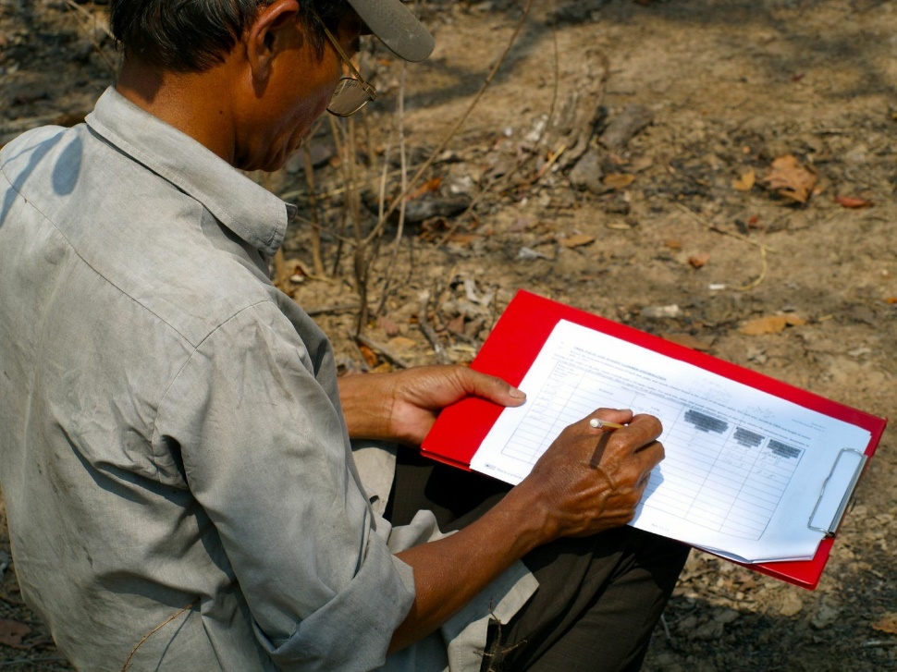
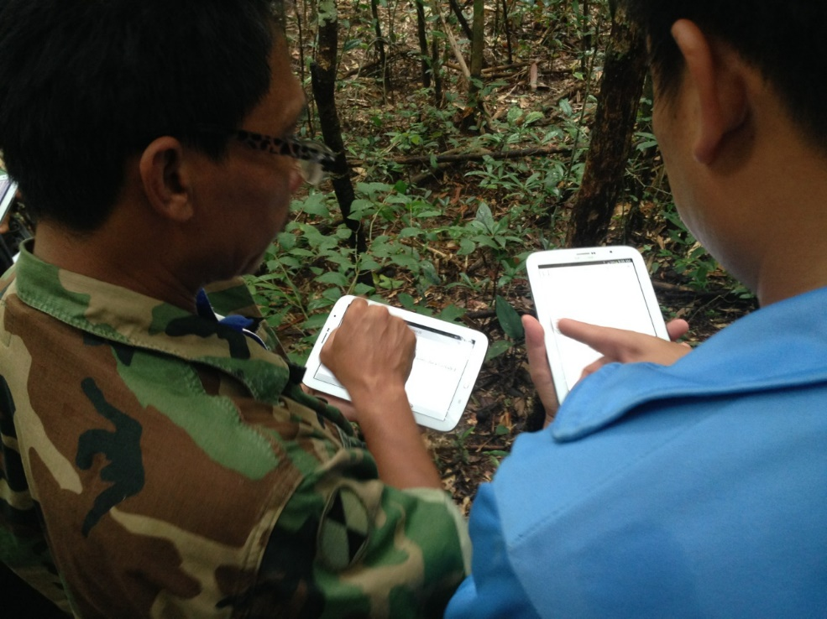
Field Data Management
Data collection in the field
Handwritten in data sheets
Surveys in handheld computers
Notes:
KEY MESSAGES:
The first step is data collection in the field or lab. It is important to have well organized and clear data sheets thought out ahead of time and make clear what units are being used for each measurement. When possible work in teams and double check values as they are recorded. It is important to emphasize that data management requires a plan well before going into the field.
Image sources:
http://www.ifriresearch.net/wp-content/uploads/2013/03/Kratie.jpg
http://forest-carbon.org/wp-content/uploads/2013/10/IMG_2977-150x150.jpg

Slide 47
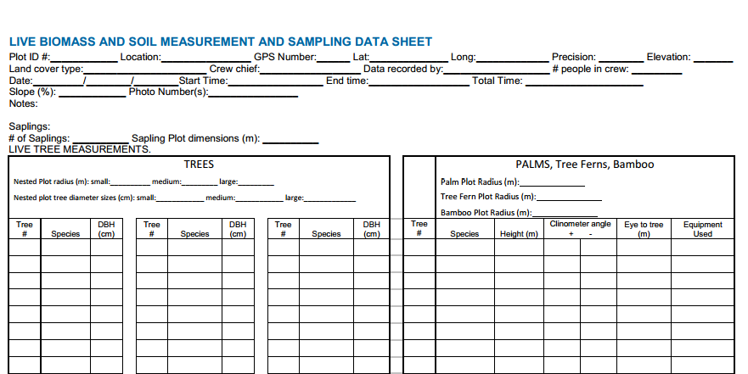
Live Biomass Datasheet
Notes:
KEY MESSAGES:
Example of a data sheet available in the Winrock manual. Students who participated in the field work exercise have some experience with data sheets and have them comment on their experience.
Data sheet source:
Walker et al. 2014. Standard Operating Procedures for Terrestrial Carbon Measurement: Version 2014. Winrock International

Slide 48
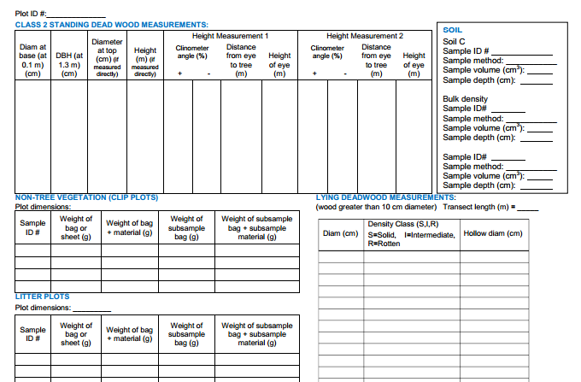
Dead Wood Measurements Datasheet
Notes:
KEY MESSAGES:
Each pool will have its own datasheet as data are collected in different ways as was discussed in the previous lecture
Data sheet source:
Walker et al. 2014. Standard Operating Procedures for Terrestrial Carbon Measurement: Version 2014. Winrock International

Slide 49
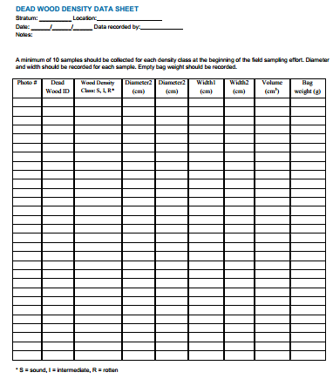
Dead Wood Density Datasheet
Notes:
KEY MESSAGES:
Each pool will have its own datasheet as data are collected in different ways as was discussed in the previous lecture
Data sheet source:
Walker et al. 2014. Standard Operating Procedures for Terrestrial Carbon Measurement: Version 2014. Winrock International

Slide 50
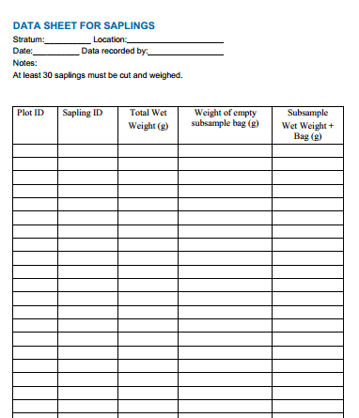
Saplings Datasheet
Notes:
KEY MESSAGES:
Each pool will have its own datasheet as data are collected in different ways as was discussed in the previous lecture
Data sheet source:
Walker et al. 2014. Standard Operating Procedures for Terrestrial Carbon Measurement: Version 2014. Winrock International

Slide 51
Field Data Management
Notes:
KEY MESSAGES:
Management covers everything that happens after data collection that helps turn data into information. Data need to be converted from written notes to computer files and those need to be checked to ensure no mistakes were made in data entry. The computerized and original written copies need to be archived so people can go back and double check measurements and other information.
Image source:
Walker et al. 2014. Standard Operating Procedures for Terrestrial Carbon Measurement: Version 2014. Winrock International

Slide 52
Take Home Message
Standard Operating Procedures for forest carbon pools measurements allow for consistency across time and among teams
Each carbon pool in the forest has a separate sampling procedure and requires a unique datasheet for recording measurements
Data management is a process from the point of data collection through report writing that ensures the integrity and quality of the data

Slide 53
References
USAID. 2015. USAID LEAF‘s Climate Change Curriculum. USAID Lowering Emissions in Asia Forests Program (USAID LEAF). Winrock International and US Forest Service. Bangkok, Thailand.
Ashton, M.S., Tyrrell, M.L., Spalding, D., and Gentry, B. (Eds.). 2012. Managing Forest Carbon in a Changing Climate. Springer. ISBN 978-94-007-2232-3
CIFOR, 2011. Standards and Methods Available for Estimating Project-Level REDD+ Carbon Benefits. Reference Guide for Projects Developer. Working Paper 52
Walker, S.M., Pearson, TRH, Casarim, N, Harris, N, Petrova,S, Grais, A, Swails, E, Netzer, M, Goslee, KM and Brown, S. 2014. Standard Operating Procedures for Terrestrial Carbon Measurement: Version 2014. Winrock International.

Slide 54
References and Resources
The curriculum of USAID’s Climate-Resilient Ecosystems and Livelihoods (CREL) in Bangladesh is a free resource of teaching materials for university professors, teachers and climate change training experts.
Reproduction of CREL’s curriculum materials for educational or other non-commercial purposes is authorized without prior written permission from the copyright holder, provided the source is fully acknowledged.
Suggested citation: Winrock International. 2016. USAID‘s Climate-Resilient Ecosystems and Livelihoods (CREL). Winrock International. Dhaka, Bangladesh.
Disclaimer: The CREL’s curriculum is made possible by the support of the American People through the United States Agency for International Development (USAID). The contents of the curriculum do not necessarily reflect the views of USAID or the US Government.

Slide 55
USAID's Climate-Resilient Ecosystems and Livelihoods (CREL) Project
Winrock International Headquarters
2101 Riverfront Drive, Little Rock
Arkansas 72202-1748 USA
Tel: 1-501-280-3000
Web: www.winrock.org

