Slide 1
Bangladesh Climate-Resilient Ecosystem Curriculum (BACUM)
Module 3: Forest Carbon Measurement and Monitoring

Slide 2
Module 3: Forest Carbon Measurement and Monitoring
SECTION II: FOREST CARBON STOCKS AND IPCC GUIDELINES
2.1. Overview of Forest Carbon Pools (Stocks)

Slide 3
Forest Carbon Measurement and Monitoring (FCMM)
FUNDAMENTALS OF FOREST CARBON IN REDD+ CONTEXT
  1.1. Forests, the Global Carbon Cycle and Climate Change
  1.2. The Roles of Forests and Forest Carbon in Global Climate Negotiations
  1.3. Challenges for Forest-based Climate Change Mitigation
FOREST CARBON STOCKS AND IPCC GUIDELINES
  2.1. Overview of Forest Carbon Pools (Stocks)
  2.2. Land Use, Land Use Change, and Forestry (LULUCF)
  2.3. IPCC Guidelines for Forest Carbon Measurement and Monitoring
  2.4. Reference Levels – Monitoring against a Baseline
FOREST CARBON MEASUREMENT AND MONITORING METHODS
  3.1. Overview of Forest Carbon Measurement and Monitoring
  3.2. Quality Assurance and Quality Control (QA/QC)
  3.3. Field Sampling Design Methods
  3.4. Forest Carbon Field Measurement Methods
  3.5. Carbon Stock Calculation and Available Tools
  3.6. Creating Activity Data and Emissions Factors
  3.7. Considerations in Developing a Monitoring System

Slide 4
Acknowledgements
EXPERT CONTRIBUTORS | SPECIFIC INPUTS
Prof. (Dr.) Manzoor Rashid | Curriculum Development for all topics
Prof. (Dr.) Md. Danesh Miah | REDD+, Forest Carbon
Prof. (Dr.) Md. Jakariya | Community NR Management, Climate Change, Natural Resources Management
UNIVERSITIES
Bangladesh Agricultural University
University of Chittagong
Dhaka University
Independent University, Bangladesh
Khulna University
Noakhali University of Science and Technology
Shahjalal University of Science and Technology
Sher-e-Bangla Agriculture University
North South University
CREL STAFF | CREL STAFF
John A Dorr | Utpal Dutta
Abu Mostafa Kamal Uddin | Ruhul Mohaiman Chowdhury
Kevin T. Kamp | Rahima Khatun
Paul Thompson | Sultana Razia Zummi
Abdul Wahab | Shams Uddin
Shahzia Mohsin Khan
DESIGN, LAYOUT AND CONTENT DEVELOPMENT: Ms. Chi Pham, Curriculum Development Expert, Bangkok, Thailand

Slide 5
Learning Objectives
At the end of this session, students will be able to:
Define the major forest carbon pools
Analyze drivers of variation in forest carbon stocks
Notes:
KEY MESSAGES:
Learners will be able to define the major pools of carbon in forest ecosystems and how they vary with environmental conditions

Slide 6
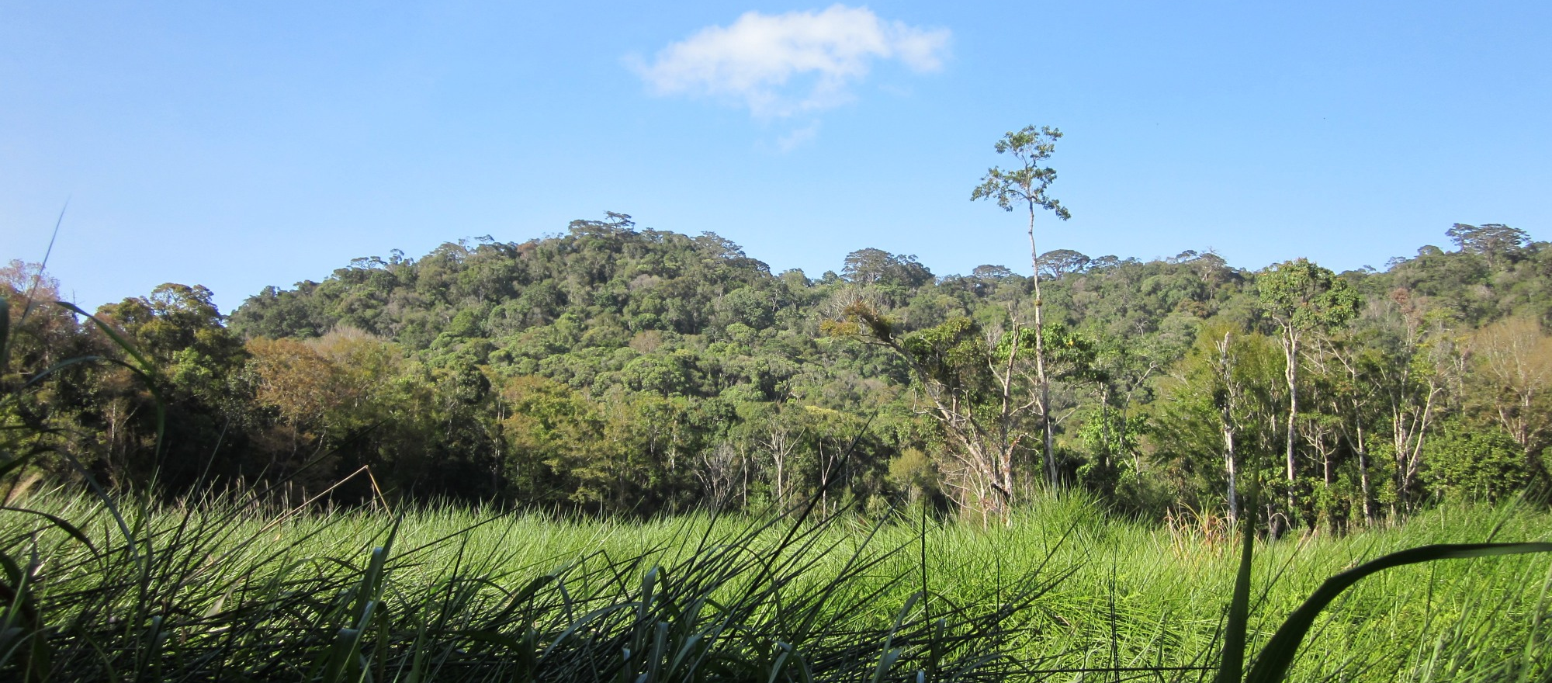
Brainstorming
Where is carbon found in forests?
Notes:
KEY MESSAGES:
Give students a few minutes to think about the question: Where is carbon found in forests?
They can pair up or team up in small group to offer suggestions.
Photo Source:
Courtesy of Mrs. Chi Pham, USAID LEAF Program

Slide 7
Forest Carbon Pools
Forest carbon is stored in five pools within and around vegetation
  Above-ground biomass:
  stems, bark, leaves, etc.
  Below-ground biomass:
  roots of all sizes
  Dead wood or dead
  organic matter in dead wood
  Litter or dead organic matter in
  litter
  Soil organic carbon (SOC)
Notes:
KEY MESSAGES:
There are 5 major pools of carbon found in natural forests. Pools may vary in absolute and relative size across landscapes and biomes: in some forests most of the carbon is found in the aboveground biomass, in others most of the carbon is found in the soil.
The pools also have different rates of turnover and carbon accumulation. In managed forests Harvested Wood Products (HWPs) are considered the 6th carbon pool, although no longer part of the forest ecosystem, because they store carbon in some cases for the long term.
Suggestions:
Discuss with students which pools they think are the largest and which ones are long-term and which ones are shorter-term. Biomass and soils are generally the largest and longest lived pools while litter and dead wood tend to be smaller and shorter lived.
Image source:
Vickers, B. et al. 2012. Community guidelines for accessing forestry voluntary carbon markets Chapter 1 Forests and Climate Change FAO Regional Office for Asia and the Pacific. http://www.fao.org/docrep/016/i3033e/i3033e01.pdf

Slide 8
Flows Among Carbon Pools
Atmospheric Carbon (CO2)
Photosynthesis
Respiration
Mortality
Decomposition
Exudation
Notes:
KEY MESSAGES: The 5 major forest carbon pools are connected to one another and to the atmospheric carbon pool through a number of important fluxes.
Notes: The first step is photosynthesis where atmospheric CO2 is “fixed” into organic molecules in the plant canopy. These organic molecules then build above and belowground biomass ( blue arrow). When the leaves, branches and entire trees die the carbon is transferred from the biomass pools to litter (leaves and small branches), dead wood (larger branches and stems) pools ( black arrows). Through decomposition carbon from the litter and dead wood pools are transferred to the soil organic matter pool ( brown arrows). In addition some carbon is exuded from the live root biomass into the soil organic matter pool (green arrow). Finally all living cells respire or breathe out CO2 back to the atmosphere so the above and belowground biomass, the soil microbial community and the microbes living on and decomposing the leaf litter and dead wood all send carbon back to the atmosphere as CO2 (yellow arrows)
Image adapted from:
Vickers, B. et al. 2012. Community guidelines for accessing forestry voluntary carbon markets Chapter 1 Forests and Climate Change FAO Regional Office for Asia and the Pacific. http://www.fao.org/docrep/016/i3033e/i3033e01.pdf

Slide 9
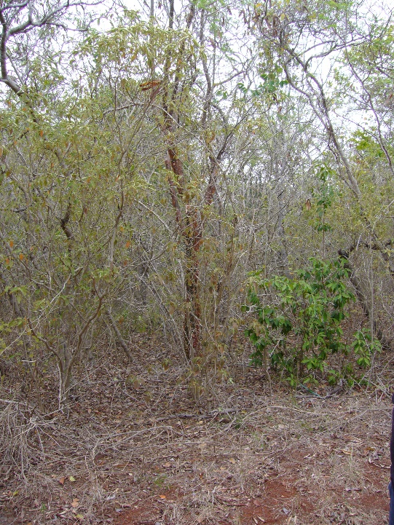
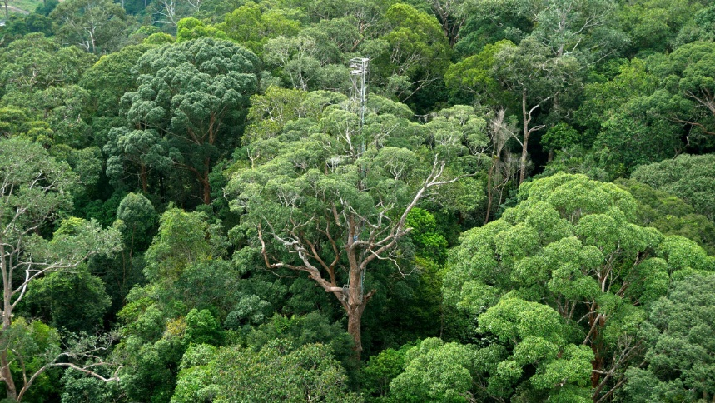
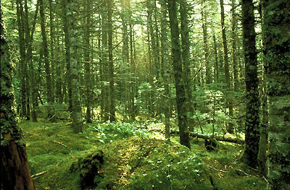
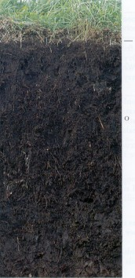
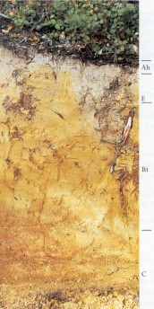
Variation in forest carbon stocks
Wet tropical forest
Boreal forest
Dry tropical forest
Organic
soil
Ultic
soil
Notes:
KEY MESSAGES:
The absolute and proportional amounts of carbon in each pool vary widely at both landscape and biome scales
Climatic factors like precipitation (moisture) and temperature can affect carbon pool sizes as can soil nutrient status. Patterns can be seen at landscape to biome spatial scales. Again the most well-studied pools are aboveground biomass and soils and here are some examples of how they vary with climate factors
Photo source:
dry tropical forest Guanica Puerto Rico photo from Megan McGroddy: wet tropical forest http://www.gcb.uzh.ch/Research/TestSites/Malaysian.html; boreal forest http://www.thecanadianencyclopedia.ca/en/article/boreal-foest/
Soil profiles http://soils.landcareresearch.co.nz/contents/SoilNames_NZSoilClassification_SoilOrders.aspx

Slide 10
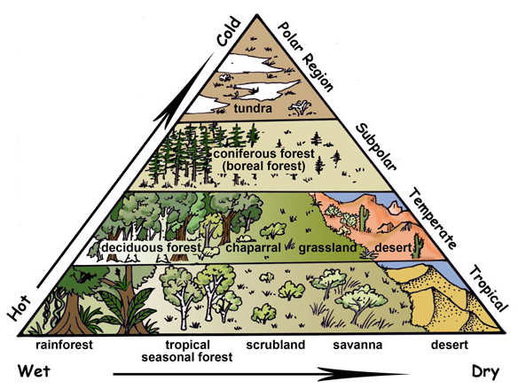
Introduction to forest biomes
Biomes on earth
Forests are found from the tropics to sub-polar regions
Where water is limiting forests cede to grasslands and deserts
Notes:
KEY MESSAGES:
Different forest biomes are found in different climates- determined by both rainfall and temperature. Forests are not found in the driest and coldest parts of the Earth but are found everywhere else.
The graph shows that biomes were formed by climate (rain and temperature) and location on Earth (tropics to polar regions).
Image source:
http://www.exploringnature.org/db/detail.php?dbID=27&detID=1190

Slide 11
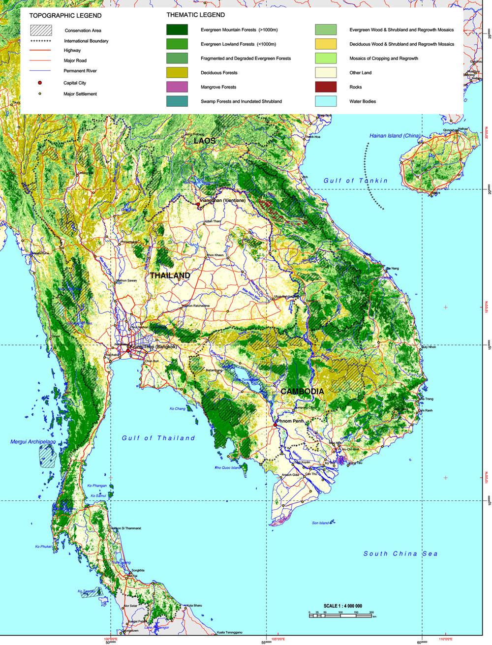
Landscape Variation
At smaller spatial scales, climate factors (microclimate) and variation in soil factors result in different forest types distributed across the landscape
Notes:
KEY MESSAGES:
At smaller spatial scales, variation in soil nutrients become important in determining the species composition and biomass of forests occurring across the landscape. Precipitation and temperature continue to be important drivers as well.
Notes: The image here is a map of naturally occurring forest types in Thailand- you can probably find a similar map for any country in SE Asia if you want to substitute your own country in as an example. Students can discuss what they think controls the distribution shown in the map.
Map source:
http://www.learnnc.org/lp/multimedia/9518

Slide 12
Class Exercise Individual exploration
Visit the GRID-Arendal website to explore information on variations in carbon stocks of different biomes (or information in hard copy is provided and answer the following questions)
  What are the top two biomes that store the greatest amount of carbon?
  Where majority of their carbon is stored and why?
Notes:
KEY MESSAGES:
Steps:
1. Let students explore the given website for about 25 mins ( if no web access in the classroom print out the biome carbon stock tables as handouts for the students instead)
2. Let students answer the questions and share their answers to the class and discuss for about 10 mins
- Tropical and sub-tropical forest stores greatest carbon and its carbon is stored mainly in aboveground vegetation.
- Boreal forest stores second greatest carbon and its carbon is stored mainly in soil and litter.
Reference:
Website for biome map is www.grida.no/graphicslib/detail/carbon-stored-by-biome_9082

Slide 13
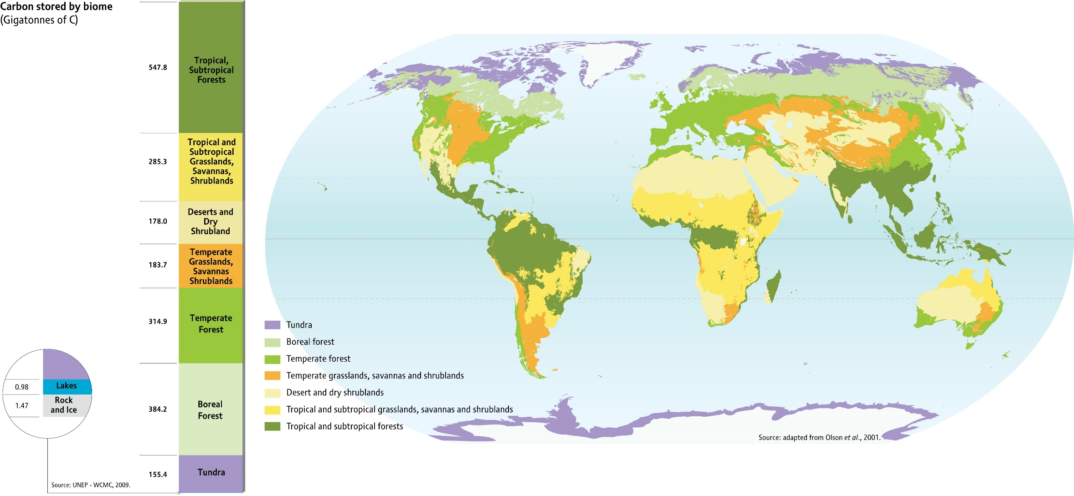
Biomass and soil - C stocks in different biomes
Source: www.grida.no
Notes:
KEY MESSAGES:
Terrestrial ecosystems store almost three times as much carbon as is stored in the atmosphere.
Notes: Tropical and boreal forests represent the largest stores, almost 550 and 384 Gt respectively. Deserts and dry shrublands have very little aboveground biomass but are significant soil carbon reservoirs and cover very large areas. The tundra biome covers the smallest area, but has the highest density of carbon storage.
You can discuss with or ask your students where you expect the highest biomass carbon storage and where the highest soil pool storage and why for each- see what they think are the important drivers of storage and where the largest pools are found answers are on the next slide
Map Source:
http://www.grida.no/publications/rr/natural-fix/page/3724.aspx

Slide 14
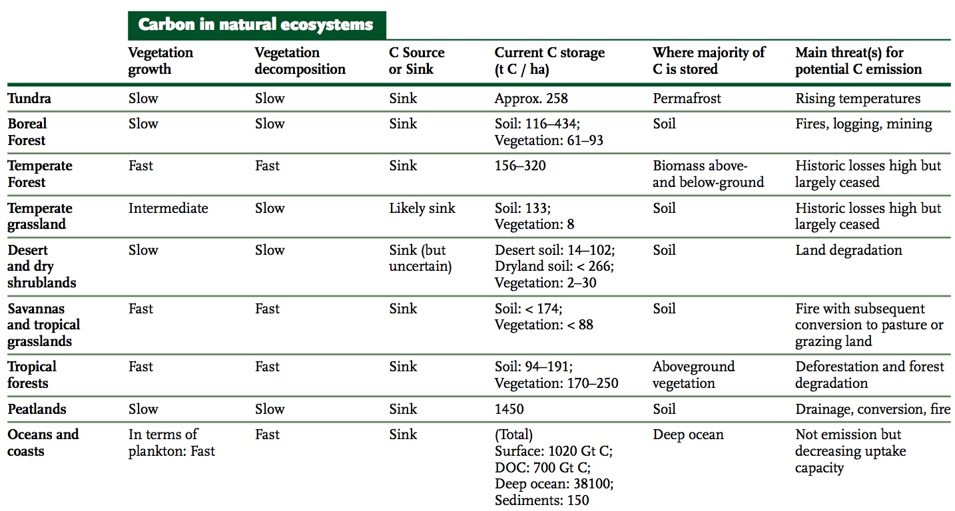
Summary of Carbon Stocks and Trends in Different Biomes and Oceans
Source: Trumper et al. (2009)
Notes:
KEY MESSAGES:
Different forest types / biomes store different amounts of carbon and whether carbon is in the vegetation or soil depends on the type / biome.
Notes:
- Tropical forest stores greatest carbon and its carbon is stored mainly in aboveground vegetation.
- Boreal forest stores second greatest carbon and its carbon is stored mainly in soil.
-- Peatlands also store huge amounts of carbon and are not well studied.
Chart source:
Trumper, K., Bertzky, M., Dickson, B., van der Heijden, G.,Jenkins, M., Manning, P. June 2009. The Natural Fix? The Role of Ecosystems in Climate Mitigation. A UNEP Rapid Response Assessment. United Nations Environment Programme, UNEPWCMC, Cambridge.
Image Source:
http://www.grida.no/graphic.aspx?f=series/rr-the-natural-fix/figure16.jpg

Slide 15
Class Exercise Analytical skill
Consider the Table Carbon stock in forest by region and sub-region in 2010 and answer the following questions
  Which region has the highest total carbon stock? Why?
  What percent of the global carbon stock does it account for ?
  Please also look at the data of total Carbon stock in Asia. What can you say about this?
Notes:
KEY MESSAGES:
Steps:
Let students have a look at the Table Carbon stock in forest by region and sub-region in 2010 from FAO report (chart is produced on the next slide and could be printed out as a handout for the class)
Let students answer the questions and share their answers to the class for about 15 mins
- South America has the greatest carbon stock accounting for 29% of the global carbon stock
If you have internet in the classroom you could project the table or have students access it on their laptops or alternatively you can make copies of the tables as handouts and pass them out in class. To avoid confusion note that regions are identified with Total ( Total Africa, Total Asia etc)

Slide 16
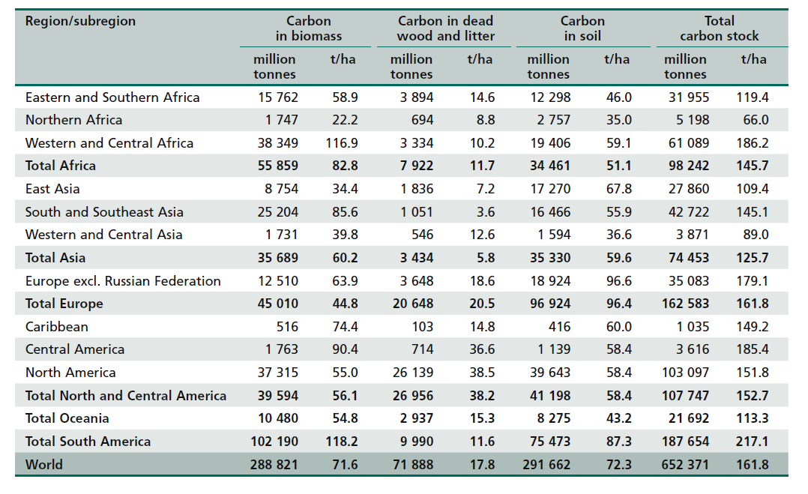
Carbon in Forest by Region/Sub-region in 2010
Source: FAO (2010)
Notes:
KEY MESSAGES:
This table has both total carbon stock and carbon stock per hectare for various regions and sub regions. Carbon stocks depend on both carbon density (t/ha) and total area. Were the students surprised that South America has the highest stocks and density? What factors are driving that and why do they think Asia is so much lower than South America in terms of both total stocks and density.
Table source:
FAO. 2010. Forest Genetic Resources Assessment 2010: Main Report. Food and Agriculture Organization of The United Nations, Rome. Table 2-21
Image Source:
http://www.fao.org/docrep/013/i1757e/i1757e.pdf
Version date Oct 01 2015

Slide 17
Total Carbon Stock in Forest by Region in 2010
Source: Data from FAO (2010)
Notes:
KEY MESSAGES:
South America has the greatest carbon accounting for 29% of the global carbon stock Asia ,Africa and Oceania the other tropical regions represent much less forest carbon- Africa and Asia in part because so much of the area is dry and in part due to heavy deforestation. Oceania has low forest values mainly due to the limited land mass.
Chart source:
Chart created by RECCD team members from data in FAO. 2010. Forest Genetic Resources Assessment 2010: Main Report. Food and Agriculture Organization of The United Nations, Rome.
http://www.fao.org/docrep/013/i1757e/i1757e.pdf
Image Source: Created by CMM team as note above from FAO data

Slide 18
Class Exercise: Analytical skill
Consider the Table Trends in carbon stocks in forest biomass by region and sub-region, 1990–2010 and answer the following questions
  Which region has the lowest carbon stock in forest biomass per unit land area during 1990-2010 ? Why?
  Which region has the lowest carbon stocks in forest biomass in 2010 ? Why?
Notes:
Exercise Objective:
This exercise will provide some ideas to the deforestation and forest degradation and their drivers.
Steps:
1. Let students have a look at Table Trends in carbon stocks in forest biomass by region and subregion, 1990–2010 from the FAO 2010 report reproduced on the following slide
2. Let students answer the questions and share their answers to the class and discuss the answer for about 15 mins
- Europe has the lowest carbon stocks in forest biomass per unit land area.
- Oceania has the lowest carbon stocks accounting in forest biomass for only 4% of the global carbon stock in forest biomass

Slide 19
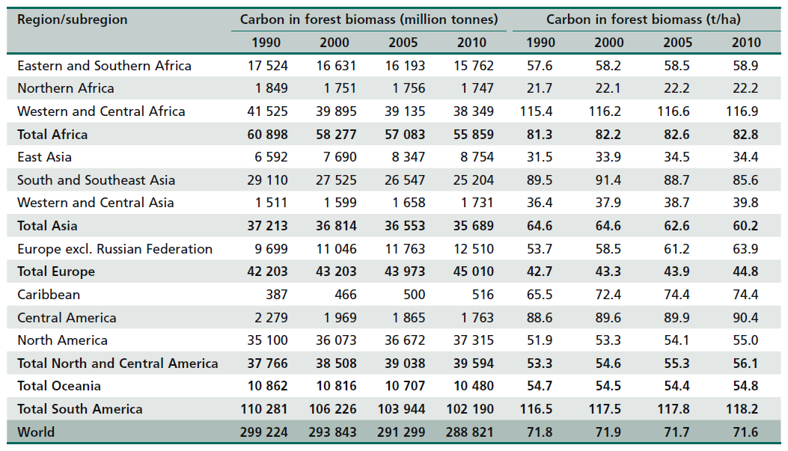
Trends in forest C stocks by region and sub-region, 1990–2010
Source: FAO (2010)
Notes:
KEY MESSAGES:
Europe has the lowest carbon stocks in forest biomass per unit land area.
Oceania has the lowest carbon stocks accounting in forest biomass for only 4% of the global carbon stock in forest biomass.
Chart Reference:
FAO. 2010. Forest Genetic Resources Assessment 2010: Main Report. Food and Agriculture Organization of The United Nations, Rome.
http://www.fao.org/docrep/013/i1757e/i1757e.pdf

Slide 20
Carbon stock in forest biomass by region in 2010
Source: Data from FAO (2010)
Notes:
KEY MESSAGES:
When we look only at carbon in biomass (so excluding soils) the proportion stored in tropical regions, particularly South America and Africa increases compared to the pattern for total carbon seen in the last pie chart.
Ask the students to explain this pattern. HINT: go back to the table that shows carbon distribution for different biomes and compare soil and biomass importance in temperate and tropical forests.
Oceania (island countries in Pacific ocean) still has a very small proportion of the biomass carbon globally again due largely to low land mass.
Chart Source:
Chart was generated by RECCD team members using data from FAO. 2010. Forest Genetic Resources Assessment 2010: Main Report. Food and Agriculture Organization of The United Nations, Rome.

Slide 21
Take Home Message
All forests have 5 major pools where carbon is stored with aboveground biomass and soil that are the most important pools
The distribution of forest biomes is largely driven by precipitation and temperature
The absolute and proportional amounts of carbon in soil and aboveground biomass are controlled by precipitation and temperature, and at local scales by soil nutrients as well.

Slide 22
References and Resources
USAID. 2015. USAID LEAF‘s Climate Change Curriculum. USAID Lowering Emissions in Asia Forests Program (USAID LEAF). Winrock International and US Forest Service. Bangkok, Thailand.
FAO. 2010. Forest Genetic Resources Assessment 2010: Main Report. Food and Agriculture Organization of The United Nations, Rome.
FAO. 2012. Community Guidelines for Accessing Forestry Voluntary Carbon Markets. RAP Publication 2012/16. Food and Agriculture Organization of The United Nations, Rome.
Trumper, K., Bertzky, M., Dickson, B., van der Heijden, G.,Jenkins, M., Manning, P. June 2009. The Natural Fix? The Role of Ecosystems in Climate Mitigation. A UNEP Rapid Response Assessment. United Nations Environment Programme, UNEPWCMC, Cambridge.
Le Quéré, C., R. Andres, T. Boden, T. Conway, R. Houghton, J. House, G. Marland, G. Peters, G. van der Werf, A. Ahlström, R. Andrew, L. Bopp, J. Canadell, P. Ciais, S. Doney, C. Enright, P. Friedlingstein, C. Huntingford, A. Jain, C. Jourdain, E. Kato, R. Keeling, K. Klein Goldewijk, S. Levis, P. Levy, M. Lomas, B. Poulter, M. Raupach, J. Schwinger, S. Sitch, B. Stocker, N. Viovy, S. Zaehle and N. Zeng (2012), “The Global Carbon Budget 1959–2011”, Earth System Science Data, http://www.earth-syst-sci-data.net/6/235/2014/essd-6-235-2014.html, DOI:10.5194/essdd-5-1107-2012
Global Carbon Budget. 2012. Carbon Budget 2012: An Annual Updates of Global Carbon Budget and Trends. Available Source: http://www.globalcarbonproject.org/carbonbudget/index.htm.
Kissinger, G., M. Herold, V. De Sy. 2012. Drivers of Deforestation and Forest Degradation: A Synthesis Report for REDD+ Policymakers. Lexeme Consulting, Vancouver.
GRID-Arendal website: http://www.grida.no/publications/rr/natural-fix/page/3724.aspx
Earthlabs website: http://www.grida.no/publications/rr/natural-fix/page/3724.aspx

Slide 23
References and Resources
The curriculum of USAID’s Climate-Resilient Ecosystems and Livelihoods (CREL) in Bangladesh is a free resource of teaching materials for university professors, teachers and climate change training experts.
Reproduction of CREL’s curriculum materials for educational or other non-commercial purposes is authorized without prior written permission from the copyright holder, provided the source is fully acknowledged.
Suggested citation: Winrock International. 2016. USAID‘s Climate-Resilient Ecosystems and Livelihoods (CREL). Winrock International. Dhaka, Bangladesh.
Disclaimer: The CREL’s curriculum is made possible by the support of the American People through the United States Agency for International Development (USAID). The contents of the curriculum do not necessarily reflect the views of USAID or the US Government.

Slide 24
USAID's Climate-Resilient Ecosystems and Livelihoods (CREL) Project
Winrock International Headquarters
2101 Riverfront Drive, Little Rock
Arkansas 72202-1748 USA
Tel: 1-501-280-3000
Web: www.winrock.org

