Slide 1
Bangladesh Climate-Resilient Ecosystem Curriculum (BACUM)
Module 3: Forest Carbon Measurement and Monitoring

Slide 2
Module 3: Forest Carbon Measurement and Monitoring
SECTION I: FUNDAMENTALS OF FOREST CARBON IN REDD+ CONTEXT
1.1. Tropical Forests, the Global Carbon Cycle and Climate Change

Slide 3
Forest Carbon Measurement and Monitoring (FCMM)
FUNDAMENTALS OF FOREST CARBON IN REDD+ CONTEXT
  1.1. Forests, the Global Carbon Cycle and Climate Change
  1.2. The Roles of Forests and Forest Carbon in Global Climate Negotiations
  1.3. Challenges for Forest-based Climate Change Mitigation
FOREST CARBON STOCKS AND IPCC GUIDELINES
  2.1. Overview of Forest Carbon Pools (Stocks)
  2.2. Land Use, Land Use Change, and Forestry (LULUCF)
  2.3. IPCC Guidelines for Forest Carbon Measurement and Monitoring
  2.4. Reference Levels – Monitoring against a Baseline
FOREST CARBON MEASUREMENT AND MONITORING METHODS
  3.1. Overview of Forest Carbon Measurement and Monitoring
  3.2. Quality Assurance and Quality Control (QA/QC)
  3.3. Field Sampling Design Methods
  3.4. Forest Carbon Field Measurement Methods
  3.5. Carbon Stock Calculation and Available Tools
  3.6. Creating Activity Data and Emissions Factors
  3.7. Considerations in Developing a Monitoring System

Slide 4
Acknowledgements
EXPERT CONTRIBUTORS | SPECIFIC INPUTS
Prof. (Dr.) Manzoor Rashid | Curriculum Development for all topics
Prof. (Dr.) Md. Danesh Miah | REDD+, Forest Carbon
Prof. (Dr.) Md. Jakariya | Community NR Management, Climate Change, Natural Resources Management
UNIVERSITIES
Bangladesh Agricultural University
University of Chittagong
Dhaka University
Independent University, Bangladesh
Khulna University
Noakhali University of Science and Technology
Shahjalal University of Science and Technology
Sher-e-Bangla Agriculture University
North South University
CREL STAFF | CREL STAFF
John A Dorr | Utpal Dutta
Abu Mostafa Kamal Uddin | Ruhul Mohaiman Chowdhury
Kevin T. Kamp | Rahima Khatun
Paul Thompson | Sultana Razia Zummi
Abdul Wahab | Shams Uddin
Shahzia Mohsin Khan
DESIGN, LAYOUT AND CONTENT DEVELOPMENT: Ms. Chi Pham, Curriculum Development Expert, Bangkok, Thailand

Slide 5
Learning Objectives
At the end of this session, students will be able to:
Identify the major ways that forests affect climate
Describe drivers of variation in forest cover and forest cover change
Explain patterns in historic forest cover change

Slide 6
Pre-class Assignment
Choose one of the following options:
Homework 1:
Watch this video on the global carbon cycle
http://epa.gov/climatestudents/basics/today/carbon-dioxide.html
Homework 2:
Assigned reading: Harris 2012, Houghton 2003
Notes:
Reference:
Homework 1: The video is very clear. Might be too low level depending on students
Homework 2:
Harris, N et al 2012. Baseline map of carbon emissions from deforestation in tropical regions. Science 336:1573
Houghton 2003. Revised estimates of the annual net flux of carbon to the atmosphere from changes in land use and management 1850-present. Tellus 55B: 378

Slide 7
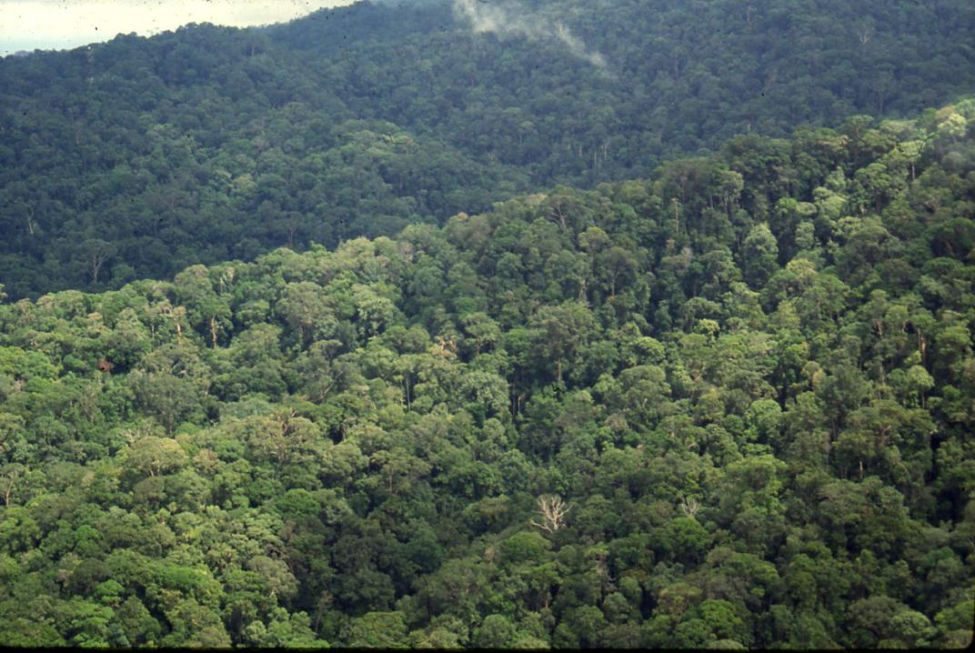
Tropical Forests and Climate
Forests have always affected climate
Notes:
KEY MESSAGES:
See text on slide
Photo Source:
Photo courtesy of Deborah Lawrence

Slide 8
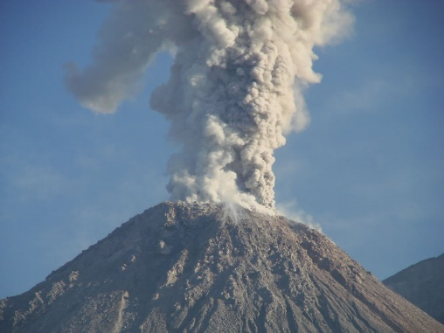
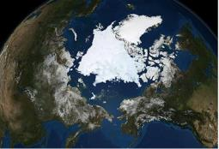
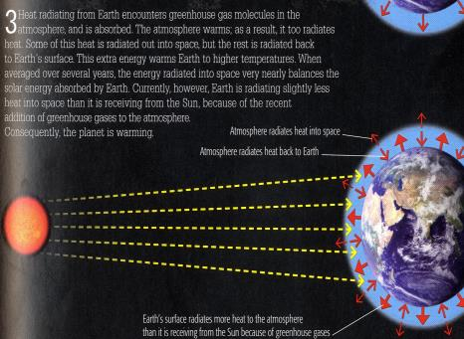
Quick Reminder
Which climate factors are affected by tropical forests?
A
B
C
D
A, B, D
B and D
A and D
A
C
Aerosols/volcanoes
Solar radiation
1700 1800 1900 2000
CO₂
B
D
Albedo
Greenhouse gases
Notes:
KEY MESSAGES:
As with the previous activity you could do this either as a quiz to check each student’s understanding or have the class work together to choose answers

Slide 9
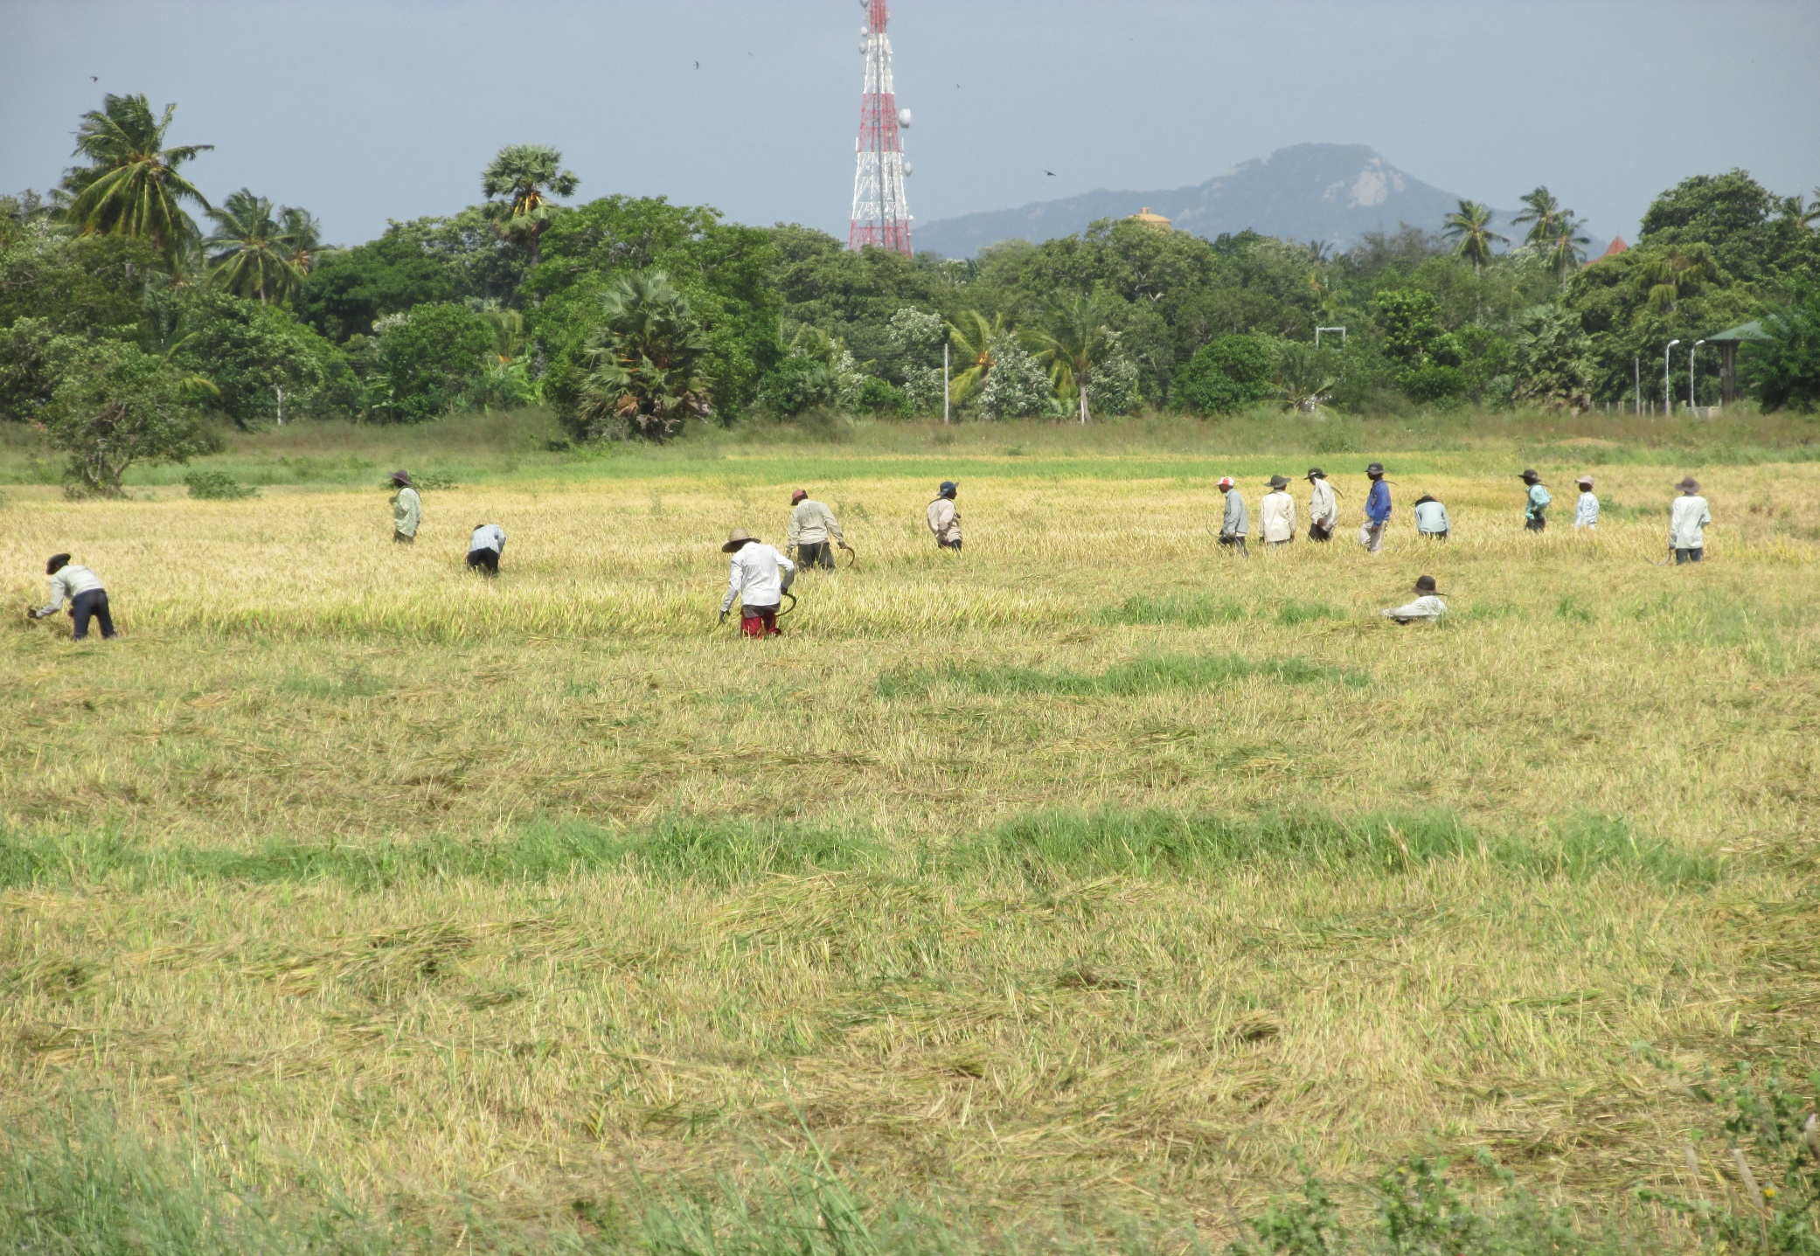
Tropical Forests and Climate
Land use change
has affected climate for a long time
Notes:
KEY MESSAGES:
Today’s lecture focusses on how land cover and land use affect climate and what drivers are affecting land cover and land use changes. You can start by seeing what ideas the students have on how land use change affects climate
Photo Source:
Photo courtesy of Megan McGroddy

Slide 10
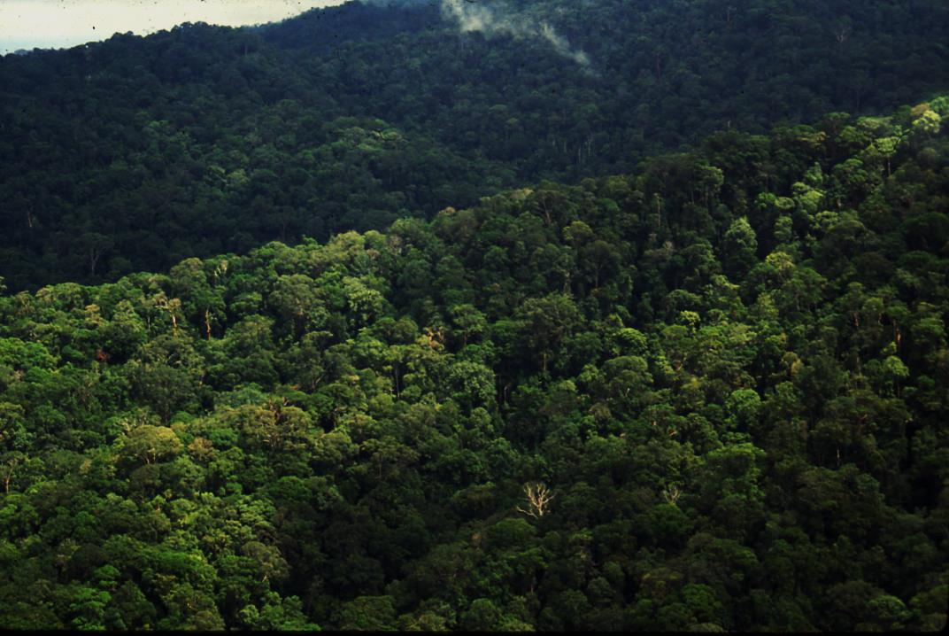
Today –
Relating Tropical Forests and Climate Change
What is climate?
What controls climate?
How has climate changed?
Why has climate changed?
How do forests affect climate?
What controls forest cover?
How has forest cover changed?
Notes:
KEY MESSAGES:
Reminder of previous lecture: The last lecture covered the first four topics listed.
Today’s lecture: Today’s lecture is going to focus on how forests affect climate, what factors control the amount and location of forests and how forest cover has changed over time
Photo Source:
Photo courtesy of Deborah Lawrence

Slide 11

Drivers of Climate
Solar radiation
Volcanoes and aerosols
1700 1800 1900 2000
CO₂
CO₂ and other greenhouse gases
Albedo
Notes:
KEY MESSAGES:
Last time we talked about the 4 most important factors controlling climate on the scale of decades to centuries: solar radiation, atmospheric aerosols, albedo and atmospheric GHG concentrations primarily CO2.
Image Source:
Source of graphic of greenhouse effect: Michael Mann and Lee Kump. 2007. Dire Predictions: Understanding Global Warming – The Illustrated Guide to the Findings of the IPCC. DK Publishing, New York. See p. 23.
Source of volcano image: http://geology.com/volcanoes/santa-maria/el-caliente-eruption.jpg
Source of albedo image: NASA's Aqua satellite shows the state of Arctic sea ice on September 10 2008 Photo: REUTERS. (Likely shown in many newspapers, due to the Reuters source, this link is but one of many: http://i.telegraph.co.uk/multimedia/archive/01439/NASA_arcticSea_1439012c.jpg)

Slide 12

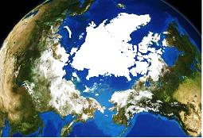
Drivers of Climate
And some of those factors are influenced
by forest cover
Aerosols
CO₂
CO₂ and other greenhouse gases
Albedo
Notes:
KEY MESSAGES:
And as we discussed all of these except solar radiation are influenced by the amount of forest cover.
Notes:
If students ask how areosols are affected by forest cover, skip ahead 2 slides or make it a classroom discussion. Forests affect aerosols primarily via fires. So, the image of a volcano here is used mainly to be consistent with previous materials the students would have seen.
Image Source:
Greenhouse Effect: Michael Mann and Lee Kump. 2007. Dire Predictions: Understanding Global Warming – The Illustrated Guide to the Findings of the IPCC. DK Publishing, New York. See p. 23.
Source of volcano image: http://geology.com/volcanoes/santa-maria/el-caliente-eruption.jpg
Source of albedo image: NASA's Aqua satellite shows the state of Arctic sea ice on September 10 2008 Photo: REUTERS

Slide 13
Drivers of Climate
We will analyze how forests affect each of these climate factors
but there is one more way that forests affect climate…
Notes:
KEY MESSAGES:
see text slide and….So today we are going to discuss how forests especially tropical forests affect these climate drivers
Good opportunity to have students think about other ways forests can affect climate- if there is time to have them offer ideas
Photo Source:
Photo courtesy of Deborah Lawrence

Slide 14
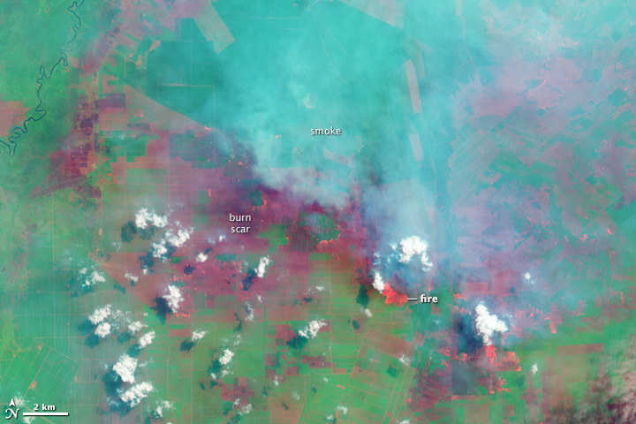
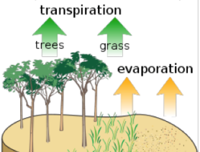
Four Ways that Forests Affect Climate
Not Volcanoes, but forest fires
Evapotranspiration
Aerosols
CO₂
Albedo
CO₂ and the carbon cycle
Notes:
KEY MESSAGES:
Evapotranspiration is very important particularly at local to regional scales.
Notes:
In addition to the 4 climate drivers we have already discussed forests can influence climate through evapotranspiration: the movement of water from the soil to the atmosphere through the trees.
Image source:
Evaporation image source: http://en.wikipedia.org/wiki/Evapotranspiration
Fire image source: http://www.fire.uni-freiburg.de/GFMCnew/2013/07/25/indonesia_oli_2013176.jpg
Source of albedo image: NASA's Aqua satellite shows the state of Arctic sea ice on September 10 2008 Photo: REUTERS
Source of graphic of gh effect: Mann and Kump 2007

Slide 15
Outline for Today
Four ways that forests affect climate
Drivers of variation in forest cover and forest cover change
Historic change in forest cover
Notes:
KEY MESSAGES:
To review today’s lecture will cover three topics

Slide 16



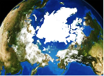
Role of Forests in the Global Carbon Cycle
Evapotranspiration
Biggest effect:
CO₂ and the carbon cycle
Aerosols
1700 1800 1900 2000
Albedo
Notes:
KEY MESSAGES:
There are four ways that forests affect climate, but the biggest impact comes from the role forests play in the global carbon cycle. It is important to understand the carbon cycle and the role forests play in order to understand climate change.
Image Source:
Source of graphic of greenhouse effect: Mann, M.E. and L.R. Kump. 2008. Dire Predictions: Understanding global warming. The illustrated guide to the findings of the IPCC (Intergovernmental Panel on Climate Change). DK, Publishing, NY, NY. ISBN 978-0-7566-3995-2.
Fire image source: http://www.fire.uni-freiburg.de/GFMCnew/2013/07/25/indonesia_oli_2013176.jpg
Source of albedo image: NASA's Aqua satellite shows the state of Arctic sea ice on September 10 2008 Photo: REUTERS
Source of evapotranspiration image: Evaporation image source: http://en.wikipedia.org/wiki/Evapotranspiration

Slide 17
What is the Carbon Cycle?
Pre-class assignment or homework: watch this video on the global carbon cycle
http://epa.gov/climatestudents/basics/today/carbon-dioxide.html
Notes:
KEY MESSAGES:
To understand the link between forests and climate you need to understand the carbon cycle.
Notes:
Ideally students have watched the video listed here before class or have studied the carbon cycle in earlier classes. Have them share what they learned. Many of the questions they might have or the ideas they offer will be covered in more detail in the following slides.

Slide 18
Carbon Cycle
The movement of carbon
through the atmosphere, the oceans,
the earth’s surface and living things
Notes:
KEY MESSAGES:
The carbon cycle describes the movement of carbon atoms through the atmosphere, the oceans, the biota (living things) and the earth’s surface (minerals or rocks). There are many paths connecting these components.
Image Source:
modified from: http://dataintheclassroom.noaa.gov/Documents/OA%20Level%202.pdf

Slide 19
Carbon Cycle
Slow cycle (large light arrows)
millions of years
Fast cycle (small darker arrows)
10s-100s of years
Notes:
KEY MESSAGES:
As I said in the previous slide, there are many pathways connecting the cycle’s components and while the slow cycle gives an overview of a broad pattern occurring over millions of years, looking at the cycles on shorter time scales (decades to centuries) you can see more of the details and the multiple pathways between the atmosphere the biota etc.
Notes:
The slow cycle (over millions of years): carbon is taken from the atmosphere by plants and moves into the soil when the plant dies and decomposes. Then the carbon in the soil is washed into the ocean by erosion where it has a long residence time. Eventually through geologic uplift, the carbon in the ocean bottom is brought up to the land surface where it can once again be released to the atmosphere and the cycle begins again.
Image Source:
modified from: http://dataintheclassroom.noaa.gov/Documents/OA%20Level%202.pdf

Slide 20
Carbon Cycle
Reservoirs (stocks)
Fluxes (transfers between reservoirs)
Notes:
KEY MESSAGES:
The C cycle can be described by studying C stocks (or reservoirs, circles) and fluxes (lines showing transfers between reservoirs).
Notes:
Reservoirs or stocks are components that can store carbon for long periods and they include the atmosphere, the deep ocean, the ocean bed, forests, carbonate minerals and fossil fuel reserves (oil, coal and natural gas). Fluxes are another essential part of the carbon cycle (both the fast and slow cycles) and they represent the transfer from one reservoir to another. The rate of fluxes and the size of the reservoirs are both important to understanding the carbon cycle.
Image Source:
modified from: http://dataintheclassroom.noaa.gov/Documents/OA%20Level%202.pdf

Slide 21
Carbon Reservoirs
1500 Gt
900 Gt
Gt (Pg) C
750 Gt
560 Gt
Notes:
KEY MESSAGES:
This graph gives the sizes of some of the major carbon reservoirs on Earth. You can see that soils are a very important reservoir- twice the size of the atmosphere. Also a good chance to review units- a Gigaton is the same as a Petagram or 10^15 grams.
Image Source:
Graph created with data from: Schlesinger Biogeochemistry 1997 and 2013 editions.
Full citation for 2013 edition: Schlesinger, W.H. and E.S. Bernhardt. 2013. Biogeochemistry: An analysis of global change. 3rd Edition. Elsevier, Amsterdam.

Slide 22
Carbon Reservoirs
4,000 Gt*
Gt (Pg) C
Active pools
1500 Gt
750 Gt
900 Gt
560 Gt
Notes:
KEY MESSAGES:
- Fossil fuel reservoirs are almost 7 times larger than the soil reservoir.
Until the industrial age fossil fuels were not an active pool – pools are hard to estimate
Image Source:
Graph created with data from: Schlesinger Biogeochemistry 1997 and 2013 editions.
Full citation for 2013 edition: Schlesinger, W.H. and E.S. Bernhardt. 2013. Biogeochemistry: An analysis of global change. 3rd Edition. Elsevier, Amsterdam.
Fossil fuel data from Sudquist and Visser 2005 cited in Schlesinger & Bernhardt 2013

Slide 23
Carbon Reservoirs
37,000 Gt
Gt (Pg) C
Notes:
KEY MESSAGES:
Deep oceans are the largest carbon reservoir and are not actively exchanging with the other reservoirs on the time scale of decades to centuries-
Image Source:
Graph created with data from: Schlesinger Biogeochemistry 1997 and 2013 editions.
Full citation for 2013 edition: Schlesinger, W.H. and E.S. Bernhardt. 2013. Biogeochemistry: An analysis of global change. 3rd Edition. Elsevier, Amsterdam.

Slide 24
The Carbon Cycle
Vegetation
Atmosphere
Oceans
Soil
Fossil fuels
Big
Reservoirs
Big
Big (active)
Twice as big
Very big
Notes:
KEY MESSAGES:
In summary here are the carbon cycle reservoirs active on in the short term cycle and their relative sizes.

Slide 25
The Carbon Cycle
Vegetation
Atmosphere
Oceans
Soil
Fossil fuels
Big
Reservoirs
Big
Big (active)
Huge (inactive deep oceans)
Twice as big
Very big
Notes:
KEY MESSAGES:
Deep oceans are a significant reservoir but as I said previously they are also very inactive and only exchange with the other reservoirs on much longer time scales ( 100’s of thousands of years)

Slide 26
Classroom Activity
Pair work: Turn to your neighbor and discuss
Estimate how much (what fraction) of each reservoir moves into the other each year.
Reminder: There may be more than one pathway connecting reservoirs.
Notes:
KEY MESSAGES:
Classroom activity to encourage students to actively learn!
Notes: You can assign specific pools to each pair of students and ask them to estimate how much (what fraction) of each reservoir moves into the other each year. There may be more than one pathway connecting reservoirs. When they are done discussing have the pairs come to the board and see if together the class can reconstruct the C cycle diagram based on their discussions

Slide 27
Processes Controlling the Major Fluxes of Carbon
Photosynthesis
Respiration
Decomposition
Combustion
Diffusion
Biological
Human (and natural)
Physical/Chemical
Notes:
KEY MESSAGES:
In addition to the reservoirs the carbon cycle is driven by the fluxes between reservoirs- each flux is driven by a different process. The processes in green are biological in nature, in red both natural and driven by human activities and in blue physical/ chemical

Slide 28
Fluxes to/from the Atmosphere
Photosynthesis
Respiration
Decomposition
Combustion
Diffusion
( out of atmosphere)
( into atmosphere)
Notes:
KEY MESSAGES:
Here, remind students that because climate change is driven by changes in ATMOSPHERIC CO2, we focus on and are concerned about fluxes into or out of the atmosphere.
Brainstorming Question: What processes are controlling the accumulation of CO2 in the atmosphere?

Slide 29
Major Annual Fluxes into and Out of the Atmosphere
120 Gt
120 Gt
Atmosphere
fluxes
90 Gt
92 Gt
1-1.5 Gt
8-9 Gt
Biosphere
Fossil Fuels
Oceans
Photosynthesis/respiration
Combustion
Carbon pools
Diffusion
Notes:
KEY MESSAGES:
Looking at just the annual fluxes between the atmosphere and the other reservoirs you can see that the largest fluxes are in balance (equal amounts going in and out of the atmosphere on an annual basis- for example the exchanges with the oceans and the biosphere).
Notes:
Data sources for the #s shown in this slide are missing. A similar graphic with different values for atmosphere-ocean fluxes and fossil fuel flux is at this link.
Reference:
http://eesc.columbia.edu/courses/ees/slides/climate/carbon_res_flux.gif. SkepticalScience.com provides a graphic (at the following link), which shows fluxes of similar magnitude (as the one in this slide) but lower flux for fossil fuels: http://upload.wikimedia.org/wikipedia/commons/thumb/8/82/Carbon_cycle-cute_diagram.svg/1000px-Carbon_cycle-cute_diagram.svg.png

Slide 30
Natural Annual Fluxes
120 Gt
120 Gt
Atmosphere
fluxes
90 Gt
92 Gt
1-1.5 Gt
8-9 Gt
Biosphere
Fossil Fuels
Oceans
Photosynthesis/respiration
Combustion
Carbon pools
Diffusion
Notes:
KEY MESSAGES:
These balanced fluxes are “natural” fluxes- note that in the absence of fossil fuel burning and land cover change (and burning) the carbon fluxes are close to balanced
Notes:
Data sources for the #s shown in this slide are missing. A similar graphic with different values for atmosphere-ocean fluxes and fossil fuel flux is at this link.
Reference:
http://eesc.columbia.edu/courses/ees/slides/climate/carbon_res_flux.gif. SkepticalScience.com provides a graphic (at the following link), which shows fluxes of similar magnitude (as the one in this slide) but lower flux for fossil fuels: http://upload.wikimedia.org/wikipedia/commons/thumb/8/82/Carbon_cycle-cute_diagram.svg/1000px-Carbon_cycle-cute_diagram.svg.png

Slide 31
Anthropogenic Fluxes
(Small But Important)
120 Gt
120 Gt
Atmosphere
fluxes
90 Gt
92 Gt
1-1.5 Gt
8-9 Gt
Biosphere
Fossil Fuels
Oceans
Photosynthesis/respiration
Combustion
Carbon pools
Diffusion
Notes:
KEY MESSAGES:
Anthropogenic fluxes (those driven by human activities) are much smaller but important because they are not balanced by an equal flux out of the atmosphere the anthropogenic flux from the biosphere represents deforestation and biomass burning
Notes:
Data sources for the #s shown in this slide are missing. A similar graphic with different values for atmosphere-ocean fluxes and fossil fuel flux is at this link.
Reference:
http://eesc.columbia.edu/courses/ees/slides/climate/carbon_res_flux.gif. SkepticalScience.com provides a graphic (at the following link), which shows fluxes of similar magnitude (as the one in this slide) but lower flux for fossil fuels: http://upload.wikimedia.org/wikipedia/commons/thumb/8/82/Carbon_cycle-cute_diagram.svg/1000px-Carbon_cycle-cute_diagram.svg.png

Slide 32
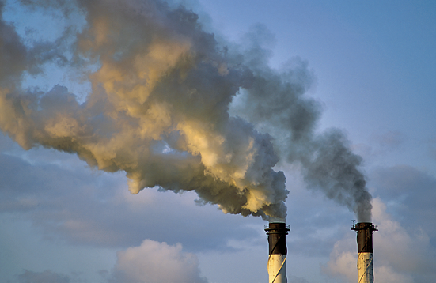

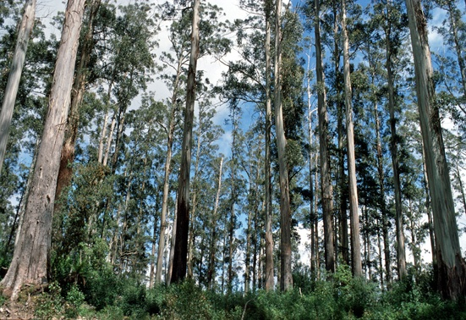
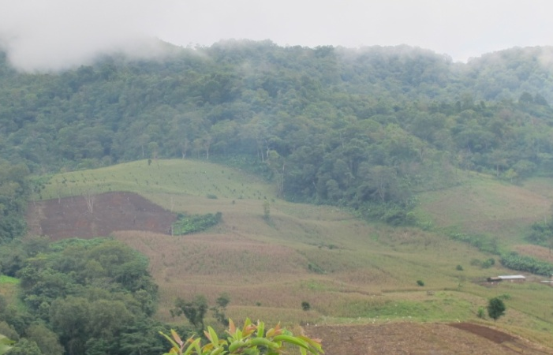
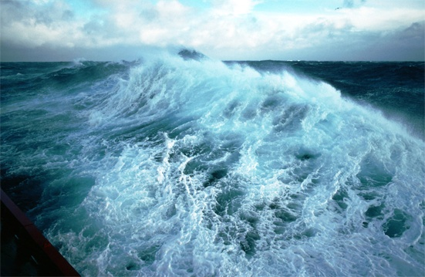
Fate of Anthropogenic CO₂ Emissions
8.3±0.4 PgC/yr
46%
4.3±0.1 PgC/yr
90%
Atmospheric growth
Fossil fuels and cement
+
28%
2.6±0.8 PgC/yr
1.0±0.5 PgC/yr
10%
Land sink
26%
2.5±0.5 PgC/yr
Land-use change
Source: Le Quéré et al. 2012; Global Carbon Project 2012
Ocean sink
Notes:
KEY MESSAGES:
Only about half of the flux attributed to human activity ends up in the atmosphere. Vegetation and the ocean take up the other half.
Land sink Calculated as the residual of all other flux components: atmospheric and ocean sinks can be measured (ie the Keeling curve we saw in the last lecture): So almost half of the carbon emitted each year from human activities ends up in the atmosphere. Increases in atmospheric CO2 would be much more rapid if oceans and vegetation on land were not taking up the other half of human emissions
Notes:
The #s shown in this slide are continually updated by The Global Carbon Project. The latest update (based on 2004-2013 averages) is available at this link:
Reference:
http://www.globalcarbonproject.org/carbonbudget/14/files/GCP_budget_2014_lowres_v1.02.pdf
Image Source:
Le Quéré et al. 2012; Global Carbon Project 2012

Slide 33
Effect of Anthropogenic Fluxes
Small anthropogenic fluxes (about 10 Gt per year) add up to big changes in the atmospheric carbon pool
http://www.youtube.com/watch?v=SXHDwdd7Tf8
Notes:
KEY MESSAGES:
The embedded video shows the change in atmospheric CO2 over multiple time scales- the early part (1979- to present) is due to anthropogenic fluxes and you can compare their impact to other forces over the past several hundred thousand years of Earth’s history- If you are not going to have internet access in the classroom you might want to download at least a set of key screenshots to show the main points of the video

Slide 34
Carbon Reservoirs & Forest Pool
Gt (Pg) C
Deep waters Marine sediments
Tropical Forests
Forests
50% of vegetation pool
50% of forest pool
Notes:
KEY MESSAGES:
Going back to the graph on active carbon reservoirs, forests represent 50% of the vegetation pool and tropical forests are 50% of the forest pool (or 25% of the total vegetation pool)
Notes:
Ask students -- Now that you have a general sense of the carbon cycle both the rapid and the slow components where do the forests fit in?
What role do forests play in the carbon cycle?
Image Source:
Graph created with data from: Schlesinger Biogeochemistry 1997 and 2013 editions.
Full citation for 2013 edition: Schlesinger, W.H. and E.S. Bernhardt. 2013. Biogeochemistry: An analysis of global change. 3rd Edition. Elsevier, Amsterdam.

Slide 35
Biomass Burning Happens in Forests, Especially with Land Use Change in the Tropics
fluxes
Atmosphere
1-1.5 Gt
8-9 Gt
Biosphere
Fossil Fuels
Oceans
Photosynthesis/respiration
Combustion
Carbon pools
Diffusion
Notes:
KEY MESSAGES:
Tropical forests are also a major source of biomass burning and if the burning is associated with land use change (rather than a natural fire followed by regrowth) there is no balancing flux down from the atmosphere into forest regrowth

Slide 36
Carbon Fluxes Critical to Climate Mitigation
Photosynthesis
Respiration
Decomposition
Combustion
Diffusion
Photosynthesis: the only real, large, viable pathway OUT of the atmosphere that humans can control
This is the basis of REDD+:
Maintain and expand forests
so they continue to absorb carbon
Notes:
KEY MESSAGES:
This is the fundamental idea behind REDD+ : increase the flux of CO2 out of the atmosphere by maintaining and expanding tropical forests.
Note that we cannot alter the rate of photosynthesis, but rather we alter the amount of land where photosynthesis occurs and we alter the size of the trees doing photosynthesis.

Slide 37
REDD+
Reducing emissions from deforestation, forest degradation, conservation of forests, sustainable forest management and enhancement of forest carbon stocks
Notes:
KEY MESSAGES:
REDD stands for Reducing emissions from deforestation and forest degradation and the + indicates the inclusion of sustainable forest management, forest conservation and enhancement of forest carbon stocks

Slide 38
Carbon Fluxes Critical to Climate Mitigation
Photosynthesis
Respiration
Decomposition
Combustion
Diffusion
Combustion- Critical flux INTO the atmosphere humans can control
Notes:
KEY MESSAGES:
Combustion is also largely under human control and we can reduce CO2 flux to the atmosphere by reducing biomass burning

Slide 39
Processes Controlling the Major Fluxes of Carbon
Photosynthesis
Respiration
Decomposition
Combustion
Diffusion
Critical flux INTO the atmosphere humans can control
Also the basis of REDD+
Avoid deforestation and release of carbon
Notes:
KEY MESSAGES:
Burning in tropical forests is generally associated with deforestation and land use change and is included in REDD+
Notes:
Processes controlling the major fluxes of carbon

Slide 40

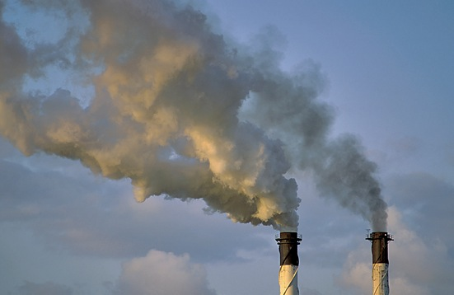
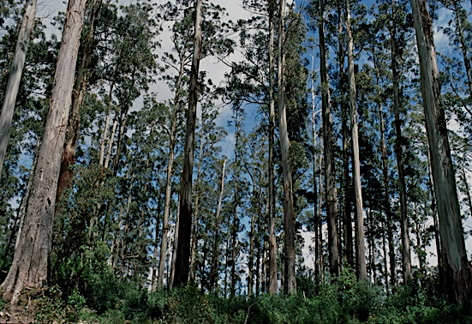
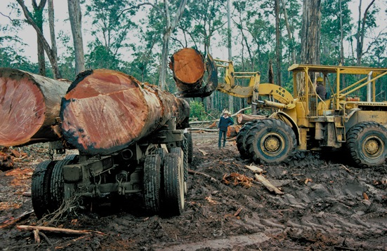
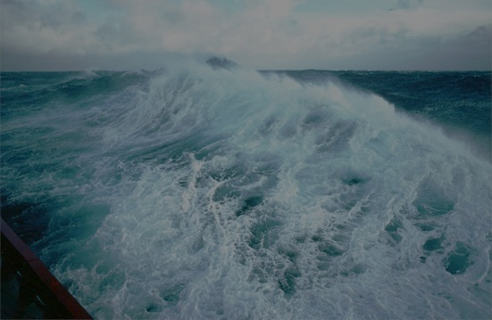
Forests are an Important Sink for Natural & Anthropogenic Emissions
1/2
+
1/4
1/4
Notes:
KEY MESSAGES:
Forests absorb about one quarter of the emissions from human activities
Another quarter is absorbed by the ocean resulting in only half of the emissions stay in the atmosphere. Without the forest and ocean sinks, atmospheric CO2 concentrations today would be significantly higher.
Image Source:
Le Quéré et al. 2012; Global Carbon Project 2012
The latest update (based on 2004-2013 averages) is available at this link: http://www.globalcarbonproject.org/carbonbudget/14/files/GCP_budget_2014_lowres_v1.02.pdf

Slide 41
Forest Have Always Affected Climate
How do forests affect climate?
What controls forest cover?
How has forest cover changed?
Notes:
Photo Source:
Photo courtesy of Deborah Lawrence

Slide 42
Forests Impact the Global Carbon Cycle
How do forests affect climate?
What controls forest cover?
How has forest cover changed?
1. Forests impact the global carbon cycle
  Forests are half of global vegetation pool
  Tropical forests are ¼ of global vegetation pool
  Large natural flux and critical carbon sink
  Small, but important anthropogenic flux
CO₂
Forests and the
carbon cycle
Notes:
KEY MESSAGES:
This slide reviews what we have discussed so far about how forests affect the global carbon cycle.
Notes: It’s important at this stage to help students loop back to previous understanding of factors influencing climate and how forests influence those factors so students can clearly see link between forests, C pools and fluxes, and climate
Photo Source:
Photo courtesy of Deborah Lawrence

Slide 43
Forests Impact the Global Carbon Cycle
How do forests affect climate?
What controls forest cover?
How has forest cover changed?
Q: How does forest cover affect the reflectance of incoming solar radiation?
CO₂
Forests and the
carbon cycle
Albedo
Notes:
KEY MESSAGES:
So now we are going to consider how forests affect albedo…
Notes: may need to remind students about definition of albedo
Photo Source:
Photo courtesy of Deborah Lawrence

Slide 44

Albedo
How do forests affect climate?
What controls forest cover?
How has forest cover changed?
Forests (dark color) absorb sunlight energy
Notes:
KEY MESSAGES:
Forest cover has a very low albedo reflecting back only a small fraction of the sunlight energy it receives and absorbing most of it. On average forests reflect back only 10% of the sunlight they receive.
Photo Source:
Photo courtesy of Megan McGroddy

Slide 45
Albedo
How do forests affect climate?
What controls forest cover?
How has forest cover changed?
Cropland and pasture (light color) reflect sunlight energy
Notes:
KEY MESSAGES:
In contrast pastures and grasslands have a higher albedo and reflect about 25% of the sunlight received back as shortwave radiation absorbing only 75%.
Photo Source:
Photo courtesy of Megan McGroddy

Slide 46
Albedo
How do forests affect climate?
What controls forest cover?
How has forest cover changed?
Deforestation increases albedo
Notes:
KEY MESSAGES:
So converting a forest to a grassland results in a doubling of the amount of energy reflected back to space and a net cooling of the land surface
Photo Source:
Photo courtesy of Megan McGroddy

Slide 47
Forests Impact the Global Carbon Cycle
How do forests affect climate?
What controls forest cover?
How has forest cover changed?
2. Forests have a low albedo
This is a warming effect
Land use change in forests increases albedo (produces a cooling effect)
CO₂
Forests and the
carbon cycle
Albedo
Notes:
KEY MESSAGES:
In summary forests absorb 90% of the sunlight they receive (low albedo) and warm the environment. Converting forests to pastures results in a decrease in sunlight absorbed and a net cooling effect
Photo Source:
Photo courtesy of Deborah Lawrence

Slide 48
Forests Impact the Global Carbon Cycle
CO₂
How do forests affect climate?
What controls forest cover?
How has forest cover changed?
Q: How does forest cover effect evapotranspiration?
Evapotranspiration
Notes:
KEY MESSAGES:
So now we will turn to the third way in which forests affect climate: evapotranspiration
Photo Source:
Photo courtesy of Deborah Lawrence

Slide 49
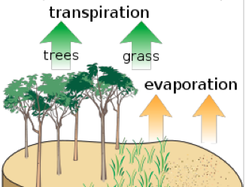
Evapotranspiration
Water moves from moist to dry conditions (from soil to atmosphere)
Evaporation from bare surface
Transpiration through plants
Notes:
KEY MESSAGES:
Evapotranspiration moves water from the ground to the atmosphere; some of the water may move directly from soil to the air and some flows from the ground through vegetation to the air. The net result (not shown on the graphic) is cooling. Take some time with students to discuss how this process works.
Brainstorming question: How does evapotranspiration work?
Notes:
Evaporation is a physical process where water moves directly from the soil to the atmosphere and is driven by the difference in water concentration ( moves from moist soil to dry air).
In transpiration: Trees transport water from a moist environment (the soil) up through the stem and out to the atmosphere through their leaves.
In both processes water moves from the moist soil to the drier air but transpiration requires transport through the plants and evaporation is most effective at a bare surface (greatest contact between moist soil and dry air). Because it is difficult to determine whether an individual molecule of water moved from the soil to the atmosphere via evaporation or via transpiration we generally refer to the two processes together as evapotranspiration.
Image source:
http://en.wikipedia.org/wiki/Evapotranspiration

Slide 50
Evapotranspiration
Forested
Deforested
Bigger plants = more leaf area = more ET = more cooling
Notes:
KEY MESSAGES:
Higher rates of evapotranspiration mean greater cooling.
Notes:
Ask students: How does that work?
Because plants can actively take up water from the soil and from fairly deep in the soil as well as surface layers and because forests can have several meters of leaf surface per meter of soil surface evapotranspiration in forested areas is much stronger than in deforested areas. Converting water from liquid to gas form requires energy and results in a net cooling (just as it does for us when we sweat)
Image source:
http://en.wikipedia.org/wiki/Evapotranspiration

Slide 51
Evapotranspiration
Cools the atmosphere above the canopy (or land surface)
Creates a ‘pump’ to recycle water and enhance rainfall
Notes:
KEY MESSAGES:
In addition to the cooling effect of evapotranspiration there is also a positive effect on rainfall.
As the air above the forest moves upward (now with lots of water vapor) it cools and the water vapor condenses out and falls back to the ground as rain. So ET also acts as a pump- allowing rainfall to be recycled from the soil back to the atmosphere.
Image source:
http://en.wikipedia.org/wiki/Evapotranspiration

Slide 52
Forests Impact the Global Carbon Cycle
CO₂
How do forests affect climate?
What controls forest cover?
How has forest cover changed?
3. Evapotranspiration is high in forests
Results in a cooling effect
Enhances local-regional rainfall
Forests and the carbon cycle
Albedo
Evapotranspiration
Notes:
KEY MESSAGES:
In summary high levels of ET in forests result in cooler temperatures and higher rainfall at the local to regional scale.
The next factor I am going to present is the effect of forests on atmospheric aerosols. We discussed in the last lecture how aerosols like those from volcanoes can reflect sunlight back to space from the atmosphere resulting in a net cooling effect. Large volcanic eruptions are easily detected in the record of mean global temperatures.
Image Source:
Source of graphic of greenhouse effect: Mann, M.E. and L.R. Kump. 2008. Dire Predictions: Understanding global warming. The illustrated guide to the findings of the IPCC (Intergovernmental Panel on Climate Change). DK, Publishing, NY, NY. ISBN 978-0-7566-3995-2.
Source of albedo image: NASA's Aqua satellite shows the state of Arctic sea ice on September 10 2008 Photo: REUTERS
Source of evapotranspiration image: Evaporation image source: http://en.wikipedia.org/wiki/Evapotranspiration

Slide 53
Forests Impact the Global Carbon Cycle
CO₂
How do forests affect climate?
What controls forest cover?
How has forest cover changed?
Q: How does forest cover affect atmospheric aerosols?
Forests and the carbon cycle
Albedo
Evapotranspiration
Aerosols
Notes:
KEY MESSAGES:
The next factor I am going to present is the effect of forests on atmospheric aerosols. We discussed in the last lecture how aerosols like those from volcanoes can reflect sunlight back to space from the atmosphere resulting in a net cooling effect. Large volcanic eruptions are easily detected in the record of mean global temperatures.
Image Source:
Source of graphic of greenhouse effect: Mann, M.E. and L.R. Kump. 2008. Dire Predictions: Understanding global warming. The illustrated guide to the findings of the IPCC (Intergovernmental Panel on Climate Change). DK, Publishing, NY, NY. ISBN 978-0-7566-3995-2.
Source of albedo image: NASA's Aqua satellite shows the state of Arctic sea ice on September 10 2008 Photo: REUTERS
Source of evapotranspiration image: Evaporation image source: http://en.wikipedia.org/wiki/Evapotranspiration
Fire image source: http://www.fire.uni-freiburg.de/GFMCnew/2013/07/25/indonesia_oli_2013176.jpg

Slide 54
Aerosols
Aerosols are produced by forests via two pathways:
Volatile organic compounds (VOC) are a natural byproduct of tree metabolism
Biomass burning releases VOC, smoke and soot
Notes:
KEY MESSAGES:
In the last lecture we talked about the effects of aerosols from volcanoes. Forests also emit aerosols both as part of normal tree metabolism (VOCs) as well as during burning. While the effect is not as dramatic as that seen in the case of volcanic eruptions it is still significant

Slide 55
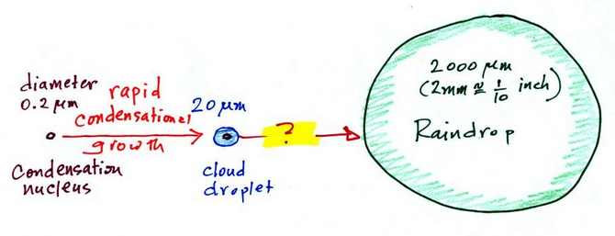
Aerosols
Critical to cloud formation
Affect amount of incoming solar radiation
Affect rainfall
Alter chemistry of the atmosphere
Notes:
KEY MESSAGES:
VOCs and other aerosols emitted by trees or biomass burning affect rainfall through their role as cloud condensation nuclei- this is a complex relationship and the size and nature of the aerosol determines the direction of the effect on rainfall. As with aerosols emitted by volcanoes some aerosols emitted by trees either through natural metabolism or biomass burning reflect the sunlight back before it reaches the Earth’s surface thereby cooling the planet’s surface. Finally VOCs are reactive and interact with one another and other molecules in the atmosphere leading to changes in the atmosphere
Image source:
http://www.atmo.arizona.edu/students/courselinks/fall12/atmo170a1s1/coming_up/week_8/nucleus_droplet_raindrop.jpg

Slide 56
Forests Impact the Global Carbon Cycle
CO₂
How do forests affect climate?
What controls forest cover?
How has forest cover changed?
4. Forests produce aerosols
  Complex net effect: cooling?
Forests and the carbon cycle
Albedo
Evapotranspiration
Aerosols
Notes:
KEY MESSAGES:
As discussed in the previous slide the effect of aerosols from both metabolism and biomass burning are complex but overall it is thought they generally act to cool the Earth’s surface slightly.

Slide 57
Forests Impact the Global Carbon Cycle
How do forests affect climate?
What controls forest cover?
How has forest cover changed?
Climate
Humans
Notes:
KEY MESSAGES:
So we have looked at how forests affect climate in various ways. Now we are going to look at what controls forest cover- where forests are and how large and dense they grow. There are two major factors to consider: climate and human activity

Slide 58
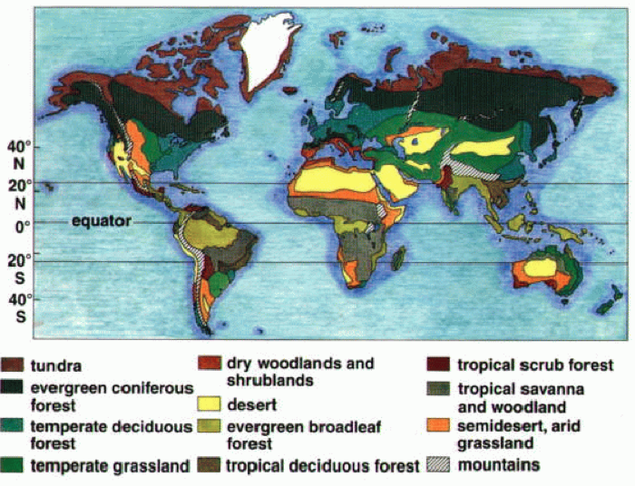
Forests are Widespread
Notes:
KEY MESSAGES:
Forests can be found almost everywhere on the Earth. On this map you can see that forests and woodlands are the most common ecosystem types.
Image Source:
http://www.plantsciences.ucdavis.edu/gepts/pb143/LEC10/Pb143l10.htm

Slide 59
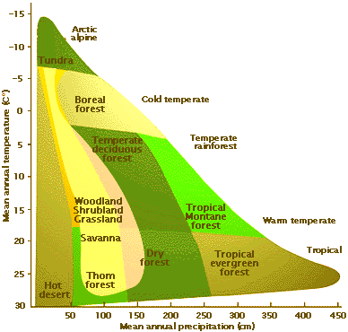
Forest Biomes
Temperature and precipitation control where forests are found
Notes:
KEY MESSAGES:
The image shows the distribution of biomes related to temperature and precipitation. Here you can clearly see that forest cover is strongly linked to temperature and precipitation. As climate gets warmer and drier forests are replaced by woodland/grasslands and then deserts.
Image Source:
http://www.globalchange.umich.edu/globalchange1/current/lectures/kling/ecosystem/ecosystem.html

Slide 60
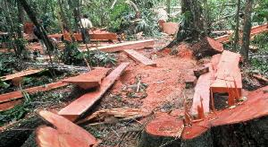
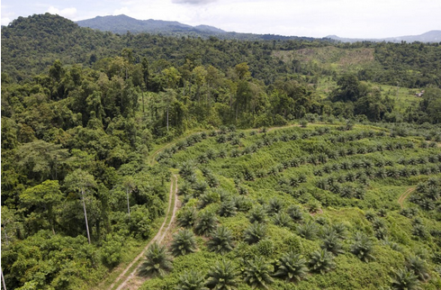
Humans Cut and Use Forests
altering stand structure and forest cover on the landscape
Notes:
KEY MESSAGES:
Humans have had an enormous impact on the extent of forest cover cutting and burning forests for timber products and to convert forests to pastures, crops and cities.
Image source:
http://understory.ran.org/2010/02/24/cargill-leaves-a-palm-oil-mess-in-papua-new-guinea/
http://www.ens-newswire.com/ens/may2007/2007-05-30-03.asp

Slide 61
Forests Impact the Global Carbon Cycle
How do forests affect climate?
What controls forest cover?
How has forest cover changed?
Past 8000 years
Past 150 years
Past 40 years
Notes:
KEY MESSAGES:
Use this slide to review and consolidate lessons from previous slides, and to ask students how forest cover has changed in the past 8000 years.
Question for discussion: So given that climate controls where forests can occur and humans have actively altered forest cover what do we know about how forest cover has changed at different time scales?
Notes: the embedded animation at this link <http://www.youtube.com/watch?v=gBTlIaf12-4> covers the time period from 8000 years ago up to current.
Be prepared to pause the animation at 200 years ago to allow the students to focus on the more recent changes (150 years approximately at 1:17 and 40 year 1:20 time periods). There is an English language narration which you can use or mute as you see fit.
First let’s look at the longest time scale: how has forest cover changed over the past 8000 years- since humans began to practice agriculture.
As you watch the video you can see natural vegetation cover disappear as different cultures develop starting in the Fertile Crescent and China. The final seconds of the video representing the last 150- 100 years show a much more dramatic and widespread change in vegetation cover

Slide 62
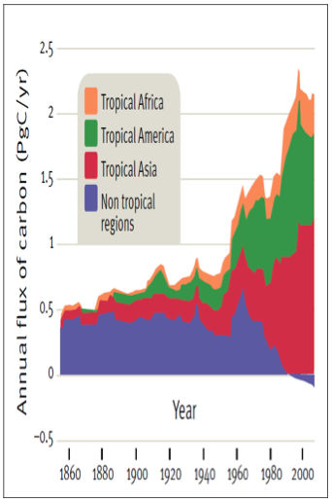
Emissions from Land Use Change
1850 - present
Notes:
KEY MESSAGES:
The effect of changing patterns in land cover change are reflected in measurements of C flux. This graph shows the flux of C from land use change since 1860 roughly the period we refer to as the Industrial Age
Reference:
Image: Houghton 2005 in Moutinho and Schwarzmann. Found at http://www.desdemonadespair.net/2009/11/graph-of-day-annual-carbon-flux-from.html

Slide 63
Emissions from Land Use Change
Temperate forest emissions have declined since 1960
Notes:
KEY MESSAGES:
The pattern in temperate regions has been a decline since the 1960s ( remember this is only C flux from land cover change not totals)
Reference:
Houghton 2005 in Moutinho and Schwarzmann. Found at http://www.desdemonadespair.net/2009/11/graph-of-day-annual-carbon-flux-from.html

Slide 64
Emissions from Land Use Change
Tropical forest emissions
grew rapidly from the 1940s
Notes:
KEY MESSAGES:
Tropical regions in contrast saw a rapid rise in land cover associated C emissions starting in the 1960s and only slowing recently.
Reference:
Houghton 2005 in Moutinho and Schwarzmann. Found at http://www.desdemonadespair.net/2009/11/graph-of-day-annual-carbon-flux-from.html

Slide 65
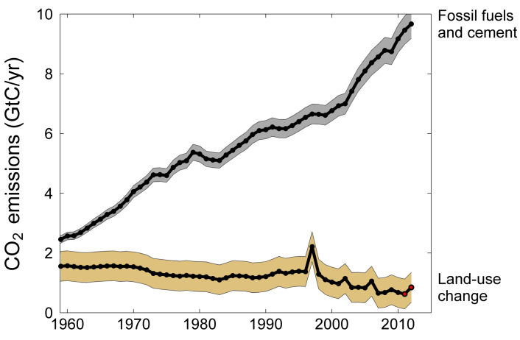

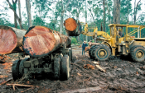
Emissions from Land Use Change
The last 50 years
Global Carbon Project
Notes:
KEY MESSAGES:
This graph shows the patterns in CO2 emissions from land use change and industrial emissions for the last 50 years.
While in the last graph we saw a shift in source from temperate to tropical areas as the major source of C from land use change we see here that globally the total emissions have declined slightly despite the increase in deforestation in tropical regions and as a percent of total C emissions land use has declined significantly due to the sharp increase in fossil fuel and cement emissions.
Total global emissions: 10.5 ± 0.7 GtC in 2012, 43% above 1990 emissions
Percentage attributed to land-use change: 38% in 1960, 17% in 1990, 8% in 2012 mostly from shifting cultivation and burning in the tropics
Reference:
Le Quéré et al 2013; CDIAC Data; Houghton & Hackler (in review); Global Carbon Project 2013.
Image Source:
http://www.globalcarbonproject.org/carbonbudget/14/files/GCP_budget_2014_lowres_v1.02.pdf

Slide 66
Classroom or Homework Activity
Amazing model with deforestation scenario and climate/carbon cycle model linked to temperature
Have students use the model, look at carbon storage in different pools and climate effects
http://www.challenger.org/blog/sciencechallenges/cc-earth-4-u-online-interactives/
Notes:
KEY MESSAGES:
This website has a great option that can be done as homework or a classroom activity.

Slide 67
Take Home Message
Tropical forests have a net cooling effect on climate, at present
Forest cover is largely controlled by climate (temperature and precipitation) and human activities
Over time human impacts on forest cover have increased in intensity and extent as human populations have increased

Slide 68
References and Resources
  USAID. 2015. USAID LEAF‘s Climate Change Curriculum. USAID Lowering Emissions in Asia Forests Program (USAID LEAF). Winrock International and US Forest Service. Bangkok, Thailand.
  Harris, N et al 2012. Baseline map of carbon emissions from deforestation in tropical regions. Science 336:1573
  Houghton 2003. Revised estimates of the annual net flux of carbon to the atmosphere from changes in land use and management 1850-present. Tellus 55B: 378
  Forests and Climate Change: Forcings, Feedbacks, and the Climate Benefits of Forests
  Gordon B. Bonan, et al. 2008. Science 320, 1444 (2008); DOI: 10.1126/science.1155121

Slide 69
References and Resources
The curriculum of USAID’s Climate-Resilient Ecosystems and Livelihoods (CREL) in Bangladesh is a free resource of teaching materials for university professors, teachers and climate change training experts.
Reproduction of CREL’s curriculum materials for educational or other non-commercial purposes is authorized without prior written permission from the copyright holder, provided the source is fully acknowledged.
Suggested citation: Winrock International. 2016. USAID‘s Climate-Resilient Ecosystems and Livelihoods (CREL). Winrock International. Dhaka, Bangladesh.
Disclaimer: The CREL’s curriculum is made possible by the support of the American People through the United States Agency for International Development (USAID). The contents of the curriculum do not necessarily reflect the views of USAID or the US Government.

Slide 70
USAID's Climate-Resilient Ecosystems and Livelihoods (CREL) Project
Winrock International Headquarters
2101 Riverfront Drive, Little Rock
Arkansas 72202-1748 USA
Tel: 1-501-280-3000
Web: www.winrock.org

