Slide 1
Bangladesh Climate-Resilient Ecosystem Curriculum (BACUM)
Module 1: Introduction to Climate Change

Slide 2
Module 1: Introduction to Climate Change
SECTION III: REPONSES TO CLIMATE CHANGE - MITIGATION AND ADAPTATION
3.2. Principles and Practices of Climate Vulnerability Assessment

Slide 3
Introduction to Climate Change (ICC)
HOW AND WHY THE CLIMATE IS CHANGING
  1.1. Introduction to Climate Science and Climate Change
  1.2. Causes of Climate Change
  1.3. Climate Intensification: Floods, Droughts and Cyclone
IMPACTS OF CLIMATE CHANGE ON PEOPLE AND THE ENVIRONMENT
  2.1. Introduction to Climate Change Impacts
  2.2. Sea Level Rise
  2.3. Climate Change and Water Resources
  2.4. Climate Change and Food Security
  2.5. Climate Change and Human Health
  2.6. Climate Change and Terrestrial Ecosystems
RESPONSES TO CLIMATE CHANGE – MITIGATION AND ADAPTATION
  3.1. Climate Change and Forest Management
  3.2. Climate Change and Water Resources: Responses and Adaptation
  3.3. Principles and Practices of Climate Vulnerability Assessment
  3.4. Uncertainties in Climate Change
  3.5. Climate Change and Ecosystem Services
  3.6. Effective Communications in Climate Change

Slide 4
Acknowledgements
EXPERT CONTRIBUTORS | SPECIFIC INPUTS
Prof. (Dr.) Manzoor Rashid | Curriculum Development for all topics
Prof. (Dr.) Md. Danesh Miah | REDD+, Forest Carbon
Prof. (Dr.) Md. Jakariya | Community NR Management, Climate Change, Natural Resources Management
UNIVERSITIES
Bangladesh Agricultural University
University of Chittagong
Dhaka University
Independent University, Bangladesh
Khulna University
Noakhali University of Science and Technology
Shahjalal University of Science and Technology
Sher-e-Bangla Agriculture University
North South University
CREL STAFF | CREL STAFF
John A Dorr | Utpal Dutta
Abu Mostafa Kamal Uddin | Ruhul Mohaiman Chowdhury
Kevin T. Kamp | Rahima Khatun
Paul Thompson | Sultana Razia Zummi
Abdul Wahab | Shams Uddin
Shahzia Mohsin Khan
DESIGN, LAYOUT AND CONTENT DEVELOPMENT: Ms. Chi Pham, Curriculum Development Expert, Bangkok, Thailand

Slide 5
Learning objectives
At the end of this session, students will be able to:
Distinguish the difference between resilience and vulnerability
Identify important elements and principles of climate vulnerability assessment
Evaluate and apply the most relevant gender sensitive vulnerability assessment framework
Interpret climate vulnerability assessment results
Develop corresponding adaptation strategies

Slide 6
Outline
Terminology
What is “vulnerability”?
Conceptual Model
Why assess vulnerability
How to conduct an assessment
Case Studies

Slide 7
Climate Change and Vulnerability
Climate change will lead to changes in geophysical, biological and socio-economic systems.
Vulnerability to climate change is the degree to which these systems are susceptible to, and unable to cope with, adverse impacts.
Vulnerability of ecosystems and species is partly a function of the expected rapid rate of climate change relative to the resilience of many such systems.

Slide 8
Terminology
Resilience
Vulnerability
To promote resilience you need to know vulnerability
“Two sides of the same coin.”
Notes:
Reference: Graphic by MJ Furniss
Key message:
You cannot reckon one without reckoning the other. These are "two sides of the same coin." Opposites.
You can start with either one, define either one, but not independent of the other as they are poles.
In watershed condition, we can be more specific and point to solutions more readily by starting with vulnerability
Definitions of resilience will tend to be more general and arm-wavy, while vulnerability can be focused on how we have mucked it up and therefore what we might do to reduce vul and thereby increase resilience

Slide 9
What is meant by “Resilience”
In ecology, resilience is the capacity of an ecosystem to response to a disturbance by resisting damage and recovering quickly.
But in climate adaptation usage:
Resilience = Resistance + Capacity to recover
So ability to resist impacts is part of what is meant by most when using the term “resilience”.
Notes:
This emphasize the concept of resilience.
In Vietnamese, sometimes “Resilience” is called “Phuc hoi” means “Resistance” so that it is not full of concept. Vietnamese people should use “Khả năng chống chịu và phục hồi nhanh” (Ability of resisting damage and recovering quickly).

Slide 10
Exercise
Describe the characteristics of an ideal “resilient” watershed or landscape.
  Step 1: Identify a list of watersheds.
  Step 2: Select one. ( as a group or individuals)
  Step 3: Identify its characteristics that create and maintain resilience.
  Step 4: Give a brief presentation with explainations

Slide 11
Another Look
Vulnerability
Exposure ➔ Sensitivity ➔ Values
To Impacts
Fussel 2007
Time scale
Spatial scale
What is valued or domain
Attribute of concern
Hazard
Adaptive Capacity
Inherent and by Human intervention
Notes:
Reference: Graphic by MJ Furniss
Exposure: Extrinsic - atmospheric changes
Sensitivity – Intrinsic to the landscape. How it can change in response to exposure
Values – What we care about; what can be lost; the stakes; ecosystem services
Adaptive capacity: natural and via human intervention
Intention: cut through semantic confusion and resulting delays and thinking difficulties. Parse vulnerability assessment problem as simply and clearly as possible. Exposure tends to be modeled and provided at large scales and not from local analysts. Sensitivity is largely a meso-scale determination and done more locally. (although impact models will contribute)
Adaptation can modify Sensitivity

Slide 12
Components of Vulnerability
Exposure
Sensitivity
Potential Impact
Adaptive Capacity
Vulnerability
(Marshall et al. 2009)
Notes:
Reference: Allen Consulting, 2005: 'Climate Change Risk and Vulnerability'; Final report to the Australian Greenhouse Office by The Allen Consulting Group, March 2005, 159pp

Slide 13
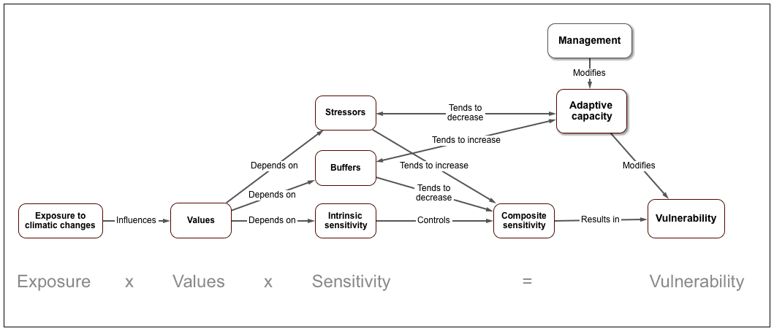
Detailed ontological diagram and model for vulnerability assessment, based on IPCC and Furniss et al. 2013
Exposure x Sensitivity ÷ Adaptive Capacity = Vulnerability
Notes:
Reference: Graphic by MJ Furniss
Here is a detailed model of vulnerability. Study it.
NOTE: SENSITIVITY means SENSETIVITY TO IMPACTS. YOU MAY SUBSTITUTE THE PHRASE TO MAKE IT MORE CLEAR IF YOU WISH.

Slide 14
Two earthquakes illustrate concepts of vulnerability
Loma Prieta (San Francisco USA) 1989
Haiti 2010
Magnitude 7
316,000 dead
300,000 injured
$14 billion in damages
Magnitude 6.9
62 dead
4,000 injured
$6 billion in damages
How can we explain these large differences in the consequences? How can we express this in terms of
Exposure?
Sensitivity?
Vulnerability?
Adaptation?
Notes:
Same Exposure, different sensitivity, different vulnerability and consequences. SF is resilient, Haiti is sensitive. Haiti has very few earthquakes, SF has many. SF was ready, Haiti was not. Building codes, disaster preparedness. Economic resources.

Slide 15
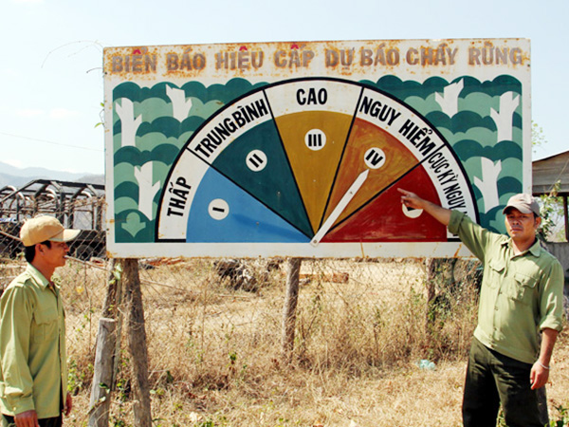
Fire risk signs. An indicator of vulnerability
How does “fire hazard” correlate to vulnerability?
Notes:
Reference: Photo from Professor Vinh
Key message:
This orient students to understand the concepts of Vulnerability.
Have ever you seen it?
It is easy to be seen in front of forest gates in Vietnam. This type of sign may not be used in other countries. The sign is painted in 5 colors which indicate 5 level of forest fire danger.
In this picture, the arrow bar shows Level 4. Can you understand the status of forest at Level 4? (This question just only to connect the next slide, no need answer).

Slide 16
Fire risk signs. An indicator of vulnerability
Exposure
Weather
Wind
Temperature
Humidity
Sensitivity
Fuel
Topography
Fire suppression resources
Disaster response resources
= Vulnerability to Wildfire
We can adapt with:
Public Awareness (as in this sign)
Maintaining fire suppression and disaster response resources,
Doing fuels treatments,
Remote fire detection, and so on.
Notes:
Reference: Photo from Nguyen Le Ai Vinh of Vinh University, Vietnam.
Key message:
This orient students to understand the concepts of Vulnerability.
Have ever you seen it?
It is easy to be seen in front of forest gates in Vietnam. This type of sign may not be used in other countries. The sign is painted in 5 colors which indicate 5 level of forest fire danger.
In this picture, the arrow bar shows Level 4. Can you understand the status of forest at Level 4? (This question just only to connect the next slide, no need answer).

Slide 17
V = Combination of S and A
Sensitivity Adaptability
Vulnerability
Notes:
Sensitivity: The degree to which a system will respond to a given change in the climate
Adaptability: The ability of a system to adjust to a given change in climate thereby reducing
Vulnerability: The extent to which a climate change may damage or harm a system, depending not only on the system’s sensitivity but also its capacity to adapt to the given change.

Slide 18
Adaptive Capacity
Capability to adapt
Function of:
  Wealth
  Technology
  Education
  Institutions
  Information
  Infrastructure
  “Social capital”
Having adaptive capacity does not mean it is used effectively
Notes:
Reference: Lars Friberg Potsdam University
Adaptive capacity is the capability to adapt. The factors listed under the second bullet are from the IPCC Third Assessment Report (Smit et al., 2001). Having capacity does not guarantee it will be used effectively (a good evacuation plan may not be effectively implemented).

Slide 19
More terminology examples
EXPOSURES
SENSITIVITY/IMPACTS
Rainfall (P)
Temperature (T)
Wind speed (W)
Sunshine
Relative humidity (RH)
Independent of impact
Soil moisture
Crop/tree growth
Crop/tree productivity
Health (human, animal)
Depend on crop/human sensitivity & vulnerability
Notes:
From: Elisabeth Simelton & Le Thi Tam
Hanoi Sept 4-5 2013

Slide 20
Key Concept:
A primary job for natural resources managers is to discern differences in sensitivity, understand expected impacts, set priorities to improve resilience to the greatest extent possible.
Notes:
Do not obsess over the uncertainties of climatic exposure. These will remain uncertain. This is not our work. Our disciplines are what is essential and needed to understand how to respond, based on our abilities to discern sensitivities and adaptive capacities.

Slide 21
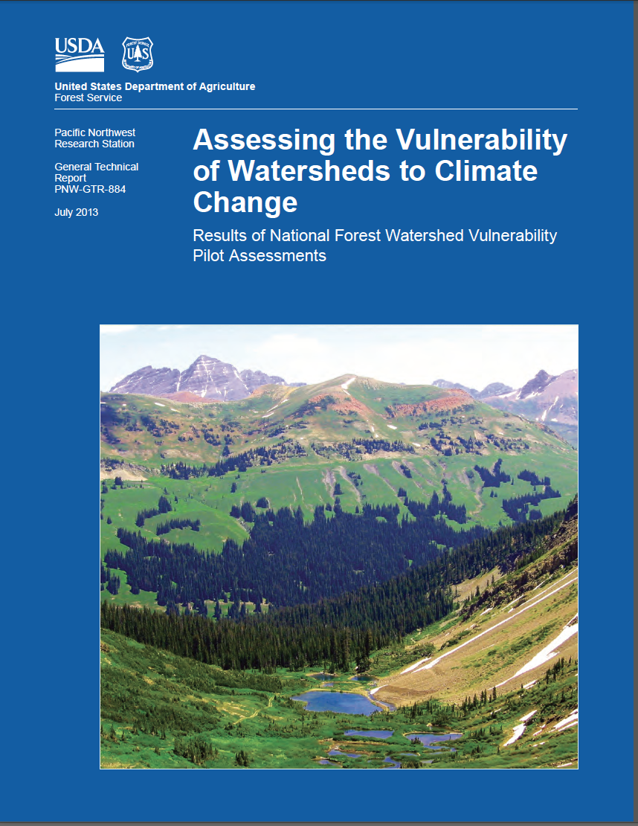
Assigned Reading
Read this publication (in References and Readings):
BCC_GTR_884 Watershed Vulnerability Assessment

Slide 22
In-Class Questions
(after reading pub referenced in last slide)
What is this report about?
What is the challenge to the USFS? Climate change, how will it affect ecosystems values and services, particularly those related to water, how to prepare/manage/adapt? How to begin to develop institutional capacity to do this kind of work.
What are typical water resource values for USFS lands? (infrastructure, species, habitats, water supply)
How do they define watershed resilience? Ability to resist and recover from disturbance, impacts. What do you think "resilience" means?
What is exposure?
Where does exposure data come from? GCMs – downscaled to local predictions for future climate, temp, rainfall typically.
Could be linked with hydrologic models to give stream flow, groundwater recharge rates. Hard to do this accurately, peak flows, droughts.
What is sensitivity?
How does management affect sensitivity? (some factors of sensitivity are intrinsic – geology, locations, some are management related, harvest, roads.

Slide 23
In-Class Questions
(after reading pub referenced in last slide)
What is the discussion of HUC 4 5 6 about? (Hydrologic UnitCategory scale of watershed size – USGS delineation – entire USA mapped. Scale or resolution. Larger scale may have more climate exposure data, but obscures finer trends.
Management best done at HUC 6 scale. See figure 3.
What is vulnerability (interaction of climate exposure with values at risk and watershed sensitivity)
What is an adaptive management response? (road work, buy water rights, grazing allotments, fire regimes, meadow functioning)
What if we find out a particular species is going to be extremely difficult to save? (Consider putting money somewhere else. Triage).
What are the advantages of local historical data? (it happened - verified, management relevant, easy to tie into local resource. Smaller scale data often available, better than broad scale GCMs.
Discuss Figure 2. Provide examples of each of the bubbles and arrows in the figure. What point is the figure trying to illustrate?

Slide 24
In-Class Questions
(after reading pub referenced in previous slide)
Report mentioned NEPA requirements and watershed condition work – an area staff have experience with. How can we learn more about NEPA and watershed condition assessments?
Discuss: two assumptions – strong correlation exists between condition and resilience of watersheds, and climate change is one of many factors natural and human, that affect watershed condition and hydrology. – are these assumptions realistic?
Discuss Figure 2. Provide examples of each of the bubbles and arrows in the figure. What point is the figure trying to illustrate?

Slide 25
Many Human Systems are Sensitive to Climate Change, and Some are Vulnerable (IPCC)
Human systems that are sensitive to climate change include mainly water resources; agriculture (especially food security) and forestry; coastal zones and marine systems (fisheries); human settlements, energy, and industry; insurance and other financial services; and human health.
The vulnerability of these systems varies with geographic location, time, and social, economic, and environmental conditions.

Slide 26
Exercise
Describe the characteristics of an “vulnerable” watershed or landscape.
Which elements of vulnerability could be modified to make the place more resilient?

Slide 27
Why assess vulnerability?
To contribute to climate-aware land-use planning.
To understand the implications and impacts of rapid climate change.
To promote resilience you must know vulnerability
Set priority areas for adaptation.
  high exposure, high sensitivity,
  adaptability
  Refugia (high value, low sensitivity or exposure, or both)
Design adaptive responses.
Provide a base-case description (do-nothing condition).
Focus and prioritize research and monitoring.
Notes:
management days = case studies in vulnerability assessments

Slide 28
Questions that vulnerability assessment can answer
  Which places are vulnerable?
  Which places are resilient? What areas are the best candidates for refugia?
  Do alternative ecosystem services exist?
  Where will conflicts arise first, and worst?
  Where are the potential refugia?
  What are the priorities for adaptive efforts?
  How to design context-sensitive adaptations?
  What needs further assessment, tracking, and monitoring? How can it be accomplished?
Notes:
Key message:
Vulnerability assessments are a tool that will provide managers with answers to the following questions:
What is the local, regional, or national importance of ecosystem services, including ecological, economic, and social resources?
Which important aquatic species may be at risk of population decline or habitat loss due to changes in water flows or levels?
In which watersheds is the risk to these resources greatest?
Which watersheds may serve as climate change refugia because they are expected to experience the least impact?
Which watersheds are high priorities for management to sustain desired hydrologic functions under changing climate?
What ecosystem services are most vulnerable to climate shifts or to the land- and water-use changes likely to accompany them?
What watershed properties are likely to be affected by climate trends, such as changes in runoff from shrinking snowpacks, changing patterns of groundwater recharge, and loss of habitat for sensitive species?
What management actions may reduce the unwanted effects of climate change, protect high value watershed resources, or increase watershed resilience?
What measures can be used to detect and track evidence of climate-related change as early as possible?

Slide 29
Generalizations about climate vulnerability of human populations
Vulnerability will be greater in highly dense populations
Vulnerability will be greatest in areas of low resources for health care
Vulnerability will be greatest in areas of low resources for disaster and emergency response
Vulnerability will be greatest in areas of over allocated, polluted, and inadequate water supplies
Vulnerability will be greatest in areas of low diversity of agricultural cropping systems
Vulnerability will be greatest in areas of high proportion of women and children in the population
Greater vulnerability for populations with serious existing problems
Notes:
Key message:
Here are some generalities about vulnerability that are instructive, but are too generalized to be useful for a vulnerability assessment, except perhaps a very coarse large-scale rapid assessment.
But: Beware of generalities, as exceptions are always present in our disciplines.

Slide 30
Generalizations about ecosystem vulnerability
Vulnerability will be greater in low diversity ecosystems
Vulnerability will be greatest in areas of high stressors, cumulative effects, and population pressure
Vulnerability will be greatest in areas of over-allocated and inadequate water supplies
Vulnerability will be greatest in areas of shallow, fragile, and dry soils
Greater problems for species already in decline
Resilience may be weakened in fragmented ecosystems
Further reductions in habitat will impact threatened, endangered, and rare species
Ecosystem changes will have significant effects on wildlife and aquatic biota
Notes:
Key message:
Here are some generalities about vulnerability that are instructive, but are too generalized to be useful for a vulnerability assessment, except perhaps a very coarse large-scale rapid assessment.
But: Beware of generalities, as exceptions are always present in our fields.

Slide 31
Examples of adaptations informed by vulnerability assessment
Which places (watersheds) should be our focus for reducing environmental effects and risk? Which areas are most in need of restoration?
Which places (watersheds) are good candidates for refugia, new protected areas?
Which areas can anchor the conservation of species and ecosystem types?
Which places (watersheds) should be reviewed and assessed for the application of land management best practices to reduce climate impacts?
Which populations and communities are at greatest risk, so that they can receive priority for assistance in health delivery, disaster response readiness, migration, and education and awareness?
Which values may be irretrievably lost, and which can be sustained?
Which areas will have the greatest conflicts, so that these can be pro-actively managed with land-use planning, water allocation, restoration, public awareness, and so on. Which areas are most at risk for water shortages?
Which species are at greatest risk of loss, and for which we may collect seed, consider assisted migration, habitat restoration, and establishing refugia for conservation?
What additional information, GIS layers, and analysis is most needed for the future?
Where and how should monitoring and evaluation be conducted? For how long?
What research is needed to resolve critical uncertainties revealed by the VA?
Notes:
Key message:
Vulnerability assessments are a tool that will provide managers with answers to the following questions:
What is the local, regional, or national importance of ecosystem services, including ecological, economic, and social resources?
Which important aquatic species may be at risk of population decline or habitat loss due to changes in water flows or levels?
In which watersheds is the risk to these resources greatest?
Which watersheds may serve as climate change refugia because they are expected to experience the least impact?
Which watersheds are high priorities for management to sustain desired hydrologic functions under changing climate?
What ecosystem services are most vulnerable to climate shifts or to the land- and water-use changes likely to accompany them?
What watershed properties are likely to be affected by climate trends, such as changes in runoff from shrinking snowpacks, changing patterns of groundwater recharge, and loss of habitat for sensitive species?
What management actions may reduce the unwanted effects of climate change, protect high value watershed resources, or increase watershed resilience?
What measures can be used to detect and track evidence of climate-related change as early as possible?

Slide 32
Vulnerability ➔ Priority setting
 | Low Sensitivity | High Sensitivity
Low Values | No Worries | Watch
High Values | Refugia | Priority
Notes:
Reference: MJ Furniss

Slide 33
How assess vulnerability?
IPCC (4AR): 7 criteria to identify ‘Key Vulnerabilities’
  Magnitude
  Timing
  Persistence & Reversibility
  Likelihood
  Potential for Adaptation
  Distribution
  Importance of the system

Slide 34
Top level focus of vulnerability analyses
Which to chose:
Species?
Specific Habitats?
By exposure mechanism?
Issue?
My department?
Places – Watersheds are ideal and reflect an ecosystems and ecosystems services approach
  Then others can be built in, species, habitats, impact mechanisms, and so on.

Slide 35
Recommended Steps
Set up the assessment. Identify values.
Assess Exposure
Evaluate the sensitivity of identified values
Evaluate and Categorize Vulnerability
Set Priorities for Adaptive Responses
Critique the Assessment
Notes:
Team members met, and outlined a stepwise approach to the assessment. One change displayed here: the first iteration assessed sensitivity before exposure, work showed that reversing these steps- looking at likely hydrologic changes resulting from exposure, enabled a more focused assessment of sensitivity.

Slide 36
Exposure
Initially can be the most difficult step:
  Climate change projections are available globally. Downscaled projections available in only a few places
    What emission scenarios to use?
    What time period?
    What attributes?
  Using globally available projections is sufficient for most VAs at this time.
Important Finding from USFS assessment pilots:
  Don't obsess about exposure projections & downscaled projections are not necessary for most vulnerability assessments -- focus on sensitivity. Uncertain about exposure, clear on values, sensitivity to impacts, and, importantly, on adaptive capacity.

Slide 37
Exposures
Drought
Heavy Storm
Whirl Wind
Cold Humid Wind
Hot Dry Wind
Saline Water Intrusion/Winds
Cold Spell
Hot Spell
Heavy Rain
Flood (Rain)
Landslide
Early Onset of Rain Season
Delayed Onset of Rain Season
Notes:
Reference: From: Elisabeth Simelton & Le Thi Tam
Hanoi Sept 4-5 2013

Slide 38
Exposure
Historic Data Makes a Strong Case
Always gather local weather records and try to define local climates. Global projections are expressed as changes from current climates, so you need to know what your local baselines are.
Notes:
Reference: USFS Watershed Vulnerability Assessment
Key message:
Often, the trend in historic data relevant to place is more compelling than more abstract projections. For the western US, the work of best fit between historic data and the multitude of projections has been done by the CIG at the University of Washington, these modeling data is available to forests in regions 1,2,3,4 and 6.

Slide 39
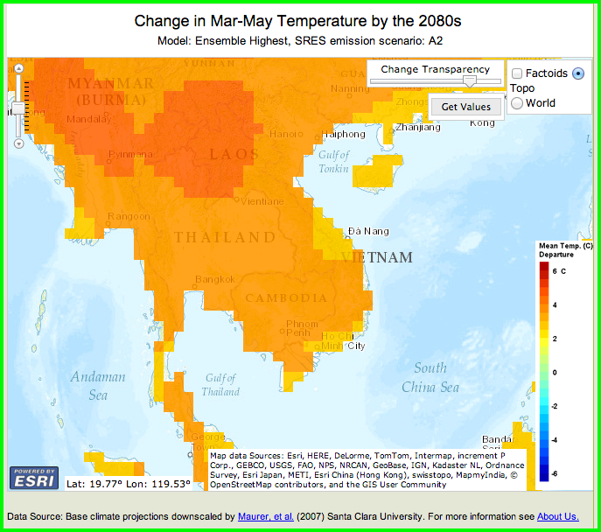
Where to get climatic exposure data
Climate Wizard (www.climatewizard.org)
IPCC (http://www.ipcc.ch)
WorldClim (http://worldclim.org)
Notes:
Reference: Graphic from Climate Wizard by The Natural Conservancy

Slide 40
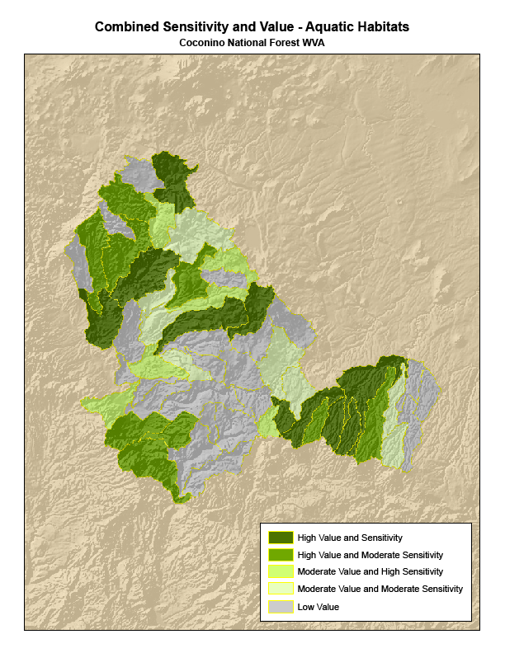
Sensitivity (to impacts)
Approaches will vary, based on place, resource values and information available
This step is the strength of the assessments
Generally, includes both stressors and buffers
Notes:
Reference: Furniss, Michael J.; Roby, Ken B.; Cenderelli, Dan; Chatel, John; Clifton, Caty F.; Clingenpeel, Alan; Hays, Polly E.; Higgins, Dale; Hodges, Ken; Howe, Carol; Jungst, Laura; Louie, Joan; Mai, Christine; Martinez, Ralph; Overton, Kerry; Staab, Brian P.; Steinke, Rory; Weinhold, Mark. 2013. Assessing the vulnerability of watersheds to climate change: results of national forest watershed vulnerability pilot assessments. Gen. Tech. Rep. PNW-GTR-884. Portland, OR: U.S. Department of Agriculture, Forest Service, Pacific Northwest Research Station. 32 p. plus appendix. http://bit.ly/watervulnerability

Slide 41
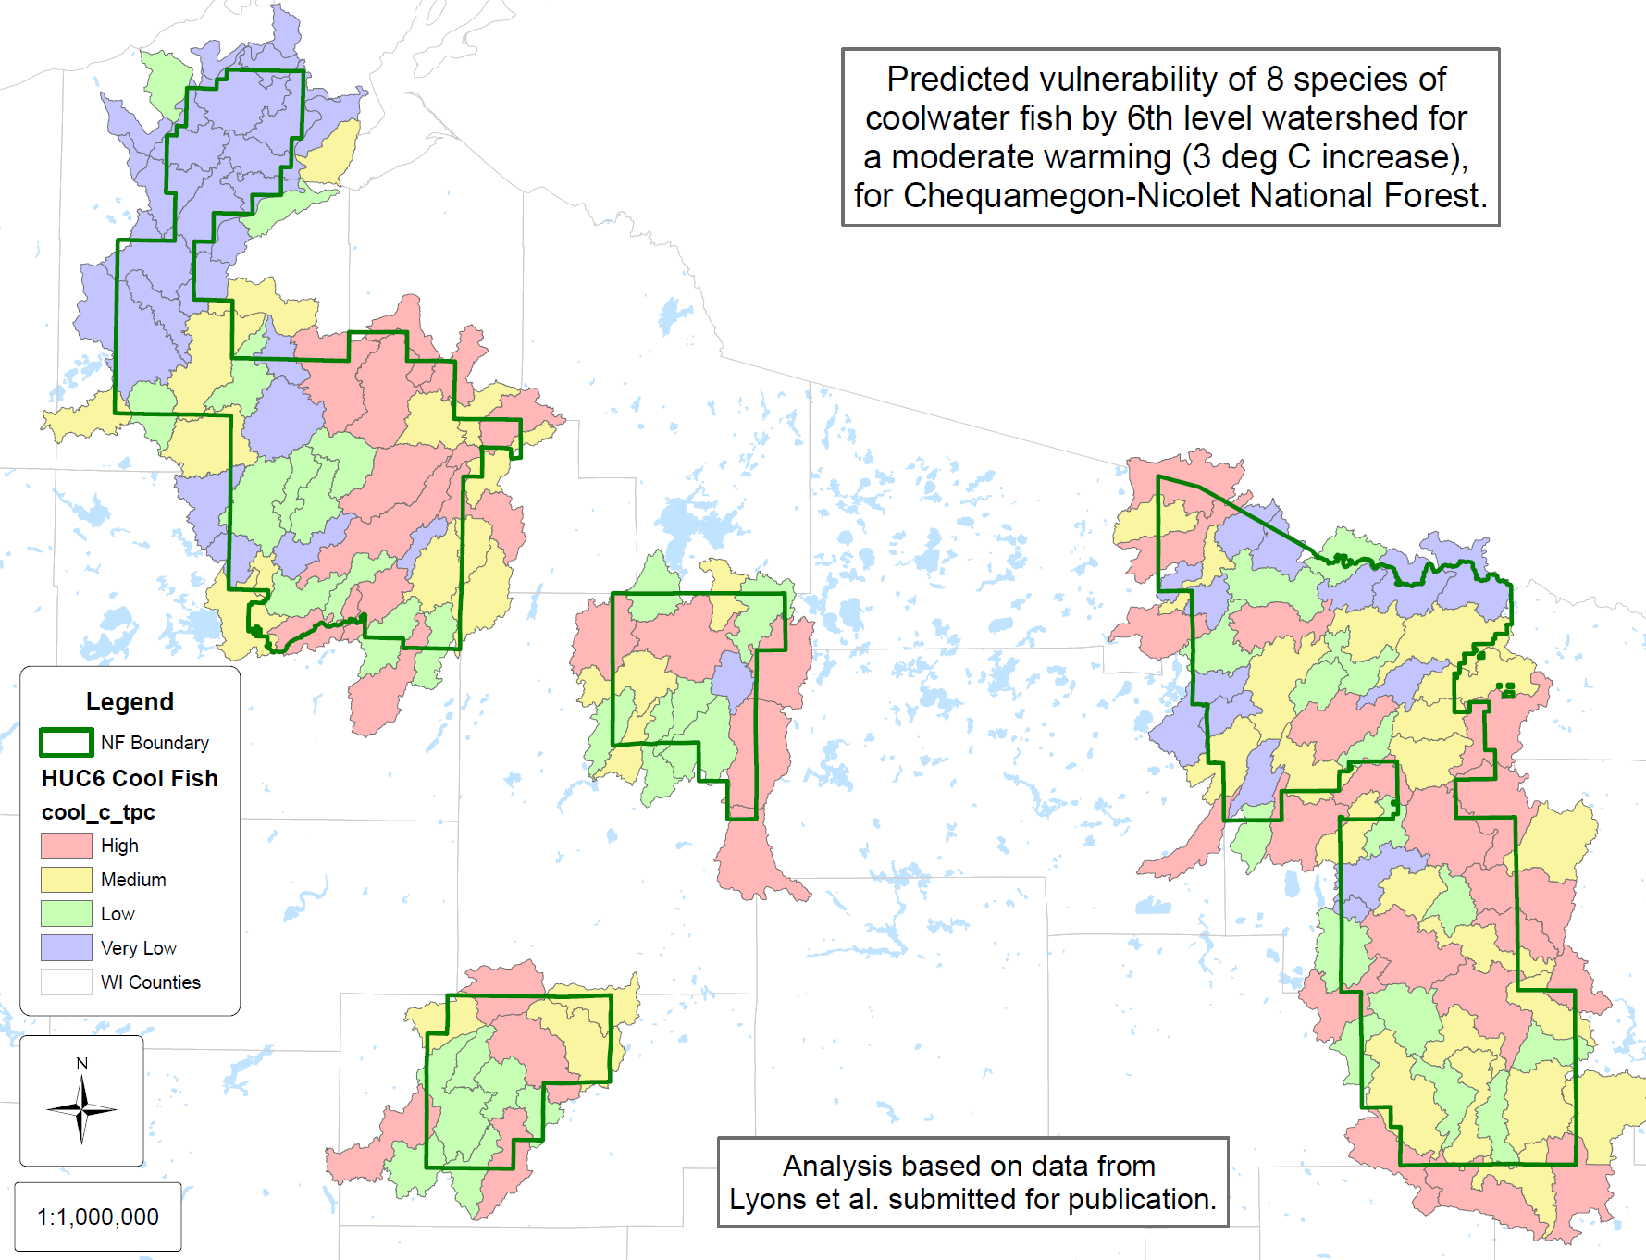
Vulnerability
Based on Combination of Sensitivity, Resource Values and Exposure Ratings
Nearly all pilots used HUC-6 as the reporting unit
The ratings are relative (in most cases: high, moderate, low)
Those watersheds with greatest vulnerability are priority
Notes:
Reference: Furniss, Michael J.; Roby, Ken B.; Cenderelli, Dan; Chatel, John; Clifton, Caty F.; Clingenpeel, Alan; Hays, Polly E.; Higgins, Dale; Hodges, Ken; Howe, Carol; Jungst, Laura; Louie, Joan; Mai, Christine; Martinez, Ralph; Overton, Kerry; Staab, Brian P.; Steinke, Rory; Weinhold, Mark. 2013. Assessing the vulnerability of watersheds to climate change: results of national forest watershed vulnerability pilot assessments. Gen. Tech. Rep. PNW-GTR-884. Portland, OR: U.S. Department of Agriculture, Forest Service, Pacific Northwest Research Station. 32 p. plus appendix. http://bit.ly/watervulnerability

Slide 42
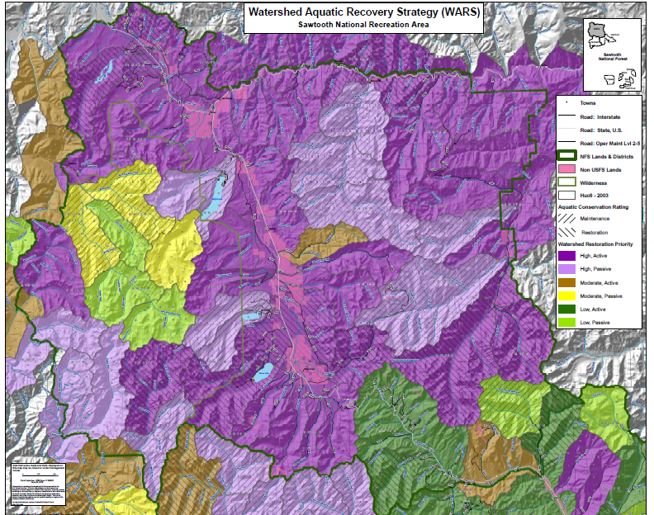
Adaptive response
This is the “Why”
Pilots overlaid results with existing strategies, constraints and opportunities
A natural connection and extension of the Watershed Condition Assessment
Notes:
A Vulnerable Watershed
Waterbodies are listed as impaired or threatened
Aquatic organism consumption advisories exist for 20% or more of the watershed
Considerable evidence of acidification or nutrient enrichment due to atmospheric pollution
Significant departure from natural streamflow condition and changes to aquatic habitat, channel morphology, and riparian vegetation
Small amounts of continuous high quality aquatic habitat with most stream channels showing evidence of degraded conditions
Small wildly scattered populations of native aquatic species and pervasive introduced species
Large percent of riparian vegetation not in proper functioning condition
High road densities, greater than 15% of road network is hydrologically connected, and poorly maintained roads. Drainage features have high or unknown risks and problems.
Soils with evidence of significant alteration to reference soil condition
Fire regime condition class has a high departure from the reference fire regime
More than 15% NFS forest land is not supporting forest cover,
Less than 60% of active range allotments meet Forest Plan direction for ecological condition
Non-native terrestrial plant invasive species populations infest more than 20% of the watershed
More than 20% of the forested land has the potential for experiencing significant tree mortality
Reference: Furniss, Michael J.; Roby, Ken B.; Cenderelli, Dan; Chatel, John; Clifton, Caty F.; Clingenpeel, Alan; Hays, Polly E.; Higgins, Dale; Hodges, Ken; Howe, Carol; Jungst, Laura; Louie, Joan; Mai, Christine; Martinez, Ralph; Overton, Kerry; Staab, Brian P.; Steinke, Rory; Weinhold, Mark. 2013. Assessing the vulnerability of watersheds to climate change: results of national forest watershed vulnerability pilot assessments. Gen. Tech. Rep. PNW-GTR-884. Portland, OR: U.S. Department of Agriculture, Forest Service, Pacific Northwest Research Station. 32 p. plus appendix. http://bit.ly/watervulnerability

Slide 43
Example analysis for drought
Risk Assessment
    Risk = Consequence x Probability
Current Stress/ Impact | Future Stress with climate change | Sensitivity | Adaptive Capacity | Vulnerability | Consequence (low, medium, high) | Probability (low, medium, high, unknown) | Risk (high, medium, low)
Managing summer drought | Lower snowpack and warmer drier summers = more drought | High | Low | High | High – public safety threat, loss of confidence | High – already a concern and warmer, drier conditions expected. | High
Notes:
Reference: Graphic by MJ Furniss

Slide 44
Gender Issues in Vulnerability Assessment
Everyone is being/will be affected by climate changes, but not equally.
Research shows that women disproportionately suffer the impacts of climate change because of cultural norms and the inequitable distribution of roles, resources, power, and child-bearing.
Lack of power plays a role: lack of independence and decision-making power, under-representation, cultural restrictions
Early childbearing, high fertility exacerbate risks
Notes:
Key message:
Poverty and limited education are barriers: Women in general have less access to education and information that would allow them to manage climate-related risks
With good opportunities, women can and do influence change.
Women have a strong base of traditional/environmental knowledge from raising families, collecting/managing resources. Women more likely than men to use resources for family health/economic stability, and more likely to change strategies in response to new information to minimize risk.
This requires that climate change interventions recognizes women’s change agents role and link it with development, rather than always treating them as victims.

Slide 45
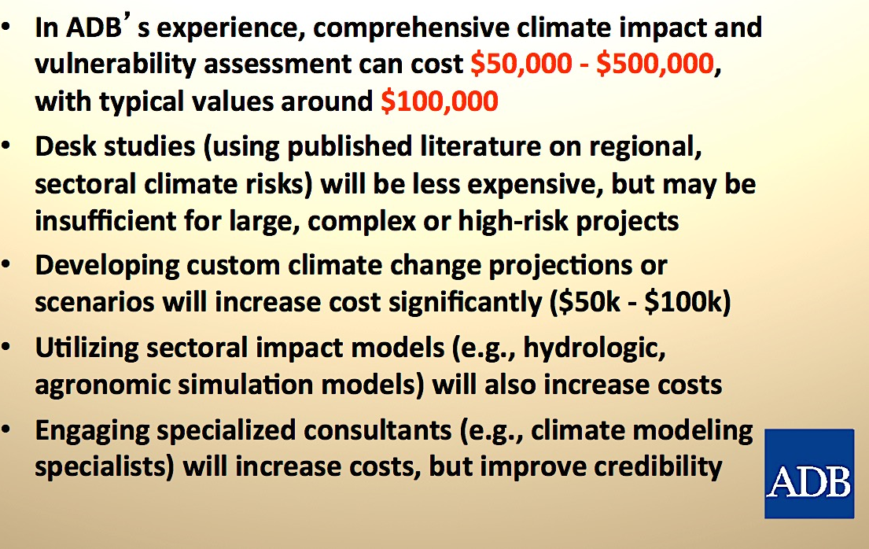
Costs of vulnerability assessment
Notes:
Reference: Charles Rodgers Asian Development Bank Manila, Philippines

Slide 46
Assessment Principles
(from Furniss et al. 2014)
Use Resource Values to focus the analysis
The subwatershed is currently the best choice for analysis and reporting (~10-100 sq km.)
Local climate data provides context.
Assess exposure before sensitivity
Don’t get lost or confused by exposure data: it is varied and uncertain and not nearly as important in the assessment as sensitivity.
Keep the end product in mind.
Notes:
management days = case studies in vulnerability assessments

Slide 47
Generalizations about climate vulnerability of human populations
Vulnerability will be greater in highly dense populations
Vulnerability will be greatest in areas of low resources for health care
Vulnerability will be greatest in areas of low resources for disaster and emergency response
Vulnerability will be greatest in areas of over allocated, polluted, and inadequate water supplies
Vulnerability will be greatest in areas of low diversity of agricultural cropping systems
Vulnerability will be greatest in areas of high proportion of women and children in the population
Greater vulnerability for populations with serious existing problems
Notes:
Key message:
Here are some generalities about vulnerability that are instructive, but are too generalized to be useful for a vulnerability assessment, except perhaps a very coarse large-scale rapid assessment.
But: Beware of generalities, as exceptions are always present in our disciplines.

Slide 48
Generalizations about ecosystem vulnerability
Vulnerability will be greater in low diversity ecosystems
Vulnerability will be greatest in areas of high stressors, cumulative effects, and population pressure
Vulnerability will be greatest in areas of over-allocated, inadequate, and polluted water supplies
Vulnerability will be greatest in areas of shallow, fragile, and dry soils
Greater problems for species already in decline
Resilience is weakened in fragmented ecosystems
Further reductions in habitat will impact threatened, endangered, and rare species
Ecosystem changes will have significant effects on wildlife and aquatic biota
Notes:
Key message:
Here are some generalities about vulnerability that are instructive, but are too generalized to be useful for a vulnerability assessment, except perhaps a very coarse large-scale rapid assessment.
But: Beware of generalities, as exceptions are always present in our fields.

Slide 49
Examples of adaptations informed by vulnerability assessment
Which places (watersheds) should be our focus for reducing environmental effects and risk? Which areas are most in need of restoration?
Which places (watersheds) are good candidates for refugia, new protected areas?
Which areas can anchor the conservation of species and ecosystem types?
Which places (watersheds) should be reviewed and assessed for the application of land management best practices to reduce climate impacts?
Which populations and communities are at greatest risk, so that they can receive priority for assistance in health delivery, disaster response readiness, migration, and education and awareness?
Which values might be irretrievably lost, and which can be sustained?
Which areas will have the greatest foreseeable conflicts, so that these can be pro-actively managed with land-use planning, water allocation, restoration, public awareness, and so on. Which areas are most at risk for water shortages?
Which species are at greatest risk of loss, and for which we may collect seed, consider assisted migration, habitat restoration, and establishing refugia for conservation?
What additional information, GIS layers, and analysis is most needed for the future?
What research is needed to resolve critical uncertainties revealed by the VA?
Notes:
Key message:
Vulnerability assessments are a tool that will provide managers with answers to the following questions:
What is the local, regional, or national importance of ecosystem services, including ecological, economic, and social resources?
Which important aquatic species may be at risk of population decline or habitat loss due to changes in water flows or levels?
In which watersheds is the risk to these resources greatest?
Which watersheds may serve as climate change refugia because they are expected to experience the least impact?
Which watersheds are high priorities for management to sustain desired hydrologic functions under changing climate?
What ecosystem services are most vulnerable to climate shifts or to the land- and water-use changes likely to accompany them?
What watershed properties are likely to be affected by climate trends, such as changes in runoff from shrinking snowpacks, changing patterns of groundwater recharge, and loss of habitat for sensitive species?
What management actions may reduce the unwanted effects of climate change, protect high value watershed resources, or increase watershed resilience?
What measures can be used to detect and track evidence of climate-related change as early as possible?

Slide 50
Rapid assessment of vulnerability
Notes:
Reference: MJ Furniss
Zoom in to read the detail.
This is a schematic for a workshop-based assessment that will set the stage for further assessment.

Slide 51
Questions for Group Discussion:
Gender Issues in Vulnerability Assessment
Do women and men have the same skills and capacity to cope with Climate change?
Are the impact of climate change on women and men same?
What would be the potential solutions to improve women’s opportunities?
What lessons do you learn from this activity?
Notes:
Notes to the instructor:
Situate this exercise prior to talking about gender issues, but after the instructor touches on vulnerability.
1. The purpose of this exercise is to establish that climate change have disproportionate effects on men and women. As a result, women are more vulnerable to the impacts of climate change.
2. Provide a scenario: Give a climate extreme event (suh as flood or fire as relevant to the teaching context) and ask the group to ponder on these question.
3. Use group’s discussions to orient their thinking on the following points:
There is differentiated impact of climate change on men and women and that, women have different skills and capacities to cope with climate change.
Establish the inter-linkages amidst climate change, development and gender equality.
4. Provide the presentation to re-emphasize the points (next slide).

Slide 52
Exercise for Impacts and Vulnerability Topic:
Which choice is TRUE?
Vulnerability is (the same / the opposite) of “resilience”.
Exposure is related to (climate change / how sensitive the land is).
Climate change is happening ( now / in the distant future).
There is (much / very little) we can do to adapt to a changing climate.
Sea level rise is (especially serious / not a big problem) for Vietnam.
We can adapt to sea level changes by (In many ways / only by building sea walls).
Assessing vulnerability requires (climate scientists / local experts in key sectors).
Climate change causes impacts that (are due to climate changes alone / combine with other impacts and make them worse.
The best scale for adapting to climate change is at the (local and provincial level / national and global level).
Local sea level rise depends (only on global sea levels / how the land elevation is changing and big storms).
Notes:
Reference: MJ Furniss

Slide 53
PRACTICE
Case studies in US
Case studies in Vietnam

Slide 54
Case Studies Follow
from US National Forests
Also Please see: http://bit.ly/watervulnerability
Notes:
Case studies from the US National Forest System follow. Need Asian examples.
Also Please see: http://bit.ly/watervulnerability

Slide 55
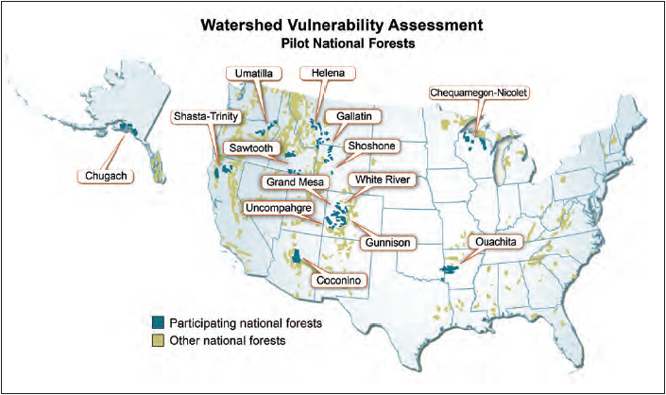
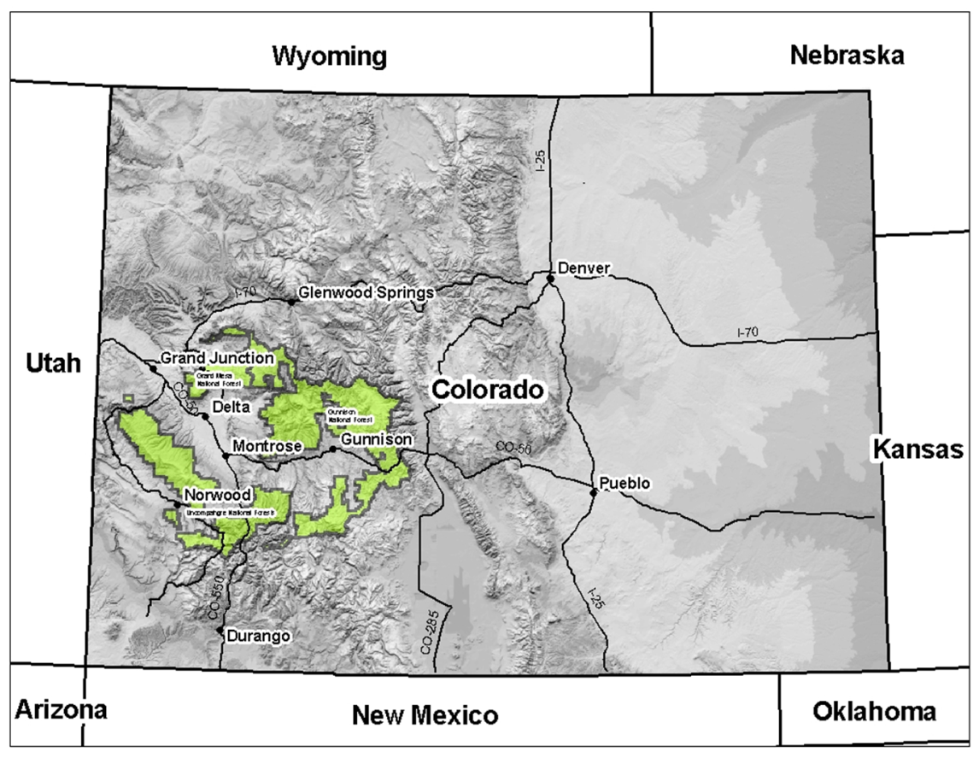
Notes:
Reference: (for images and graphics on all following slides about the GMUG Forest) --- US Forest Service C. Howe
The GMUG National Forests are located in western Colorado. Our forests are in the headwaters of the upper Colorado River, which produces water for most of the southwestern US.

Slide 56
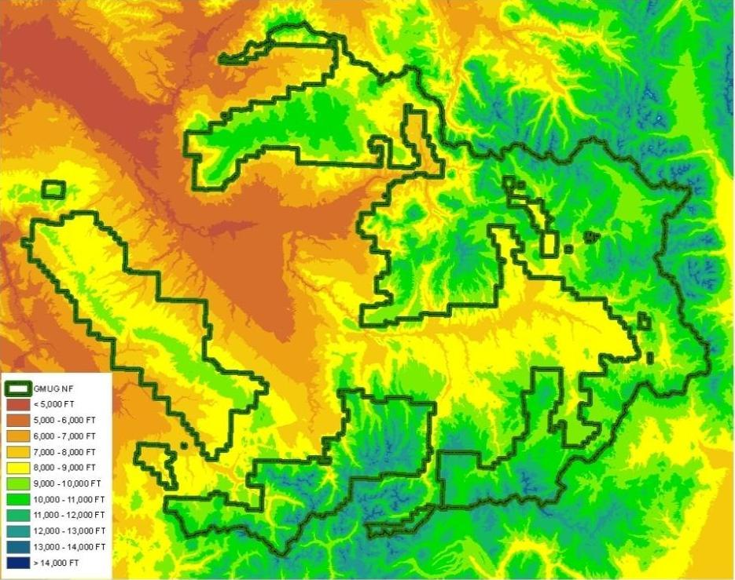
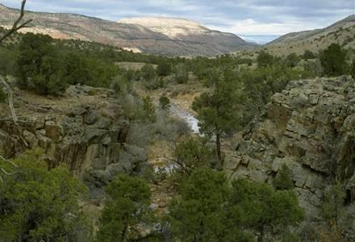
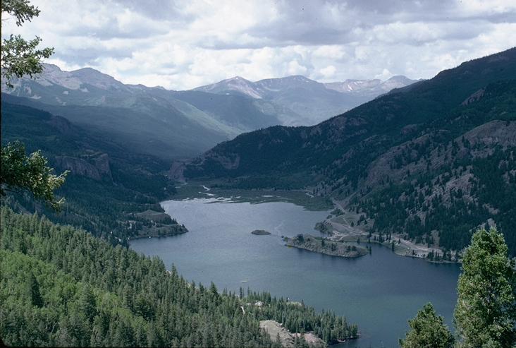
The GMUG NF:
1.3 million hectares
Elevations 6,000 to 14,000 +
Wide diversity of habitat
Notes:
Reference: (for images and graphics on all following slides about the GMUG Forest) --- US Forest Service C. Howe
Key message:
The GMUG National Forests is a large forest
- covering 3.2 million acres
- Elevations range from just under 6,000 feet to over 14,000 feet
Wide diversity of habitats from desert shrub and pinyon-juniper and other habitats similar to the Colorado Plateau, up to spruce-fir forests and Alpine Tundra.

Slide 57
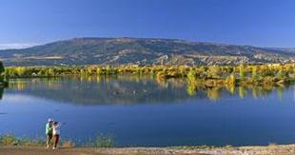
The GMUG NF:
1.3 million Ha
Elevations 6,000 to 14,000 +
Wide diversity of habitat
2.9 million acre-feet annually
3,500 miles of streams
1.7 million acre-feet storage
USFS photo
Notes:
Key message:
The GMUG National Forests is a large forest
- Annually produces an average of 2.9 million acre-feet of water
that flows off the Forest in 3,500 miles of streams.
Has some of highest numbers of water rights of any National Forest with over 1.7 million acre –feet of water storage facilities occurring on the forest.

Slide 58
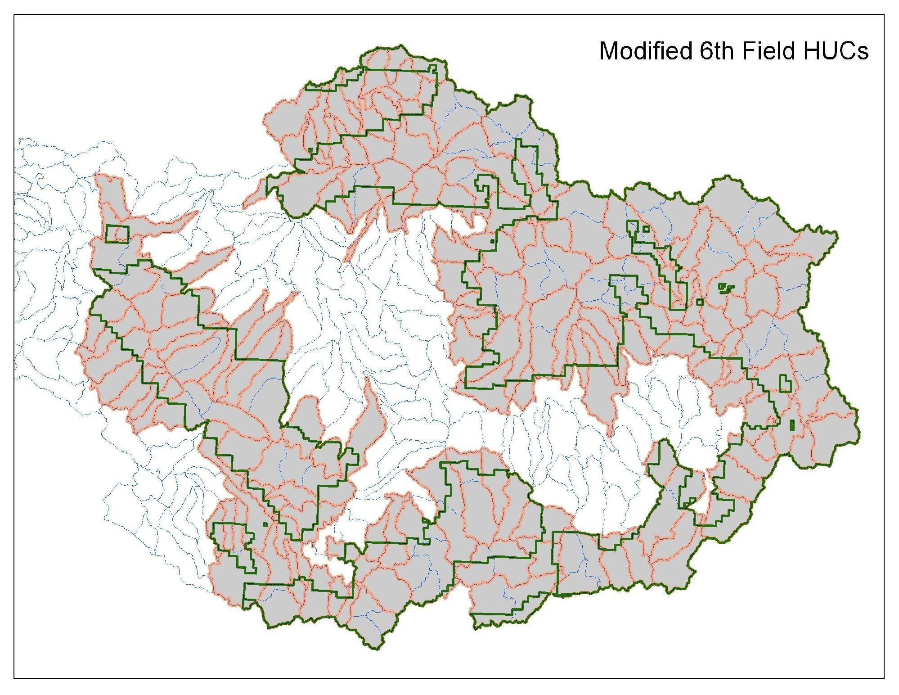
Scales of Assessment
Subwatersheds (HUC6)
Notes:
Reference: Furniss, Michael J.; Roby, Ken B.; Cenderelli, Dan; Chatel, John; Clifton, Caty F.; Clingenpeel, Alan; Hays, Polly E.; Higgins, Dale; Hodges, Ken; Howe, Carol; Jungst, Laura; Louie, Joan; Mai, Christine; Martinez, Ralph; Overton, Kerry; Staab, Brian P.; Steinke, Rory; Weinhold, Mark. 2013. Assessing the vulnerability of watersheds to climate change: results of national forest watershed vulnerability pilot assessments. Gen. Tech. Rep. PNW-GTR-884. Portland, OR: U.S. Department of Agriculture, Forest Service, Pacific Northwest Research Station. 32 p. plus appendix. http://bit.ly/watervulnerability
The First step in the assessment process was to identify the scope or scale of the assessment.
We completed our watershed vulnerability assessment at three different scales.
Most of our analysis was done at the subwatershed or HUC6 scale. (pink outline)
We selected those subwatersheds that were mostly on NFS lands (shown in shaded areas). 205 subwatersheds

Slide 59
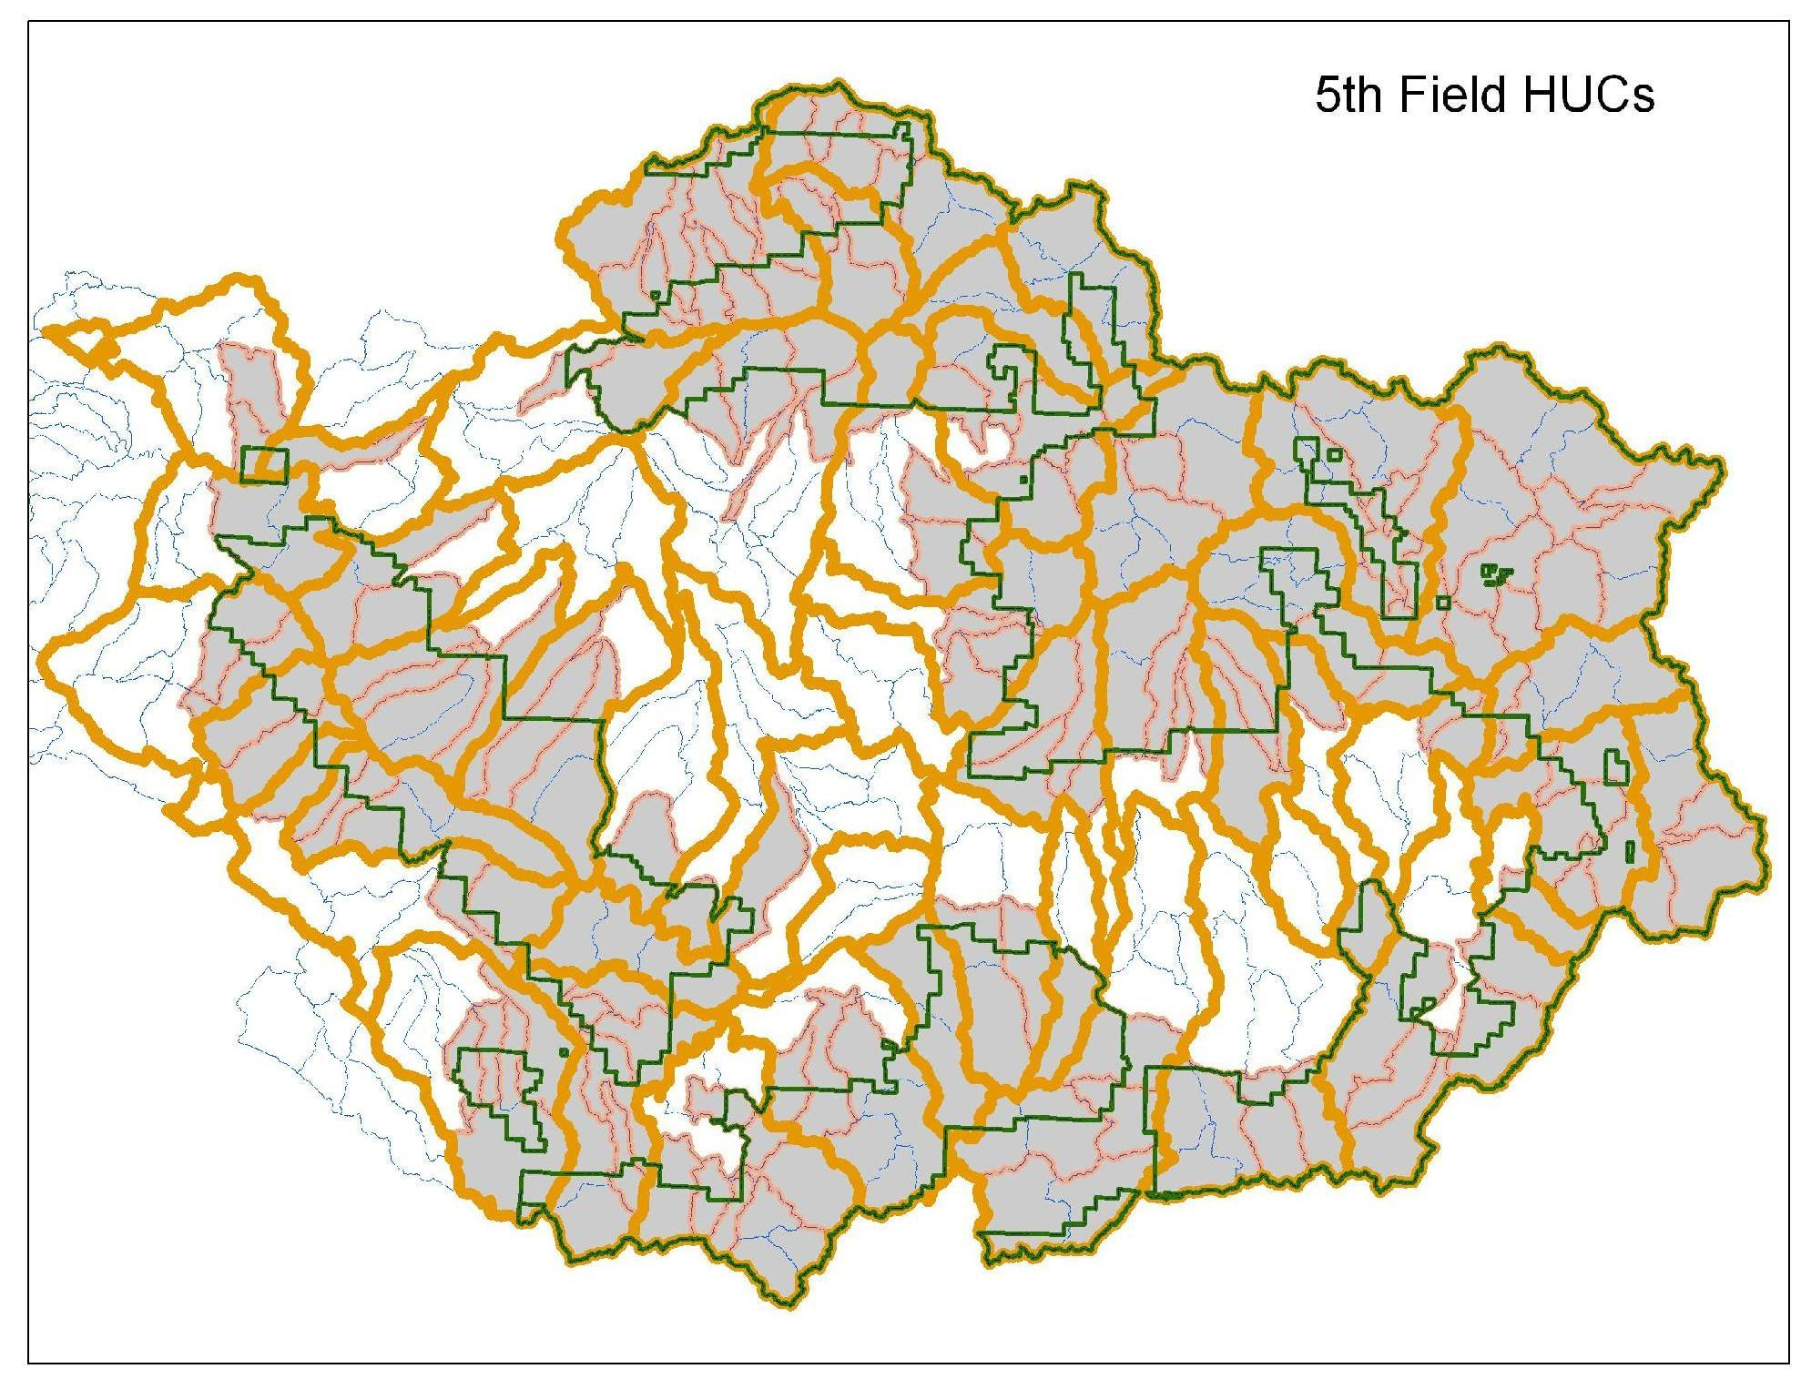
Scales of Assessment
Watersheds (HUC5)
Notes:
Reference: Furniss, Michael J.; Roby, Ken B.; Cenderelli, Dan; Chatel, John; Clifton, Caty F.; Clingenpeel, Alan; Hays, Polly E.; Higgins, Dale; Hodges, Ken; Howe, Carol; Jungst, Laura; Louie, Joan; Mai, Christine; Martinez, Ralph; Overton, Kerry; Staab, Brian P.; Steinke, Rory; Weinhold, Mark. 2013. Assessing the vulnerability of watersheds to climate change: results of national forest watershed vulnerability pilot assessments. Gen. Tech. Rep. PNW-GTR-884. Portland, OR: U.S. Department of Agriculture, Forest Service, Pacific Northwest Research Station. 32 p. plus appendix. http://bit.ly/watervulnerability
We also used the watershed or HUC5 scale (shown in orange) to assess predicted climate changes. 49 Watersheds
Some watersheds extended far off the forest and included wide ranges in elevation, which resulted in averaging wide ranges of climate parameters that were not very representative of areas on the NF.
We also had very limited resource data for most areas off-Forest.

Slide 60
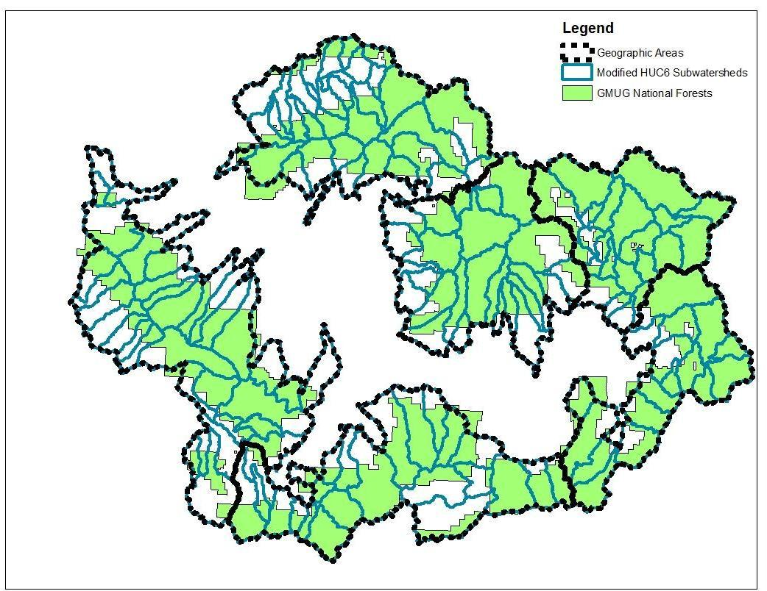
Scales of Assessment
Grand Mesa
Upper Taylor
West Elks
Uncompahgre
Cochetopa
San Juans
Notes:
Reference: Furniss, Michael J.; Roby, Ken B.; Cenderelli, Dan; Chatel, John; Clifton, Caty F.; Clingenpeel, Alan; Hays, Polly E.; Higgins, Dale; Hodges, Ken; Howe, Carol; Jungst, Laura; Louie, Joan; Mai, Christine; Martinez, Ralph; Overton, Kerry; Staab, Brian P.; Steinke, Rory; Weinhold, Mark. 2013. Assessing the vulnerability of watersheds to climate change: results of national forest watershed vulnerability pilot assessments. Gen. Tech. Rep. PNW-GTR-884. Portland, OR: U.S. Department of Agriculture, Forest Service, Pacific Northwest Research Station. 32 p. plus appendix. http://bit.ly/watervulnerability
As we looked at the climate change data we began to see patterns that related to areas of similar elevation and climatic regimes.
We combined subwatersheds into six geographic areas, shown by the black outlines.
When we averaged climate change parameters across a given geographic area, we got more representative results than when using the HUC5 scale.

Slide 61
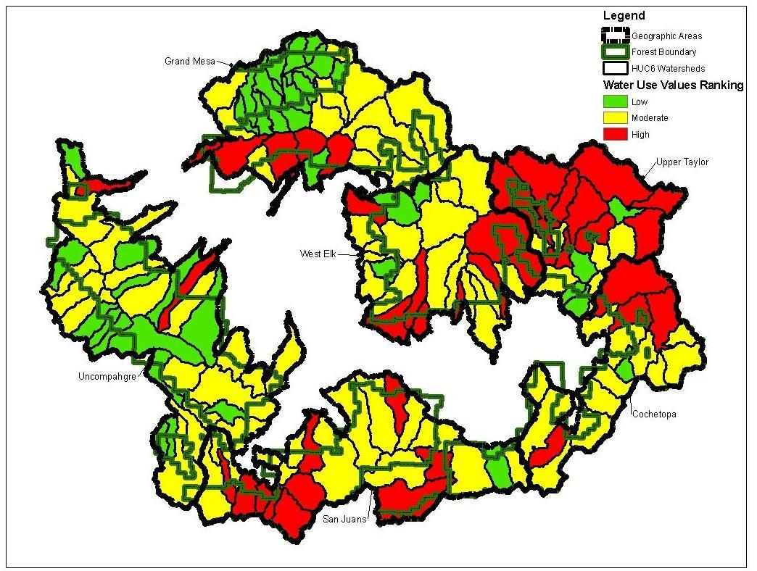
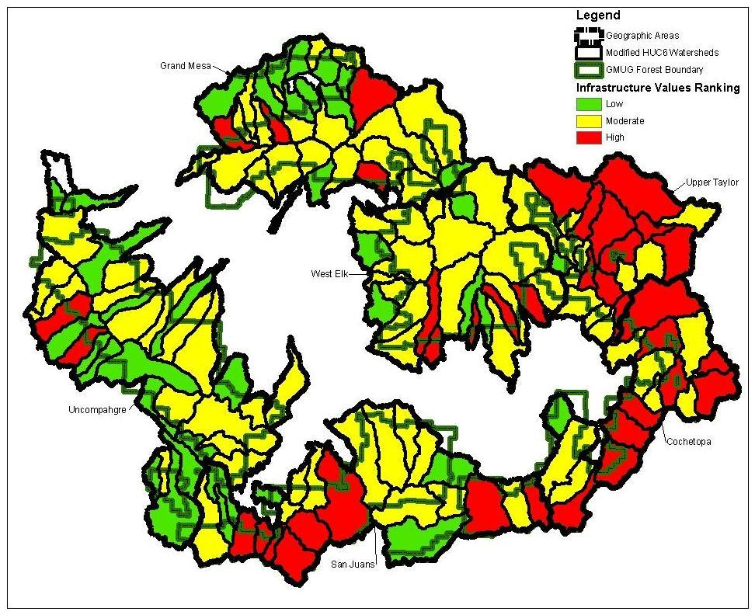
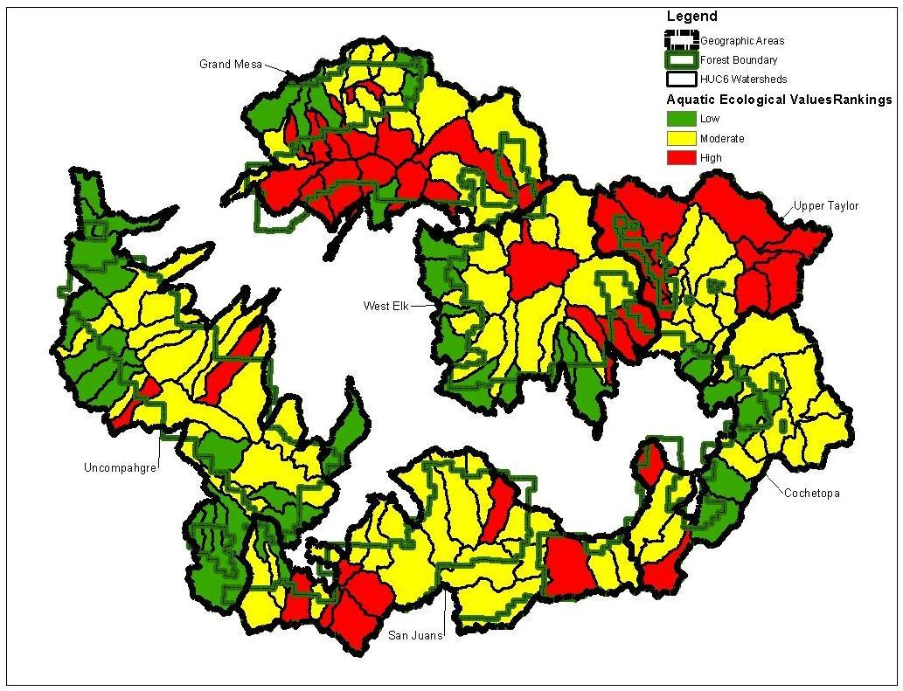
Aquatic Values
Aquatic Values
Water Uses
Infrastructure
Species & Habitats
Aquatic Values
Water Uses
Infrastructure
Species & Habitats
Water Uses
Infrastructure
Species/Habitat
Notes:
Reference: Furniss, Michael J.; Roby, Ken B.; Cenderelli, Dan; Chatel, John; Clifton, Caty F.; Clingenpeel, Alan; Hays, Polly E.; Higgins, Dale; Hodges, Ken; Howe, Carol; Jungst, Laura; Louie, Joan; Mai, Christine; Martinez, Ralph; Overton, Kerry; Staab, Brian P.; Steinke, Rory; Weinhold, Mark. 2013. Assessing the vulnerability of watersheds to climate change: results of national forest watershed vulnerability pilot assessments. Gen. Tech. Rep. PNW-GTR-884. Portland, OR: U.S. Department of Agriculture, Forest Service, Pacific Northwest Research Station. 32 p. plus appendix. http://bit.ly/watervulnerability
We also had to identify the resources of concern. Our vulnerability assessment was focused on three types of Aquatic Resource Values.
Water Uses: Public and private water rights for storage, diversions, spring developments and wells that are primarily used for irrigation, domestic water, and stockwater. Also included State held Instream Flow water rights.
Infrastructure values included roads, trails, stream crossing structures, recreational developments, residences within and adjacent to stream courses and associated floodplains.
Aquatic Species and Habitats :conservation populations of cutthroat trout, coldwater fisheries, streams, waterbodies, fens, wetlands, riparian habitats
For each value group we aggregated information by subwatershed. Subwatersheds with the highest concentrations of values are shown in RED. Subwatersheds with the lowest concentrations of values are in GREEN. Those that fell in the middle are shown in YELLOW.
You can see there are differences in how the three groups of aquatic values are distributed across the Forest.
There is also a difference in how these aquatic values may be impacted by climate change. Species and habitat values are more affected by changes in water temperatures. Changes in water quantity (such as flood events) may have more affect on infrastructure values. Water use values are affected by changes in both water quality and quantity.

Slide 62
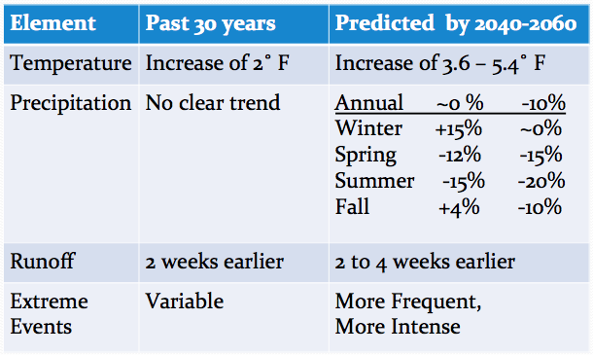
Exposure
Notes:
Reference: Furniss, Michael J.; Roby, Ken B.; Cenderelli, Dan; Chatel, John; Clifton, Caty F.; Clingenpeel, Alan; Hays, Polly E.; Higgins, Dale; Hodges, Ken; Howe, Carol; Jungst, Laura; Louie, Joan; Mai, Christine; Martinez, Ralph; Overton, Kerry; Staab, Brian P.; Steinke, Rory; Weinhold, Mark. 2013. Assessing the vulnerability of watersheds to climate change: results of national forest watershed vulnerability pilot assessments. Gen. Tech. Rep. PNW-GTR-884. Portland, OR: U.S. Department of Agriculture, Forest Service, Pacific Northwest Research Station. 32 p. plus appendix. http://bit.ly/watervulnerability
Step 2 in the process is Assess Exposure or the predicted climate change.
There is a lot of uncertainty with climate change models and their predictions. We used several sources of climate change predictions for our assessment.
- Two climate change reports for the State of Colorado prepared for the Colorado Water Conservation Board. Both reports focus on changes in water quantity and availability.
- We used Variable Infiltration Capacity (VIC) modeled data from the Climate Impacts Group at the University of Washington. We reviewed this data at both a 6 km grid scale, and summarized data at the watershed scale for historic trends, a more moderate emissions climate change scenario, and a more extreme emissions scenario.
- Downscaled climate change predictions for two scenarios developed by Dr. Joe Barsugli of U of CO, and Linda Mearns of Natl Center of Atmospheric Research.
Climate change isn’t just something that may happen in the future. Colorado has already been experiencing changes in our climate.
Over the past 30 years the average annual temperature has increased about 2 F (approx 1 C). Over the next 30 to 50 years temperatures in Western Colorado are expected to increase another 3-6 F (2-4 C).
Over the past 30 years there is no clear trend in past precipitation, just lots of variability. There is not as much confidence in future predicted changes in precipitation as in temperature. Here are two precipitation scenarios for this area. A more moderate scenario on the left, and a more extreme scenario on the right. Predictions vary from little change in annual precipitation to a decrease of up to 10%. Annual averages are not the complete picture, however. Seasonal changes in precipitation may be quite significant. Winters may get wetter, and springs and summers are predicted to get much drier.
In the past 30 years spring runoff has shifted two weeks earlier. Runoff is predicted to shift an additional 2 to 4 weeks earlier over the next 30 to 50 years.
This can be further exacerbated by dust on snow events, which have been shown to cause both earlier and reduced amounts of runoff. If we end up with much hotter and drier climates more dust on snow events are likely to occur.
The climate record for extreme event is also quite variable. This is not just extreme storm events, but also includes droughts, wind events and other disturbances like wildfire. Extreme events are predicted to become more frequent and more intense in the future.

Slide 63
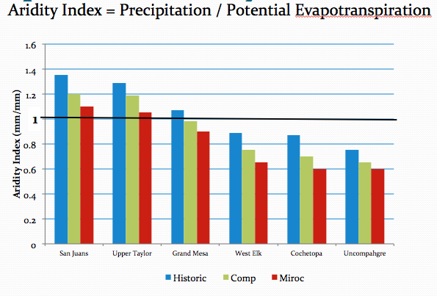
Exposure – Aridity Index
Notes:
Reference: Furniss, Michael J.; Roby, Ken B.; Cenderelli, Dan; Chatel, John; Clifton, Caty F.; Clingenpeel, Alan; Hays, Polly E.; Higgins, Dale; Hodges, Ken; Howe, Carol; Jungst, Laura; Louie, Joan; Mai, Christine; Martinez, Ralph; Overton, Kerry; Staab, Brian P.; Steinke, Rory; Weinhold, Mark. 2013. Assessing the vulnerability of watersheds to climate change: results of national forest watershed vulnerability pilot assessments. Gen. Tech. Rep. PNW-GTR-884. Portland, OR: U.S. Department of Agriculture, Forest Service, Pacific Northwest Research Station. 32 p. plus appendix. http://bit.ly/watervulnerability
We used an Aridity Index to forecast how water availability may be affected by predicted climate change.
An Aridity Index is the ratio of precipitation to potential evapotranspiration.
AI > 1 means precipitation exceeds the demand of evapotranspiration and there is available water in the system.
AI = 1 means precipitation meets the demand of potential evapotranspiration.
AI < 1 means evapotranspiration exceeds precipitation and plants are under water stress. There is a water deficit in the system. There is reduced soil moisture and baseflow in streams may be reduced or eliminated.
This chart shows the annual change in the aridity index by geographic area. Two scenarios were compared to the historic trend (in blue).
Take home messages:
AI is decreasing everywhere. All areas are getting drier.
Drier areas on the forest have always had water limitations (West Elk, Cochetopa, Uncompahgre). Increases in this water deficit may have significant implications on water availability for livestock management in these geographic areas. Available moisture for plant recovery following grazing may not be there and we may not see any regrowth in the late summer early fall.
The Grand Mesa may see a change from a water surplus to a water deficit on an annual basis. Grand Mesa has the highest concentration of water uses. Not sure how the high concentration of water bodies, fens, wetlands and riparian areas may buffer this affect.

Slide 64
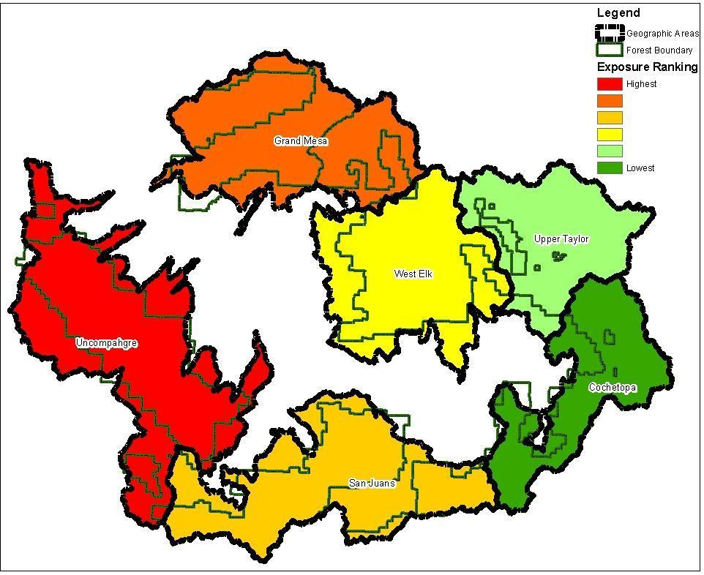
Exposure ranking
Notes:
Reference: Furniss, Michael J.; Roby, Ken B.; Cenderelli, Dan; Chatel, John; Clifton, Caty F.; Clingenpeel, Alan; Hays, Polly E.; Higgins, Dale; Hodges, Ken; Howe, Carol; Jungst, Laura; Louie, Joan; Mai, Christine; Martinez, Ralph; Overton, Kerry; Staab, Brian P.; Steinke, Rory; Weinhold, Mark. 2013. Assessing the vulnerability of watersheds to climate change: results of national forest watershed vulnerability pilot assessments. Gen. Tech. Rep. PNW-GTR-884. Portland, OR: U.S. Department of Agriculture, Forest Service, Pacific Northwest Research Station. 32 p. plus appendix. http://bit.ly/watervulnerability
When we consider the predicted climate changes at the geographic area scale, here is the resulting ranking.
The Uncompahgre is predicted to have the largest change; followed by the Grand Mesa, the San Juans, West Elk, Upper Taylor, then the Cochetopa.
The coloring makes the difference look large, but the differences between these rankings is subtle.

Slide 65
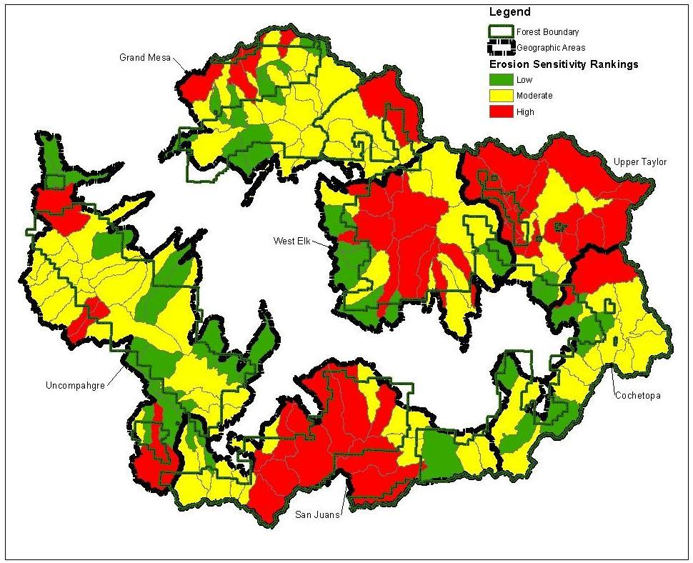
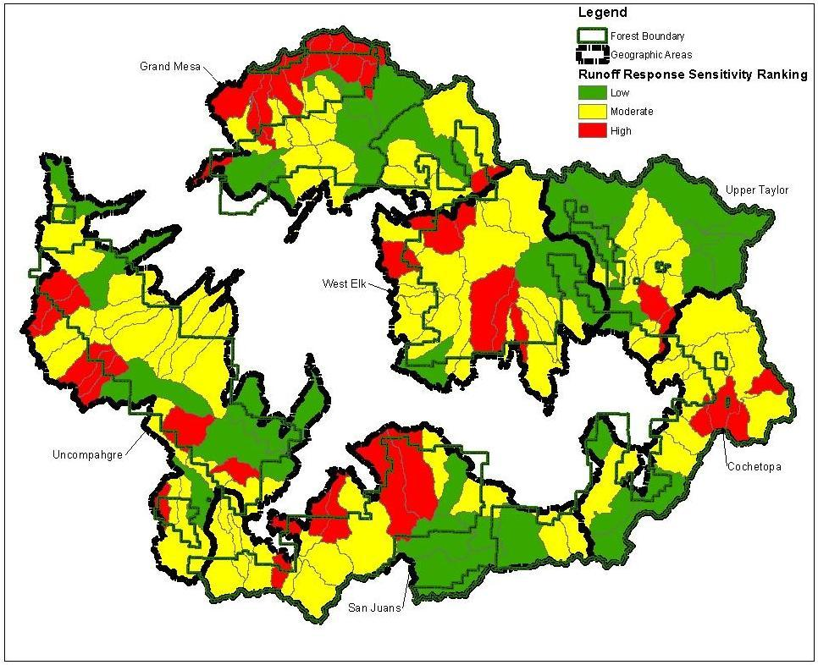
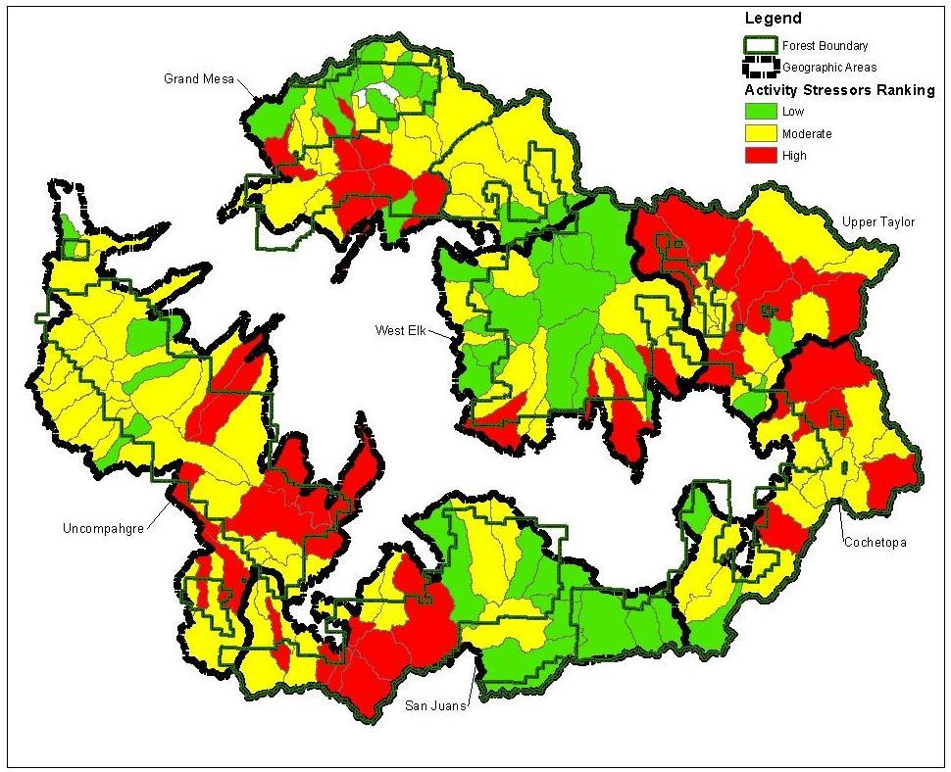
Watershed Risk - Sensitivity & Stressors
Erosion / Sediment Production (Sensitivity)
Runoff Response (Sensitivity)
Activities (Stressors)
Notes:
Reference: Furniss, Michael J.; Roby, Ken B.; Cenderelli, Dan; Chatel, John; Clifton, Caty F.; Clingenpeel, Alan; Hays, Polly E.; Higgins, Dale; Hodges, Ken; Howe, Carol; Jungst, Laura; Louie, Joan; Mai, Christine; Martinez, Ralph; Overton, Kerry; Staab, Brian P.; Steinke, Rory; Weinhold, Mark. 2013. Assessing the vulnerability of watersheds to climate change: results of national forest watershed vulnerability pilot assessments. Gen. Tech. Rep. PNW-GTR-884. Portland, OR: U.S. Department of Agriculture, Forest Service, Pacific Northwest Research Station. 32 p. plus appendix. http://bit.ly/watervulnerability
Step 3 – Assess sensitivities and stressors in Watersheds. Collectively we considered these watershed risk.
We identified inherent landscape characteristics that influence how sensitive these subwatersheds would be to some disturbance. Climate change can be considered a disturbance.
Sensitivity factors were grouped in two ways.
Erosion or sediment production Sensitivity. The factors we considered for this included parent geology, soils characteristics that influenced runoff and infiltration, erosion potential, and mass wasting potential (identified areas with known and potential instability). Areas that are more sensitive to erosion or sediment production are shown in Red, those that are less sensitive are shown in green.
Runoff Response Sensitivity. This was based on factors that influenced how quickly water moves through the system. Considered, slope, watershed shape, stream density as well as some similar geology and soil characteristics mentioned before. Areas that would have the most rapid runoff are our steeper, narrower, straighter watersheds, shown in red. Those watersheds with less sensitivity for rapid runoff are shown in yellow and green
You can see there are differences between these two sensitivities.
Note the concentration of red watersheds sensitive to erosion and sediment production in the San Juans geographic area. Historically our extreme storm events have happened more often over the San Juans geographic area.
Extreme events have a greater potential to dramatically change some of our subwatersheds than do some of the more gradual predicted climate changes.

Slide 66
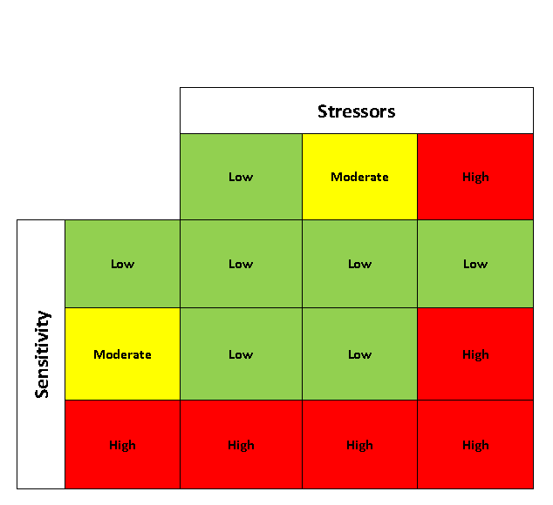
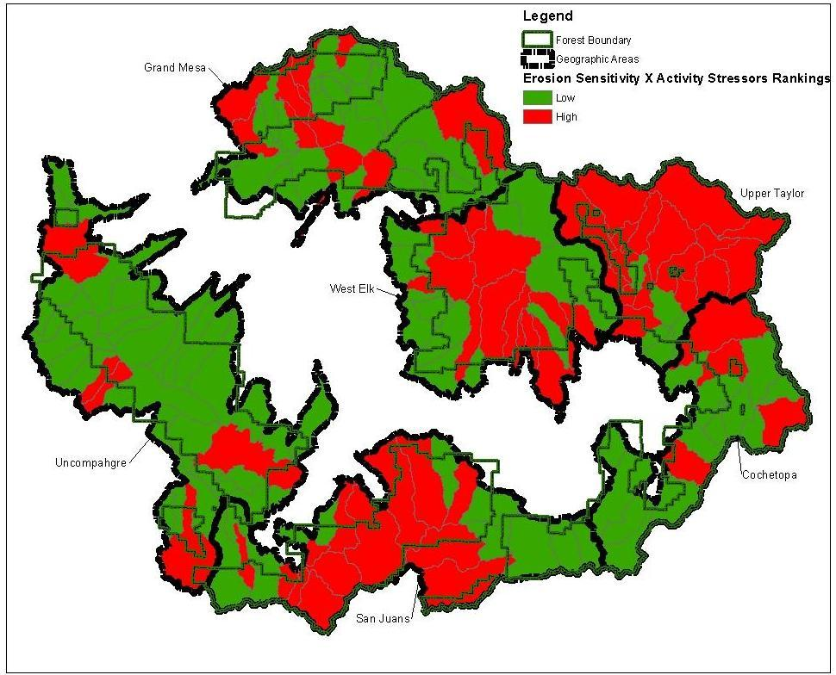
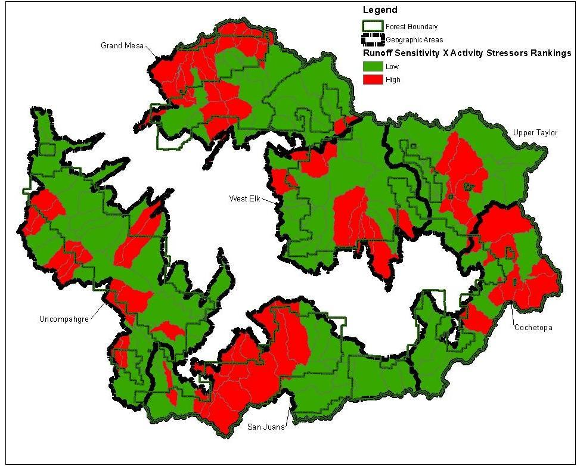
Watershed Risk – Ranking
Erosion X Stressors
Runoff X Stressors
Notes:
Reference: Furniss, Michael J.; Roby, Ken B.; Cenderelli, Dan; Chatel, John; Clifton, Caty F.; Clingenpeel, Alan; Hays, Polly E.; Higgins, Dale; Hodges, Ken; Howe, Carol; Jungst, Laura; Louie, Joan; Mai, Christine; Martinez, Ralph; Overton, Kerry; Staab, Brian P.; Steinke, Rory; Weinhold, Mark. 2013. Assessing the vulnerability of watersheds to climate change: results of national forest watershed vulnerability pilot assessments. Gen. Tech. Rep. PNW-GTR-884. Portland, OR: U.S. Department of Agriculture, Forest Service, Pacific Northwest Research Station. 32 p. plus appendix. http://bit.ly/watervulnerability
Because our Erosion sensitivity and Runoff Sensitivity results were so different we did not combine them, but related each to our activity stressors using the matrix shown in the upper left.
If a subwatershed had high or moderate sensitivity (was red or yellow) and a high concentration of stressors, it was given a high watershed risk ranking and is red in the results shown in the two maps below.

Slide 67
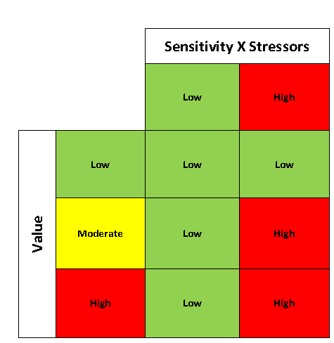
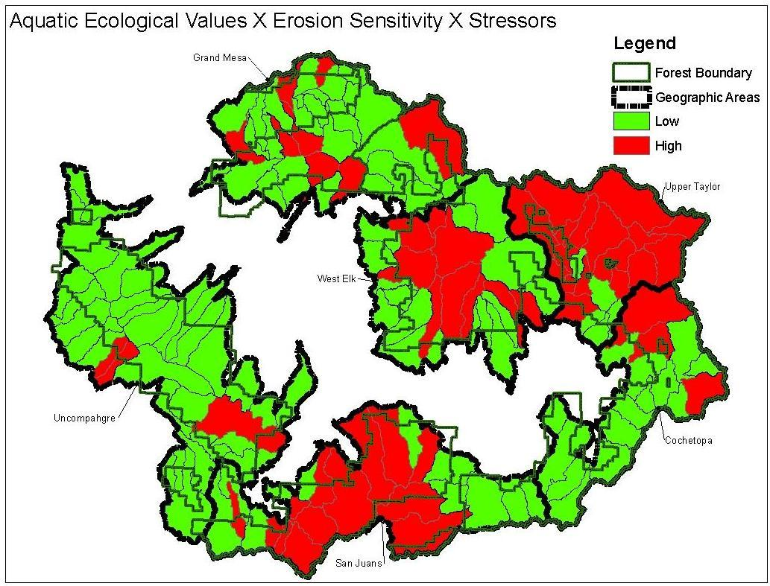
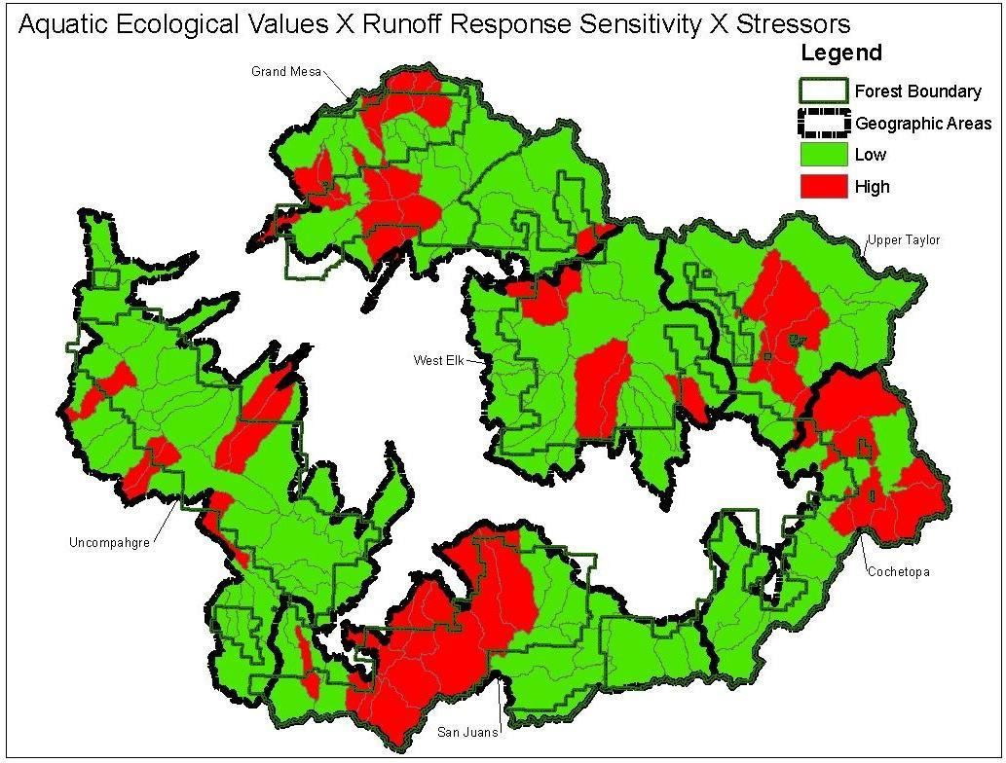
Aquatic Values
X Watershed Risk - Ranking
Species/Habitats X Erosion X Stressors
Species/Habitats X Runoff Response X Stressors
Notes:
Reference: Furniss, Michael J.; Roby, Ken B.; Cenderelli, Dan; Chatel, John; Clifton, Caty F.; Clingenpeel, Alan; Hays, Polly E.; Higgins, Dale; Hodges, Ken; Howe, Carol; Jungst, Laura; Louie, Joan; Mai, Christine; Martinez, Ralph; Overton, Kerry; Staab, Brian P.; Steinke, Rory; Weinhold, Mark. 2013. Assessing the vulnerability of watersheds to climate change: results of national forest watershed vulnerability pilot assessments. Gen. Tech. Rep. PNW-GTR-884. Portland, OR: U.S. Department of Agriculture, Forest Service, Pacific Northwest Research Station. 32 p. plus appendix. http://bit.ly/watervulnerability
We then related each of the three aquatic value groups to both of the Watershed Risk (sensitivity X stressor) rankings using the matrix in the upper right.
Here are examples for the Species and Habitat Values. We have similar pairs for Infrastructure and Water Use Values, for a total of six value and watershed risk rankings.

Slide 68
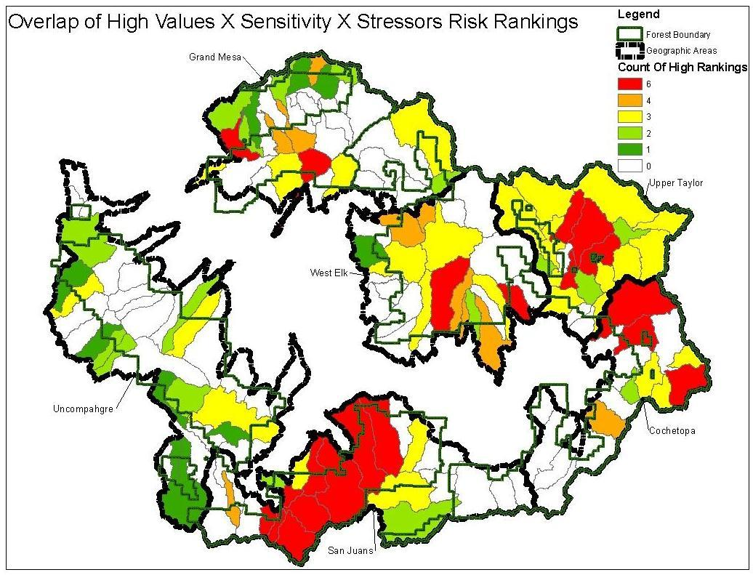
Vulnerability
Notes:
Reference: Furniss, Michael J.; Roby, Ken B.; Cenderelli, Dan; Chatel, John; Clifton, Caty F.; Clingenpeel, Alan; Hays, Polly E.; Higgins, Dale; Hodges, Ken; Howe, Carol; Jungst, Laura; Louie, Joan; Mai, Christine; Martinez, Ralph; Overton, Kerry; Staab, Brian P.; Steinke, Rory; Weinhold, Mark. 2013. Assessing the vulnerability of watersheds to climate change: results of national forest watershed vulnerability pilot assessments. Gen. Tech. Rep. PNW-GTR-884. Portland, OR: U.S. Department of Agriculture, Forest Service, Pacific Northwest Research Station. 32 p. plus appendix. http://bit.ly/watervulnerability
When we combined all six of the value and watershed risk rankings together to see where all the High rankings overlap we get this map.
Many subwatersheds have high rankings for aquatic values, sensitivities and stressors multiple times. Largest possible count of high rankings is 6– shown in red. The lowest possible is 0 – shown in white. No high rankings for aquatic values, sensitivities and stressors.
You see a concentration of vulnerable subwatersheds in the San Juans geographic area. There is another concentration of subwatersheds in the Upper Taylor that have three or more high rankings.

Slide 69
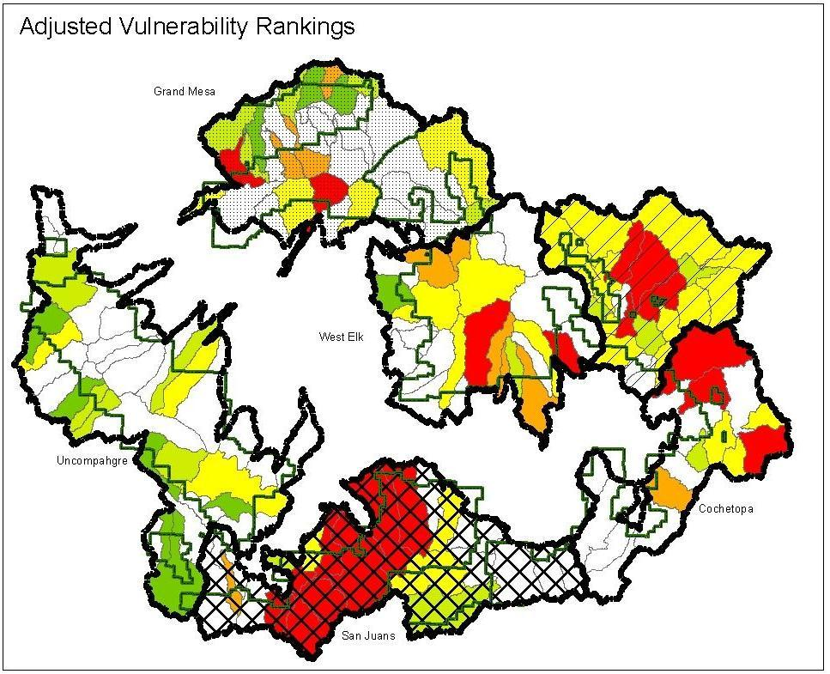
Vulnerability
Upper Taylor
Geographic Areas | Exposure Ranking | Value Risk Ranking | Adjusted Vulnerability Ranking
Uncompahgre | 6 | 1 | 3
Grand Mesa | 5 | 2 | 4
San Juans | 4 | 6 | 6
West Elk | 3 | 3 | 2
Upper Taylor | 2 | 5 | 5
Cochetopa | 1 | 4 | 1
Notes:
Reference: Furniss, Michael J.; Roby, Ken B.; Cenderelli, Dan; Chatel, John; Clifton, Caty F.; Clingenpeel, Alan; Hays, Polly E.; Higgins, Dale; Hodges, Ken; Howe, Carol; Jungst, Laura; Louie, Joan; Mai, Christine; Martinez, Ralph; Overton, Kerry; Staab, Brian P.; Steinke, Rory; Weinhold, Mark. 2013. Assessing the vulnerability of watersheds to climate change: results of national forest watershed vulnerability pilot assessments. Gen. Tech. Rep. PNW-GTR-884. Portland, OR: U.S. Department of Agriculture, Forest Service, Pacific Northwest Research Station. 32 p. plus appendix. http://bit.ly/watervulnerability
When we combine the exposure rankings with the values and risk rankings, the San Juans geographic area has the highest vulnerability ranking, followed by the Upper Taylor, then Grand Mesa, Uncompahgre and Cochetopa.

Slide 70
Applications
Monitoring and Inventory to fill data gaps
  Culvert inventory - are pipes the right size?
  Stream temperature - what is it now, how does it change?
  Actual climate changes – same as predicted?
Design Projects to Improve Resilience/Adaptation
  Prioritize route decommissioning in subwatersheds with high road/trail densities in riparian habitats.
  Improve riparian/wetland habitat conditions.
  Identify areas suitable for water storage developments.
Future Assessments – Terrestrial Resources
Link to Watershed Condition Framework
  Prioritize Watersheds
  Incorporate Condition Attributes into Vulnerability
Climate Change Scorecard (Element 6) √
Notes:
Now that we have some results from the Watershed Vulnerability Assessment, what can we do with them?
The Watershed Vulnerability Assessment identified the need for monitoring and inventory to fill in data gaps.
It identified where the most vulnerable watersheds are located so we can focus on projects to improve resilience and adaptation to protect aquatic resource values.
We are using the exposure information in future vulnerability assessment.
We used the watershed vulnerability assessment to help prioritize watersheds for the watershed condition framework.
Completion of a vulnerability assessment can be counted on the climate change performance scorecard.

Slide 71
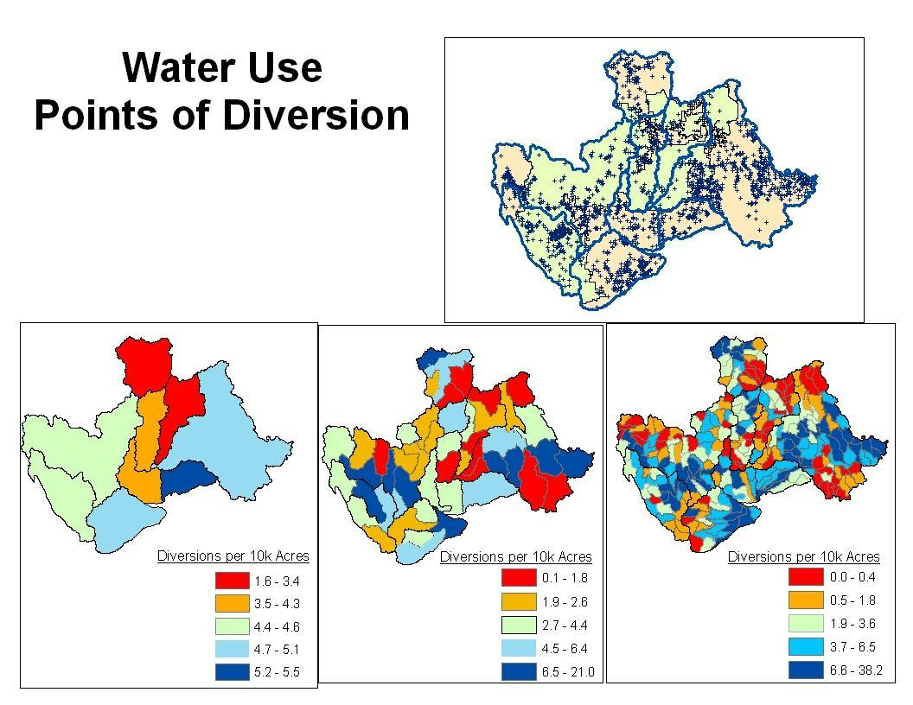
Notes:
Reference: Furniss, Michael J.; Roby, Ken B.; Cenderelli, Dan; Chatel, John; Clifton, Caty F.; Clingenpeel, Alan; Hays, Polly E.; Higgins, Dale; Hodges, Ken; Howe, Carol; Jungst, Laura; Louie, Joan; Mai, Christine; Martinez, Ralph; Overton, Kerry; Staab, Brian P.; Steinke, Rory; Weinhold, Mark. 2013. Assessing the vulnerability of watersheds to climate change: results of national forest watershed vulnerability pilot assessments. Gen. Tech. Rep. PNW-GTR-884. Portland, OR: U.S. Department of Agriculture, Forest Service, Pacific Northwest Research Station. 32 p. plus appendix. http://bit.ly/watervulnerability

Slide 72
Water Resource Values
Consumptive Water Uses (Public and Private)
Infrastructure within/adjacent to stream courses
  Roads, trails, crossings,
  Recreation Developments
Aquatic Habitats and Species
  Fens, wetlands, riparian areas
  Waterbodies
  Instream Flow Water Rights
  Cutthroat Trout and other fisheries
Notes:
Water Resource Values considered in this vulnerability assessment included:
Consumptive Water Uses (Public and private water points of storage, diversion, springs and wells (primarily for irrigation, domestic use, and stockwater)
Infrastructure within and adjacent to stream courses and associated floodplains
Aquatic Habitats and Species
Initially our list of values was longer than this. As we started gathering data we dropped items originally considered as values because there was limited data, or the values occurred in very limited areas.
We also combined values into three groups based on similarities in the way these values might be affected by climate change.
Time constraints also played into some of our decisions.

Slide 73
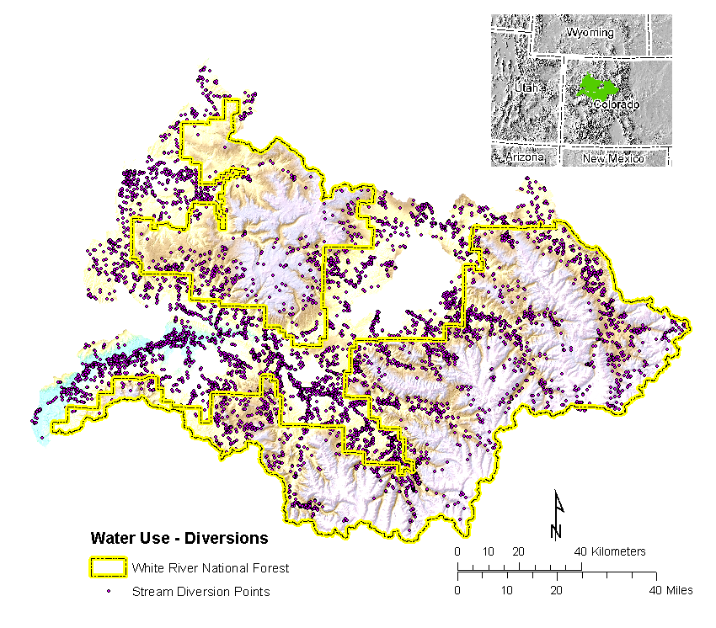
Value: water diversions
Notes:
Reference: USDA Forest Service, Furniss et al. 2013

Slide 74
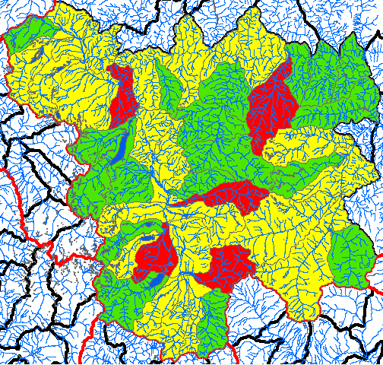
Infrastructure (Amount)
Notes:
Reference: Furniss, Michael J.; Roby, Ken B.; Cenderelli, Dan; Chatel, John; Clifton, Caty F.; Clingenpeel, Alan; Hays, Polly E.; Higgins, Dale; Hodges, Ken; Howe, Carol; Jungst, Laura; Louie, Joan; Mai, Christine; Martinez, Ralph; Overton, Kerry; Staab, Brian P.; Steinke, Rory; Weinhold, Mark. 2013. Assessing the vulnerability of watersheds to climate change: results of national forest watershed vulnerability pilot assessments. Gen. Tech. Rep. PNW-GTR-884. Portland, OR: U.S. Department of Agriculture, Forest Service, Pacific Northwest Research Station. 32 p. plus appendix. http://bit.ly/watervulnerability

Slide 75
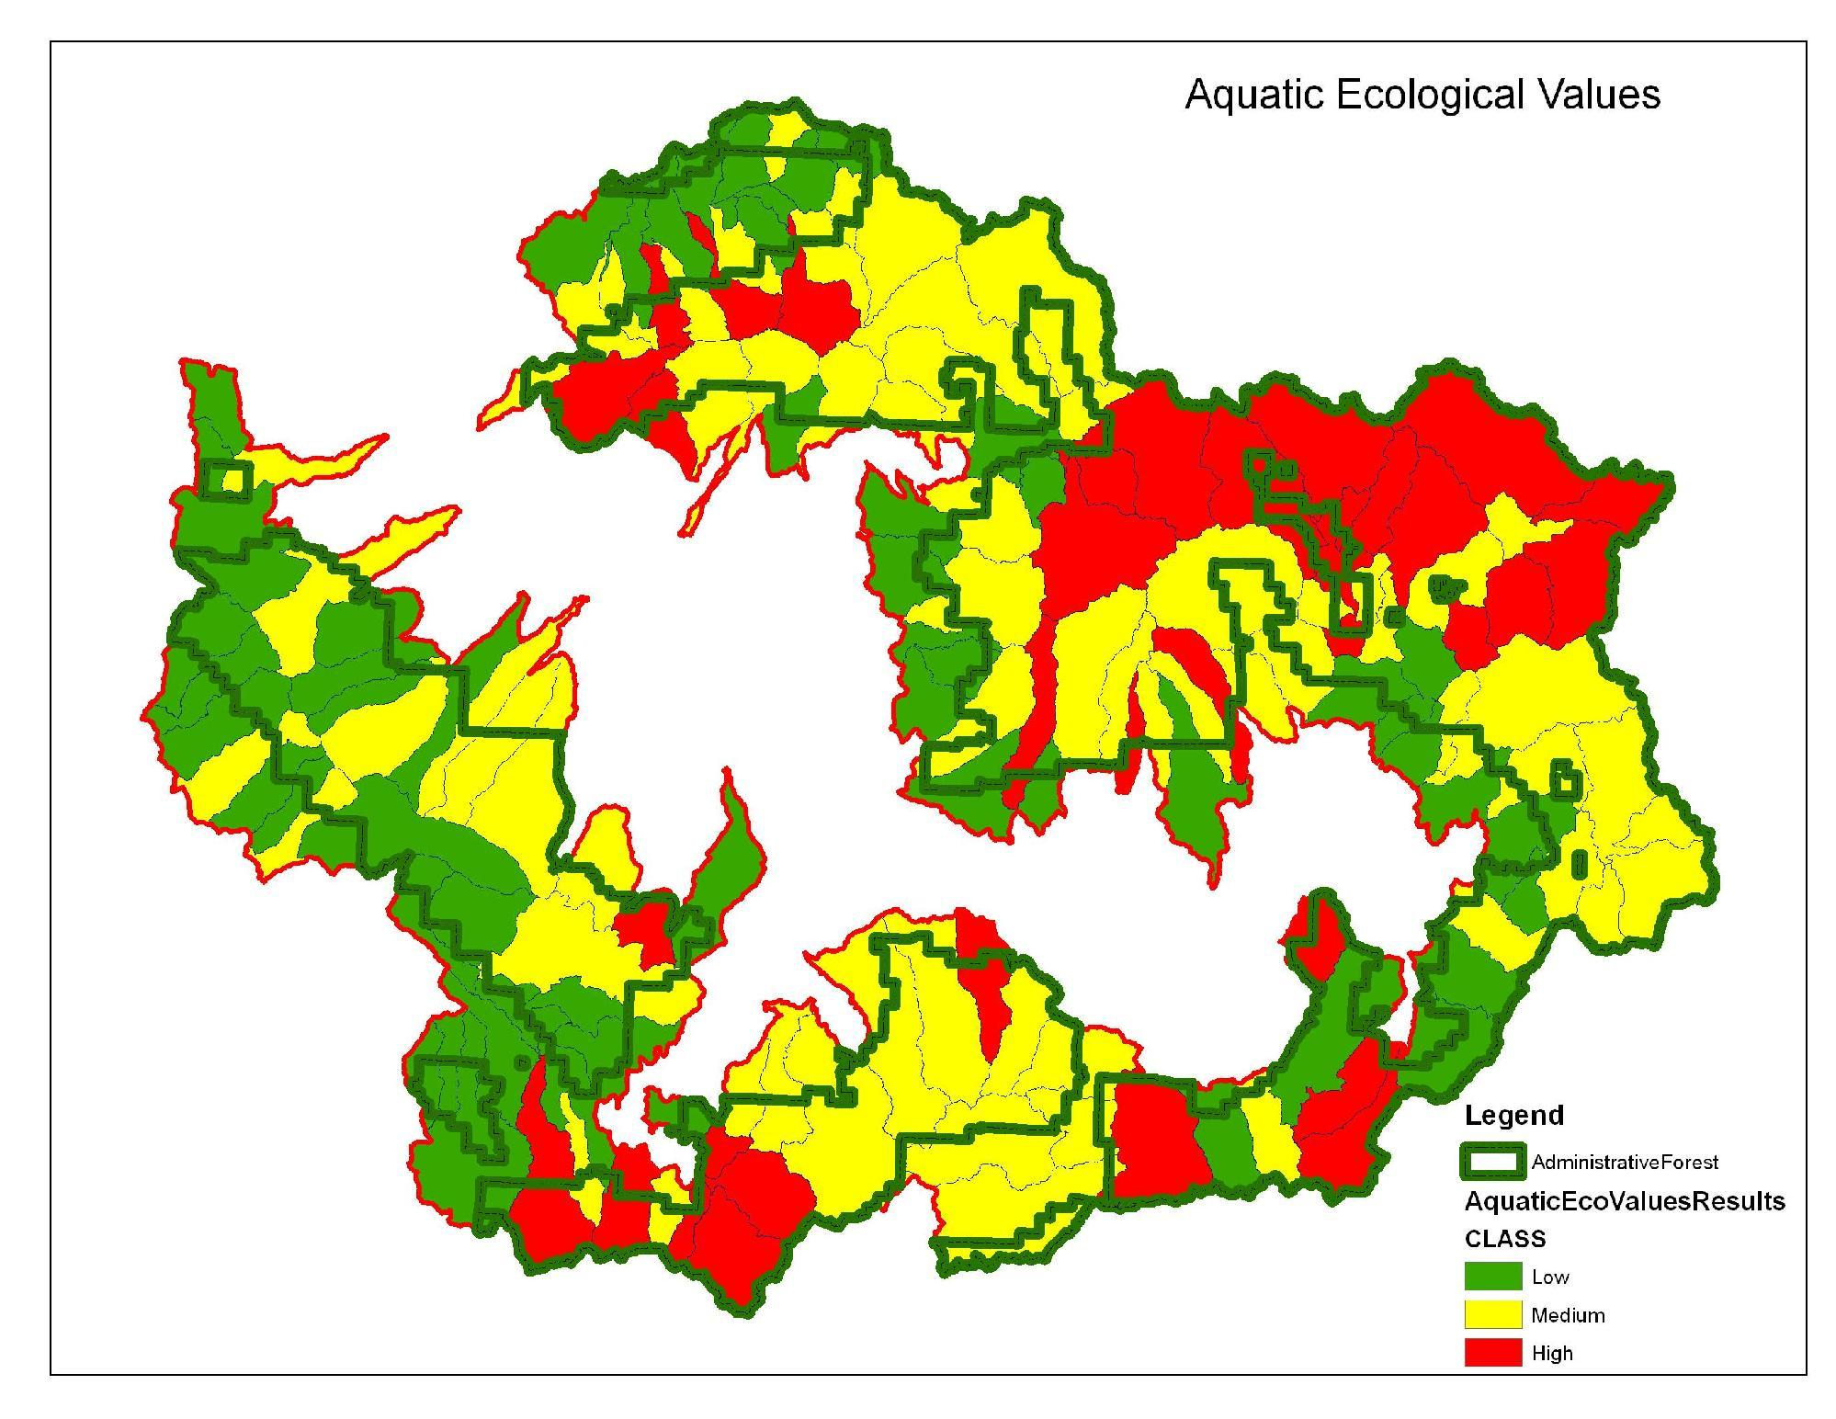
Notes:
Reference: Furniss, Michael J.; Roby, Ken B.; Cenderelli, Dan; Chatel, John; Clifton, Caty F.; Clingenpeel, Alan; Hays, Polly E.; Higgins, Dale; Hodges, Ken; Howe, Carol; Jungst, Laura; Louie, Joan; Mai, Christine; Martinez, Ralph; Overton, Kerry; Staab, Brian P.; Steinke, Rory; Weinhold, Mark. 2013. Assessing the vulnerability of watersheds to climate change: results of national forest watershed vulnerability pilot assessments. Gen. Tech. Rep. PNW-GTR-884. Portland, OR: U.S. Department of Agriculture, Forest Service, Pacific Northwest Research Station. 32 p. plus appendix. http://bit.ly/watervulnerability
Resulting ranking of aquatic ecological values (fens, wetlands, riparian habitats, waterbodies, instream flow water rights, fisheries).
We determined individual ratings for each value, then standardized the ratings, and summed these ratings together for each watershed.
Green watersheds had the fewest aquatic ecological values present, red the most.
We ended up with three displays for values based on our three groups (consumptive uses, infrastructure, habitats and species).

Slide 76
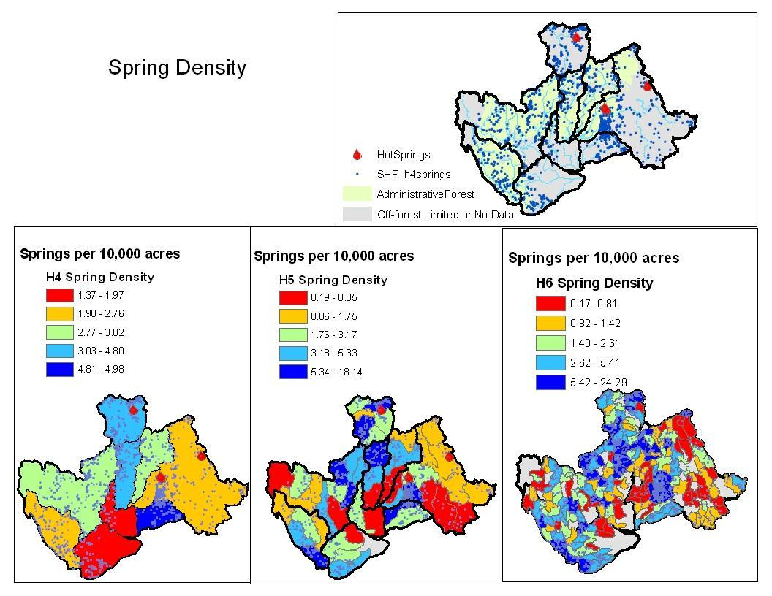
Geometric distribution
>1400 Springs
Notes:
Reference: Furniss, Michael J.; Roby, Ken B.; Cenderelli, Dan; Chatel, John; Clifton, Caty F.; Clingenpeel, Alan; Hays, Polly E.; Higgins, Dale; Hodges, Ken; Howe, Carol; Jungst, Laura; Louie, Joan; Mai, Christine; Martinez, Ralph; Overton, Kerry; Staab, Brian P.; Steinke, Rory; Weinhold, Mark. 2013. Assessing the vulnerability of watersheds to climate change: results of national forest watershed vulnerability pilot assessments. Gen. Tech. Rep. PNW-GTR-884. Portland, OR: U.S. Department of Agriculture, Forest Service, Pacific Northwest Research Station. 32 p. plus appendix. http://bit.ly/watervulnerability

Slide 77
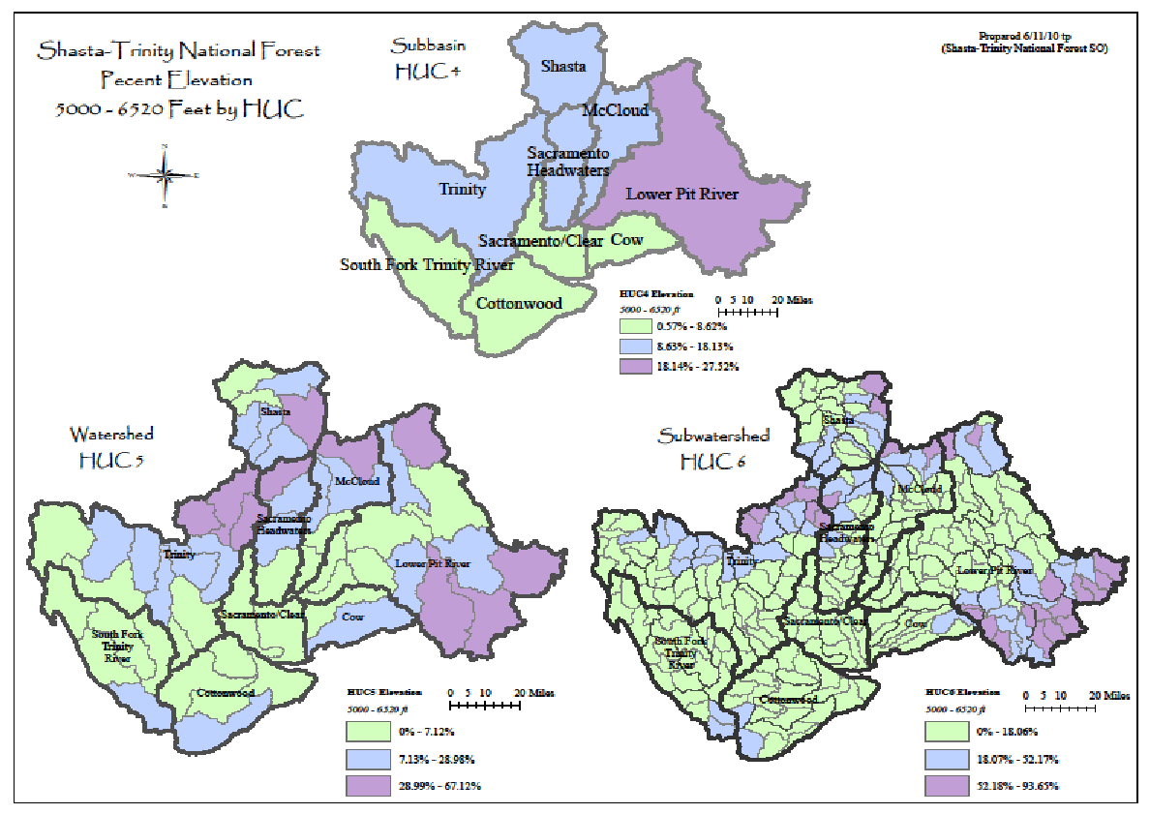
Rain on Snow Zones
Notes:
Reference: Furniss, Michael J.; Roby, Ken B.; Cenderelli, Dan; Chatel, John; Clifton, Caty F.; Clingenpeel, Alan; Hays, Polly E.; Higgins, Dale; Hodges, Ken; Howe, Carol; Jungst, Laura; Louie, Joan; Mai, Christine; Martinez, Ralph; Overton, Kerry; Staab, Brian P.; Steinke, Rory; Weinhold, Mark. 2013. Assessing the vulnerability of watersheds to climate change: results of national forest watershed vulnerability pilot assessments. Gen. Tech. Rep. PNW-GTR-884. Portland, OR: U.S. Department of Agriculture, Forest Service, Pacific Northwest Research Station. 32 p. plus appendix. http://bit.ly/watervulnerability

Slide 78
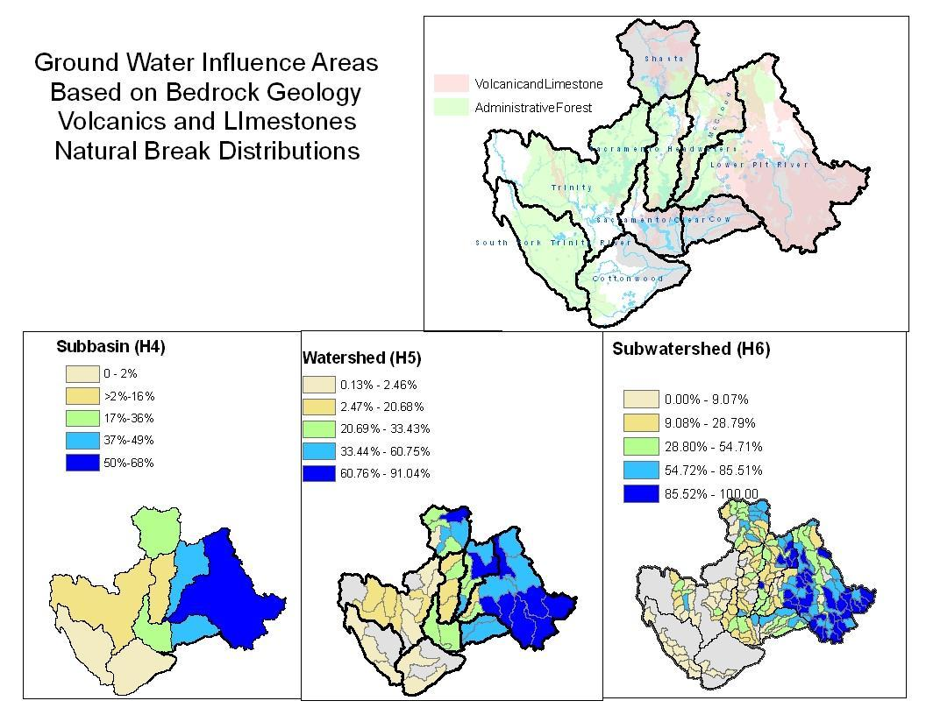
Notes:
Reference: Furniss, Michael J.; Roby, Ken B.; Cenderelli, Dan; Chatel, John; Clifton, Caty F.; Clingenpeel, Alan; Hays, Polly E.; Higgins, Dale; Hodges, Ken; Howe, Carol; Jungst, Laura; Louie, Joan; Mai, Christine; Martinez, Ralph; Overton, Kerry; Staab, Brian P.; Steinke, Rory; Weinhold, Mark. 2013. Assessing the vulnerability of watersheds to climate change: results of national forest watershed vulnerability pilot assessments. Gen. Tech. Rep. PNW-GTR-884. Portland, OR: U.S. Department of Agriculture, Forest Service, Pacific Northwest Research Station. 32 p. plus appendix. http://bit.ly/watervulnerability

Slide 79
Stressors
(Land Uses/Management)
Stream Miles Below Diversions
Stream Miles Below Reservoirs
Stream Miles Innundated by Reservoirs
Motorized Route Density in Watershed and in Riparian/Floodplain
Motorized Route Stream Crossings
Past Vegetation Treatments (included Wildland fire)
Past Mining Activities
Areas of High Recreational Use
Private Inholdings
Notes:
Reference: Furniss, Michael J.; Roby, Ken B.; Cenderelli, Dan; Chatel, John; Clifton, Caty F.; Clingenpeel, Alan; Hays, Polly E.; Higgins, Dale; Hodges, Ken; Howe, Carol; Jungst, Laura; Louie, Joan; Mai, Christine; Martinez, Ralph; Overton, Kerry; Staab, Brian P.; Steinke, Rory; Weinhold, Mark. 2013. Assessing the vulnerability of watersheds to climate change: results of national forest watershed vulnerability pilot assessments. Gen. Tech. Rep. PNW-GTR-884. Portland, OR: U.S. Department of Agriculture, Forest Service, Pacific Northwest Research Station. 32 p. plus appendix. http://bit.ly/watervulnerability
We used work done in an earlier assessment that identified stressors. Because our watershed boundaries had been modified, we massaged numbers in speadsheets rather than reclip all the data in GIS.
Data was limited to NFS lands.
Results of using existing data saved some time, but missed updated data, and still did not include off forest data.

Slide 80
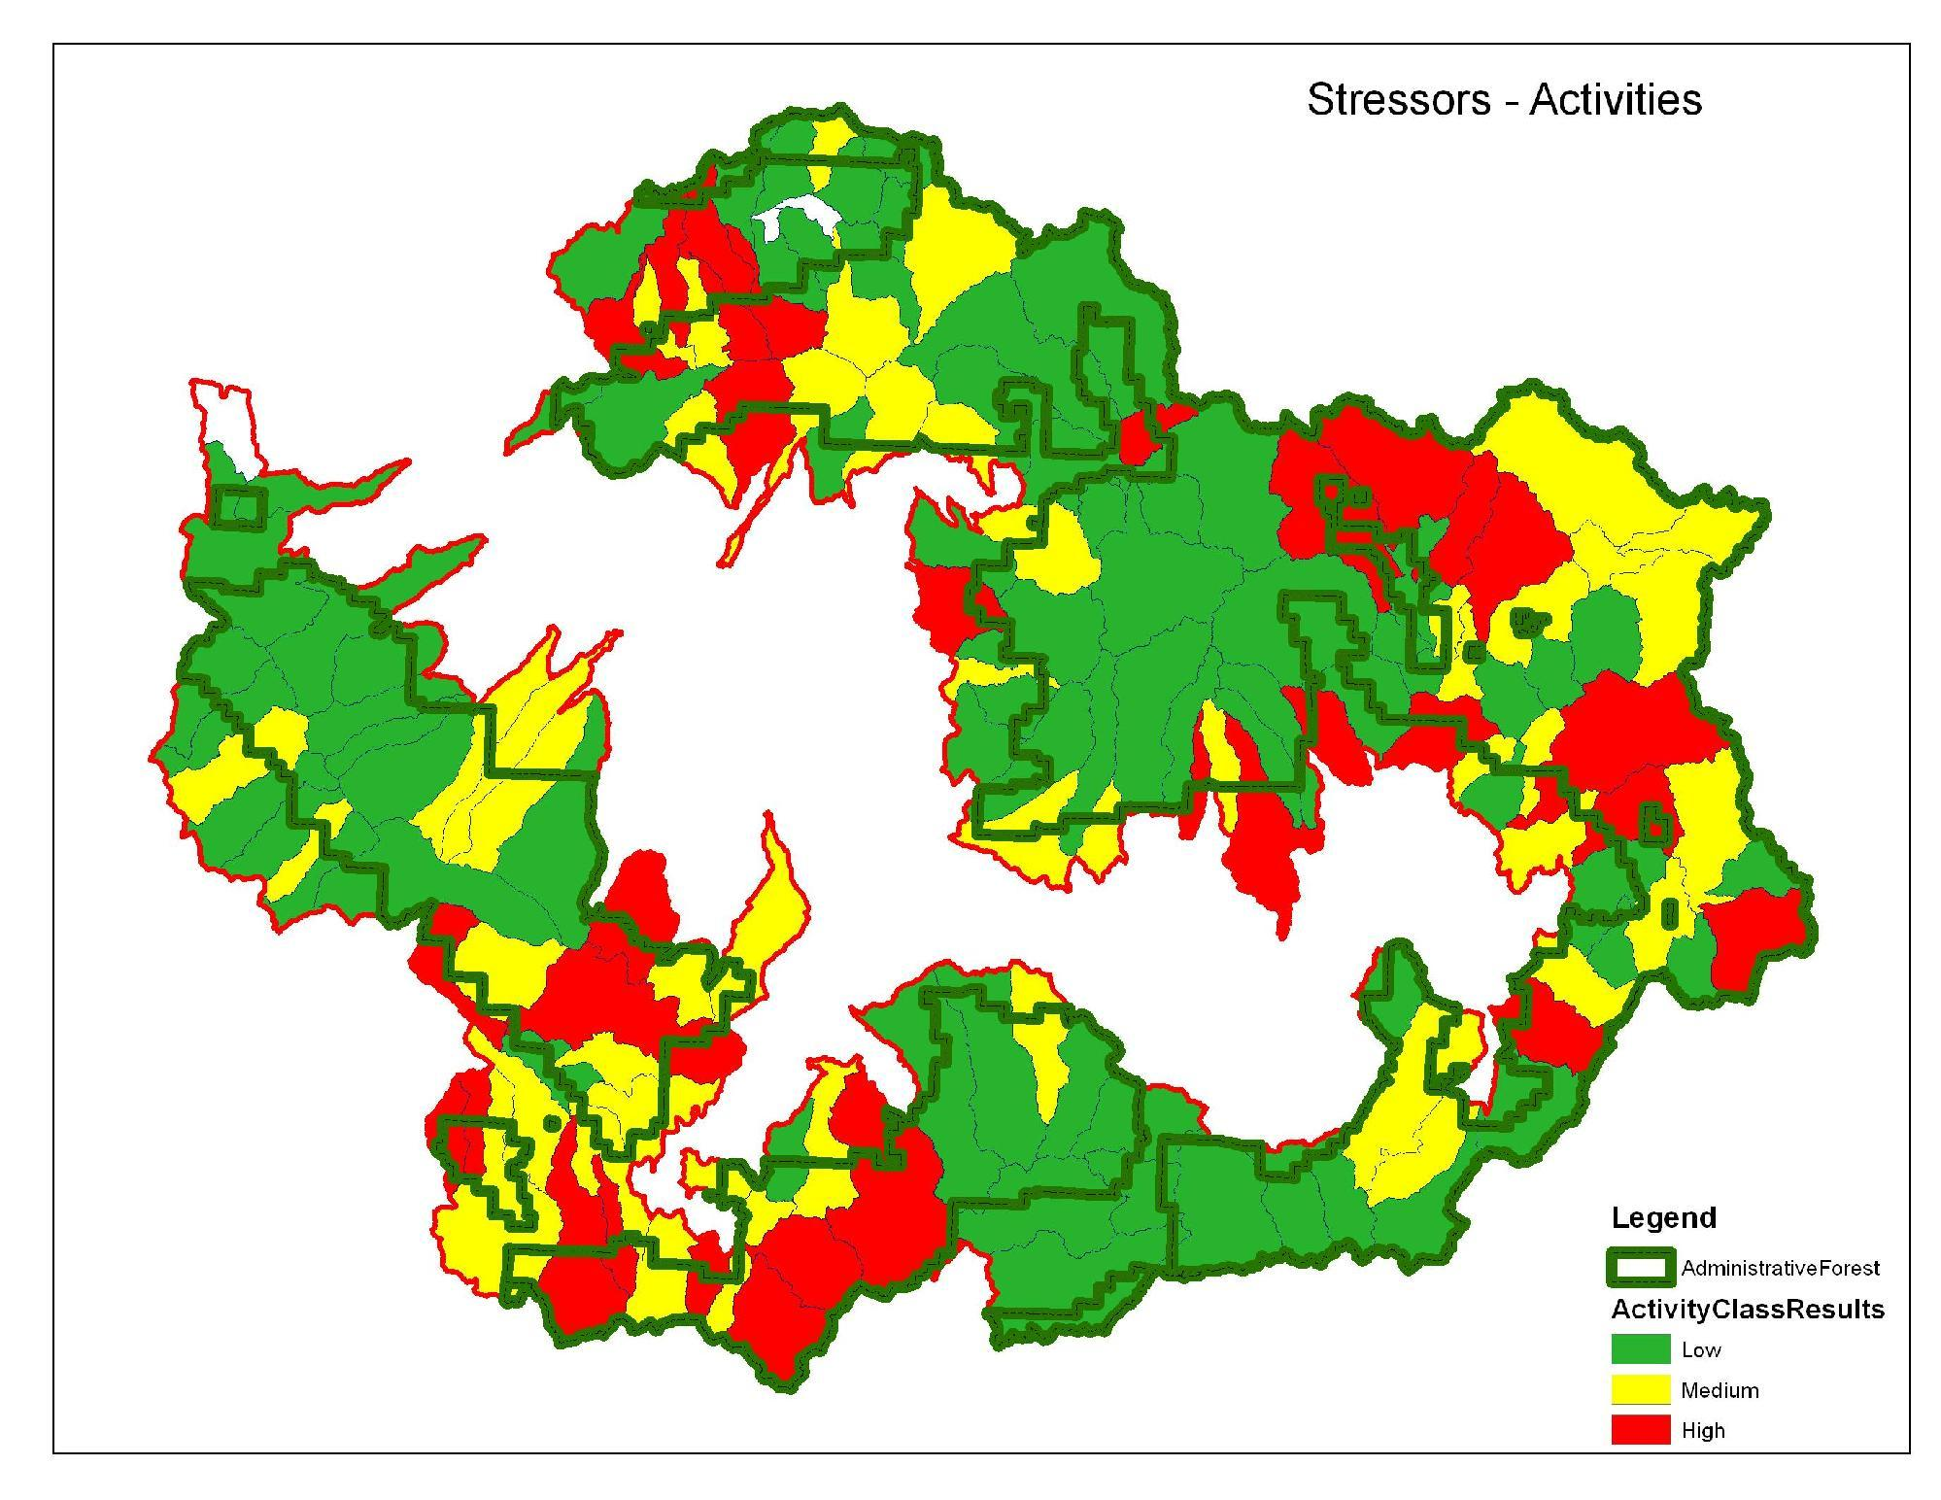
Notes:
Reference: Furniss, Michael J.; Roby, Ken B.; Cenderelli, Dan; Chatel, John; Clifton, Caty F.; Clingenpeel, Alan; Hays, Polly E.; Higgins, Dale; Hodges, Ken; Howe, Carol; Jungst, Laura; Louie, Joan; Mai, Christine; Martinez, Ralph; Overton, Kerry; Staab, Brian P.; Steinke, Rory; Weinhold, Mark. 2013. Assessing the vulnerability of watersheds to climate change: results of national forest watershed vulnerability pilot assessments. Gen. Tech. Rep. PNW-GTR-884. Portland, OR: U.S. Department of Agriculture, Forest Service, Pacific Northwest Research Station. 32 p. plus appendix. http://bit.ly/watervulnerability
Combined stressors ranking.
Some stressors were considered to be serious enough that if they were present the watershed was ranked as high: 303D streams, recent wildfire activity that affect >25% of watershed, watersheds where >20% of natural yield was withdrawn or >10% of stream network was diverted.
Green areas have the lowest combined past activities, Red the highest.
Key stressor that was not included in past grazing, we don’t have range condition data.

Slide 81
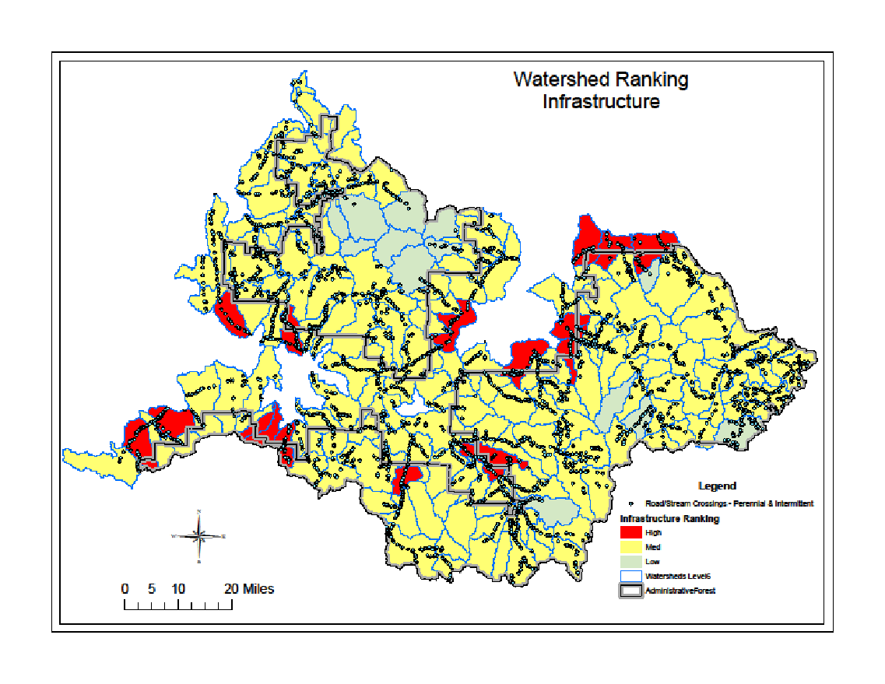
Results: Infrastructure
Notes:
Reference: Furniss, Michael J.; Roby, Ken B.; Cenderelli, Dan; Chatel, John; Clifton, Caty F.; Clingenpeel, Alan; Hays, Polly E.; Higgins, Dale; Hodges, Ken; Howe, Carol; Jungst, Laura; Louie, Joan; Mai, Christine; Martinez, Ralph; Overton, Kerry; Staab, Brian P.; Steinke, Rory; Weinhold, Mark. 2013. Assessing the vulnerability of watersheds to climate change: results of national forest watershed vulnerability pilot assessments. Gen. Tech. Rep. PNW-GTR-884. Portland, OR: U.S. Department of Agriculture, Forest Service, Pacific Northwest Research Station. 32 p. plus appendix. http://bit.ly/watervulnerability
Look at crossings in high vulnerability areas for div potential and Q capacity.

Slide 82
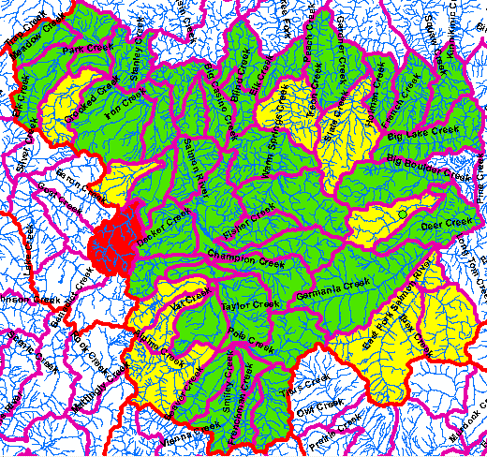
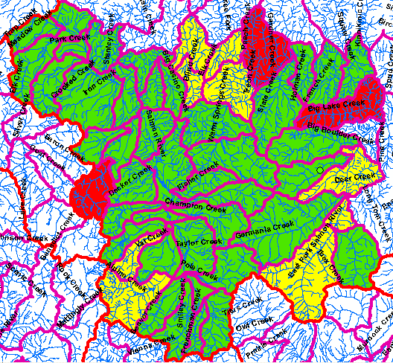
Watershed Sensitivity(Risks)
Subwatershed Vulnerability
% of Subwatershed with Sensitive Landtypes (Inherent surface soil erosion, sediment yield and mass instability)
Landslide Prone Terrain
Low - 0-9 % of 6th Field
Moderate - 9-23%
High - > 23%
Notes:
Reference: Furniss, Michael J.; Roby, Ken B.; Cenderelli, Dan; Chatel, John; Clifton, Caty F.; Clingenpeel, Alan; Hays, Polly E.; Higgins, Dale; Hodges, Ken; Howe, Carol; Jungst, Laura; Louie, Joan; Mai, Christine; Martinez, Ralph; Overton, Kerry; Staab, Brian P.; Steinke, Rory; Weinhold, Mark. 2013. Assessing the vulnerability of watersheds to climate change: results of national forest watershed vulnerability pilot assessments. Gen. Tech. Rep. PNW-GTR-884. Portland, OR: U.S. Department of Agriculture, Forest Service, Pacific Northwest Research Station. 32 p. plus appendix. http://bit.ly/watervulnerability

Slide 83
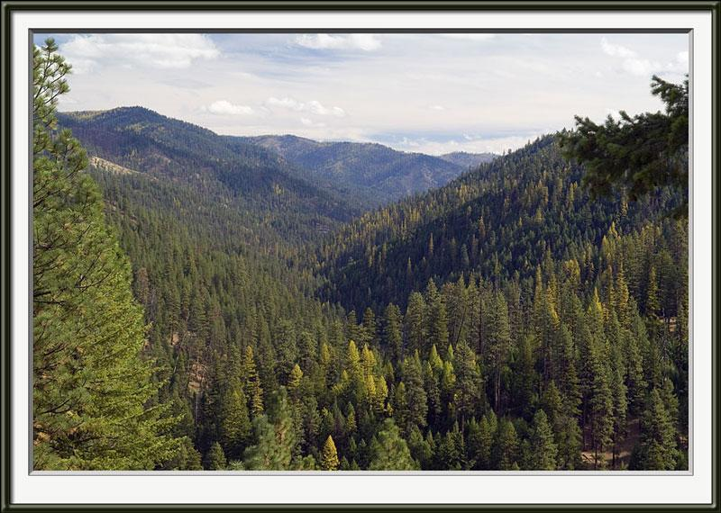
Watershed Vulnerability Assessment for the Umatilla National Forest
or
How Does Climate Change…
Change the Game?
Notes:
Reference: Furniss, Michael J.; Roby, Ken B.; Cenderelli, Dan; Chatel, John; Clifton, Caty F.; Clingenpeel, Alan; Hays, Polly E.; Higgins, Dale; Hodges, Ken; Howe, Carol; Jungst, Laura; Louie, Joan; Mai, Christine; Martinez, Ralph; Overton, Kerry; Staab, Brian P.; Steinke, Rory; Weinhold, Mark. 2013. Assessing the vulnerability of watersheds to climate change: results of national forest watershed vulnerability pilot assessments. Gen. Tech. Rep. PNW-GTR-884. Portland, OR: U.S. Department of Agriculture, Forest Service, Pacific Northwest Research Station. 32 p. plus appendix. http://bit.ly/watervulnerability

Slide 84
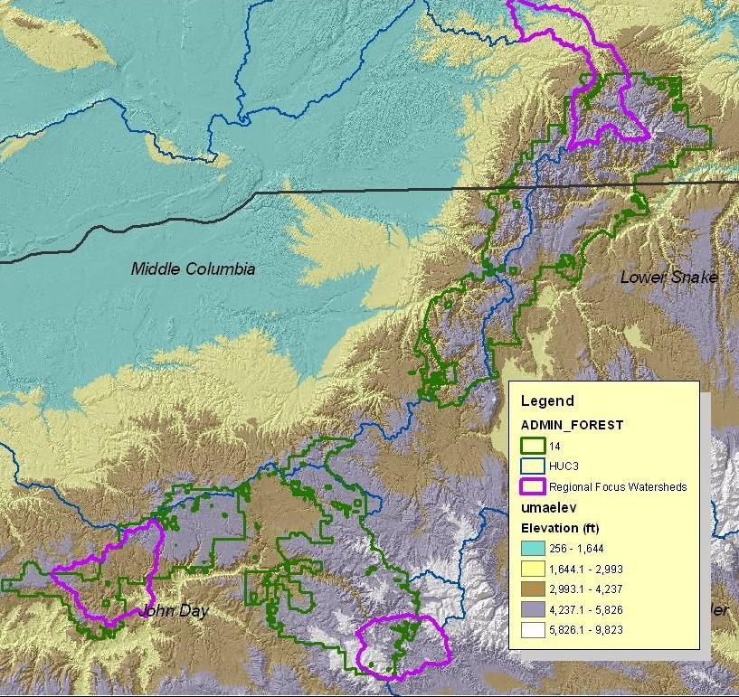
Forest Scope:
Umatilla National Forest
2 States, 3 Basins, 156 Subwatersheds,
inland headwaters, low elevation,
“At risk” snow
…land of many waters, tribes, and communities
Focus assessment on critical areas TBD based on…
…Resource Values:
Water Uses, Aquatics, Infrastructure
Notes:
Reference: Furniss, Michael J.; Roby, Ken B.; Cenderelli, Dan; Chatel, John; Clifton, Caty F.; Clingenpeel, Alan; Hays, Polly E.; Higgins, Dale; Hodges, Ken; Howe, Carol; Jungst, Laura; Louie, Joan; Mai, Christine; Martinez, Ralph; Overton, Kerry; Staab, Brian P.; Steinke, Rory; Weinhold, Mark. 2013. Assessing the vulnerability of watersheds to climate change: results of national forest watershed vulnerability pilot assessments. Gen. Tech. Rep. PNW-GTR-884. Portland, OR: U.S. Department of Agriculture, Forest Service, Pacific Northwest Research Station. 32 p. plus appendix. http://bit.ly/watervulnerability

Slide 85
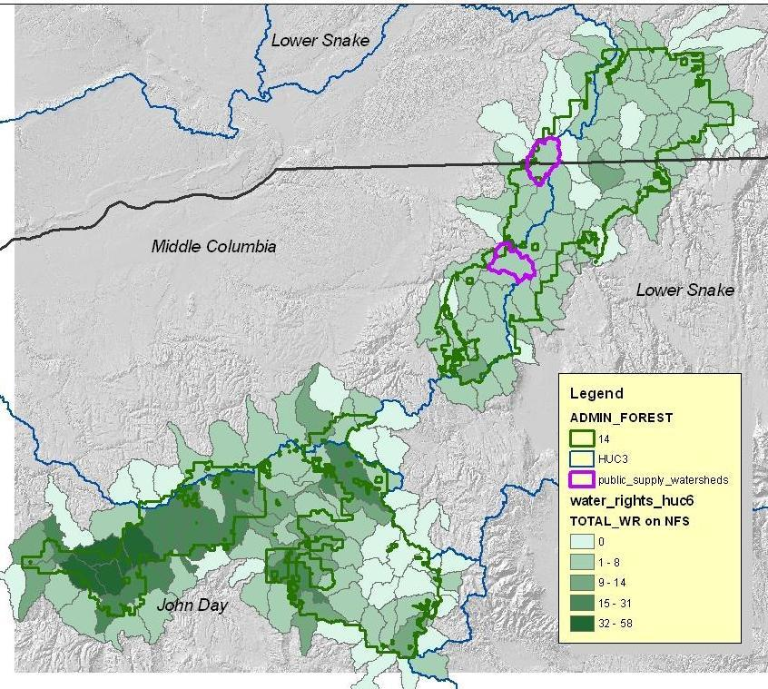
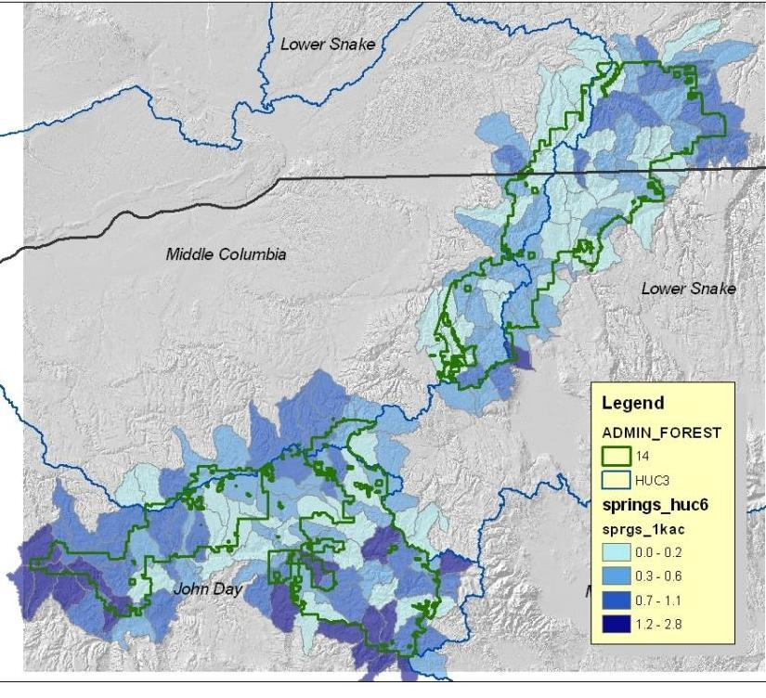
Public water supply watersheds :
Walla Walla WA and Pendleton OR, pop. served ~50,000
Total # of water rights (HU6) on NFS (FS + Other)
Values
Water Use
Indicators
What places are important, what purpose, timing of uses, and impacts?
Spring density: Groundwater-dependent ecosystem indicator , and measure of resilience
Notes:
Reference Furniss, Michael J.; Roby, Ken B.; Cenderelli, Dan; Chatel, John; Clifton, Caty F.; Clingenpeel, Alan; Hays, Polly E.; Higgins, Dale; Hodges, Ken; Howe, Carol; Jungst, Laura; Louie, Joan; Mai, Christine; Martinez, Ralph; Overton, Kerry; Staab, Brian P.; Steinke, Rory; Weinhold, Mark. 2013. Assessing the vulnerability of watersheds to climate change: results of national forest watershed vulnerability pilot assessments. Gen. Tech. Rep. PNW-GTR-884. Portland, OR: U.S. Department of Agriculture, Forest Service, Pacific Northwest Research Station. 32 p. plus appendix. http://bit.ly/watervulnerability

Slide 86
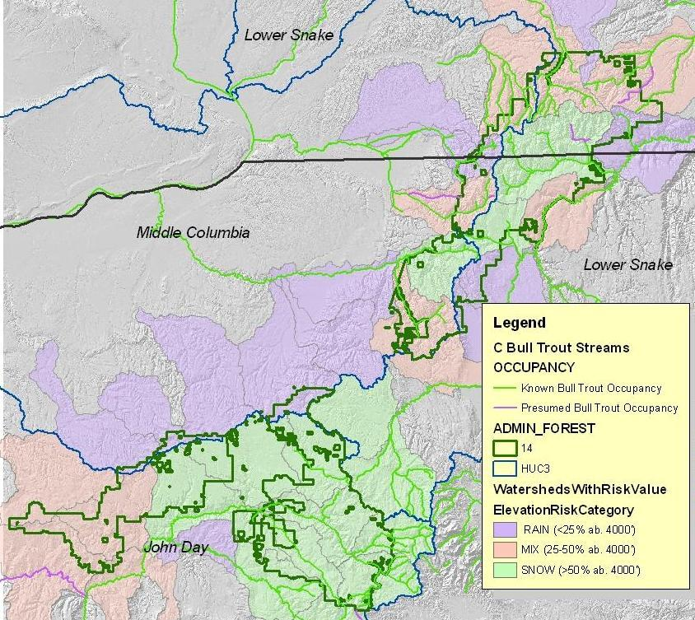

Values
Aquatics indicators Bull trout distribution and elevation class
North half lower elevation most vulnerable?
Isaak and others, RMRS
Notes:
Reference: Furniss, Michael J.; Roby, Ken B.; Cenderelli, Dan; Chatel, John; Clifton, Caty F.; Clingenpeel, Alan; Hays, Polly E.; Higgins, Dale; Hodges, Ken; Howe, Carol; Jungst, Laura; Louie, Joan; Mai, Christine; Martinez, Ralph; Overton, Kerry; Staab, Brian P.; Steinke, Rory; Weinhold, Mark. 2013. Assessing the vulnerability of watersheds to climate change: results of national forest watershed vulnerability pilot assessments. Gen. Tech. Rep. http://www.fs.usda.gov/ccrc/library/biblio/3430

Slide 87


Step 2. Sensitivity
Existing Condition
Watershed Condition Scores from Forest Plan Revision (Gecy analysis), tweak with climate change factors…TBD
Add Risks, Threats, and Adaptations (present and future)
both on and off Forest – Example of OR State water planning data, “adaptation” or “risk”?
OWRD surface water potential storage sites
Notes:
Reference: Furniss, Michael J.; Roby, Ken B.; Cenderelli, Dan; Chatel, John; Clifton, Caty F.; Clingenpeel, Alan; Hays, Polly E.; Higgins, Dale; Hodges, Ken; Howe, Carol; Jungst, Laura; Louie, Joan; Mai, Christine; Martinez, Ralph; Overton, Kerry; Staab, Brian P.; Steinke, Rory; Weinhold, Mark. 2013. Assessing the vulnerability of watersheds to climate change: results of national forest watershed vulnerability pilot assessments. Gen. Tech. Rep. PNW-GTR-884. Portland, OR: U.S. Department of Agriculture, Forest Service, Pacific Northwest Research Station. 32 p. plus appendix. http://bit.ly/watervulnerability

Slide 88




Step 3. Exposure
Columbia Basin Climate Change Scenarios Project
2-year research project (finalizing Spring 2010) designed to provide a comprehensive suite of 21st century hydroclimatological scenarios for the Columbia River basin
297 Streamflow sites
Notes:
Reference: VIC Macroscale Hydrological Model: Liang, X., D. P. Lettenmaier, E. F. Wood, and S. J. Burges, 1994: A Simple hydrologically Based Model of Land Surface Water and Energy Fluxes for GSMs, J. Geophys. Res., 99(D7), 14,415-14,428.
Reference: Climate Change Scenarios Report and Streamflow sites image: “Hamlet, A.F., P. Carrasco, J. Deems, M.M. Elsner, T. Kamstra, C. Lee, S-Y Lee, G. Mauger, E. P. Salathe, I. Tohver, L. Whitely Binder, 2010, Final Project Report for the Columbia Basin Climate Change Scenarios Project, http://warm.atmos.washington.edu/2860/report/”.

Slide 89






Snow and Runoff Summary for 3 sites on the Umatilla: Asotin (Left), Umatilla (Center) and NFJD (Right)
Exposure
Downscaling climate models…297 stream gages
Hydro- metrics:
Temperature, ET, SWE, Flow
Scenario Ensembles
Ensemble Mean
Historic Mean
Notes:
Reference: USFS and UW Climate Impacts Group
Reference: Furniss, Michael J.; Roby, Ken B.; Cenderelli, Dan; Chatel, John; Clifton, Caty F.; Clingenpeel, Alan; Hays, Polly E.; Higgins, Dale; Hodges, Ken; Howe, Carol; Jungst, Laura; Louie, Joan; Mai, Christine; Martinez, Ralph; Overton, Kerry; Staab, Brian P.; Steinke, Rory; Weinhold, Mark. 2013. Assessing the vulnerability of watersheds to climate change: results of national forest watershed vulnerability pilot assessments. Gen. Tech. Rep. PNW-GTR-884. Portland, OR: U.S. Department of Agriculture, Forest Service, Pacific Northwest Research Station. 32 p. plus appendix. http://bit.ly/watervulnerability

Slide 90




Example
Integrated climate change potential vulnerability risk for
Mid-Columbia River steelhead (HU6)
-Springtime water availability change risk,
-Summer temperature change risk,
-Historical variation in precipitation
Implications for Forest Priorities and Activities?
SOURCE: Conservation and Recovery Plan for Oregon Steelhead Populations in the Middle Columbia River Steelhead Distinct Population Segment, 2009
Notes:
Reference: Conservation and Recovery Plan for Oregon Steelhead Populations in the Middle Columbia River Steelhead Distinct Population Segment, 2009, Richard W. Carmichael, Oregon Department of Fish and Wildlife and Barbara J. Taylor. http://www.westcoast.fisheries.noaa.gov/publications/recovery_planning/salmon_steelhead/domains/interior_columbia/middle_columbia/mid-c-oregon.pdf

Slide 91
Step 4. Vulnerability Ratings…the big spreadsheets: Values, condition, risks, exposure…ratings. TBD
Step 5. Results…may be:
AFFIRMING – Focus watersheds and actions? Doing the right work in the right places?
CONFOUNDING – shift priorities and resources? “Lost causes”?
Next…Design and conduct analysis
Integrate and reference related projects
Notes:
Reference: USFS

Slide 92
Simple…Conceptual Outline of Watershed Vulnerability Assessment
STEP 1 |  | STEP 2 | STEP 3 | STEP 4 | STEP 5 | STEP 6
Value Type | Value Indicator | Sensitivity | Exposure | Vulnerability Rating (relative) Risk/Impact | Response | Evaluate and Monitor
Water Uses | Public water supply - Mill Creek Municipal watershed | Quantity, quality, timing (year round, summer demand, winter peak flows impact quality) | Less snow, earlier runoff, higher peaks (sediment) | M/H | Public awareness, conservation, back up sources | TBD
Water Uses | South Zone livestock watering | Quantity, timing (summer use) | less snow, earlier runoff | M/L | adjust operation | TBD
Aquatics | Bull trout streams… | Quality (summer temperature), availability (spring flows), seasonal variability | Less snow, earlier runoff, high summer temperatures | H/H | Prioritize and restore cold water refugia | TBD
Infrastructure | Tucannon campground | Quantity, proximity to river (floodprone) | Peak flows | H/M | Move campground | TBD
Notes:
Reference: Graphic by USFS
An example of vulnerabilty for HCMC. Even a small sea level rise, combined with a large flood event is expected to result in inundation of substantial areas of the city. HCMC is vulnerable. How might its reslience be increased?

Slide 93

Case studies in Vietnam
The Ministry of Natural Resources and Environment of Vietnam
Notes:
Reference: MONRE (Bộ Tài Nguyên Môi Trường) (2012a) Kịch bản Biến đổi khí hậu, nước biển dâng cho Việt Nam. Hà Nội (Ministry of Natural Resources and Environment (2012) Climate change scenarios and sea level rise for Vietnam, Hanoi)

Slide 94

Case studies in Vietnam
What region could be the most seriously affected by sea level rise in Vietnam?
The areas are vulnerable to be submerged when sea level rises 1m
Notes:
MONRE (Bộ Tài Nguyên Môi Trường) (2012a) Kịch bản Biến đổi khí hậu, nước biển dâng cho Việt Nam. Hà Nội (Ministry of Natural Resources and Environment (2012) Climate change scenarios and sea level rise for Vietnam, Hanoi)
http://www.preventionweb.net/files/11348_ClimateChangeSeaLevelScenariosforVi.pdf

Slide 95

Case studies in Vietnam
How can we set the priority for Mekong Delta?
Notes:
Reference: MONRE (Bộ Tài Nguyên Môi Trường) (2009) Kịch bản Biến đổi khí hậu, nước biển dâng cho Việt Nam. Hà Nội (Ministry of Natural Resources and Environment (2009) Climate change scenarios and sea level rise for Vietnam, Hanoi). http://www.preventionweb.net/files/11348_ClimateChangeSeaLevelScenariosforVi.pdf; http://tuoitre.vn/tin/chinh-tri-xa-hoi/20091206/xem-de-thuc-tinh/351583.html
Need more assessment of vulnerability

Slide 96

Work in groups
Sea level rise and Global Warming
?
Mekong Delta
Resilient?
Vulnerable?
Notes:
In fact, vulnerability can be invisible such as salt invasion, flood, crop productivity, etc.

Slide 97
What problems will occur in Bangladesh if Sea Level rises 1m?
Salt Invasion?
Land Lost?
Drought?
Biodiversity Degradation?
Environmental Pollution?
Food Security?
Flood?
Notes:
Students have different ideas with explanations.

Slide 98

Homework
Salt Invation in Bangladesh delta areas
Distance from Seaside | Exposure | Sensitivity (L, M, H) | Vulnerability (L, M, H)
10 km
30 km
50 km
100 km
Notes:
Search for reative information and fill in the table.

Slide 99
Review: Recommended Steps in Climate Vulnerability Assessment
Set up the assessment. Identify values.
Assess Exposure
Evaluate the sensitivity of identified values
Evaluate and Categorize Vulnerability
Set Priorities for Adaptive Responses
Critique the Assessment
Notes:
Team members met, and outlined a stepwise approach to the assessment. One change displayed here: the first iteration assessed sensitivity before exposure, work showed that reversing these steps- looking at likely hydrologic changes resulting from exposure, enabled a more focused assessment of sensitivity.

Slide 100
Instructor Review of Materials
What was useful?
What is missing?
How did you, or would you, modify the materials to make them better fit your instructional context?
Please share your experience and modifications here: climatecurriculum@googlegroups.com

Slide 101
Recommended Reading
Furniss, Michael J.; Roby, Ken B.; Cenderelli, Dan; Chatel, John; Clifton, Caty F.; Clingenpeel, Alan; Hays, Polly E.; Higgins, Dale; Hodges, Ken; Howe, Carol; Jungst, Laura; Louie, Joan; Mai, Christine; Martinez, Ralph; Overton, Kerry; Staab, Brian P.; Steinke, Rory; Weinhold, Mark. 2013. Assessing the vulnerability of watersheds to climate change: results of national forest watershed vulnerability pilot assessments. Gen. Tech. Rep. PNW-GTR-884. Portland, OR: U.S. Department of Agriculture, Forest Service, Pacific Northwest Research Station. 32 p. plus appendix. http://bit.ly/watervulnerability
Morgan, C. L. (2011). Vulnerability Assessment: A Review of Approaches. Building Resilience to climate change impacts-coastal southeast asia Gland, Switzerland: IUCN. http://data.iucn.org/dbtw-wpd/edocs/2011-068.pdf
Glick, Patty; Stein, Bruce A.; Edelson, Naomi A. 2011. Scanning the conservation horizon: A guide to climate change vulnerability assessment. Washington, D.C.: National Wildlife Federation. 168 p. http://www.fs.fed.us/rm/pubs_other/rmrs_2011_glick_p001.pdf
Scanning the Conservation Horizon: A Guide to Climate Change Vulnerability Assessment. 2011. National Wildlife Federation, Washington, D.C. Retrieved from http://www.nwf.org/vulnerabilityguide
Gardali, T., N. E. Seavy, R. T. DiGaudio, and L. A. Comrack. 2012. A climate change vulnerability assessment of California’s at-risk birds. PLoS ONE 7:e29507. doi: 10.1371/journal.pone.0029507
Black, Bruce, & Egener (2009) Adapting to Climate Change: A Risk-Based Guide for Alberta Municipalities. Retrieved November 22, 2009 from: http://adaptation.nrcan.gc.ca/projdb/pdf/176a_e.pdf
Carter, Parry, Nishioka , & Harasawa (1994) Technical guidelines for assessing climate change impacts and adaptations. University College London, England and Centre for Global Environmental Research, Tsukuba, Japan, 59 pp
Harford, D. (2008) Climate Change Adaptation: Planning for BC. Retrieved from Pacific Institute for Climate Solutions website: www.pics.uvic.ca/research.php
Hilson, D (2002) Extending the risk process to manage opportunities. International Journal of Project Management, 20, 235–240.

Slide 102
References
Noble, Bruce, Egener, (2005) An Overview of the Risk Management Approach to Climate Change in Canada. Retrieved March 11, 2010 from: http://adaptation.nrcan.gc.ca/pdf/NobleBruceEgener2005_e.pdf
USDA Forest Service, 2009. Implementation Guide for Assessing and Tracking Changes to Watershed Condition. Watershed, Fish, Wildlife, Air, and Rare Plants Staff, Washington, DC., Draft Manuscript, Oct. 30, 2009, 82 p.
K. Gallo et al. 2005. Northwest Forest Plan-the first 10 years (1994-2003): Prelimary assessment of the condition of watersheds. PNW-GTR-647
Trush, W. J., S. M. McBain, and L. B. Leopold. 2000. Attributes of an alluvial river and their relation to water policy and management. Proceedings of the National Academy of Sciences 97: 11858-11863.
DEBANO, L.F., AND L.J. SCHMIDT. 1990. Healthy riparian areas as related to watershed stability. P. 55–56 in Proc. of conf. XXI erosion control: Technology in transition. Internat. Erosion Control Assoc., Steamboat Springs, CO. 324 p.
NRCAN (Natural Resources Canada) (2007) From Impacts to Adaptation: Canada in a Changing Climate. Chapter 8 –British Columbia. Retrieved November 28, 2009 from http://adaptation.nrcan.gc.ca/assess/2007/index_e.php
Parzen, J. (ed). (2008). Chicago Area Climate Change Quick Guide: Adapting to the Physical Impacts of Climate Change. For Municipalities and Other Organizations. Retrieved March 9, 2010 from: http://www.chicagoclimateaction.org/filebin/pdf/Chicago_Quick_Guide_to_Climate_Change_Preparation_June_2008.pdf
Schneider, Semenov, & Patwardhan, (2007) Assessing key vulnerabilities and the risk from climate change. Chapter 19, Contribution of Working Group II to the Fourth Assessment Report of the Intergovernmental Panel on Climate Change. Cambridge University Press, Cambridge, UK, 976 pp
Snover, Whitely Binder, Lopez, Willmott, Kay, Howell, & Simmonds. (2007). Preparing for Climate Change: A Guidebook for Local, Regional, and State Governments. In association with and published by ICLEI – Local Governments for Sustainability, Oakland, CA.

Slide 103
References
Vulnerability Assessment Frameworks and Guidance
Intergovernmental Panel on Climate Change (IPCC). 2005. Guidance Notes for Lead Authors of the IPCC Fourth Assessment Report on Addressing Uncertainties. Intergovernmental Panel on Climate Change, Geneva. Geneva.http://www.ipcc.ch/pdf/supporting-material/uncertainty-guidance-note.pdf.
National Research Council (NRC). 2009. Informing Decisions in a Changing Climate. Panel on Strategies and Methods for Climate-Related Decision Support, Committee on the Human Dimensions of Global Change. Division of Behavioral and Social Sciences and Education. National Academies Press, Washington, D.C. http://www.nap.edu/openbook.php?record_id=12626&page=R1.
Olmos, S. 2001. Vulnerability and Adaptation to Climate Change: Concepts, Issues, Assessment Methods. Climate Change Knowledge Network, International Institute for Sustainable Development, Winnipeg.http://www.cckn.net/pdf/va_foundation_final.pdf. United Nations Framework Convention on Climate Change (UNFCCC). 2008. Compendium on Methods and Tools to Evaluate Impacts of, Vulnerability and Adaptation to, Climate Change.UNFCC, Bonn, Germany.http://unfccc.int/adaptation/nairobi_work_programme/knowledge_resources_and_publications/items/2674.php.
U.S. Environmental Protection Agency (EPA). 2009. A Framework for Categorizing the Relative Vulnerability of Threatened and Endangered Species to Climate Change. EPA/600/R-09/011. National Center for Environmental Assessment, Washington, D.C. http://www.epa.gov/ncea.
U.S. Global Change Research Program (USGCRP). 2009. Global Climate Change Impacts in the United States. A report of the USGCRP. USGCRP, Washington, D.C. http://www.globalchange.gov/usimpacts/.
Williams, S.E., L.P. Shoo, J.L. Isaac, A.A. Hoffmann, and G. Langham. 2008. Towards an integrated framework for assessing the vulnerability of species to climate change. PloS Biology 6: 2621–2626.http://www.plosbiology.org/article/info:doi/10.1371/journal.pbio.0060325.
.

Slide 104
References
General Climate Change Adaptation Principles and Planning
Association of Fish and Wildlife Agencies (AFWA). 2009. Voluntary Guidance for States to Incorporate Climate Change into State Wildlife Action Plans and Other Management Plans. AFWA, Washington, D.C.http://www.fishwildlife.org/pdfs/ClimateChangeGuidance%20Document_Final_reduced%20size.pdf.
Glick, P., A. Staudt, and B. Stein. 2009. A New Era for Conservation: Review of Climate Change Adaptation Literature.National Wildlife Federation, Washington, D.C. http://www.nwf.org/News-and-Magazines/Media-Center/Reports/Archive/2009/~/media/PDFs/Global Warming/Reports/CimateChangeAdaptationLiterature
Review.ashx.
Groves, C., M. Anderson, C. Enquist, E. Girvetz, T. Sandwith, L. Schwarz, and R. Shaw. 2010. Climate Change and Conservation: A Primer for Assessing Impacts and Advancing Ecosystem-based Adaptation in The Nature Conservancy.The Nature Conservancy, Arlington, VA. http://conserveonline.org/workspaces/climateadaptation/documents/a-primer-for-assessing-impacts/view.html.
General Climate Change Adaptation Principles and Planning
Heller, N.E., and E.S. Zavaleta. 2009. Biodiversity management in the face of climate change: A review of 22 years of recommendations. Biological Conservation 142: 14–32.http://www.lagunadesantarosa.org/knowledgebase/sites/default/files/Heller%20and%20Zavaleta%202009.pdf.
Lawler, J.J. 2009. Climate change adaptation strategies for resource management and conservation planning. Annals of the New York Academy of Sciences 1162: 79–98. http://training.fws.gov/branchsites/lkm/climate_change/june_09/cc-adaptreview.pdf.
Mawdsley, J.R., R. O’Malley, and D.S. Ojima. 2009. A review of climate-change adaptation strategies for wildlife management and biodiversity conservation. Conservation Biology 23: 1080–1089.http://cses.washington.edu/cig/outreach/seminarfiles/2009seminars/Mawdsley-etal-2009.pdf.

Slide 105
References
General Climate Change Adaptation Principles and Planning
National Research Council (NRC). 2010. Adapting to the Impacts of Climate Change. America’s Climate Choices: Panel on Adapting to the Impacts of Climate Change. National Academies Press, Washington, D.C.http://americasclimatechoices.org/paneladaptation.shtml.
U.S. Climate Change Science Program (U.S. CCSP). 2008. Preliminary Review of Adaptation Options for Climate-sensitive Ecosystems and Resources. A report by the U.S. Climate Change Science Program and the Subcommittee on Global Change Research. S.H. Julius and J.M. West (eds.); J.S. Baron et al. (authors). U.S. EPA, Washington, D.C.http://downloads.climatescience.gov/sap/sap4-4/sap4-4-final-report-all.pdf.

Slide 106
References and Resources
The curriculum of USAID’s Climate-Resilient Ecosystems and Livelihoods (CREL) in Bangladesh is a free resource of teaching materials for university professors, teachers and climate change training experts.
Reproduction of CREL’s curriculum materials for educational or other non-commercial purposes is authorized without prior written permission from the copyright holder, provided the source is fully acknowledged.
Suggested citation: USAID. 2016. Bangladesh Climate-Resilient Ecosystem Curriculum (BACUM). USAID‘s Climate-Resilient Ecosystems and Livelihoods (CREL) Project. Winrock International. Dhaka, Bangladesh.
Disclaimer: The CREL’s curriculum is made possible by the support of the American People through the United States Agency for International Development (USAID). The contents of the curriculum do not necessarily reflect the views of USAID or the US Government.

Slide 107
USAID's Climate-Resilient Ecosystems and Livelihoods (CREL) Project
Winrock International
House 13/B, Road 54, Gulshan 2, Dhaka 1212
Bangladesh
Tel: +880-2-9848401 www.winrock.org

