Slide 1
Bangladesh Climate-Resilient Ecosystem Curriculum (BACUM)
Module 1: Introduction to Climate Change

Slide 2
Module 1: Introduction to Climate Change
SECTION II: IMPACTS OF CLIMATE CHANGE ON PEOPLE AND THE ENVIRONMENT
2.4. Climate Change and Food Security

Slide 3
Introduction to Climate Change (ICC)
HOW AND WHY THE CLIMATE IS CHANGING
  1.1. Introduction to Climate Science and Climate Change
  1.2. Causes of Climate Change
  1.3. Climate Intensification: Floods, Droughts and Cyclone
IMPACTS OF CLIMATE CHANGE ON PEOPLE AND THE ENVIRONMENT
  2.1. Introduction to Climate Change Impacts
  2.2. Sea Level Rise
  2.3. Climate Change and Water Resources
  2.4. Climate Change and Food Security
  2.5. Climate Change and Human Health
  2.6. Climate Change and Terrestrial Ecosystems
RESPONSES TO CLIMATE CHANGE – MITIGATION AND ADAPTATION
  3.1. Climate Change and Forest Management
  3.2. Climate Change and Water Resources: Responses and Adaptation
  3.3. Principles and Practices of Climate Change Vulnerability Assessment
  3.4. Uncertainties in Climate Change
  3.5. Climate Change and Ecosystem Services
  3.6. Effective Communications in Climate Change

Slide 4
Acknowledgements
EXPERT CONTRIBUTORS | SPECIFIC INPUTS
Prof. (Dr.) Manzoor Rashid | Curriculum Development for all topics
Prof. (Dr.) Md. Danesh Miah | REDD+, Forest Carbon
Prof. (Dr.) Md. Jakariya | Community NR Management, Climate Change, Natural Resources Management
UNIVERSITIES
Bangladesh Agricultural University
University of Chittagong
Dhaka University
Independent University, Bangladesh
Khulna University
Noakhali University of Science and Technology
Shahjalal University of Science and Technology
Sher-e-Bangla Agriculture University
North South University
CREL STAFF | CREL STAFF
John A Dorr | Utpal Dutta
Abu Mostafa Kamal Uddin | Ruhul Mohaiman Chowdhury
Kevin T. Kamp | Rahima Khatun
Paul Thompson | Sultana Razia Zummi
Abdul Wahab | Shams Uddin
Shahzia Mohsin Khan
DESIGN, LAYOUT AND CONTENT DEVELOPMENT: Ms. Chi Pham, Curriculum Development Expert, Bangkok, Thailand

Slide 5
Learning Objectives
At the end of this session, students will be able to:
Explain and analyze how climate change is affecting agriculture and food security and increase women’s specific vulnerabilities in relation to agriculture and food security
Propose potential adaptation actions to reduce the negative impacts of climate change on agriculture to ensure food security considering gender needs and priorities
Propose potential improvements in agricultural systems to improve food security while mitigating climate change (i.e., reducing emissions from the agriculture land use sector) considering men and women potentials
Notes:
Key message:
Note to instructor. This unit includes a section on the influence of agriculture on greenhouse gas emissions. This is a separate but related topic. You may wish to omit this topic or a
pair it with other topics, based on how you elect to structure your course.

Slide 6
Outline
The concepts of food security: definitions, food availability, food access, food utilization, key factors stress FS
How agriculture can affect greenhouse gas emissions
Effects of climate change on food security: Sources of food, factors control resources, lower crop and livestock yields, higher and variable temperatures, changes in precipitation patterns, xtreme weather events and lower availability of agriculture land due to sea level rise
Approaches to mitigate or adapt the effects of climate change in agriculture and food security: Increasing productivity, Accessible Adaptation, Improved institutions and capacities

Slide 7
Agriculture role on GHG emission and climate change
Notes:
Now we look at how agricuture effects on GHG emission and climate change.

Slide 8
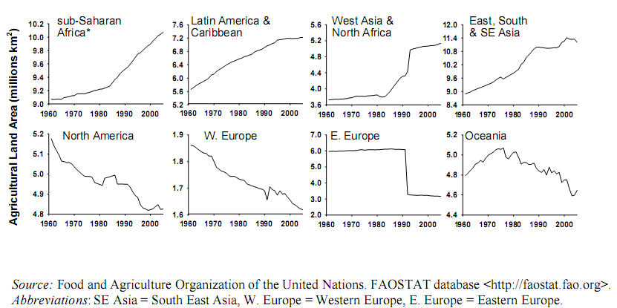
Trends of agricultural land area
Notes:
It should be emphasized that agricultural expansion is based on deforestation
From the above figure, we will see that agricultural land area in the developing country regions tends to increase from 1960-2000, expecially in East, South and SE Asia . But the opposite trend was generally observed for agricultural land area for the developed country regions.

Slide 9
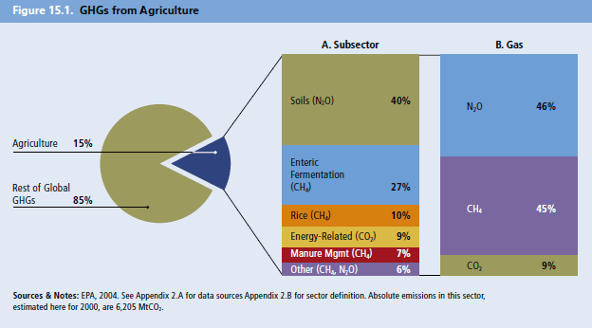
Agriculture and GHG emission
Source: EPA (2004)
Notes:
Source: http://na.unep.net/geas/articleImages/Oct-12-figure-6.jpg
What we can see here is Agriculture sector is one of the contributor to GHG emission. GHG from Agri is for “survival” not for “luxury” as some sectors, e.g., tourism.
In the above figure , Can you tell me how many percent does agriculture contribute of the world’s GHG emission?(15%)
In the globe, How many percent of GHG emission from agricultural soil? from livestock and from rice field?
In agriculture sector is in the following sequences; (1) agricultural soils (40%), (2) enteric fermentation (27%) and (3) paddy rice field (10%).
What is the most important GHGs from agriculture?
IPCC reported that agriculture contributes to 51% of total CH4 and 70% of total N2O emissions in 2004. Methane is a potent greenhouse gas, more more heat absorbing than carbon dioxide. But it is not as long-lived. Nitrous oxide has 298 times the potential to heat the world compared with CO2.

Slide 10
Thailand’s agriculture GHG emmissions
CH₄ = 60% of total CH₄
N₂O = 87% of total N₂O
Source: ONEP (2006)
Notes:
Key message:
But the GHG contribution is greater and the sequence is different for different countries. For example, agricultural GHG emission in Thailand contributes 24% of the total emission, mainly due to (1) rice cultivation (55%), (2) agricultural soil (29%), and (3) enteric fermentation (10%).
Remark: Lecturer may change the GHG emission to their own country. ***

Slide 11
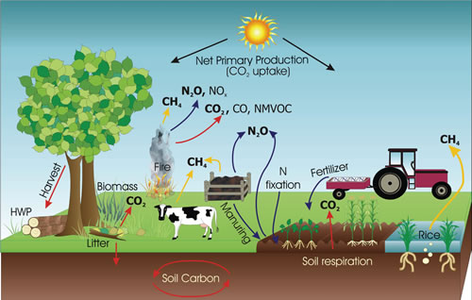
Agriculture sector: GHG emissions
6
burning
5
1
Rice field
Agricultural soils
2
3
Manure management
4
Enteric fermentation
7
Soil carbon sequestration
Source: Cplan (2009) (http://www2.cplan.org.uk/index.php?_load=page&_pageid=4)
Notes:
Please see the detailed information in this this slide.
Greenhouse gas emission from rice field, from livestock supply chains, from agricultural practices. Carbon dioxide releases from agricultural soils, deforestation, respiration, burning. Methane releases from rice cultivation and enteric fermentation Greenhouse gas emission from rice field, from livestock supply chains, from agricultural practices. Carbon dioxide releases from agricultural soils, deforestation, respiration, burning. Methane releases from rice cultivation and enteric fermentation in cattle; Nitrous oxide releases from burning, manuring, fertilizer application. In soils, nitrogen changes forms by cattle; Nitrous oxide releases from burning, manuring, fertilizer application. In soils, nitrogen changes forms by the nitrification and denitrification, then emits nitrous oxide.
HWP: harvested wood production; NMVOC:non-methane volatile organic compounds: benzene, ethanol, formaldehyde, cyclohexane or acetone
nitrification and denitrification, then emits nitrous oxide.
HWP: harvested wood production; NMVOC:non-methane volatile organic compounds: benzene, ethanol, formaldehyde, cyclohexane or acetone
Where does aquaculture fit in?

Slide 12
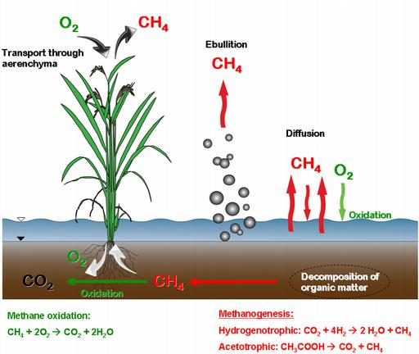
Greenhouse gas emission from rice field
(Winne, 2010)
Notes:
Reference: Winne, 2010
Key message:
Because most rice fields are flooded, they deveopment anerobic conditions (very low Oxygen) and therefore nitrogen in the soil is converted to methane by reduction. Methane is a potent greenhouse gas, more more heat absorbing than carbon dioxide. It is however not as long-lived.

Slide 13
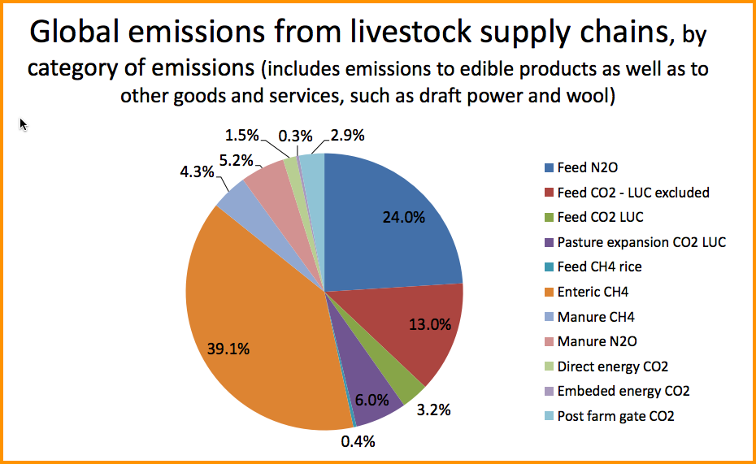
GHG Emissions from livestock supply chains
Notes:
Reference: FAO fao.org/climatechange

Slide 14
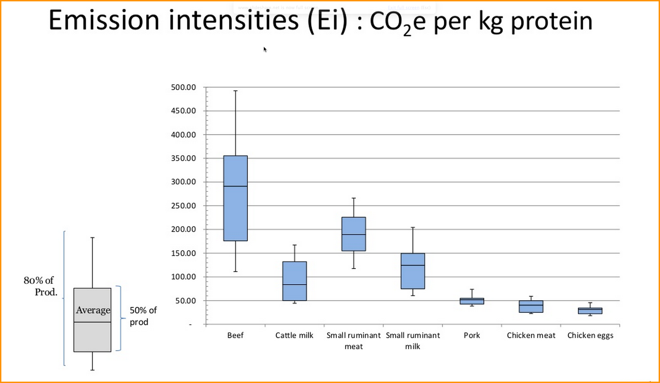
GHG Emissions from livestock
Notes:
Reference: World Resources Institute, http://www.wri.org/sites/default/files/uploads/emissions_from_animal_products_0.jpg
Message: Where would fish fit into this? Clearly beef is the highest. Fish might be on the same scale as chicken meat?

Slide 15
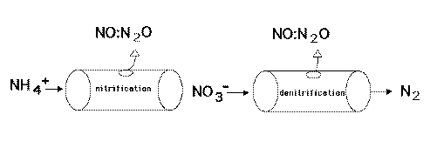
Greenhouse gas emission from agricultural soils
“Hole in the pipe” concept
(Keller, 1995)
N₂O
↑
NH₃ / NH₄⁺ → NO₂⁻ → NO₃⁻ → NO₂⁻ → NO → N₂O → N₂
Nitrification Denitrification
Notes:
Source: Here is how nitrogen changes forms in soils

Slide 16
Effects of Agricultural Practices on GHG Emissions
Soil carbon storage is very large.
Agriculture affects soil Carbon storage.
  Positive and negative effects
  Adding C (organic materials) / decreasing C (esp. tillage)
  Leading to an increased GHG emission (CO2) or enhancing carbon sequestration into soil.
Notes:
Key message:
Soil carbon is a very large reservoir of carbon. It is harder to study than above-ground carbon but is very important. Research about how agriculture affects soil carbon is very active now. Positive and negative effects
Adding C (organic materials) / decreasing C (esp. tillage)
Leading to an increased GHG emission (CO2) or enhancing carbon sequestration into soil.
Agricultural practices, such as organic fertilizer and green manuring, can be very effective in sequestering carbon and in reducing the overall impacts of agriculture on GHG emissions.
One of the more recent promising practices is “no-till” or “conservation” agriculture. These reduces GHG emissions by not tilling the soil.

Slide 17
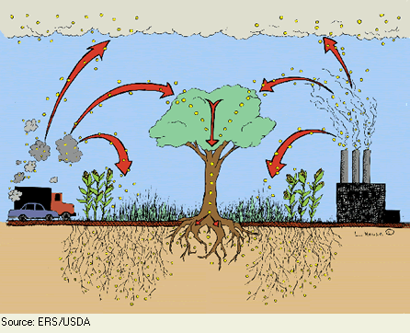
Agriculture sector: carbon sequestration
CO₂
CO₂
CO₂
CO₂
CO₂
CO₂
CO₂
CO₂
Soil organic carbon
Soil organic carbon
Soil carbon sequestration
Notes:
Reference: US Department of Agriculture
As you know, agricultural practices have negative effects in decreasing carbon by increasing GHG emission but it also has positive effects from adding carbon by enhancing carbon sequestration into soil.
Soil carbon is a very large reservoir of carbon.
Agricultural practices, such as organic fertilizer and green manuring and conservation agriculture can be very effective in sequestering carbon and in reducing the overall impacts

Slide 18
Effect of nitrification inhibitors on GHG emission in upland crops
Cassava field in Thailand
N₂O
Source: Pengthamkeerati et al. (2014)

Slide 19
Potential options to mitigate GHG emission by agriculture
Notes:
Lets go to the Potention options …….
It should be known that mitigation is actions to reduce and replace or avoid GHG emissions and enhance carbon sinks.

Slide 20
GHG mitigations in agriculture sector
Practices that conserve soil C and reduce methane emissions contribute to climate change mitigation.
Incentive and pay for ecosystem services (PES) systems for limiting emissions are developing but not as advanced as REDD+

Slide 21
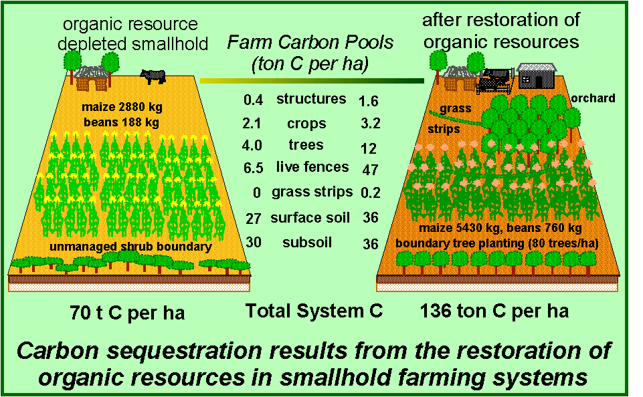
Restoring organic resources
Source: Forum for Organic Resource Management and Agricultural Technologies (FORMAT), online-available at http://www.formatkenya.org/files/Organic%20Resource%20Notebook.htm
Notes:
Soil carbon can be restored through well-developed practices.

Slide 22
GHG mitigation options
Agricultural soils
  Minimizing amount of N applied
  Appropriate time and practices for fertilizer application (synchronize with plant utilization)
  Application of nitrification/urease inhibitors/slow release fertilizer
Burning crop residues (on-site)
  Reduce or prohibit crop residue burning
Notes:
Some Ag pratices that are helfpul in limiting GHG emissions, e.g . fertilizer application and reduce or prohibit crop residues burning

Slide 23
GHG mitigation options
Paddy rice : Move towards Aerobic Rice
Water management (e.g., keeping soils more aerobic to reduce methane emissions by reducing water levels (mid-season drainage and multiple draining)
Appropriate fertilizer application (amount and timing)
Apply specific chemical fertilizer (e.g., sulfate-containing fertilizer)
Breeding of rice varieties for low water (to reduce GHG emissions)
Notes:
Some practices to mitigate in paddy rice culture: water management, fertilizer application, breeding of rice varieties.

Slide 24
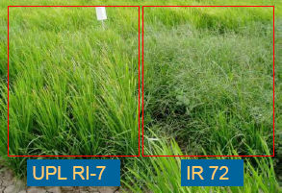
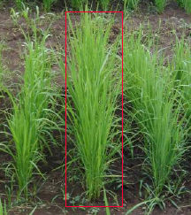
Aerobic rice
Aerobic rices: high harvest index, even under moderate stress.
Aerobic rice cultivars (middle):
have vigorous seedlings rapid biomass development deep roots and erect leaves.
IRRI
Notes:
Reference: IRRI
Aerobic rice is an excellent solution to reducing methane emissions, and has beenfits for productivity and water conservation as well.

Slide 25
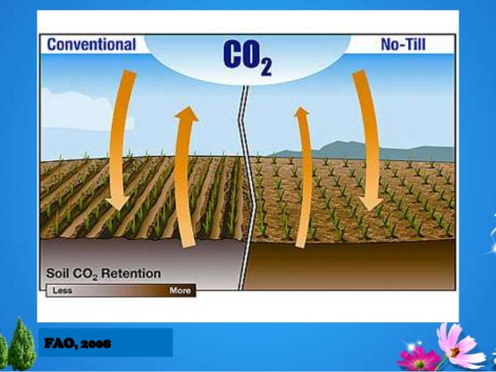
No Till Agriculture Reduces CO2 emissions
Notes:
Source: FAO 2006. https://www.google.com/search?q=conservation+agriculture+GHG&hl=en&gl=us&authuser=0&tbm=isch&source=lnms&sa=X&ved=0ahUKEwiN66LK5aXRAhWIqY8KHVrgBOcQ_AUICSgC&biw=1438&bih=631&dpr=1#q=conservation+agriculture+GHG&gl=us&hl=en&authuser=0&tbm=isch&tbs=rimg:Cck37b2o6YcIIjh5sCsqd5Gw0wpY6GzbQu3aBj_1D4sobZRhgfi320UPv8nx0bZQq6caEuVFrOPi1iDzo-TVq3021QSoSCXmwKyp3kbDTET_10KJgDcKtwKhIJCljobNtC7doRTL5ypJb-n0wqEgkGP8PiyhtlGBFxOTdf0ovJ_1CoSCWB-LfbRQ-_1yEYjYXqBwwMmXKhIJfHRtlCrpxoQRTykC51EjgHEqEgm5UWs4-LWIPBHfBf9jmSe8nCoSCej5NWrfTbVBEe-YLzZ2aQcq&imgrc=CljobNtC7drVrM%3A

Slide 26
GHG mitigation options
Enteric fermentation (livestock)
Variety selection / breeding improvement for higher meat
Change diets to minimize methane production during enteric fermentation
Manure management
Close system and CH₄ utilization for fuel (biogas)
Appropriate conditions of animal manure fermentation to GHG mitigation (more aerobic conditions and avoid anaerobic bacteria)
Notes:
More practices that are helfpul

Slide 27
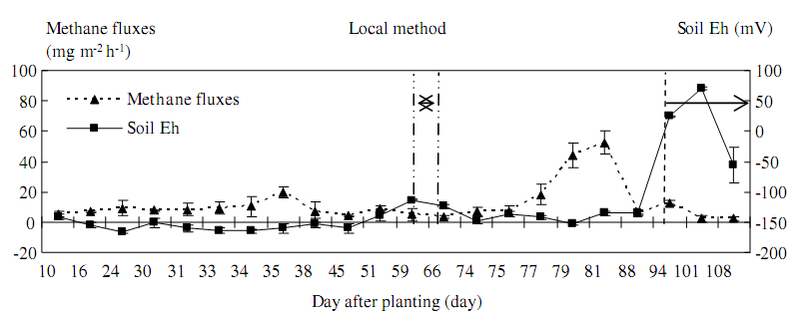
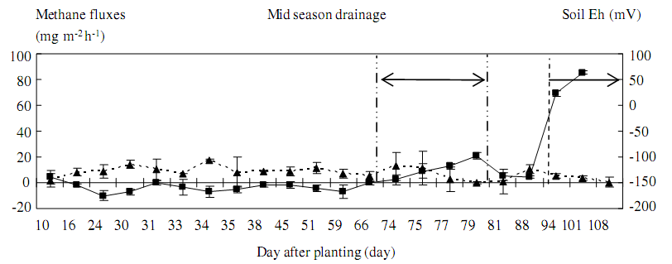
Water management affected GHG emission in rice field
Drainage
CH₄
Source: Towprayoon et al. (2005)
Notes:
Reference: TOWPRAYOON, S.; SMAKGAHN, K. & POONKAEW, S. Mitigation of methane and nitrous oxide emissions from drained irrigated rice ûelds. Chemosphere, 59:1547-1556, 2005.
Data to show effect of water management on emissions of methane

Slide 28
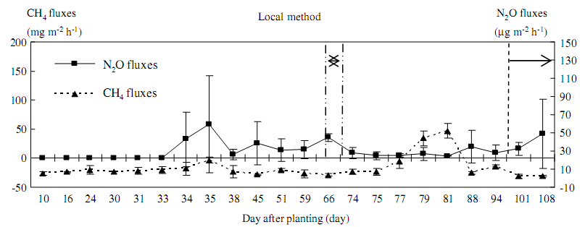
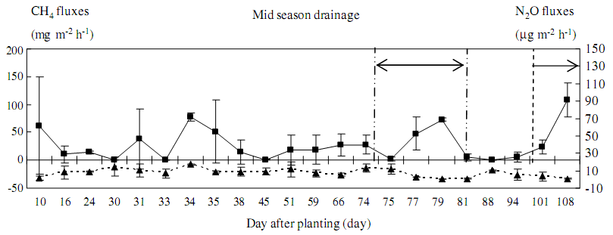
Water management affected GHG emission in rice field
Drainage
N₂O
Source: Towprayoon et al. (2005)
Notes:
Reference: TOWPRAYOON, S.; SMAKGAHN, K. & POONKAEW, S. Mitigation of methane and nitrous oxide emissions from drained irrigated rice ûelds. Chemosphere, 59:1547-1556, 2005.
How drainage affects denitrificaiton

Slide 29
Examples of GHG mitigation in agricultural lands
Enhancing soil carbon sequestration
  Promote crop residue incorporations and organic matter applications (e.g., alternative agriculture, organic farming)
  Reduced or no tillage
  Agro-forestry
  Intercropping and cover crop
  Energy crop, including fast-grow crop/tree
Notes:
Practices that improve retention of carbon in soils.

Slide 30
Restoring organic resources
Source: Forum for Organic Resource Management and Agricultural Technologies (FORMAT), online-available at http://www.formatkenya.org/files/Organic%20Resource%20Notebook.htm
Notes:
Reference: Organic Resource Management and Agricultural Technologies (FORMAT)
Soil carbon can be restored through well-developed practices.

Slide 31
Discussion questions
Does agriculture sector play an important role in GHG emission in Bangladesh?
What is the major GHG contributors of the agriculture sector in Bangladesh?
Can Bangladesh grow more aerobic-based rice?
Notes:
Work in pairs, if yes, provide at least one GHG contributor of agriculture sector in your local area.

Slide 32
Food security and climate change
Notes:
I’d like to turn now From the above figure, we will see that agricultural land area in the developing country regions tends to increase from 1960-2000. But the opposite trend was generally observed for agricultural land area for the food security and climate change developed country regions.

Slide 33

Assigned Reading
2013. Turn down the heat :
Why a 4°C Warmer World Must Be Avoided
Chapter 5 – South Asia
pages 105-138
Washington DC ; World Bank
https://openknowledge.worldbank.org/handle/10986/11860
Notes:
Note: This same assignment occurs in the Food Security Topic.
Questions:
World Bank. 2012. Turn Down the Heat: Why a 4°C Warmer World Must Be Avoided. Washington, DC. © World Bank. https://openknowledge.worldbank.org/handle/10986/11860
By the end of the 21rst century, how does projected sea level rise along the South Asian coastline compare to the global mean sea level rise?
What are the projections for sea level rise in a 2°C world versus a 4°C world?
What is land subsidence? What are some of its causes? Why is it particularly important at river deltas?
Both agriculture and aquaculture in South Asia are concentrated along river deltas. This makes them particularly vulnerable to sea level rise and land subsidence. Can you think of an example of how coastal agriculture in your region has already been impacted by climate change and what steps are being taken to mitigate this risk?
What risks does salt water intrusion pose? What are some of the drivers that cause salt water intrusion to extend further inland in addition to sea level rise?
What are some of the health risks of consumption of salt contaminated water?
What are some of the impacts of coastal erosion?
What is one way to mitigate coastal erosion?
Agricultural productivity in South Asia is projected to decline with climate change. Even rice production, which is largely grown in deltaic regions and is relatively tolerant of unstable water levels, is at risk. What are the major threats to rice cultivation? Can you think of any ways in which rice cultivation could be adapted to be more resilient to climate change?
Aquaculture plays an important role in South Asia’s economic development. What aspects of climate change threaten aquaculture? Name at least 3.
What are some ways to adapt aquaculture so that it is less vulnerable to climate change? What are some of the barriers to such adaptation?

Slide 34
Exercises Group discussion
How would you define "food security"?
What could the term “food security mean for urban and rural Bangladesh?
How are they different?
Is food security for urban and rural Bangladesh the same as for European countries? Why or why not?

Slide 35
The concept of food security
Definition
The World Food Summit of 1996 defined Food security as existing:
“When all people at all times have access to sufficient, safe, nutritious food to maintain a healthy and active life.”
Notes:
The concept of food security has evolved significantly over time. The definition of food security used in this course is adopted from World Food Summit in 1996
Food security has been a concern and problem to humanity from the beginning of human existence on Earth in terms of agricultural production, trade, income, food quality, clean water, sanitation, governance and political stability.
Currently, many people in the world are food insecure and expected to remain food insecure for some time to come.
Agriculture productivity affects not only the availability and price of food, but the purchasing power of many, sales of agricultural commodities, income for many people and foreign exchange income for developing countries.

Slide 36
Four main dimensions of food security
Physical AVAILABILITY of food
Economic and physical ACCESS to food
Food UTILIZATION
STABILITY of the other three dimensions over time
Notes:
I would like to show you 4 dimensions….
Food availability addresses the supply of food security: food production, stock levels and net trade.
Food access: having sufficient resources , appropriate foods for a nutritious diet.
Food utilization: use based on nutrition and care, adequate water and sanitation.
Stability of three above dimensions.
Note that Bangladesh, because of the high urban population, are increasingly dependent upon the economic access to food. This is even true in rural areas where landlessness is common. The other issue in Bangladesh is utilization as often the diet is high in carbohydrates (rice) but insufficient in terms of vitamins (vegetables),, protein and oils. In urban populations, over-nutrition is a problem leading to significant health-diet related problems.

Slide 37
Exercise: work in groups – Defining food security
For each concept, put the definition into the correct box
Availability | Physical and economic access
Access | All people, at all times
Utilization | Sufficient food
Stability | Safe and nutritious food that meets their dietary needs
Notes:
Reference: FAO
This can be done as a homework assignment, in class in groups or individually, or as a quiz.

Slide 38
Answers
Availability | Sufficient food
Access | Physical and economic access
Utilization | Safe and nutritious food that meets their dietary needs
Stability | All people, at all times
Notes:
Reference: FAO http://www.fao.org/docrep/014/i2043e/i2043e02e.pdf
Understanding the various dimensions of food security is important when establishing priorities in food security policy and program formulation, making long term investment decisions, and in evaluating response options when responding to food emergencies
In terms of food securuty, 29 countries have “alarming“ or “extremely alarming” levels of hunger (2009 Global Hunger Index ).

Slide 39
Exercise: work in groups
Can you please tell us how the climate change affect on four dimensions of food security?
  Availabilty
  Access
  Utilization
  Stabilty
Notes:
Climate change affects not only the food production but all four dimension of food security.
Divide in four groups. Each group is 1 dimension. Can you please tell us how the climate change affect on four dimensions of food security?
Climate change effect on food availability: Loss in food production, Indirect environmental feedbacks).
Food access: Infrastructure damage, asset losses, Loss of income and employment opportunities).
Food utilization: Human health risks, nutrition).
Food satbility: Increased livelihood risks, pressure on food prices, Higher dependency on food imports and food aid

Slide 40
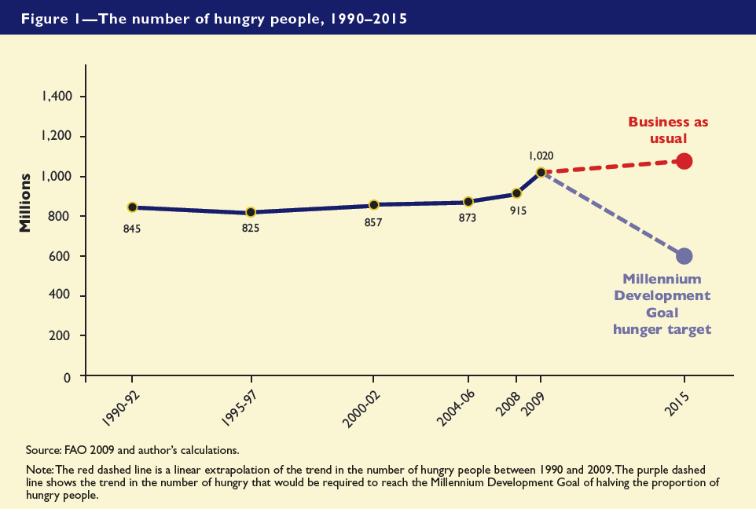
The number of hungry people needs to fall by 73 mil. per year to meet MDG
Notes:
Reference: Shenggen Fan, IFPRI, http://www.slideshare.net/shenggenfan/climate-change-agriculture-and-food-security-4055009
I’d like to mention the hunger. Hunger is rooted in food insecurity. Food insecurity translates into a high degree of vulnerability to hunger.
As you can see in the graph, the red dashed is a linear extrapolation of the trend in the number of hungry people between 1990 and 2009. The purple dashed line shows the trend in the number of hungry that would be required to each the Millennium Development Goal of halving the proportion of hungry people. It would need to be reduced the number of hungry people by 73 million people per year to meet Millennium Development Goal.

Slide 41
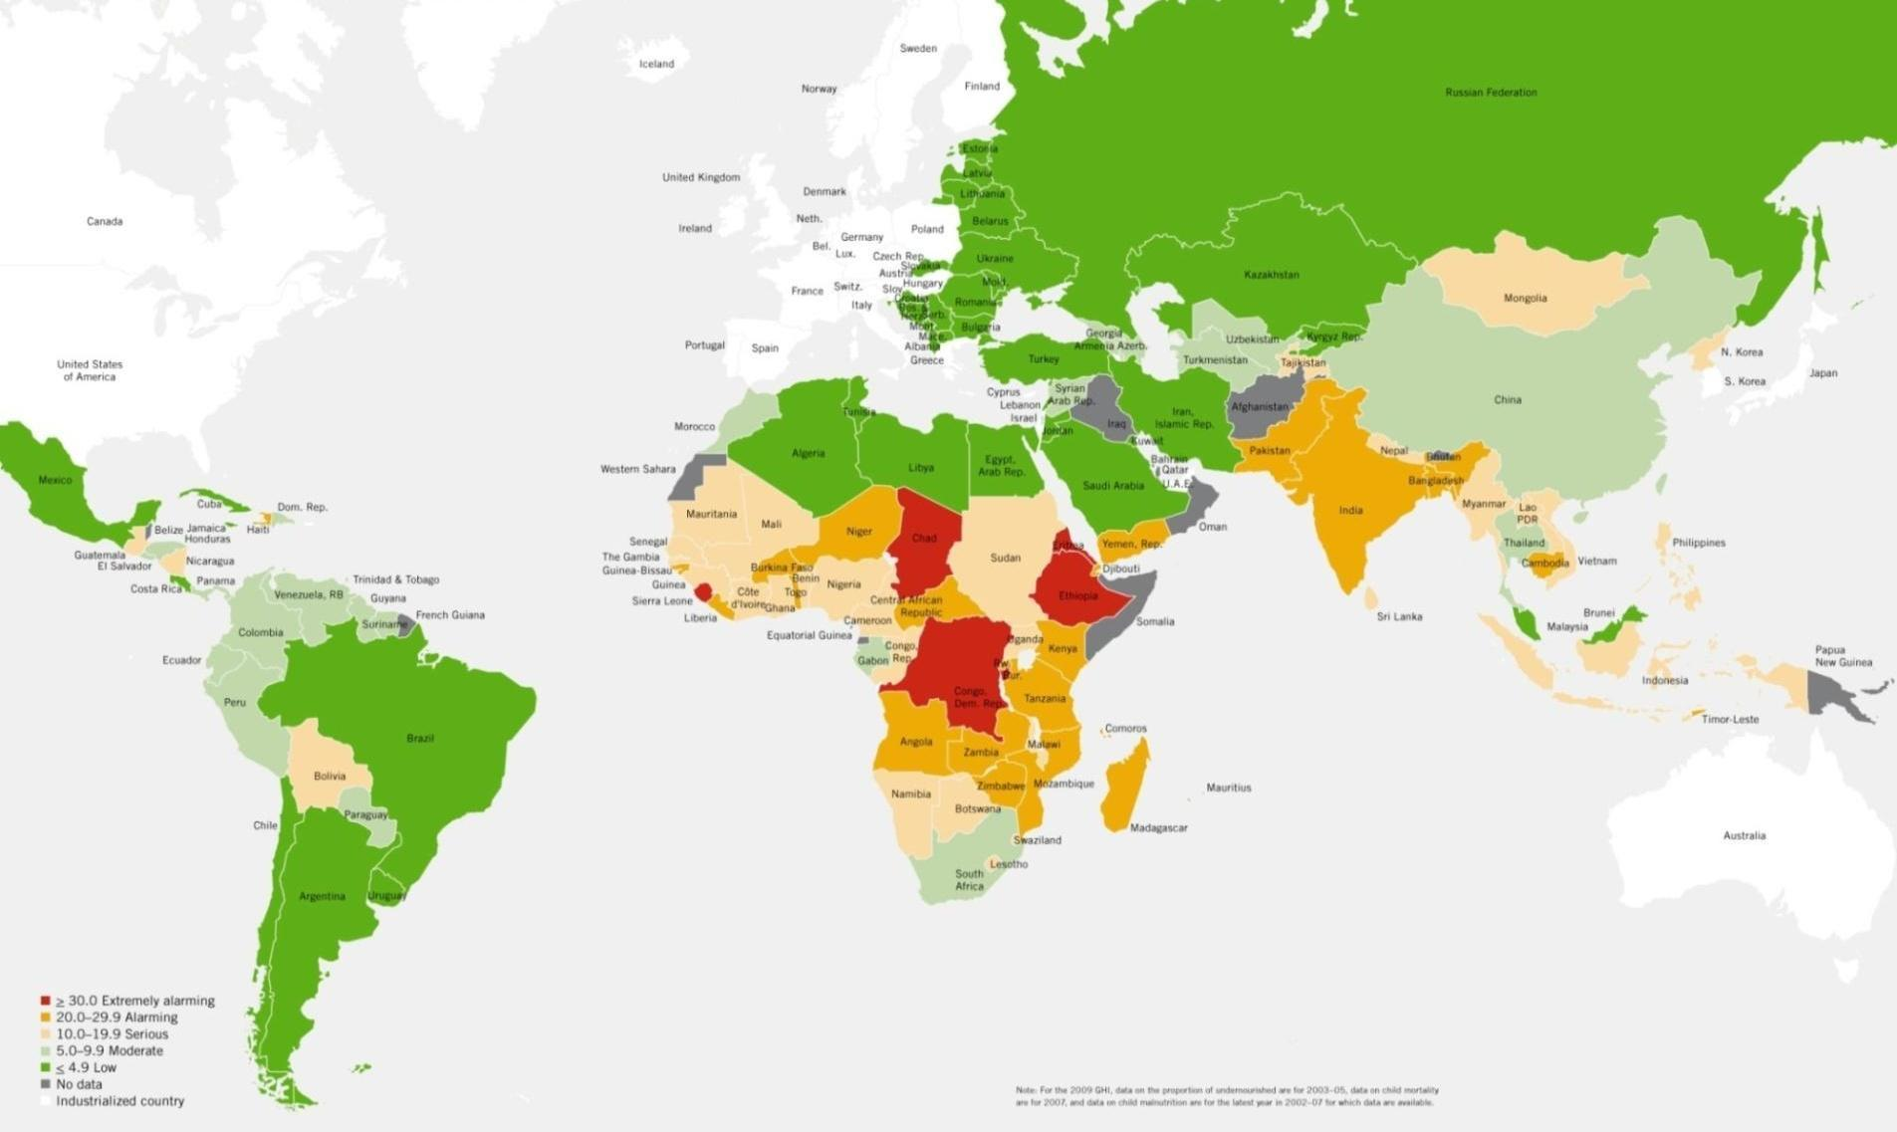
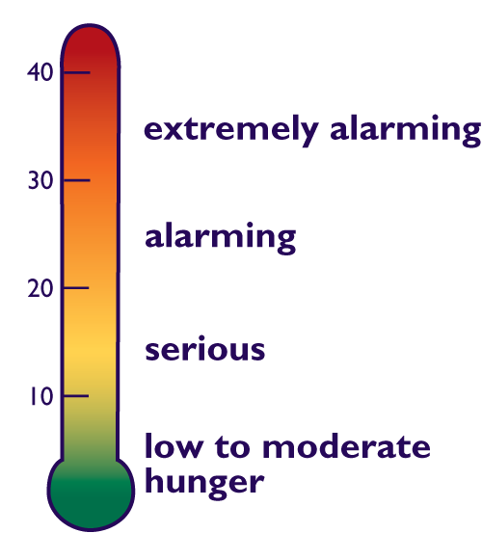
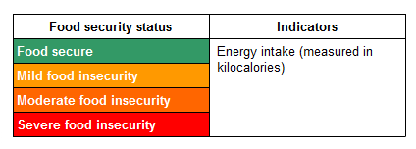
29 countries have “alarming“ or “extremely alarming” levels of hunger (2009 GHI)
Global Hunger Index (GHI) components are proportion of undernourished, prevalence of underweight in children and under-five mortality rate.
Source: von Grebmer et al. 2009
Notes:
Reference: Shenggen Fan, IFPRI, http://www.slideshare.net/shenggenfan/climate-change-agriculture-and-food-security-4055009
Key message:
The levels of hunger in the world were study by Global Hunger Index (GHI), 2009. The intensity of food insecurity may be measured in terms of levels of food intake.
Undernourishment refers to the proportion of the population whose dietary energy consumption is less than a threshold(usually 2,100 kcal per person per day)
Undernourishment are also referred to as suffering from food deprivation.
One option is to relate the severity of food insecurity to how consumption as a threshold of 2,100 kcal per day.
Another example is the Integrated Food Security Phase Classification (IPC). This provides a classification system for food security and humanitarian crises based on a range of livelihood needs:

Slide 42
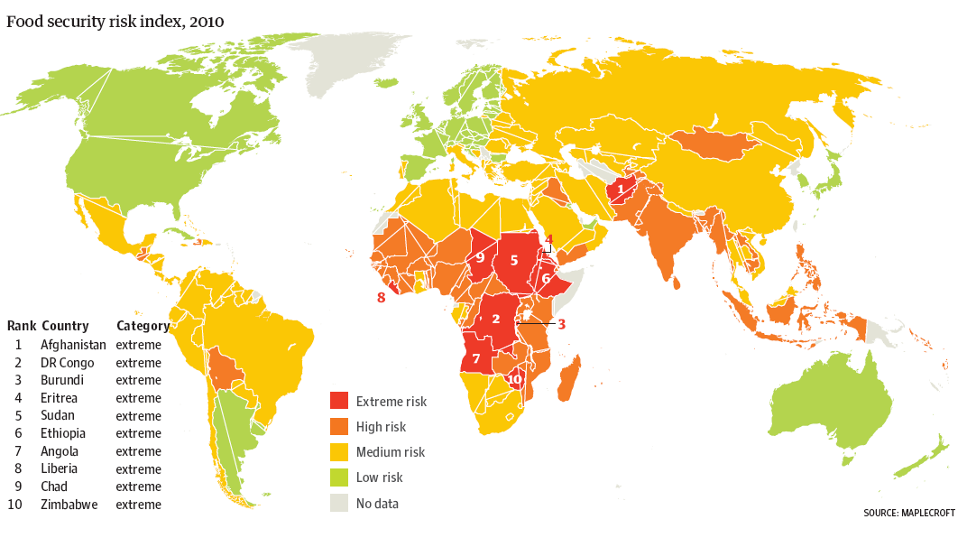
Food security index, 2010
Notes:
Reference: Maplecroft https://www.maplecroft.com/about/news/food-security.html
This is a map showing the level of food security by country but a risk assessment company. Africa and south Asia have the great concern.
Understanding the various dimensions of food security is important when establishing priorities in food security policy and program formulation, making long term decisions, and in evaluating response options to food emergencies.

Slide 43
Exercise
List the countries that face the most serious problem on food security (by using levels of hunger map)
How would you find out the rate or rates of hunger? What are the rates of change?
How would you explain the potential impacts of food security in Bangladesh?
How might Climate Change affect this?

Slide 44
Summary of the concept of food security
Food security exists when all people, at all times, have physical and economic access to sufficient safe and nutritious food that meets their dietary needs and food preferences for an active and healthy life.
From this definition four main dimensions of food security can be identified:
  physical availability of food
  economic and physical access to food
  adequate food utilization
  stability of the other three dimensions over time
There are also important differences in the duration and severity of the way in which people experience food insecurity.
Understanding the various dimensions of food security is important when establishing priorities in food security policy and program formulation, making long term investment decisions, and in evaluating response options when responding to food emergencies

Slide 45
Online Resources:
FAO (1996) World Food Summit: Rome Declaration and Plan of Action. October 1996. www.fao.org/wfs
FAO (2006) Integrated Food Security and Humanitarian Phase Classification (IPC) Framework, ESA Policy Brief, 06-01. ftp://ftp.fao.org/es/ESA/policybriefs/pb_01.pdf
WFP (2005) Emergency Food Security Assessment Handbook. www.wfp.org/operations/emergency_needs/EFSA_section1.pdf

Slide 46
Additional Reading
Sen, A.K. (1981) Poverty and Famines: An Essay on Entitlements and Deprivation. Oxford: Clarendon Press.
Stamoulis K., Zezza A. (2003). A Conceptual Framework for National Agricultural, Rural Development, and Food Security Strategies and Policies, Working Paper 03-17, ESA Division, FAO.
Devereux, S. (2006) Distinguishing between chronic and transitory food insecurity in emergency needs assessments. SENAC, WFP, Rome.

Slide 47
Stress Factors to Food Security
Population growth and demographic changes
Land and water constraints
Climate change
Source: World Bank 2010..
Notes:
Now, we move on the challenges to achieving food security: water crisis, land degradation, climate change

Slide 48
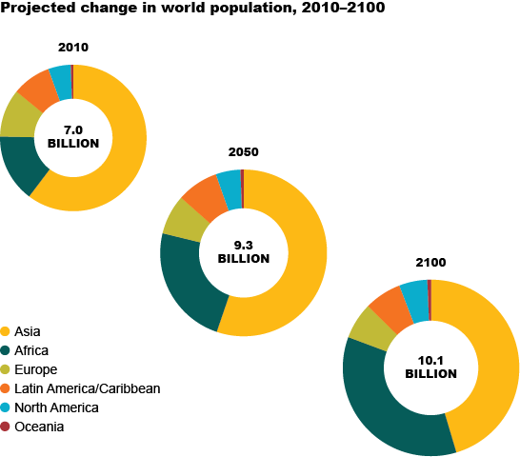
Global Population
The world population is expected to rise throughout the 21st century, although this growth is projected to decelerate markedly in 2050 to 2100.
Currently, the world population’s annual growth rate is 1.1%.
Notes:
Firstly, I’d to mention the global population
As we all know, … (márkili)
Explain about the projected change in world population which means more food is required.
Source: http://ccafs.cgiar.org/bigfacts/population
UN-DESA, 2011

Slide 49
Global food demand
Overall demand for agricultural products (including food, feed, fibre and biofuels) is expected to increase 1.1% per year from 2005/07 to 2050.
To meet global food demand in 2050, agricultural production must be 60% higher by weight than in 2005. (Alexandratos and Bruinsma, 2012)
To meet projected demand, world cereals production, which increased by 1,225 MT between 1961/63-2005/07, is projected to increase by another 940 MT to reach 3 BT in 2050.
Notes:
Messages: Higher global food demand includes food, feed, fibre and biofuels, other agriculture production.
This is the data of global food demand that is expected to increase.
MT = million tons, BT = billion tons
Source: Alexandratos, N. and J. Bruinsma.2012. World agriculture towards 2030/2050: the 2012 revision. ESA Working paper No. 12-03. Rome, FAO.
Available from http://www.fao.org/docrep/016/ap106e/ap106e.pdf

Slide 50
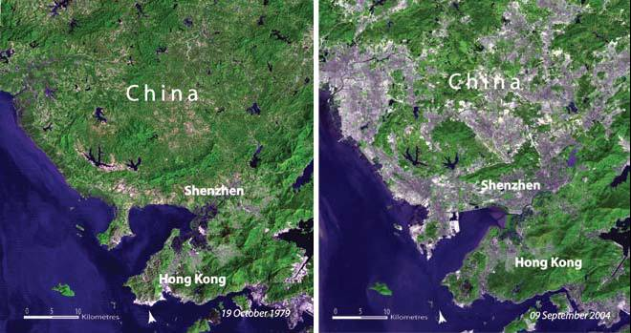
Population and land-use changes: major stressors
1979
2004
Notes:
Reference: NASA imagery
What different between two map of this region in 1979 Can you tell me what is different?
Impacts of Climate Change and food security must be placed in the context of land use change: changes are fast and profound, and continuing.

Slide 51
IPCC & World Bank projection for tropical regions
“At lower latitudes, especially in seasonally dry and tropical regions, crop productivity is projected to decrease for even small local temperature increases (1 to 2°C) which would increase the risk of hunger (medium confidence).”
From: IPCC AR4 as quoted in: World Bank, 2012. Turn Down the Heat
Notes:
Key message:
This regions experiencing near the limit of heat tolerance to crops would be more vulnerable to global climate change (compared to template region). This leads to food insecurity for this area. In addition, adaptation to climate change of this area may be limited or less ability.
This is the opposite in northern climates where increases in temperature (and CO2) might lead to increases in production.

Slide 52
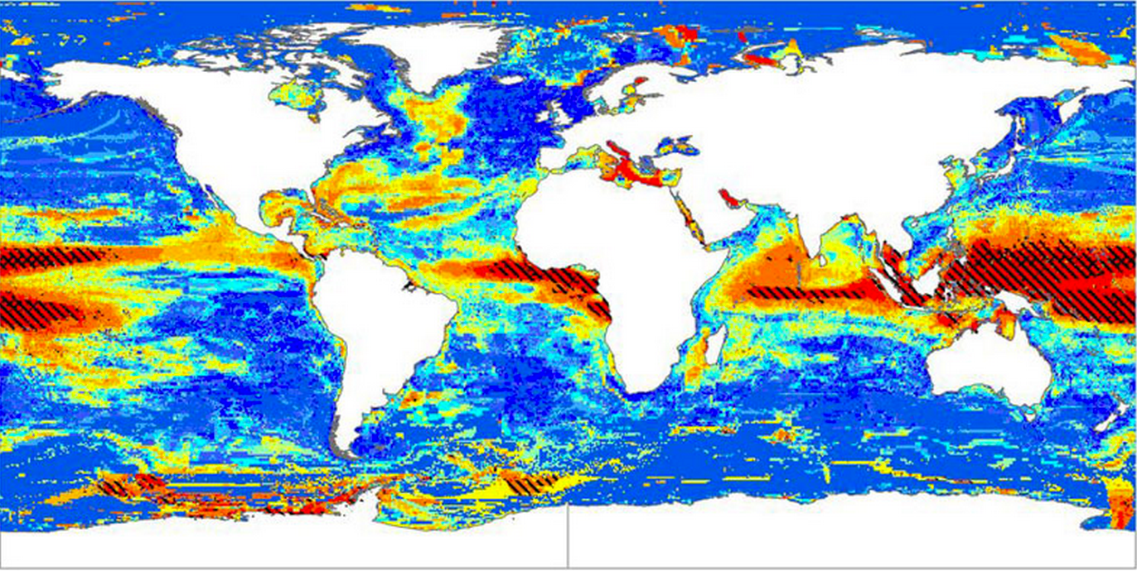
Climate change is likely to make some fish species go extinct in the tropics. Fish predicted to be moving north.
This map shows hotspots of local extinction for fish and marine invertebrates between the years 2000 and 2050, under the worst-case climate change scenario of three degrees of warming by 2100. Red indicates the highest rates of local extinctions, and blue indicates the lowest rates. (Image credit: Jones and Cheung, 2014, ICES Journal of Marine Science) From Yale Environment
Notes:
Reference: Yale Environment http://e360.yale.edu/digest/climate_change_to_make_many_fish_species_locally_extinct_in_tropics_study_says/4273/
13 OCT 2014: CLIMATE CHANGE TO MAKE MANY FISH SPECIES EXTINCT IN TROPICS, STUDY SAYS
Climate change is likely to drive fish and marine invertebrates toward the poles and cause extinctions near the tropics, according to researchers at the University of British Columbia. Under the conservative climate change scenario of one degree Celsius of warming by 2100, the 802 species modeled in the study are predicted to move away from their current habitats by as much as 9 miles, or 15 kilometers, every decade — a rate similar to what scientists have observed over the past few decades. Under the worst-case scenario of three degrees of warming, the researchers predict marine species will move toward the poles at a rate of 26 kilometers per decade. Under that scenario, an average of 6.5 species per 0.5 degrees of latitude would become locally extinct closest to the equator. The shifts will be caused by the species' reactions to warming waters, changing ocean chemistry, and ecosystem structure near the tropics, as well as new habitats opening up nearer the poles, the researchers say.

Slide 53
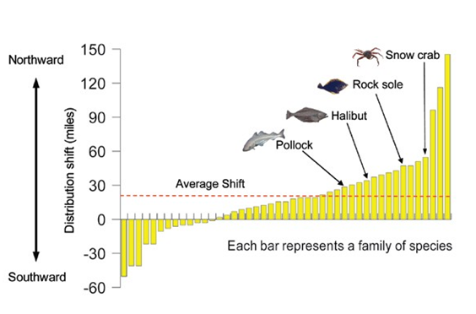
Local Availability Issues
Notes:
Reference: U.S. Global Change Research Program 2009. (USGCRP 2009), http://epa.gov/climatechange/impacts-adaptation/agriculture.html
Key Message: As air and water temperatures rise, marine species are moving northward, affecting fisheries, ecosystems, and coastal communities that depend on the food source. On average, by 2006, the center of the range for the examined species moved 19 miles north of their 1982 locations

Slide 54
Discussion on Small Group Questions
How is climate change affecting agriculture and food security in Bangladesh?
What will be the effects on wild fish? Aquaculture?
What are the causes of lower crop yields?
Are we prepared for food security adaptation and mitigation?
What can we do to better prepare and adapt?

Slide 55

Climate change impacts on agriculture
Notes:
Reference:Photo from Shutterstock
Third challenge to food security is climate change

Slide 56
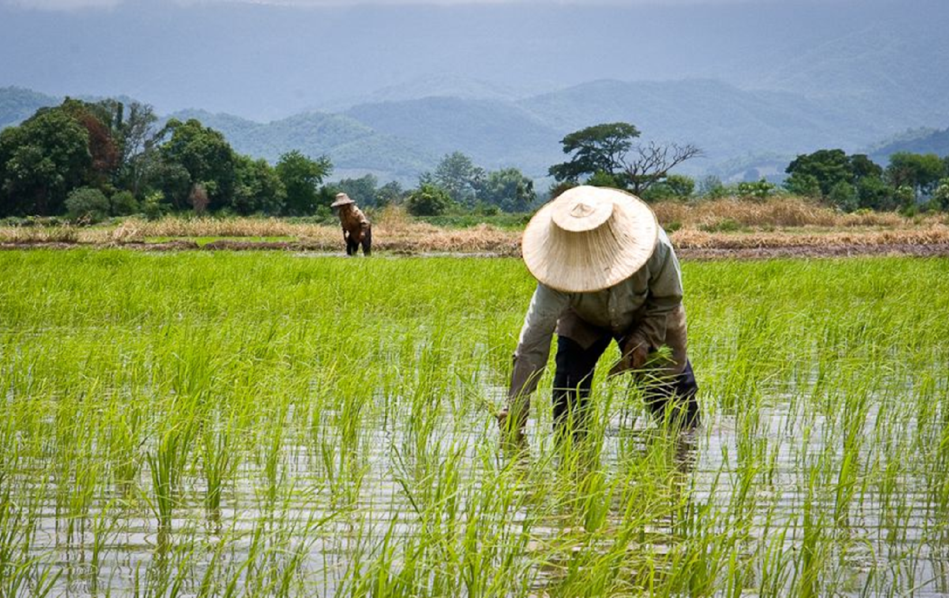
Climate change will affect or is affecting agriculture
What crops people can grow?
How often they can plant these crops?
How productive they are?
How easily they can be harvested?
Notes:
Climate change will have positive and negative impacts on agriculture. What negative? and What is positive?

Slide 57
How climate change affects agriculture
Increasing crop growth and production:
  Higher average temperatures (some areas have a positive effect, if not too high of a temperature increase.)
  Increased crop yields due to CO2 fertilization, greater water use efficiency (CO2 effect)
  Increased length of growing season in some areas
  More suitable climates at higher elevation lands
  Increased precipitation in some areas
Notes:
Key message:
Some discussion on each of these, after they are presented, is appropriate. This is one of the areas where climate warming can have some distinct benefits, along with the impacts.
57

Slide 58
How climate change affects agriculture
Decreasing crop growth and production:
  Extreme weather events (e.g. more frequency and intensity of strong storms)
  Climate variability (e.g., changes in precipitation patterns, rainfall deficits, heat waves, more drought and flooding)
  Higher average temperatures (increased heat stress)
  => Increasing spread of weeds, pests and pathogens induced by climate change
  => food prices, food security, import-export flows, and land use decisions
Notes:
Key message:
Climate change will have positive and negative impacts on agriculture.
Increased frequency and intensity of extreme weather events cause the global adverse effects on crop growth and production of major crops are important drivers of food prices , food security soil loss (soil erosion/landslide) and unuseable cropland (flooding).
Climate variability (e.g. , import-export flows rainfall deficits , change in the length of the growing season) leads to short-term fluctuation in rainfed agricultural production.
Drought: soil erosion (by wind) and decreasing crop production.
Heat wave: affect crop growth and land use decisions crop production.
58

Slide 59
How climate change affects agriculture
Less available of cropland:
  Soil salinity and inaccessible cropland due to sea level rise
  Surface soil loss (through soil erosion and landslide) caused by climate intensification -- more extreme flooding and drought
Notes:
Key message:
Climate change may be a cause of less availability of agricultural lands due to (1) soil salinity caused by sea level rise and (2) soil loss causing by extreme weather events (surface runoff and landslide) and drought.
59

Slide 60
Impacts on crops
The potential yield loss is about 5% for each degree Celsius of global warming (Lobell et al., 2011).
Yields of maize and wheat are sensitive to temperatures above 30ºC.
Changes in the global production of major crops are important drivers of food prices, food security, import-export flows, and land use decisions.
Notes:
Key message:
Global impacts of climate change on yields cannot be estimated due to variation among locations and crop types. But the overall impact on grain is negative.
For example, each day above 30 degrees Celsius in the growing season reduces the final yield of maize by 1 percent under optimal rainfed conditions and by 1.7 percent under drought conditions (Lobell et al. 2011).

Slide 61
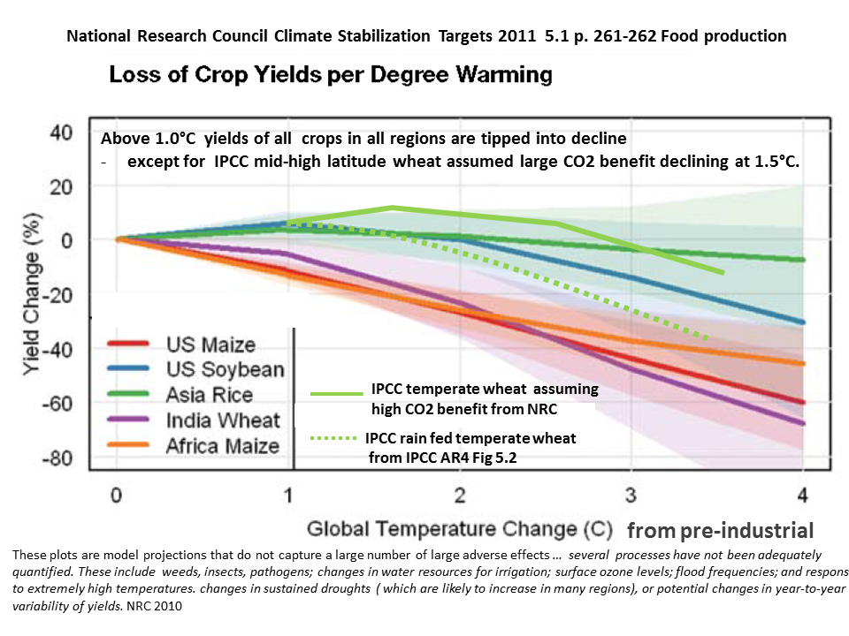
Notes:
Reference: National Research Council http://nas-sites.org/americasclimatechoices/more-resources-on-climate-change/climate-change-lines-of-evidence-booklet/evidence-impacts-and-choices-figure-gallery/figure-28/
Key message:
Higher temperatures may have a positive effect on plant growth and production for some area, e.g. template region, if an increase was not too high. But, in general, higher temperature may lead to heat stress for plants, increasing sterility and lowering overall productivity. Higher temperatures and increased atmospheric moisture capacity also increase evaporation from plants and soils, increasing water requirements while lowering water availability.
Interaction between higher temperature and CO₂ fertilization suggested that CO₂ fertilization enhances the heat tolerant of crop. But too high temperature still has an adverse effect on crop yields.

Slide 62
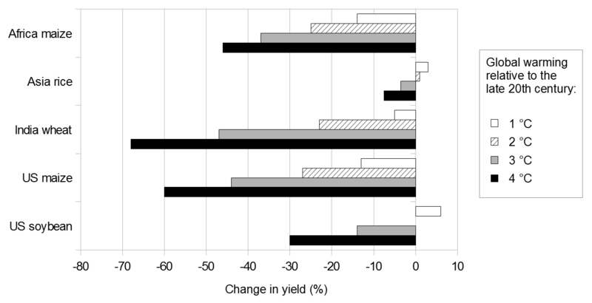
Projected changes in crop yield
Agriculture in least developed countries (LDCs) is likely to be hardest hit by climate change and will suffer bigger declines in crop yields
Notes:
Reference: US NRC (2011), Climate Stabilization Targets: Emissions, Concentrations, and Impacts over Decades to Millennia, Washington, D.C., USA: National Academies Press
Statistical crop models and climate projections for 2030 from 20 general circulation models indicate that South Asia and Southern Africa are two regions that, “without sufficient adaptation measures, will likely suffer negative impacts on several crops that are important to large food-insecure human populations.” (Lobell et al. 2008)

Slide 63
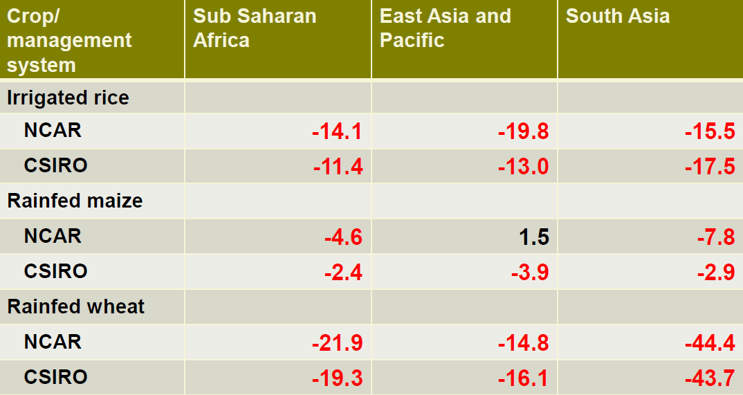
Climate change impact: change in average yields
NCAR A2a
Notes:
Reference: Shenggen Fan, IFPRI, http://www.slideshare.net/shenggenfan/climate-change-agriculture-and-food-security-4055009.
Source: Nelson et al. 2009
NCAR - National Center for Atmospheric Research
CSIRO – Commonwealth Scientific and Industrial Research Organization.
The production of irrigated rice, rainfed maize and rainfed wheat in three regions show lower than average yields (negative value refer to decline in percent)
Source: Nelson et al. 2009. (Need to add date of projection)
NCAR - National Center for Atmospheric Research
CSIRO – Commonwealth Scientific and Industrial Research Organization.
Rainfed wheat, which is rely on rainfall for water.

Slide 64
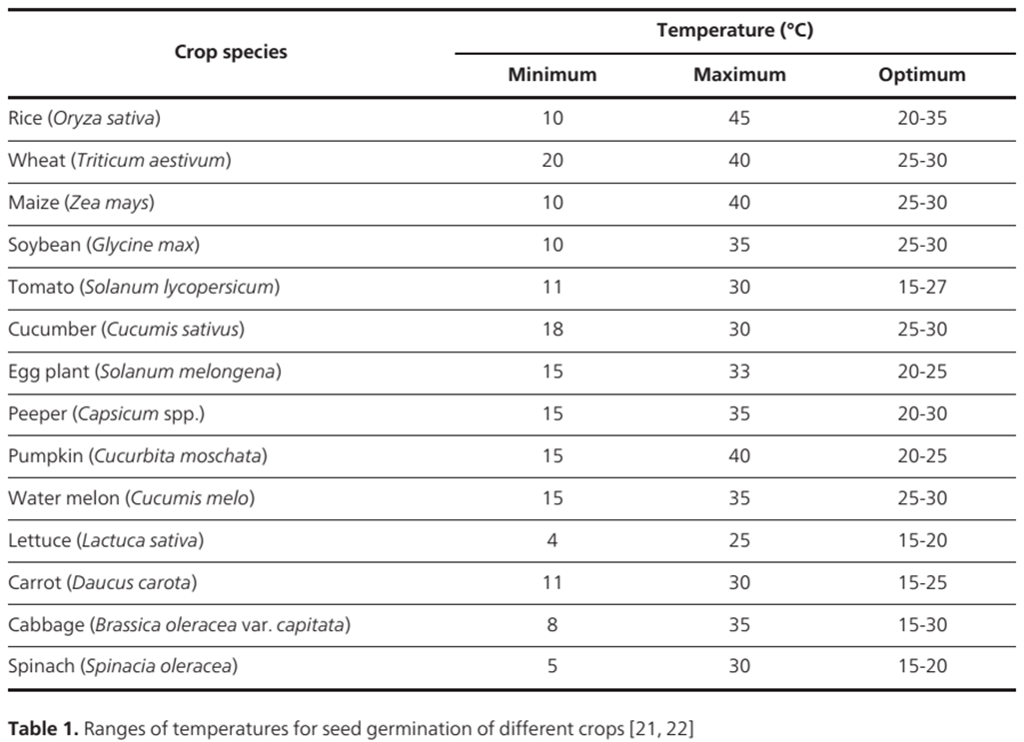
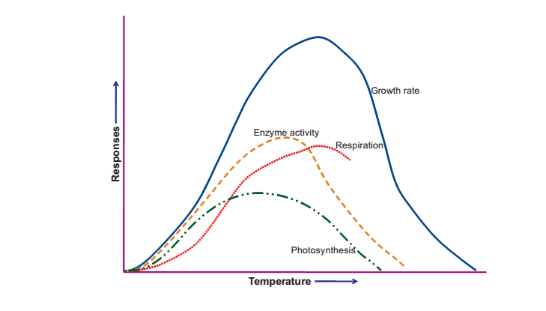
Physiology - temperature stress
The processes of germination, plant growth, metabolism, and reproduction have optimum temperature limits
Temperatures exceeding adaptation limits negatively influence the viability and yield of many crops
Notes:
Reference: Mirza Hasanuzzaman, Kamrun Nahar and Masayuki Fujita (2013).
Shortening of such a cycle could have an adverse effect on productivity because senescence would occur sooner. The effect of climate change (temperature) on crop growth and production is also depended on crop variety.
Extreme Temperature Responses, Oxidative Stress and Antioxidant Defense in Plants, Abiotic Stress - Plant Responses and Applications in Agriculture, Dr. Kourosh Vahdati (Ed.), ISBN: 978-953-51-1024-8, InTech, DOI: 10.5772/54833. Available from: http://www.intechopen.com/books/abiotic-stress-plant-responses-and-applications-in-agriculture/extreme-temperature-responses-oxidative-stress-and-antioxidant-defense-in-plants

Slide 65
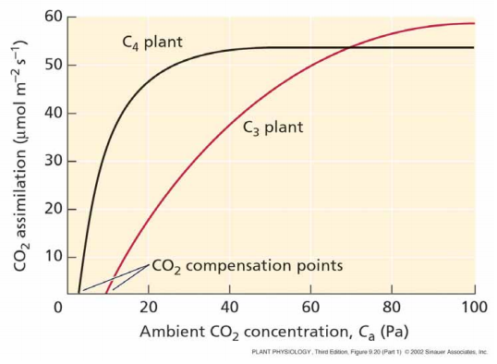
Physiology – Plant functional types (e.g. C3 vs. C4) respond differently
C3 plant (e.g. soy, wheat) productivity is more responsive to increased CO₂ than C4 plant (e.g. maize, sugar cane,corn ) productivity.
Carbon isotope evidence from the last glacial maximum suggests that low CO₂ favors C4 plants.
Notes:
Reference: http://www.chem.hope.edu/~stewart/
The three types of photosynthesis are C3, C4, and CAM. C3 plants use C3 photosynthesis which uses CO2 in a 3-carbon compound and C4 plants use C4 photosynthesis in a 4-carbon compound. These compounds represent different types of sugar. C3 photosynthesis is the typical photosynthesis that most plants use. C3 photosynthesis variety is more efficient than the C4 variety since it requires fewer enzymes under normal light conditions. C4 photosynthesis is adaptations to arid conditions, resulting in better water use efficiency.
Note: this is appropriate for advanced students that know what C3 and C4 plants mean. http://www.chem.hope.edu/~stewart/photosynthesis/C3C4

Slide 66
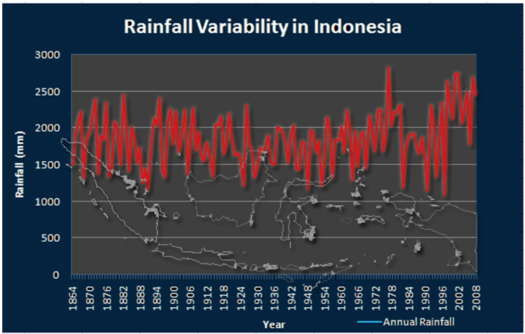
Climate intensification, variability & extreme events
Changes in average annual temperature or precipitation may shift where a particular crop can be grown, however, an increase in climate variability and intense extremes (heat waves, frost, droughts, floods) will affect crop productivity and the timing of agricultural operations and can be more harmful than a small change in mean temperature
Notes:
Reference: (Voildoire and Royer 2004, Medvigy et al. 2011) http://www.rimes.int/cc/climate-change-analysis

Slide 67
Changes in seasonality
While total rainfall is important, the seasonal pattern of rainfall is also critical to agricultural productivity.
Longer growing seasons as a result of climate change may benefit crops in some regions, however, this is contingent on water- availability.
Warmer temperatures can shorten development stages of determinate crops and reduce yields of a given variety.
Evidence from the distant past suggest that abrupt changes in climate have been associated with a shift of seasonal monsoons to the south, which could put rice fields in Vietnam and other tropical countries at risk (Severinghaus et al. 2009)
Notes:
Key message:
In seasonarity, change in total rainfall, longer growing season, warmer temperature and seasonal monsoons could reduce yield of given variety in certain countries.
We are not able to predict how this will change, but there is high confidence that it will change, with all aspects of climate becomming more variable.
Severinghaus J. P. et al. 2009. Oxygen-18 of O₂ Records the Impact of Abrupt Climate Change on the Terrestrial Biosphere. Science 324(5933): 1431-1434.

Slide 68
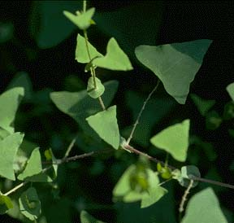
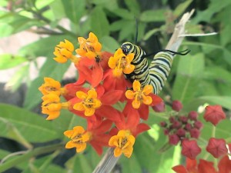

Weeds, pests and pathogens
Weeds evolve rapidly to overcome control measures. Rate of evolution will increase in hotter, drier conditions and in 'extreme years', could lead to some types of herbicide tolerance becoming more common
Possible increase in the range of many native pests, and species that at present are not economically important may become so
The temperate zone is likely to experience longer periods of temperatures suitable for pathogen/fungi growth and reproduction if climates warm.
Notes:
Reference: http://www.asiahomegarden.com/keeping-it-looking-pretty-plant-issues-weeds-pests-and-diseases/
In hotter, drier conditions and in 'extreme years', could lead to some weeds of herbicide tolerance
Warm climate, such as higher temperature and humid are suitable for pest and pathogens growth and reproduction.
In some cases, warming will favor the invasive plants of the desired plants, as the invasive plants are opportunists. In some cases new and differ
ent invasive plants will appear, while the local species will be under stress and more easily invaded.

Slide 69
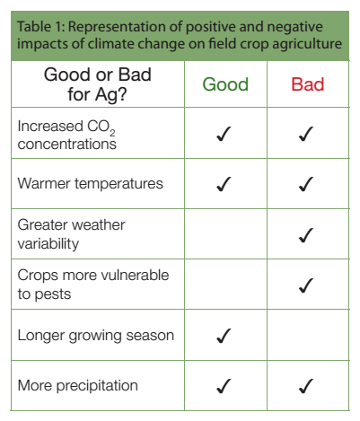
Positive and negative impacts
Climate change and agriculture fact sheet series E3149, Michigan State University Extension, April 2011
Notes:
Reference: http://climate.msue.msu.edu/uploads/files/field_crop_agriculture_and_climate_change.pdf
Key message:
Increased CO2 concentrations: can enhance production, but only if water and nutrients are not limiting.
Warmer temperatures: (+) can increase productivity, but (-) increase plant water use and could cause water to become limited.
Greater weather variability: unpredictable events e.g. late spring frosts, excessive rain events or droughts can harm crops. Intense extremes (very warm years, very cold nights, downpours, or droughts) can be more harmful to agricultural productivity;
Crops more vulnerable to pests: insect abundance and plant pathogens increase with temperature and increased rain. W, P, P are able to migrate farther north.
Longer growing season: Allows for flexibility in management of crops, reduces risk of early frost and allows the growth of longer-season varieties or harvests in some regions
More precipitation: Increased rainfall can be beneficial during the growing season, but heavy downpours can cause damage to crops, N loss, erosion, and other fertility problems.

Slide 70
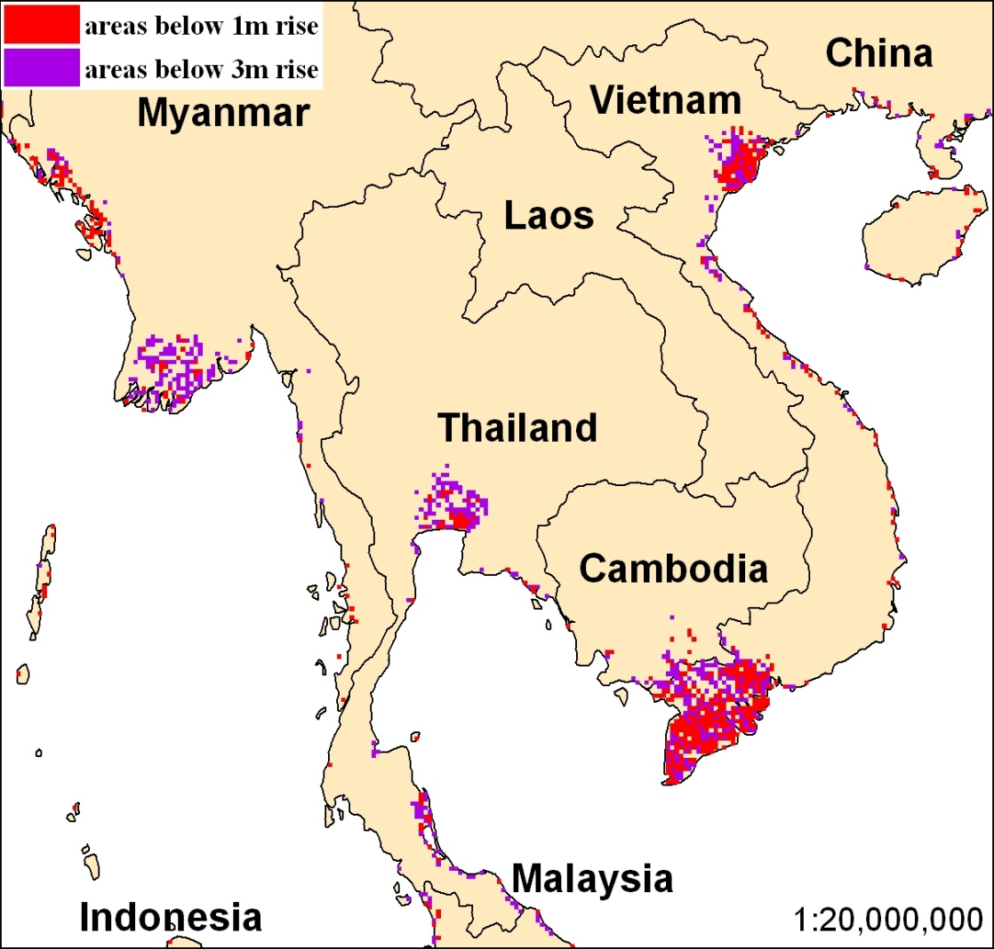
Lost agricultural area from sea level rise
 | With 1 meter rise (‘000 ha) | With 3 meter rise (‘000 ha)
Myanmar | 295 | 1,214
Thailand | 199 | 796
Cambodia | 35 | 118
Vietnam | 2,513 | 4,281
30% of Vietnam rice growing area!!!
Source: Nelson 2010.
How much rice growing area will Bangladesh lose??
Notes:
Reference: Shenggen Fan, IFPRI, http://www.slideshare.net/shenggenfan/climate-change-agriculture-and-food-security-4055009
Key Message: A 1-2 meter rise is expected by the end of this century.
Note that Vietnam effect doesn’t account increased salinity but it is already becoming a problem, even before much sea level rise has taken place. Nor do these vulnerability maps include flooding from peak tides, storm surge, and freshwater flooding, and ignore land surface elevations, which are dropping due to subsidence and sediment starvation.
Flooding due to climate variability is a significant problem for rice farming, especially in the lowlands of South and Southeast Asia. Flooding already affects about 10 to 15 million hectares of rice fields in South and South East Asia, causing an estimated $1 billion USD in yield losses per year. These losses could increase considerably given sea level rise as well as an increase in the frequencies and intensities of flooding caused by extreme weather events (Bates et al. 2008).

Slide 71
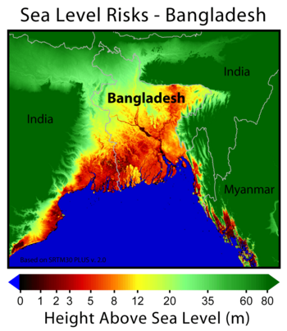
Bangladesh: Worst Affected by Sea Level Rise
Bangladesh will probably be one of the most negatively affected by sea level rise.
This is due to it's low land levels and high population in areas close to the sea.
Notes:
Reference: American University; https://www.google.com/search?q=Loss+of+land+in+Bangladesh+due+to+sea+level+rise&hl=en&gl=us&authuser=0&tbm=isch&source=lnms&sa=X&ved=0ahUKEwiE77PevcrQAhVEuI8KHWUKDaMQ_AUICCgB&biw=1821&bih=799&dpr=1#imgrc=NvIyYdPtJprw5M%3A

Slide 72
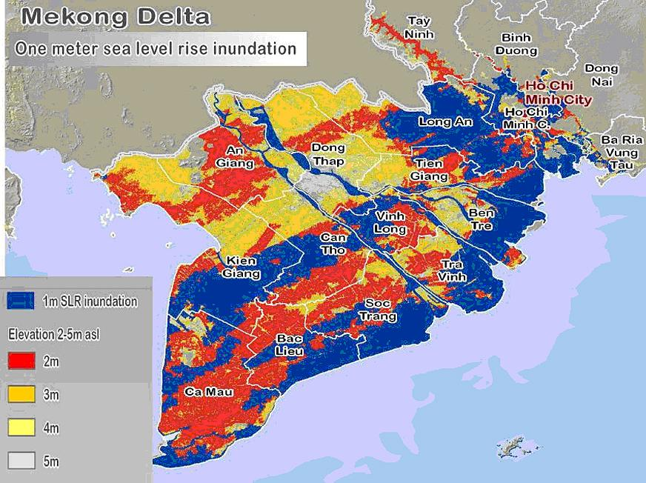
Lower availability of agriculture land
Sea level rise results in loss of agriculture land by salt invasion, increased flooding and sea water inundation.
For example, in the Mekong Delta, very substantial areas of agricultural land and capacity will be lost with just 1 meter of sea level rise.
Notes:
Reference: http://vietbao.vn/Khoa-hoc/Viet-Nam-chiu-anh-huong-ra-sao-boi-bien-doi-khi-hau/20763910/188/
There are at least three mechanisms that cause the loss of agricultural land due to sea level rise: (1) invasion by salt water, (2) increased frequency and duration and severity of flooding, and (3) inundation of land making it unusable.
Salt invasion usually happens first and is already happened in large delta areas such as the Mekong and Bangladesh.
In some cases not only rice cultivation but also other product cultivation such as shrimp can be effected. For long time, the land is converted to a marine environment and humans must relocate.

Slide 73
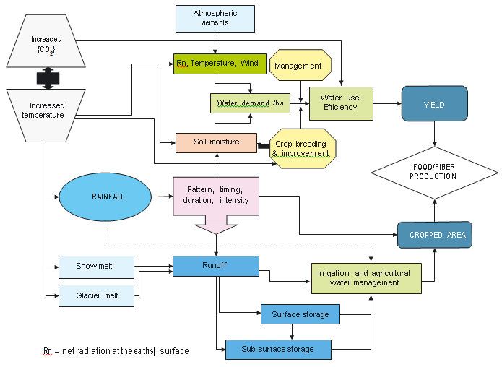
Local Stability Issues
The agricultural production cycle, as impacted by climate change (FAO 2008)
Notes:
Reference: FAO 2008. Climate Change, Water, and Food Security. http://www.fao.org/3/a-i2096e.pdf
This is an "influence diagram" that shows the factors that can affect agricultural production. Clearly, there are many factors and many of the are interrelated with other factors.

Slide 74
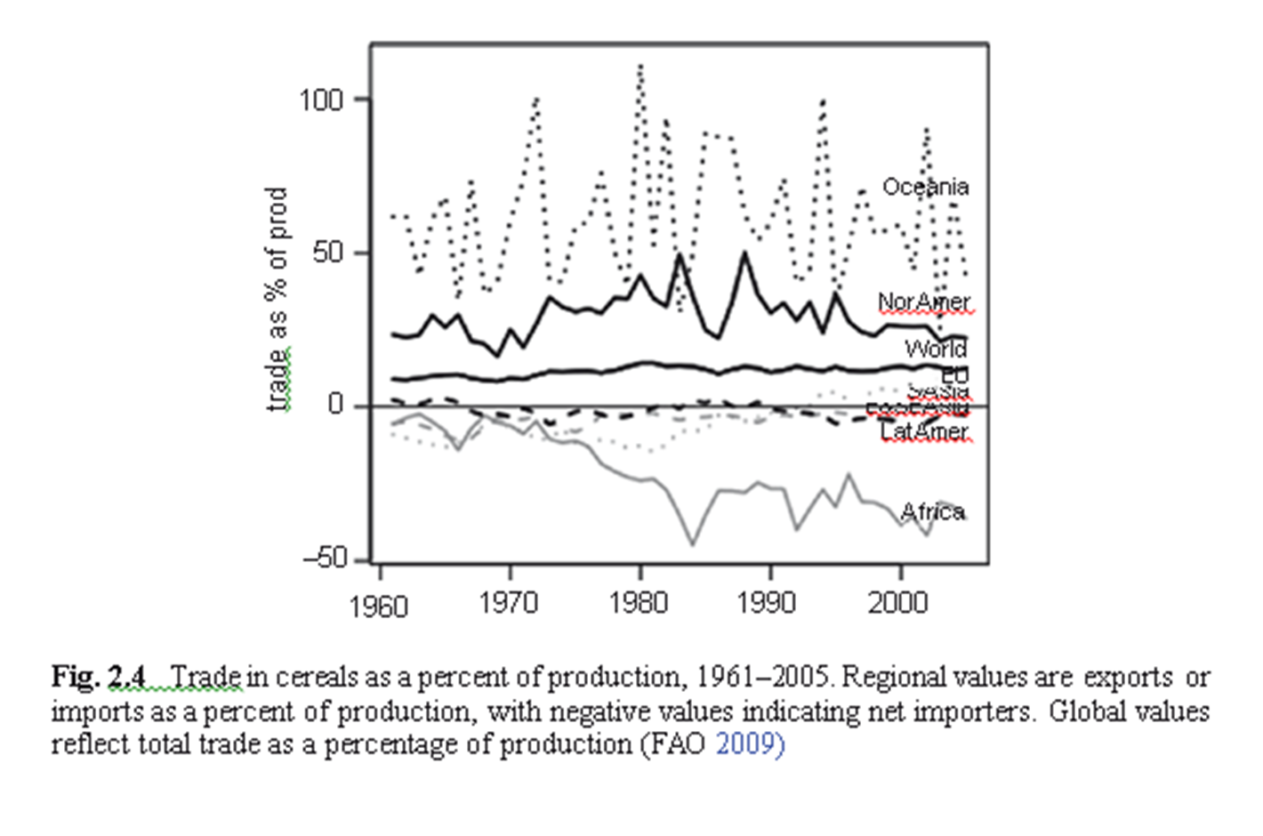
Global Availability Issues
Notes:
Reference: Lobel, D. a. (2009). Climate Change and Food Security: Adapting Agriculture to a Warmer World. Advances in Global Change Research. Springer.
Uneven distribution of food availability in different regions of the world. Climate change may even affect the availability of food to be worse in some areas, e.g., Africa.

Slide 75
Key points – Climate change impacts on agriculture
Physiological heat and drought stress limits will shift where particular crops can be grown
Crop yields are projected to decline in the coming century particularly in the least developed countries
C3 crops may respond more positively to increasing atmospheric CO₂
Weeds, pests, and fungi may become more prevalent and harder to control in a warmer world.
Notes:
Review of key points.

Slide 76
What are the “projected” crop yield changes by the end of the 21st Century ?

Slide 77
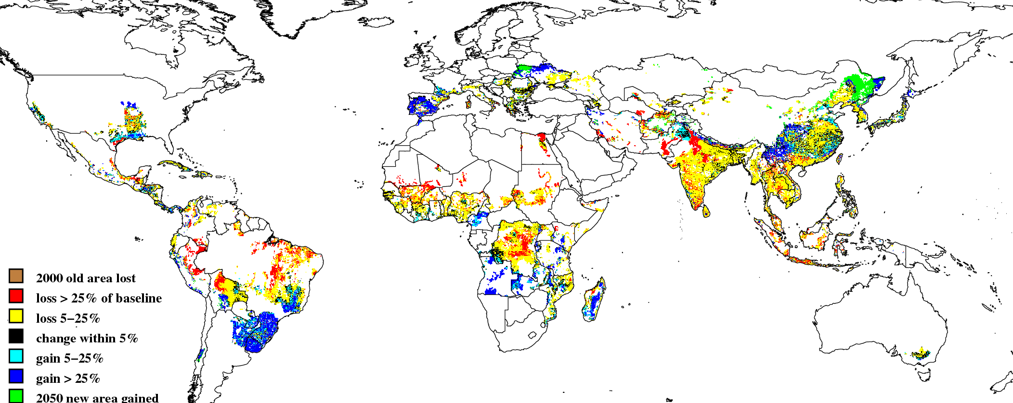
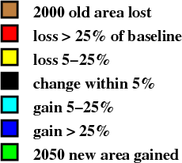
Irrigated rice yields
NCAR A2
Source: M. Rosegrant 2010
Notes:
Reference: Shenggen Fan, IFPRI, http://www.slideshare.net/shenggenfan/climate-change-agriculture-and-food-security-4055009
Explain the projected change in world irrigated rice yields in the 2050.

Slide 78
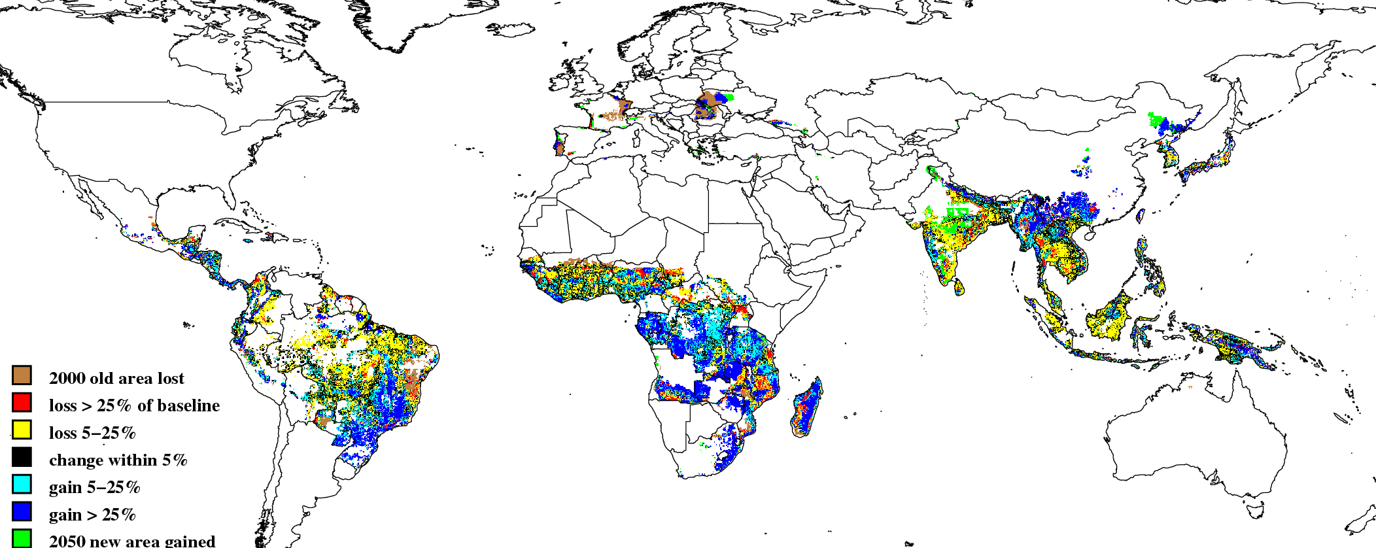
Rainfed rice yields
NCAR A2
Source: M. Rosegrant 2010
Notes:
Reference: Shenggen Fan, IFPRI, http://www.slideshare.net/shenggenfan/climate-change-agriculture-and-food-security-4055009
Explain the projected change in world rainfed rice yields in the 2050.

Slide 79
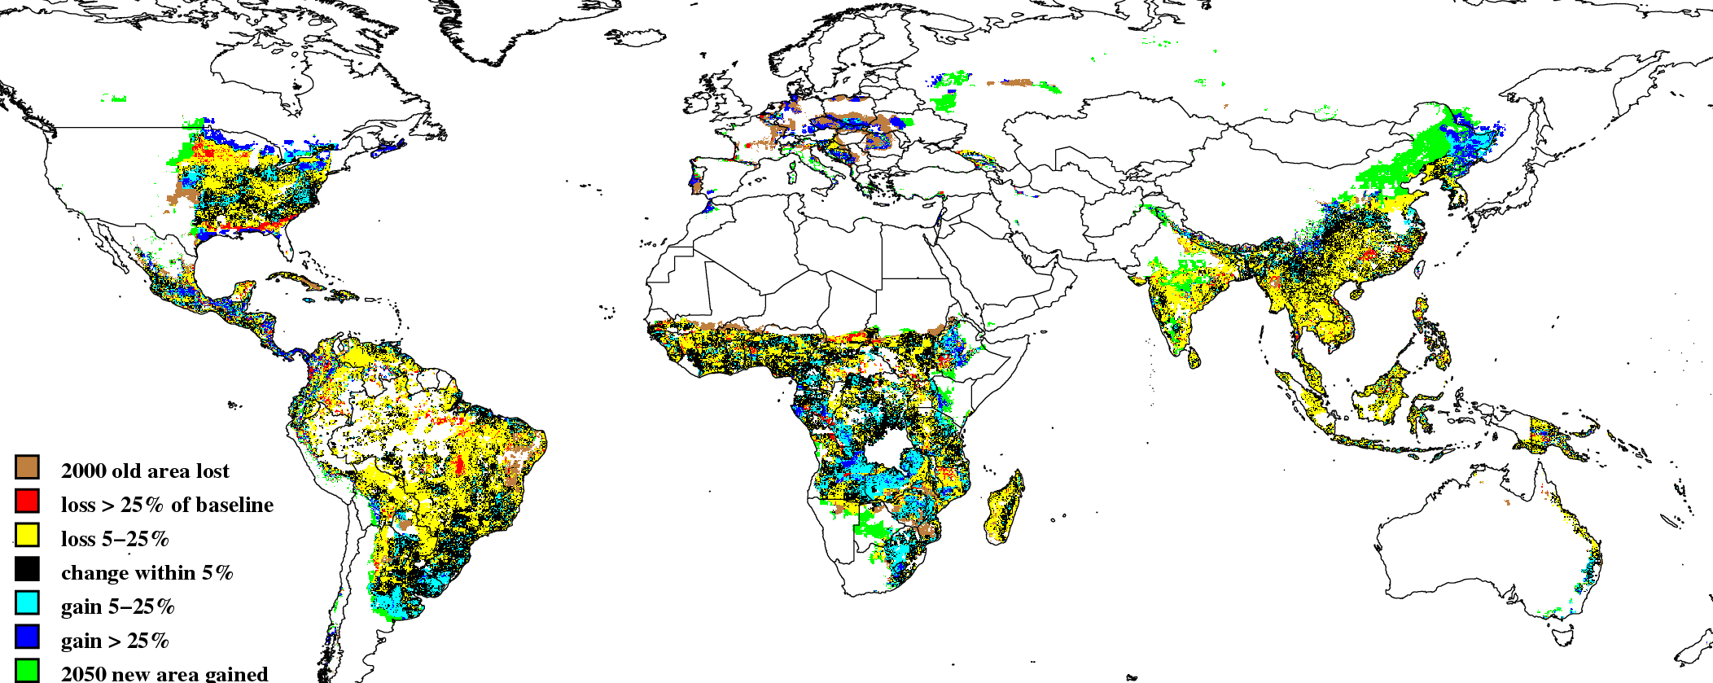
Rainfed maize yields
NCAR A2
Source: M. Rosegrant 2010
Notes:
Reference: Shenggen Fan, IFPRI, http://www.slideshare.net/shenggenfan/climate-change-agriculture-and-food-security-4055009
Explain the projected change in world rainfed maize yields in the year 2050.

Slide 80
Climate change is likely to make some fish species go extinct in the tropics. Fish predicted to be moving north.
This map shows hotspots of local extinction for fish and marine invertebrates between the years 2000 and 2050, under the worst-case climate change scenario of three degrees of warming by 2100. Red indicates the highest rates of local extinctions, and blue indicates the lowest rates. (Image credit: Jones and Cheung, 2014, ICES Journal of Marine Science) From Yale Environment
Notes:
http://e360.yale.edu/digest/climate_change_to_make_many_fish_species_locally_extinct_in_tropics_study_says/4273/
13 OCT 2014: CLIMATE CHANGE TO MAKE MANY
FISH SPECIES EXTINCT IN TROPICS, STUDY SAYS
Climate change is likely to drive fish and marine invertebrates toward the poles and cause extinctions near the tropics, according to researchers at the University of British Columbia. Under the conservative climate change scenario of one degree Celsius of warming by 2100, the 802 species modeled in the study are predicted to move away from their current habitats by as much as 9 miles, or 15 kilometers, every decade — a rate similar to what scientists have observed over the past few decades. Under the worst-case scenario of three degrees of warming, the researchers predict marine species will move toward the poles at a rate of 26 kilometers per decade. Under that scenario, an average of 6.5 species per 0.5 degrees of latitude would become locally extinct closest to the equator. The shifts will be caused by the species' reactions to warming waters, changing ocean chemistry, and ecosystem structure near the tropics, as well as new habitats opening up nearer the poles, the researchers say.

Slide 81
Exercise
A previous slide shows Sea Level Rise Risks scenario for southern part of Vietnam.
Can you find, or build such a map for Bangladesh?
Tool: GIS is applicable? Can you find the data layers? How would you go about looking for them? Who would you contact? Could you produce some useful information somehow?
Notes:
This is an exercise relevant in areas where SLR is an impact mechanism, and is optional.

Slide 82
Read and Discuss
ICE Case Studies. Number 265, December, 2011
The Impacts of Climate Change on the Mekong Delta
Katie Padilla
http://www1.american.edu/ted/ICE/mekong-migration.html
Discuss this paper.
Do you agree with the concepts and conclusions?
Are any important influences missing?
How could this be applied to other deltas and agricultural areas?

Slide 83
Read and Discuss
Pages 105-138 in “Turn Down the Heat” World Bank 2012
Discuss this section.
What are the primary impacts to agriculture from climate change?
What are the mechanisms of impact?
What can be done to adapt?

Slide 84
Potential options to mitigate or adapt to the effect of climate change on agriculture and food security
Notes:
Now, we have to identify the potential options….We can not ignore what will happen with our croplands, no land to cultivate, decreasing crop production. So confronting with the effect of climate change on agriculture and food supply, adaptation is unavoidable. What is difference between mitigation and adaption? Both are to repsonse action
Mitigation: the actions taken to reduce the severity. Mitigation refers to any strategy or action taken to remove the GHGs released into the atmosphere, or to reduce their amount.
Adaptation: “responsive adjustment to an environmental condition”.Adaptation refers to the ability of a system to adjust to climate change in order to reduce its vulnerability, and enhance the resilience to observed and anticipated impacts of climate change (involving changes in social and environmental processes, perceptions of climate risk, practices and functions to reduce risk, exploration of new opportunities to cope with the changed environment)

Slide 85
Discussion Questions:
What are the major mitigation or adaptations to increase agriculture productivity under climate change stress in Bangladesh?
What are the issues of food availability affected by climate change at both local and global levels?
Notes:
Take 3 minutes

Slide 86
Mitigation and adaptation to climate change for agriculture and food security
What should we do to our croplands considering the changes that are expected?
Let it happen? Can we ignore it?
How do we live with it?
What can we do to lessen the impact to people and society?
Some scientists argue that genetically modification (transgenic) is the only way to address CC in agriculture. Do you agree?
Notes:
Confronting the effect of climate change on agriculture and food supply. Adaptation is unavoidable.

Slide 87
Adaptation to agriculture and food security
CSIRO (2011)
Notes:
Reference: CSIRO
According to CSIRO (2011), this diagram shows adapting agriculture to climate change

Slide 88
Agricultural adaptation policy needs
Fund research that improves understanding of climate change and agriculture interactions
Invest in technology, infrastructure, data collection (e.g. high resolution spatially-explicit data), and institutional innovation
Support national and international institutions that foster resilience
Source: Rosegrant 2009
Notes:
Fristly, I would like to talk about supporting policies
- Agriculture should include in funds for adaptation that improve …….such as development policies for sustainable growth and climate-change adaption and support the important synergies between adaption and mitigation.
- Funding should also be available for technology, infrastructure and institutional innovations, and global data collection. Global data collection efforts are not yet up to the task and we urgently need more spending on data collection, especially high resolution spatially-explicit data. Equally important is that these data are disseminated freely and without restrictions on their use.

Slide 89
Agricultural mitigation policy needs
Include carbon sequestration from soil carbon in global carbon trading system
Fund development and implementation of low-cost monitoring systems
Allow innovative payment mechanisms and support novel institutions for agricultural mitigation
Create institutional innovations linking communities to global markets e.g. regional centers for carbon trading
Source: Rosegrant 2009
Notes:
Key message:
It is recommended that agriculture be included in carbon trading….
…. And linking communities to global markets – eg establish regional centers for carbon trading, deal with permanence issue in carbon sequestration.

Slide 90
Availability Adaptations for cropping systems (examples)
Managing water (irrigation)
Altering timing and location of cropping.
Diversification of crops (drought resistant variety, tolerant breeds)
Improving effectiveness of pest and disease management
The alteration of inputs
Wider use of technologies (less impact to CC)
Using climate forecasting
Citation
Howden, Mark S. et all "Adapting Agriculture to Climate Change." PNAS 104.50 11 Dec. (2007):
19691-96. Web. 13 Oct. 2012.
Notes:
Secondly, available options in agriculture such as:….
Source: Howden, Mark S. et al, 2007

Slide 91
Agriculture Adaptation Approaches
Agricultural research
  Crop breeding for irrigated and rainfed agriculture
  Biotechnology for stress-tolerant planting materials
Soil and water management
  Minimum tillage, integrated soil fertility management, water harvesting
Rural investment
  Rural infrastructure investment to improve access to markets, risk insurance, credit, inputs
Source: Rosegrant 2009
Notes:
91
After water demand for different sectors

Slide 92
Adaptation measures differ by country in Africa
Notes:
Reference: Shenggen Fan, IFPRI, http://www.slideshare.net/shenggenfan/climate-change-agriculture-and-food-security-4055009. Original Source: M. Rosegrant, 2010.
Adaption methods for Africa

Slide 93
Case studies on Agriculture Adaptation to CC
10 Pioneer projects have already implemented on climate change adaptation to agriculture in Thailand.
Examples are:
  Develop rice cultivation practices to fit with changes in growing season (e.g., growing a short grown rice) (Southern).
  Dealing with heat stress on orchard area (e.g., applying shading net) (Central)
  Dealing with water deficit by having a small/village reservoir (North-eastern)
http://www.greennet.or.th/article/1027
Notes:
Messages: What projects has Bangladesh implemented??

Slide 94
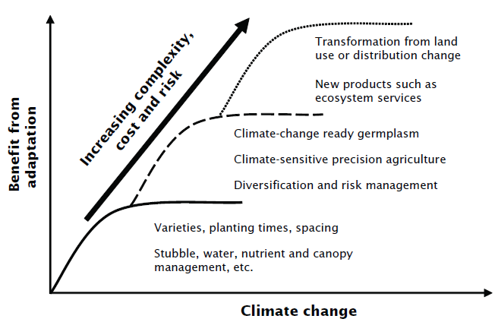
Adaptation to agriculture and food security
CSIRO (2011)
Notes:
Reference: CSIRO (2011) Adapting agriculture to climate change http://www.csiro.au/Outcomes/Climate/Climate-Change-Book/Chapter-7-Adapting-agriculture-to-climate-change.aspx
Key message:
This graph describes how to access the benefit from various adaptive agricultural strategies. There are many adaptive strategies in agriculture and food security to climate change
CSIRO (2011) Adapting agriculture to climate change

Slide 95
Invest in climate change adaptation and mitigation
Annual expenditure to counteract climate change effects on child nutrition by 2050 (million 2000 US$)
 | Sub-Saharan Africa | South Asia | Developing countries
Agric. research | 314 | 172 | 1,316
Irrigation expansion | 537 | 344 | 907
Irrigation efficiency | 187 | 999 | 2,158
Rural roads | 2,015 | 17 | 2,737
Total | 3,053 | 1,531 | 7,118
.
Notes:
Reference: Nelson et al. (IFPRI) 2009. Climate Change: Impact on Agriculture and Costs of Adaptation http://www.ifpri.org/sites/default/files/publications/pr21.pdf

Slide 96
Agricultural adaptation policy needs
Fund research that improves understanding of climate change and agriculture interactions
Invest in technology, infrastructure, data collection (e.g. high resolution spatially-explicit data), and institutional innovation
Support national and international institutions that foster resilience
Source: Rosegrant 2009
Notes:
Reference: Shenggen Fan, IFPRI, http://www.slideshare.net/shenggenfan/climate-change-agriculture-and-food-security-4055009
Key message:
- Negotiating outcomes should include agriculture in funds for adaptation. They should recognize the connection between pro-poor development policies for sustainable growth and climate-change adaption and support the important synergies between adaption and mitigation.
- Funding should also be available for technology, infrastructure and institutional innovations, and global data collection. Global data collection efforts are not yet up to the task and we urgently need more spending on data collection, especially high resolution spatially-explicit data. Equally important is that these data are disseminated freely and without restrictions on their use.

Slide 97
Agricultural mitigation policy needs
Include carbon sequestration from soil carbon in global carbon trading system
Fund development and implementation of low-cost monitoring systems
Allow innovative payment mechanisms and support novel institutions for agricultural mitigation
Create institutional innovations linking communities to global markets e.g. regional centers for carbon trading
Source: Rosegrant 2009
Notes:
Reference: Shenggen Fan, IFPRI, http://www.slideshare.net/shenggenfan/climate-change-agriculture-and-food-security-4055009
Key message:
It is recommended that agriculture be included in any mitigation funding modalities, with funds available for development and implementation of low-cost monitoring systems and that allow innovative payment mechanisms to address the characteristics of agriculture, especially in developing countries, where small producer predominate and legal institutions are not always fully effective. The principle of common by differentiated responsibilities implies that any funding should support mitigation of agricultural emissions by the poorest but as countries progress and their incomes rise, the burden of mitigation should be adjusted too.
5) Linking communities to global markets - Establish regional centers for carbon trading, specialized business services and local intermediaries. Simplify standards for small-scale projects. Deal with permanence issue in carbon sequestration.

Slide 98
Global Accessibility Adaptations
Increase production and exports of food from temperate areas
Reduce current loss and waste of food
  improve technology and investment in food production and processing systems

Slide 99
Local Accessibility Adaptations
Physical Access:
  Shift your diet
  Grow your own food
  Buy locally sustainably grown foods
Economic Access:
  Increase government programs
  Food assistance, school meals
  Increase donations to food charities
  Reduce loss and waste of food
Notes:
These show some individual as well as public adaptation opportunties

Slide 100
Local Utilization Adaptations
Changing crops and technology
  Increase heat resistance
  Crops that are well suited to the area
  Crops that are well suited to the future predictions of the area
  Use poly-culture instead of monoculture
Changing land use
Keeping food local (growing and eating for a local market)
changing diet
Climate aware planning
Enhanced education and outreach
Notes:
These show some individual as well as public adaptation opportunties

Slide 101
Review of primary concepts in food security and climate change
Climate change will impact the ability of certain areas to provide food.
The impacts of climate change on food production are likely to be inequitably distributed.
There are many adaptations that can help reduce the impacts of climate change on food security.
Notes:
Message:
Climate change will impact food security. Impacts are not going to be equitable, or consistent and adaptation and mitigation can offset potential negative impacts

Slide 102
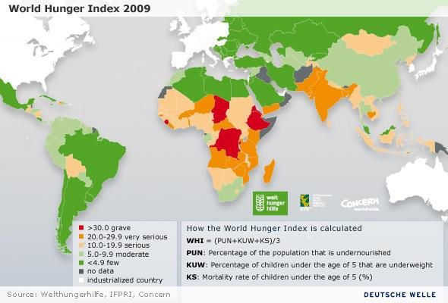
Exercise: Discussion
Propose appropriate measures and approaches to mitigate the effects of climate change on food security in 2 orange or red countries on the map.
Notes:
Reference: von Grebmer et al. 2009 http://www.dw.de/feeding-the-world-in-years-to-come/a-4792057

Slide 103
Sample Test Questions
What regions are the most vulnerable to food security?
Describe how climate change influences crop yield.
How have yields changed during the last few decades?
Is this correlated with warming? What else?
Describe at least 3 measures that can improve food security at the local and global level.

Slide 104
Case Study
Global scale-crop yield relationships and the impacts of recent warming
Video:
Global warming reduce plant productivity
How to feed the world in 2050
http://www.youtube.com/watch?v=gjtIl5B1zXI

Slide 105
Instructor Review of Materials
What was useful?
What is missing?
How did you, or would you, modify the materials to make them better fit your instructional context?
Please share your experience and modifications here: climatecurriculum@googlegroups.com

Slide 106
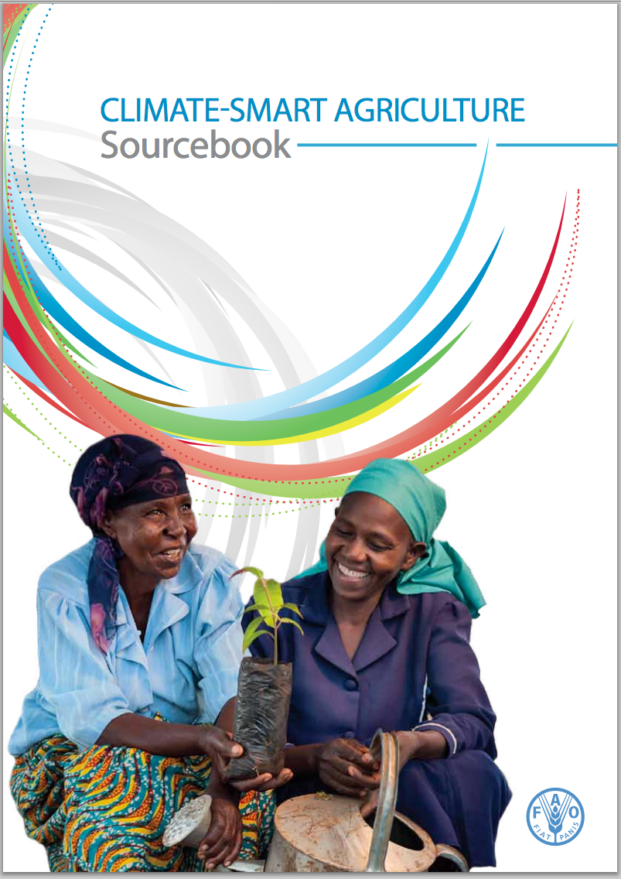
Key Reference
In BCC References and available at http://www.fao.org/docrep/018/i3325e/i3325e.pdf
Notes:
http://www.fao.org/docrep/018/i3325e/i3325e.pdf

Slide 107
References and Reading
Alexandratos N, Bruinsma J. 2012. World agriculture towards 2030/2050, the 2012 revision. ESA Working Paper No. 12-03, June 2012. Rome: Food and Agriculture Organization of the United Nations (FAO). (Available from http://www.fao.org/docrep/016/ap106e/ap106e.pdf)
Lobell DB, Schlenker W, Costa-Roberts J. 2011. Climate trends and global crop production since 1980. Science 333(6042):616-620.
Lobell DB, Field CB. 2007. Global scale climate—crop yield relationships and the impacts of recent warming. Environmental Research Letters 2:1-7. (Available from http://iopscience.iop.org/1748-9326/2/1/014002/pdf/1748-9326_2_1_014002.pdf
Gerald C. Nelson, et al.2009. Climate change impact on Agriculture and Cost of adaptation. IFPRI
Rodomiro Ortiz, et ,al. 2008. Climate Change: Can wheat beat the heat? Agriculture, Ecosystems and Environment 126(2008)46-58.

Slide 108
References and Reading
Thomas W. Hertel et, al. 2010. The poverty implication of climate-induced crops yields change s by 2030. Global Environmental change, 20(2010)577-585. Journal homepage: www.elsevier.com/loate/gloenvch
Thornton PK, PG Jones, Gopal Alagarswamy, Jeff Andresen, Mario Herrero. 2010. Adapting to climate change: agricultural system and household impacts in East Africa. Agricultural Systems 103:73–82.
Thornton P, Cramer L, eds. 2012. Impacts of climate change on the agricultural and aquatic systems and natural resources within the CGIAR’s mandate. Copenhagen: CCAFS Working Paper 23. CGIAR Research Program on Climate Change, Agriculture and Food Security. (Available from http://cgspace.cgiar.org/handle/10568/21226)
  Adger N, 1999 Social vulnerability to climate change and extremes in coastal Vietnam. World Dev. 27, 249–269. doi:10.1016/S0305-750X(98)00136-3. CrossRefWeb of Science
  Pandey S, Bhandari H, Hardy B. 2007. Economic costs of drought and rice farmers’ coping mechanisms: a cross-country comparative analysis. Manila: International Rice Research Institute. (Available from http://dspace.irri.org:8080/dspace/bitstream/123456789/951/1/9789712202124.pdf
  Bates BC, Kundzewicz ZM, Wu S, Palutikof JP, eds. 2008. Climate Change and Water. Technical Paper of the Intergovernmental Panel on Climate Change. Geneva: IPCC. (Available from http://www.ipcc.ch/pdf/technical-papers/climate-change-water-en.pdf)
  Howden, Mark S. et all "Adapting Agriculture to Climate Change." PNAS 104.50 11 Dec. (2007): 19691-96. Web. 13 Oct. 2012
  Brett Harris , 2009. How Climate Change Threatens Food Security. climateandcapitalism.com http://climateandcapitalism.com/2009/01/22/how-climate-change-threatens-food-security

Slide 109
References and Resources
The curriculum of USAID’s Climate-Resilient Ecosystems and Livelihoods (CREL) in Bangladesh is a free resource of teaching materials for university professors, teachers and climate change training experts.
Reproduction of CREL’s curriculum materials for educational or other non-commercial purposes is authorized without prior written permission from the copyright holder, provided the source is fully acknowledged.
Suggested citation: USAID. 2016. Bangladesh Climate-Resilient Ecosystem Curriculum (BACUM). USAID‘s Climate-Resilient Ecosystems and Livelihoods (CREL) Project. Winrock International. Dhaka, Bangladesh.
Disclaimer: The CREL’s curriculum is made possible by the support of the American People through the United States Agency for International Development (USAID). The contents of the curriculum do not necessarily reflect the views of USAID or the US Government.

Slide 110
USAID's Climate-Resilient Ecosystems and Livelihoods (CREL) Project
Winrock International
House 13/B, Road 54, Gulshan 2, Dhaka 1212
Bangladesh
Tel: +880-2-9848401 www.winrock.org

