Slide 1
Bangladesh Climate-Resilient Ecosystem Curriculum (BACUM)
Module 1: Introduction to Climate Change

Slide 2
Module 1: Introduction to Climate Change
SECTION II: IMPACTS OF CLIMATE CHANGE ON PEOPLE AND THE ENVIRONMENT
2.1. Introduction to Climate Change Impacts

Slide 3
Introduction to Climate Change (ICC)
HOW AND WHY THE CLIMATE IS CHANGING
1.1. Introduction to Climate Science and Climate Change
1.2. Causes of Climate Change
1.3. Climate Intensification: Floods, Droughts and Cyclones
IMPACTS OF CLIMATE CHANGE ON PEOPLE AND THE ENVIRONMENT
2.1. Introduction to Climate Change Impacts
2.2. Sea Level Rise
2.3. Climate Change and Water Resources
2.4. Climate Change and Food Security
2.5. Climate Change and Human Health
2.6. Climate Change and Terrestrial Ecosystems
RESPONSES TO CLIMATE CHANGE – MITIGATION AND ADAPTATION
3.1. Climate Change and Forest Management
3.2. Climate Change and Water Resources: Responses and Adaptation
3.3. Principles and Practices of Climate Vulnerability Assessment
3.4. Uncertainties in Climate Change
3.5. Climate Change and Ecosystem Services
3.6. Effective Communications in Climate Change

Slide 4
Acknowledgements
EXPERT CONTRIBUTORS | SPECIFIC INPUTS
Prof. (Dr.) Manzoor Rashid | Curriculum Development for all topics
Prof. (Dr.) Md. Danesh Miah | REDD+, Forest Carbon
Prof. (Dr.) Md. Jakariya | Community NR Management, Climate Change, Natural Resources Management
UNIVERSITIES
Bangladesh Agricultural University
University of Chittagong
Dhaka University
Independent University, Bangladesh
Khulna University
Noakhali University of Science and Technology
Shahjalal University of Science and Technology
Sher-e-Bangla Agriculture University
North South University
CREL STAFF | CREL STAFF
John A Dorr | Utpal Dutta
Abu Mostafa Kamal Uddin | Ruhul Mohaiman Chowdhury
Kevin T. Kamp | Rahima Khatun
Paul Thompson | Sultana Razia Zummi
Abdul Wahab | Shams Uddin
Shahzia Mohsin Khan
DESIGN, LAYOUT AND CONTENT DEVELOPMENT: Ms. Chi Pham, Curriculum Development Expert, Bangkok, Thailand

Slide 5
Learning Objectives
At the end of this session, students will be able to:
Differentiate between climate change and climate impacts
Explain how climate impacts are discerned
Analyze how impacts of climate change on natural and human systems and differently impacts on men and women.
Explain what impact pathways are, how to discern and evaluate them
Notes:
Discussion – guided open discussion, try to give everyone a chance to speak:
Prompts/questions to raise for students to respond to –
Within a game what decisions face the captain; between games what decisions face management (coach, captain, etc)?
What might they consider?
What are the uncertainties they face?
What are the complexities?
Do they experiment?
Is there incremental learning? – does what happened in one game or series influence future decisions?
Is this learning by chance or do they follow a method or process?

Slide 6
Outline
Climate change impacts and SE Asia
What is a climate impact?
Cumulative and combined effects
Confidence in projections and impacts
Determining climate impacts
Examples of climate impacts
Notes:
Discussion – guided open discussion, try to give everyone a chance to speak:
Prompts/questions to raise for students to respond to –
Within a game what decisions face the captain; between games what decisions face management (coach, captain, etc)?
What might they consider?
What are the uncertainties they face?
What are the complexities?
Do they experiment?
Is there incremental learning? – does what happened in one game or series influence future decisions?
Is this learning by chance or do they follow a method or process?

Slide 7
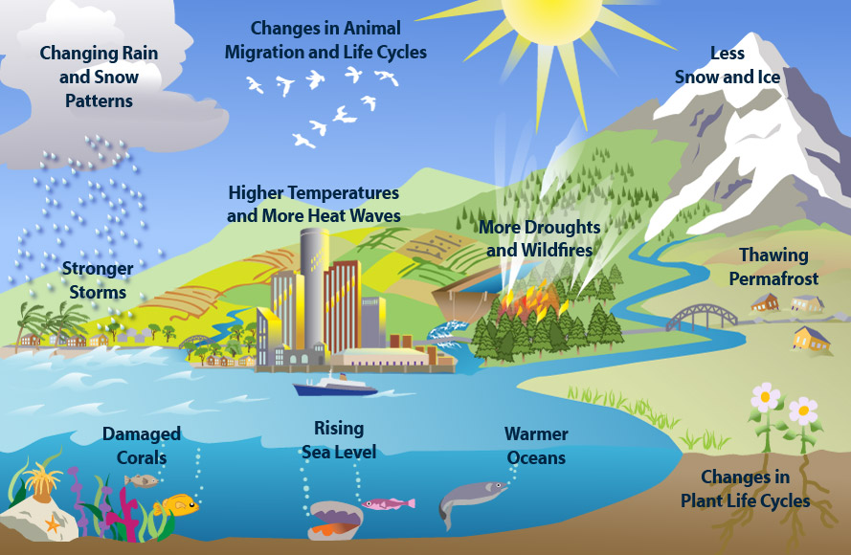
Climate Change Impacts
Notes:
Key Message:
There are many listings and illustrations of climate impacts in the literature
But local differences can be great and highly significant
For a good listing of South Asian and South East Asian Impacts, see “Turn Down the Heat” publications by the World Bank, 2012.
NOTE: “climate impacts” is the same as “climate change impacts” – no difference. You may use either term, but try to be consistent.
Reference: Image from: http://africagreenmedia.co.za/south-africa-to-store-co2-underground/

Slide 8
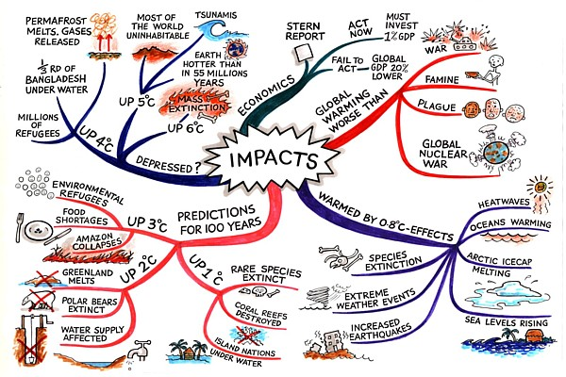
Mind Map of Climate Change Impacts
Notes:
Key Messages:
Here is an example of a graphical depiction of climate change impacts.
There are 5 key areas of impact on this graphic. On the left side the top Blue Line depicts a change in 4-6 degrees and the significant impacts, including mass extinction! The Red Line on the bottom left shows impacts expected for a 1-3 degree increase in global temperature with significant, but less impacts. The Blue Line on the right bottom shows a 0.8 degree rise in temperature. The top right Red Line is a general outcome of the impact of global climate change.
Reference: Source: http://www.mindmapart.com/climate-impacts-mind-map-jane-genovese/

Slide 9
What is a Climate Change Impact?

Slide 10
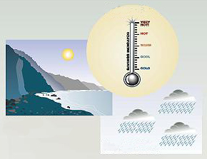
Impacts of Climate Change
Water resources
Water supply, water quality...
Consequences of climate change:
Forests
Composition, health and productivity...
Species and natural areas
Biodiversity, modification of ecosystems...
Agriculture and food security
Crop yields, irrigation demands...
Coastal areas
Erosion, inundation, cost of prevention...
For example:
Temperature increase
Sea level rise
More rain
Human health
Infectious diseases, human settlements...
Notes:
Key Message:
Have students suggest more examples of the impact of climate change on the environment and society.
It is important to note that not all effects are negative, and in some areas climate change would have a positive impact, such as extended growing seasons in agriculture.
However, in most cases and on a global scale the results are overwhelmingly negative.
If greenhouse gas concentrations keep rising, climatic changes are likely to result. Those changes will potentially have wide-ranging effects on the environment and socio-economic and related sectors, such as health, agriculture, forests, water resources, coastal areas and biodiversity.
Reference: http://www.globalchange.umich.edu/globalchange2/current/lectures/climate_change/climate_impacts.jpg

Slide 11
Climate change is a Risk Multiplier
Existing weather-related problems, stresses and risks are multiplied by climate change. For example:
Droughts
Floods
Cyclones
Shortage of suitable water supply
Flooding
Storm frequency and intensity and irregularity
Notes:
Key Message:
The types of risks are not new (with a few exceptions).
We have had them all along.
Most risks are intensified, and the values at risk are under greater threat due to climate change.

Slide 12
Modes of Climate Change
Changes in:
Average condition
Intensity
Return periods
Duration
Intensity
Timing of transition
Duration
Inter-annual min & max
Average condition
State shift to new ‘normal’
1
3
2
4
5
6
8
7
8
7
10
9
Notes:
Key Message:
Changes to the environment take a variety of forms.
It is important to know what mode or type of changes are occurring or projected.
For example, for flooding, the frequency (how often they occur), the timing (when they occur), Duration (how long they last), and intensity (how severe they are) all need to be defined.
Reference: Matthews & Matthews , 2012 – Vulnerability to what change? UNFCCC Technical Workshop on Water, Climate Change Impacts, and Adaptation Strategies, Mexico City, Mexico 18-20 July, 2012.

Slide 13
Cumulative and combined effects
Notes:
Key Message:
Climate changes influence vegetation, water, and disturbance frequencies, and these changes, in turn, influence one another. A change in one aspect causes a cascade of responses that in some cases counteract and in others magnify the initial change. Such interactions make prediction of the likely effects of climate change difficult at particular locations even if the nature of the climate change is known.
Ordinarily we rely on the past for evidence needed to predict the future, but when the context for a change is unprecedented, we must instead use our basic understanding of physical, ecological, and sociological processes and their interactions. At this point we can be certain that changes will occur, but we do not yet know the mode, timing, or magnitude of changes or environmental responses even at a regional scale.
Natural resource students and professionals will be required to assess and understand how effects occur, and this entails complexity and sophisticated analysis.
See Reid, CCRC

Slide 14
Changes and Impacts in Context
Notes:
Key Message:
Climate changes are cumulative effects and all changes of concern must be viewed in the context of cumulative effects.
Climate change can impact to and changing any concerns such as evapotranspiration, increasing drought, fire, flooding, vegetation structure, pattern and type, and snow melting rate.
Exercises:
Form groups of 4-6 students and study and discuss this and the next slides.
Reference: Michael Furniss, US Forest Service.

Slide 15
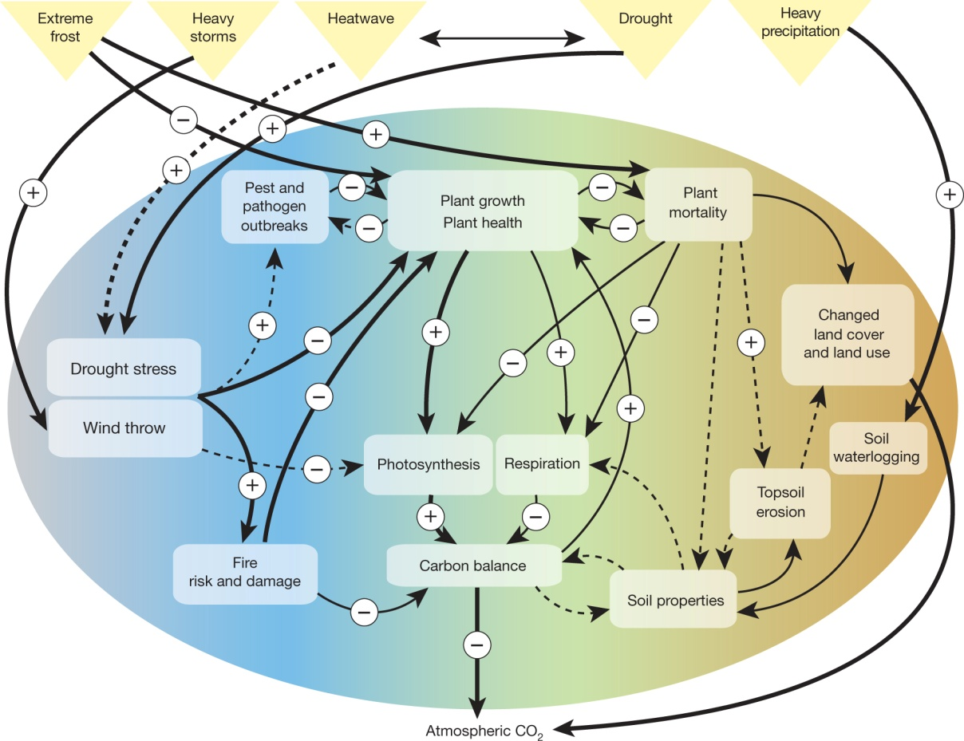
Processes and feedbacks triggered by extreme climate events
M Reichstein et al. Nature 500, 287-295 (2013) doi:10.1038/nature12350
Notes:
Key Messages:
Processes and feedback to climate impacts triggered by extreme climate events
The extreme events considered are droughts and heatwaves, heavy storms, heavy precipitation and extreme frost. Solid arrows show direct impacts; dashed arrows show indirect impacts. The relative importance of the impact relationship is shown by arrow width (broader arrows are more important).
Things get complicated, but must be considered. That is why you are in the University, to help the world sort out the complexity and inform our future decisions.
Reference: Reichstein, M. et al. 2013. Climate extremes and the carbon cycle. Nature. Vol 500: 287-295.

Slide 16
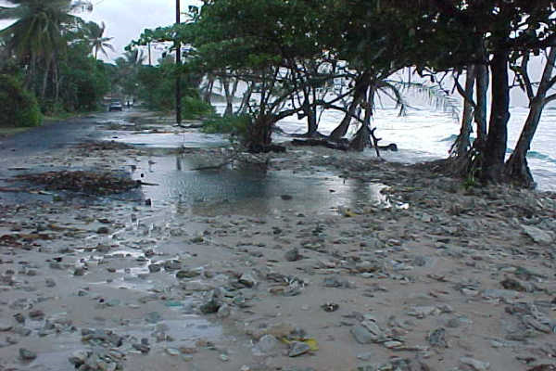
Effects that add up
For example, in terms of
coastal threats from the sea:
Sea Level rise
Storm surge
River flooding during higher tides
High erosive waves
Coastal erosion
All have negative impacts and are additive
Notes:
Key Message:
The same explanation as in the slide.
Image source: https://www.google.com/search?q=high+tide+damage&hl=en&gl=us&authuser=0&biw=1438&bih=631&tbm=isch&source=lnms&sa=X&ved=0ahUKEwj7mqyLl4fRAhUHvI8KHZZtD3cQ_AUIBigB&dpr=1#imgrc=P4E9CNzsceWugM%3A

Slide 17
Warm Up Exercise
Let students work in groups or pair on the following
List major impacts of climage change in Bangladesh
List major impacts of climate change to their own communities
Think of future options

Slide 18
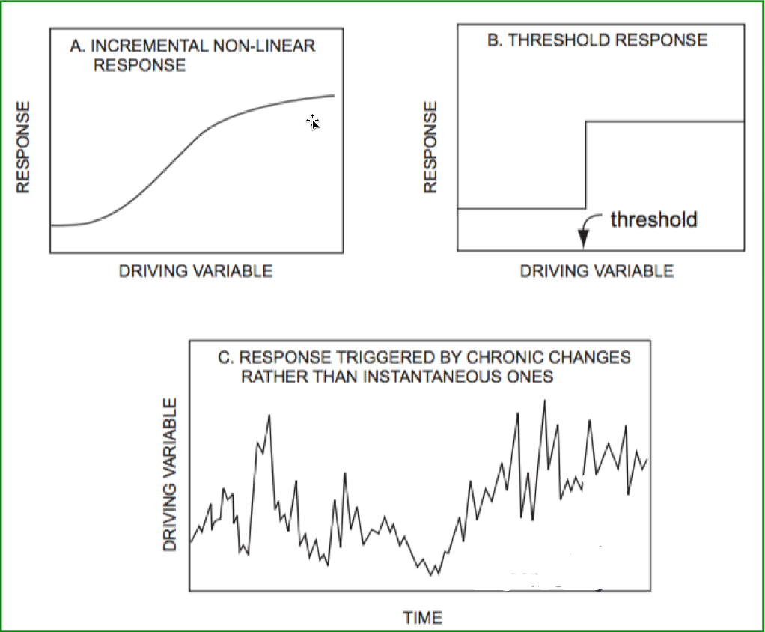
Types of system response
Notes:
Key Message:
How ecosystems and watersheds can respond to driving variables
“Response” can be, for example, proportion of channels gullied, fish population, water treatment costs, and so on.
“Driving variable” can be sediment input, peak flow discharge, length of active roads, or some other parameter.
Impact significance is sometimes evaluated against a “threshold of concern,” where levels of impact below a certain value are considered acceptable and higher levels are not. However, physical and biological systems usually respond incrementally to change (Fig. A) rather than experiencing true thresholds (Fig. B).
Even when a response involves a dramatic change in state, factors causing the change rarely exhibit a simple threshold. For example, an abrupt shift in channel pattern rarely results from a single year’s sediment input; annual variation in sediment input under undisturbed conditions would likely have included values characteristic of the altered input rate (Fig. C). Chronically increased inputs can increase the probability of channel disruption, but there is rarely a definable value at which response is certain.
Reference: Reid, Leslie M. 1993. Research and cumulative watershed effects. Gen. Tech. Rep. PSW-GTR-141. Albany, CA: Pacific Southwest Research Station, Forest Service, U.S. Department of Agriculture; 118 p.

Slide 19
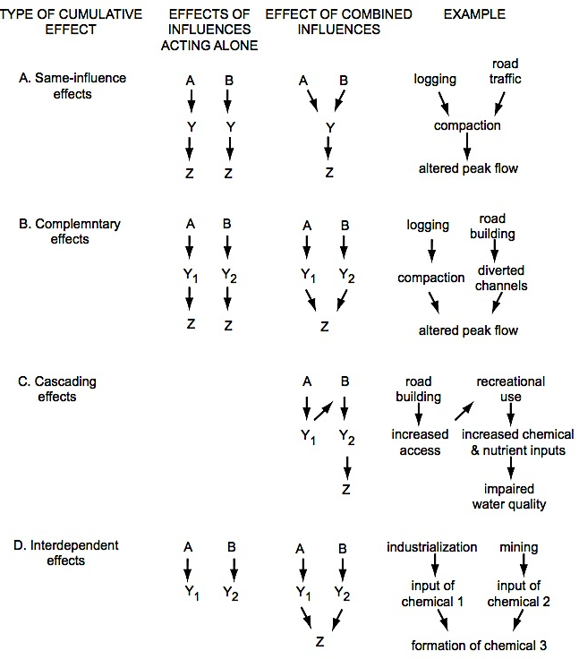
Types of cumulative effects
Notes:
Key Messages:
Combinations of influences that can generate cumulative effects.
Description: A and B are activities, Y is an environmental parameter, and Z is an impact.
Reference: Reid, Leslie M. 1993. Research and cumulative watershed effects. Gen. Tech. Rep. PSW-GTR-141. Albany, CA: Pacific Southwest Research Station, Forest Service, U.S. Department of Agriculture; 118 p.

Slide 20
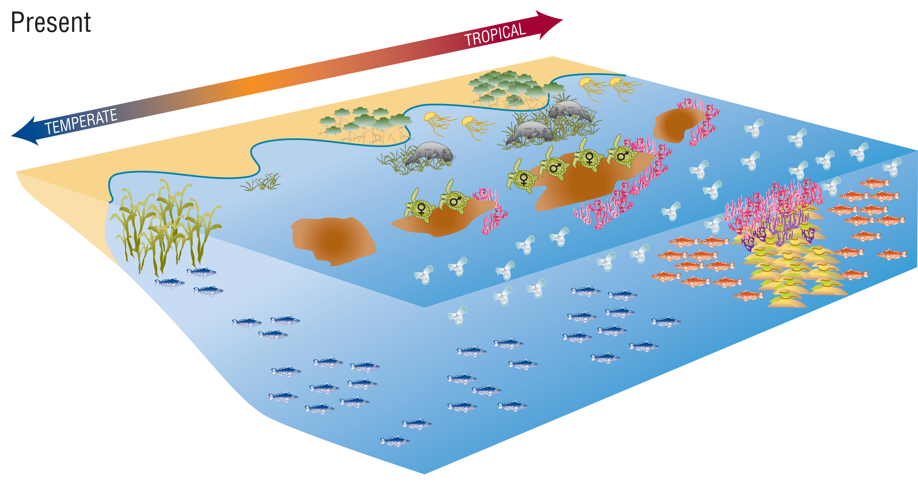
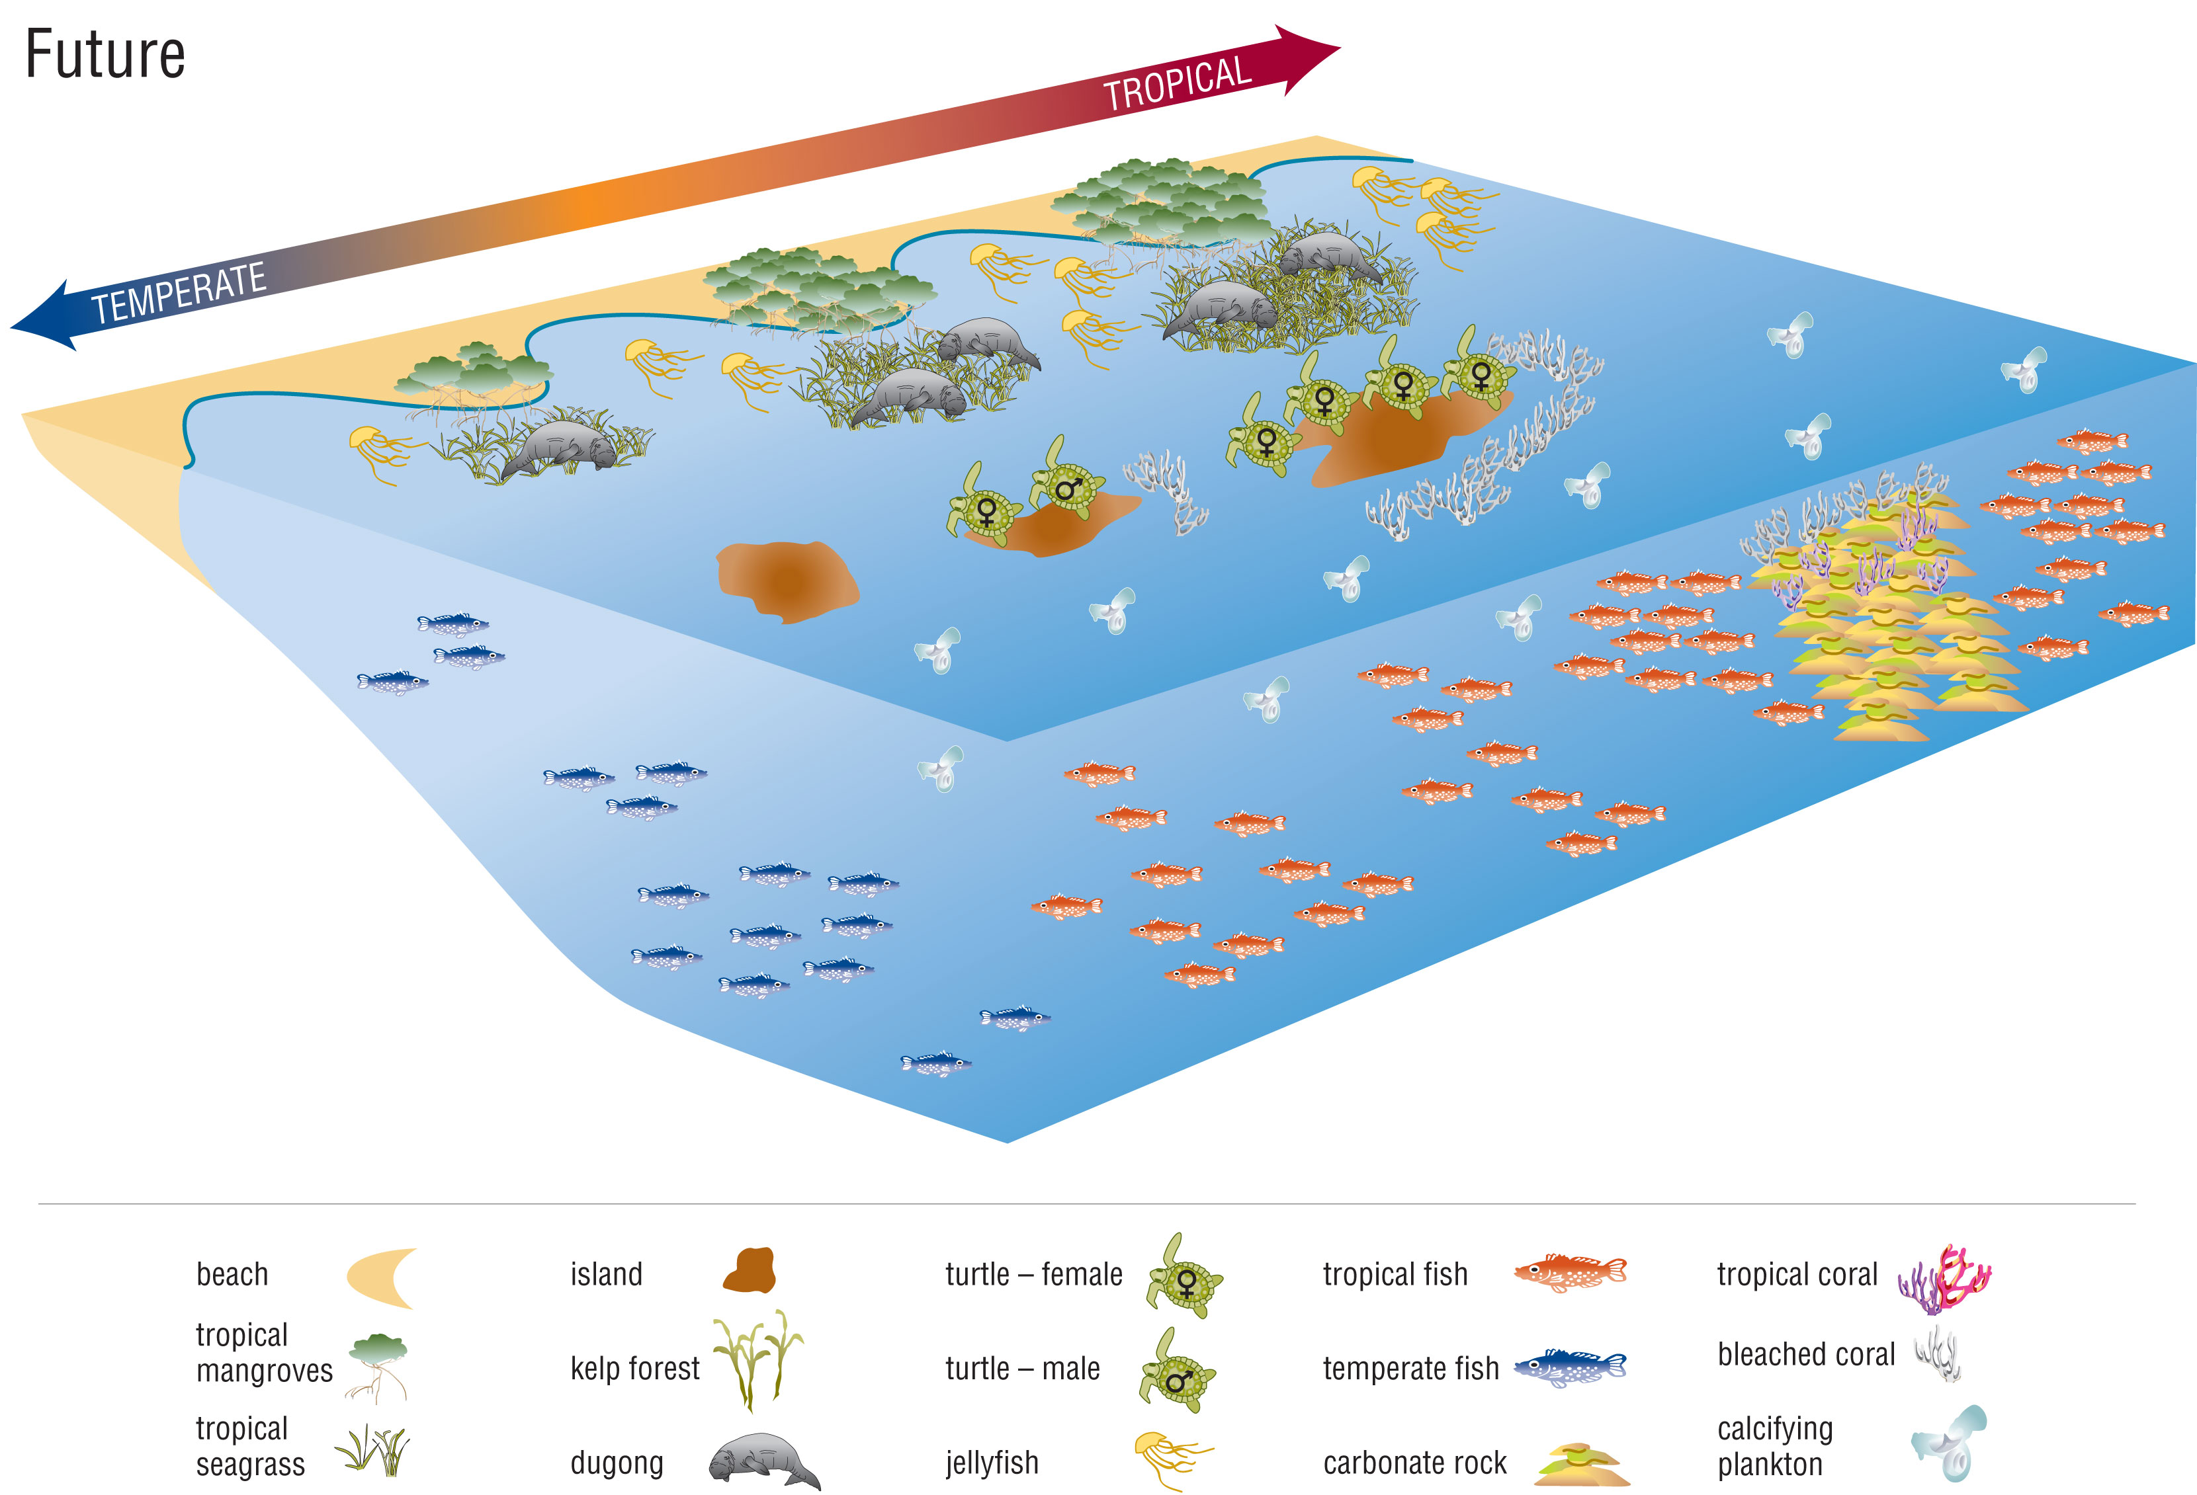
Impacts have an important time component. Most climate impacts are slow
How can water temperature change the environment?
Notes:
Key Messages:
This image shows that it takes time for impacts to propagate and show up in the environment.
There is a time component to impacts and it can be very important to know this, to anticipate effects and to discern changes.
Reference: Images copyright and courtesy of the Commonwealth Scientific and Industrial Research Organisation (CSIRO)
http://www.cmar.csiro.au/climateimpacts

Slide 21
Cascading Effects
Linked cumulative effects
More transpiration, less runoff ➔ shorter stream networks.
Warmer and windier ➔ Drier soils and veg ➔ More fires ➔ More sedimentation
+
Warmer water, more invasive species, less winter insulation by snow = Reduced fish populations, reduced food security, reduced aquatic biodiversity, and so on, even before we add population pressures, and other effects.
Environmental effects are almost never just one thing!!
Notes:
Key Messages:
Effects interact in complex ways that must be appreciated and considered.
Many effects cascade, have pathways of impact.

Slide 22
Cascade of Changes
Warmer temperatures ➔ Drier soils ➔ Drier vegetation ➔ More and larger fires ➔ More Erosion and Stream Sedimentation ➔ Less fish
➔ Less high-quality food.
What are the consequences of increased rainfall?

Slide 23
Class Activity - Irreversible Impacts
This can be done either with actual coins, or simply as a thought experiment .
Each student has one coin.
We will flip the coins repeatedly to get “heads” or “tails”.
There is only one rule: if the coin comes up ‘tails”, you may not flip it again. (indicates an irreversible change).
Now, flip your coins. Class raise hands for “heads”. Raise hands for “tails”. All take note of the distribution. Flip again (if you can). Show hands again. Repeat.
Discuss the implications of this for land development, forest management, groundwater management and other topics of interest to the class.
Key Message:
Irreversible impacts accumulate. This can lead to conditions that no one wants, simply being the consequence of repeated imposition of irreversible changes.

Slide 24
Impact pathways
Notes:
Reference: Image copyright by and courtesy of CSIRO. http://www.cmar.csiro.au/climateimpacts

Slide 25
Impact pathways, linked effects
Linked cumulative effects
For Example:
Drier soils ➔ less vegetal cover ➔ more erosion ➔ More sedimentation ➔ Less fish ➔ Decreased food security
More variable rainfall & More heavy rainfall & warmer temperatures ➔ Less robust rainfed agriculture ➔ Decreased food security
More demand for hydropower -> Reservoirs operated such that freshwater to deltas is decreased ➔ More saltwater intrusion

Slide 26
Feedback
Notes:
Reference: http://climatekids.nasa.gov/arctic-animals/

Slide 27
Class Activity
What are the problems and risks that climate change brings to:
Forests
Urban areas
Agricultural lands
How important do you judge each problem and risk for an area you are familiar with?

Slide 28
Climate Impact Modeling

Slide 29
Modeling vegetation change with a changing climate
Notes:
Notes: This graph shows the distribution of ponderosa pine trees, at the present time and predicting their distribution given a certain climate change (temperature) prediction.
Reference:
Rehfeldt et al. 2006. Empirical analyses of plant-climate relationships for the western United States. Int. J. Plant Sci 167(6): 1123-1150
http://www.fs.fed.us/rm/pubs_other/rmrs_2006_rehfeldt_g001.pdf

Slide 30
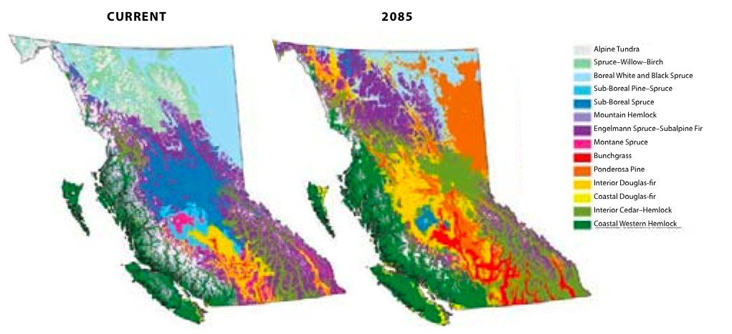
Impacts of climate change on forest composition: an example
Notes:
Reference: British Columbia Forest Service, Canada: http://www.for.gov.bc.ca/HRE/becweb/resources/classificationreports/provincial/index.html

Slide 31
Impact modeling
Notes:
Discussion Point: how does this diagram indicate impact modeling? Given the example on the previous slide on Ponderosa Pine trees, the model relates the changes in 80 tree species (habitat for birds) as a result of climate change with the incidence of birds under a future scenario.
Reference:
US Forest Service: http://www.nrs.fs.fed.us/disturbance/climate_change/landscape_ecological_modeling/distrib_bird/

Slide 32
Vulnerability and Resilience
Vulnerability ⬅ ➔ Resilience
Notes:
Key Messages:
These two terms are the opposites of each other.
Two sides of the same coin.
What is vulnerable is not resilient, what is resilient is not vulnerable.
The build resilience in systems, we should first know their vulnerabilities.
Vulnerabilities are much easier to detect and discern than resilience.

Slide 33
Conduct vulnerability assessment to determine impacts: where and how they will occur and guide what can be done
For any given value, such as biodiversity, water supply, food security …
Exposure x Sensitivity ÷ Adaptive Capacity = Vulnerability
Notes:
Notes: This is a logical model. The greater the adaptive capacity (the denominator) the lower the vulnerability. The greater the exposure and the greater the sensitivity (the numerator) the greater the sensitivity. Therefore, even with high exposure or high sensitivity, if the adaptive capacity is also high then the vulnerability might not be so high. But when adaptive capacity is low, species with are highly sensitive or have significant exposure are highly vulnerable to climate change.

Slide 34
Confidence in Projections and Effects

Slide 35
Confidence in projections
Climate Variable
Atmospheric CO₂ concentration Global-mean sea-level
Global-mean temperature
Regional seasonal temperature
Regional temperature extremes
Regional seasonal precipitation/cloud cover
Changes in climatic variability (e.g. El Niño, daily precipitation regimes)
Rapid or non-linear change (for example, disintegration of the West Antarctic Ice Sheet)
High confidence
Low confidence
Very low or unknown
Notes:
Reference: MJ Furniss
As a result, impact models and predictions based on these changes also carry these uncertainties.

Slide 36
Modelling climate variability
Most impacts are sensitive to climate variability rather than the mean or “average” change.
HOWEVER
Climate models represent climate variability relatively poorly
Extremes of precipitation and “storminess” don’t come out of the models

Slide 37
Examples of Climate Change Impacts
Notes:
This is NOT a comprehensive listing of climate impacts, but is included to show some of what is occurring and projected.

Slide 38
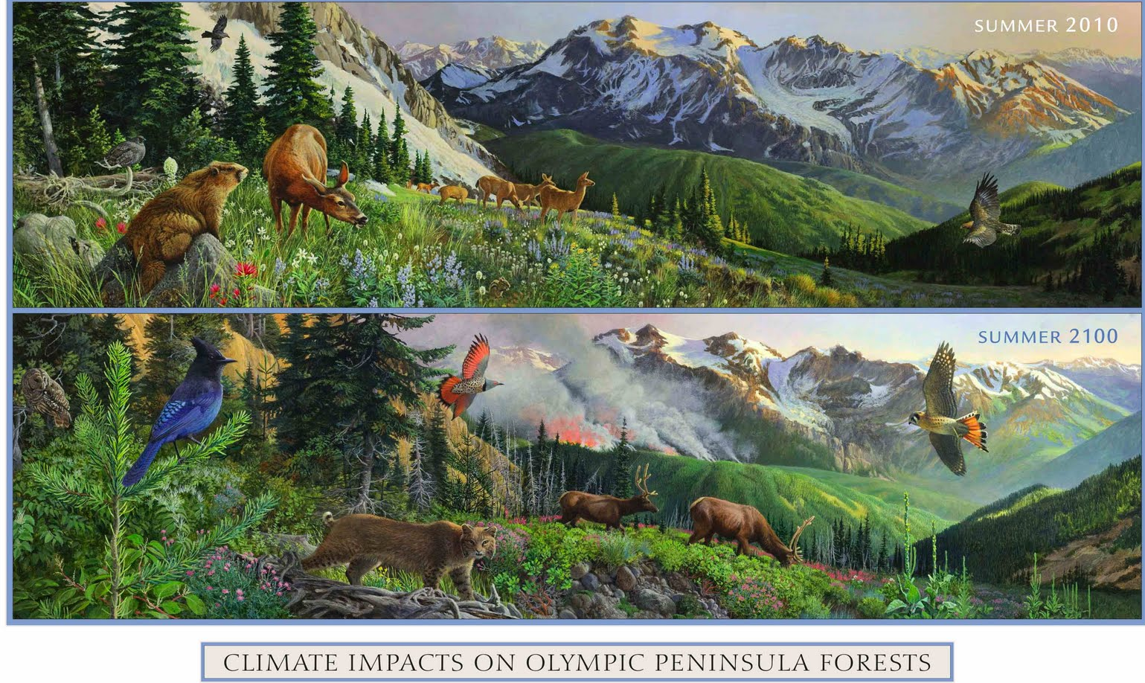
Discussion: What are the differences?
CLIMATE CHANGE IMPACTS ON MOUNTAIN AREAS IN USA
Notes:
Question: What differences between the images do you notice?
Exercise Procedure:
Pair up and compare.
Then share with the class.
Reference: USFS Pacific Northwest Research Station

Slide 39
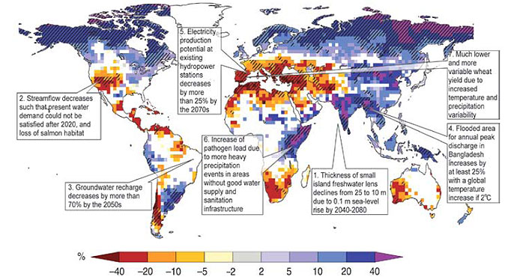
Impacts of climate change on freshwater availability
Notes:
Key Message:
Freshwater will be strongly affected by climate change in many but not all parts of the world.
Reference: IPCC AR4 2007 https://www.ipcc.ch/publications_and_data/publications_and_data_reports.shtml

Slide 40
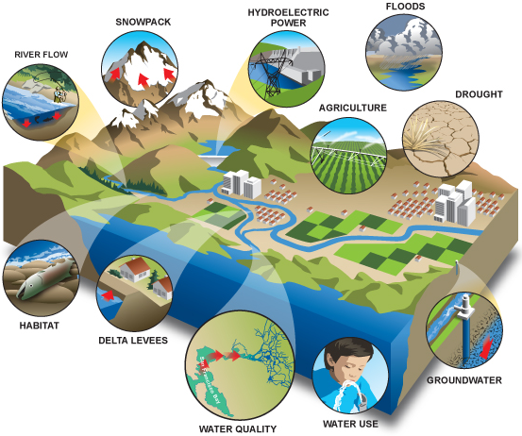
Impacts of climate change on water resources
Notes:
Key Message:
The image shows the possible impacts of climate change on water resources
Reference: https://www.e-education.psu.edu/geog438w/node/240

Slide 41
Impacts on crop yields,… Impacts on food security

Slide 42
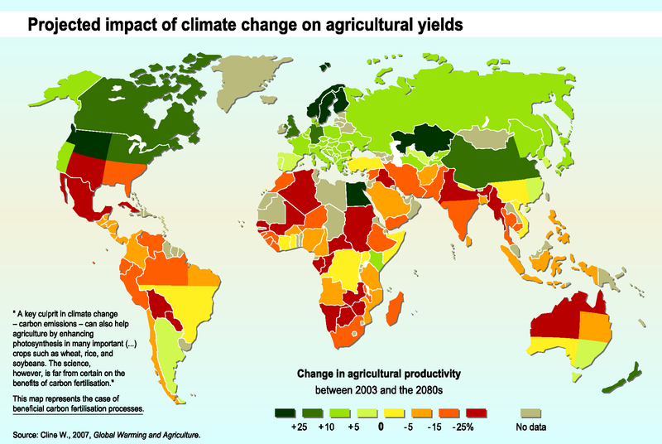
Impacts of climate change on agriculture and food supply Projected impact of climate change on agricultural yields
Notes:
Reference: Cline W. 2007 Global Warming and Agriculture https://www.imf.org/external/pubs/ft/fandd/2008/03/pdf/cline.pdf

Slide 43
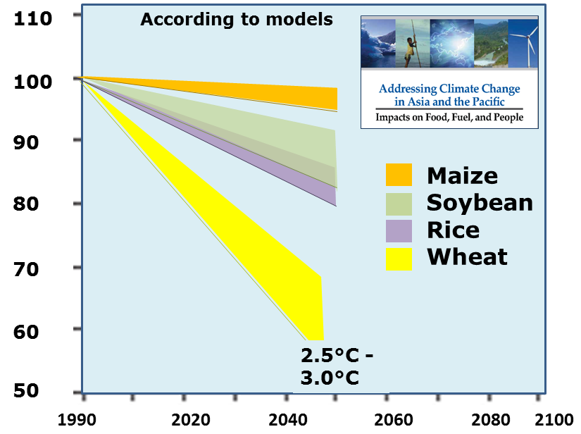
Crop yield reductions from global climate change in Southeast Asia by 2050
Notes:
Reference: Asia Development Bank. 2010. Addressing Climate Change in Asia and the Pacific: Impacts on Food, Fuel, and People
http://www.adb.org/publications/addressing-climate-change-asia-and-pacific-impacts-food-fuel-and-people

Slide 44
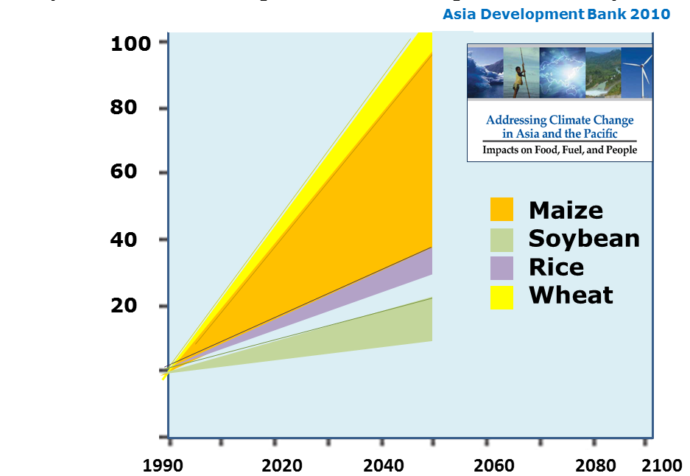
Food Price Increases from Global Climate Change in Southeast Asia by 2050
According to models
% increase
Notes:
Note: These prices changes are of a much greater magnitude than the crop reductions. A 20% reduction in wheat production (2020) would result in a 40% increase in wheat prices, according to this model.
Reference: Asia Development Bank. 2010. Addressing Climate Change in Asia and the Pacific: Impacts on Food, Fuel, and People
http://www.adb.org/publications/addressing-climate-change-asia-and-pacific-impacts-food-fuel-and-people

Slide 45
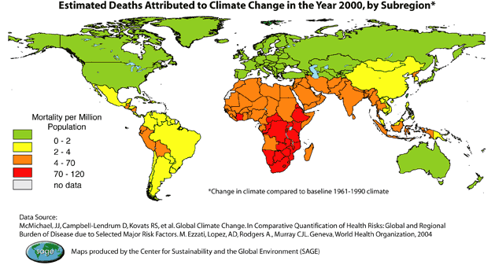
Estimated deaths attributed to climate change in the year 2000, by subregion*
Notes:
Key Message:
A recently released UNICEF UK report titled Our Climate, Our Children, Our Responsibility: The Implications of Climate Change for the World’s Children recognizes the same reality that our two most recent resources have. Reading, “For the vast majority of people the impact of climate change means an increased risk of losing their homes and livelihoods, more disease, less security and sometimes death. Children in the world’s poorest communities are the most vulnerable. They are already seeing the impacts of climate change through malnutrition, disease, poverty, inequality and increasing risk of conflict – and ultimately an increase in child mortality rates”, the report puts into focus the reality that those bearing the least responsibility for the changing climate are those feeling the greatest impact.
Reference: United Nations http://ecojustice.wordpress.com/2008/04/29/children-poverty-and-climate-change/

Slide 46
Climate change and mosquito-borne disease: IPCC
Notes:
Key Message: Mosquito-borne disease tend to increase in range and incidence … actual occurrence strongly influenced by local conditions
Reference: IPCC AR4 2007 https://www.ipcc.ch/publications_and_data/publications_and_data_reports.shtml

Slide 47
How climate warming affects mosquito behavior and disease transmission
Incubation period
Biting frequency
Survival probability
50
1
40
0.3
0.8
30
0.2
0.6
(days)
(per day)
(per day)
20
0.4
0.1
0.2
10
0
0
0
15
20
25
30
35
40
10
15
20
25
30
35
40
10
15
20
25
30
35
40
Temp (°C)
Temp (°C)
Temp (°C)
TRANSMISSION POTENTIAL
1
P.vivax
0.8
P.falciparum
0.6
0.4
0.2
0
14
17
20
23
26
29
32
35
38
41
Temperature (°C)
Notes:
Reference: IPCC AR4 2007 https://www.ipcc.ch/publications_and_data/publications_and_data_reports.shtml

Slide 48
Exercise and Discussion
How can linked or cascading effects, including climate warming, combine to increase the incidence of mosquito-borne disease? Think broadly.

Slide 49
Exercise and Discussion
Work in groups (depending on the class size)
Analyze possible climate change impacts on men and women impacts
Each group present their group results
Don´t repeat the same ideas that other groups have presented earlier
Highlight the most challenging impacts on men & women in Bangladesh
Notes:
NOTE:
Teachers can use the group results and add on other possible impacts that he/she has already prepared.

Slide 50
Instructor Review of Materials
What was useful?
What is missing?
How did you, or would you, modify the materials to make them better fit your instructional needs?
Please share your experience and modifications here: climatecurriculum@googlegroups.com

Slide 51
Reference and Readings
Asia Development Bank 2010 Addressing Climate Change in Asia and the Pacific: Impacts on Food, Fuel, and People
IPCC 2013. AR5 Synthesis Report http://www.ipcc.ch/report/ar5/
John Houghton, 2009, Global Warming: the complete briefing, fourth edition, Cambridge University Press
Robert Henson, 2011, The rough guide to Climate change, third edition, Rough Guide Ltd.
Reichstein, M. et al. 2013. Climate extremes and the carbon cycle. Nature. Vol 500: 287-295.
Reid, Leslie M. 1993. Research and cumulative watershed effects. Gen. Tech. Rep. PSW-GTR-141. Albany, CA: Pacific Southwest Research Station, Forest Service, U.S. Department of Agriculture; 118 p.

Slide 52
References and Resources
The curriculum of USAID’s Climate-Resilient Ecosystems and Livelihoods (CREL) in Bangladesh is a free resource of teaching materials for university professors, teachers and climate change training experts.
Reproduction of CREL’s curriculum materials for educational or other non-commercial purposes is authorized without prior written permission from the copyright holder, provided the source is fully acknowledged.
Suggested citation: USAID. 2016. Bangladesh Climate-Resilient Ecosystem Curriculum (BACUM). USAID‘s Climate-Resilient Ecosystems and Livelihoods (CREL) Project. Winrock International. Dhaka, Bangladesh.
Disclaimer: The CREL’s curriculum is made possible by the support of the American People through the United States Agency for International Development (USAID). The contents of the curriculum do not necessarily reflect the views of USAID or the US Government.

Slide 53
USAID's Climate-Resilient Ecosystems and Livelihoods (CREL) Project Winrock International House 13/B, Road 54, Gulshan 2, Dhaka 1212 Bangladesh Tel: +880-2-9848401 www.winrock.org

