Slide 1
Bangladesh Climate-Resilient Ecosystem Curriculum (BACUM)
Module 1: Introduction to Climate Change

Slide 2
Module 1: Introduction to Climate Change
SECTION I: HOW AND WHY THE CLIMATE IS CHANNGING
1.3. Climate Intensification: Floods, Droughts and Cyclones

Slide 3
Introduction to Climate Change (ICC)
HOW AND WHY THE CLIMATE IS CHANGING
  1.1. Introduction to Climate Science and Climate Change
  1.2. Causes of Climate Change
  1.3. Climate Intensification: Floods, Droughts and Cyclones
IMPACTS OF CLIMATE CHANGE ON PEOPLE AND THE ENVIRONMENT
  2.1. Introduction to Climate Change Impacts
  2.2. Sea Level Rise
  2.3. Climate Change and Water Resources
  2.4. Climate Change and Food Security
  2.5. Climate Change and Human Health
  2.6. Climate Change and Terrestrial Ecosystems
RESPONSES TO CLIMATE CHANGE – MITIGATION AND ADAPTATION
  3.1. Climate Change and Forest Management
  3.2. Climate Change and Water Resources: Responses and Adaptation
  3.3. Principles and Practices of Climate Vulnerability Assessment
  3.4. Uncertainties in Climate Change
  3.5. Climate Change and Ecosystem Services
  3.6. Effective Communications in Climate Change

Slide 4
Acknowledgements
EXPERT CONTRIBUTORS | SPECIFIC INPUTS
Prof. (Dr.) Manzoor Rashid | Curriculum Development for all topics
Prof. (Dr.) Md. Danesh Miah | REDD+, Forest Carbon
Prof. (Dr.) Md. Jakariya | Community NR Management, Climate Change, Natural Resources Management
UNIVERSITIES
Bangladesh Agricultural University
University of Chittagong
Dhaka University
Independent University, Bangladesh
Khulna University
Noakhali University of Science and Technology
Shahjalal University of Science and Technology
Sher-e-Bangla Agriculture University
North South University
CREL STAFF | CREL STAFF
John A Dorr | Utpal Dutta
Abu Mostafa Kamal Uddin | Ruhul Mohaiman Chowdhury
Kevin T. Kamp | Rahima Khatun
Paul Thompson | Sultana Razia Zummi
Abdul Wahab | Shams Uddin
Shahzia Mohsin Khan
DESIGN, LAYOUT AND CONTENT DEVELOPMENT: Ms. Chi Pham, Curriculum Development Expert, Bangkok, Thailand

Slide 5
Learning Objectives
At the end of this session, students will be able to explain:
Explain what climate intensification is
Explain how climate intensification occurs
Describe the evidence of climate intensification: floods, droughts and cyclones and how these affects are different for men and women particularly in Bangladesh
Explain the unusual climate intensification: El Niño and La Niña
Identify strategies to mitigate climate intensification considering gender needs and priorities in Bangladesh
Notes:
Learning Objectives:
Students need to learn, understand, and can explain …..meaning or what is climate intensification, climate intensification in terms of flooding & drought, Unusual climate phenomenon of flooding; La Nina and Unusual climate phenomenon of drought; El Nino.
Can calculate flooding risk using probability of exceedance.

Slide 6
Outline
What is climate intensification?
How climate intensification occurs?
Evidence for intensified climate
  Flooding
  Drought
  Cyclone
Unusual climate intensification
  La Niña
  El Niño
Flooding risk calculation
Notes:
Unreferenced slides are credit to the RECCCD Basic Climate Change Development Team

Slide 7
What is climate intensification?
Climate has greater extremes, particularly:
Intensified storms and related flooding
Longer, drier droughts
Stronger windstorms
Notes:
Key message: what is climate intensification? It means …. Climate becomes greater extremes…

Slide 8
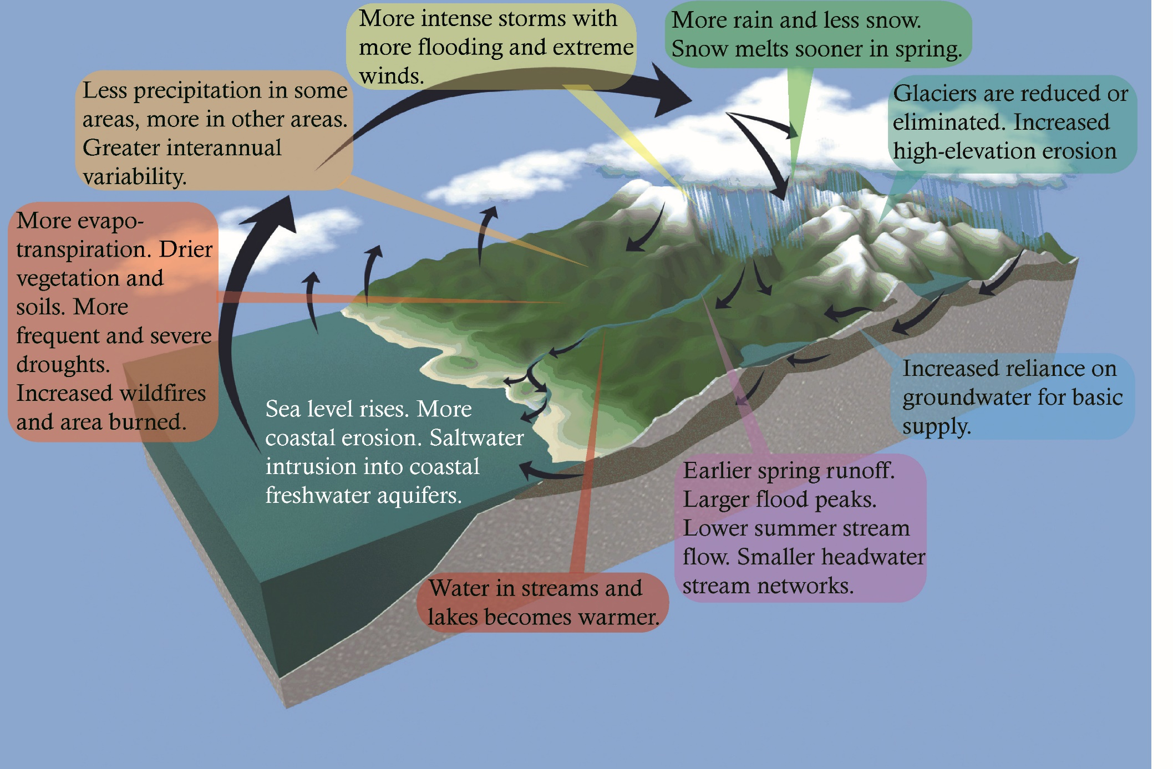
Intensification of the hydrologic cycle
Notes:
Reference: Base image from COMET, University Corporation for Atmospheric Research (UCAR). Annotations by MJ Furniss
Key Message:
“According to model predictions, the most significant manifestation of climate change would be an acceleration of the global water cycle, leading to … a general exacerbation of extreme hydrologic regimes, floods and droughts” (NASA Global Water and Energy Cycle, 2000).
“There is evidence that suggests that the global hydrologic cycle may be intensifying, leading to an increase in the frequency of extremes” (Hornberger et al, USGCRP water cycle science plan)

Slide 9
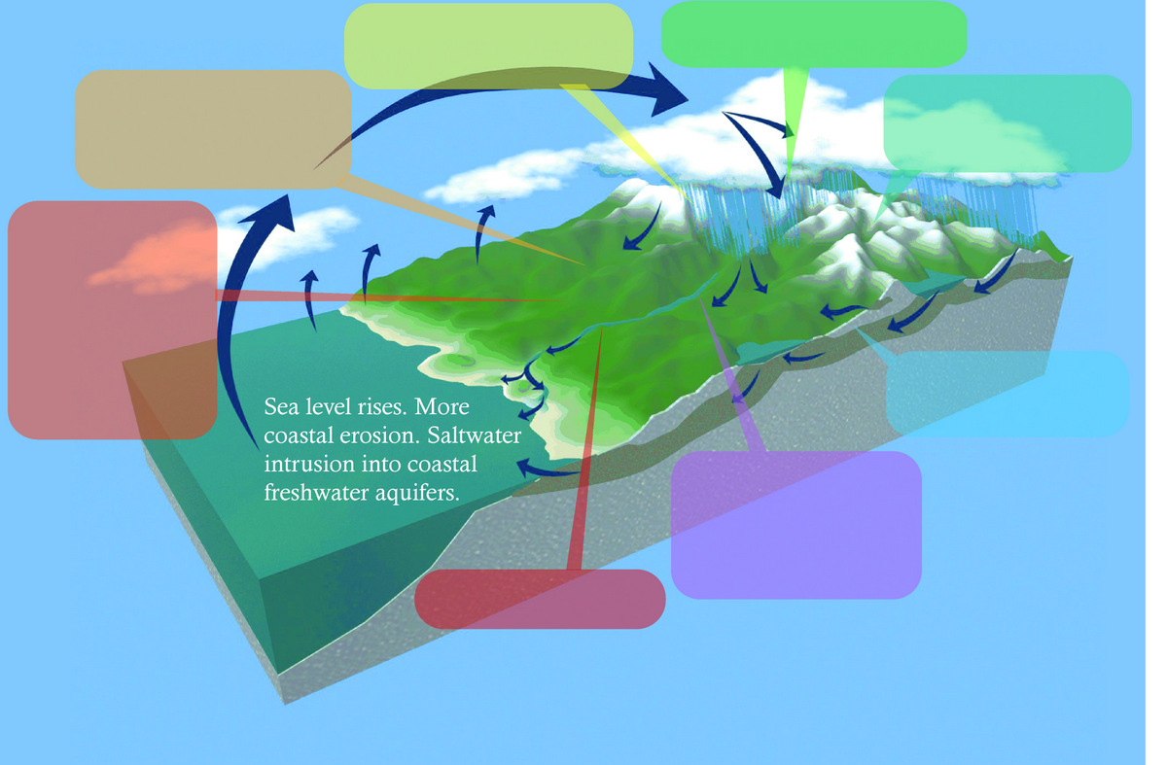
Fill in the blanks based on previous slide
Notes:
Reference: Base image from COMET, University Corporation for Atmospheric Research (UCAR). Annotations by MJ Furniss

Slide 10
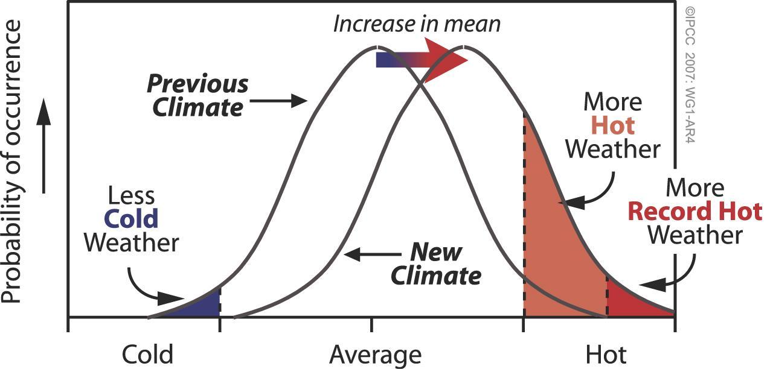
Basic statistics indicate intensification
Notes:
Reference: US EPA http://www.epa.gov/climatechange/Downloads/wycd/Climate_Basics.pdf
Key Message:
Climate projections provide reasonable projections of changes in mean values. However, changes in the frequency and magnitude of “extreme events” will drive many of the most significant impacts on ecosystems and natural resources. While we can understand the general statistical principle of how a change in the mean is likely to affect the frequency of extremes, quantitative estimates of the projected frequency and magnitude of extremes are not yet widely available – especially at sub-regional scales. This is another key source of uncertainty quite relevant to natural resource management.

Slide 11
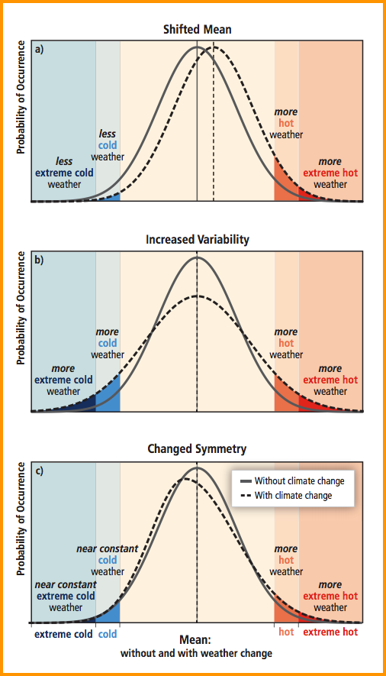
Several kinds of non-stationarity
Source: IPCC SREX Report:
http://ipcc-wg2.gov/SREX/
Notes:
Reference: IPCC
Key Message:
The effect of changes in temperature distribution on extremes. Different changes in temperature distributions between present and future climate and their effects on extreme values of the distributions:
(a) effects of a simple shift of the entire distribution toward a warmer climate;
(b) effects of an increase in temperature variability with no shift in the mean;
(c) effects of an altered shape of the distribution, in this example a change in asymmetry toward the hotter part of the distribution.

Slide 12

Heat and Climate Intensification
Adding heat to the atmosphere is like pushing a swing.
More heat = intensified weather and climate
Heat drives the global weather system.
  More energy and heat differentials to drive the global weather engine
  and
  More water in atmosphere
  therefore …
  More variability in weather and climate
  Greater extremes
Photo from wired.com
Notes:
Reference: http://www.wired.com/2013/06/dutch-designer-puts-the-fun-back-in-functional/

Slide 13
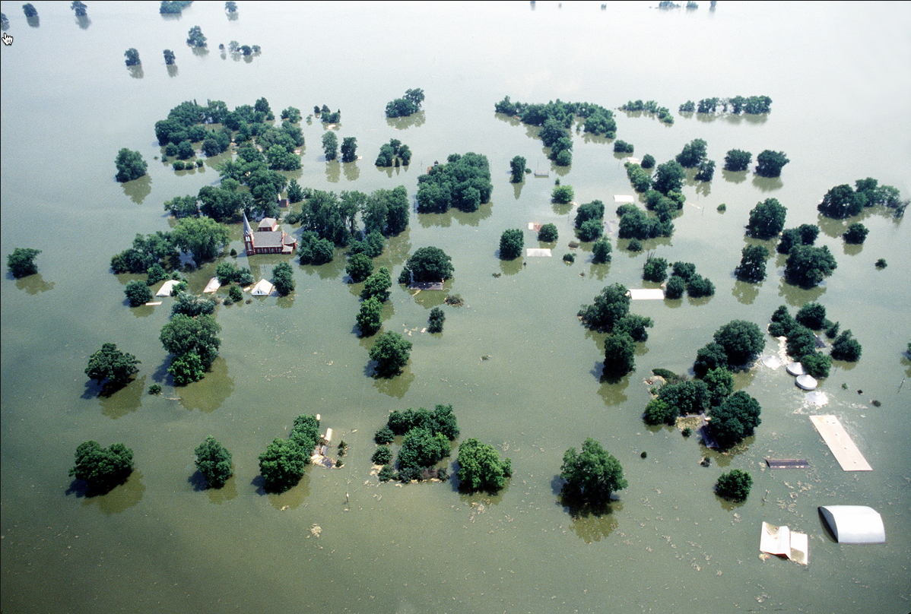
Climate Intensification: Floods
Notes:
Reference: http://upload.wikimedia.org/wikipedia/commons/f/fd/Kaskaskia_Island_1993_flooding.jpg

Slide 14
Flooding Intensification
So far, global trends in annual maximum flooding is not much more than would be expected by chance.
Most scientists believe that since variability is very large and the sample size is very small that this obscures changes. (Rare events, even if they become more common, are still rare).
Catastrophic damage may not become obvious until it breaks through your door.
Notes:
Key Message:
Results of U.S. studies seemingly inconsistent, but based on statistical analysis, number of trends in annual maximum flood is barely larger than would be expected by chance
But, natural variability is large enough and sample size small enough to obscure fairly large changes.

Slide 15
Climate intensification makes heavy precipitation
In the USA, the return period of “very heavy” precipitation events changed during the past century in the Midwestern US from 10 to 7 years, in the South from 4 to 2.7 years, and in the Northeast from 26 to 11 years.
This is predicted by theory and models
More floods in second half of 20th century than in first half; statistically significant even accounting for record differences
Groisman et al (2001)
Notes:
Climate intensification can make heavy precipitation, statistically, in the western US from 10 to 7 years, in the south from 4 to nearly 3 years, and in the northeast from 26 to 11 years
And they have more floods in the second half of 20 century than the first half. They are absolutely more climate intensification, particularly precipitation.

Slide 16
Most people think flooding has increased markedly
....but people’s perceptions might be wrong, because:
The longer you live, the more rare events you see
Humans are increasingly “in the way”. Damage from flooding has increase dramatically, largely due to development of vulnerable areas
You hear about it more than ever due to the news media. Flooding is an easy story to cover by news media.
Intensification happens naturally, but moves from place to place. You don’t hear about the places that have calmed.
Flooding disasters in South Asia have been common and very damaging in recent decades
Notes:
Based on physics, climate theory, meteorology, and modeling, we can confidently expect significantly intensified flooding. This is, more frequent and larger storms and flooding.
Statistical evidence of this will take many decades due to high variability and small sample size.
Now, obviously, flooding has increased over the world, but move from place to place, and sometimes more intenses.

Slide 17
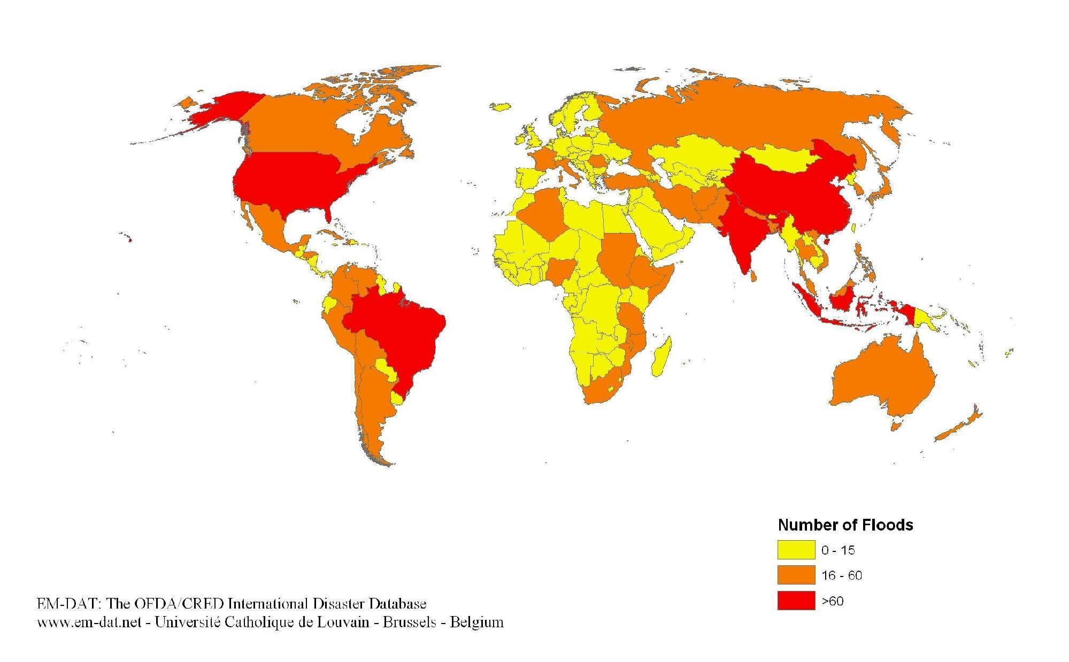
The number of flood disasters by country from 1974 to 2003
What has been the flood history of Bangladesh?
Based on this map, and given the size of Bangladesh, compared to USA, is flooding more of a problem in Bangladesh?
Pielke et al., 2002
Notes:
Key Message:
The map shows statistic number of flood disasters over the world from 1974 to 2003. Obviously, north America, some part of south America, and south and south-east Asia were impacted more frequently then other areas.
Reference: Pielke Sr., R. A., Marland, G., Betts, R. A., Chase, T. N., Eastman, J. L., Niles, J. O., Niyogi, D., and
Running, S.: 2002, ‘The Influence of Land-Use Change and Landscape Dynamics on the Climate
System-Relevance to Climate Change Policy beyond the Radiative Effect of Greenhouse Gases’,
Phil. Trans. A. Special Theme Issue 360, 1705–1719.

Slide 18
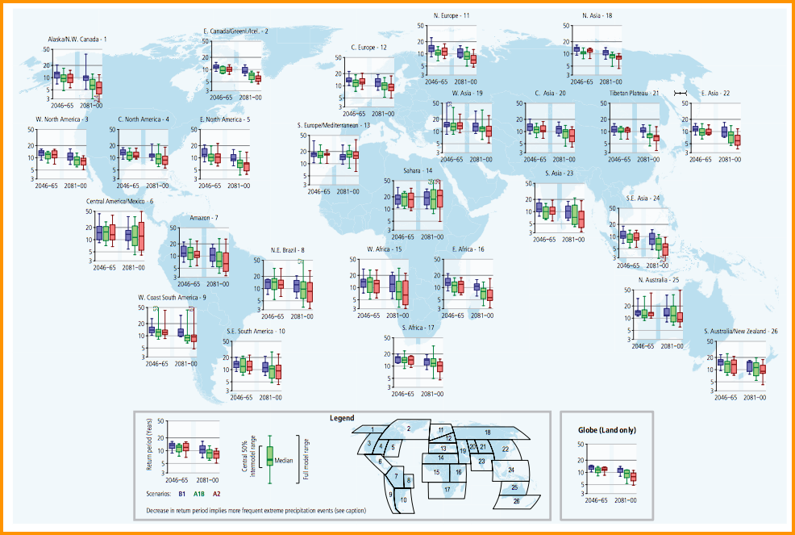
Projected decrease in 20-year rainfall event
Source: IPCC_SREX: http://ipcc-wg2.gov/SREX/images/uploads/SREX-SPMbrochure_FINAL.pdf
Notes:
Reference: IPCC
Key Message:
Projected return periods for a daily precipitation event that was exceeded in the late 20th century on average once during a 20-year period (1981–2000). A decrease in return period implies more frequent extreme precipitation events (i.e., less time between events on average). The box plots show results for regionally averaged projections for two time horizons, 2046 to 2065 and 2081 to 2100, as compared to the late 20th century, and for three different SRES emissions scenarios (B1, A1B, A2) (see legend). Results are based on 14 GCMs contributing to the CMIP3. The level of agreement among the models is indicated by the size of the colored boxes (in which 50% of the model projections are contained), and the length of the whiskers (indicating the maximum and minimum projections from all models). See legend for defined extent of regions. Values are computed for land points only. The ‘Globe’ inset box displays the values computed using all land grid points

Slide 19
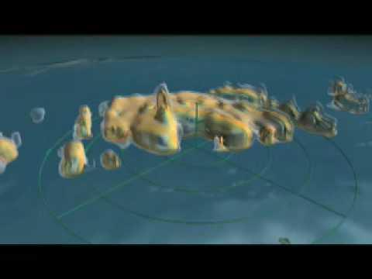
Video: Towers in the Tempest
BCC Teaching Unit: Climate Intensification
Hurricane intensification can be caused by phenomenon called 'hot towers', which form as air spirals inward towards the eye and is forced rapidly upwards, accelerating the movement of energy into high altitude clouds.
https://youtube.googleapis.com/v/kUG4-TEqPYc
~ 4.5 minutes
Notes:
The video shows climate intensification of hurricane that cause ‘hot towers’, it is actually an important element of cyclonic phenomenon. In some place calls Hurricane.

Slide 20
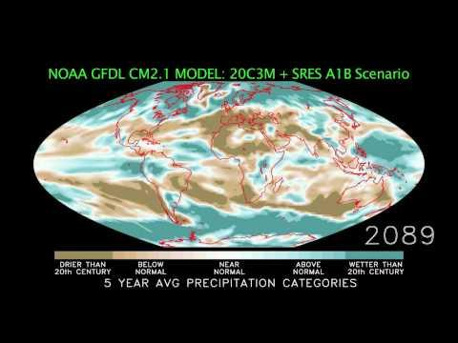
Video: Will the Wet Get Wetter and the Dry Drier?BCC Teaching Unit: Climate Intensification
With the help of computer model simulations this NOAA video describes climate intensification and its causes.
https://youtube.googleapis.com/v/wAbMuefx3oE
~ 4 minutes
Notes:
The video present computer model simulation of the NOAA meteorological satellite to describe climatic intensification and its causes.

Slide 21
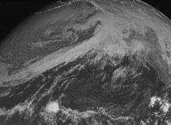
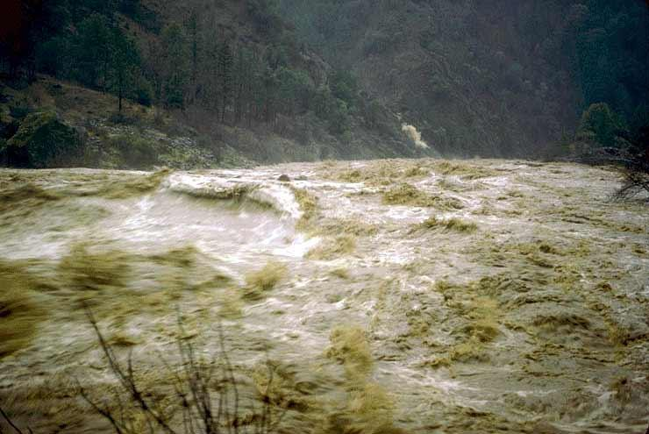

Very large floods are conspiracies
… between ocean, atmosphere, and landscape
For example, when coastal rivers flood, storm surge and large waves are also often present, and combine with high tides and intensive land development, all of which make the flooding more server and of greater consequence.
For example, the 1964 Flood in N. California
Warm and very wet “pineapple express”
Cold and very wet Aleutian front
These two fronts collided over California
Large snowpack in place
Extensive poor land use
Storm surge, high tides, wet soil mantle, high flows
Notes:
Reference: US Weather Service
The pictures show big flooding in US in the past (1964).
The most serious floods tend to be “perfect storms” when extreme events combine.

Slide 22
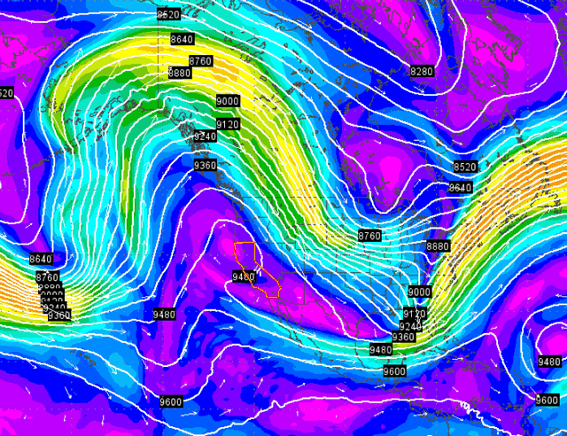
Jet Stream changes
Advanced topic: Changes in the northern hemisphere jet stream due to “arctic amplification” The cause of the 2012-2013 jet stream anomalies, “polar vortex”: extreme drought (California), extreme cold (eastern US), extreme rainfall (UK).
Please see: https://www.youtube.com/watch?v=4spEuh8vswE
And: http://www.wunderground.com/blog/JeffMasters/comment.html?entrynum=2665
And BCC_JenniferFrances_Arctic_Amplification.pptx in References
Notes:
Reference: US Weather Service and Jennifer Francis at Rutgers University
The arctic is warming much more quickly than equatorial regions, due to large losses in sea ice. This decreases albedo (water surface is much less reflective than ice surface), leading to very rapid warming in at high latitudes.
(A strong positive feedback)
This decreases the slope of the troposphere and de-intensifies the gradients driving the jet streams.
This makes the jet streams more more slowly, and tend to have greater amplitude of meanders, and get more readily “stuck” in persistent patterns. This is believed to be the cause of the 2013/2014 phenomena of extreme drought in the western US, extreme cold in the eastern US, and extreme rainfall in northern Europe. That is, the Jet Stream was sluggish, and had very large waves that were persistent, bringing weather across large latitudes for a long period;
an outcome of global warming and the arctic amplification.

Slide 23
Effect of arctic amplification on Jet Stream amplitude and movement
Arctic Amplification
High latitudes warming more than mid-latitudes, especially in fall and winter, but also in summer over land
=> Poleward thickness gradient weakening
Weaker upper-level, zonal-mean flow, reduced phase speed
Peaks of upper-level ridges elongate northward, wave amplitude increases
Rossby waves in the Jet Stream progress more slowly
Weather conditions more persistent
Increased probability of extremes: cold spells, heat waves, flooding, prolonged snowfall, and drought
J.A. Francis – Rutgers Univ.
Notes:
Reference: Jennifer Francis, Rutgers University
https://www.youtube.com/watch?v=_nzwJg4Ebzo
https://www.youtube.com/watch?v=tY0RdXmLGdU

Slide 24
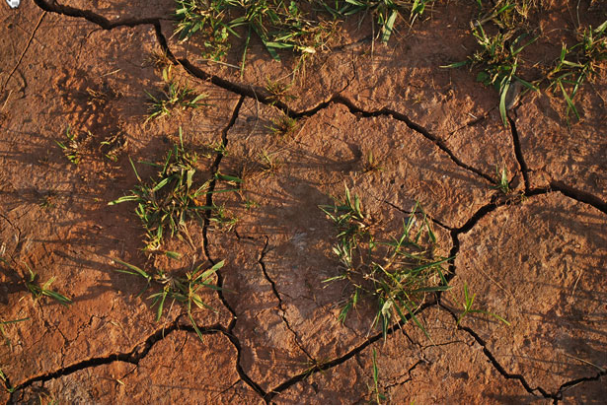
Drought
Notes:
Reference: Photo: Drought by Peter Griffen http://www.publicdomainpictures.net/view-image.php?image=3400

Slide 25
Types of Drought
Meteorological drought—This type of drought refers to the weather and occurs when there is a prolonged period of below average precipitation, which creates a natural shortage of available water.
Green-Water or Agricultural drought—This type of drought occurs when there isn’t enough moisture to support average crop production on farms or average grass production on range land. Although agricultural drought often occurs during dry, hot periods of low precipitation, it can also occur during periods of average precipitation when soil conditions or agricultural techniques require extra water.
Blue-Water or Hydrological drought—This type of drought occurs when water reserves in aquifers, lakes and reservoirs fall below an established statistical average. Again, hydrological drought can happen even during times of average or above average precipitation, if human demand for water is high and increased usage has lowered the water reserves
Notes:
And identifies types of drought, there are meteo. Drought, agri. Drought, hydrological drought. Students can learn diff. causes and diff. impacts particularly from each drought.

Slide 26
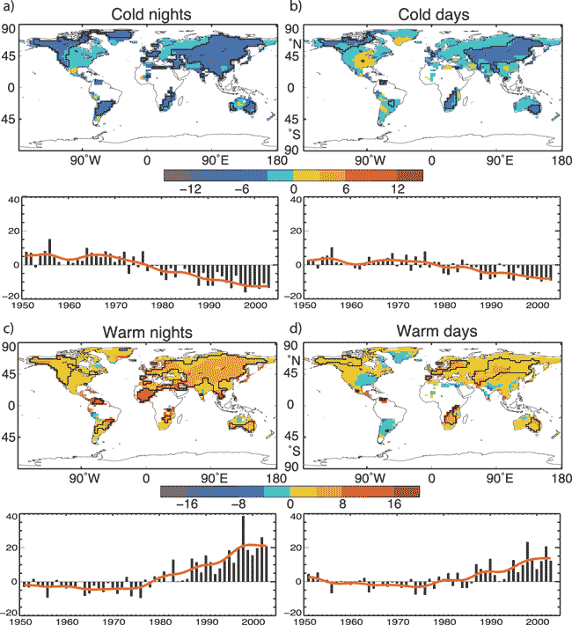
How will this affect Bangladesh?
Will it be colder or warmer?
Or both?
Notes:
Reference: IPCC, 2007: Climate Change 2007: The Physical Science Basis. Contribution of Working Group I to the Fourth Assessment Report of the Intergovernmental Panel on Climate Change [Solomon, S., D. Qin, M. Manning, Z. Chen, M. Marquis, K.B. Averyt, M.Tignor and H.L. Miller (eds.)]. Cambridge University Press, Cambridge, United Kingdom and New York, NY, USA
These show a clear trend in extreme temperatures, and day and night differences are biologically imporant

Slide 27
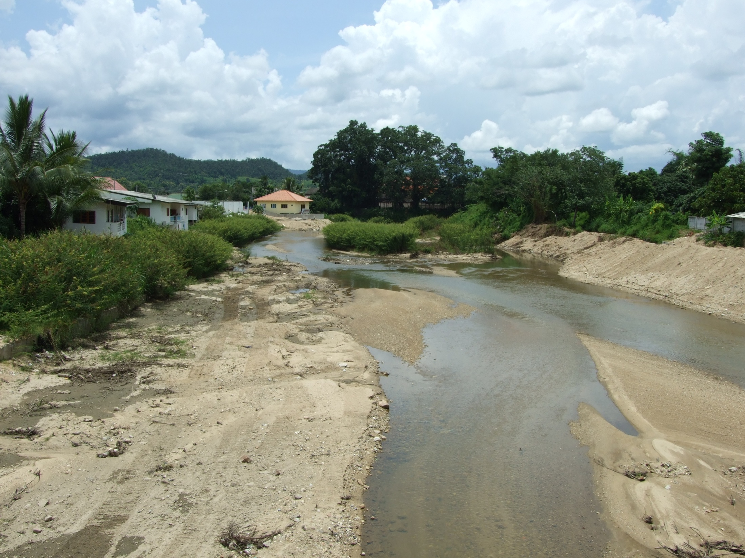
Drought from Climate Intensification in upper Mae Tha watershed in April, 2013. Thailand
Drought
Notes:
Reference: Images from Thaworn Onpraphai, Chiang Mai University, Thailand

Slide 28
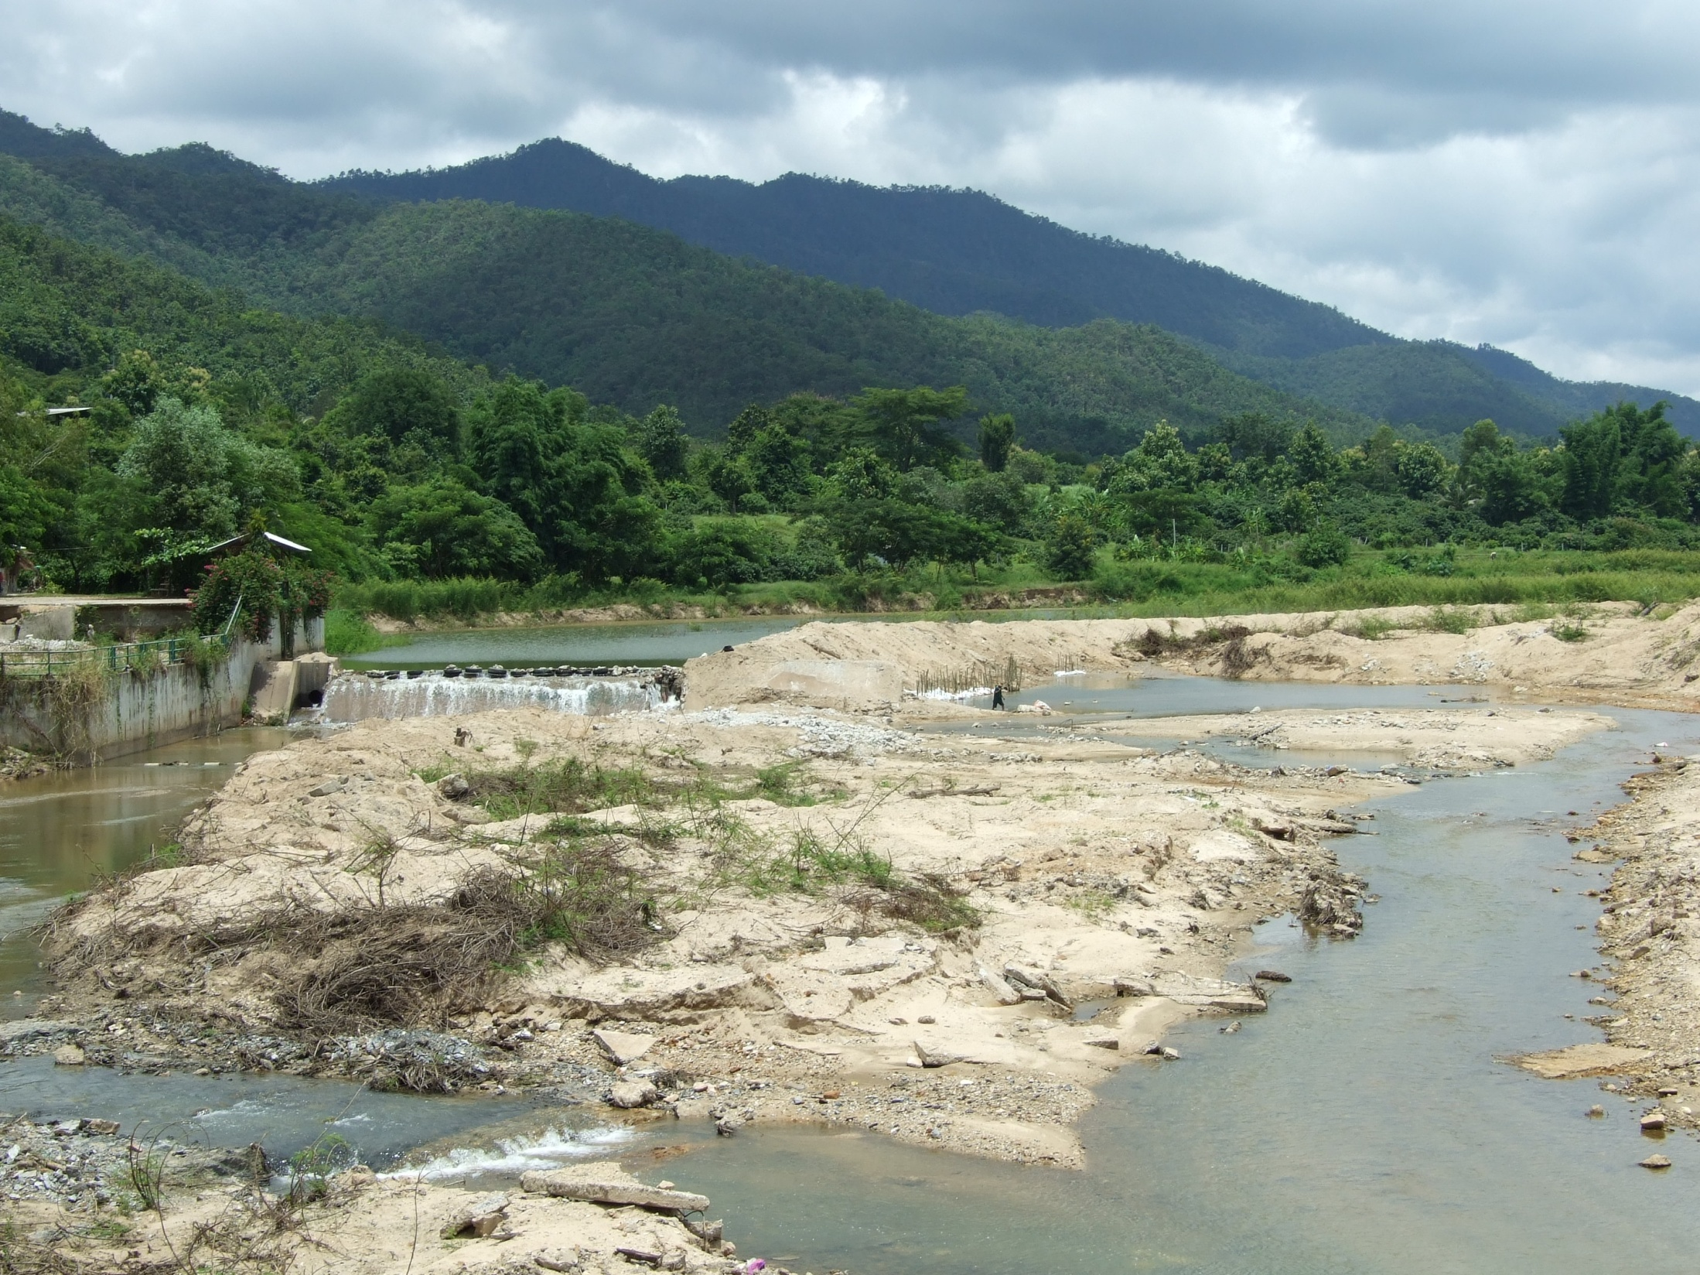
Drought from Climate Intensification in upper Mae Tha watershed in April, 2013. Thailand
Drought
Notes:
Reference: Images from Thaworn Onpraphai, Chiang Mai University, Thailand

Slide 29
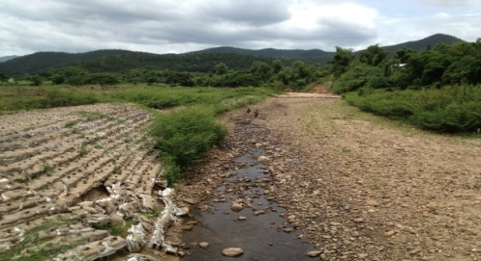
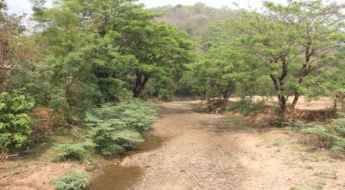
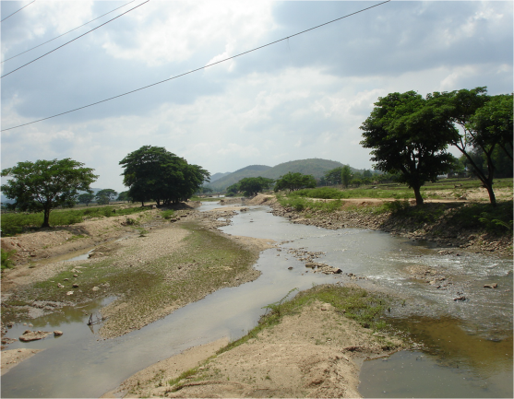
Middle-Mae Tha Watershed. Thailand
Severe drought
Notes:
Reference: Images from Thaworn Onpraphai, Chiang Mai University, Thailand

Slide 30
Droughts of similar dryness are harsher when temps higher
Warmer temperatures increase plant evapotranspiration, water requirements, and thus worsen the drought in terms or plant growth, and, often, water supply as well.
So, even without intensification of drought occurrence, drought impacts and overall severity are worsened by warming trends.

Slide 31
Palmer-Drought-Severity Index (soil-plant)
Palmer Classifications
4.0 or more | extremely wet
3.0 to 3.99 | very wet
2.0 to 2.99 | moderately wet
1.0 to 1.99 | slightly wet
0.5 to 0.99 | incipient wet spell
0.49 to -0.49 | near normal
-0.5 to -0.99 | incipient dry spell
-1.0 to -1.99 | mild drought
-2.0 to -2.99 | moderate drought
-3.0 to -3.99 | severe drought
-4.0 or less | extreme drought
NOAA 2005
Notes:
PDSI is a very good way to define the severity of a drought, and has been widely used for many years.

Slide 32
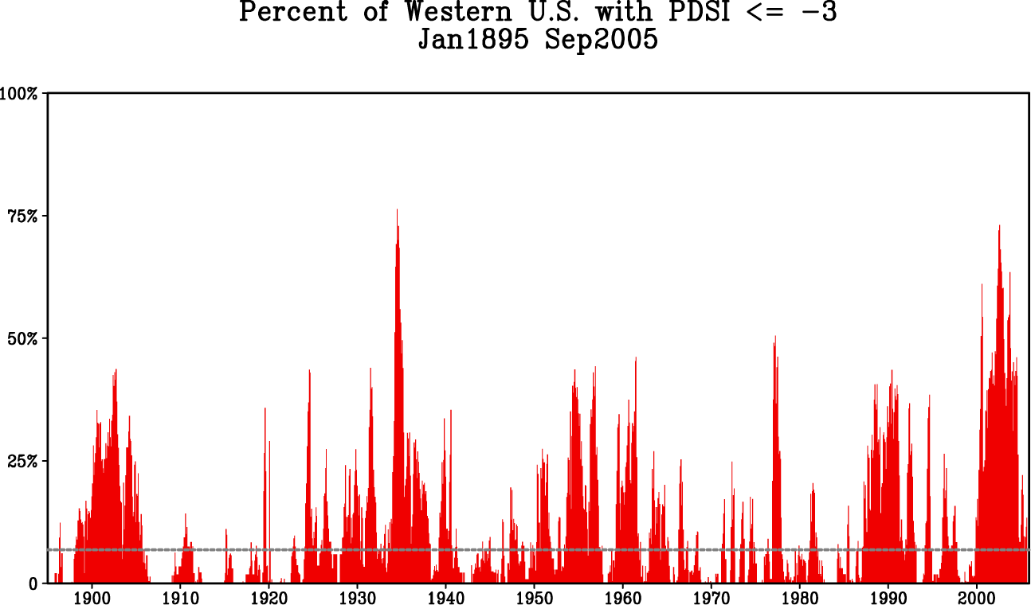
Trends in Western USA: Droughts
Palmer-Drought-Severity Index (soil-plant)
Notes:
Notes: Clearly, droughts are not a new occurrence in the USA and there does not appear to be a significant increase in the number of droughts or their severity.
Reference: US Agriculture Research Service

Slide 33
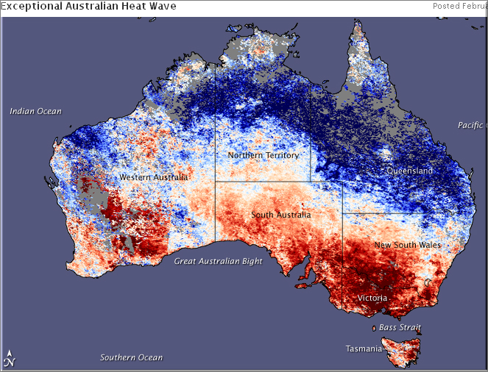
7 February 2009. SE Australian Bush Fires
Surface temp anomalies. NASA
Worst in >100 years
  Coincidence of conditions
  Record long drought
  Record heat
  Record low humidity
  High winds
Climate intensification? We cannot say for single events. Theory, models, and recent observations all point to these kinds of extreme events becoming more common and more likely.
Notes:
Notes: The Black Saturday bushfires^{[8]} were a series of bushfires that ignited or were burning across the Australian state of Victoria on and around Saturday, 7 February 2009 and were Australia's all-time worst bushfire disasters. The fires occurred during extreme bushfire-weather conditions and resulted in Australia's highest ever loss of life from a bushfire;^{[9]} 173 people died^{[7][10]} and 414 were injured as a result of the fires.
As many as 400 individual fires were recorded on 7 February. Following the events of 7 February 2009 and its aftermath, that day has become widely referred to in Australia as Black Saturday.
Reference: http://en.wikipedia.org/wiki/Black_Saturday_bushfires

Slide 34
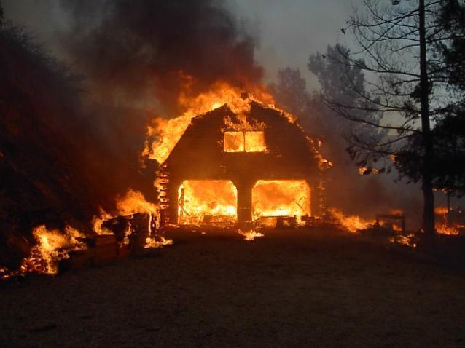
What happens to your area?
If it is:
  Hotter?
  Dryer?
  Windier?
Notes:
Students chose and describe an area they are familiar with. Then answer these questions, orally and in writing, in groups or as homework assignment
Image credit: DTINews http://www.dtinews.vn/en/news/021/27434/-prolonged-drought-increases-forest-fire-risks.html

Slide 35
Case Studies of flooding from Thailand

Slide 36
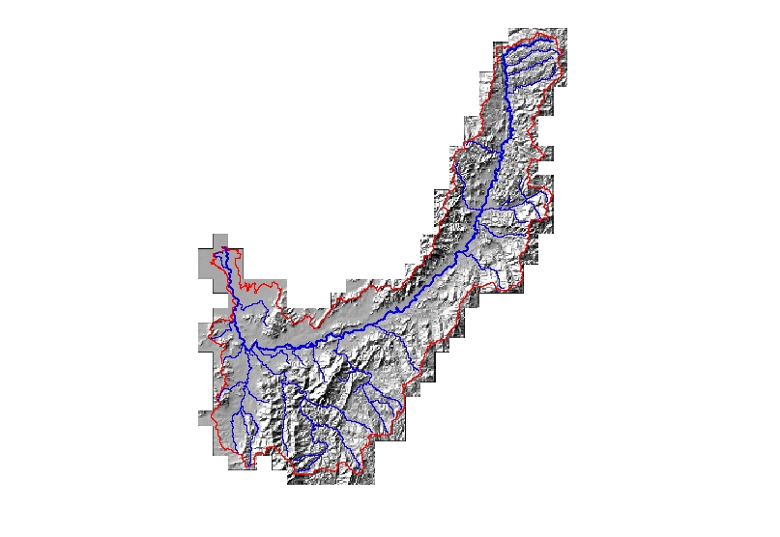

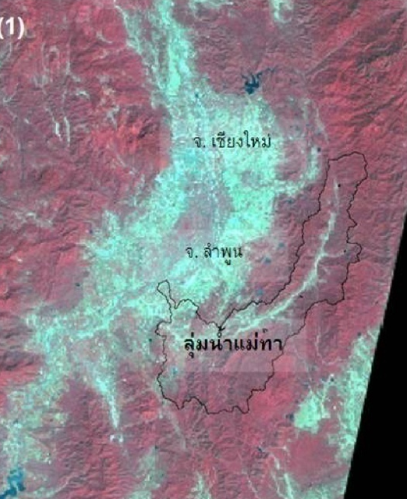

An example in Mae Tha Watershed
Lumphun, Northern Thailand
Elevation (msl.)
High: 1362.20 meters
Low: 284.52 meters
Stream lines
Notes:
Reference: Images from Thaworn Onpraphai CMU, Thailand
An example of heavy flooding in northern Thailand. In the area of Mae Tha watershed, Lunphun province close to Chiang Mai province.

Slide 37
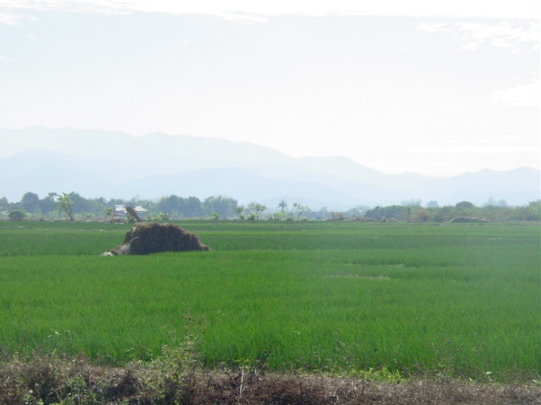
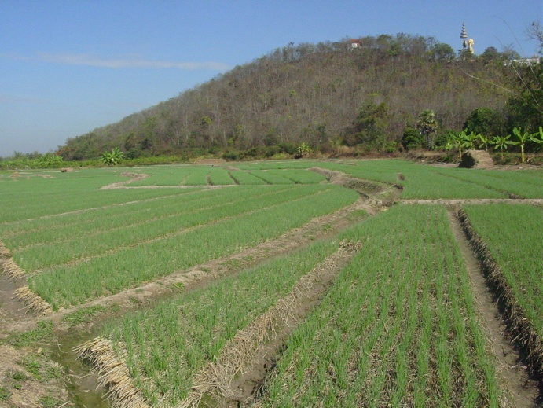
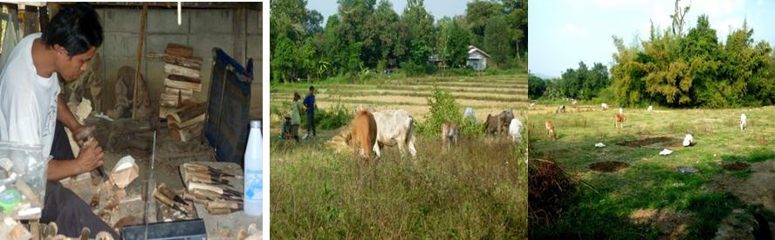
Mae Tha Watershed
There are two main parts;
  Hills with forest areas
  Low lands and floodplains without mountainous and forest areas
    Most of areas are fertile and suitable for agriculture
    Many urban and communities locate on this area
Seasonal rice
Garlic / Onion
Livestock
Notes:
Reference: Images from Thaworn Onpraphai CMU, Thailand

Slide 38
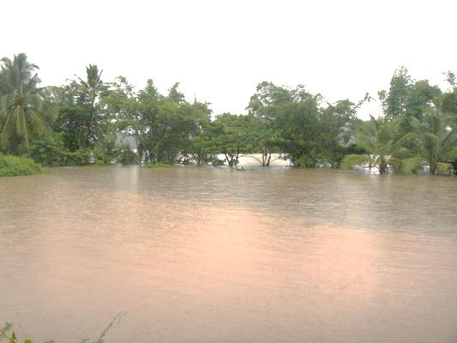
Flooding in Mae Tha River, Thailand
Extreme flooding in upper-Mae Tha River watershed in rainy season
Notes:
Reference: Images from Thaworn Onpraphai CMU, Thailand

Slide 39
Flooding in Mae Tha River, Thailand
Impacts from extreme flooding in upper-Mae Tha Watershed in August, 2004
Notes:
Reference: Images from Thaworn Onpraphai CMU, Thailand

Slide 40
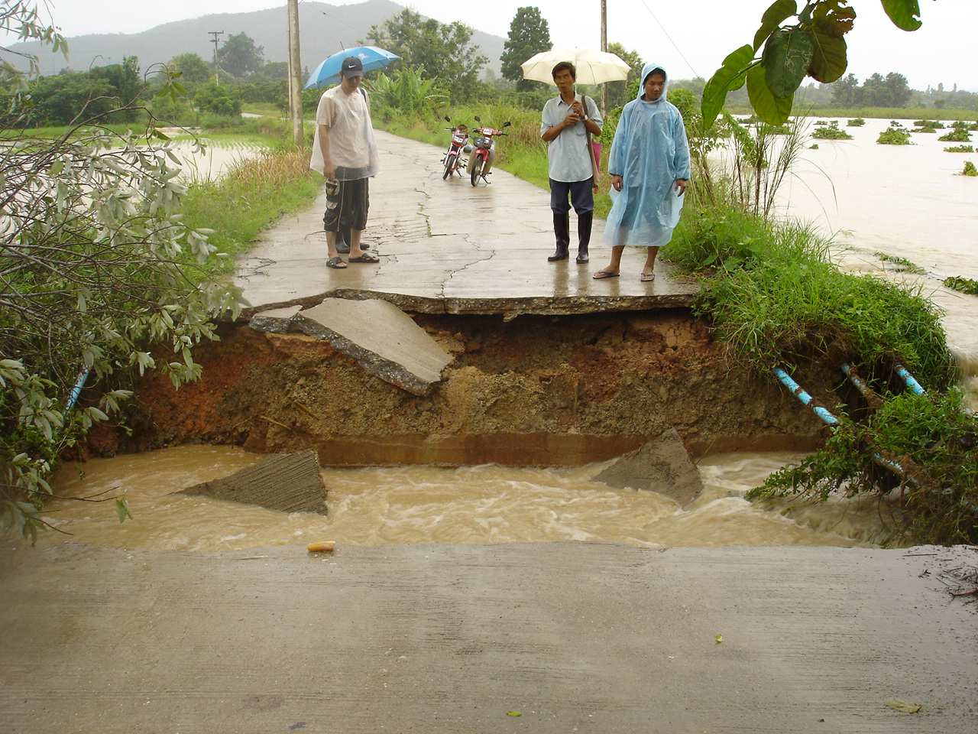
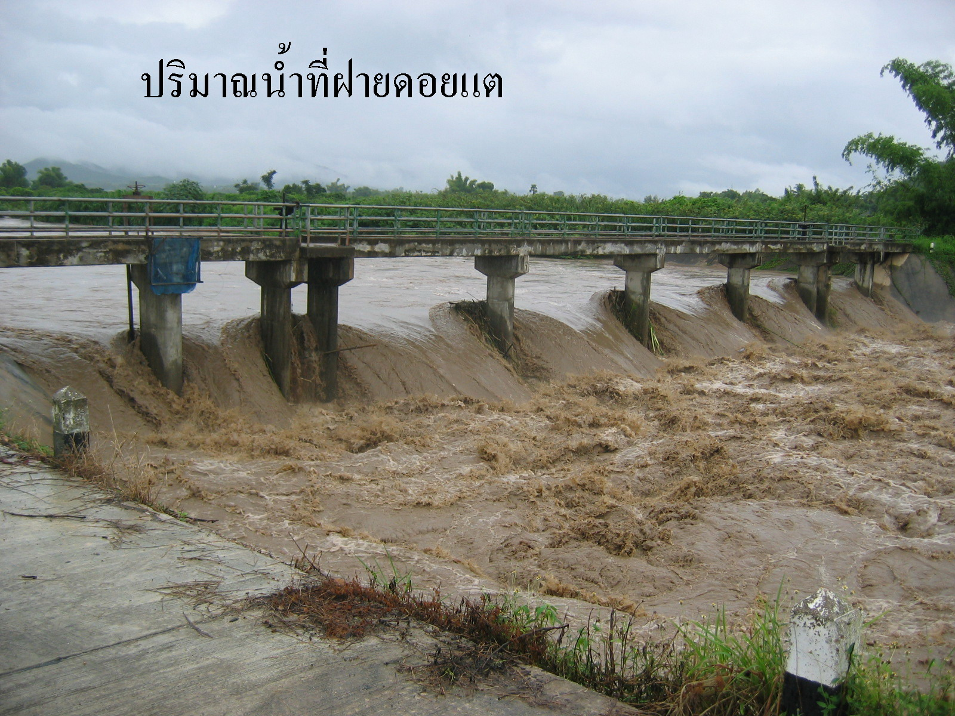
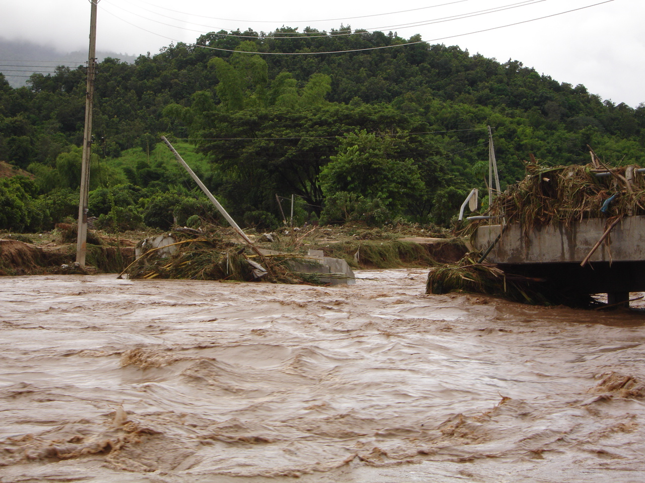
Extreme flooding in upper-Mae Tha Watershed August, 2004
Notes:
Reference: Images from Thaworn Onpraphai CMU, Thailand
This flooding happened in 2004 along the Mae Tha river, the main river or main stream of the watershed.

Slide 41
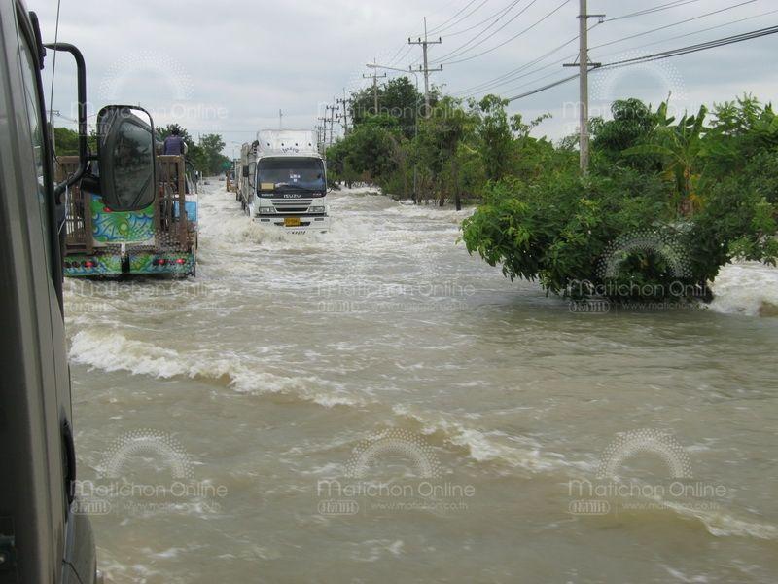
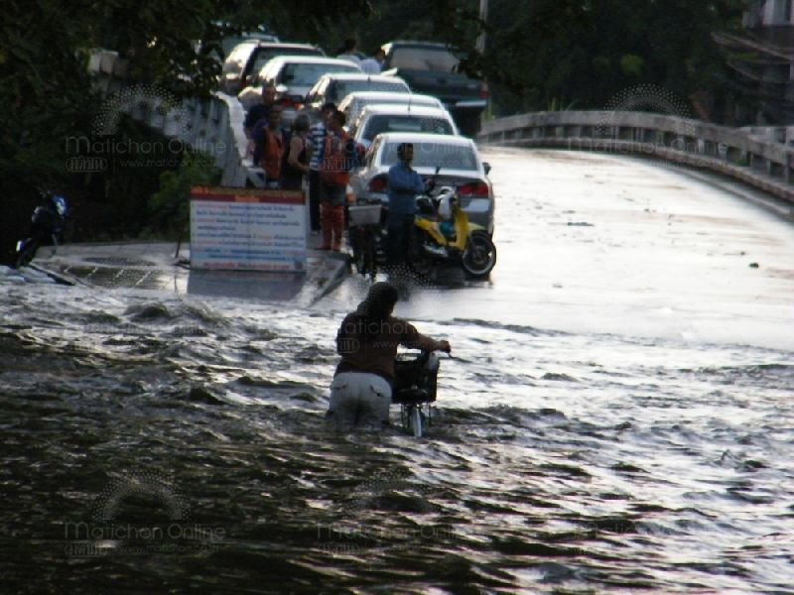
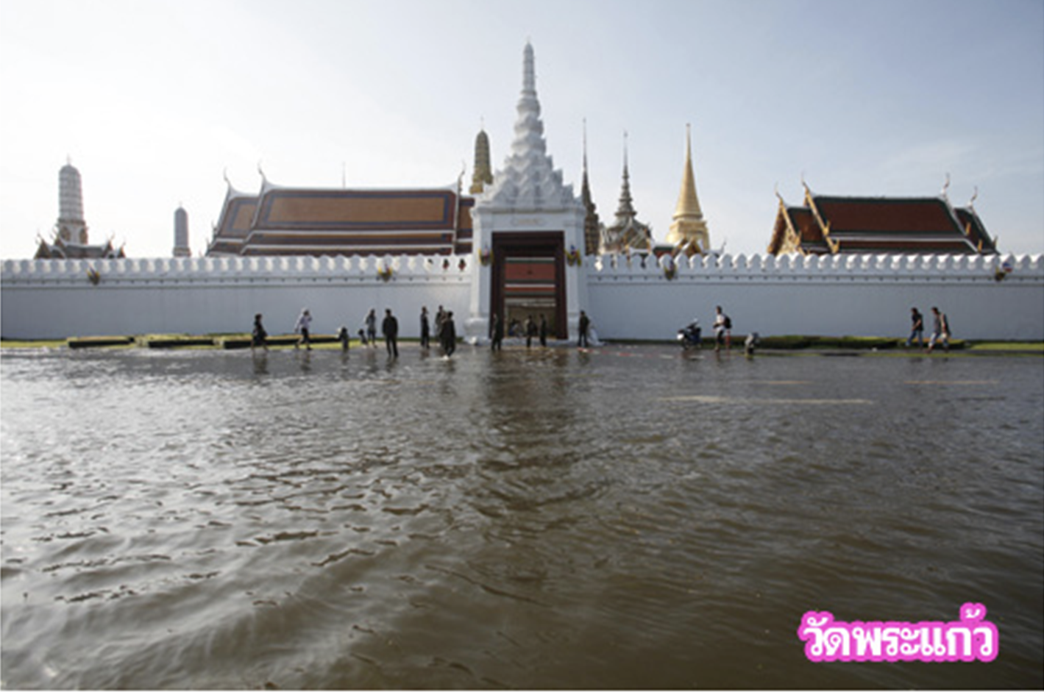
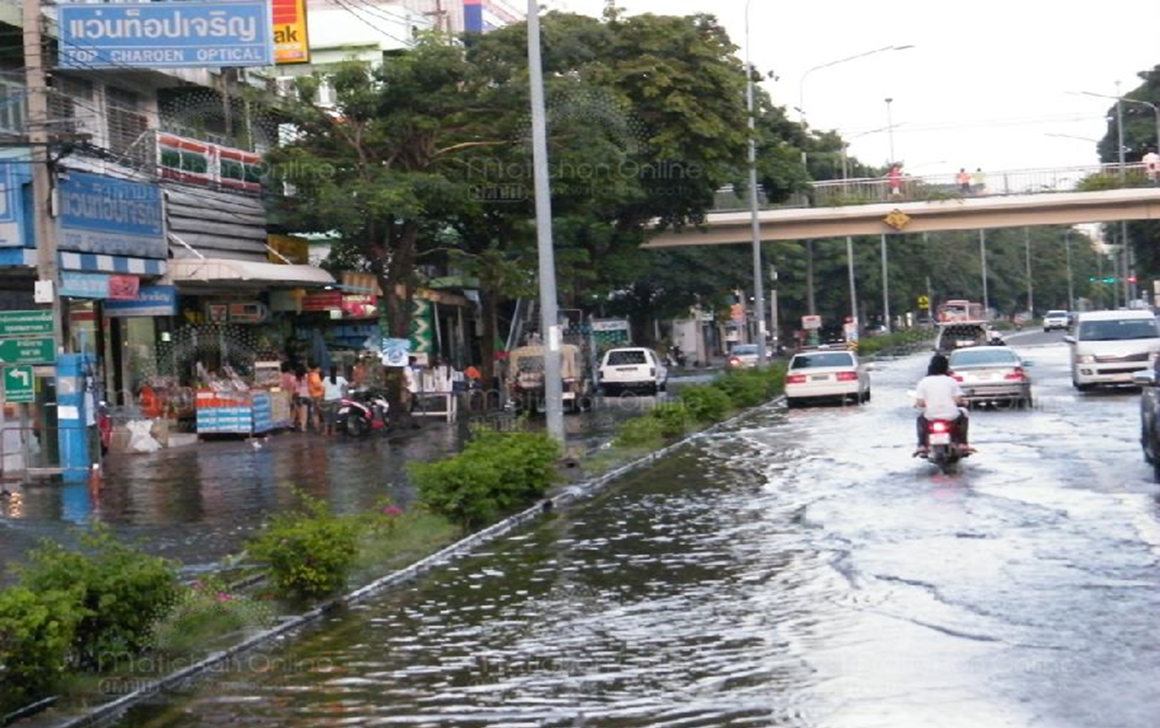
Extreme Flooding at Bangkok in October 2011
Notes:
Reference: http://www.matichon.co.th/news_detail.php?newsid=1320237611&grpid=01&catid&subcatid
This is big flooding in central part of Thailand and also Bangkok in 2 years ago.

Slide 42
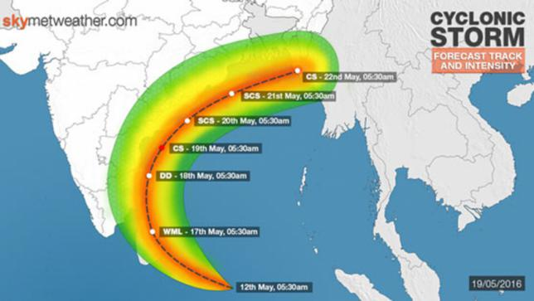
Cyclones: Bangladesh
Cyclone Roanu
2016
Notes:
Source: Daily Star newspaper

Slide 43
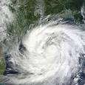
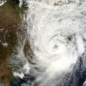
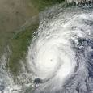
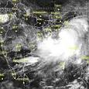
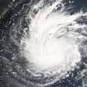
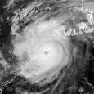
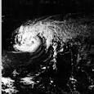
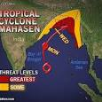
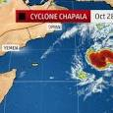
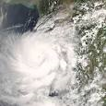
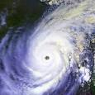
Bangladesh Cyclone History (before 2016)
Hudhud
2014
Kormen
2015
Sidr
2007
Phailin
2015
Aila
2009
Odisha
1999
Bhola
1970
Viyaru
2013
Chipala
2015
Nargis
2008
Bangladesh
1991
Notes:
Note: A detailed program for storm prevention was outlined by the government following the cyclone of 1991. A Comprehensive Cyclone Preparedness Programme (CPP) is jointly planned, operated, and managed by the Ministry of Disaster Management and Relief and the Bangladesh Red Crescent Society; a volunteer force of more than 32,000 are trained to help in warning and evacuation in the coastal areas.^{[2]} Around 2,500 cyclone shelters have been constructed in the coastal regions. The shelters are built on elevated platforms and serve the dual role of schools or community centers during normal weather. In Patenga, Chittagong, the coast has been heavily protected with concrete levees. Also, afforestation has been initiated in the coastal regions to create a green belt. https://en.wikipedia.org/wiki/List_of_Bangladesh_tropical_cyclones
Source: https://www.google.com.bd/search?sa=X&biw=1438&bih=631&q=Cyclone+Hudhud&stick=H4sIAAAAAAAAAONgFuLVT9c3NEzOs4zPTom3UOLWz9U3MDQyjC8ottDid65MzsnPSw3OTEktT6wsBgCAXmjLLwAAAA&ved=0ahUKEwjl_Jflw83QAhULvo8KHQLfAKQQxA0I0gEwGA&dpr=1#q=Cyclone+Phailin&stick=H4sIAAAAAAAAAONgFuLVT9c3NEzOs4zPTom3UOLSz9U3qDQ1qsgz1-J3rkzOyc9LDc5MSS1PrCwGAD6fQ88uAAAA

Slide 44
Danger of Bangladesh cyclones
Cyclones and their fearsome sea surges descend on Bangladesh with a furious intensity that has killed millions of people over the centuries. Between 1947 and 1988 alone, 13 severe cyclones ravaged the lowlands, causing thousands of deaths and sweeping away villages and defensive embankments.
1970’s Cyclone Bhola brought winds as high as 185 kilometers an hour. At least half a million people died, as well as a million head of cattle. More than 400,000 houses vanished. Forty-six thousand fishermen perished.
Notes:
Source: http://e360.yale.edu/feature/as_extreme_weather_increases_bangladesh_braces_for_the_worst/2659/

Slide 45
Class Discussion: What is the future for cyclones in Bangladesh?
What will happen in the future, if, as scientists are predicting, warmer conditions bring stronger and more frequent cyclones, and Himalayan glaciers far to the north melt faster and swell the great rivers hundreds of kilometers downstream? Most of Bangladesh lies on the fertile alluvial plains of the Ganges and Brahmaputra rivers. Would conventional flood works provide a solution?
Discuss among yourselves in small groups.

Slide 46
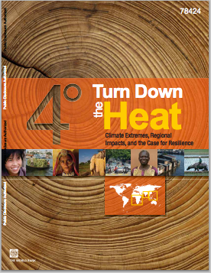
Assigned Reading
2013. Turn down the heat : climate extremes, regional impacts, and the case for resilience
Chapter 5 – South Asia
pages 105-138
Washington DC ; World Bank. http://documents.worldbank.org/curated/en/2013/06/17862361/turn-down-heat-climate-extremes-regional-impacts-case-resilience-full-report
Notes:
Questions:
By the end of the 21st century, how does projected sea level rise along the South East Asian coastline compare to the global mean sea level rise?
What are the projections for sea level rise in a 2°C world versus a 4°C world?
What is land subsidence? What are some of its causes? Why is it particularly important at river deltas?
Both agriculture and aquaculture in South East Asia are concentrated along river deltas. This makes them particularly vulnerable to sea level rise and land subsidence. Can you think of an example of how coastal agriculture in your region has already been impacted by climate change and what steps are being taken to mitigate this risk?
What risks does salt water intrusion pose? What are some of the drivers that cause salt water intrusion to extend further inland in addition to sea level rise?
What are some of the health risks of consumption of salt contaminated water?
What are some of the impacts of coastal erosion?
What is one way to mitigate coastal erosion?
Agricultural productivity in South East Asia is projected to decline with climate change. Even rice production, which is largely grown in deltaic regions and is relatively tolerant of unstable water levels, is at risk. What are the major threats to rice cultivation? Can you think of any ways in which rice cultivation could be adapted to be more resilient to climate change?
Aquaculture plays an important role in South East Asia’s economic development. What aspects of climate change threaten aquaculture? Name at least 3.
What are some ways to adapt aquaculture so that it is less vulnerable to climate change? What are some of the barriers to such adaptation?

Slide 47
Extremes Assignment #2
Chapter 2 – The Global Picture pages 13-16
BCC sections: Climate Intensification: Floods and Droughts, Sea Level Rise, Climate Change and Water Resources: Effects
What effect does warming the lower atmosphere have on the hydrological cycle? Why? In general, how does this affect dry regions? Wet regions? What mechanisms might lead to deviations from this general pattern?
Name one region that does not follow the wet gets wetter pattern and is likely to experience strong intensification of heat and water stress.
What are the key contributors to sea level rise? Which of these is more difficult to predict?
If warming is limited to 2°C what is the projected sea level rise by 2100? In a 4°C world?
How does sea level rise differ by latitude? Can you explain the reason for this difference?
For scenarios of 4°C + warming a further decrease in ocean pH of 0.3 is predicted. This is equivalent to a ____% increase in acidity.
Does the degree and rate of observed ocean acidification have an precedent in the geological past? How does ocean warming impact the effect of acidification on calcifying species?
How does ocean warming relate to warming on land?

Slide 48
Extremes Assignment #3
Chapter 4 – South Asia, pages 105-138
Models predict moderate mean surface warming relative to the global average over land and moderate changes in average rainfall for South Asia. What might be the reason for this?
Given the relatively moderate projected changes in average rainfall and temperature in this region, explain why climate change still poses a very strong threat in this region.
How do warming sea surface temperatures affect the characteristics of tropical cyclones?
Describe some of the risks associated with rising sea levels in South Asia.
Name some of the slow-onset impacts and some of the sudden-onset impacts of climate change in South Asia. Give an example of how these types of impacts may act in concert to weaken agricultural productivity and food security in the region.
Coral reef dieback is projected at levels of warming well below 4°C. Name three of the drivers impacting coral reef health. What are some of the potential negative consequences of coral reef dieback?
Discuss the major threats to river deltas in South Asia and how this might affect food security in the region.
What are some of the health impacts of rising sea levels and intensified tropical cyclones.
Why are the effects of heat extremes particularly pronounced in urban areas?

Slide 49
Extremes Assignment #4
Chapter 5 – South Asia pages 70-76
BCC sections: Climate Intensification: Floods and Droughts & Climate Modeling
Why is it more challenging to make climate projections for South Asia than for some other regions? Discuss both temperature and rainfall.
Although models do not agree on the magnitude or sign of rainfall projections for South Asia, what do they agree on in terms of the rainfall regime in a warmer world? What are some of the likely impacts of these changes in the rainfall regime?
What are the two locations where models predict that the number of heat extremes will increase strongly even under low-emission scenarios?
What are the global trends in tropical cyclone frequency and intensity?
Why might tropical cyclone intensity in the Western North Pacific co-vary with ENSO?

Slide 50
Exercise
Consider an area that you know about: a watershed, landscape, town, city, province.
How would an increase in flood frequency and size affect this place? Its infrastructure, ecosystems, population, and so on? List all possible effects, and assign a probability/likelihood to each (as best you can) (Use the IPCC likelihood classes at the last slide.)

Slide 51
Exercise
Consider an area that you know about: a watershed, landscape, town, city, province. If you don't know of one, your instructor will provide a description
Describe the place in terms of values it produces, like human habitation, ecosystems, water supplies, and so on.
How would an increase in drought affect this place and the values you have defined? What kinds of consequences to humans, plants and wildlife populations are possible; which are likely in your judgement?

Slide 52
Instructor Review of Materials
What was useful?
What is missing?
How did you, or would you, modify the materials to make them better fit your instructional context?

Slide 53
References
IPCC, 2012: Managing the Risks of Extreme Events and Disasters to Advance Climate Change Adaptation. A Special Report of Working Groups I and II of the Intergovernmental Panel on Climate Change [Field, C.B., V. Barros, T.F. Stocker,D. Qin, D.J. Dokken, K.L. Ebi, M.D. Mastrandrea, K.J. Mach, G.-K. Plattner, S.K. Allen,M. Tignor, and P.M. Midgley (eds.)]. Cambridge University Press, Cambridge, UK, and New York, NY, USA, 582 pp.
Report in References section of BCC

Slide 54
References
Non-Journal Literature Library from IPCC SREX
This digital library, compiled as part of the IPCC review and drafting process, is a database of non-journal-based literature cited in SREX (Extreme Events) chapters. The corresponding literature citations and/or the full text of underlying sources can be searched, for individual chapters or the report overall. Clicking on a chapter number lists citations for that chapter only, and the search field can be used to filter results by keyword for the selected chapter. The search query can be applied to the full text of documents by checking 'Include Full Text.' For each citation, the 'Download PDF' link provides access to the document if available. Standard querying conventions are supported.

Slide 55
References
Explaining Extreme Events from a Climate Perspective
American Meteorological Society
http://www2.ametsoc.org/ams/index.cfm/publications/bulletin-of-the-american-meteorological-society-bams/explaining-extreme-events-of-2013-from-a-climate-perspective/

Slide 56
References
Karl, T.R., and R.W. Knight, 1998: Secular trends of precipitation amount, frequency, and intensity in the USA. Bull. Amer. Meteorol. Soc., 79, 231-241.
Pielke Sr., R. A., Marland, G., Betts, R. A., Chase, T. N., Eastman, J. L., Niles, J. O., Niyogi, D., and Running, S.: 2002, ‘The Influence of Land-Use Change and Landscape Dynamics on the Climate System-Relevance to Climate Change Policy beyond the Radiative Effect of Greenhouse Gases’, Phil. Trans. A. Special Theme Issue 360, 1705–1719.

Slide 57
References and Resources
The curriculum of USAID’s Climate-Resilient Ecosystems and Livelihoods (CREL) in Bangladesh is a free resource of teaching materials for university professors, teachers and climate change training experts.
Reproduction of CREL’s curriculum materials for educational or other non-commercial purposes is authorized without prior written permission from the copyright holder, provided the source is fully acknowledged.
Suggested citation: USAID. 2016. Bangladesh Climate-Resilient Ecosystem Curriculum (BACUM). USAID‘s Climate-Resilient Ecosystems and Livelihoods (CREL) Project. Winrock International. Dhaka, Bangladesh.
Disclaimer: The CREL’s curriculum is made possible by the support of the American People through the United States Agency for International Development (USAID). The contents of the curriculum do not necessarily reflect the views of USAID or the US Government.

Slide 58
USAID's Climate-Resilient Ecosystems and Livelihoods (CREL) Project
Winrock International
House 13/B, Road 54, Gulshan 2, Dhaka 1212
Bangladesh
Tel: +880-2-9848401 www.winrock.org

